Slide 1
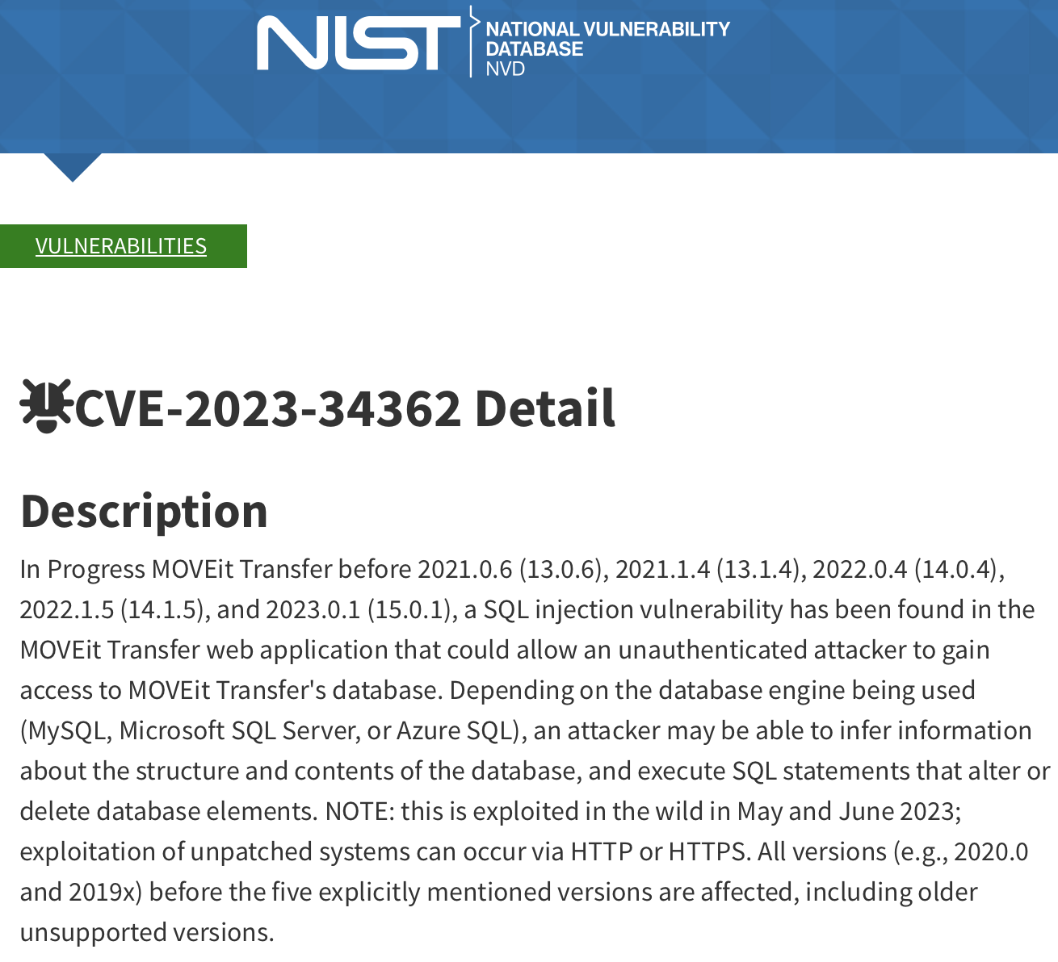
SQL injection
Perhaps the single most devastating attack vector
Just this one
2700+ organizations
95+ million people
SSNs of all UC employees (including me)
Notes:
Stats from https://www.emsisoft.com/en/blog/44123/unpacking-the-moveit-breach-statistics-and-analysis/

Slide 2
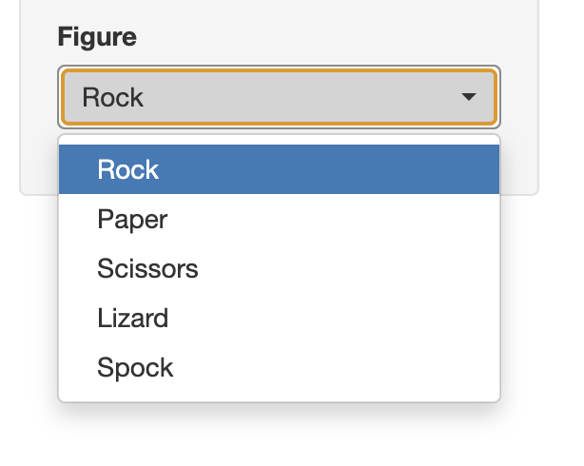
Web browser
Shiny app
HTML page
if (!(input$v %in% c("Rock", …))) {
error
}
v=‘Spock’
use input$v…
query <- paste(
"SELECT … WHERE figure = '",
input$v,
"' GROUP BY …"
)
dbSendQuery(conn, query)
v=‘Aardvark’
Rogue client
v=‘Glorp!3x*’
v=‘%@#;;"4!&’
Notes:
A well-behaved client follows the rules set up by the application, but a rogue client need not. And it’s trivial to construct a rogue client and deliver app inputs that mimic an authentic client. Solution can be as simple as validating inputs. This is a general issue, not specific to SQL. But for SQL specifically, it’s very common to interpolate (splice) externally-provided input into SQL statements.

Slide 3
Lethal combination
Unvalidated inputs
Simple string interpolation
Assumption that SQL will be syntactically valid and do what you expect (and only what you expect)
Vulnerable Python
input.v() = [input variable]
query = "SELECT … WHERE figure = '%s' GROUP BY …"
conn.sql(template % input.v())
Right way: use SQL parameterized statements
query = "SELECT … WHERE figure = ? GROUP BY …"
conn.sql(query, [input.v()])

