Slide 1
Introduction to SQL
EDS213 - Databases & Data Management
Week 3
Greg Janée
Research Data Services, UCSB Library
rds@library.ucsb.edu

Slide 2
Learning objectives
Understand the relationship of SQL to relational databases
Understand how local databases differ from client/server databases
Understand basic SQL syntax and statements
Be able to answer basic questions about data

Slide 3
Recap of week 1
Takeaways
Data modeling is an important part of the process of working with data
To have confidence in data, we need assurance that it matches our assumptions and expectations
Relational databases/SQL provide an opportunity (a place) to both define and constrain data
Notes:
Recall quote from week 1: “Even though the data modelling phase represents only a relatively small share of the total development effort of data systems, its impact on the final result is probably greater than that of any other phase”

Slide 4
The relational way
Hierarchical:
Sites
Nests
Eggs
Relational:
Sites
Nests
Eggs
Observers
Species
Predators
Weather
…
Notes:
We often organize data hierarchically: filesystems, XML, HTML, JSON, …
Relational: group all entities of given type together. Expensive (though as will be seen, indexes assuage that a lot), but allows for arbitrary relationships

Slide 5
Data modeling parting thoughts
Effective modeling depends on functional needs
Data entry
Recall table with species counts listed in wide format
Transactional
Might split one entity into different tables
Analytical
Might denormalize, even down to one table, for simplicity/sanity
Notes:
Transactional: might split off infrequently-used attributes to limit amount of I/O required
Analytical: might grab desired attributes of species (scientific name, endemic, etc.) and just fold them into main observation table for convenience

Slide 6
Good idea or not?
House
House_ID | integer (PK)
Name | text
Housemaster | text
Animal | text
Num_students | integer
Notes:
Pro: more efficient if that is a frequently needed quantity. Recall that all students will be in same table, so filtering/counting may be expensive.
Con: must be (re)computed, must remember to (re)compute it

Slide 7
Relational database – why?
Want a single, unified view of data
Work with data too large to fit in memory
R/Python dataframes: limited to RAM (typically, a few GB)
Local database (DuckDB, SQLite): many GBs, millions of rows
Client/server database (PostgreSQL, MySQL): many TBs, billions of rows

Slide 8
Comparison
 | CSV files | Local RDBMS (DuckDB) | Client/server RDBMS (PostgreSQL)
Storage location | Local filesystem | Local filesystem | On server
Max data size | Fit in RAM (few GB) | Big (many GBs) | Gargantuan (many TBs)
Access | R, Python, Excel, … | App | Client tool, API
Support for SQL | N/A | Hit and miss | Very good
Administration | N/A | None | User accounts, passwords, permissions
Data portability | Universal format; file sharing | App-specific format; file sharing | Export/import

Slide 9
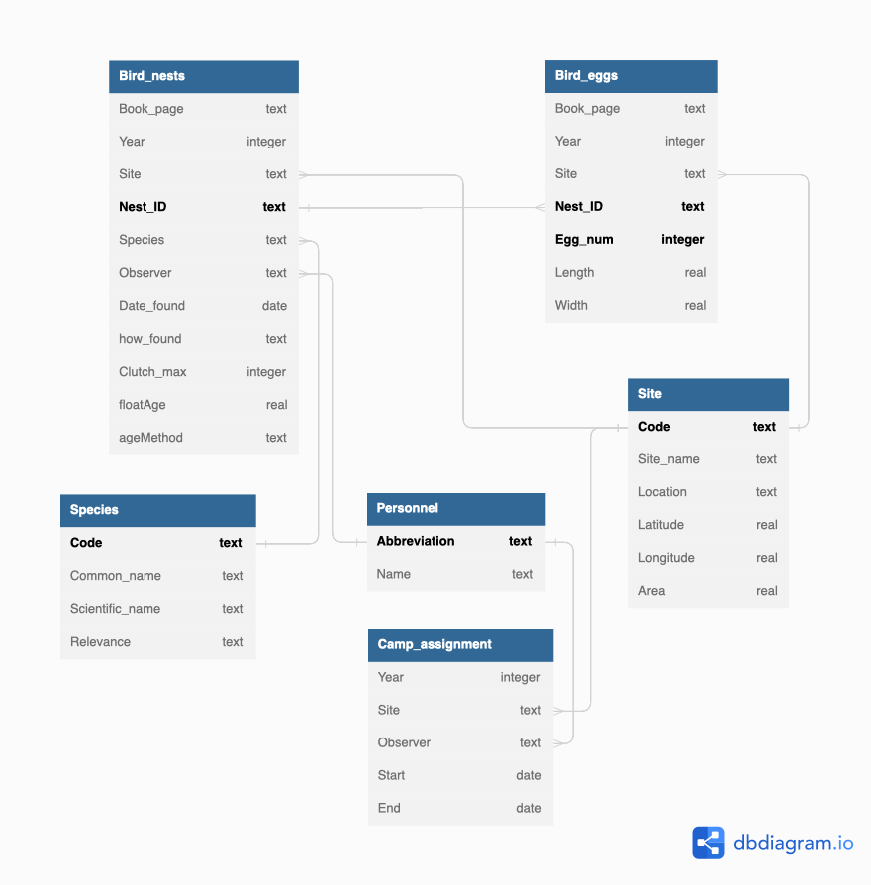
Our running example
Crow’s foot: many side of many-to-one relationship
Primary keys in bold

Slide 10
SQL’s role and nature
Standardized language
For doing everything (defining, accessing, managing data) in a RDBMS
The only thing that is standardized
Alas, variations in what is supported and how
Lots of proprietary extensions: statements, functions, data types
Also serves as the API
Your code must create strings containing SQL statements
Declarative language, not procedural
Say what you want, not how to compute it

Slide 11
Readings
ASDN E-R diagram
Tuck it under your pillow
ASDN database schema (15min)
bren-eds213-data/database/schema-build-script.sql
Look at how data is described
Play with database (20min)
Practice what we covered in class on all tables

