Slide 1
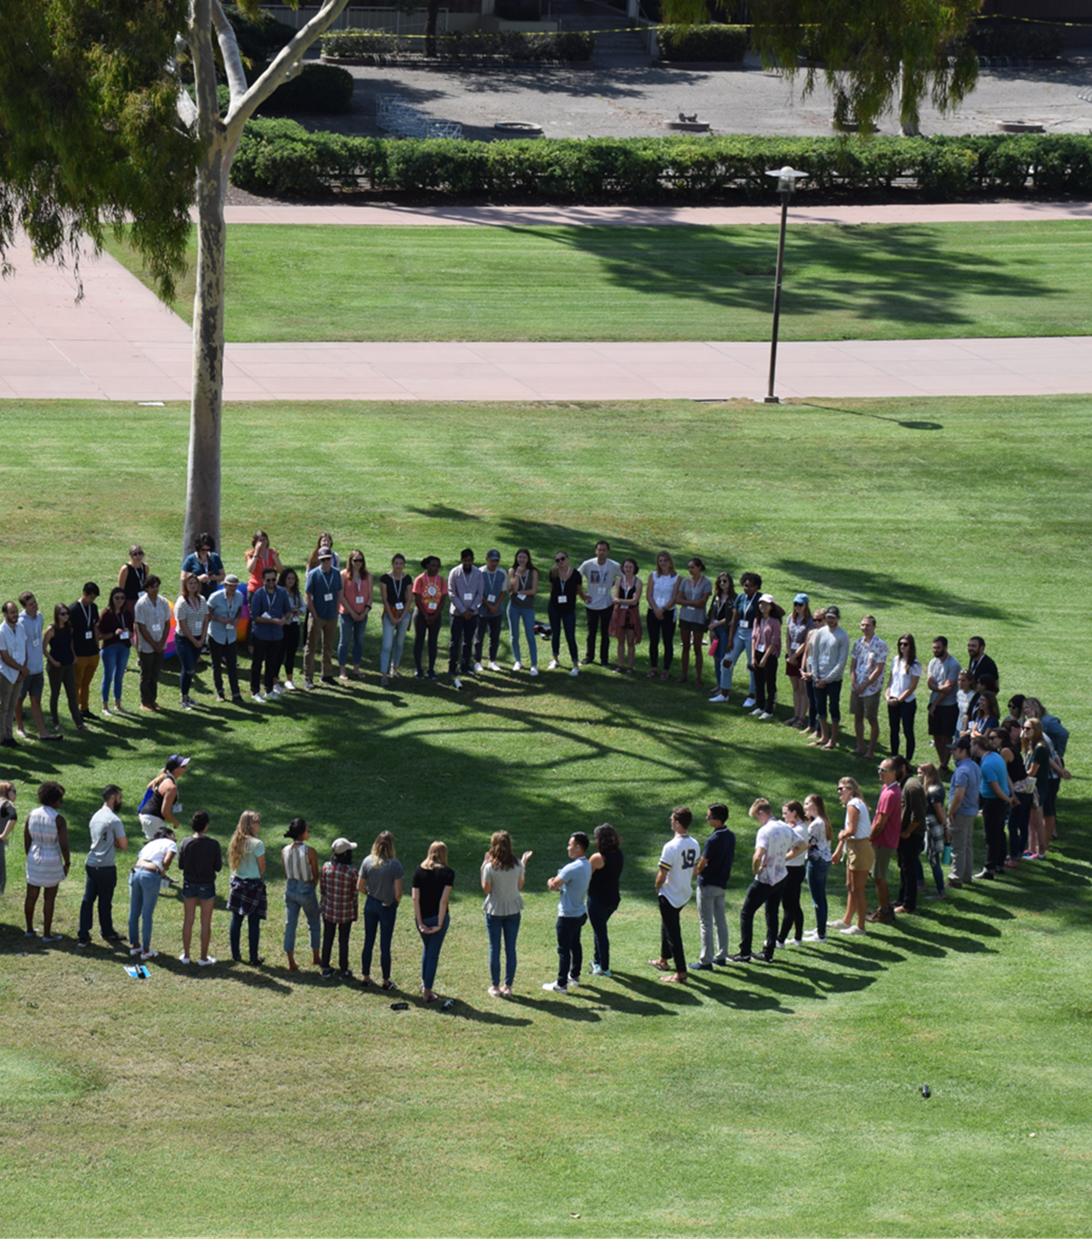
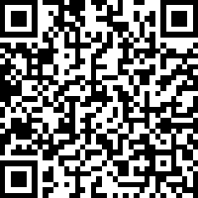
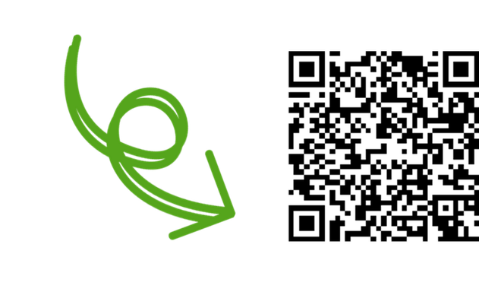
Networking at Bren: Build Your Relationship Team (1:1 Chats, LinkedIn, BrenConnect, & More)
Bren School Career Development Program Fall 2026
Scan to tell us
you’re here!

Slide 2

Networking 202
Online Platforms
1:1 Chats
      Networking Events
TODAY'S AGENDA
Notes:
4

Slide 3
Networking 202

Slide 4
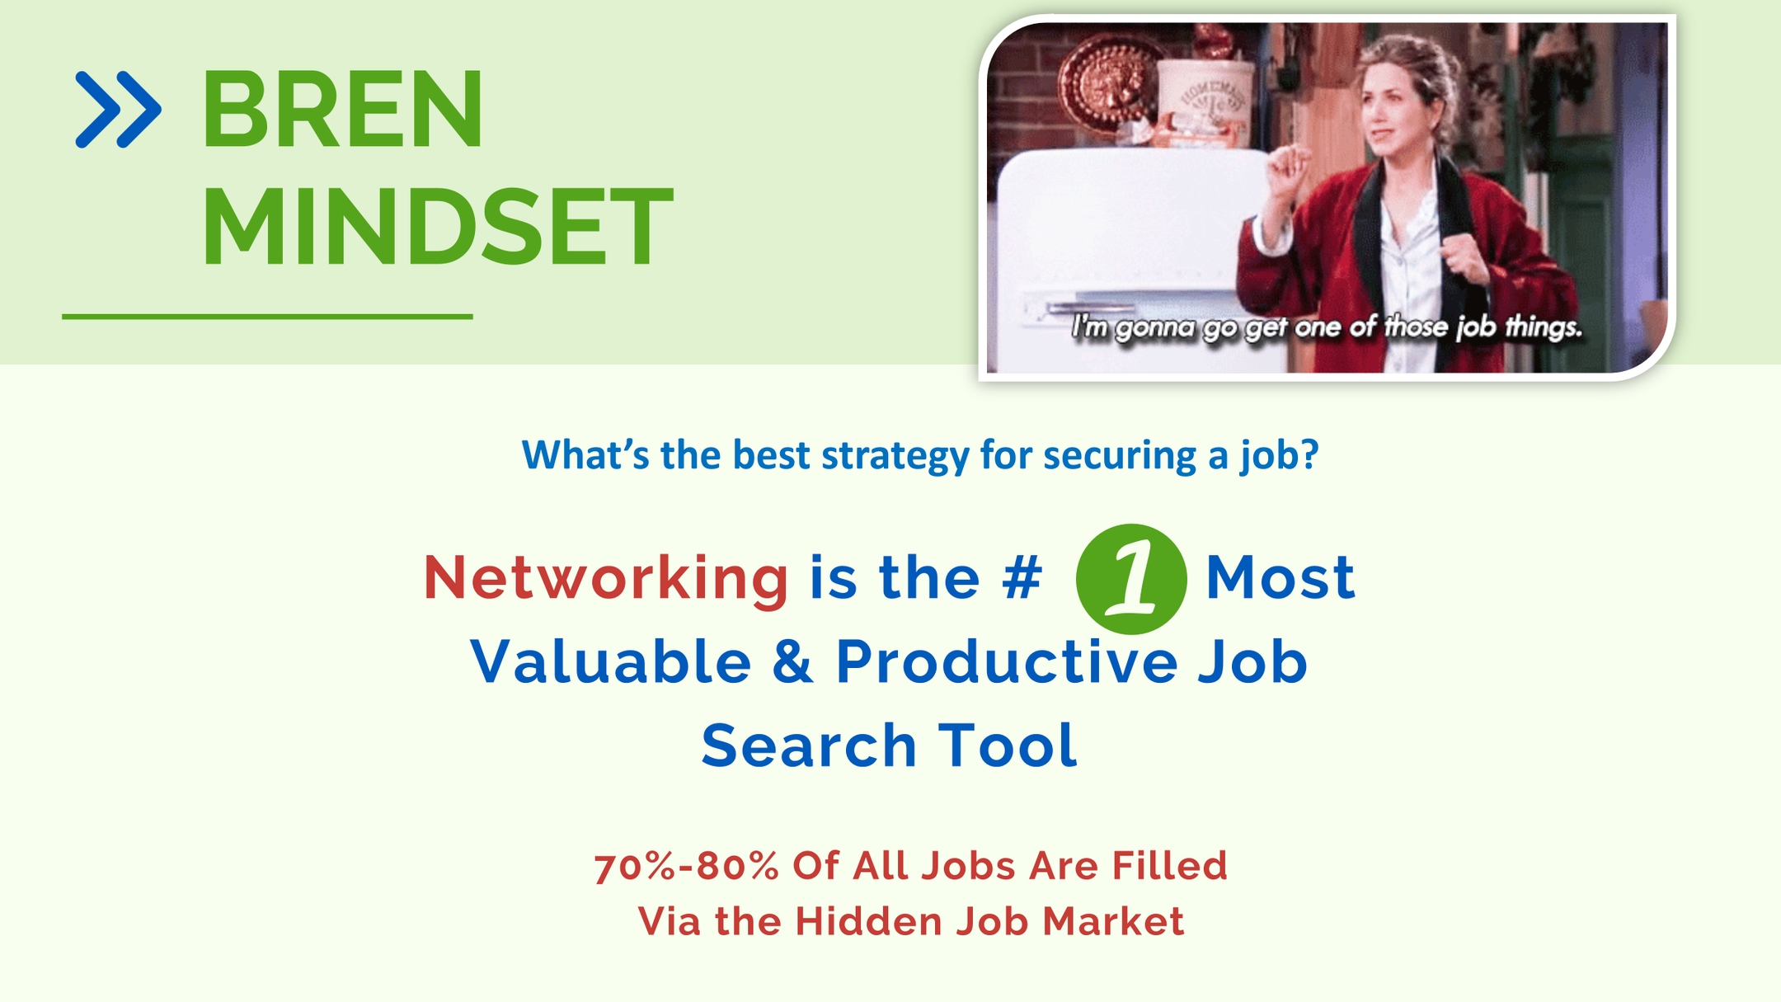

Slide 5







BREN MINDSET: NETWORKING
Golden Ticket—Student Card
    People are often more willing to sit down and discuss their careers with you while you are still a student
Make Meaningful Connections
    Build Quality Relationships (give and take)
    Care about the other person
    Look to help the person
Bren Alumni Love to Give Back—“It’s the Bren Way”
    Pay it Back & Pay it Forward
Notes:
Golden Ticket Student Card:
Mindset- You are a student- use example if they were contacted by someone who went to their undergrad- or that participated in a club in undergrad. Would you be willing to talk to them?
In reviewing your comfort with networking – that you submitted for your 1-on-1 resumes many people have expressed concern about networking b/c they are new to the field- in some people words “they don’t know anything about the environmental field.” Well is that not why you came to Bren? YOU are a student & professional working in the field don’t expect you to be an expert, or have years of experience. You are a student- the expectations are lower than you think.
Make Meaningful Connections: Thinking of how networking also allows you to give back to others—when you connect with people, it’s not just about what you can get from them, it’s also about how you might be able to help them now or later. If you hadn’t connected with them, you wouldn’t have the opportunity to help them. When connecting – you can do this from a palace of authenticity. If you don’t want the connection to feel to sales, or not genuine. Then just set that intention- go in with the goal to learn, grow, and connect. Not get anything specifically. You can also give the person, your exquisite attention! In today’s world where things are busy, we are constantly doing.. One of the biggest giftst you can give someone is to go into a conversation and pay exquisite attention (that in itself is a gift).
Use the Personal example Kiya example 1. came to me for networking during Fall Quarter of her 1st year when I worked at EDC (an NGO). Showed interest in developing a GP (we worked together to do this it was accepted). We worked together for 1.5 years on the project and she interned with me over the summer. This immediately gave back b/c this was a project I would not have been able to do if it had not been for the 5 students who were working on it with me. 2) When she graduated…. Tell Louis Capps example. Our relationship was cemented long before I needed to ask for the letter from Lois caps (I could not have foreseen this 2 years prior and I was so grateful for the relationship we had build long before I needed to make this ask), she know the projects I was working on. Was able to help within 24 hours get a letter signed by Louis Capps for our project. Now would Kiya as a student… have know that she was helping me form a GP project (and get more work done) or that she might be able to help me out with a letter from her employer to support a big project I was working on? NO – when she reach out she was seeking help… but this help was easy for me to give (an in person meeting so she could learn about my job). But later in her career she was able to give back to me in ways we never would have thought at the onset of our meeting. Why were we able to do this? B/c she reached out early and was genuine interested in learning about the work I did and the NGO I worked at. Soo, as I was saying just set the intention to give back (either now or later) and then you can come from a more authentic place when networking.
This examples show how people matter when it comes to thriving at work and in your career, but it’s also important to have these connections for the meaning that they provide and relationships that can be built.
Things like this happens all the time in our Bren community… The environmental field may feel big but it actually fairly small and connected. You are also only a Bren student for two years– you are a Bren alum for life (that is a long time) This ties into the third point..
Bren Alum- every class of Bren Alumni for the last 24+ years has been taught this same approach. They were encouraged (and many of them did) network when they were students. Now they are alumni and they are excited and enthusiastic about giving back. I know this was my own personal experience and its reaffirmed year after year. The Alumni sign-up rate on BrenConnect is off the roof. We blow other schools out of the water. 76% other schools were in the 30% range- hard to find any other schools to compare ourselves with. Engage in the platform
5

Slide 6
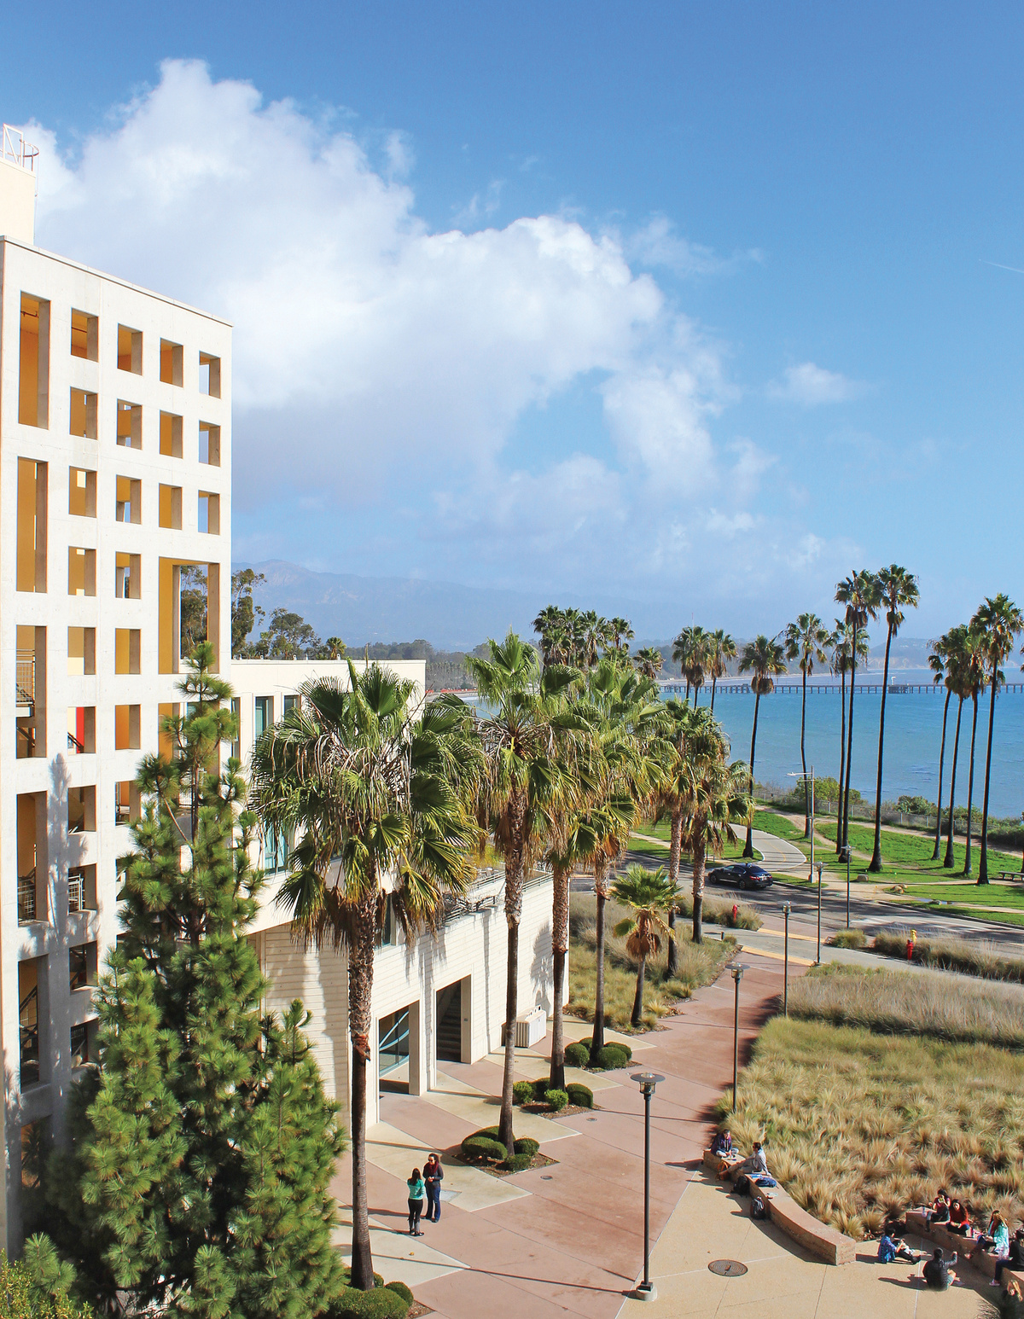
NETWORKING IS...
A Big Part of the Bren Experience
Learn About Your Classmates
  Lifelong friendships + professional connections
  Professional + personal goals overlap
Learn About Careers & Jobs
  Connect with amazing alumni doing meaningful work + cool jobs
  Connect with inspiring professionals
Magic of Bren OR Special Sauce
  Access to Bren community = Building community

Slide 7
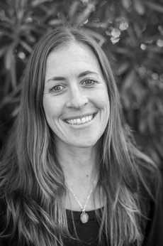
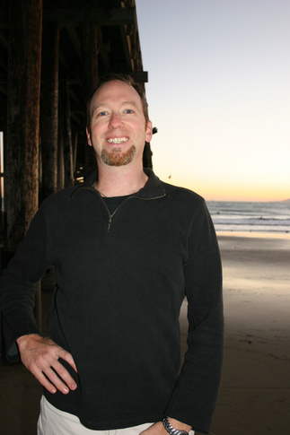
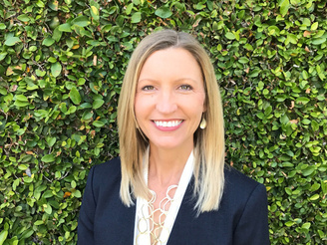
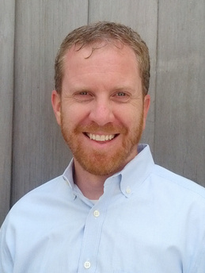
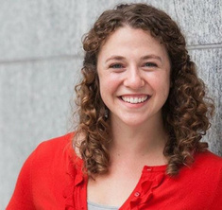
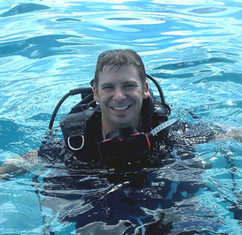
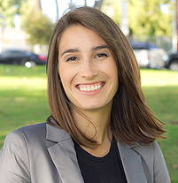
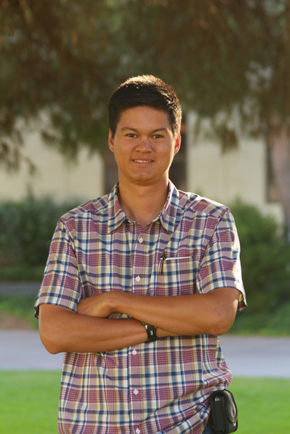
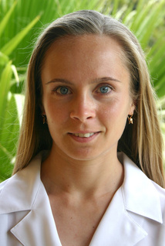
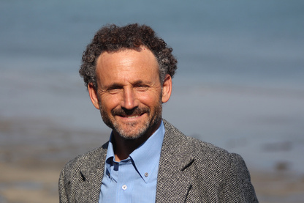
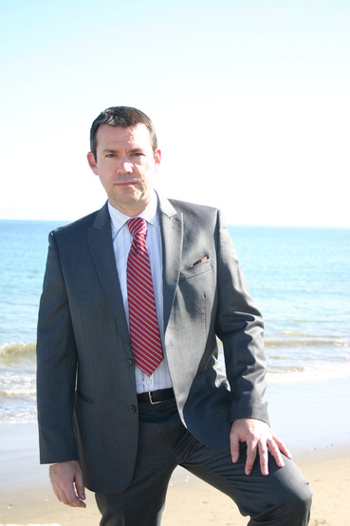
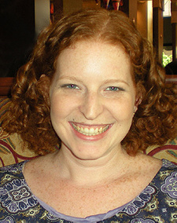
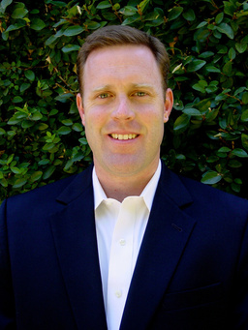

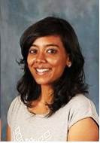
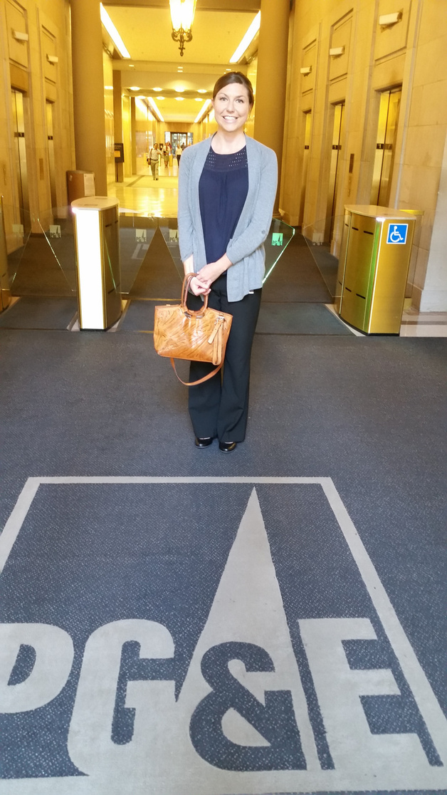
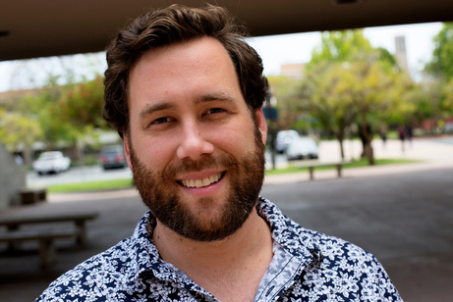
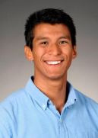
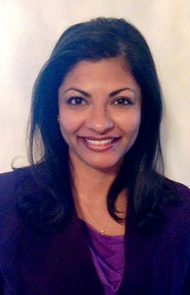
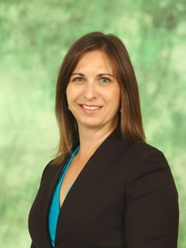

BREN EDGE IS...
BREN NETWORK
The Magic...
of Bren is....
our Bren Alumni Network
+
YOUR Existing Network:
    Professional connections
    Undergraduate connections
    Friends/family
Notes:
The Bren Alumni is your networking edge- low hanging fruit. Available, easy to get contact info on BrenConnect, are ready and waiting for you to reach out.
You can also rely on your existing network of friends, past colleagues, family, friends. You are not starting from scratch- you already have a big networking or networking potential! Draw upon you existing
-What if you don’t feel like you have an existing network?
At the end of this slide- ask the student to turn to each other and in 2 sentences share something that you are going to take away from this part of the workshop. This is only 1 min each. At one min ask them to switch.
8

Slide 8
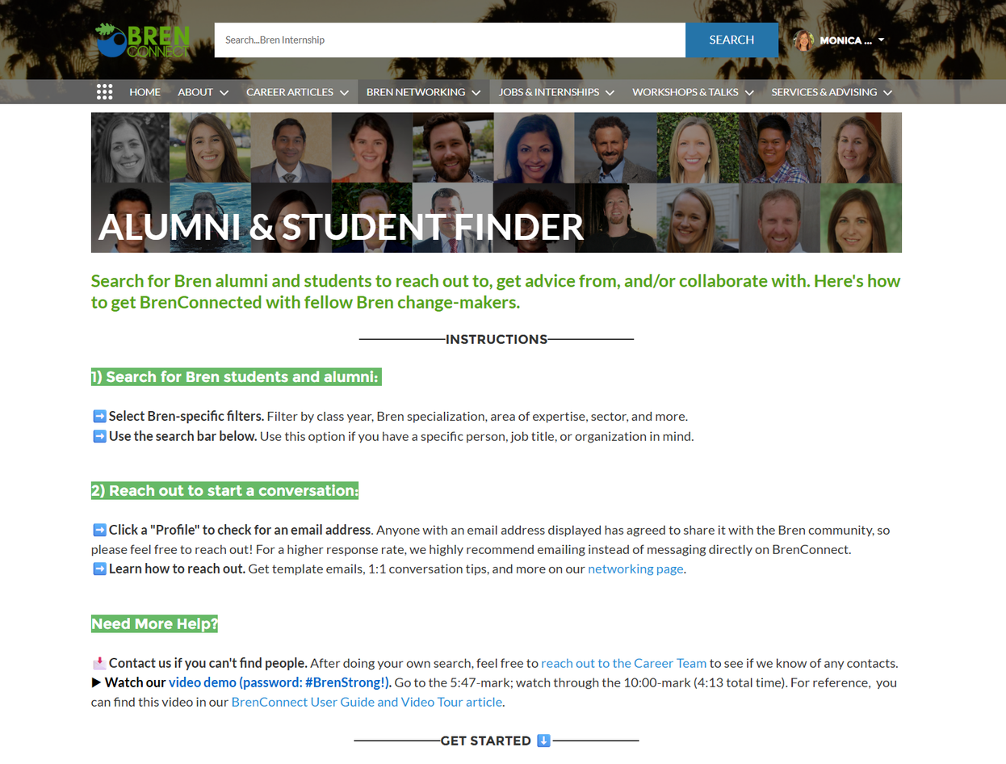
More Ways to Find Contacts
  Alumni & Student Finder on BrenConnect
  LinkedIn
  Organization websites
  Where else?

Slide 9


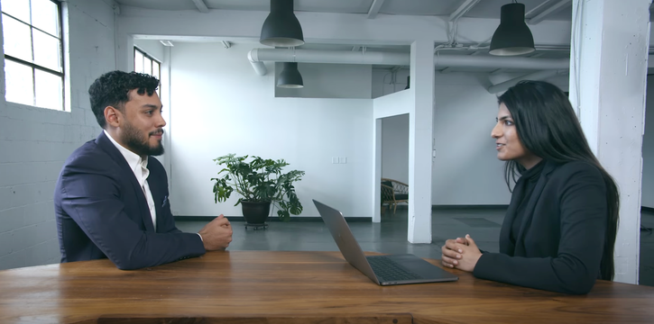
Tips for Before Any Interaction
Identify People You Want to Meet
Research People's Background
When/How To Meet With Them?
    Target Organizations (check out staff directories)
    Get referrals
    Listen to speakers (podcasts, Bren seminars, NCEAS roundtables, career talks)
    What are you comfortable with?
      Phone/Zoom/In-Person
    What are they comfortable with/what works best for them?
    BrenConnect
    LinkedIn
    Company Website = bio
    Google
    X (Twitter) + Other Social Media Feeds
Notes:
Think about: What do you want to know?
7

Slide 10

Bren Mindset - Being a “Professional”
Key Adaptability Skills:
Communication: Adjusting info shared between academic, community, and professional contexts
Context Awareness: Recognizing appropriate behavior for different situations (lab work vs. community meetings vs. conferences)
Cultural Competence: Working effectively across different cultural backgrounds
Flexibility: Balancing practicality with professional presentation

Slide 11
Online Platforms

Slide 12

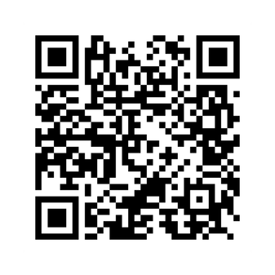
Alumni & Student Finder Demo
Follow along -->

Slide 13

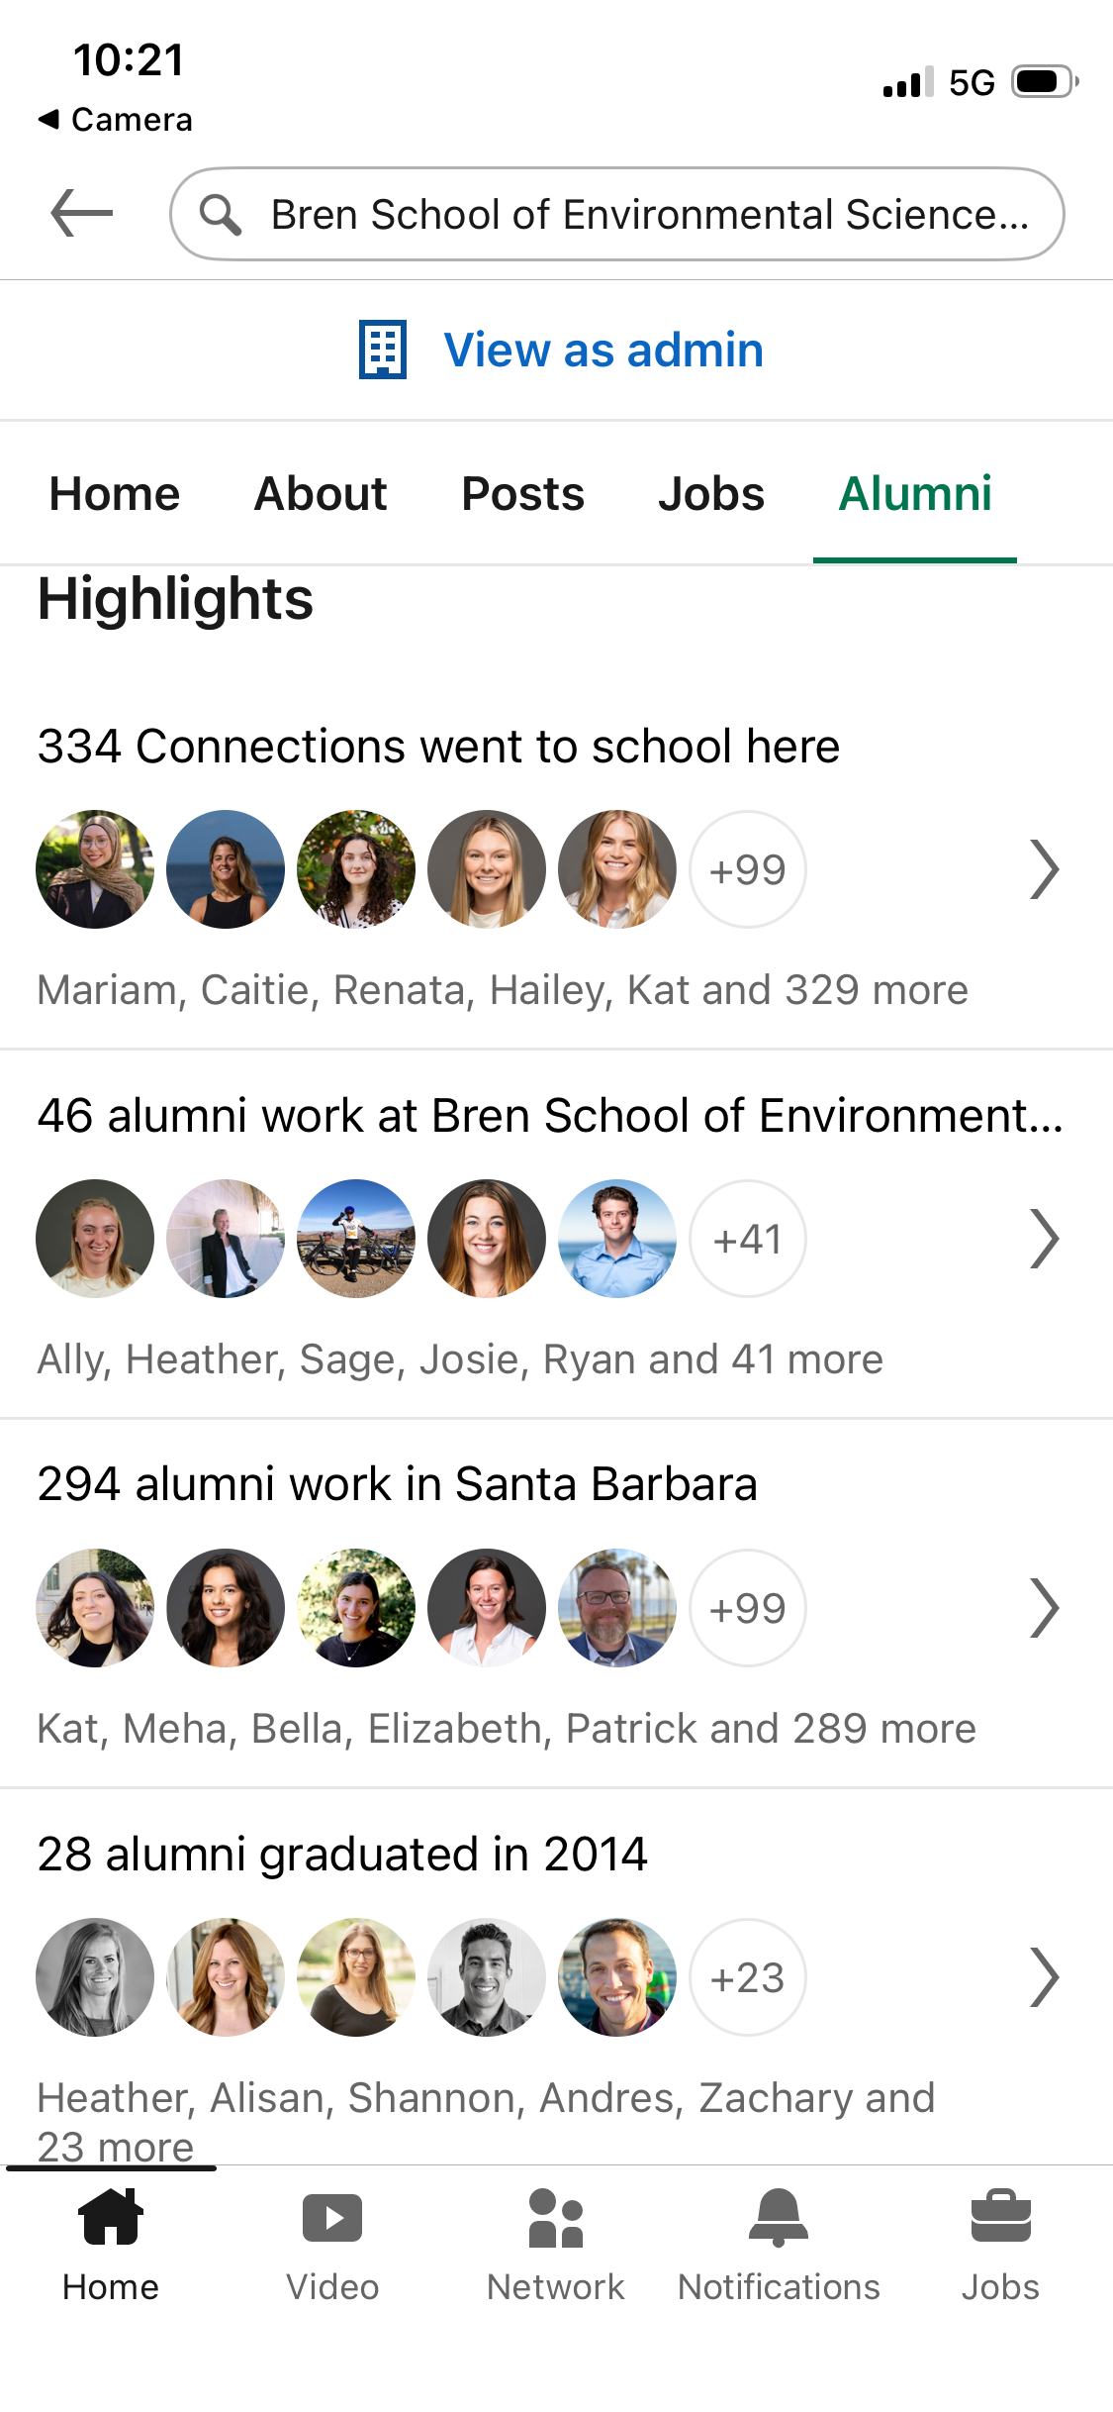
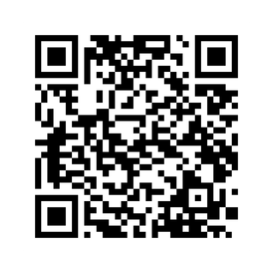
LinkedIn Alumni Tool Demo
Follow along -->

Slide 14
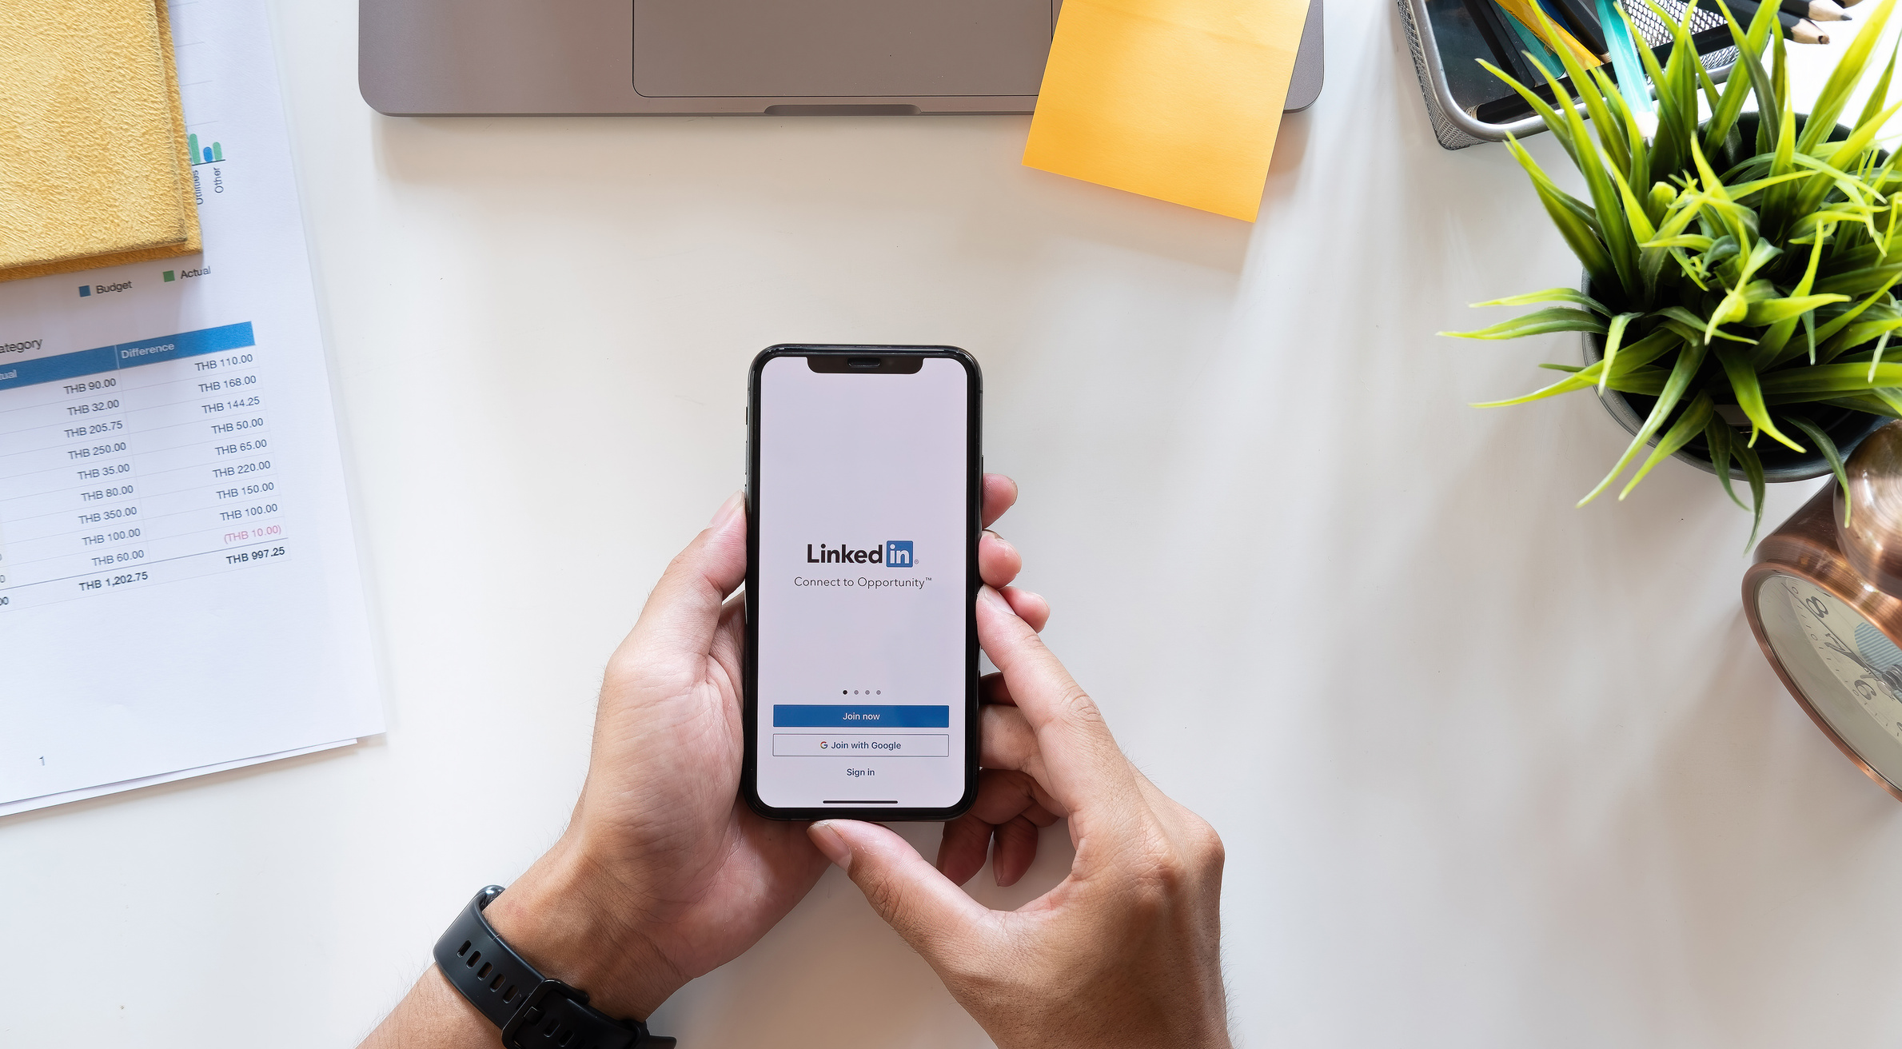
Why is LinkedIn important?
  Recognition
  Opportunities
  Credibility
  Allows you to define and tell your story
  Showcases your brand

Slide 15
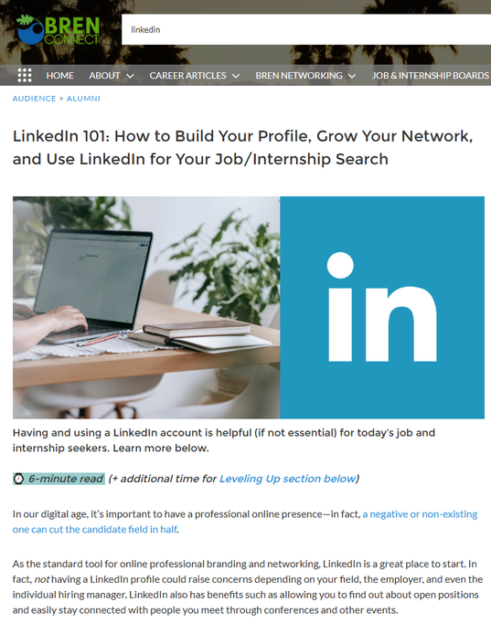

QUICK LINKEDIN PROFILE TIPS
Some Things to Start With:
  Customize your profile URL
  Add profile and background photos if you’re comfortable doing so
  Complete these main sections:
    Education
    Headline
    About
    Experience
    Skills
Optional: Consider adding projects if applicable
Resources to Learn More:
Free Learning LinkedIn course
LinkedIn 101 article from us on BrenConnect! 🙂

Slide 16
How to Use Both Effectively
  Write in the first person narrative
    Your career story is more authentic when it is told by YOU!
  Use short-concise paragraphs
    Highlight your work, expertise, and IMPACT!
  Reserve bullet points for key skills, accomplishments, and results
    Easier for the reader
  When making changes, use the toggle switch to share or not share edits with your community

Slide 17
1:1 Chats

Slide 18

Time to Connect!
Informational Interviews AKA Informational Meetings
AKA Brief Question-and-Answer (BQAA) Sessions

Slide 19

USE BREN'S TWO-STEP
FEW QUESTIONS APPROACH
AVOID USING PHRASE "INFORMATIONAL INTERVIEW”
    Code for “I am trying to get a job or internship.”
    Informational interviews = sounds time-consuming
ASK FOR A BRIEF CONVERSATION (15-20 min) using
our Bren “few questions” approach
    Respect the person’s time
    Avoid “informational interview” phrase
Access Resources on BrenConnect:
411 on Conducting Informational Interviews
(including how to write inquiry emails)
Notes:
You RAD email this week for both MEDS and MESM went over why we don’t call it an informational interview…
We use “Brief Conversation,” Or “Few Questions” or Do you have time to connect to talk about XX.
12

Slide 20
Tips for Before Any Interaction
Identify People You Want to Meet
Research People's Background
When/How To Meet With Them?
    Target Organizations (check out staff directories)
    Get referrals
    Listen to speakers (podcasts, radio, Bren seminars, NCEAS roundtables, career talks)
    What are you comfortable with?
      Phone/Zoom/In-Person
    What are they comfortable with/what works best for them?
    BrenConnect
    LinkedIn
    Company Website = bio
    Google
    X (Twitter) + Other Social Media Feeds
Notes:
Think about: What do you want to know?
7

Slide 21
How to Write an Informational Inquiry Email
Begin with an effective subject line:
  Interest in Learning More About Dangermond’s XXX Project
  Enjoyed Your Seminar Talk - Would Love to Get Your Advice
  Nice to meet you! Coffee?
Keep your email short (2-3 paragraphs):
  Establish a connection and explain why you are contacting them
  Share about yourself a bit (consider including your resume)
  Outline next steps
  End with a professional signature

Slide 22
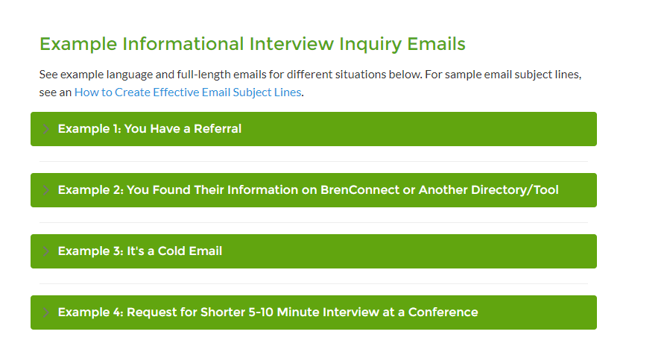
How to Write an Informational Inquiry Email

Slide 23
When + How Often To Follow Up (if needed)
Forward your original email with a polite note:
  After one or more weeks
  Remember they are also busy professionals
You can say something like:
  “I know you must be busy, but I wanted to follow up on my message from last week to make sure you received it.”
Offer to facilitate the process:
  Make the process easy for them
  Give them some days/times that will work for you
  Offer to call, meet in-person, or correspond through email if that might be easier for them

Slide 24


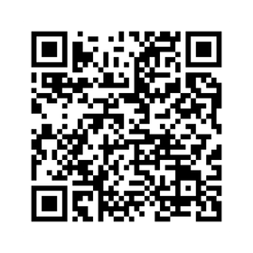
During
Keep in Mind:
  Zoom--present yourself in the right light. How?
  Make the best impression--how?
  Ask for advice and come away with something tangible
  You are playing the long game
Access Resources on BrenConnect:
  Questions to Ask

Slide 25
Sample Informational Meeting Questions
About their Job / Career / Organization:
  What makes you successful in this role?
  What does a typical week/day look like?
  What is it like working for this organization/company?
  What are some challenges you face in your job?
  Has there been anything you’ve done that’s been particularly helpful in preparing you for this job?
Notes:
What to ask during your informational interview

Slide 26
Sample Informational Meeting Questions
About the Field and How to Prepare:
  Are there any organizations you would recommend I explore for possible jobs/internships within this XX field?
  Is there anyone else I could talk to about this work/field/company?
  Are there any good conferences or associations that you should I attend/join?

Slide 27

After
Keep in Mind:
  Send a thank-you note
  Reach out to referrals you received
  Follow up
  Go above and beyond
Access Resources on BrenConnect:
  How to Write Thank-You Emails (see the 411 article)

Slide 28
Now, it’s Your Turn:
Putting it Into Practice
✅ Identify 2-3 people
✅ Craft an email
✅ Set up a time to meet!

Slide 29
Networking Events

Slide 30

Other Ways to Connect
  Conferences & external events
  Professional association membership and events
  Mixers
  Bren career talks/panels
  Bren seminars and lunches with the speaker

Slide 31
Tips for Before Any Interaction
Identify People You Want to Meet
Research People's Background
When/How To Meet With Them?
    Target Organizations (check out staff directories)
    Get referrals
    Listen to speakers (podcasts, Bren seminars, NCEAS roundtables, career talks)
    What are you comfortable with?
      Phone/Zoom/In-Person
    What are they comfortable with/what works best for them?
    BrenConnect
    LinkedIn
    Company Website = bio
    Google
    X (Twitter) + Other Social Media Feeds
Notes:
Think about: What do you want to know?
7

Slide 32

How to Approach
  Consider the situation/context
  Have a goal in mind
  Gauge your comfort level
  Attend the Art of Mingling!

Slide 33
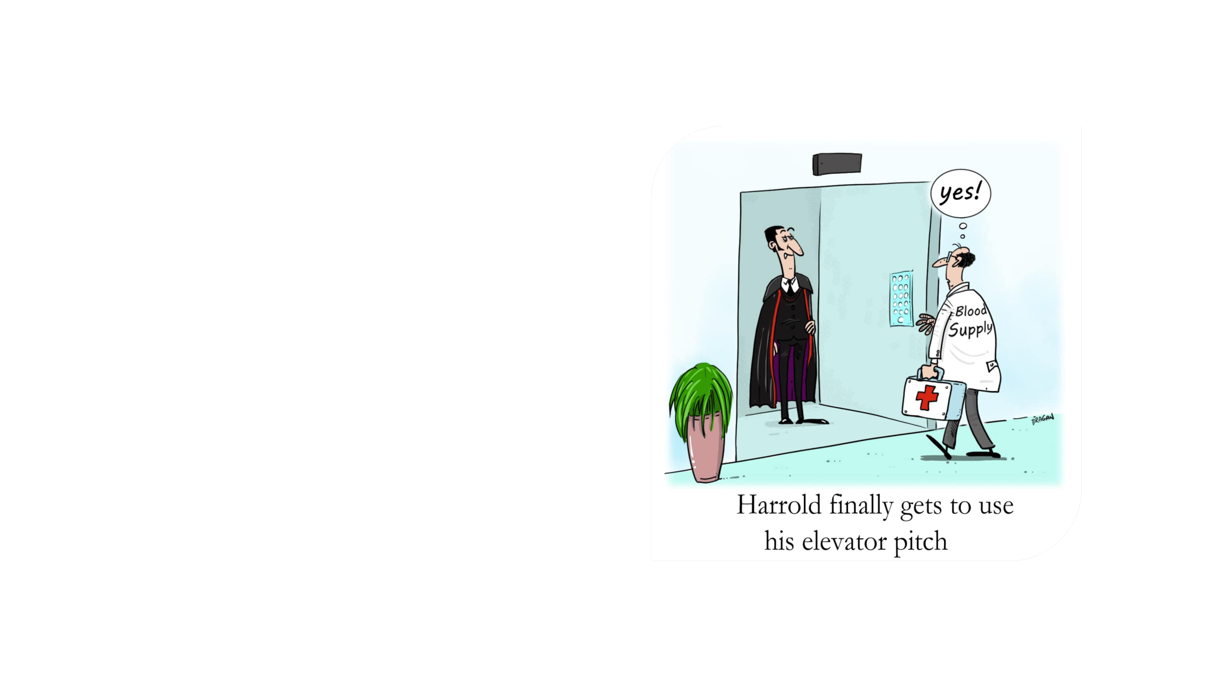
CURIOSITY
STATEMENTS
  Attention-Grabbing Statement
  Give and Take
  Your Needs
What grabs the listener’s attention? What makes them ask for more info?

Slide 34

Remember...
We are building connections and community
Be curious...it’s a conversation
  Connect with people, ask for advice (don’t ask for a job or internship unless appropriate)
Come away with something that moves you forward

Slide 35

Staying Connected
  Be prepared to exchange contact info:
    LinkedIn’s QR code feature
    Digital business cards
    Physical business cards
  Follow up with people afterward:
    The Muse's 5 Email Templates That Make Following Up With Anyone Way Less Awkward
  Stay in touch:
    Our 4 Times You Should Check in with Your Connections to Maintain a Lifelong Professional Network on BrenConnect

Slide 36

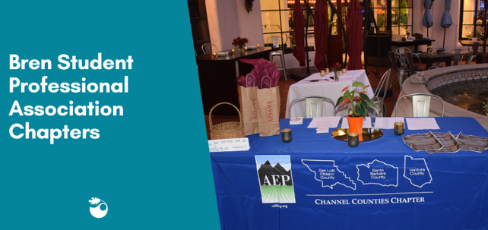
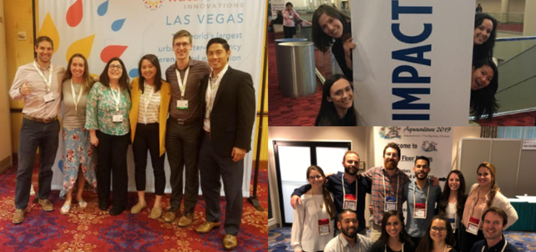

BrenConnect Resources
Professional Associations
External Professional Associations and Online Networks to Consider Joining
Bren Student Professional Association Chapters
Conferences
Potential Conference Opportunities for the Bren Community
Strategies for Gaining Conference Entry and Funding + How to Maximize Your Conference Experience

Slide 37

Thank You!

