Slide 1
Overall Match

Slide 2
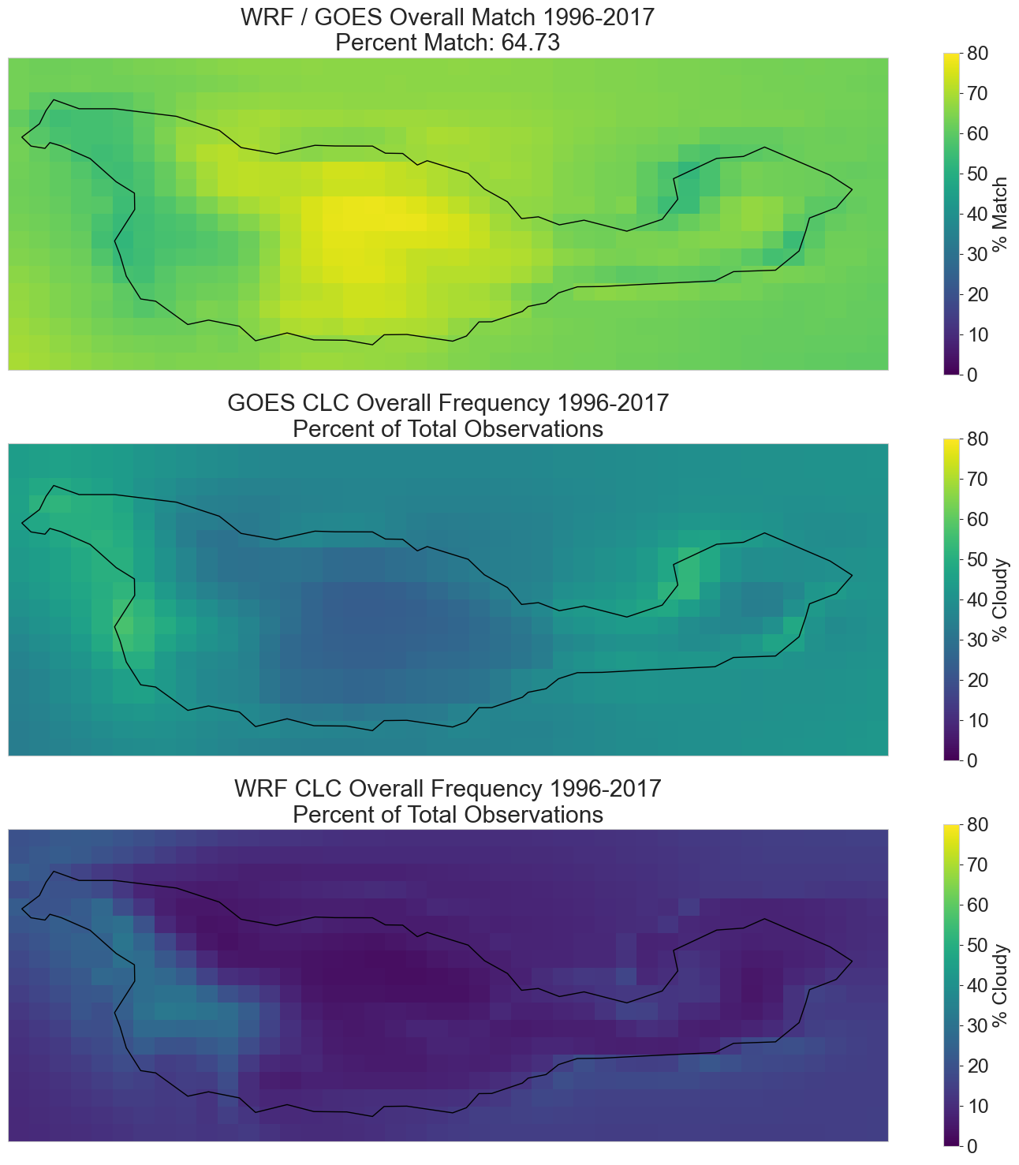
Notes:
Observations:
Generally speaking, the match % is the inverse of the GOES CLC frequency plot → WRF does worse for areas that are more cloudy
The exception is that WRF does have higher CLC frequency on the west end, which bears more investigation

Slide 3
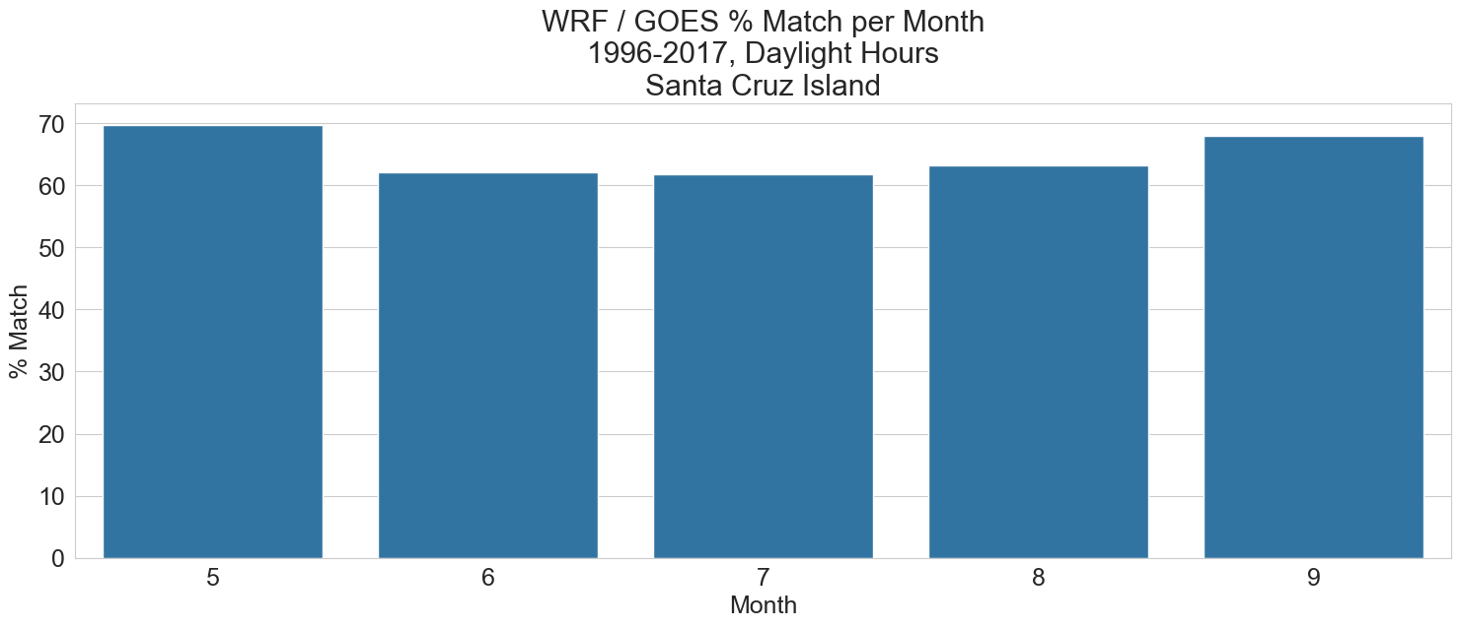
Notes:
Show that pattern is consistent between months
Model performs worst during foggiest months

Slide 4
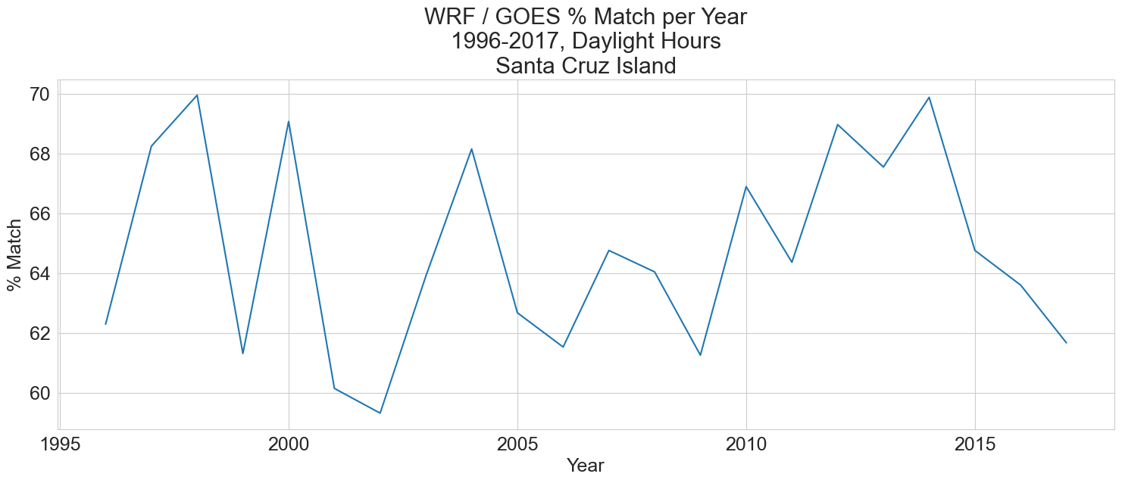
Notes:
- Year to year variability

Slide 5
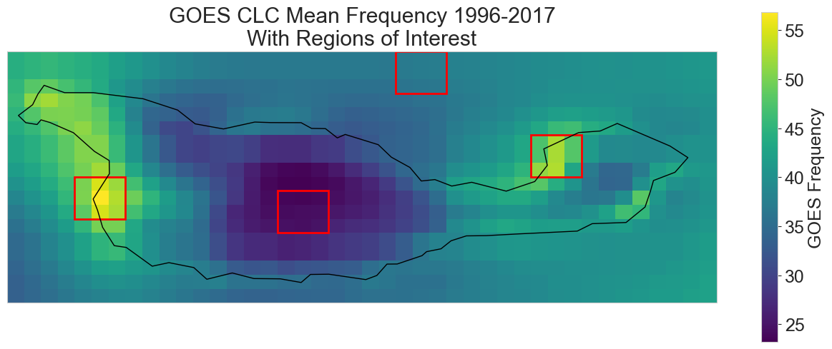
North Ocean
Coches Point
West End
Inland

Slide 6
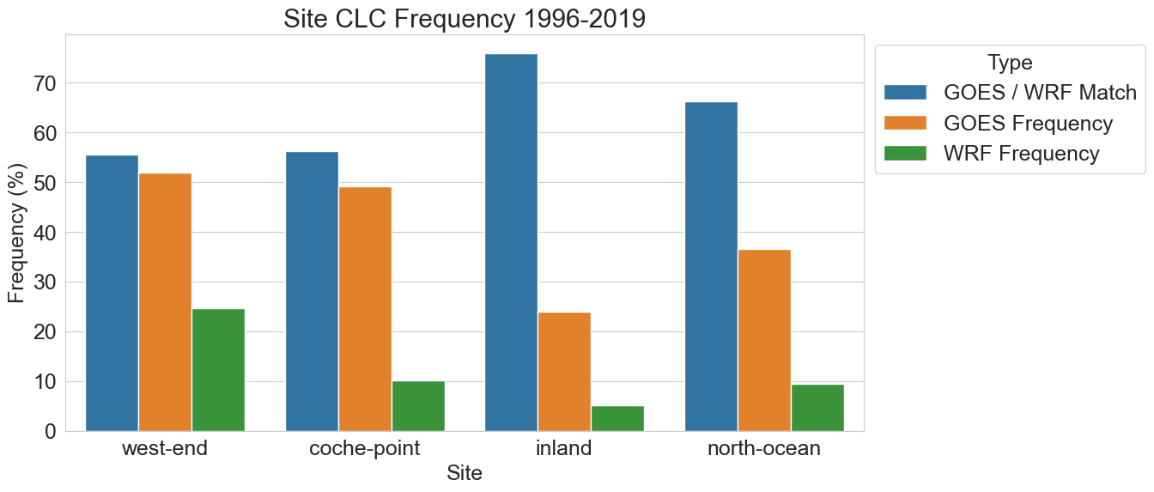
Notes:
Demonstrate difference between CLC Frequency differences between sites

Slide 7
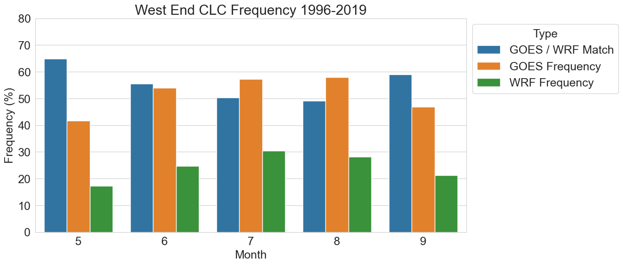

Slide 8
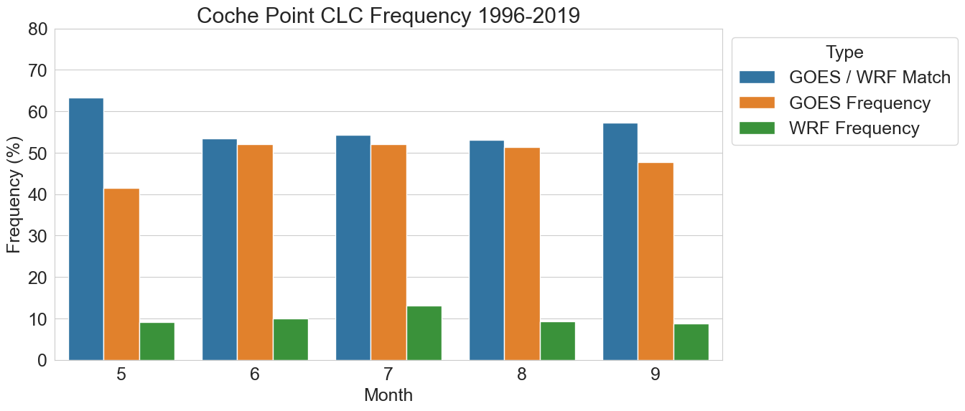

Slide 9
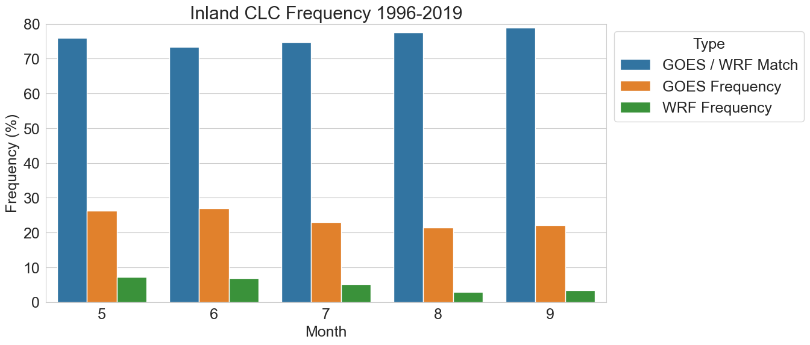

Slide 10
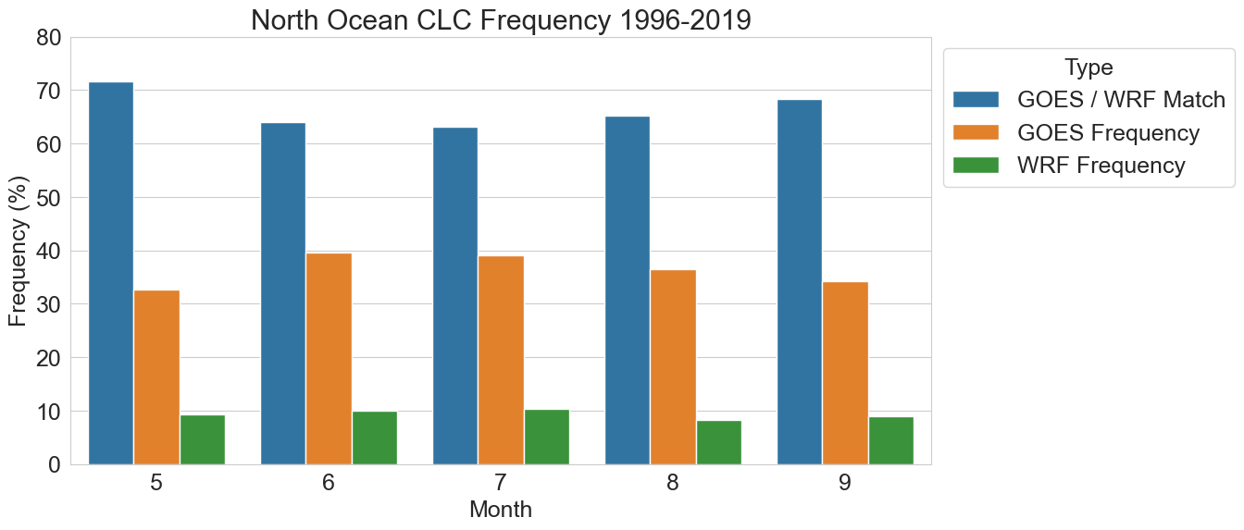

Slide 11
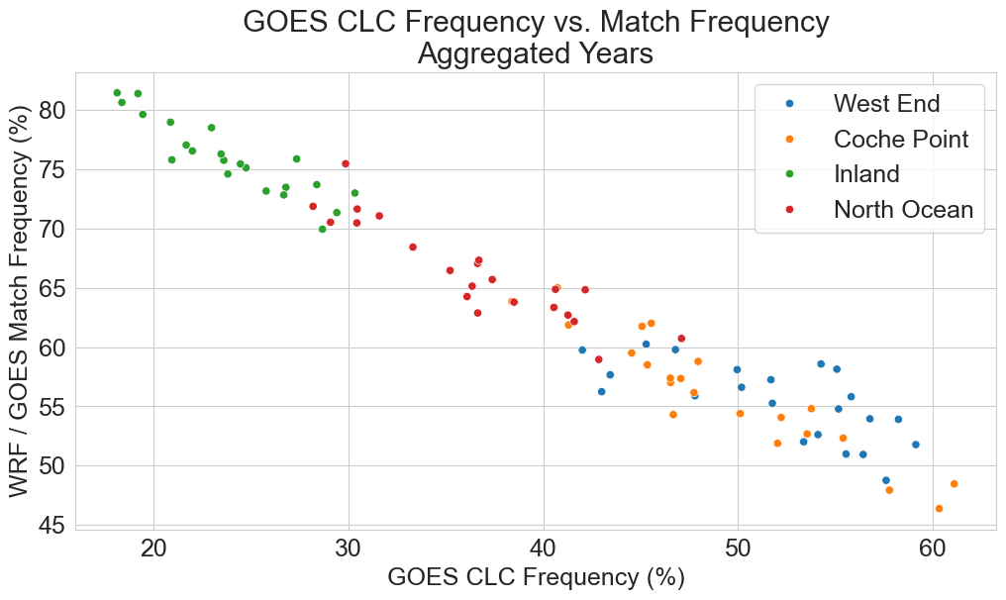
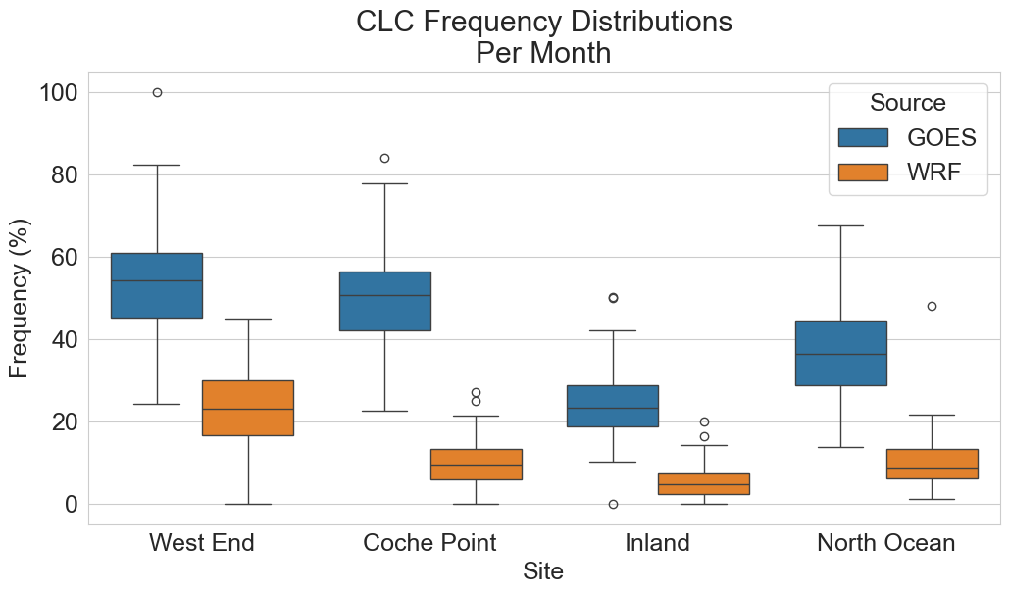

Slide 12
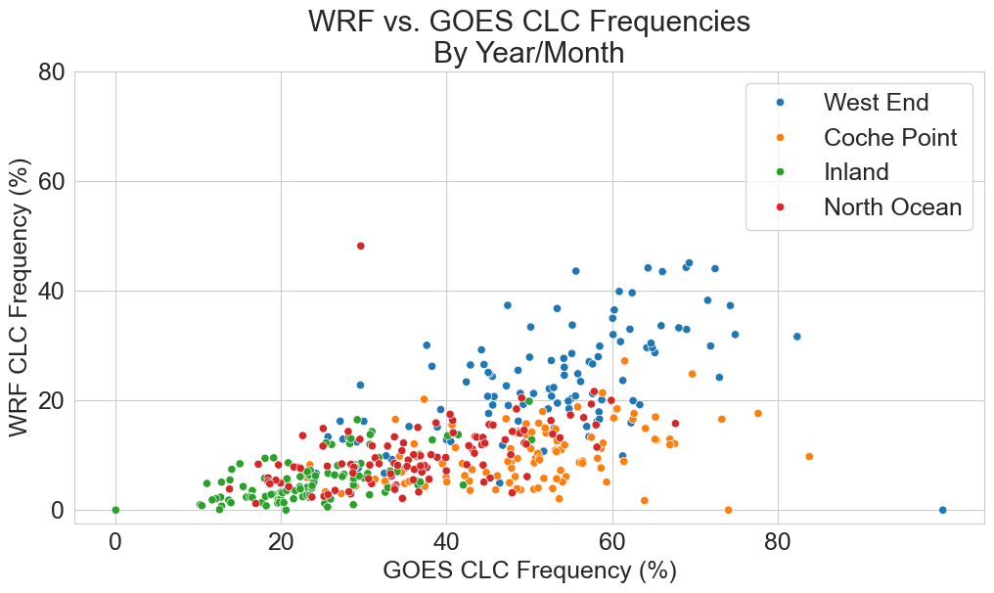
Correlation: 0.624

Slide 13
Interannual Trends

Slide 14
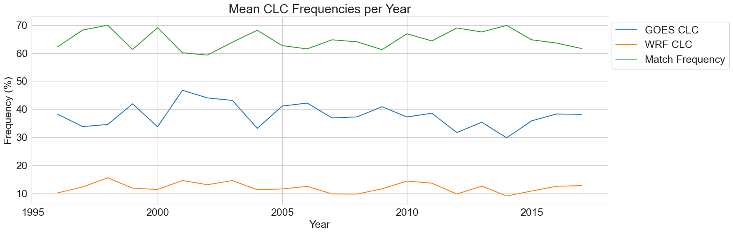
Notes:
Points:
- Match frequency varies between 60-70 perecent
Match frequency is inversely related to GOES CLC – better match in years with less coverage
WRF CLC follows a sort of smoothed version of GOES CLC – we’ll come back to this in more detail

Slide 15
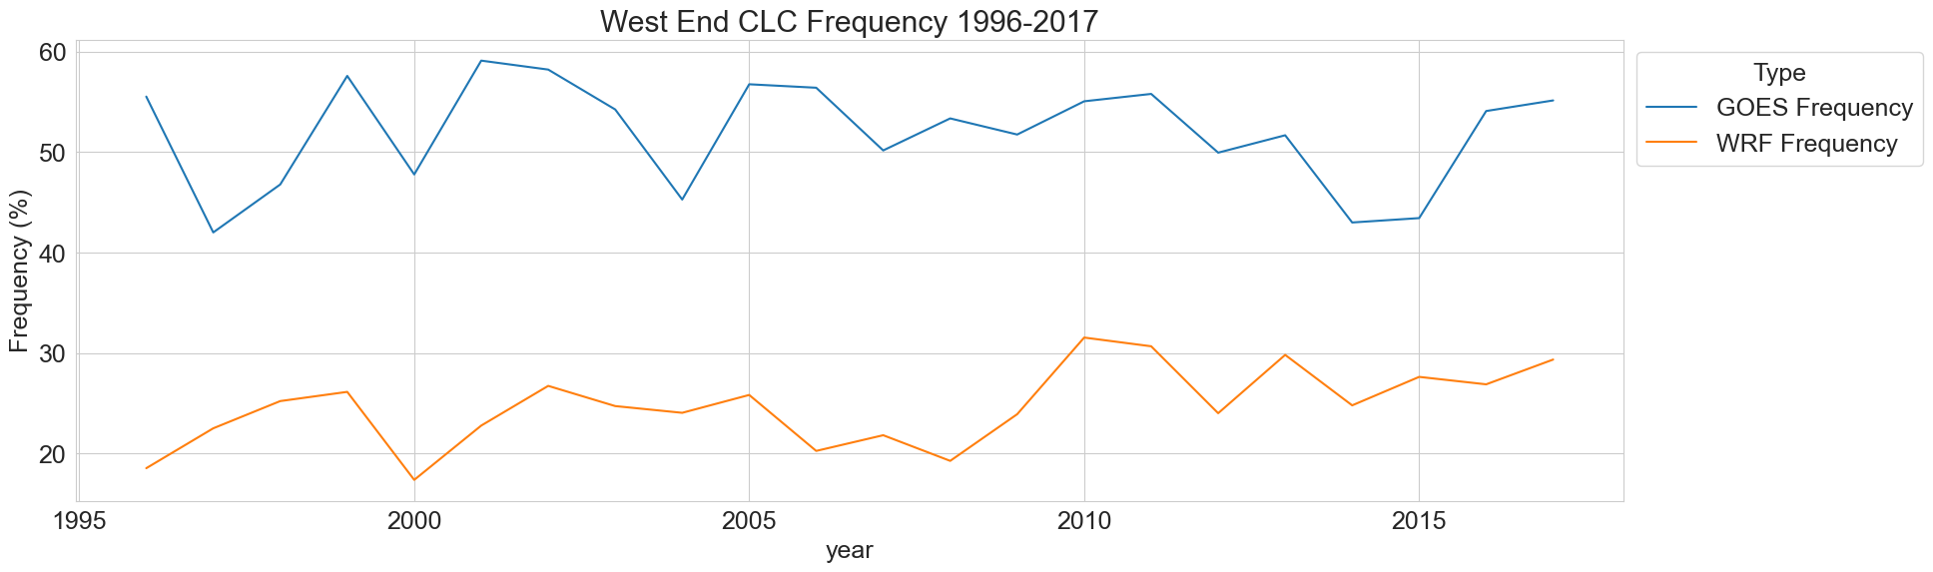
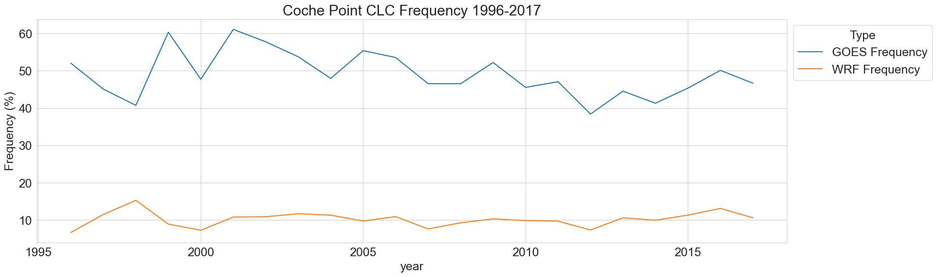

Slide 16
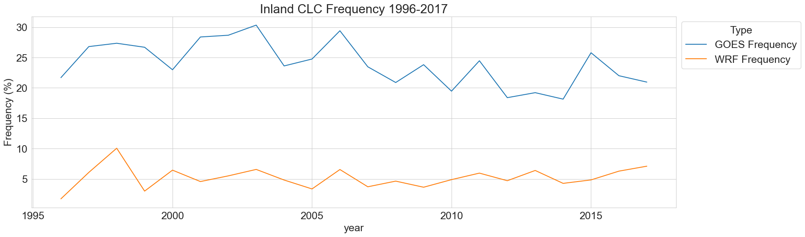
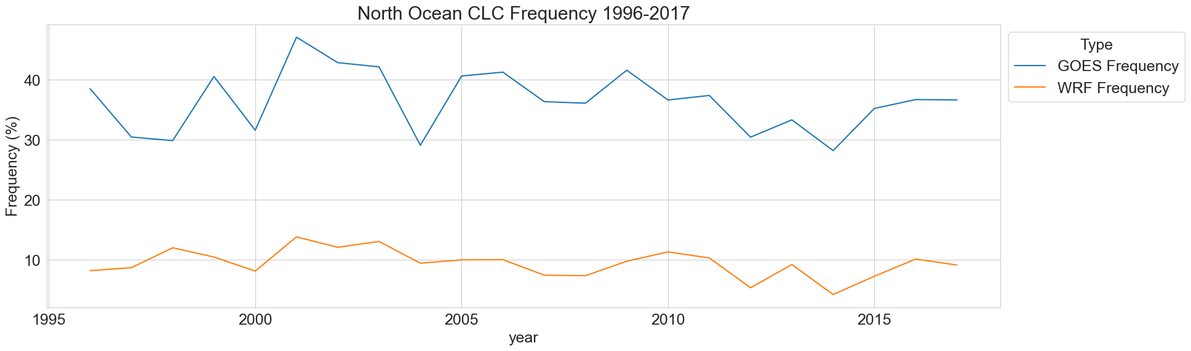

Slide 17
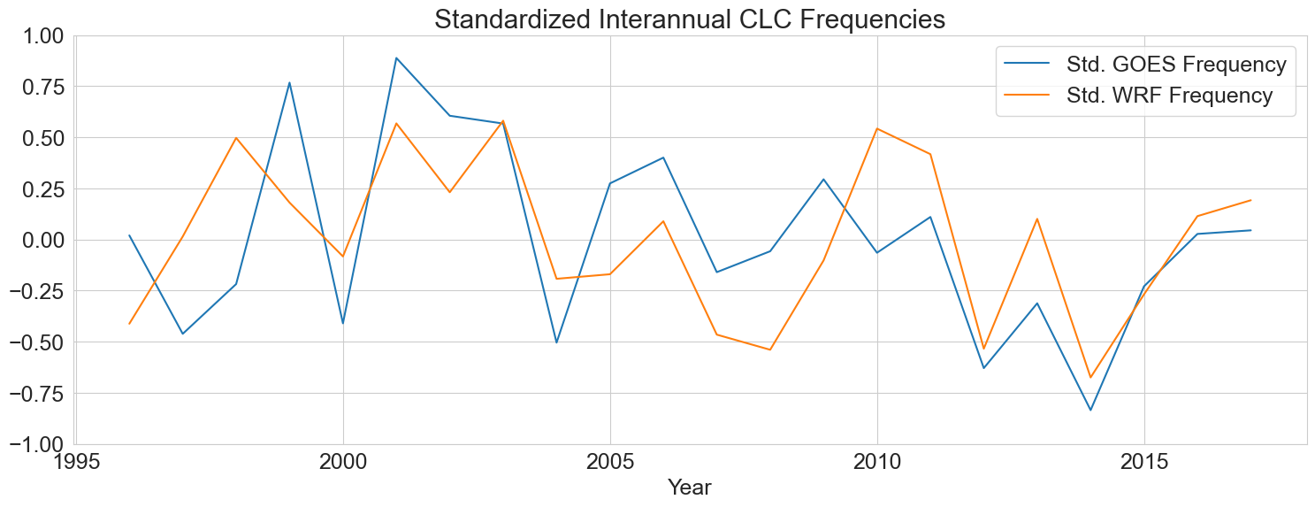

Slide 18
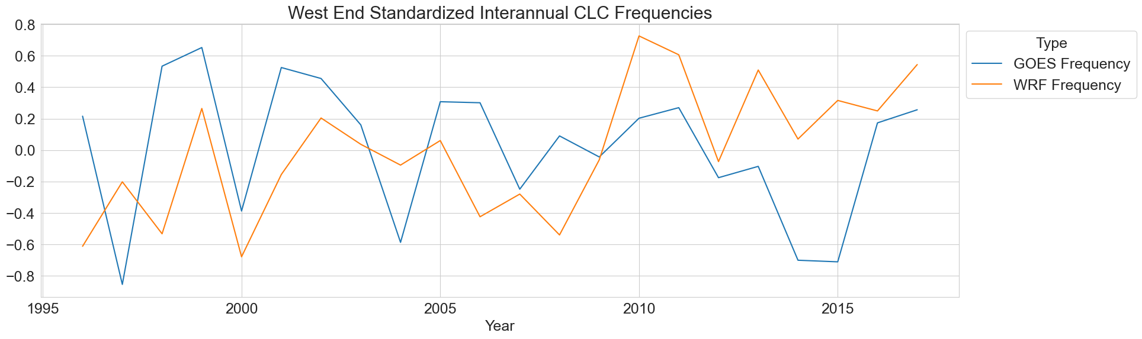

Slide 19
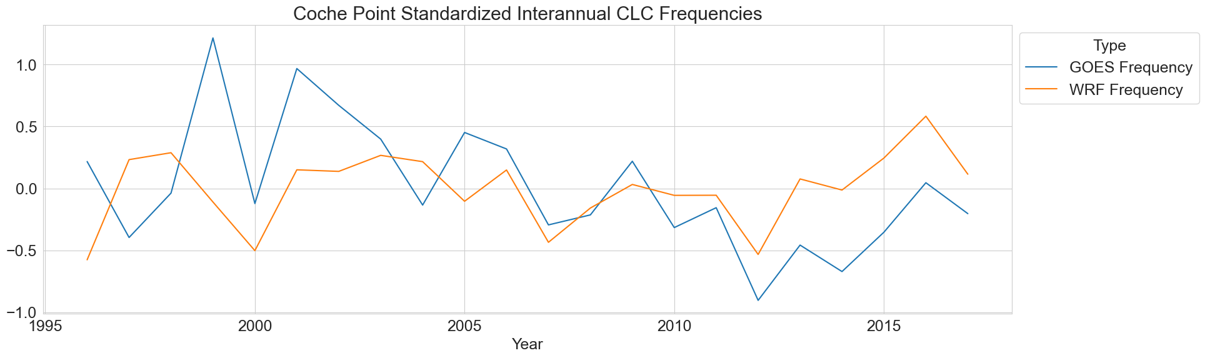

Slide 20
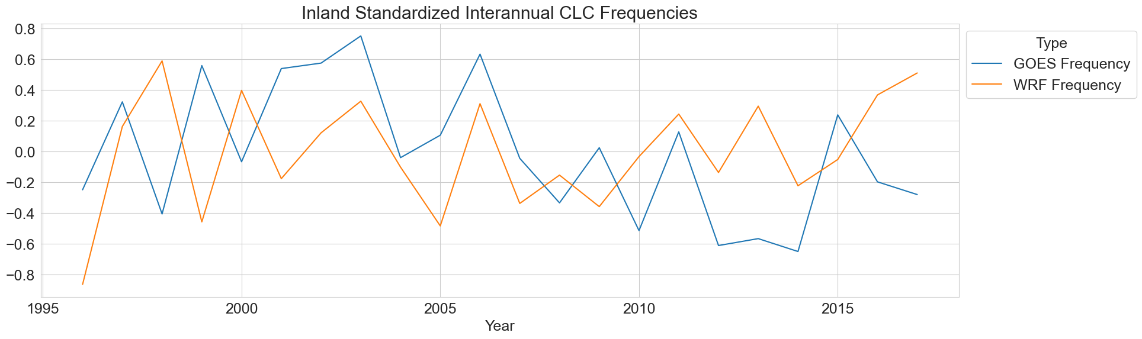

Slide 21
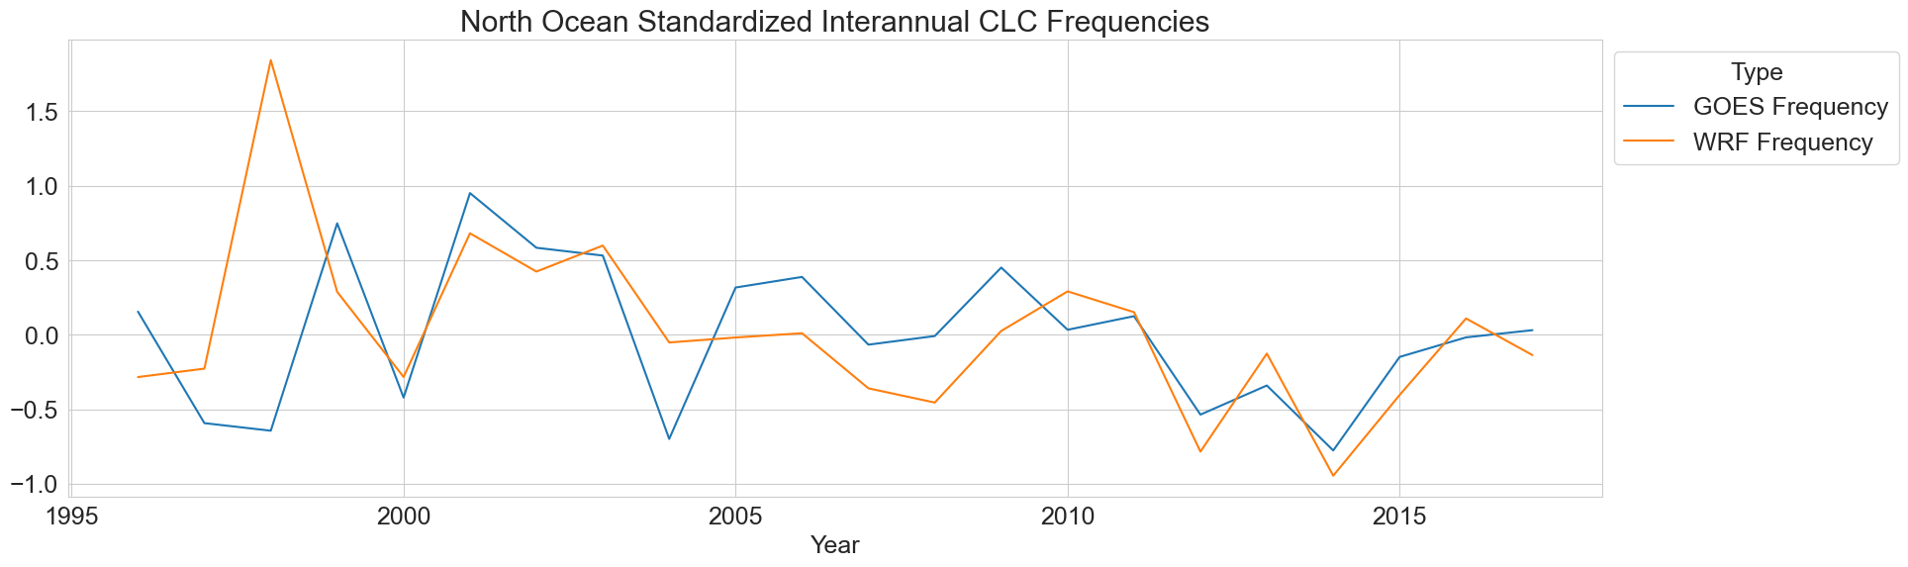

Slide 22
Extra Plots

Slide 23
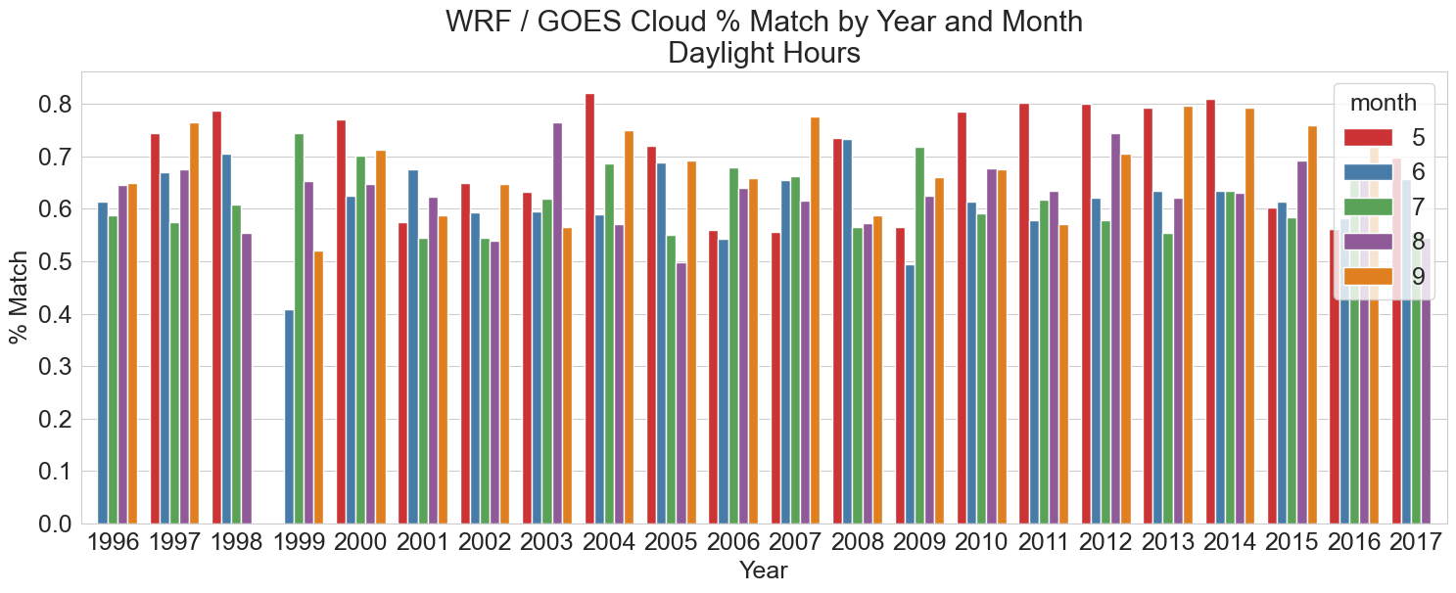

Slide 24
