Slide 1
WRF Coastal Low Clouds (CLC) Performance
Assessing WRF performance in simulating CLC for Santa Cruz Island, using a GOES derived CLC dataset (Clemesha et al., below) as truth
Groundwork for assessing WRF performance in simulating fog at Santa Cruz Island
CLC defined as clouds below 2000m for both WRF and GOES
WRF CLC extracted using wrf-python wrf.cloudfrac() to get cloud fraction, then made into binary variable using threshold value
GOES CLC defined as cells where cloud albedo > 8.5%, set based on communication with Rachel Clemesha
Clemesha, R. E, et al. (2021). A high-resolution record of coastal clouds and fog and their role in plant distributions over San Clemente Island, California. Environmental Research Communications, 3(10), 105003.
DOI 10.1088/2515-7620/ac2894

Slide 2
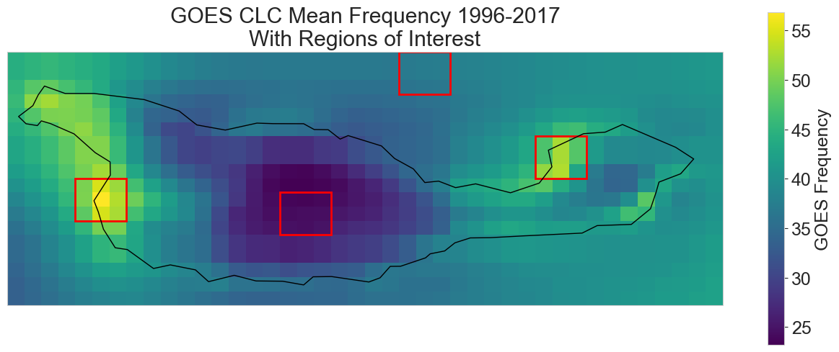
North Ocean
Coches Point
West End
Inland
GOES Frequency defined as the total number of times a cell was cloudy, divided by total number of observations
Regions of Interest defined to compare WRF performance at coastal fog ‘hotspots’ against ocean sites and inland sites that are relatively clear.

Slide 3
Cloud Fraction Threshold
Analysis to determine optimal threshold to define low clouds using cloud fraction returned from wrf-python

Slide 4
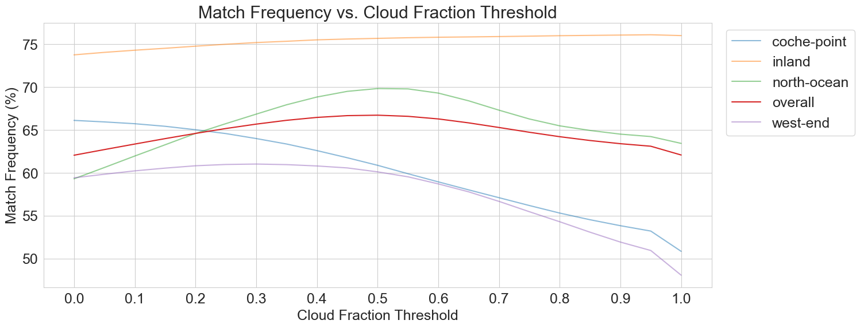
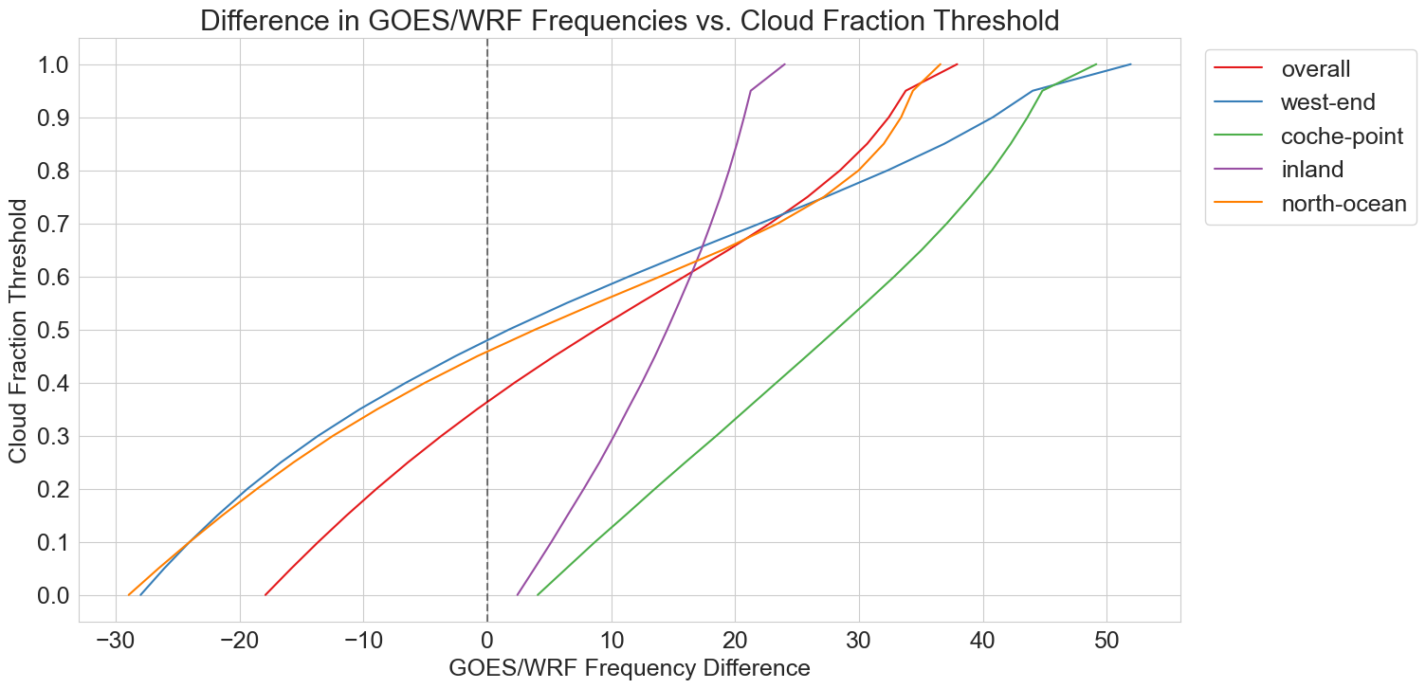
WRF performance was assessed against a range of thresholds, and 0.45 was chosen to balance performance between overall and west end.

Slide 5
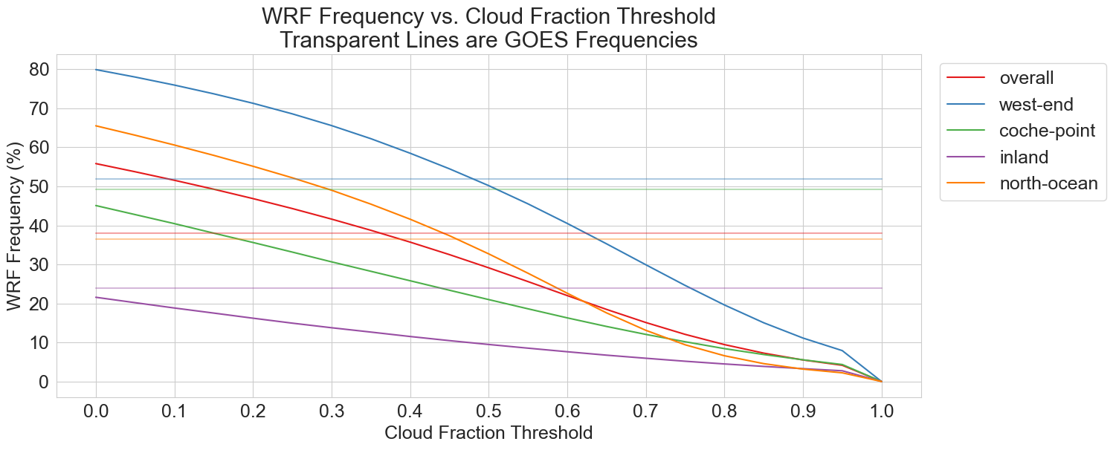
Another way to visualize same plots as above. Horizontal transparent lines represent ‘true’ frequencies defined using GOES.

Slide 6
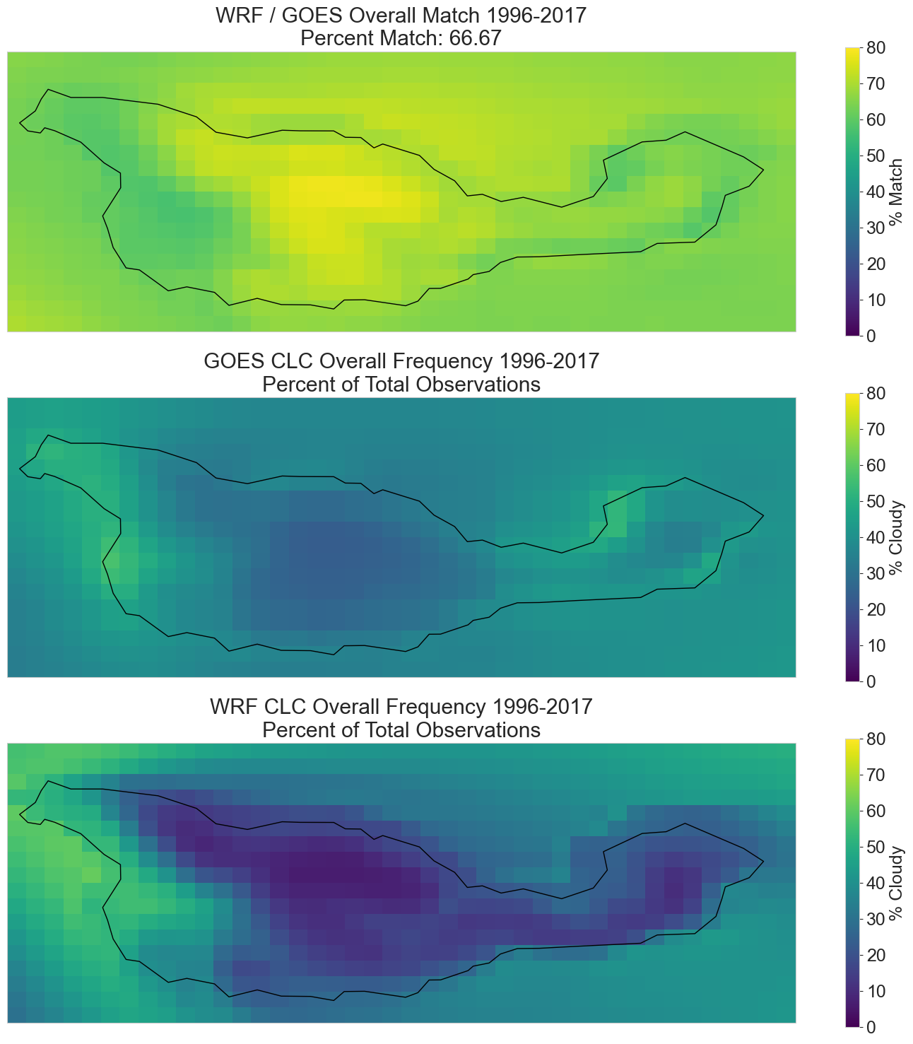
Overall Patterns
Percent match defined by calculating the number of hourly timesteps where WRF and GOES were both ‘cloud’ or both ‘no cloud’
WRF performs worst at foggiest sites (west end, northeast end)
WRF does simulate frequent CLC at west end, suggesting the timing is somewhat misaligned

Slide 7
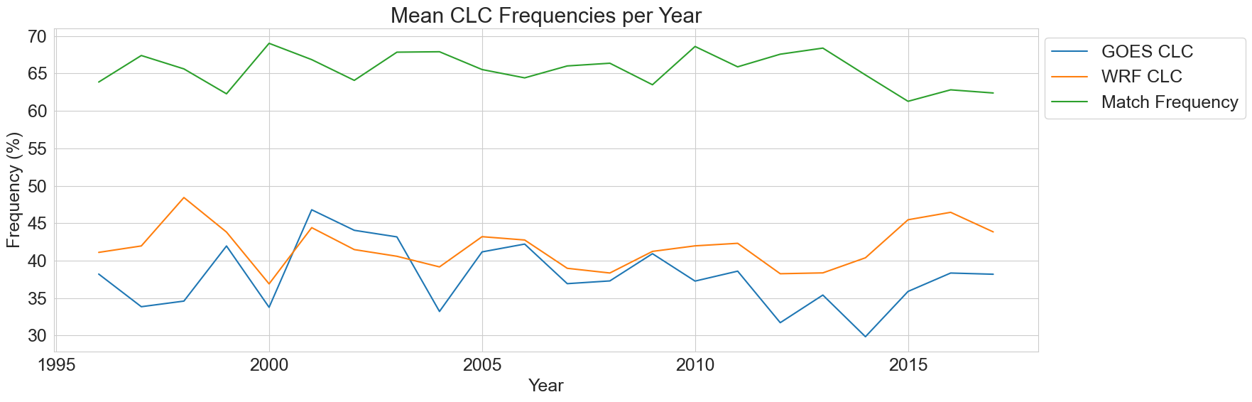
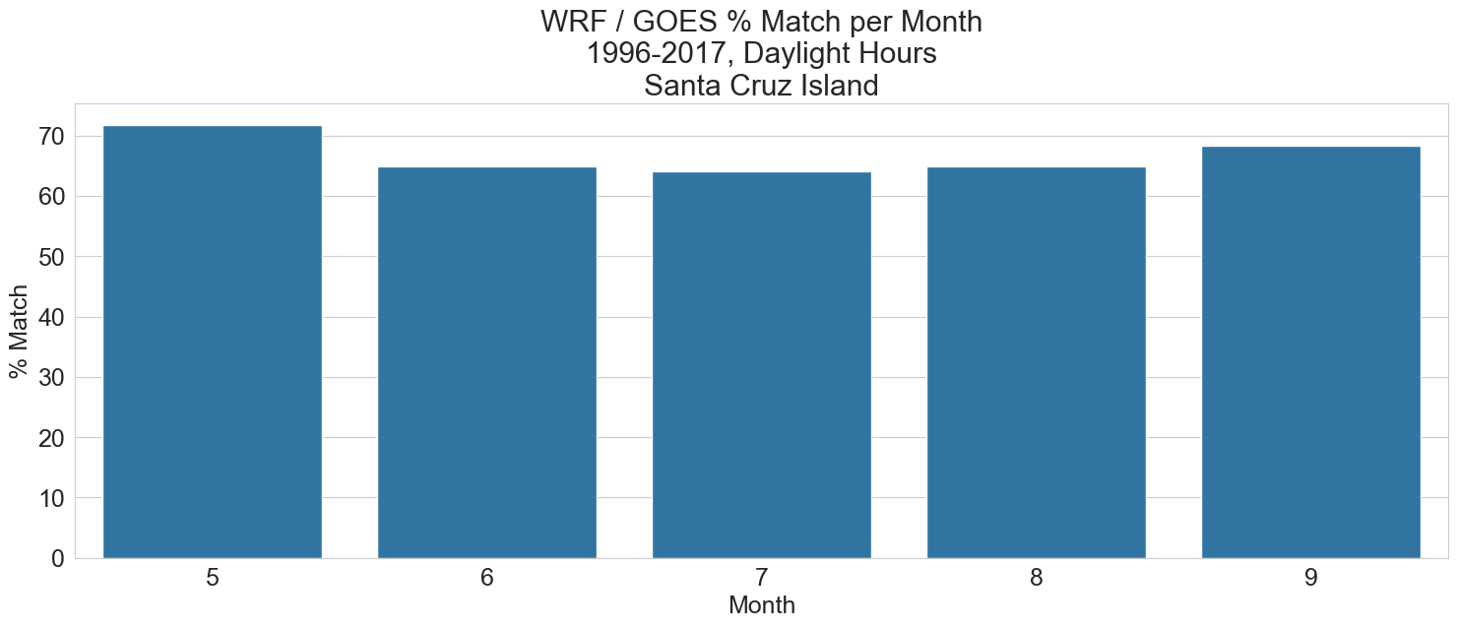
Temporal Patterns
Inverse relationship between match % and GOES frequency – the cloudier the year / month, the lower the performance
WRF CLC does follow the trend of GOES CLC well

Slide 8
ROI Analyses
North Ocean
Coches Point
West End
Inland

Slide 9
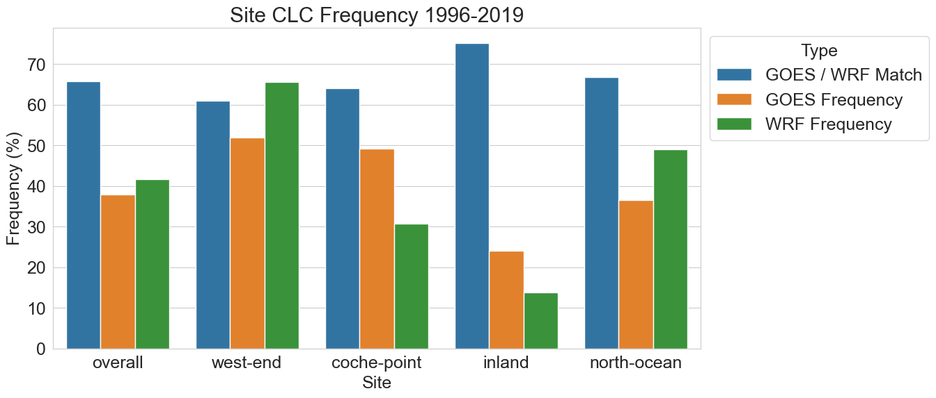
Overall Frequencies
Chosen threshold leads to overestimation at west end and north-ocean, but underestimation at inland and coche-point
Balances the overall score
Best match performance at inland, which is the least cloudy site

Slide 10
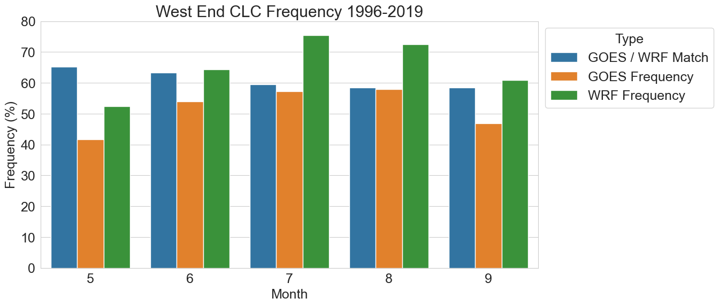
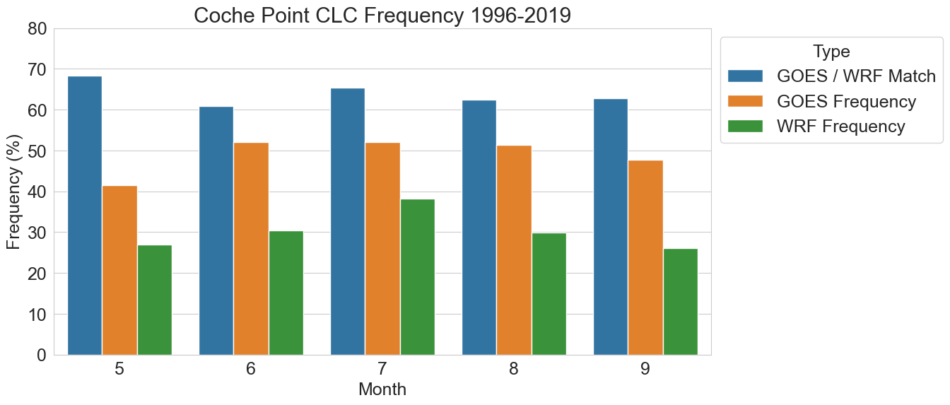
Monthly Breakdown by Site
These are the cloudiest sites
WRF correctly predicts relative frequency trends for both sites
For coches point, the match frequency doesn’t follow the trend

Slide 11
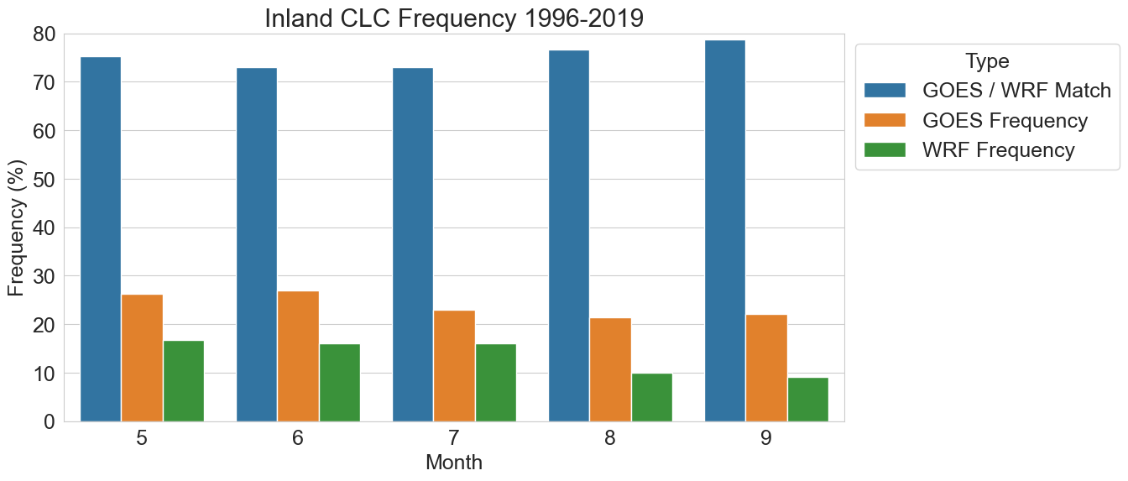
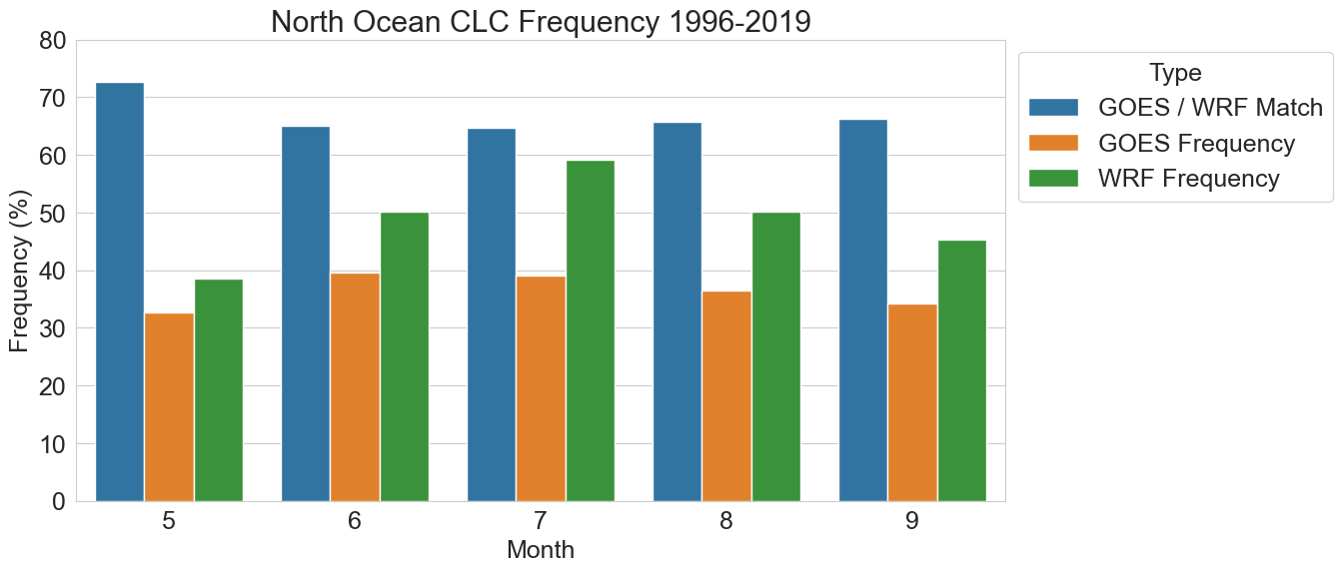

Slide 12
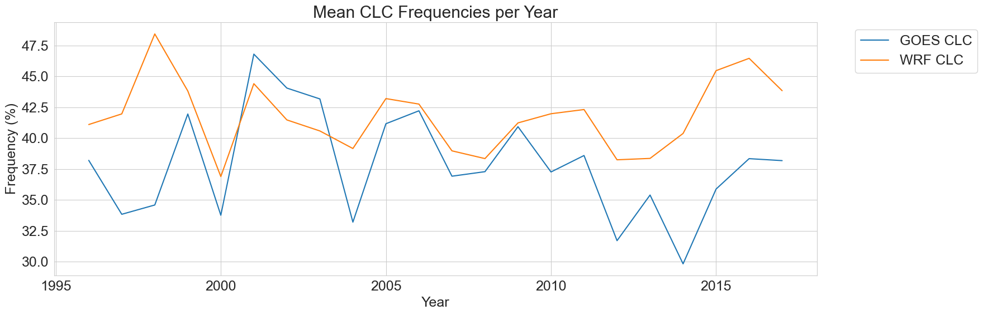
Interannual Trends
Overall Santa Cruz Island

Slide 13
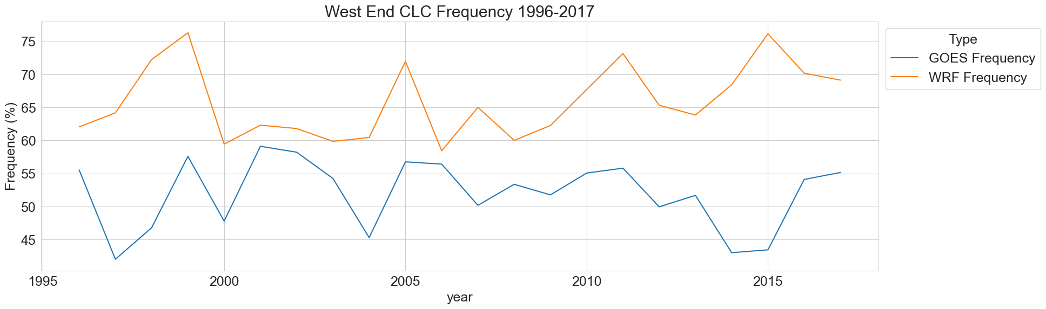
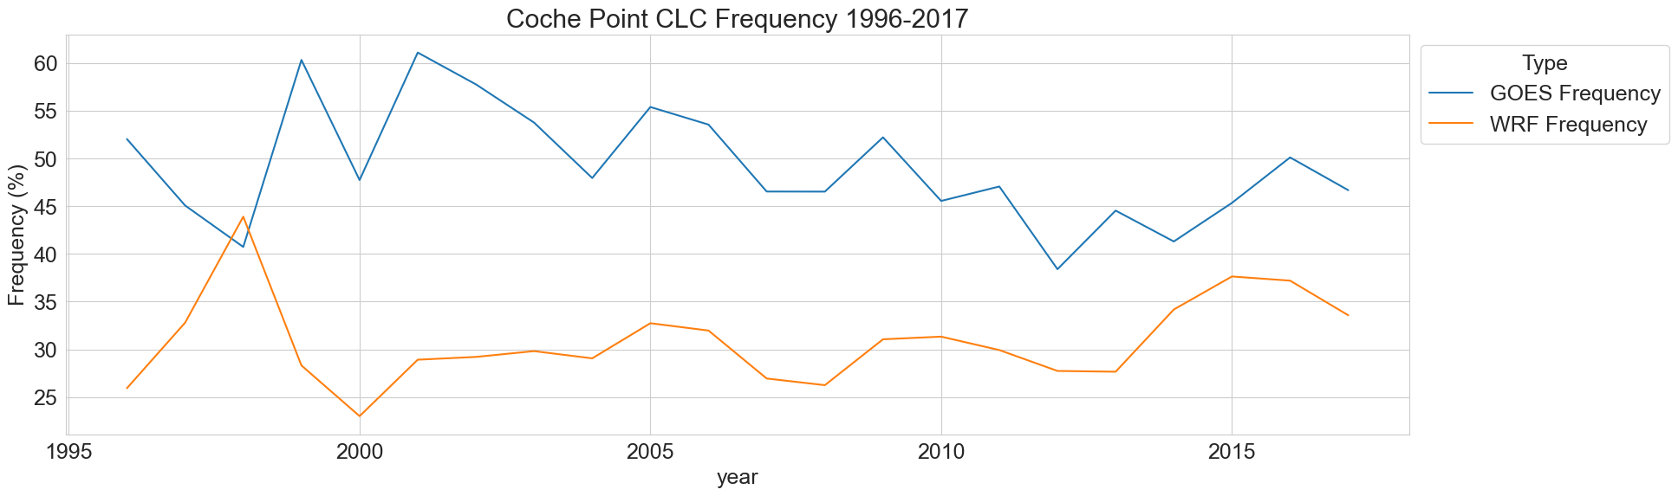

Slide 14
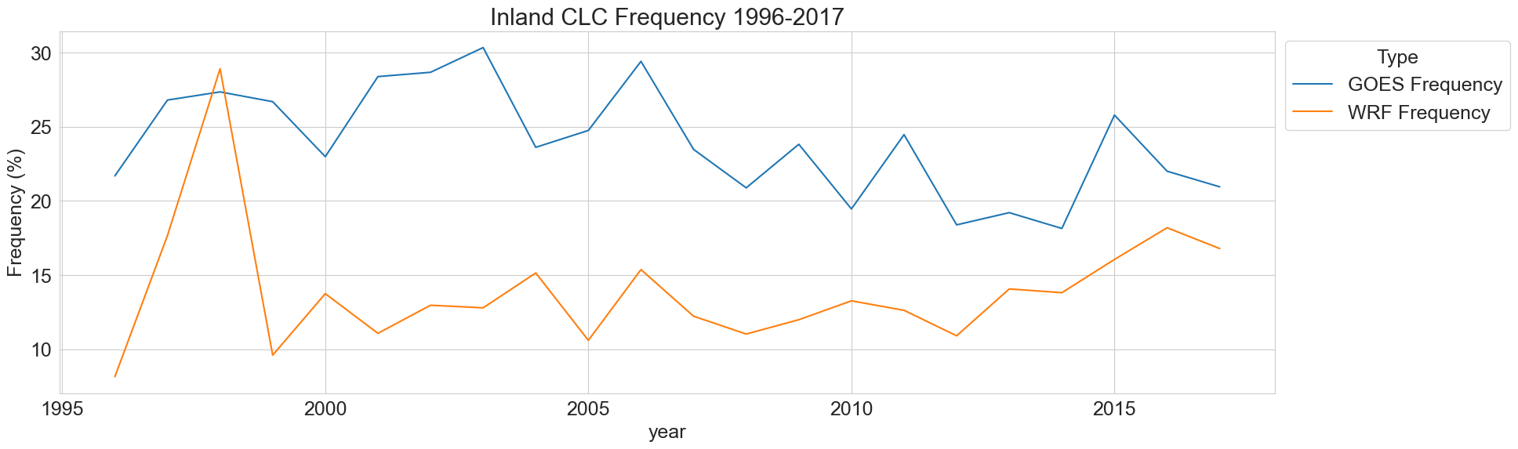
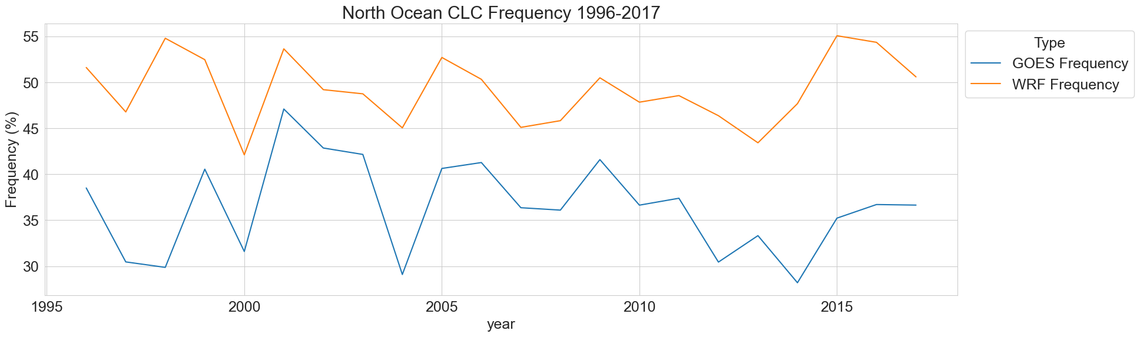

Slide 15
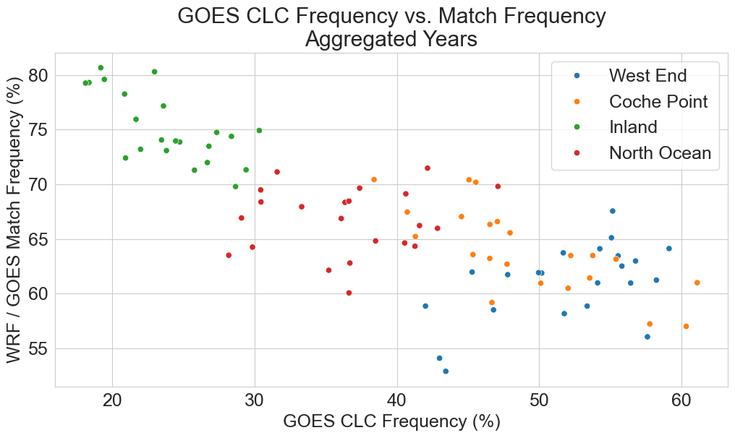
Each point is a given year/site

Slide 16
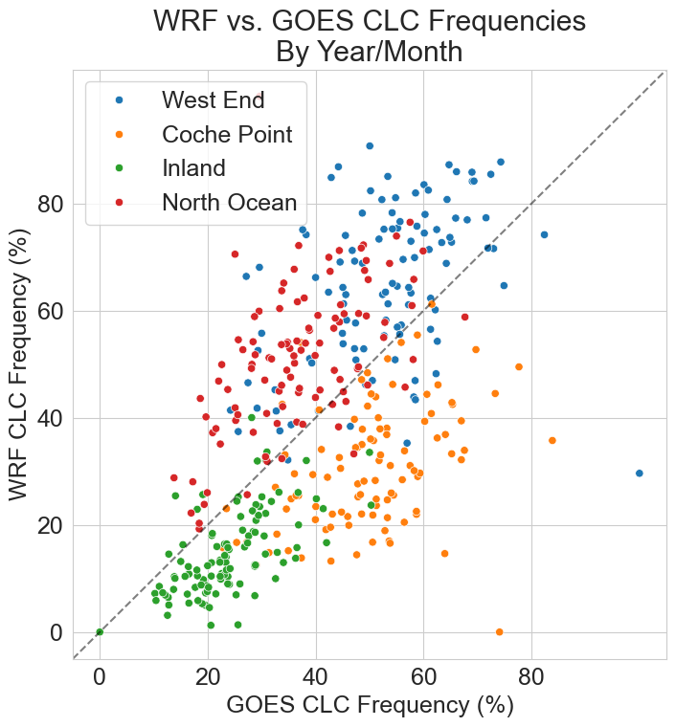
Each point represents a year/month/site
E.g. West End, July 2015
Dashed line has slope of 1
West End/North Ocean follow a similar trend, while inland and coche point follow a similar trend

Slide 17
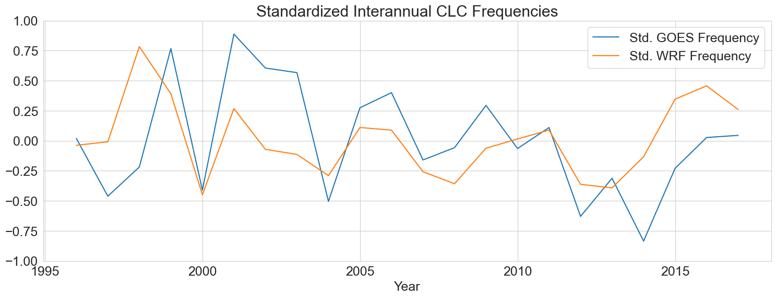
Standardized Plots
Data were standardized to have a mean of 0 and std. deviation of 1
Removes bias in order to assess interannual trends

Slide 18
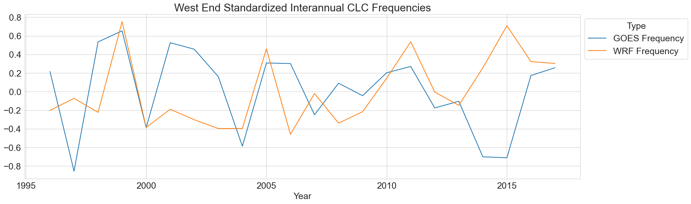
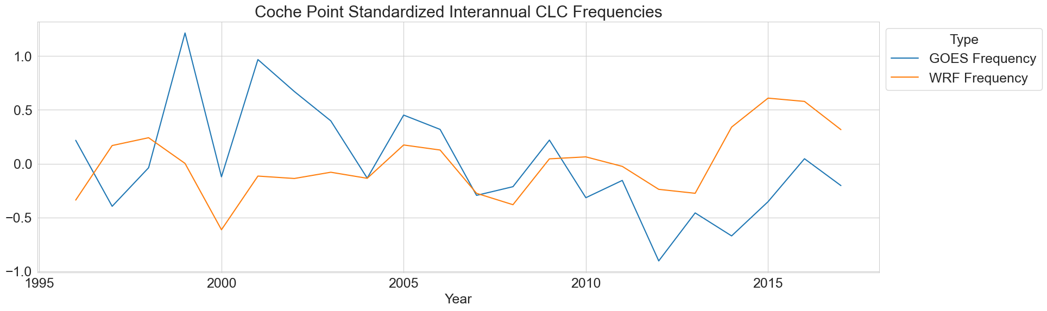

Slide 19
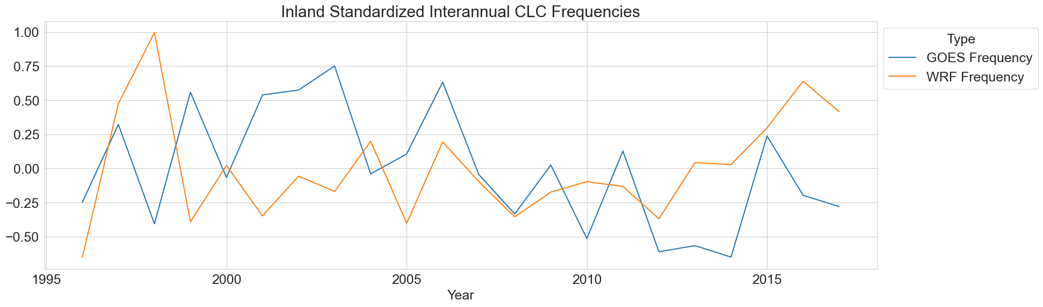
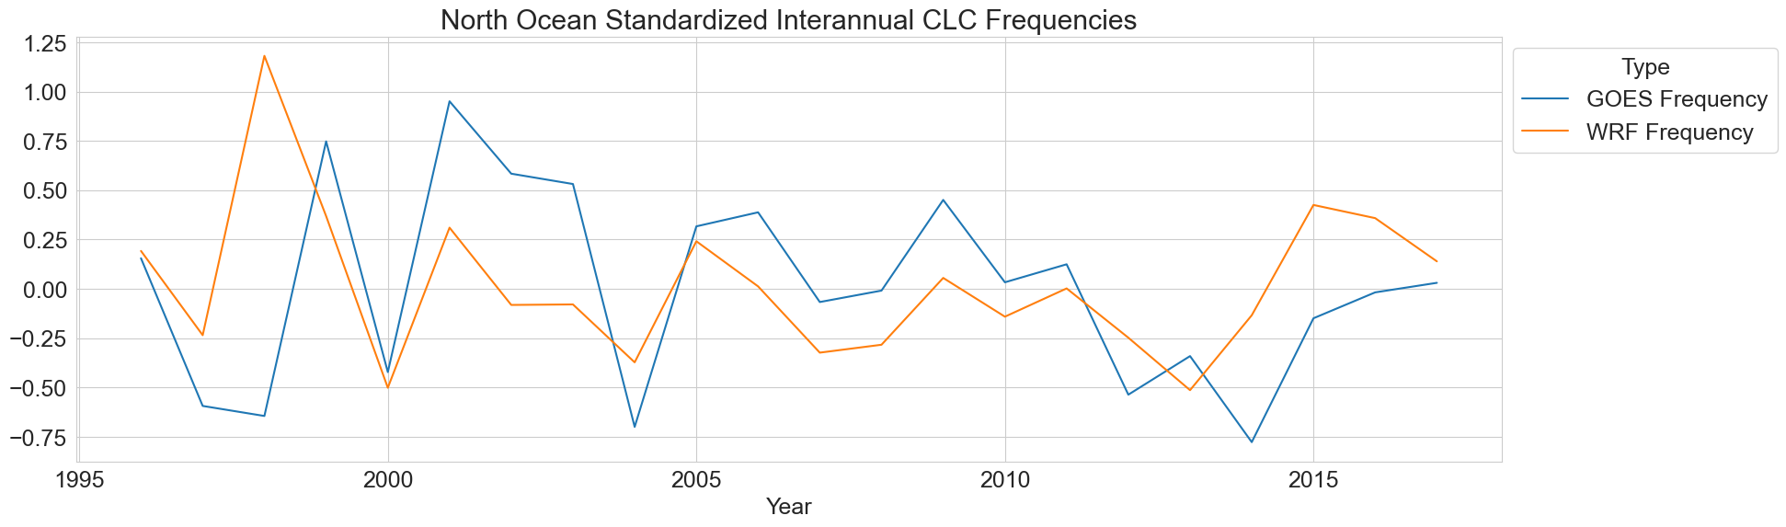

Slide 20
Extra Figures

Slide 21
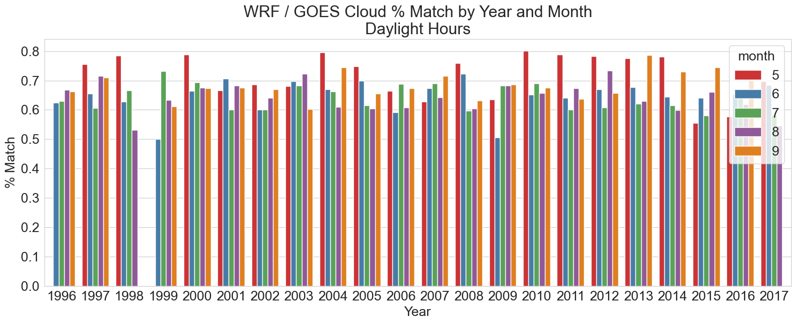

Slide 22
