Slide 1
R-Seminar Win 2024
EEMB 595R/194R
2024
Mon @ 3:30 – Noble 1231 ← ROOM CHANGE
Leander Anderegg landeregg@ucsb.edu

Slide 2
Introductions
Us:
Lee Anderegg – landeregg@ucsb.edu, Github @leanderegg
Patrick Green – pagreen@ucsb.edu, @ (Patrick’s handle?)

Slide 3
What is R-Seminar?
1st Hour –
Tutorial about [insert your interests here]
”Favorite Function” presentations from 194R folks
2nd Hour –
Code clinic

Slide 4

What is R-Seminar?

Slide 5

What is R-Seminar?

Slide 6
Seminar Logistics
Keeping track of the Schedule – https://docs.google.com/spreadsheets/d/1KVy5sDUts8ZbA43a6mORx8WoYPln6zxAxpIcuUJFJpE/edit?usp=sharing
Sharing / Collaborating on Files – GitHub Organization:
https://github.com/UCSB-RSeminar
Listserv – rstats@eemb.ucsb.edu
Subscribe: (anyone know if people can auto-subscribe to Google Groups???)
Sign up in the ‘email’ column of the schedule
Email landeregg@ucsb.edu and I’ll add you
Zoom:https://ucsb.zoom.us/j/85337845501

Slide 7
Seminar Logistics
If you're a grad enrolled in 595R, please sign up to lead (or assist with) a tutorial
If you're an undergrad enrolled in 194R, please sign up to either:
help a grad student with a tutorial (be an assistant tutorial lead)
present a 5 min ‘Favorite Function' section to
give a deep dive into a function (either your current fav/a great one you've recently discovered or one of the central functions from a prior tutorial that you wanted to know more about)
Share a coding tip or trick that makes your code more readable/transferable/robust or just something cool that makes your R life better.
(NOTE: This is actually intended to be quick, really 5mins or less)

Slide 8
Topics
Learn | Teach

Slide 9
Guidelines for Presenters
Move Slow—You know your code, data and approach better than your audience.
Make it Interactive—Include a simple exercise to give people a chance to play with the code.
Upload scripts and data at least 24hr in advance—Allows folks to install packages, work out any platform-specific kinks.
Ground in Science—We are scientists, not programmers.

Slide 10
Guidelines for Participants
Fork the repository in GitHub—This way we won’t have to worry about folks changing the original version of the code.
Try the code before the seminar—This will give you a chance to install packages and iron out any issues with file paths, etc.
Learn by doing—Follow along with the presenter by running the code yourself.

Slide 11

GitHub Demo

Slide 12

Your own version control
Github repo
‘main’ branch
Clone to local machine
(or ‘pull’ most recent version)
‘local’
‘push’ commits to the main version in the cloud
Edit project, commit changes

Slide 13
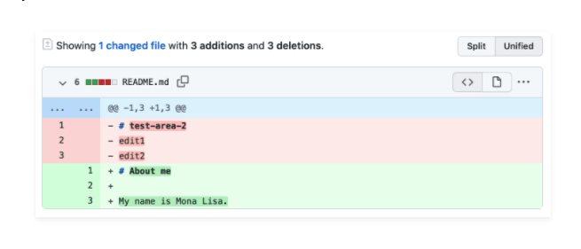
Your own version control
Github repo
‘main’ branch
Clone to local machine
(or ‘pull’ most recent version)
‘local’
‘push’ commits to the main version in the cloud
Edit project, commit changes

Slide 14
Collaborating
Github repo
‘main’ branch
Merge your branch with the master branch for official update using a ‘pull request’
‘fork’ main branch to your github account
Clone/pull to local machine
‘push’ commits to your branch
Edit project, commit changes

Slide 15
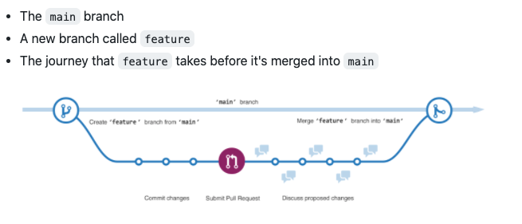
Collaborating

Slide 16
Prep for Next Week
Update to latest versions of R and Rstudio.
Install Git on the laptop you will bring to seminar.
Test the connection between GitHub and Rstudio.
See the great tutorial here:
https://cfss.uchicago.edu/setup/
https://rfortherestofus.com/2021/02/how-to-use-git-github-with-r/

Slide 17
Special Session: Intro to R

