Slide 1
Dealing w/skewed data + linear model selection
Laura Dagg
R seminar Fall 2026

Slide 2

Today’s Objectives
Define a normal vs. non-normal distribution and when it matters
1
Understand how to determine skew in your dataset
2
Develop a toolbox of how to deal with skewed data
3
Understand what to do if normalization fails.
4

Slide 3
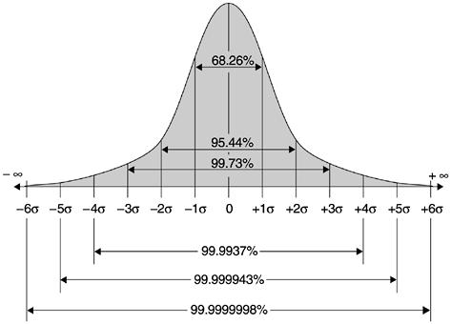
Normal Distribution – the Bell Curve
The normal/gaussian distribution is a continuous probability distribution with a symmetric bell-shaped curve.
Note that the area under the curve represents the probability of an observed value. Total area = 1 (100%)
Note the SD
This Photo by Unknown Author is licensed under CC BY-NC-ND
Notes:
A standard normal distribution has a mean is 0 and the standard deviation is 1. 68% of all values should fall within 1 SD of the mean, 95% of all values should fall within 2 SD of the mean. Values under the tails of the distribution are highly unlikely! We can calculate p-values by plotting our observed value on simulated normally distributed data ( if H0 is true) to see what the probability of getting our observed data is if H0 is true.
. It can be used to calculate the probability of a certain value’s distance from the mean via the z-score.

Slide 4
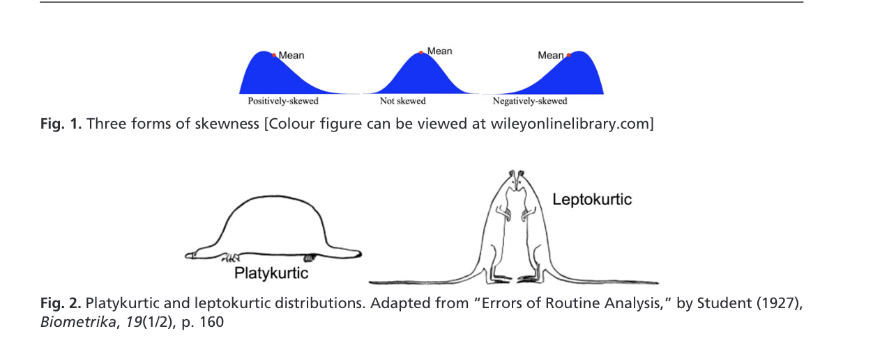
Non-normal Distribution
Skew- measure of the balance of the tails
Kurtosis – measure of the slenderness/broadness of the distribution
Notes:
Postiive or right skewed data has a long tail to the right and negative or left skewed data has a long tail to the left. Note that in our skewed data we much different values that are less probably when compared to the nomral distribution. Kurtosiss is the measure of how the SD differs really, where slender distribution with long flat tails is called leptokurtic and a distribution that has short tails and a broad distribution is lcalled platykurtic.

Slide 5
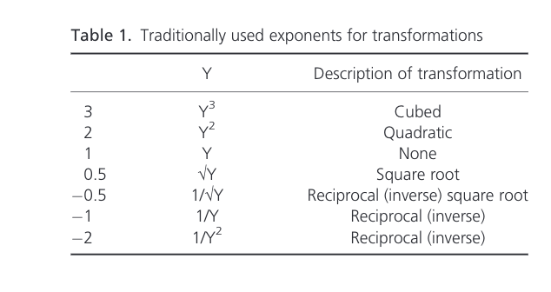
Exponents vs ln() for data normalization
Natural Log: To make data more normal, you can apply the natural log function to your dataset, but when?
Applying the log10 function to a number or a numeric df will yield an output that is the exponent to which 10 must be raised to obtain x.
Can only take the log of positive numbers.
X= log10(xi)
2 = log10(100)
Exponents: To make data more normal, can apply a function to the dataset ( an exponent per say) to normalize the data. But which exponent (ƛ) should you use for your dataset?

Slide 6
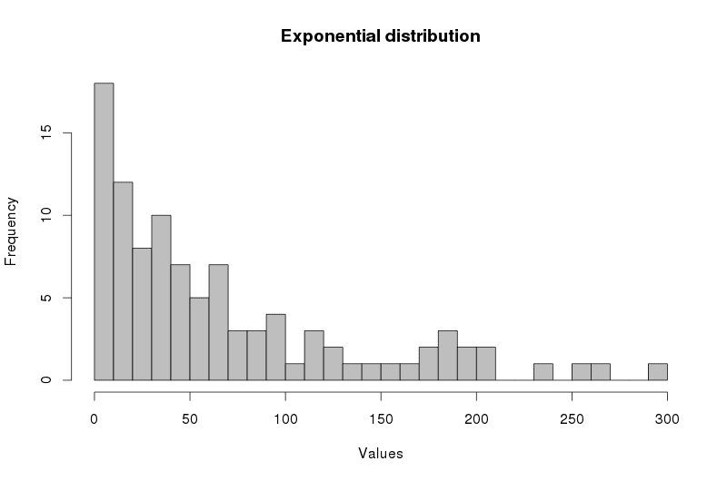
Natural Log
When applying a natural log you convert skewed data to a more normal distribution by proportionally scaling down large values more than small values, resulting in a shorter right tail.
So this works best for POSTIVE and RIGHT-SKEWED DATA where we see that most values cluster at the lower end and a few unusually large values extend the tail to the right.
Log normalization does NOT work for left-skewed data because it can distort small or negative values.
This Photo by Unknown Author is licensed under CC BY
Notes:
We use ln() natural log in r instead of log10 because it is standard practice, easier to back transform and easier to scale.

Slide 7
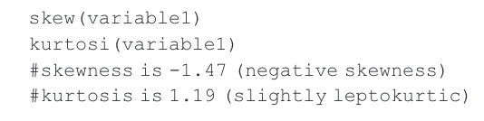


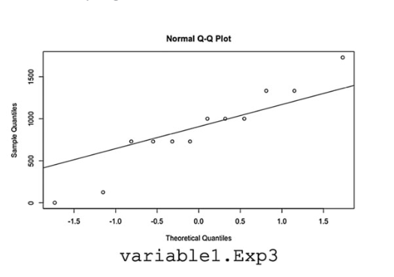
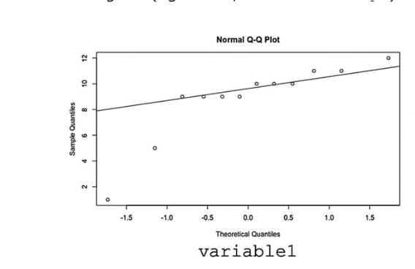
Exponents – Which one?
1) Plot a histogram and quantile-quantile plot of your dataset. (or skew coefficient)
2) Pick an exponent and try it.
3) Plot your transformed data and compare. (or skew coefficient)
4) Did that reduce the skew of your data?
YES – Well, could applying a different exponent normalize better? Try another!
NO - try another!
Notes:
Q-Q plots show you how much your data deviates from the normal distribution. If your data aligns perfectly with the normal distribution, the points will fall along the line. A Q-Q (quantile-quantile) plot compares your data’s distribution against a theoretical normal distribution. If your data is normal, the points fall along a straight diagonal line. Right-skewed data produces a curve that bows away from the line. Heavy-tailed data (more extreme values than expected) follows the line in the middle but curves off at both ends.
- Shapiro-wilks test - outputs can be sensitive to your sample size, more likely to fail shapiro-wilks test when you have large sample sizes.
- doesn't tell you what's wrong
- is your error distribution problematic or non-problematic
- outlier removal... is it biological or is it bad data? or bad methods?
- remove outilier and run model, add outlier and run model
- platykurtic data will have an s-shaped curve on the QQ plot, r shape or j shape BAD
-
- distribution of raw response variable doesn't matter
- can also use a Shapiro-wilk test to test for normality.

Slide 8
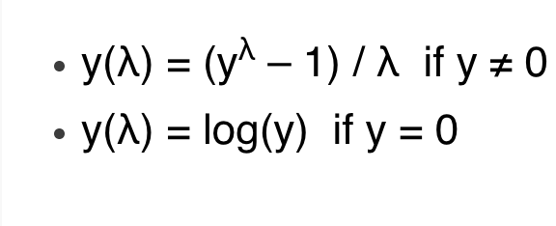
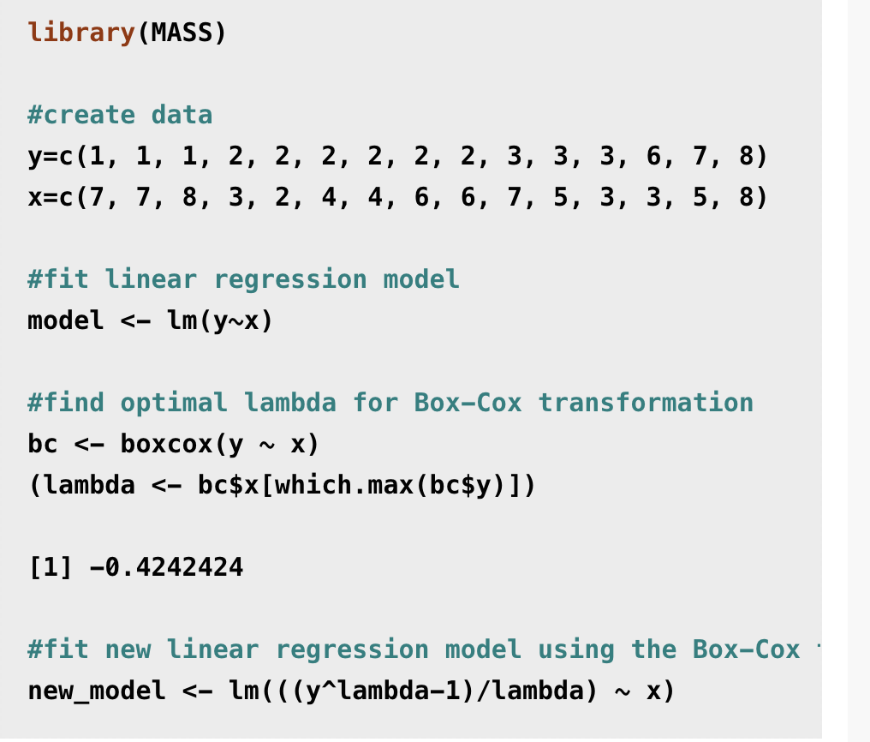
Box-cox
Box-cox method tests a range of power transformations and picks the one that best normalized your data.
Lamba(ƛ)= parameter the method optimizes, could be one of these landmark values below, or a value tailored to your specific data like 0.4
Only works with POSITIVE values!
Use box-cox() function in R, fit lm() model, find and define optimal lambda, fir new lm() with box-cox!
Notes:
- absolute lambda is less important than if its postive or negative.
- postive lambda apply log function
- negative lambda apply sqrt
- boxcox figures out what is best by shrinking small values to shrinnking large value, which one looks more normal.
-

Slide 9
Yeo-Johnson
Dataset with zeros and negatives?
Yeo-Johnson transformation splits data into non-negative and negative values. For negative values it takes the absolute value of y +1, and for all non-negative values it applies the box-cox transformation to y+1.
Notes:
- if you have zero-inflated data, hurdle model , poisson model
- really changing half your dataset,
- could shift your data
- linear transformatino doesn't change the intercept model

Slide 10
If all else fails..
Rank-based transformations..
Pick a new model, a non-parametric test to try.
Non-parametric tests rank all observations and compare the sum of ranks between groups. Yields a valid result where parametric tests would not for genuinely non-normal data.

Slide 11
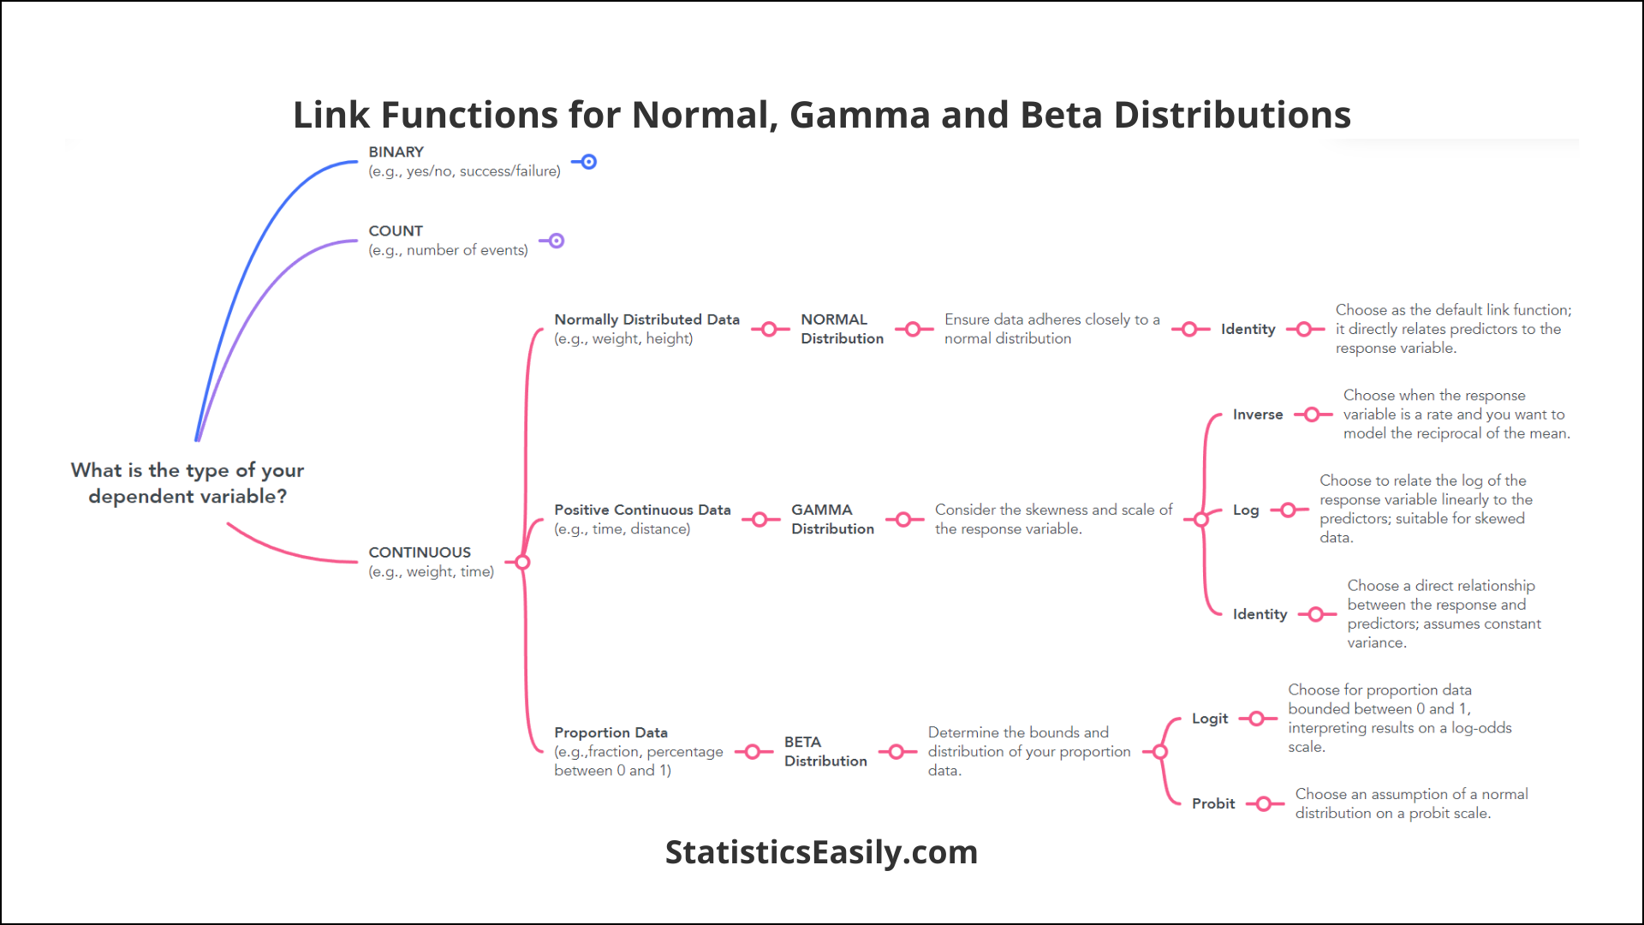
Non-parametric linear models
Kernel Regression – estimated by weighted average of nearby data points
Smoothing Splines – fits a spline functions that minimizes sum of squared residuals
Generalized Additive Models
Generalized Linear Models – Handles non-normal responses by combining distribution, link function, and linear predictor.
  Negative Binomial – works for count data, where variance is greater than the mean
  Poisson – works for count data where variance is roughly equal to mean
Notes:
Nonparametric regression refers to a class of regression techniques that do not assume a specific functional form for the relationship between a predictor and a response. It allows the data to speak for itself

Slide 12
Generalized Linear Models
Using base r you can extract fitted values from your model using the predict() function, then compute the standardized residuals using rstandard(), lastly plot!
Dispersion test comes from the “AER” package and can only be run on poisson GLM. The function is dispersiontest().
To perform a likelihood ratio test, you can use the function lrtest()
1) Fit both of your models
2. Choose a diagnostic Method
a) Plot standardized deviance r residuals vs. fitted values
b) Check dispersion
c) Likelihood Ratio test
3) Select model based on diagnostic methods.
Notes:
Likelihood ratio test compare the goodness of fir between two models
poisson = mean = variance
negative binomial = variance > mean

Slide 13
To Recap…
If data is non-normal, pick appropriate function..
Compare transformed data to non-transformed data
If data is truly non-normal, choose a non-parametric linear model
Check dataset for normality by plotting or with skew coefficient.
skew()
kurtosi()
qnorm()
qqline()
lm(y~x)
Bxcx <- boxcox(y~x)
Lamba <- …
New_lm <- lm (((y^lambda-1)/lamba) ~x)
skew(lm$y)
skew(new_lm$y)
qqnorm(new_lm$y)
qqline(new_lm$y)
Model <- glmer(y ~x + 1|random), data = ?, family= ?l(link=“?”)
R
tool-set

Slide 14
Today’s Objectives
Let’s open R!
Define a normal vs. non-normal distribution and when it matters
1
Understand how to determine skew in your dataset
2
Develop a toolbox of how to deal with skewed data
3
Understand what to do if normalization fails.
4

Slide 15
References:
https://scienceinsights.org/how-to-transform-non-normal-data-in-statistics/
https://www.geeksforgeeks.org/data-analysis/log-normalization-for-outliers-convert-skewed-data-to-normal-distribution/
https://www.youtube.com/watch?v=lE_HBLDnZFE
https://mike-data-analysis.share.connect.posit.cloud/sec-nonparametric-regression.html

