Slide 1
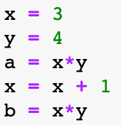





Instruction...
Instruction...
Instruction...
Instruction...
Instruction...

Slide 2
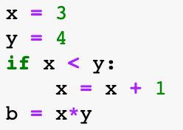





Instruction...
Instruction...
if…
Instruction...
Instruction...

Slide 3
Instruction...
Instruction...
if…
else
Instruction...
Instruction...
Instruction...

Slide 4
Instruction...
Instruction...
if…
elif…
elif…
else…
Instruction...
Instruction...
Instruction...
Instruction...
Instruction...

Slide 5
Instruction...
Instruction...
if…
if…
elif…
Instruction...
Instruction...
Instruction...
if…
Instruction...
Instruction...
Instruction...

Slide 6
Instruction...
Instruction...
while...
for ...
Instruction...
Instruction...
Instruction...
Instruction...

