Slide 1
Carrier Frequency Offset Estimation Methods
~Arya d. Keni

Slide 2
Signal Processing Fundamentals Utilized
The covered methods involve: Angle of Mean (AOM) or Mean of Angle (MOA) for signal samples with or without reusing (R or NR) of sampled data blocks, Maximum likelihood Estimates (MLE), Best Linear Unbiased Estimator (BLUE) and Conventional CFO-E (Carrier/Center Frequency Offset Estimates).
The main conditions against which predictions are checked against are: corrected phase error, mean squared error, standard deviation, Cramer-Rao (Lower) Bound, and Error Vector Magnitude. These are metrics for testing in DSP commonly used.
These conditions are statistical measures in DSP specifically used to measure performances of different estimator methodologies
W=4 is utilized (non-logged variable, for B,Q effective mapping, as a functional hyperparameter)

Slide 3
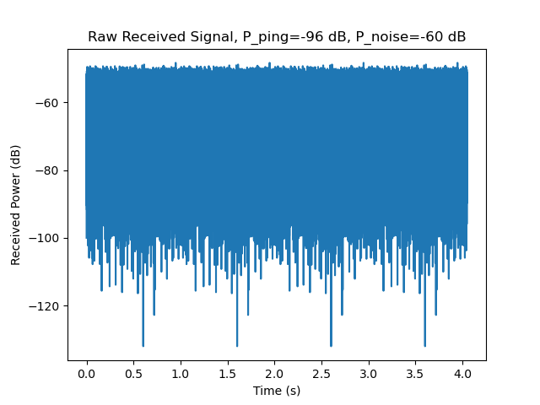
Results against Test Signal
This code was run against the generated test signal as described by code in ”autocorrelation_tests.py” in the NH0 branch of the main repo. Simple plot of signal Power with time the signal is received for.
The results indicate a 99.98% accuracy in prediction to the actual offset, along with additional analysis for best methods given certain conditions.

Slide 4
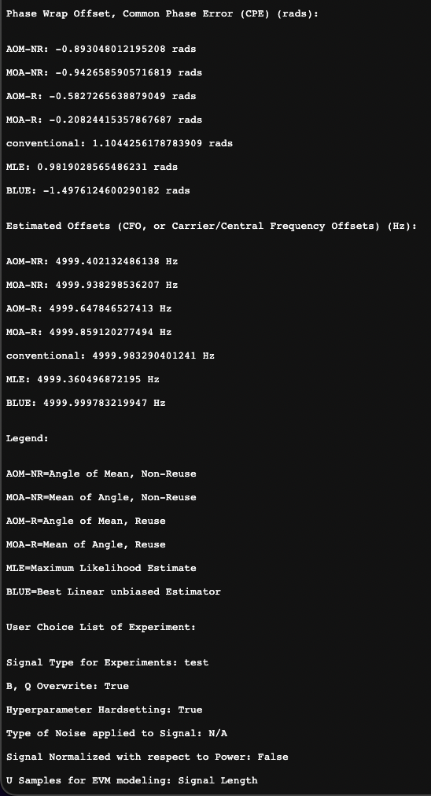
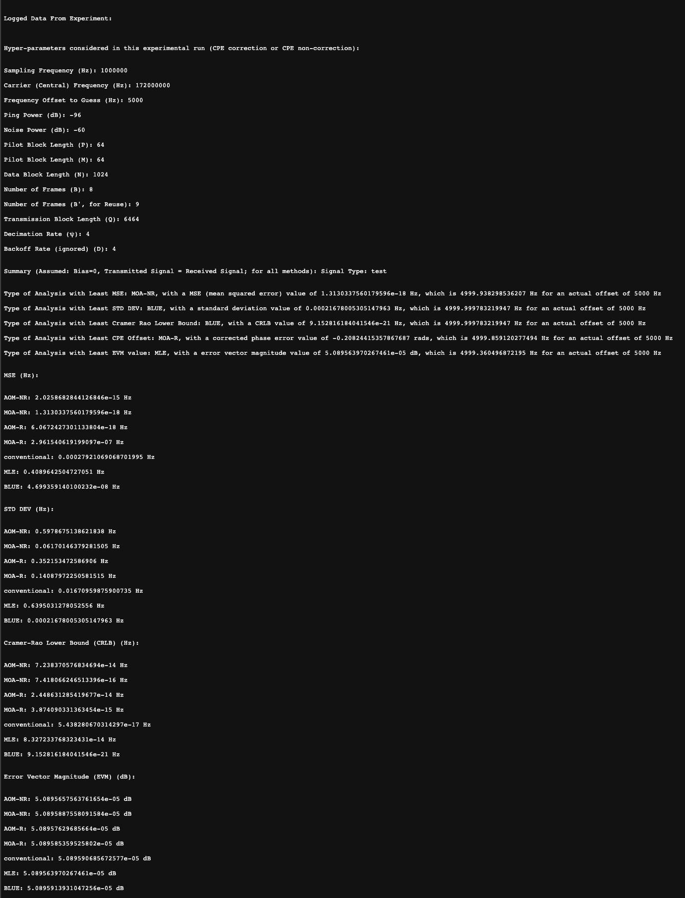
Results against Test Signal
Shown are the .txt file snapshots of the data processing performed on the signal
It covers experimental parameters, conditional analysis, and predictions with each method instantiation
Zoom in to view details ^

Slide 5
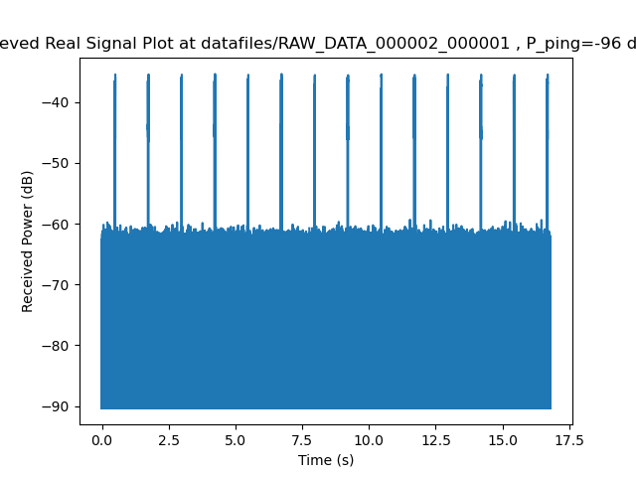
Results against Real Signal
Received
This code was run against the real signal as read from the RAW data binary taken from the drone by Mia. Simple plot of signal Power with time the signal is received for.
The results indicate a 99.98% accuracy in prediction to the actual offset, along with additional analysis for best methods given certain conditions. (Same as test signal, with different predicted magnitudes)

Slide 6
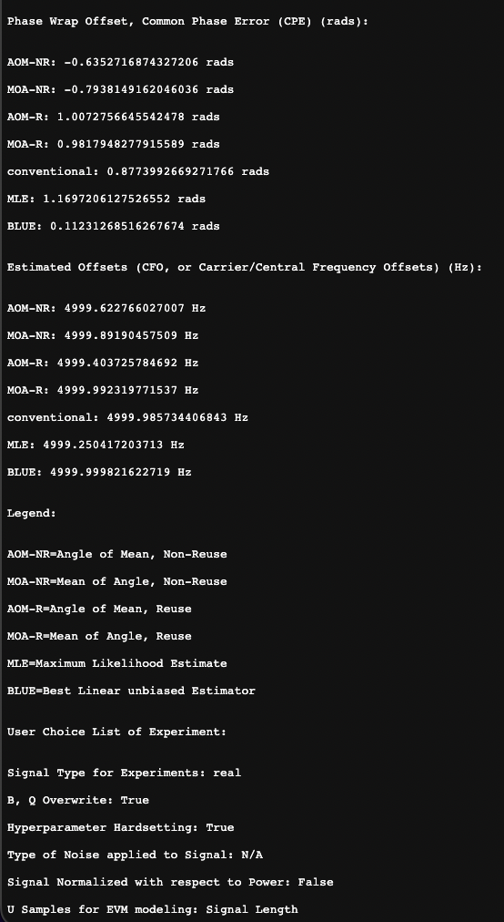
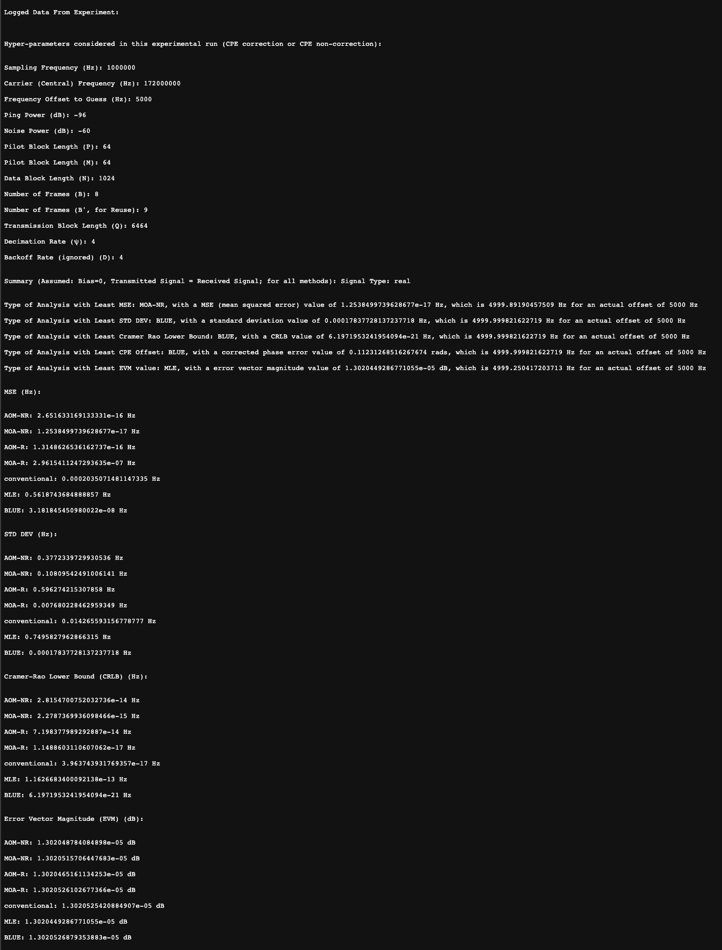
Results against Real Signal
Shown are the .txt file snapshots of the data processing performed on the signal
It covers experimental parameters, conditional analysis, and predictions with each method instantiation
Zoom in to view details ^

Slide 7
Programming Overview
The code uses a CLI (Command Line Interface) to ask the user certain experimental parameters, which aid in finetuning specific processes performed, leading to slightly different estimates, within the same aforementioned accuracy range.
The code is fully written in python 3.8+ and utilizes the certain dependencies (see later) for mathematical analysis, depiction and optimization
The code is self contained within 1 file, and also utilizes file I/O to specified folders
Matplotlib is another plot and image processing dependency used that writes to specified folders, for signal plots.

Slide 8
Programming Overview: User Inputs
For the terminal-based inputs for used prompting when navigated to the directory with the code with filename “offset_est.py” and running it, please adhere to the given user input choices, and advice.
Follow the advice in the CLI prompt for experimental options of hyperparameter setting, computation of hyperparameters, noise addition, normalization, and EVM sampling.
Further notes on results with these inputs:
The results are consistent for real and test data, with a very high value of accuracy from the given aim of Center Frequency Offset(at minimum) (4999/5000)x100%=~99.98%
The results are explained in detail with abbreviations, metrics and values in the txt file containing them.

Slide 9
Dependencies
The code has the following dependencies (latest versions via pip installs):
Scipy: for integration
Numpy: for mathematical computations
Matplotlib: signal plotting
Struct: real data binary reads
os: file path traversal for raw data access
Datetime, time, warnings: minor resolution handling

Slide 10
References
The mathematics behind DSP in this code is in accordance to the processes described in:
The novel journal paper: “High Resolution Carrier Frequency Offset Estimation in Time-Reversal Wideband Communications, Chen Et. Al. (University of Maryland), IEEE Transactions on Communications, 2018” Link: http://sig.umd.edu/publications/Chen_CFOest.pdf
And, the conference paper for the same (abridged): “Accurate Carrier Frequency Offset Estimation in Time-Reversal Communications, Chen Et. Al. (University of Maryland), 2015 IEEE GlobalSIP” Link: http://sig.umd.edu/publications/Chen_globalsip_2015.pdf
Other knowledge such as conventional or BLUE methods is ubiquitously known in Signal Processing (I can still provide common resources for them if needed)

