Slide 1
Convolutional Neural Networks
ECE 116 | Fall 2026
Visual sequence adapted from ByteQuest, CNN Explained Visually
Notes:
Source: ByteQuest, CNN Explained Visually (https://www.youtube.com/watch?v=jL2G8DG-qmI). Visual sequence adapted with permission. The next slide begins the animated explanation.

Slide 2

Input Image
1
0
0
×
1
0
0
×
3
=
3
0
,
0
0
0
channel values!

Slide 3
Input Image
CONV
LAYER
1
0
0
×
1
0
0
×
3
=
3
0
,
0
0
0
channel values!
30,000 inputs → Millions of parameters!

Slide 4
Input Image
CONV
LAYER
• Edge Detection
• Texture Analysis
• Shape Recognition

Slide 5
Input Image
CONV
LAYER
• Edge Detection
3
0
,
0
• Texture Analysis
features
0
0
→
2
5
6
• Shape Recognition

Slide 6
Input Image
CONV
LAYER
Image
→
Conv Layer
→
Features
→
ANN
→
Output
Reduces complexity!
✓

Slide 7
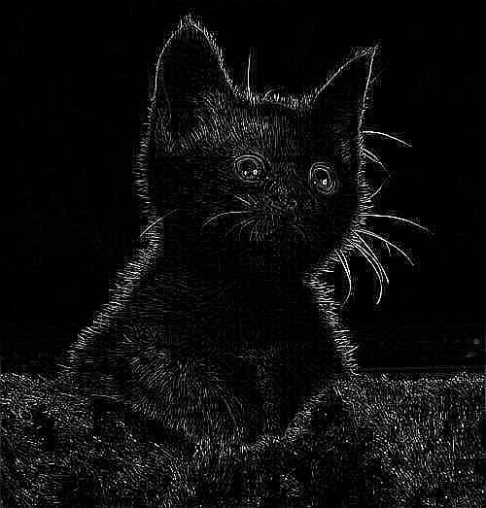
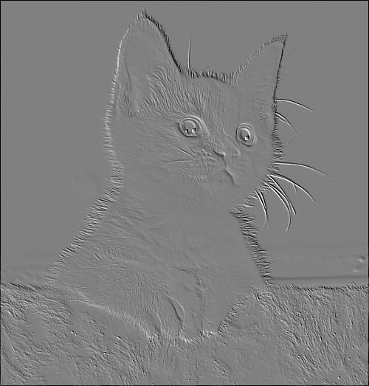
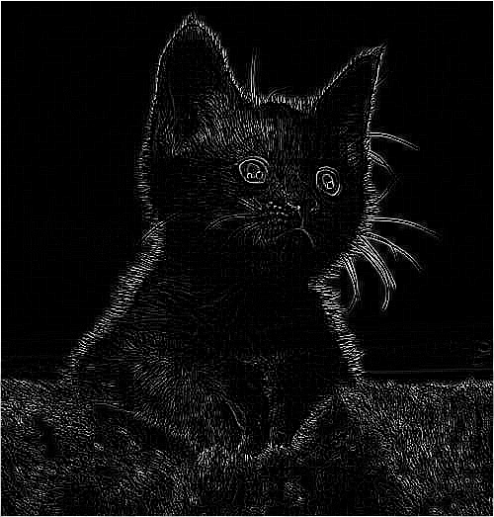
Edges
Textures
Original Image
Parts

Slide 8

Edges
Textures
Original Image
Parts
Contrast

Slide 9
Input Image
Output
6
3
7
4
6
9
Filter
2
6
7
4
3
7
?
?
?
?
-1
0
1
7
2
5
4
1
7
*
=
?
?
?
?
-1
0
1
5
1
4
0
9
5
?
?
?
?
-1
0
1
8
0
9
2
6
3
?
?
?
?
8
2
4
2
6
4

Slide 10
Input Image
6
-1
3
0
7
1
Output
6
3
7
4
6
9
Filter
2
-1
6
0
7
1
2
6
7
4
3
7
?
7
4
?
?
?
-1
2
0
5
1
-1
0
1
7
2
5
4
1
7
*
=
?
?
?
?
-1
0
1
5
1
4
0
9
5
?
?
?
?
-1
0
1
8
0
9
2
6
3
?
?
?
?
8
2
4
2
6
4
×
4
(
)
+
(
×
)
+
(
×
)
(
×
)
+
(
×
)
+
(
×
)
(
×
)
+
(
×
)
+
(
×
)

Slide 11
Input Image
Output
6
-1
3
0
7
1
4
6
9
2
-1
6
0
7
1
1
4
-9
3
11
7
4
?
?
?
7
-1
2
2
0
5
-1
1
4
-3
1
11
7
?
?
?
?
5
1
-2
4
3
0
-2
9
9
5
?
?
?
?
8
0
-4
9
1
2
4
6
8
3
?
?
?
?
8
2
4
2
6
4

Slide 12
Input Image
Output
6
3
7
4
6
9
Filter
2
6
7
4
3
7
4
1
-9
11
7
2
5
4
1
7
*
=
2
-1
-3
11
5
1
4
0
-1
9
0
5
1
-2
3
-2
9
8
0
9
2
-1
6
0
3
1
f x f
-4
1
4
8
8
2
4
2
-1
6
0
4
1
n x n
Feature Map!
(n - f + 1)
x
(n - f + 1)

Slide 13
Input Image
Center pixels contribute to up to 9 outputs!
Corner pixels contribute to only 1 output
Output
6
3
7
4
6
9
Filter
2
6
7
4
3
7
4
1
-9
11
-1
0
1
7
2
5
4
1
7
*
=
2
-1
-3
11
-1
0
1
5
1
4
0
9
5
-2
3
-2
9
-1
0
1
Count: 0
Count: 1
Count: 2
Count: 3
Count: 4
Count: 5
Count: 6
Count: 7
Count: 8
8
0
9
2
6
3
Count: 9
-4
1
4
8
Only 1 convolution!
8
2
4
2
6
4
f x f
Feature Map!
n x n
(n - f + 1)
x
(n - f + 1)

Slide 14
Solution: Add Padding!
Center pixels contribute to up to 9 outputs!
Unequal contribution = information loss at edges!
0
0
0
0
0
0
0
0
0
0
6
3
7
4
6
9
0
0
2
6
7
4
3
7
0
0
7
2
5
-1
4
0
1
1
7
Count: 9
0
0
5
1
4
-1
0
0
9
1
5
0
0
8
0
9
-1
2
0
6
1
3
0
0
8
2
4
2
6
4
0
0
0
0
0
0
0
0

Slide 15
Output (Same Size!)
0
0
0
0
0
0
0
0
0
6
3
7
4
6
9
0
?
?
?
?
?
?
0
2
6
7
4
3
7
0
?
?
?
?
?
?
?
?
?
-1
0
1
?
?
?
0
7
2
5
4
1
7
0
?
?
?
-1
0
1
?
?
?
0
5
1
4
0
9
5
0
?
?
?
?
?
?
-1
0
1
0
8
0
9
2
6
3
0
?
?
?
?
?
?
0
8
2
4
2
6
4
0
0
0
0
0
0
0
0
0

Slide 16
Output (Same Size!)
0
-1
0
0
0
1
0
0
0
0
0
0
-1
6
9
0
3
6
1
7
-1
4
-5
6
8
9
-9
0
?
?
?
?
?
?
0
-1
2
11
0
6
4
1
7
1
4
-9
3
11
-10
7
0
?
?
?
?
?
?
0
7
9
2
2
5
-1
4
-3
1
11
-13
7
0
?
?
?
?
?
?
0
5
3
1
-2
4
3
0
-2
9
9
-16
5
0
?
?
?
?
?
?
0
8
3
0
-4
9
1
2
4
6
8
-21
3
0
?
?
?
?
?
?
0
8
2
2
-3
4
2
2
-1
6
3
-12
4
0
?
?
?
?
?
?
0
0
0
0
0
0
0
0

Slide 17
Output (Same Size!)
0
0
0
0
0
0
0
0
0
6
3
7
4
6
9
0
9
6
-1
-5
8
-9
0
2
6
7
4
3
7
0
11
4
1
-9
11
-10
0
7
2
5
4
1
7
0
9
2
-1
-3
11
-13
=
*
0
5
1
4
0
9
5
0
3
-2
3
-2
9
-16
0
8
0
9
2
6
-1
3
0
0
1
3
-4
1
4
8
-21
0
8
2
4
2
6
-1
4
0
0
1
2
-3
2
-1
3
-12
0
0
0
0
0
0
-1
0
0
0
1
p = (f - 1) / 2
(n + 2p - f + 1) x (n + 2p - f + 1)

Slide 18
0
-1
0
0
0
1
0
0
0
0
0
Output (Stride=2)
9
-1
8
0
-1
6
0
3
1
7
4
6
9
0
0
-1
2
0
6
1
7
4
3
7
0
?
?
?
9
-1
11
0
7
2
5
4
1
7
0
=
*
Stride = 2
?
?
?
0
5
1
4
0
9
5
0
?
?
?
3
1
8
0
8
0
9
2
6
3
0
0
8
2
4
2
6
4
0
0
0
0
0
0
0
0
0

Slide 19
Stride = 2
2
2
6
1
3
9
6
1
0
1
9
0
0
9
3
4
0
0
4
1
7
-1
0
1
?
?
?
*
=
3
2
4
7
2
4
8
-1
0
1
?
?
?
0
7
9
3
4
6
1
-1
0
1
?
?
?
5
6
2
1
8
3
5
0
2
6
2
4
4
6

Slide 20
Stride = 2
2
-1
2
0
6
1
1
3
9
6
1
-1
0
1
0
1
1
9
0
0
0
15
9
3
-1
4
0
0
1
0
4
1
7
?
?
?
*
=
3
2
7
4
7
-3
2
4
6
8
?
?
?
0
7
9
3
4
6
1
?
?
?
5
6
12
2
1
-1
8
3
-4
5
n
+
2
p
-
f
0
2
6
2
4
4
6
⌊
n
+
2
p
-
f
+
1
⌋
+
1
s
s

Slide 21
0
0
0
0
0
0
0
0
0
6
3
7
4
6
9
0
0
2
6
7
4
3
7
0
-1
0
1
0
7
2
5
4
1
7
0
Stride = 1
Stride = 2
*
-1
0
1
0
5
1
4
0
9
5
0
-1
0
1
0
8
0
9
2
6
3
0
0
8
2
4
2
6
4
0
0
0
0
0
0
0
0
0

Slide 22
2
2
6
1
3
9
6
1
0
1
9
0
0
9
3
4
0
0
4
1
7
-1
0
1
1
0
15
*
=
3
2
4
7
2
4
8
-1
0
1
7
-3
6
n
0
7
9
3
4
6
1
-1
0
1
12
-1
-4
h
5
6
2
1
8
3
5
0
2
6
2
4
4
6
n
h
=
⌊
n
+
2
p
-
f
⌋
+
1
n
w
=
⌊
n
+
2
p
-
f
⌋
+
1
o
u
t
h
⌊
n
+
2
p
-
f
⌋
+
w
1
s
o
u
t
s
n
s
w

Slide 23
6 x 6 x 3
3 x 3 x 3
(RGB Image)
4 x 4
(Filter)
(Output)
*
=

Slide 24
6 x 6 x 3
(RGB Image)
4 x 4
(Output)

Slide 25
6 x 6 x 3
3 x 3 x 3
(RGB Image)
4 x 4
(Filter)
(Output)
*
=
3D Filter collapses volume → 2D Output

Slide 26
*
=
Multiple Filters → Multiple Feature Maps

Slide 27
Input
Vertical
Output
60
60
60
220
220
220
Filter
60
60
60
220
220
220
?
?
?
?
-1
0
1
60
60
60
220
220
220
*
=
?
?
?
?
-1
0
1
60
60
60
220
220
220
?
?
?
?
-1
0
1
60
60
60
220
220
220
?
?
?
?
60
60
60
220
220
220

Slide 28
Input
Vertical
Output
60
60
60
220
220
220
Filter
60
60
?
?
?
?
0
480
60
220
480
220
0
220
-1
0
1
60
60
?
?
?
?
0
480
60
220
480
220
0
220
*
=
-1
0
1
60
60
?
?
?
?
0
480
60
220
480
220
0
220
-1
0
1
60
60
?
?
?
?
0
480
60
220
480
220
0
220
60
60
60
220
220
220

Slide 29
Input
Input
Vertical
Now: Horizontal Edge Detection
Output
Horizontal
Output
60
60
60
220
220
220
Filter
60
60
60
60
60
60
Filter
60
60
60
220
220
220
0
480
480
0
60
60
60
60
60
60
?
?
?
?
60
60
60
220
220
220
-1
-1
-1
0
480
480
0
60
60
60
60
60
60
*
=
?
?
?
?
*
=
60
60
60
-1
0
1
0
0
0
220
220
220
0
480
480
0
?
?
?
?
220
220
220
220
220
220
Edge Detected
60
60
60
-1
0
1
1
1
1
220
220
220
0
480
480
0
220
220
220
220
220
220
?
?
?
?
60
60
60
-1
0
1
220
220
220
220
220
220
220
220
220

Slide 30
Input
Horizontal
Output
60
60
60
60
60
60
Filter
60
60
?
?
?
?
0
60
0
60
0
60
0
60
-1
-1
-1
60
480
?
?
?
?
60
480
60
480
60
480
60
60
*
=
0
0
0
220
220
?
?
?
?
480
220
480
220
480
220
480
220
1
1
1
220
220
?
?
?
?
0
220
0
220
0
220
0
220
220
220
220
220
220
220

Slide 31
Input
Horizontal
Output
60
60
60
60
60
60
Filter
60
60
60
60
60
60
0
0
0
0
60
60
60
60
60
60
*
=
480
480
480
480
220
220
220
-1
-1
-1
220
220
220
480
480
480
480
Edge Detected
220
220
220
0
0
0
220
220
220
0
0
0
0
220
220
220
1
1
1
220
220
220

Slide 32


Mean Blur
Original
Kernel
Result
1/9
1/9
1/9
1/9
1/9
1/9
1/9
1/9
1/9

Slide 33

Gaussian Blur
Mean Blur
Original
Result
Kernel
Result
Kernel
0.06
1/9
0.12
1/9
0.06
1/9
0.12
1/9
0.25
1/9
0.12
1/9
0.06
1/9
0.12
1/9
0.06
1/9

Slide 34

Gaussian Blur
Sharpen
Original
Result
Kernel
Result
Kernel
0.06
0
0.12
-1
0.06
0
0.12
-1
0.25
5
0.12
-1
0.06
0
0.12
-1
0.06
0

Slide 35
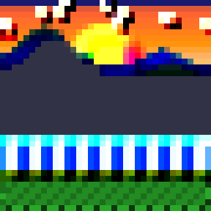
Sharpen
Emboss
Original
Result
Kernel
Result
Kernel
-2
0
-1
-1
0
0
-1
-1
5
1
-1
1
0
0
-1
1
0
2

Slide 36
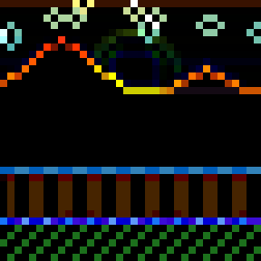
Edge Detection
Emboss
Original
Mean Blur
Gaussian Blur
Original
Result
Kernel
Result
Kernel
-2
0
-1
1
0
0
Sharpen
Emboss
Edge Detection
-1
1
-4
1
1
1
0
0
1
1
2
0

Slide 37
Gaussian Blur
Mean Blur
Sharpen
Sobel X
0.06
1/9
-1
0
0.12
1/9
-1
0
0.06
1/9
0
1
0.12
1/9
-1
-2
0.25
1/9
5
0
0.12
1/9
-1
2
0.06
1/9
-1
0
0.12
1/9
-1
0
0.06
1/9
0
1

Slide 38
Learnable Filter
Sobel X
f
f
f
-1
0
1
1
2
3
f
f
f
-2
0
2
4
5
6
f
f
f
-1
0
1
7
8
9
These values are learned during backpropagation

Slide 39
F
1
Input
*
F
2
F
3

Slide 40
F
ReLU(
+
b
)
=
1
1
Input
*
F
ReLU(
+
b
)
=
2
2
F
ReLU(
+
b
)
=
3
3

Slide 41
F
ReLU(
+
b
)
Input
1
1
*
F
ReLU(
+
b
)
=
2
2
X
F
ReLU(
+
b
)
3
3
W
WX

Slide 42
F
ReLU(
+
b
)
Input
1
1
*
F
ReLU(
WX +
2
+
b
2
)
=
a
(
l
)
F
ReLU(
+
b
)
3
3
WX
RelU(WX + )

Slide 43
F
ReLU(
+
b
)
Input
1
1
*
F
ReLU(
+
b
)
=
2
2
4x4x3
6x6x3
F
ReLU(
+
b
)
3
3
3x3x3
4x4x1

Slide 44
F
ReLU(
+
b
)
Input
1
1
*
F
ReLU(
+
b
)
=
2
2
(
l
)
4x4x3
n
×
n
(
l
)
×
n
(
l
)
H
W
c
6x6x3
n
(
l
-
1
)
×
n
(
l
-
1
)
×
n
(
l
-
1
)
H
W
c
F
ReLU(
+
b
)
3
3
3x3x3
(
l
4x4x1
f
(
l
)
×
f
(
l
)
×
n
(
l
-
1
)
n
)
×
n
(
l
)
×
1
c
H
W

Slide 45
F
ReLU(
+
b
)
Input
1
1
*
F
ReLU(
+
b
)
=
2
2
n
(
l
)
×
n
(
l
)
×
n
(
l
)
H
W
c
n
(
l
-
1
)
×
n
(
l
-
1
)
×
n
(
l
-
1
)
H
W
c
F
ReLU(
+
b
)
3
3
f
(
l
)
×
f
(
l
)
×
n
(
l
-
1
)
n
(
l
)
×
n
(
l
)
×
1
c
H
W

Slide 46
Shared filter weights
One 3 × 3 filter
Three filters
×
3 input channels
3 output channels
3 × 3 × 3 weights
+ 1 bias = 28 parameters
28 × 3 = 84 parameters
The same 84 parameters are used at all 4 × 4 output positions.

Slide 47
Max Pooling
Pooling Layers
Input (4×4)
Output (2×2)
1
3
2
1
4
6
Max
6
5
5
2
?
?
7
8
8
1
0
?
?
2
3
4
5
5
Pool Size: 2×2, Stride: 2

Slide 48
Average Pooling
Max Pooling
Input (4×4)
Input (4×4)
Output (2×2)
1
Output (2×2)
2
3
4
2
6
1
8
2.5
6.5
Avg
4
Max
1
6
3
5
5
2
7
6
?
5
?
7
8
8
6
1
4
0
2
8
?
5
?
6.5
2.5
2
7
3
5
4
3
5
1
Pool Size: 2×2, Stride: 2
Pool Size: 2×2, Stride: 2

Slide 49
Average Pooling
Output Size Formula
Input (4×4)
2
4
6
8
Output (2×2)
Avg
1
3
5
7
n
+
2
P
-
f
2.5
6.5
O
u
t
p
u
t
=
⌊
⌋
+
1
n
-
f
O
u
t
p
u
t
=
⌊
S
⌋
+
1
8
6
4
2
6.5
2.5
S
7
5
3
1
Padding is rarely used in pooling...
Pool Size: 2×2, Stride: 2

Slide 50
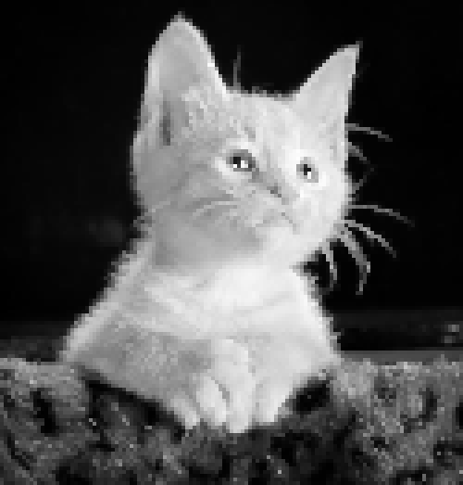

Max Pooling
Original Image
Avg Pooling

Slide 51
Input Image
CONV
LAYER
Image
Conv Layer
Conv1 + ReLU
→
→
Features
→
ANN
→
Output
Reduces complexity!
✓

Slide 52
Conv2 + ReLU
Pool1
Conv1 + ReLU

Slide 53
Flatten
Pool2
Conv2 + ReLU
Pool1
Features

Slide 54
Flatten
Pool1
Conv2 + ReLU
Conv1 + ReLU
Pool2
Input
→
Conv
→
Pool
→
Conv
→
Pool
→
Features
→
ANN
→
Output
Features
✓

Slide 55
Single 3x3 Convolution
Receptive Field
Input
7 × 7
Output
5 × 5
3x3
Output Pixel
Input Region
The receptive field is the input region
RF = 3
RF = 1
that affects one output pixel

Slide 56
Single 3x3 Convolution
Input
7 × 7
Output
5 × 5
3x3
RF = 3
RF = 1

Slide 57
Two Stacked 3x3 Convolutions
Single 3x3 Convolution
Input
Input
7 × 7
Hidden
Output
9x9
Output
7x7
5 × 5
5x5
3x3
3x3
3x3
RF = 5
RF = 3
RF = 3
RF = 1
RF = 1

Slide 58
Two Stacked 3x3 Convolutions
Input
Hidden
9x9
Output
7x7
5x5
3x3
3x3
RF = 5
RF = 3
RF = 1

Slide 59
R
F
R
F
g
r
o
g
w
r
o
s
w
m
s
u
s
c
l
h
o
w
f
a
e
s
r
t
!
e
(
r
3
!
(
→
3
5
→
)
7
)
Effect of Stride on Receptive Field
Two Stacked 3x3 Convolutions
Two Stacked 3x3 Convolutions
Formula
Stride = 2
Stride = 1
Input
Input
Hidden
Hidden
9x9
9x9
Output
RF = 3
Output
7x7
7x7
i
-
1
5x5
l
RF = 3
5x5
RF = 5
R
F
=
1
+
Σ
(
K
-
1
)
×
∏
S
RF = 7
l
i
j
3x3, s=1
3x3, s=2
3x3, s=1
3x3, s=1
3x3
i
=
1
3x3
3x3
3x3
j
=
1
1x1
3x3
3x3
RF = 5
RF = 5
5x5
RF = 3
RF = 3
RF = 1
RF = 1
Input: 7x7
Input: 7x7

Slide 60
R
F
g
r
o
w
s
Summary
m
u
c
h
f
a
s
t
e
r
!
(
3
→
7
)
Stride > 1 accelerates RF growth
Why Receptive Field Matters
Stride = 2
because each layer covers more input space
l
i
-
1
R
F
=
1
+
Σ
(
K
-
1
)
×
∏
S
l
i
j
i
=
1
j
=
1
Early Layers
Middle Layers
Deep Layers
RF = 3
RF = 7
Small RF
Medium RF
Large RF
RF = input region affecting one output pixel
• Edges
3x3, s=2
3x3, s=1
• Shapes
• Full objects
• Corners
• Patterns
• Faces
• Simple textures
• Object parts
• Semantic content
1x1
3x3
L
a
r
g
e
r
r
e
c
e
p
t
i
v
e
f
i
e
l
d
→
C
a
n
d
e
t
e
c
t
m
o
r
e
c
o
m
p
l
e
x
,
g
l
o
b
a
l
f
e
a
t
u
r
e
s
Input: 7x7

Slide 61
Summary
l
i
-
1
R
F
=
1
+
Σ
(
K
-
1
)
×
∏
S
l
i
j
i
=
1
j
=
1
RF = input region affecting one output pixel
Stacking 3x3 kernels grows RF efficiently
Stride > 1 accelerates RF growth
Early layers: small RF → edges, textures
Deep layers: large RF → objects, semantics

Slide 62
What is Dilation?
Dilation = 3
Dilation = 2
Dilation = spacing between kernel elements
Dilated Convolution
Dilation = 1 (Standard)
Covers: 5 x 5
Covers: 3 x 3
Covers: 7 x 7
Parameters: 9 (same!)
Parameters: 9
Parameters: 9 (still same!)

Slide 63
Dilation = 3
Covers: 7 x 7
S
a
Parameters: 9 (still same!)
m
e
9
w
e
i
g
h
t
s
→
L
a
r
g
e
r
r
e
c
e
p
t
i
v
e
f
i
e
l
d
!

Slide 64
Dilation = 3
Convolution with Dilation = 1
RF = 3x3
3x3, d=1
Covers: 7 x 7
Parameters: 9 (still same!)
Output: 5x5
Input: 7x7
S
a
m
e
9
w
e
i
g
h
t
s
→
L
a
r
g
e
r
r
e
c
e
p
t
i
v
e
f
i
e
l
d
!

Slide 65
Convolution with Dilation = 1
Effective Kernel Size
Convolution with Dilation = 2
S
a
m
e
9
p
a
r
a
m
e
t
e
r
s
:
R
F
:
3
×
3
→
5
×
5
RF = 3x3
RF = 5x5
K
=
K
+
(
K
-
1
)
×
(
D
-
1
)
e
f
f
3x3, d=2
3x3, d=1
K = kernel size, D = dilation rate
D
=
1
:
K
=
3
+
2
×
0
=
3
e
f
f
D
=
2
:
K
=
3
+
2
×
1
=
5
e
f
f
Output: 3x3
D
=
3
:
K
=
3
+
2
×
Output: 5x5
2
=
7
e
f
f
Input: 7x7
Input: 7x7

Slide 66
Effective Kernel Size
Receptive Field Formula
i
-
1
i
-
i
1
L
L
L
-
1
R
R
K
=
K
+
(
K
-
1
)
×
(
D
-
1
)
F
R
F
=
F
=
=
1
1
+
1
+
+
Σ
Σ
Σ
(
(
K
K
(
K
-
1
-
)
-
1
·
1
)
D
)
×
×
×
∏
∏
∏
e
f
f
S
S
S
i
e
f
i
f
,
i
i
j
j
j
i
=
i
=
1
i
=
1
1
j
=
j
=
1
j
=
1
1
K = kernel size, D = dilation rate
Standard RF formula with kernel K and stride S
Using effective kernel size
D
=
1
:
K
=
3
+
2
×
0
=
3
e
f
f
Final formula with dilation rate D!
D
=
2
:
K
=
3
+
2
×
1
=
5
e
f
f
For dilated conv, replace K with K_eff:
Substitute K_eff = K + (K-1)(D-1):
D
=
3
:
K
=
3
+
2
×
2
=
7
e
f
f

Slide 67
Summary
Receptive Field Formula
K
=
K
+
(
K
-
1
)
(
D
-
1
)
e
f
f
L
i
-
1
R
F
=
1
+
Σ
(
K
-
1
)
·
D
×
∏
S
i
i
j
i
=
1
j
=
1
• Dilation inserts gaps between kernel weights
• Same 9 parameters → Larger receptive field
Final formula with dilation rate D!
• D=1: 3x3, D=2: 5x5, D=3: 7x7
• Used in: DeepLab, WaveNet, etc.

