Slide 1
Context Engine
20 July 2016
Notes:
Make parallel vulnearbility more intuitive

Slide 2
Outline
Architecture
Key benefits
Current set of algorithms
Implementing new Context Engines (Adding new algorithms)
Implementation details

Slide 3
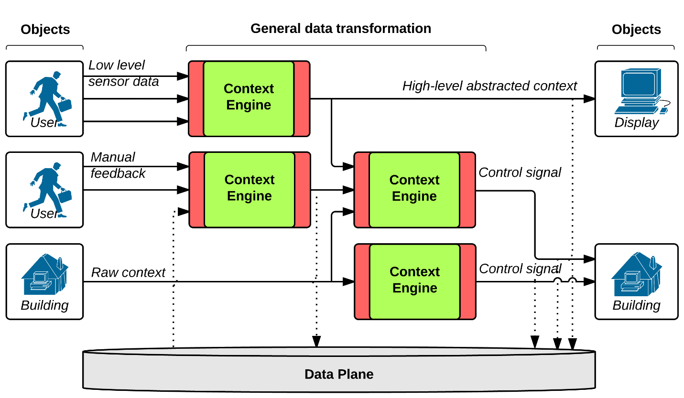
Context Engine Architecture
Middleware as a set of multi-input single-output context engines.
Reduce developer effort to determining connections
Reduce computational redundancy – expose intermediate data for reuse
Improve scalability and distribution of computation
Notes:
Transition to the processing:
Going from input to output
Animations here showing input going to output from the beginning to end
This system reduces complexity significantly
We will show this using model generation
Tesla → helps show error

Slide 4
Key Benefits [1]
Use high-level context to feed actuation interface (Future work)
Ability to implement general purpose machine learning algorithms
Provides a wrapper for general purpose machine learning algorithms and libraries.
Simple API
Initialize
Add observations
Train model
Execute test data

Slide 5
Key Benefits [2]
Facilitates input and output interfacing.
The interfacing details are concealed from the developer, and is handled solely by the base class.
Different sources of input can be combined to feed the context engine. (Heterogeneous raw data) (Future work)
Output can be channeled through different interfaces.
Console summary
GDP
Actuation (Future work)

Slide 6
Current Set of Algorithms [1]
Clustering
KMeans (sklearn)
This algorithm is used to provide clustering on incoming or outgoing data. A KMeans model is trained using the training data. Each Context Engine can have discrete (clustered) and continues I/O ports at the same time.
Classification
These algorithms can be used to classify input data into a discrete set of outputs
Current classification algorithms:
Support Vector Machine (SVM) (sklearn)
Decision Trees with Adaboost (sklearn)

Slide 7
Current Set of Algorithms [2]
Regression
These algorithms can be used to define models for continues inputs and outputs.
Current regression algorithms:
K-Nearest Neighbor regression (K-NN Regression) (sklearn)
Support Vector Regression (SVR) (sklearn)
Linear Regression and TESLA*
* http://seelab.ucsd.edu/papers/SGCOMM14_Sinan.pdf

Slide 8
Implementing New Context Engines
Developers can inherit from ContextEngineBase class to create a Context Engine object for a new algorithm
The interfacing details are concealed from the developer, and is handled solely by the base class.
Algorithm-specific parameter setting, training, and execution functions need to be defined in the inherited object.

Slide 9

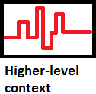
Implementation Details
Inputs
At earliest stages, more continuous data from sensors
Further stages input discrete context data
Leverage ontologies to identify the scope/enumeration of data

Slide 10
Context Engine Interface
Each Context Engine defines a “ceInterface” object that manages input and output interfaces.
Interface information are passed to the __init__ function of the class using dictionary objects.
For each input or output, and IO object (i.e., ioClass for GDP interface) is defined.
Other interface objects that deal with Bluetooth, local file etc. are projected to be added in the near future.

Slide 11
Inputs/Outputs implementation
An “ioClass” object is used to identify each GDP I/O
ioClass Attributes:
Source
i.e., GDP log name
Parameter
i.e., a certain key to look for in JSON entries of GDP
Lag
Provides time series capabilities such as in advance prediction.
Normalization
Defines a normalization function on the input data

Slide 12
Context Engine Class
Each Context Engine is an instance of the “ContextEngineBase” class.
Different algorithms that are to be used simply inherit from ContextEngineBase.
This object involves all the interface information for the context engine, and functionality to train and test models using data that is collected from different sources.

Slide 13
ContextEngineBase Methods [1]
__init__
Creates a ceInterface object and KMeans objects for clustering.
addSingleObservation
Adds an observation of length numInputs + 1 (input; output) to the observationMatrix and outputVector. These variables store the incoming data for training.
train
Trains the designated model using the data that is stored in the observationMatrix and outputVector. This function has to be overloaded by each of the specific algorithm implementations of the Context Engine.
clusterAndTrain
Performs clustering and normalization on specific inputs or outputs that has been predefined by the user, then calls train.

Slide 14
ContextEngineBase Methods [2]
execute
Returns the output of the trained model to the provided input vector. This function is also overloaded for different algorithms.
executeAndCluster
Performs required normalization and clustering before calling execute.
classify
Classifies a number based on a predefined clustering for any of inputs or outputs. This can be used to classify ground truth for measuring the performance of the model.
Normalization functions are also defined to perform the designated normalization on each of the inputs or outputs in the data.

Slide 15
Contact
Please contact Nima Mousavi for any questions or issues.
nimousav@eng.ucsd.edu
Source code for the Context Engine is available at:
https://github.com/UCSD-Terraswarm/ContextEngine

