Slide 1

UCSD Career Seminar by
Cynthia Anfinson
Asssociate Professor of Mathematics
Mathematics Learning Center Director
Palomar College

Slide 2
Background
San Diego native
Grossmont College
Revelle College, UCSD; graduated 1985 – degree in Mathematics, minor in Art History
Summa Cum Laude (1985)
Phi Beta Kappa (1985)
Cornell University, Center for Applied Mathematics – M.S. in Mathematics 1989

Slide 3
Studies
Research in Numerical Analysis and Fault Tolerant Computing
2 years’ summer internship at NOSC (Naval Ocean Systems Center) Pt. Loma; research on parallel and distributed computing

Slide 4
Work Experience
TA and Grader at UCSD
TA at Cornell University
Internship at NOSC
Adjunct Professor at San Diego Mesa College
Associate Professor at Palomar College
Mathematics Learning Center Director at Palomar College

Slide 5
Responsibilities of my position as a Community College Professor
Typical work load is teaching 15 units; about 4-5 classes
35-40 students per class
5 hours office hours/week
Prep time (preparing for lectures, writing exams, quizzes, labs, etc., grading)
Committee and campus work

Slide 6
Director of the Mathematics Learning Center at Palomar
Administer 6 self-taught courses
About 450 students in the program
Approximately 15 tutors
2 staff members (computer lab technician and office specialist)
2 computer labs

Slide 7
Classes I typically teach
Developmental Mathematics (Prealgebra, Beginning Algebra, Intermediate Algebra)
College Algebra and Precalculus
Trig
Statistics
Calculus I, II (and sometimes III)
Linear Algebra
Fortran Programming
Business Calculus

Slide 8
Value of my educational experience
My educational background has helped me to be adaptable to a variety of situations/people (community college, UC, Ivy League)
Allowed me to teach at the college level
A background in applied mathematics has allowed me to teach the “non-math people” more effectively
Notes:
I can answer the questions, “Why do we need to know this?” in a more meaningful way than “ You will use it in your next math class.”

Slide 9
Lessons
Hard work does pay off
Allow yourself to try challenging experiences
Keep current with technology; what you learn now will not be relevant 10 years from now
Develop good “people skills”

Slide 10
Interested in Teaching?
You need experience, experience, experience – be a T.A., Tutor, work part-time in a community college, go to conferences, read and learn how to better your teaching skills
Evaluations from students and supervisors count!
Join professional organizations (MAA, AMATYC, CMC^3, etc.)

Slide 11
Job Market in Community Colleges
It’s either hot or cold; depends a lot on the state funding situation
There are always adjunct positions available
Work hard to get noticed; go to departmental sponsored workshops, meetings, conferences, try to talk to other faculty, etc.
TAKE THE JOB INTERVIEW VERY SERIOUSLY!

Slide 12
Your Job Interview
For Teaching in Public Institutions; read the “Position Announcement” with a fine-toothed comb
Anything that can be asked in the interview must be in that announcement
Prepare all questions/your responses you can think of well in advance and make sure you can respond on the spot

Slide 13
Your Job Interview (continued)
Prepare your teaching demonstration and run it by several other instructors well in advance
Do your homework on the position, the department, the student body, and the school
Make sure you have a response to the question, “Do you have any questions for us?”

Slide 14
What I like about teaching
I love mathematics and the opportunity share the beauty of mathematics with others
I like to help people achieve their goals
I like to see the “aha” moment; when a student grasps a concept
It’s to rewarding to hear from former students who have gone on to be successful

Slide 15
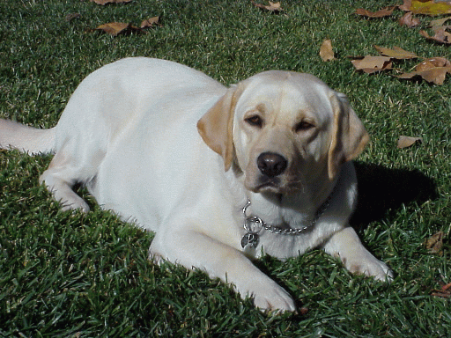
Buddy the Wonder Dog

