Slide 1
Steve Hart
UCSD Math Dept.
Career Day
November 9, 2004

Slide 2
My Background
US Air Force ’73 – ’76
BS Math ’78 – UNLV
MA Math ’80 – UCSD
Linkabit ‘79 – ’81, ’83 – ’86
  SW Eng, Sys Eng
Merdan ’81 – ’83
  Computer Security Analyst
ViaSat ’86 - Present
  Co-founder, CTO, VP Eng

Slide 3
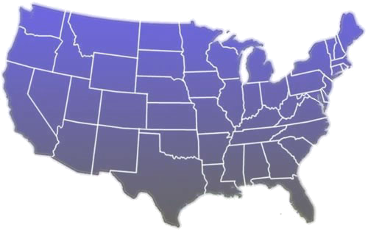



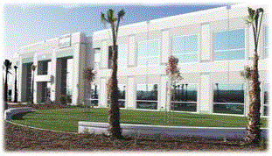
ViaSat Overview
Founded 1986, IPO 1996
Design, build & market defense and commercial satellite & secure network equipment
~1050 employees worldwide
☞

Slide 4
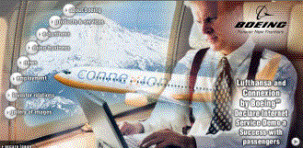
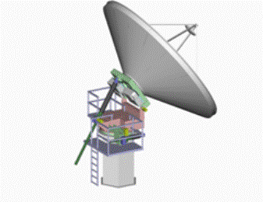
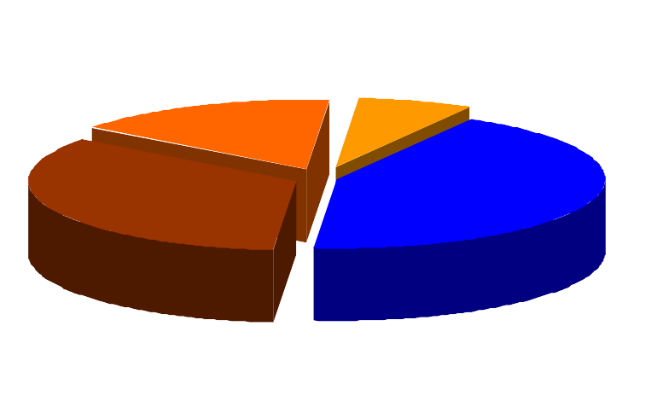
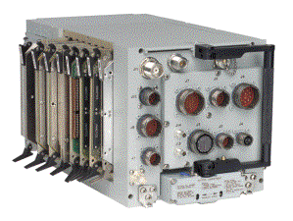
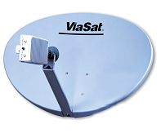
ViaSat Businesses
Antenna
BB
VSAT
DoD

Slide 5
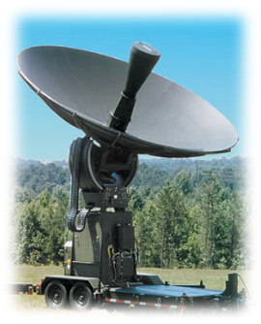
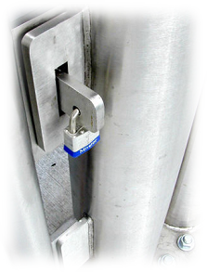

Government Technology Areas
Leading edge of emerging Network Centric Defense Communications
Information
Security
MILSATCOM
Tactical Data Links

Slide 6

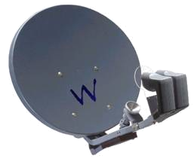
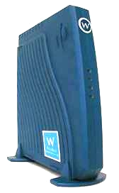
Consumer K_{a} Band Broadband
TV / Broadband Bundle
Very low cost CPE
$60M+ orders
>100,000 K_{u} & K_{a} sites on order
  WildBlue, INTELSAT/Orbit Data Systems
Service starts this year!

Slide 7




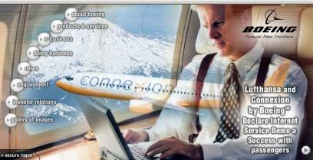
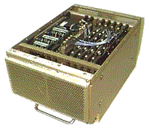
ConneXion by Boeing
In flight 2-way broadband for Boeing
  Downlinks: 256 Kbps- 30 Mbps
  Uplinks: 16 Kbps to 1.9 Mbps
Growing Adoption
  Lufthansa & British Airways trial services
  Military Programs
Comm On the Move with 2’ antenna

Slide 8
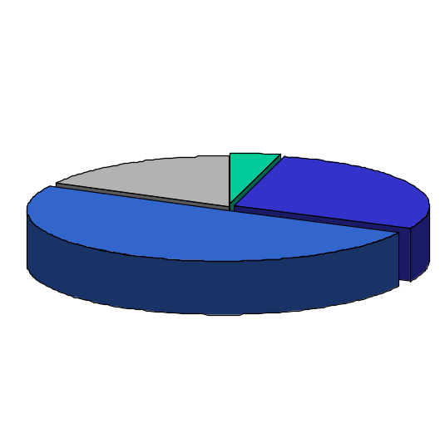
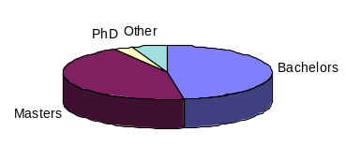
Technical Staff
Total Staff of > 520
  Includes engineers, program managers, designers, technicians
  Mix of experienced and new graduates
  Aggressive recruiting from top schools (UCSD, Rice, RPI, Purdue, UCLA, etc.)
Employee Mix
Degree Mix
Marketing
Admin
Operations
Engineering

Slide 9
From Math to Engineering
Took 2 programming courses in college (Fortran, Assembly)
Summer job writing data analysis programs for EPA
Summer job at Linkabit
  Network simulations & algorithm development (what’s a network?)
  Stayed on as an “Engineer”
  All engineering education is OJT
  Still learning!

Slide 10
Fun along the way (i.e. math)
Discrete Math
  Fast algorithms for optimal scheduling
  Analysis of software testing using graph theory
  Orderly algorithm for classifying “code words”
  “Good” heuristics for bin-packing comm channels
  Assigning codes to a trellis, with simultaneous closeness (Gray codes) and distance (Euclidean)
    Patented for dial-up modems
Probability
  Queuing analysis of communication networks
  Performance estimation of error correcting codes

Slide 11
More math
Logic
  Formal model for computer data “Integrity”
  Automated security theorem generator for additional models (with automated proofs of many of them)
  Proof of “securability” of 1750A processor
  Secure 2-level operating system – formal methods
Other
  Field theory for implementation of error-correcting codes
  Number theory for implementation of encryption codes

Slide 12
The Job Market

Slide 13
Attributes of the Ideal Candidate
Talent
  Best and brightest
  Fresh ideas and approaches
  Quickly come up to speed and make an impact
Flexibility
  ‘Best All Around Athlete’ model
  Excited by challenge
  Fearless about opportunity
Experience
  Summer job/internship outside of the University

Slide 14
Things to Consider
You Are at the Hub of the Opportunity Wheel
Education
Information
Technology
Systems
Engineering
Communications
Networking
Computers
Business Development
Mathematics
Degree
Financial &
Actuarial
Business
National Security
Research
Software
Engineering
Academia
System Test

Slide 15
Things to Consider
What do I want to do with my career?
Do the research on potential employers
  Growth rate, stability
  Company culture
  Diversity in market/technology
  How deep is their technical ‘bench’ – mentor availability
  Use your network – friends, alumni, profs, industry POCs
Take a ‘test drive’ when possible
  Summer internship
  Company sponsored research projects
How well does my personality match the culture of a prospective company?
Choose the Company, Not the Job

Slide 16
Questions?

