Slide 1
Career Opportunities in Math
"Prediction is very difficult, especially about the future."
- Niels Bohr, 1885 - 1962
V. William Porto
Exec. VP and Chief Mathematician, NSI
UCSD Math Dept. Career Seminar
November 9, 2004

Slide 2
My Career to Date
(shameless self-promotion)
Del Mar Technical Associates (DELTA)
  Ground Motion Modeling - NRC
Orincon (now part of Lockheed-Martin)
  Signal processing / detection, pattern recognition
  D.O.D., DARPA, Other ‘3-Lettered Agencies’
Natural Selection, Inc.
  D.O.D., BioPharma, JHU/APL, Manufacturing, …

Slide 3
My Current Job Duties
(what I get to do every day for $)
Analyzing and Solving Problems
Project Management
Programming
Technical Writing (proposals, papers, etc.)
Marketing
Travel

Slide 4
Real-World Applications
(cool math problems you get paid to solve)
Optimization (non-linear and stochastic)
  Stock market prediction
  Behavioral planning for autonomous vehicles
  Artificial Neural Network design
  Mathematical modeling

Slide 5
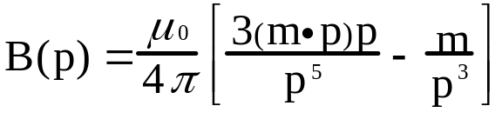
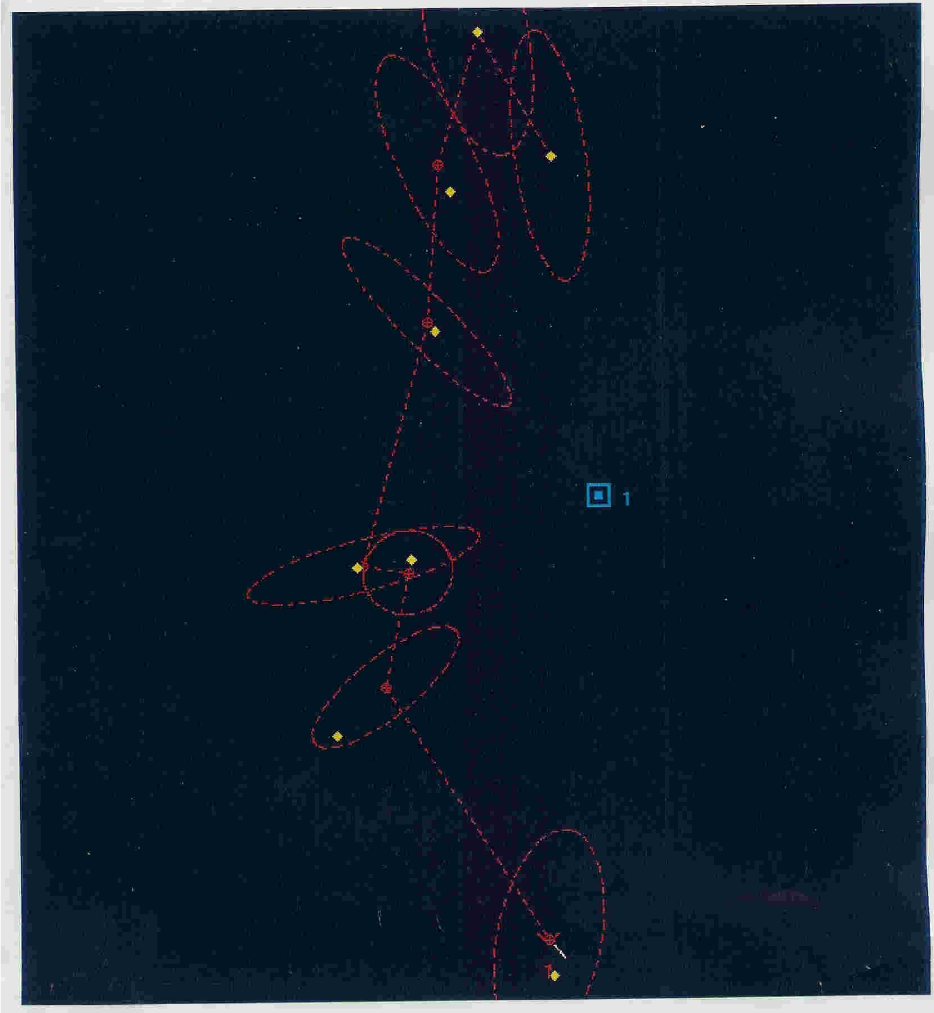
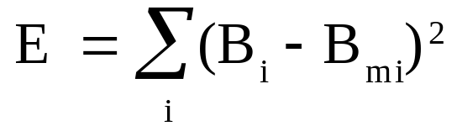
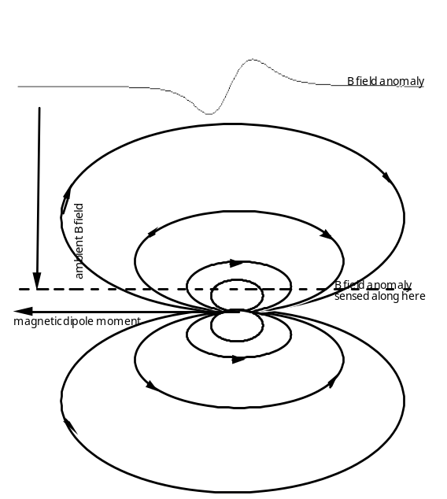
Non-Acoustic Target Tracking using Electromagnetic Models
is the magnetic induction vector at p

Slide 6
More Real-World Applications
Topology (and optimization)
  Group Homology in RNA folding problems
  Drug Docking (Ligand/HIV protease)
  Automated Marker Design

Slide 7
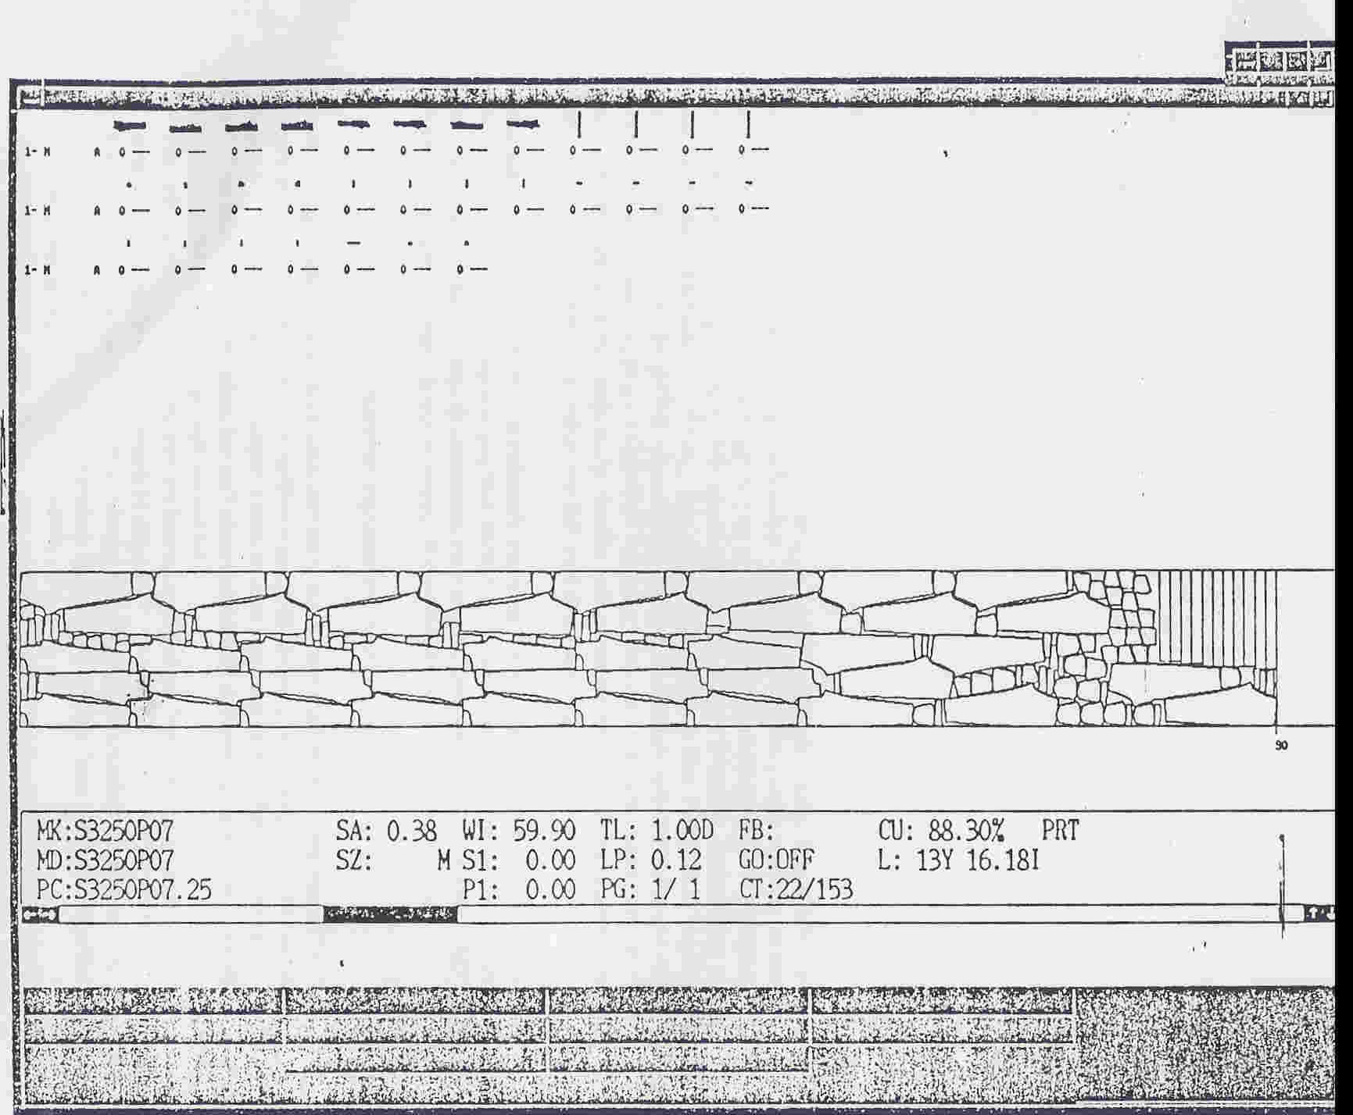
Automated Marker Design
Topologically Constrained Optimization
(overlap, part orientation)

Slide 8
Even More Applications
Number Theory
  Cryptography
Information Theory and Game Theory
  Anomaly Detection
  Co-evolutionary processes
  TSN Analysis

Slide 9
Learning Outcomes
(or does math training really provide any value ?)
Confidence (you get to tell Engineers how to do things the right way!)
Logic Skills
Expands ways to solve a problem
Growth opportunities into diverse fields

Slide 10
Lessons Learned (to date)
Don’t get rid of ANY books
Practice your writing/communication skills
Look for more than one way to solve a problem
What you learned in school will come in handy (eventually)
Don’t stop learning new ideas !

Slide 11
Lessons Learned (cont.)
90% / 10% rule
EE/CS/Physics all need mathematicians
  cross fertilization enlightens everyone
Build friendships, don’t burn bridges
You are what you do so do something you really enjoy!

Slide 12
The Current Job Market
(a biased perspective)
Learn computer programming skills!
Employers are looking for people with confident, positive attitudes who show eagerness/capability to learn
Internships make a BIG difference
Stress your problem-solving skills
Security Clearances

Slide 13
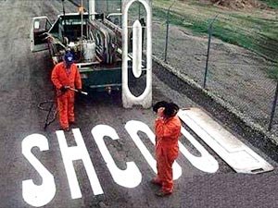
Good Help is Hard to Find

