Slide 1
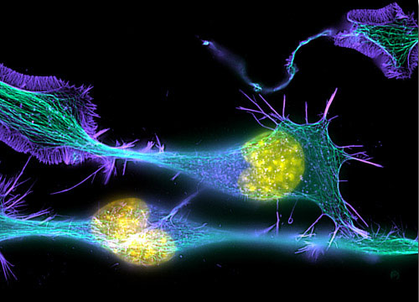
Principles & Practice of
Light Microscopy: 2
(Image: T. Wittman, Scripps)

Slide 2
Light travels more slowly in matter
Velocity slower
Wavelength slower
Frequency unchanged
Energy unchanged
E = hν
ν = c/λ
n = 1
n > 1
n = 1

Slide 3
Aperture and Resolution
Diffraction spot
on image plane
= Point Spread Function
Intermediate image plane
Objective
Tube lens
Sample
Back focal plane aperture

Slide 4
Aperture and Resolution
Diffraction spot
on image plane
= Point Spread Function
Intermediate image plane
Objective
Tube lens
Sample
Back focal plane aperture

Slide 5
Aperture and Resolution
Diffraction spot
on image plane
= Point Spread Function
Intermediate image plane
Objective
Tube lens
Sample
Back focal plane aperture

Slide 6
Aperture and Resolution
Diffraction spot
on image plane
= Point Spread Function
Intermediate image plane
Objective
Tube lens
Sample
α
Back focal plane aperture
Image resolution improves with Numerical Aperture (NA)
NA = n sin(α)
α = light gathering angle
n = refractive index of sample
where:

Slide 7
Resolution
Ernst Abbe’s argument (1873)
Consider a striped sample ≈ a diffraction grating
Back focal
plane
Objective lens
β
Diffracted beams
d sin(β) = λ
Sample
Smaller d
→ larger β
d
Condenser
Light source
Consider first
a point light source
If β > α, only one spot makes it through
⇒ no interference ⇒ no image formed
Resolution (smallest resolvable d):
dmin = λsample/sin(α) = λ/n sin(α) = λ/NA

Slide 8
(Abbe’s argument, continued)
Now consider oblique illumination
(an off-axis source point):
One spot hopelessly lost,
but two spots get through
→ interference → image formed!
βout
d [sin(βin) + sin(βout) ] = λ
βin
Two spots get through if
βout < α and βin < α.
d
Resolution (smallest resolvable d)
with incoherent illumination (all possible illumination directions):
dmin = λ/(NAobj + NAcondenser )
λ/2 NA if NAcondenser ≥ NAobj (“Filling the back focal plane”)

Slide 9
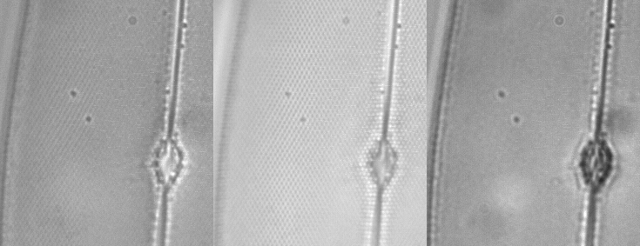
NA and Resolution
High NA Objective Low NA Objective

Slide 10
Filling the back focal plane
In trans-illumination microscopy, to get maximum resolution,
the illumination must “fill the back focal plane”
Back
focal
plane
For the highest resolution,
we need to have
α_{condenser} ≥ α_{objective}
NA_{condenser} ≥ NA_{objective}
with oil immersion objectives,
we need an oil immersion condenser!
Objective
α_{objective}
α_{condenser}
Condenser
Light source

Slide 11
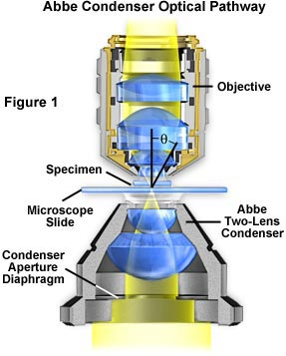
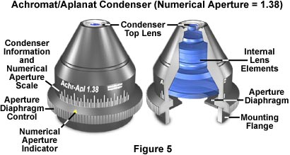
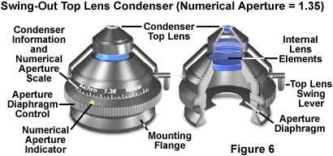
The Condenser
Tasks:
  Illuminate at all angles < α_{objective}
  Concentrate light on the field of view for all objectives to be used
Problem:
  Low mag objectives have large FOV,
  High mag objectives have large α
  (With 2X and 100x objectives we need (100/2)² = 2500 times more light than any objective uses!)
Solutions:
  Compromise
  Exchangable condensers,
  swing-out front lenses,…
Grade of correction
NA

Slide 12
Aperture, Resolution & Contrast
Can adjust the condenser NA with the aperture iris
Imaging
path
Intermed. image
Tube lens
Back aperture
Objective
Q: Don’t we always want
it full open??
A: No
Why? Tradeoff:
resolution vs. contrast
Sample
Condenser lens
Aperture iris
Field lens
Illumination
path
Field iris
Collector
Light source

Slide 13
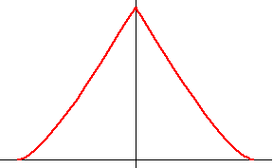
Spatial frequencies & the
Optical Transfer Function (OTF)
1
OTF(k)
Resolution limit:
k_{max} = 2 NA / λ
(Image
contrast)
k
(Spatial frequency,
periods/meter)
Observed
image
Object

Slide 14
Resolution & Contrast vs. Illumination aperture
Pupil
appearance
NA_{condenser} ≈ 0
(“Coherent
illumination”)
Contrast
(= Full aperture,
“incoherent
illumination”)
NA_{condenser} ≥ NA_{obj}
Resolution
Resolution limit:
k_{max} = (NA_{objective}+ NA_{condenser})/ λ
Increasing the illumination aperture
increases resolution
but decreases contrast

Slide 15
Definitions of Resolution
1
OTF(k)
Cutoff frequency
k_{max} = 2 NA / λ
As the OTF cutoff frequency
1/k_{max}
= 0.5 λ /NA
|k|
As the Full Width at Half Max
(FWHM) of the PSF
FWHM
≈ 0.353 λ /NA
As the diameter of the Airy disk
(first dark ring of the PSF)
= “Rayleigh criterion”
Airy disk diameter
≈ 0.61 λ /NA

Slide 16
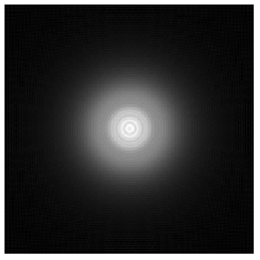
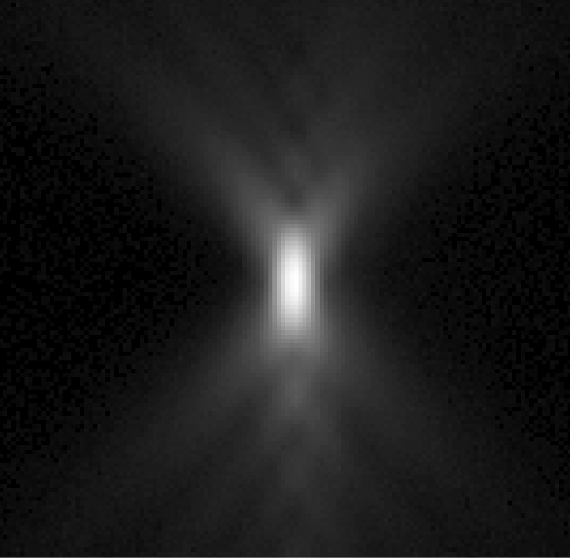
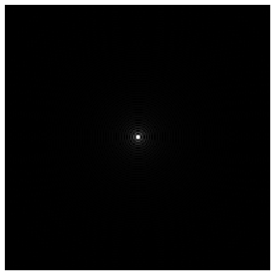
The 3D Point Spread Function (PSF)
The image of a point object
2D PSF
for different defocus
Z=+2µm
3D PSF
Calculated
Measured
z
Z=0
Z=-2µm
y
x
x

Slide 17
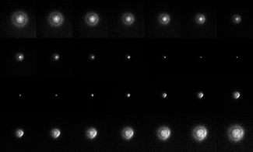
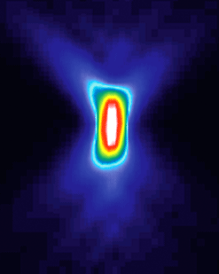
x - z

Slide 18
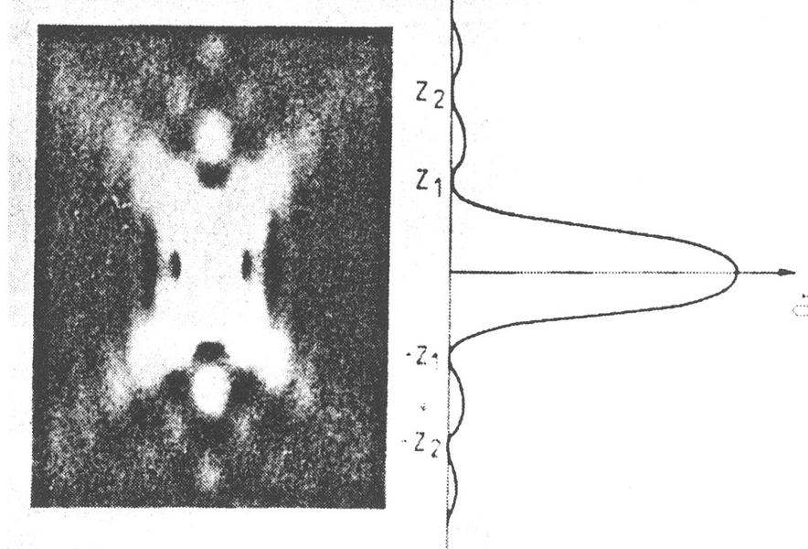
Z-resolution, a.k.a. depth of field, for widefield microscopy
Z-resolution:
2λn / NA²
NA | Resolution (nm; X-Y) | depth of field (μm)
0.3 | 1017 | 11.1
0.75 | 407 | 1.77
0.95 | 321 | 1.11
1.4 | 218 | 0.773

Slide 19
Summary: Numerical Aperture and Resolution
Numerical aperture, not magnification, sets the smallest details you can resolve in an image
Increasing NA also increases the amount of light collected by the lens, thereby increasing the brightness of the image – this scales as NA²

Slide 20
Specifications for some common objectives
Magnification | NA | Resolution (nm) | Depth of Field (nm) | Light gathering (arb. units)
10 | 0.3 | 1017 | 16830 | 0.09
20 | 0.75 | 407 | 2690 | 0.56
40 | 0.95 | 321 | 1680 | 0.90
40 | 1.3 | 235 | 896 | 1.69
60 | 1.2 | 254 | 926 | 1.44
60 | 1.4 | 218 | 773 | 1.96
100 | 1.4 | 218 | 773 | 1.96

Slide 21
Aberrations
They are the enemy

Slide 22
Aberrations
Chromatic aberrations
  Longitudinal chr. Ab.
  Lateral chr. Ab.
Wavefront aberrations
  Spherical aberration
  Astigmatism
  Coma
  …
Curvature of field
Distortion

Slide 23
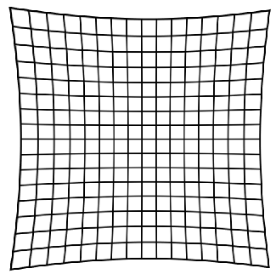
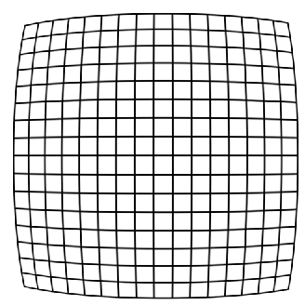
Geometric Distortion
= Radially varying magnification
Image
Object
Pincushion
distortion
Barrel
distortion
May be introduced by the projection eyepiece

Slide 24
Wavefront Aberrations
Aberrated wavefront
in the pupil
Ideal wavefront
in the pupil

Slide 25
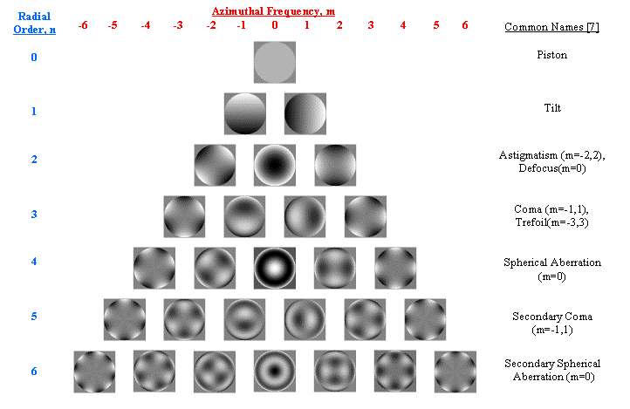
Wavefront Aberrations
(piston)
(tilt)
Astigmatism
Defocus
Coma
Trefoil
Spherical ab.
Secondary coma
Secondary
spherical ab.

Slide 26
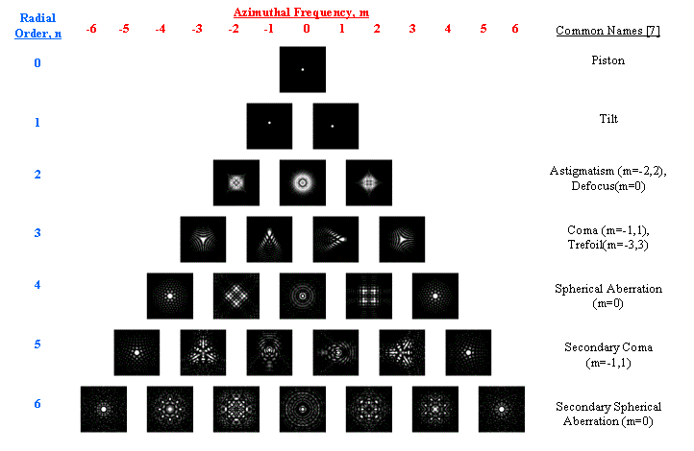
PSF Aberrations
(piston)
(tilt)
Astigmatism
Defocus
Coma
Trefoil
Spherical ab.
Secondary coma
Secondary
spherical ab.

Slide 27
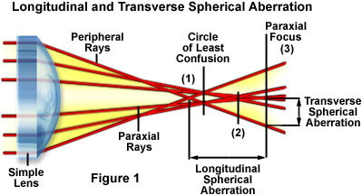
Spherical Aberration

Slide 28
Spherical Aberration
Point spread functions
Ideal
1 wave of spherical ab
z
x
x

Slide 29
Causes of spherical aberration
Modern objectives are complicated!
The optical design requires specifying the optical path length between the sample and the back focal plane of the lens
OPL = l₁n₁ + l₂n₂ + … + l_{n}n_{n}

Slide 30
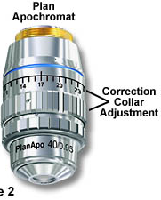
Sources of Spherical Aberration
Design compromises
Manufacturing tolerances
Immersion fluid index error
Temperature variation
Cover slip thickness
  (high-NA objectives except oil immersion)
Correction collar setting
Sample refractive index mismatch

Slide 31
Index Mismatch
& Spherical Aberration
objective
n₁
Immersion
fluid
Cover glass
n₂
Sample
Focus at cover slip
Focus
into sample
Spherical aberration
unless n₂ = n₁

Slide 32
Index Mismatch
& Spherical Aberration
z=0 µm
n₁=1.515 (oil)
z=25 µm
n₂=1.44
(Vectashield)
z=50 µm

Slide 33
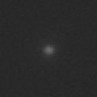
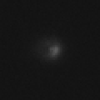
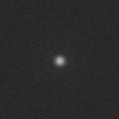
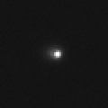
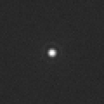
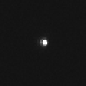
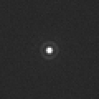
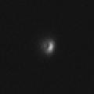
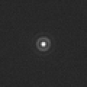
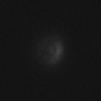
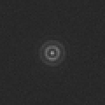
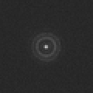
How to recognize spherical aberration
Unaberrated
Aberrated
0.5 μm steps
1 μm steps

Slide 34
What can you do about spherical aberration?
Use 0.17 mm coverslips (~ #1.5)
Work close to the coverslip
Match lenses to the refractive index of your samples, and vice versa
  For aqueous samples, use water immersion / water dipping lenses
  For fixed samples and oil immersion lenses, mount your sample in a medium with n = 1.515
Adjust objective correction collar when available
Use lower NA lenses

Slide 35
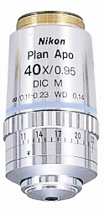
Correction collars
A correction collar can only eliminate spherical aberration at a single focal plane

Slide 36
Example
Aberrated
Unaberrated

Slide 37
Index Mismatch
& Axial Scaling
n₁
Optical
focus
step δz_{o}
n₂
Mechanical
focus
step δz_{m}
If there is index mismatch,
your z pixel size is not what you think

Slide 38
Sources of Astigmatism & Coma
Off-axis (edges of field of view)
All objectives have some
Present in the design
You get what you pay for
On-axis (center of field of view)
Should be none, by symmetry.
If they are there, they could be from:
  manufacturing or assembly tolerances
  dirt or abuse
  Misalignment (tilt, off-axis shift of something)
  bad downstream components (mirrors, dichroics, filters…)
  Air bubble in the immersion fluid or sample
  Tilted cover slip
    (dry and water-immersion high-NA lenses)

Slide 39
More about
Spatial frequencies & the
Optical Transfer Function (OTF)

Slide 40
The response to pure waves is well-defined by the
Optical Transfer Function (OTF)
1
OTF(k)
Resolution limit:
k_{max} = 2 NA / λ
(Image
contrast)
k
(Spatial frequency,
periods/meter)
Observed
image
Object

Slide 41
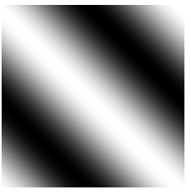
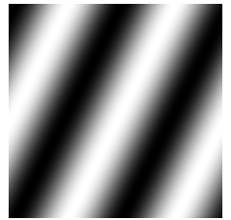
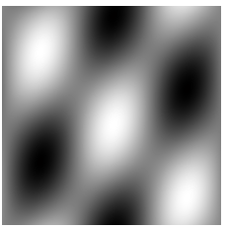
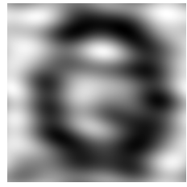
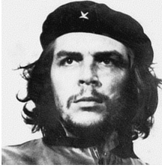
Think of Images as Sums of Waves
… or “spatial frequency components”
one wave
another wave
(2 waves)
+
=
(25 waves)
(10000 waves)
+ (…) =
+ (…) =

Slide 42
Frequency Space
To describe a wave,
we need to specify its:
Can describe it by
a value at a point
Frequency (how many periods/meter?)
Direction
Amplitude (how strong is it?)
Phase (where are the peaks & troughs?)
Distance from origin
Direction from origin
Magnitude of value
Phase of value
complex
k_{y}
k = (k_{x} , k_{y})
direction
k_{x}
period

Slide 43
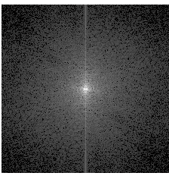
Frequency Space
and the Fourier Transform
k_{y}
Fourier
Transform
k_{y}
k_{x}
k_{x}

Slide 44
Properties of the Fourier Transform
Completeness:
The Fourier Transform contains all the information
of the original image
Symmetry:
The Fourier Transform of the Fourier Transform
is the original image
Fourier
transform

Slide 45
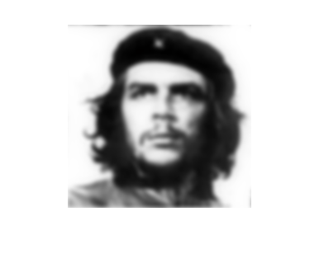
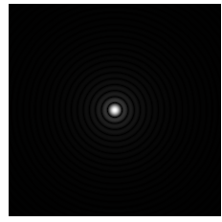
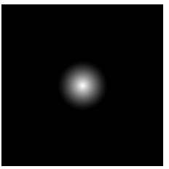
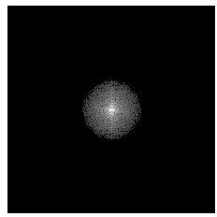
The OTF and Imaging
True
Object
convolution
Observed
Image
⊗
?
?
=
Fourier
Transform
OTF
•
=

Slide 46
Convolutions
(f ⊗ g)(r) = f(a) g(r-a) da
Why do we care?
They are everywhere…
The convolution theorem:
If
then
h(r) = (f⊗g)(r),
h(k) = f(k) g(k)
A convolution in real space becomes
a product in frequency space & vice versa
Symmetry: g ⊗ f = f ⊗ g
So what is a convolution, intuitively?
“Blurring”
“Drag and stamp”
f
g
f⊗g
⊗
=
y
y
y
⊗
=
x
x
x

Slide 47
The Transfer Function Lives in Frequency Space
Object
Observed
image
OTF(k)
|k|
k_{y}
Observable
Region
k_{x}

Slide 48
The 2D In-focus Optical Transfer Function (OTF)
OTF(k)
OTF(k)
k_{y}
|k|
k_{x}
(Idealized calculations)

Slide 49
The 3D OTF
2D PSF
2D OTF
2D F.T.
3D PSF
3D OTF
3D F.T.
?
?

Slide 50
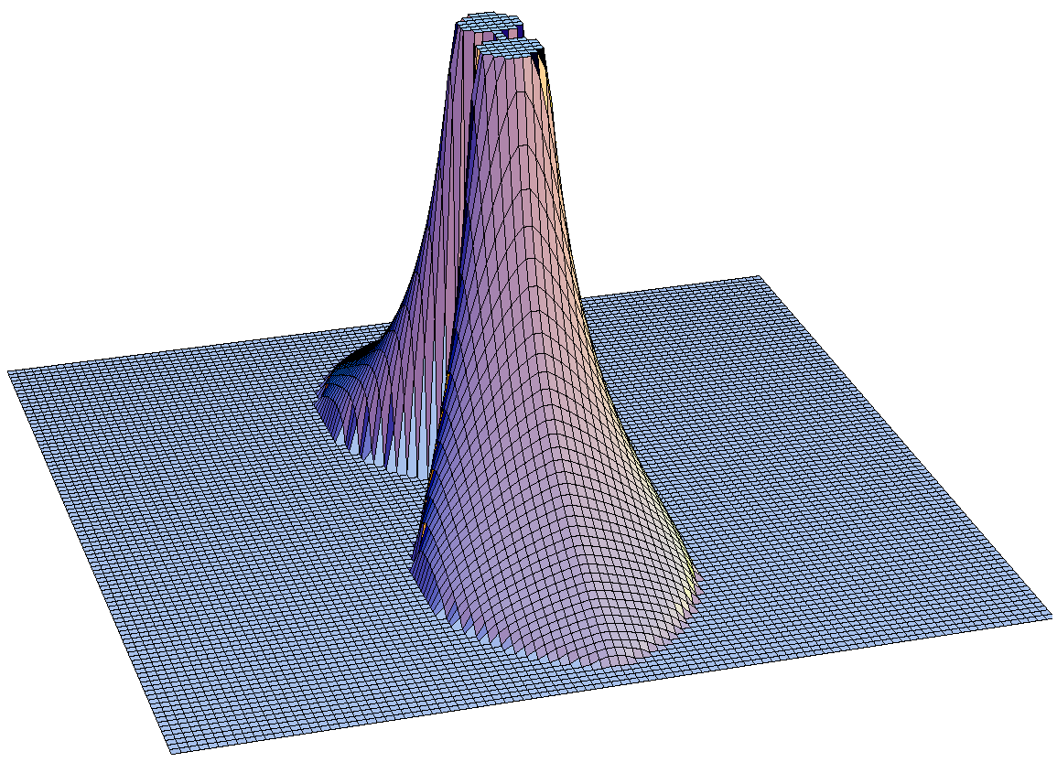
Values of the 3D OTF
k_{x}
k_{z}

Slide 51
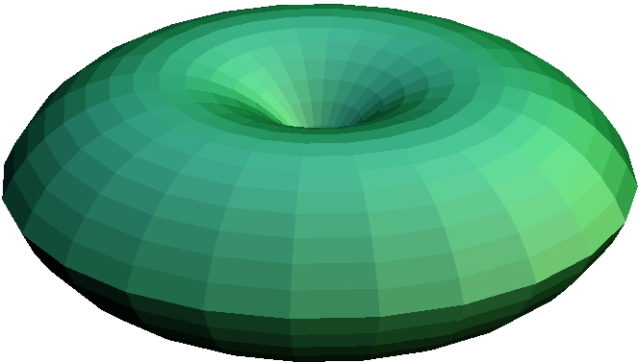
3D Observable Region
= OTF support
= Region where the OTF is non-zero
k_{y}
k_{y}
k_{z}
k_{z}

Slide 52
So what is the resolution?
k_{x}
K_{xy}max =
2 n sin(α) / λ
= 2 NA / λ
k_{z}
“Missing
Cone” of
information
K_{z}max =
n (1-cos(α)) / λ

Slide 53
So what is the resolution?
k_{x}
K_{xy}max =
2 n sin(α) / λ
= 2 NA / λ
Lowering the NA
Degrades the
axial resolution
faster than the
lateral resolution
But low axial resolution
= long depth of field
This is good,
if 2D is enough
k_{z}
“Missing
Cone” of
information
K_{z}max =
n (1-cos(α)) / λ

Slide 54
So what is the resolution?
k_{x}
Example:
a high-end objective
K_{xy}max =
2 n sin(α) / λ
= 2 NA / λ
NA = 1.4
n=1.515
α = 67.5°
λ = 600 nm
Lateral (XY) resolution:
1/ K_{xy}max = 0.21 µm
Axial (Z) resolution:
1/ K_{z}max = 0.64 µm
k_{z}
“Missing
Cone” of
information
K_{z}max =
n (1-cos(α)) / λ

Slide 55
Nomenclature
Optical Transfer Function, OTF
  Complex value with amplitude and phase
Contrast Transfer Function, CTF
Modulation Transfer Function, MTF
  Same thing without the phase information

Slide 56
Resources
Slides available at: http://nic.ucsf.edu/edu.html
http://www.microscopyu.com
http://micro.magnet.fsu.edu
Douglas B. Murphy “Fundamentals of Light Microscopy and Electronic Imaging”
James Pawley, Ed. “Handbook of Biological Confocal Microscopy, 3rd ed.”
Acknowledgements
Steve Ross, Mats Gustafsson

