Slide 1
Frequency space, fourier transforms, and image analysis
Kurt Thorn
Nikon Imaging Center
UCSF

Slide 2
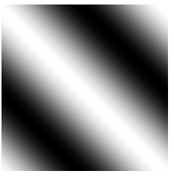
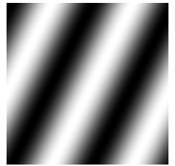
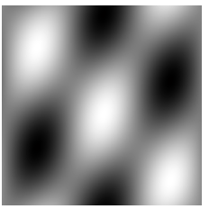
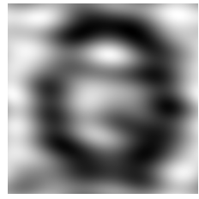
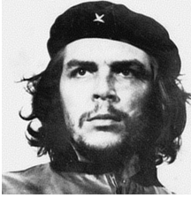
Think of Images as Sums of Waves
… or “spatial frequency components”
one wave
another wave
(2 waves)
+
=
(25 waves)
(10000 waves)
+ (…) =
+ (…) =

Slide 3
Frequency Space
To describe a wave,
we need to specify its:
Can describe it by
a value at a point
Frequency (how many periods/meter?)
Direction
Amplitude (how strong is it?)
Phase (where are the peaks & troughs?)
Distance from origin
Direction from origin
Magnitude of value
Phase of value
complex
k_{y}
k = (k_{x} , k_{y})
direction
k_{x}
period

Slide 4
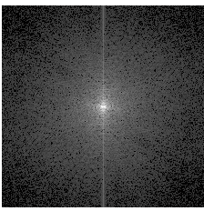
Frequency Space
and the Fourier Transform
k_{y}
Fourier
Transform
k_{y}
k_{x}
k_{x}

Slide 5
Properties of the Fourier Transform
Completeness:
The Fourier Transform contains all the information
of the original image
Symmetry:
The Fourier Transform of the Fourier Transform
is the original image
Fourier
transform

Slide 6
Frequency space and imaging
Object
Imagine a sample composed of a single frequency sine wave
It gives rise to a diffraction pattern at a single angle, which maps to a single spot in the back focal plane
k_{y}
The back focal plane IS the Fourier transform of your sample!
Back Focal
Plane
k_{x}

Slide 7
Frequency space and resolution
Object
Some frequencies fall outside the back focal plane and are not observed
k_{y}
Back Focal
Plane
k_{x}

Slide 8
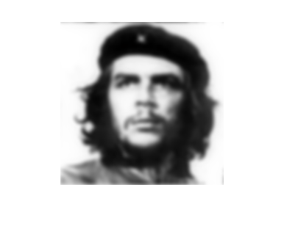
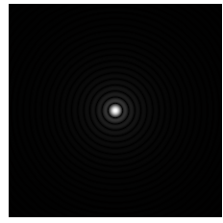
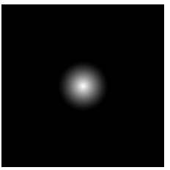
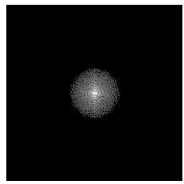
The OTF and Imaging
True
Object
convolution
Observed
Image
PSF
⊗
?
?
=
Fourier
Transform
OTF
•
=

Slide 9
Convolutions
(f ⊗ g)(r) = f(a) g(r-a) da
Why do we care?
They are everywhere…
The convolution theorem:
If
then
h(r) = (f⊗g)(r),
h(k) = f(k) g(k)
A convolution in real space becomes
a product in frequency space & vice versa
Symmetry: g ⊗ f = f ⊗ g
So what is a convolution, intuitively?
“Blurring”
“Drag and stamp”
f
g
f⊗g
⊗
=
y
y
y
⊗
=
x
x
x

Slide 10
Filtering with Fourier transforms
Fourier
transform
Low-pass
filter
Fourier
transform

Slide 11
Filtering with Fourier transforms
Fourier
transform
High-pass
filter
Fourier
transform

Slide 12
Stranger filters
Fourier
transform
Fourier
transform
Blurs vertical objects

Slide 13
Stranger filters
Fourier
transform
Fourier
transform
Blurs horizontal objects

Slide 14
Acknowledgements
Mats Gustafsson

