Slide 1
Sample Prep and Best Practices for Imaging
Alice Thwin
Nikon Imaging Center

Slide 2
What is Sample Prep?
Wikipedia definition: the ways in which a sample is treated prior to its analysis

Slide 3
What is Sample Prep?
Wikipedia definition: the ways in which a sample is treated prior to its analysis microscopy.

Slide 4
Order of events:
  Live imaging
    Dyes – Trackers, useful hints
    Additives
  Fixatives
  ImmunoHistochemistry and ImmunoCytochemistry
    Antibody information for best results
  Mounting Media
    Commercially available
  Coverslips
    The importance of a #1.5 coverslip
  Choosing your
    Objective
    Microscopy technique

Slide 5
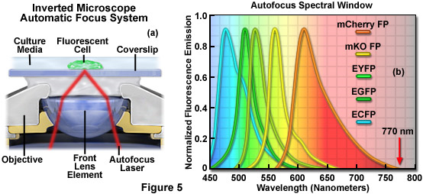
Perfect Focus System
Necessary for Time-Lapse Live cell Imaging

Slide 6
Live Cell Microscopy
Keeping your cells happy and ALIVE!
• Maintain pH
  The pH value of NaHCO3 buffered media depends on the CO2 content of the incubator atmosphere. When the CO2 supply to an incubator fails, media becomes alkaline and cells are adversely affected and may die.
  You can image cells in their normal growth medium if you supply 5% CO2 to the dish on the microscope stage.
  HEPES buffer does not require a controlled atmosphere.
  Do not image live cells in PBS.
A recipe for a HEPES buffered imaging medium is included below. (Brown et al. 2000 Traffic 1:124-140)
  Imaging Medium Stock (5x) pH 7.4
  750 mM NaCl
  100 mM HEPES
  5 mM CaCl2
  25 mM KCl
  5 mM MgCl2
Use at 1x. On day of use add 95 mg glucose and 95 mg albumin to 50 ml of medium. Warm to 37°C. Keep cells in incubator in their usual medium until immediately before imaging. When ready to image, remove their usual medium and replace it with imaging medium. Cells can normally be kept on the stage in this medium for 30-60 min.

Slide 7
Live cell Microscopy
  Keeping your fluorescent markers happy
  If you are worried about photobleaching or toxicity – measure it!
    Have internal controls, ie – a well within that 24 well plate.
  Ascorbic acid, Trolox, or Oxyrase (oxygen and free radical scavengers) can be added to the culture medium.
  N -Propyl gallate (NPG) - an antifade reagent
    difficult to dissolve
    Non-toxic
    Could protect against apoptosis – could be disrupting natural cell cycle
  Addition of sodium butyrate (approximately 1 to 5 millimolar) to the culture medium will increase the overall gene expression levels in stable cells lines expressing a fusion protein.

Slide 8
Live Cell Microscopy- dyes
Commercially available and good for internal controls for photobleaching and localization studies.
  ER-Tracker Green dye
    green-fluorescent BODIPY® FL dye and glibenclamide.
    Glibenclamide (glyburide) binds to the sulphonylurea receptors of ATP-sensitive K⁺ channels which are prominent on ER
  Mito-Trackers: per the Invitrogen website:
    MitoTracker Red or Green FM: mitochondrial stain which appears to localize to mitochondria regardless of mitochondrial membrane potential.
    MitoTracker Red CMXRos is a red-fluorescent dye that stains mitochondria in live cells and its accumulation is dependent upon membrane potential.
    MitoTracker Red CM-H₂XRos is a reduced, nonfluorescent version of MitoTracker Red (that fluoresces upon oxidation. This dye also stains mitochondria in live cells and its accumulation is dependent upon membrane potential.

Slide 9
Fixatives
Crosslinking Fixatives
  Act by creating covalent chemical bonds between proteins in tissue.
  Aldehydes
    Formaldehyde (paraformaldehyde its more stable!)
    Glutaraldehyde
Myth: PFA (paraformaldehyde) will quench my GFP
  FALSE – it’s the methanol stabilizer(upwards of 10%) that is commercially sold as 32%, 16% that is quenching your GFP.
Precipitating Fixatives (denaturing)
  Reduces the solubility of protein molecules and (often) disrupts the hydrophobic interactions that give many proteins their tertiary structure
  Alcohols – methanol, ethanol, and acetone.

Slide 10
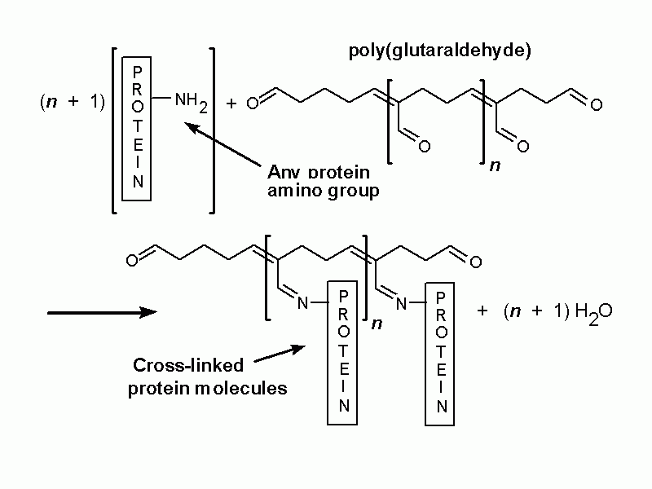
Glutaraldehyde Fixation:

Slide 11
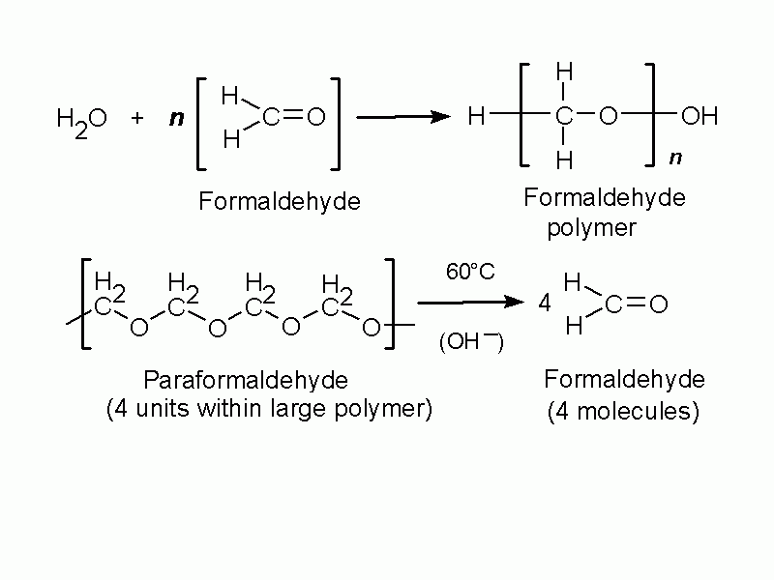
Paraformaldehyde

Slide 12
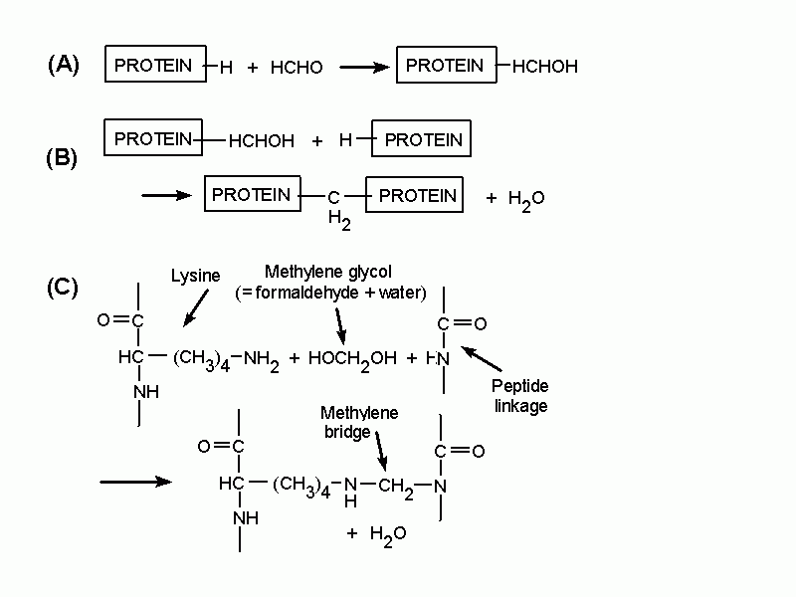
Foraldehyde fixation

Slide 13
Fixation
Per a given antigen rules of thumb (in use since 1973)
Antigen | Fixative
Most proteins, peptides and enzymes of low molecular weight | 4% PFA +/- 1%Glutaraldehyde 10% Neutral-Buffered Formalin (NBF)
Delicate Tissue | Boulin’s Fixative
Small molecules | 4% PFA + 1% Glutaraldehyde
Blood forming organs (liver, spleen, bone marrow); connective tissue | Zenker’s solution Helly Solution
Nucleic acids | Carnoy’s Solution
Large Protein antigens (immunoglobulin) | Ice cold acetone or Methanol (100%)

Slide 14
What is the IHC and ICC?
IHC – ImmunoHistochemistry (for tissue) and ICC-ImmunoCytoChemistry (for cell culture)
Combination of immunological and histological techniques
  Using Antibodies that target epitopes of an antigen of interest to directly or indirectly label
    Direct labeling uses a primary antibody that is conjugated.
    Indirect labeling is step wise process where a conjugated secondary antibody recognizes the host of the primary antibody.

Slide 15
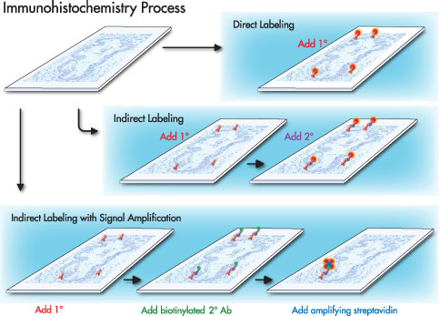
IHC Process

Slide 16
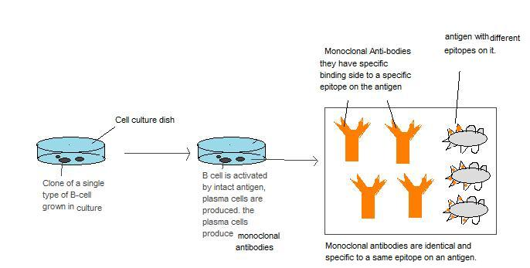
Monoclonal antibody
  A monospecific antibody made by identical immune cells that are all clones of a unique parent cell- (derived from a single cell line)
    Made by fusing myeloma cells with the spleen cells from a mouse that has been immunized with the desired antigen
    All antibodies will have affinity for the same antigen
    Recent advances allow the use of rabbit B-cells
    Needs to be purified via filtration, ion exchange chromatography, size exclusion chromatography, Protein A/G affinity chromatography or affinity purification.

Slide 17
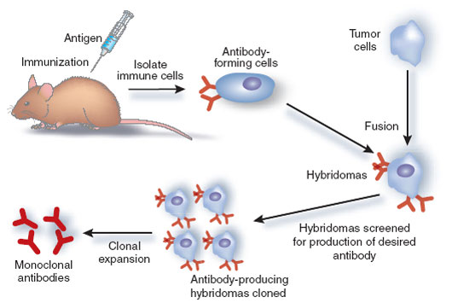
Monoclonal Antibody production:

Slide 18
Polyclonal Antibodies
Also known as antisera
  Immunoglobulin molecules that were secreted-against a specific antigen, each identifying a different epitope.
Produced in the natural immune response
Antibodies obtained are from different B-cell resources
  An antibody produced recognizes different epitopes on the same antigen and have varying affinities for the each epitope.

Slide 19
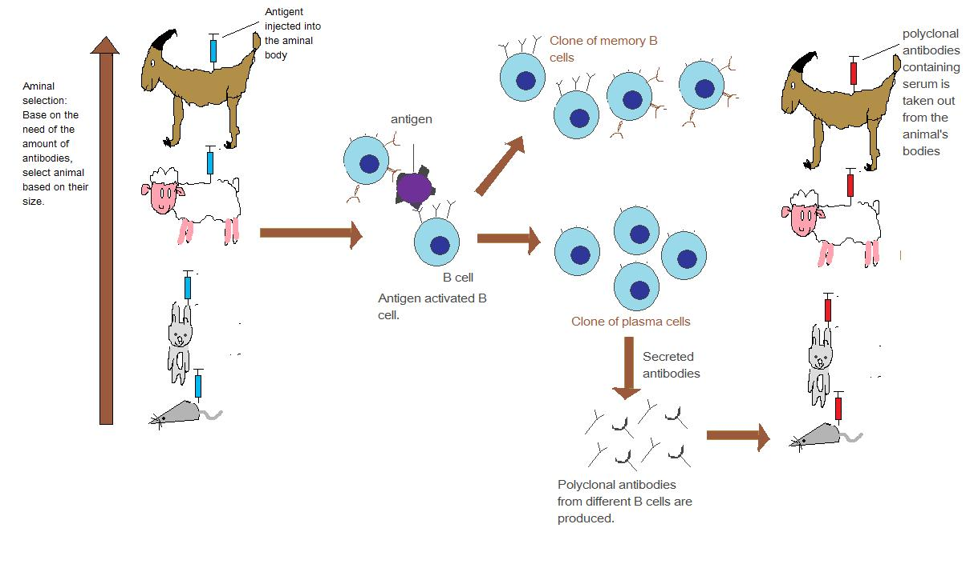
Polyclonal antibody production:

Slide 20
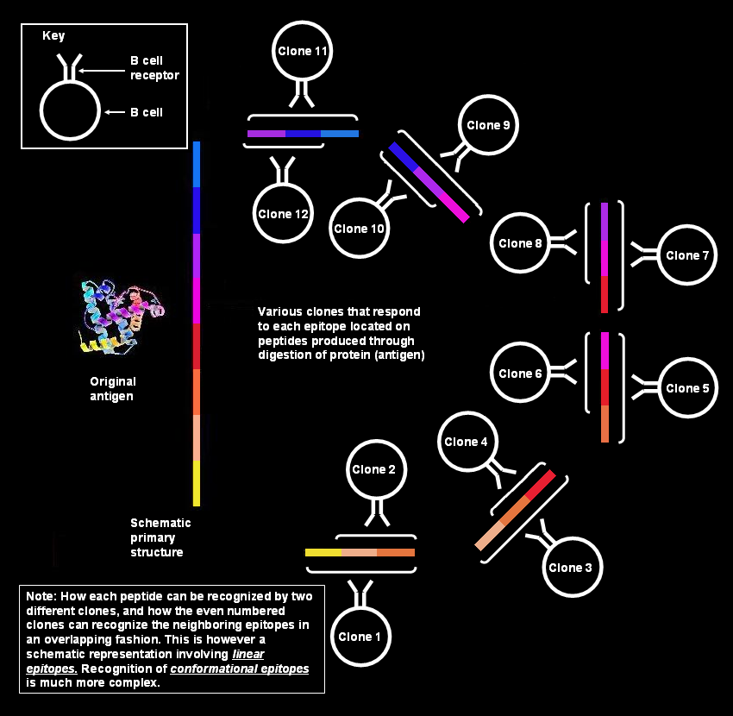
Polyclonal Antibody Production

Slide 21
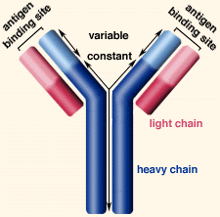
Primary antibody-
Most polyclonal antibodies are IgG class immunoglobulin – so an anti-IgG secondary antibody maybe be used.
For Monoclonal antibodies be SURE that your secondary is well matched to your primary subclass.
IgG subclass and how can it be useful?
  IgG1, IgG2a, IgG2b, IgG2c, IgG3 –
  Affinity purified (isolated) antibodies – give the lowest amount of non-specific binding.
  IgG fractions- contain very high affinity antibodies- best for when the antigen of interest is rare or present in low quantities.
  They make secondary antibodies that are specific for a IgG subclass
    Ex. Primary is a IgG2a and your secondary is against IgG2a
    Great for doing multiple labeling methods (double, triple, quadruple, etc.)

Slide 22
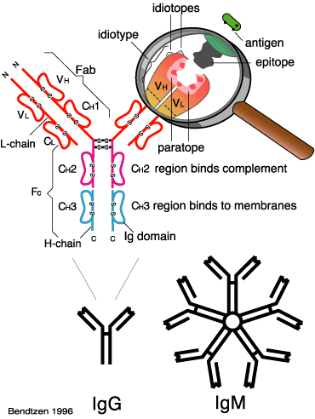
Primary Antibody

Slide 23
Secondary antibodies
Choosing a secondary
  The secondary antibody should be against the species that the primary antibody is raised – ex if your primary is raised in mouse, an anti-mouse secondary antibody should be used.
  Match the subclass of your secondary to the subclass of your primary also – ex: if your primary is one of mouse IgG subclasses( IgG1, IgG2, IgG2b, IgG2c, IgG3) any of the anti-mouse IgG can be used.
Labeled or Conjugated Secondary Antibody
  enzyme labeled – peroxidase, alkaline phosphatase
  fluorescent labeled – Alexa Fluor 405, 488, 568, 647
  biotin conjugated – best amplification of the signal and thus will give greater sensitivity than with enzyme or fluorescent conjugated secondary antibody alone.

Slide 24
Secondary antibodies- a bit more info
What if you have a lot of non-specific staining with your secondary?
Structural similarities are sometimes found among immunoglobulins from different species. Consequently, a polyclonal antibody directed to a specific species can also react with IgG from other species. This non-specific binding is called cross-reactivity.
To reduce cross-reactivity among immunoglobulins from different species, an additional purification step is applied in which antibodies are pre-adsorbed against potentially cross-reactive species.
  Solution- Adsorbed secondary antibody
    Adsorbed with an animal or human IgG.
      Ex: If working with human tissue choose a secondary that is absorbed with human serum or human IgG.
    *caution - Adsorbed antibodies will reduced epitope recognition.

Slide 25
Take away of an IHC or ICC
Indirect method will give you an amplified signal due to its step wise process.
Monoclonal affinity isolated primary antibodies
  Target only one epitope on the antigen of interest (could be harder to work with)
Polyclonal affinity isolated primary antibodies will be batch dependant
  Target many epitopes on the antigen (easier to work)
Choose your secondary antibody accordingly
  Match the subclass to primary antibody
  Adsorbed
  Fluorescently conjugated

Slide 26
Other- more sensitive detection systems – expensive!
If all else fails, and you need to see your protein in vivo.
Polymer detection system
  Polymerized reporter enzyme staining system based on polymerizing an enzyme and attaching these polymers to an antibody.
    Envision (Dako Cytomation)
    ImmPRESS (Vector Labs)
    MACH 2 (Biocare Medical)
    Polink (IHC world)
    Novolink (Leica Microsystems)

Slide 27
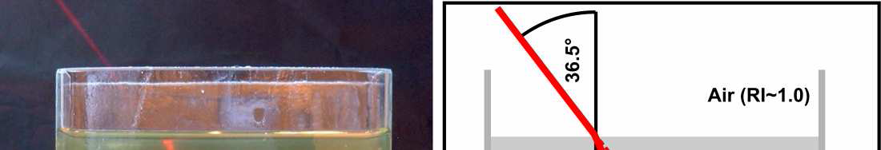
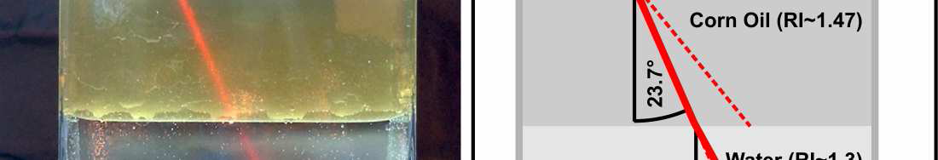
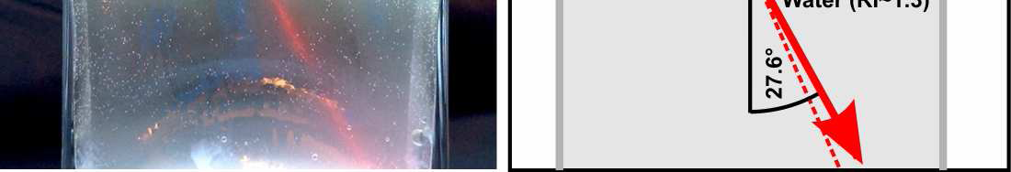
Refraction and the Refractive Index (RI)
Changes in refractive index causes light to deviate from its expected path:

Slide 28
Mounting Media
Using the correct mounting medium avoids signal loss and optical aberration and could preserve fluorescence signal with anti-fading properties.
Refractive indexes of interest:
  Water = 1.33
  Immersion Oil = 1.513
  Air = 1
Light is refracted when it crosses the interface between two media of differing refractive indices
  Mismatching refractive index between the sample’s mounting media and the immersion media is one of the largest components to image degradation in microscopy
  Mismatched refractive indices can also result in stretching/ compression of the z-axis.
    So what you think is a 1um step size for the objective does not necessarily correspond to a 1um change in the focal plane.

Slide 29
Index Mismatch
& Spherical Aberration
objective
n₁
Immersion
fluid
Cover glass
n₂
Sample
Focus at cover slip
Focus
into sample
Spherical aberration
unless n₂ = n₁

Slide 30
Index Mismatch
& Spherical Aberration
z=0 µm
n₁=1.515 (oil)
z=25 µm
n₂=1.44
(Vectashield)
z=50 µm

Slide 31
Constituents of Mounting Media
A base component- a major factor in the refractive index of the medium
  Hydrophilic: (do not require dehydration)
    Aqueous -(RI ~ 1.33)
    Glyercol (1.47)
  Hydrophobic: (require dehydration)
    Natural Oil (1.53)
    Plastic (1.51)
Antifade component - photobleaching is not fully understood – but it seems as though when the fluorescent dye is in its excited triplet state, the dyes react with molecular oxygen and lose the ability to become fluorescent
  most antifade reagents are reactive oxygen species scavengers
  P-Phenylenediamine (PPD) seems to be most effective – except cyanine dyes (Cy2 especiallly)- toxic.
  N-Propyl gallate (NPG) - difficult to dissolve – is non-toxic and can be used with live cells – could even protect against apoptosis
  1,4-Diazadicyclo-octane (DABCO) aka – triethylenediamine – less effective then PPD, and also less toxic.

Slide 32
Mounting Media commercially available
Aqueous:
  Gel Mount (without glycerol) – 1.358
  FluorSave (hardens within 1 hr, tissue shrinkage in 1 week) RI – unknown but close to 1.33
Glycerol based:
    Prolong (two component mounting medium – antifade powder + liquid base that one mixes prior to use) or Prolong Gold (premixed)
      RI ~ 1.455
      Great for AlexaFluor dyes
      Might not be so good for fluorescent proteins
      Molecular probes report that Prolong does not work well with BODIPY dyes.
    Vectashield
      Regular (RI ~ 1.458) or hard-set (RI~1.440)
      Does not work well with Cyanine dyes
    Mowiol –
      a PVA- based media designed for EM
      one has to mix the powder in glycerol and buffer

Slide 33
Mounting Media commercially available
Plastics
  Entellan (RI ~1.500) no antifade reagents
    Base constituent is poly(methylmethacrylate)
  Cytoseal 60 (RI ~1.5??) no antifade reagents
    Base constituent is poly(methylmethacrylate)
    Cheaper but inferior to Entellan
Natural Oil
  Permount (RI~1.515) – from Daigger -no antifade reagents
    Polymer dissolved in toluene.
    Highly toxic, flammable and reactive (comes with an 8 page MSDS!)
    Sets very quickly

Slide 34
A number 1.5 coverslip!
Yes- all microscopist tell you to use it, but why?
*All objectives are designed for coverslips that are .17mm thick
  Most manufacturers of coverslips do a range
    #0, .08-.13mm
    #1, .13-.17mm
    #1.5, .16-.19mm
  What happens to your image quality?
  The image quality will vary – proportionally to the difference in coverslip thickness.

Slide 35
Use a number .17mm thick coverslip
To reduce variability in performance get “high-performance” coverslips that are to be accurate to .001mm ( from Zeiss can order a .17mm thick coverslip)
Numerical Aperture | 0.01 mm Deviation | 0.02 mm Deviation
0.30 | none | none
0.45 | none | none
0.70 | 2 percent | 8 percent
0.85 | 19 percent | 57 percent
0.95 | 55 percent | 71 percent

Slide 36
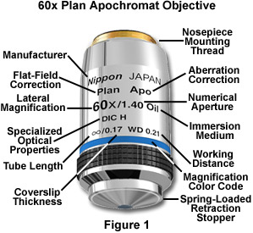
The Objective Lens

Slide 37
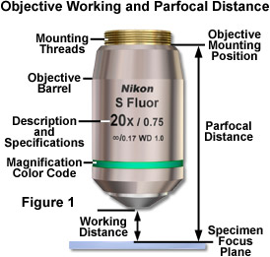
Working Distance
In general, high NA lenses have short working distances
However, extra-long working distance objectives do exist
Some examples:
10x/0.3 WD = 15.2mm
20x/0.75 WD = 1.0mm
100x/1.4 WD = 0.13mm

Slide 38


Numerical Aperture
100X / 0.95 NA
α = 71.8°
NA = n sin(α)
4X / 0.20 NA
α = 11.5°
where
= light gathering angle
n = refractive index of sample

Slide 39
Resolution of the Microscope
limited by the point-spread function
Resolution: X-Y, 0.61λ / NA; Z, λn / NA²
Resolution for some common objectives, in nm:
NA | X-Y | Z
0.3 | 1017 | 16830
0.75 | 407 | 2690
0.95 | 321 | 1680
1.4 | 218 | 770

Slide 40
Light-gathering power
Light-gathering power goes as the square of NA
All things being equal, a higher NA lens will give a brighter image
Increasing magnification generally decreases brightness as light is spread out over more pixels
NA | Brightness
0.3 | 0.09
0.75 | 0.56
0.95 | 0.90
1.4 | 1.96

Slide 41
Choosing an objective
Questions:
  What resolution do you need?
  How bright is your sample?
For high resolution, you’ll need high NA.
For dim samples, you’ll want high NA, regardless of resolution, to maximize light-gathering.
  Dim, low-resolution samples (e.g. protein abundance in nucleus): bin camera to trade off resolution for brightness

Slide 42
Choosing an objective
Questions:
  What resolution do you need?
  How bright is your sample?
When to use low NA?
  Bright samples at low resolution / low magnification
  If you need long working distance
  If spherical aberration is a concern
  If you want large depth of field to get whole structures in focus at once (avoid Z-stacks)

Slide 43
Which imaging technique should I use?
1-5 μm
TIRF (for samples at the coverslip)
Wide-field (+deconvolution)
1-20 μm
Fast
Spinning Disk Confocal
Sample Thickness
Sensitivity
10-100 μm
Line-scanning confocal
>20 μm
Point scanning Confocal
Slow
>50 μm
2-photon confocal

Slide 44
Microscope choice
Epifluorescence – routine work, low magnification, or thin samples where you don’t need high-resolution 3D reconstruction
TIRF – samples at the membrane or otherwise at the coverslip surface; very high signal-to-noise; single molecule imaging
Spinning Disk Confocal – Live tissue culture cells, yeast, etc, or thin (<30 μm) tissue sections when you need 3D reconstructions
Laser-Scanning Confocal – Thick tissues or specimens

Slide 45
Acknowledgements:
Hassel,J. and Hand, A. R. (1973) J. Histochem. Cytochem 22 229-239
Microscopyu.com
IHC world.com
Confocal listserv
Wright Cell Imaging Facility, Toronto Western Research Institute
Wikipedia
Commercial websites – Cargille, invitrogen, diagger, jackson immuno labs.

Slide 46
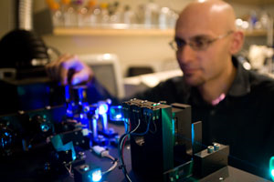
Acknowledgements:
Kurt Thorn, Director of the NIC

Slide 47
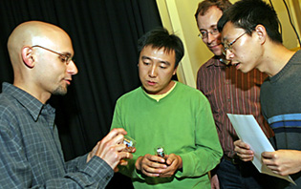
Acknowledgements:
Kurt Thorn, Director of the NIC

Slide 48
Thanks!
Go out there and do some sample prep so that I can see your samples under the scope – preferably at the NIC!
nic.ucsf.edu

