Slide 1

Light Sources for Microscopy
Focus on Fluorescence Microscopy
Regan Baird, Ph.D.

Slide 2

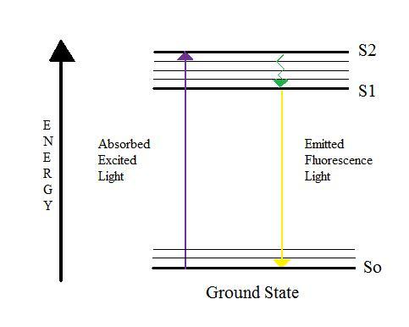
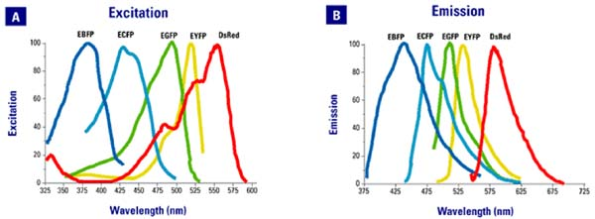
Jablonski Diagram
Fluorescence Spectra

Slide 3
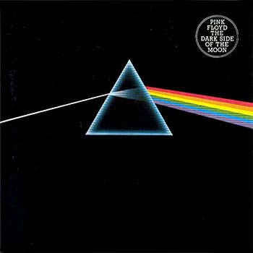
White Light provides All Wavelengths?

Slide 4
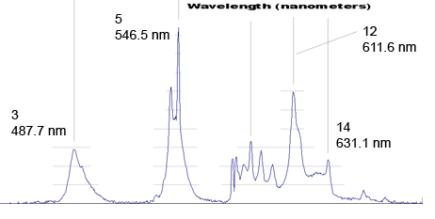
Spectra of White Florescent Light

Slide 5
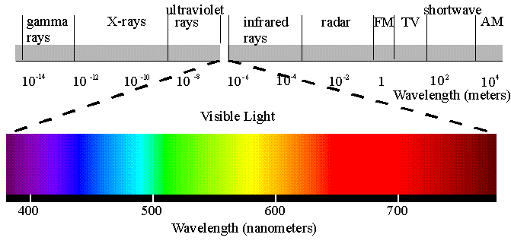
Spectrum of Light

Slide 6

Common Sources In Microscopy
Natural
Filament
Arc
Solid State

Slide 7
Illumination Needs
Spectral Requirements
Directed
Intense
Even Illumination

Slide 8

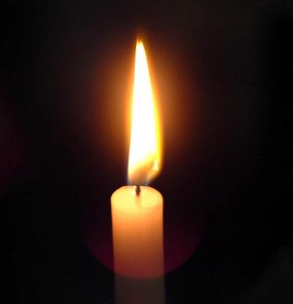
Natural sources of light
Sunlight
Fire
Full Spectrum
Difficult to Harness
No Overnight Experiments
Spectrum Depends On Fuel
Difficult to Control
Avoid Wind!

Slide 9
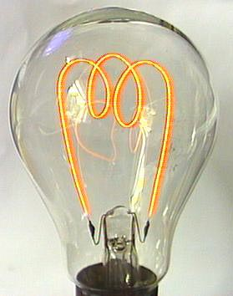
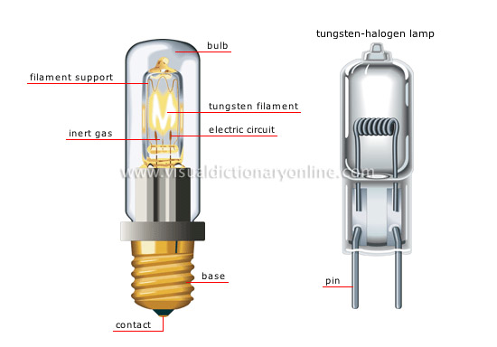
Filament Lamps

Slide 10
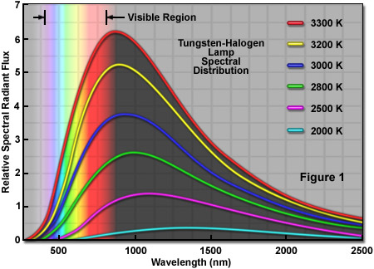
Halogen Lamp Spectra
Typically Used for Brightfield Imaging Techniques

Slide 11
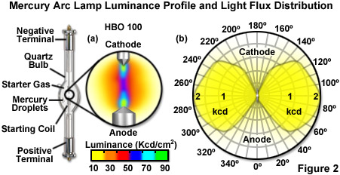
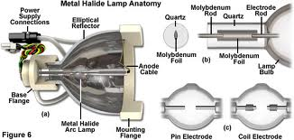
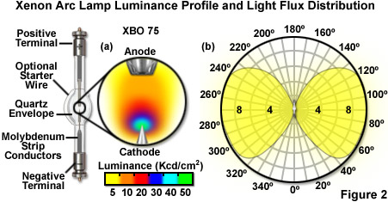
Arc Lamps
http://zeiss-campus.magnet.fsu.edu/

Slide 12
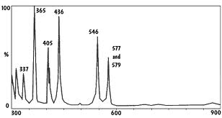
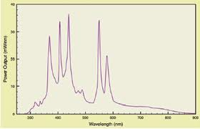
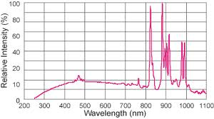
Mercury
Peak levels are not comparable
Metal Halide
Xenon

Slide 13
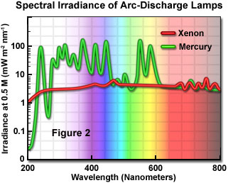
Spectral Comparison
340nm and 380nm make Xenon ideal for Fura-2 imaging (Ca++)

Slide 14
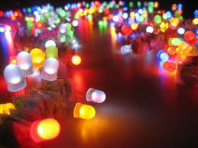
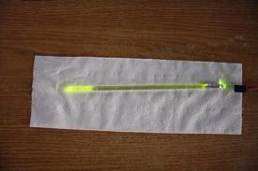
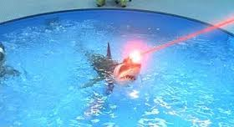
Solid State Sources
LED Hybrid
LED
Lasers

Slide 15
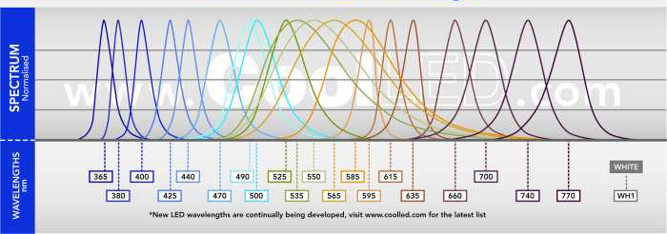
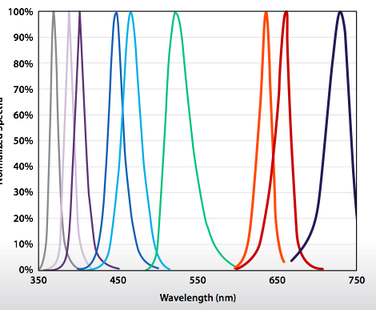
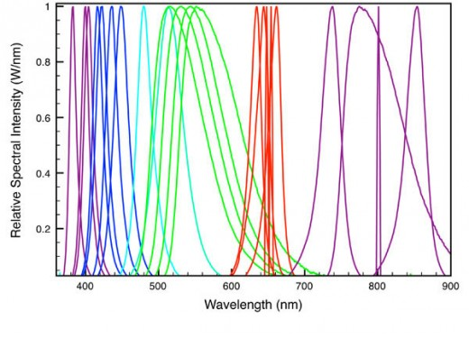
Light Emitting Diode
Don’t be fooled by the peak heights

Slide 16
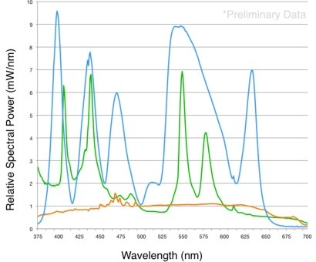
Light source Comparison

Slide 17
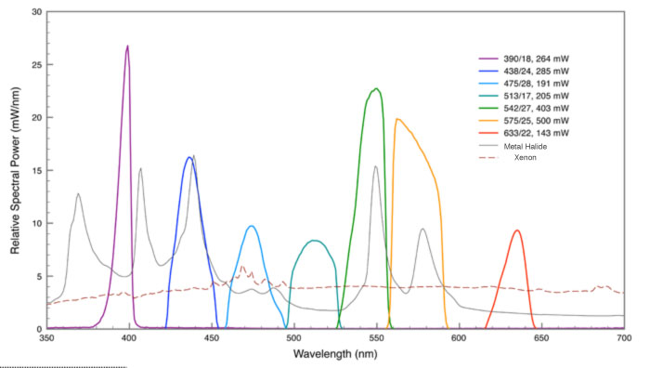
Filtered LED Source

Slide 18
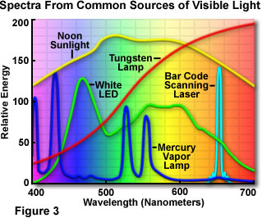
Light Source Comparison

Slide 19
Common Fluorescence SOURCES
Source | Lifetime | Stability | Consumable Cost | Wavelength Range | Warm-up | Shutter/Switch Speed | Alignment | Time to 50% degradation (hr) | Flicker | Hazard | Heat | Green
Mercury | 100 | - | $200 | UV - 600 | 30 min | External | +++ | Varies | ++++ | ++++ | ++++ | NO
Metal Halide | 2000 | + | $600 | 350-600 | 5 min | External | - | 200 | ++ | +++ | ++++ | NO
Xenon | 1000 | ++ | $600 | 340-1000 | 5 min | External | - | 500 | + | ++++ | ++++ | NO
LED | 20000 | ++++ | 0 | 360-800 | >1 min | 5kHZ | - | 20000 | -- | --- | - | YES
Lasers | 10000 | ++++ | 0 | UV-IR | > 1 min | 1MHz | - | 10000 | - | --- | - | Yes

Slide 20
Thoughts on Light Source Comparisons
Use Compatible Filters!!!
Where does the measurement matter most?
What is the unit of measure?
What is the area of illumination?
What is the hour number on the source?
What is the cost of ownership?

