Slide 1
EMCCD Cameras
Rachit Mohindra
Photometrics

Slide 2
EMCCDs – The Need for Low Light Imaging
Low excitation energy to reduce photo-bleaching/toxicity
  Live cell fluorescence
  Fast bleaching dyes
Samples in ultra-low concentrations
  ~10⁻¹⁰ M in typical single molecule fluorescence applications
Observe Processes with fast kinetics
  Motility studies
  Ion ratio imaging
Essentially - Low Light and Speed

Slide 3
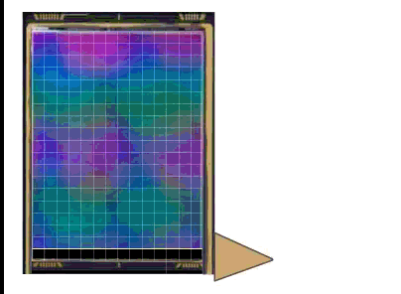
CCD Image Acquisition
Frame Transfer CCD

Slide 4
EMCCD Cameras
Normal Voltage Serial Register
High Voltage Serial Register
Back-illuminated, frame-transfer CCD (for >90% QE) or standard front-illuminated (65% QE)

Slide 5
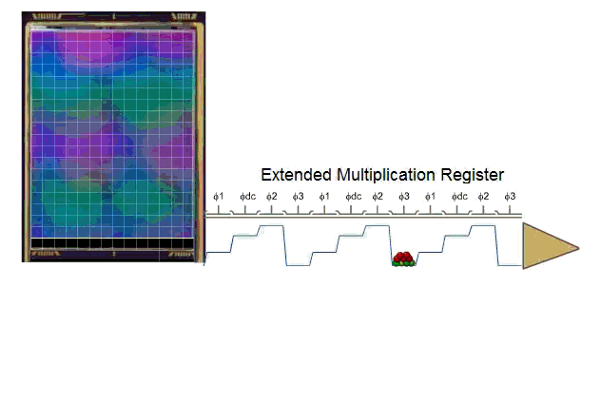
EMCCD Cameras

Slide 6
How Does this Help?
If you are trying to measure signal that is lower than the read noise – You’re not going to see anything
If you multiply up the signal over the read-noise – Then you’ll see something.
But – the signal you’re measuring isn’t actually changing.
You’re effectively reducing the read noise

Slide 7
Reduction of Read Noise
Apply EM Gain factor of 200X
Boost Signal 200X
Equivalent to reducing the read noise by a factor of 200X
If Read Noise is 50e-, after EM gain, it is equal to 0.25e-
Allows extremely low-light detection

Slide 8

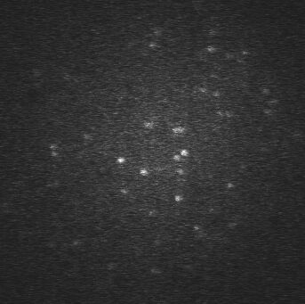
Detect Signals Below the Read-Noise
Without EM Gain
With EM Gain

Slide 9
Downfalls of EMCCDs
Clock Induced Charge increases
  Time independent (unlike dark current)
  Increases background events
Excess Noise Factor
  Increases noise by a factor of ~1.4
  “Halves the Quantum Efficiency” – Not exactly
Loss of Full Well Capacity
  Inversely proportional to the amount of EM Gain applied
Aging of EM Gain

Slide 10
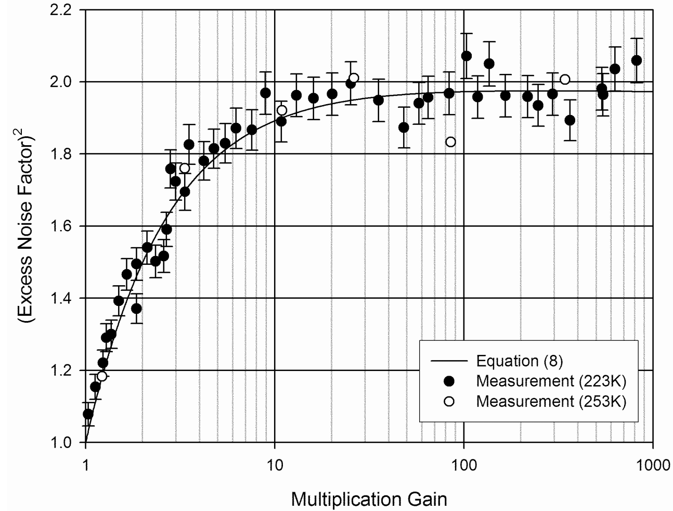
Excess Noise Factor
Increases only Shot Noise and Dark Noise by a factor of ~√2 or ~1.4
Important at higher light levels, where images are dominated by Shot Noise

Slide 11
Calibrate your EM Gain
As EM Gain ages – setting 300X doesn’t always provide 300X…
Most Cameras provide you the ability to calibrate

Slide 12
The Sweet Spot
Maximum EM Gain is not the best setting
  Maximizes Excess Noise
  Maximizes Clock Induced Charge/Spurious noise
  Drastically reduced Dynamic Range
  Read Noise asymptotically reaches a minimum Read Noise
Reduce the Read Noise to <1e-
  No more EM Gain needed
  Maximize the sensitivity, minimize the noise
  Extend the life of the EM Gain

Slide 13
With increasing EM Gain – ADU’s increase, But Signal detected by the sensor remains constant
After a certain point, the electron count will remain the same

Slide 14
EMCCD’s – A Summary
Low Light Imaging that requires Speed
Effectively reduces your EM Gain
Not a perfect technology
Find the Sweet Spot – Don’t need more EM than this

Slide 15
Thank You!
For more information please visit:-
  www.photometrics.com

