Slide 1
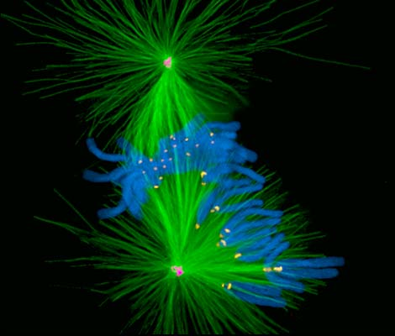
Fluorescence Microscopy: Small Molecule Probes
Kurt Thorn
NIC

Slide 2
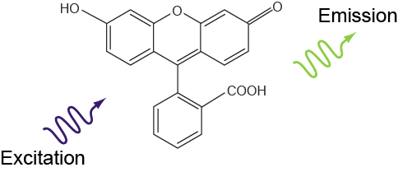
What is fluorescence?
Emission light is longer wavelength (lower energy)
than excitation light

Slide 3
Jablonski diagram
(Molecular energy diagram)
Singlet states
Spin S=0
S₂
S₁
λ_{em}
λ_{exc}
Lifetime
τ ~ 1–4 ns
fluorescence
S₀

Slide 4
Jablonski diagram
(Molecular energy diagram)
Singlet states
Spin S=0
Triplet states
Spin S=1
S₂
T₂
S₁
λ_{em}
T₁
λ_{exc}
Lifetime
τ ~ 1–4 ns
fluorescence
S₀

Slide 5
Jablonski diagram
(Molecular energy diagram)
Singlet states
Spin S=0
Triplet states
Spin S=1
S₂
T₂
Inter-
systems
crossing
S₁
T₁
Lifetime
µs–ms
λ_{exc}
λ_{phospho}
S₀
phosphorescence

Slide 6
Singlet and Triplet States
Orbital states of each electron
Spin flip
Lowest unfilled orbital
λ_{exc}
Highest filled orbital
Total spin S=0
Singlet state
Total spin S=1
Triplet state
Spin flips are “dipole forbidden” → unlikely → long triplet lifetime

Slide 7
Fluorescence Spectra
Excitation
maximum
Stokes shift
Emission
maximum
Alexa 488

Slide 8
Fluorophore saturation
S₂
Internal
conversion
Fluorescence lifetime is ~1-5ns
Once illumination intensity is high enough to excite the fluorophore as soon as it deexcites, further intensity increases will not increase brightness
S₁
hν_{A}
hν_{A}
hν_{E}
S₀
2
1
0
Usually only a problem for confocal

Slide 9
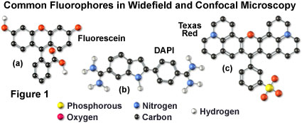
Fluorescent molecules
Systems of conjugated bonds
that share electrons
Larger system → longer wavelength
C
C
C
C

Slide 10
Parameters of fluorescent molecules
Excitation & emission maxima
Extinction coefficient ε
∝ absorption cross section
ε ≈ 50,000–100,000 M⁻¹cm⁻¹
Fluorescence quantum yield Q_{f}
= # Photons emitted / # photons absorbed
Q_{f} ≈ 25–90%
Brightness ∝ ε Q_{f}
Photo-bleaching quantum yield Q_{b}
= average # of photons emitted
per molecule before bleaching.
Depends on environment.
∝ Q_{f} / Q_{b}
I_{exc}
I_{in}
C
I_{out}
l
ε: extinction
coefficent
(M⁻¹cm⁻¹)
l: length (cm)
C: concentration (M)

Slide 11
Parameters for some common fluorophores
Dye λ_{ex} λ_{em} ε QY brightness
DAPI 350 470 27000 0.58 15.7
Fluorescein 490 520 67000 0.71 47.6
Alexa 488 494 517 73000 0.6 43.8
Rhodamine 554 573 85000 0.28 23.8
Cy3 554 568 130000 0.14 18.2
Cy5 652 672 200000 0.18 36
GFP 488 507 56000 0.6 33.6
mCherry 587 610 72000 0.22 15.8
CFP 433 475 32500 0.4 13
YFP 516 529 77000 0.76 58.5

Slide 12
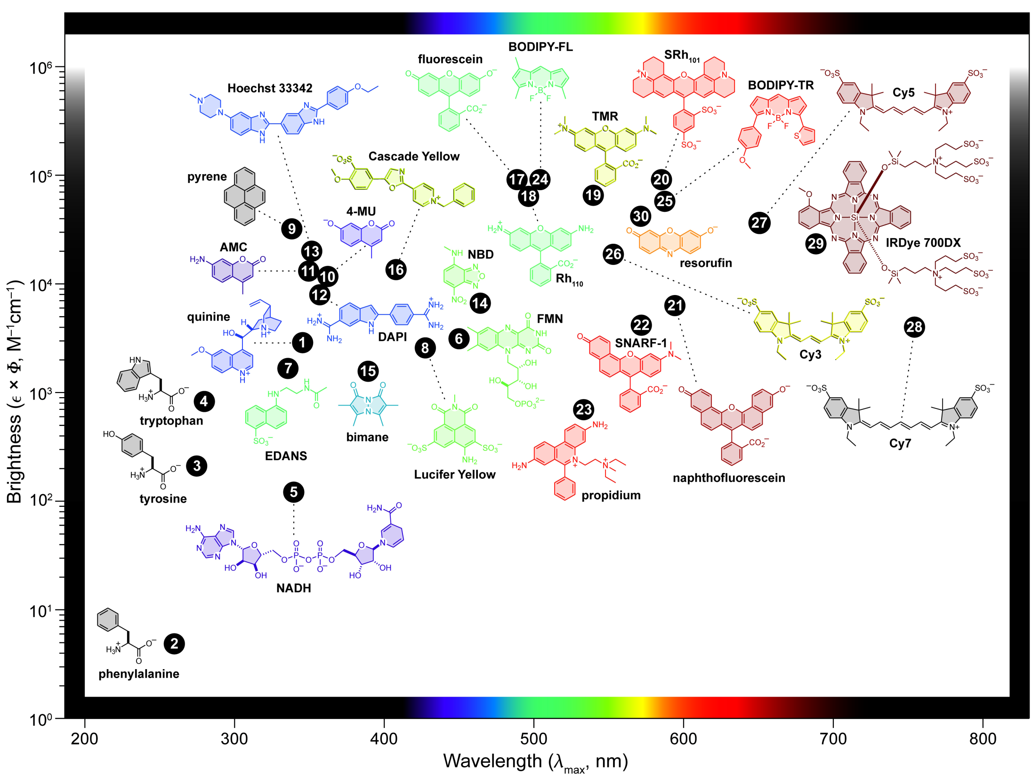
Luke D. Lavis; Ronald T. Raines; ACS Chem. Biol. 2008, 3, 142-155.

Slide 13
Commercial Dye Series
Alexa Dyes – Molecular Probes / Life Technologies
Atto Dyes – Atto-Tec GmbH
Etc…
Not chemical families – marketing families

Slide 14
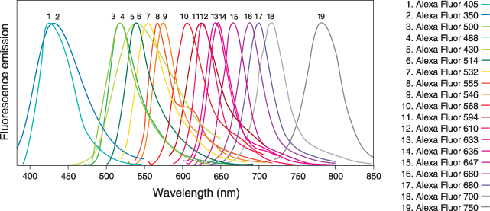
Alexa Fluors

Slide 15
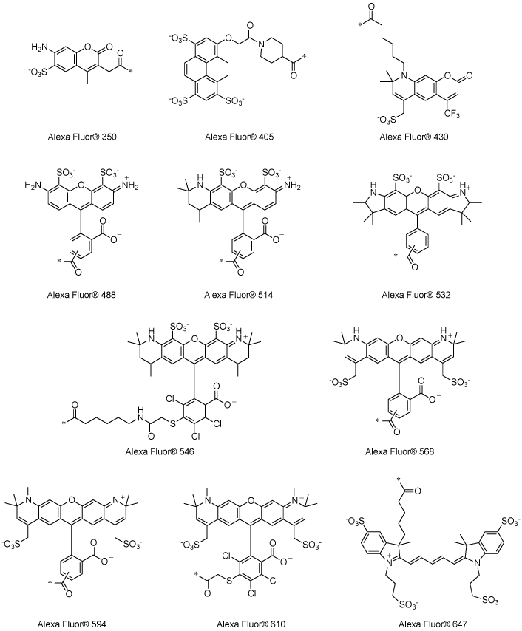
ATDBio.com

Slide 16
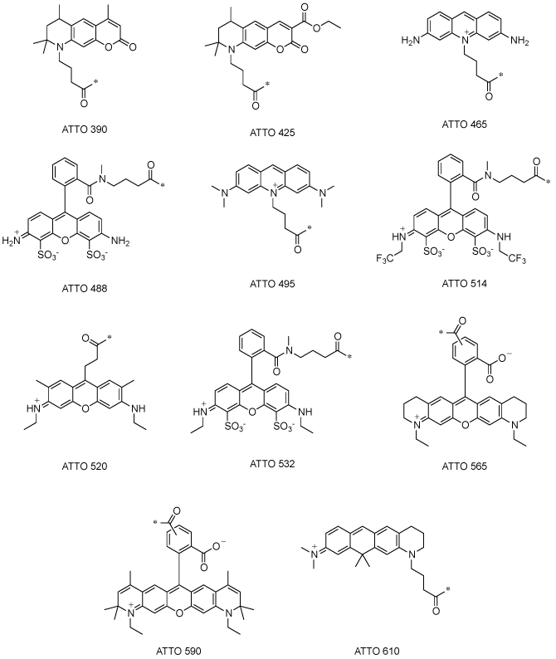
ATDBio.com

Slide 17
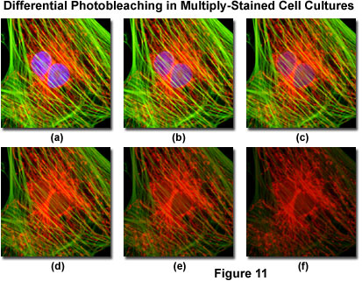
The Enemy:
Photo-bleaching
Decrease in emission intensity after exposure
Exciting a molecule once has a probability Q_{b} of killing it
Each molecule will emit only a finite number of photons

Slide 18
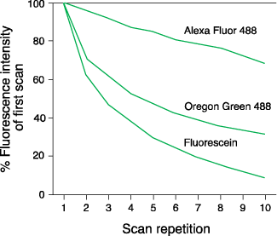
Photo-bleaching
Photostability varies between dyes

Slide 19
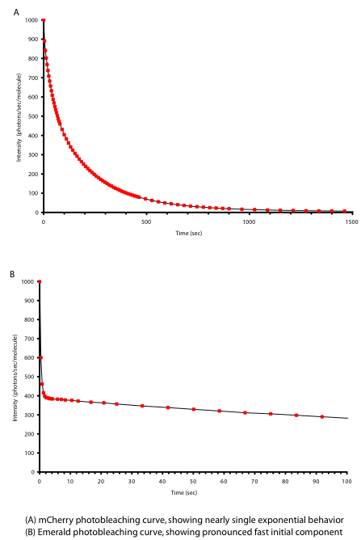
Photo-bleaching of fluorescent proteins
mCherry
Single-exponential bleaching
Photons/molecue/s
Time
Emerald
Double-exponential bleaching
Fast- and slow-bleaching populations?
Photons/molecue/s
Time

Slide 20
What to do about photo-bleaching?
Select fade-resistant dyes
Label densely
Decrease bleaching by anti-fade mounting media
  Glycerol
  Oxygen scavengers
  Free-radical scavengers
  Triplet state quenchers
Note: some anti-fade agents quench some dyes.
Budget the photons you have
  Only expose when observing
  Minimize exposure time & excitation power
  Use efficient filter combinations
  Use highly QE, low noise camera
  Use simple light path

Slide 21
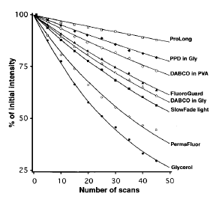
Effect of mounting medium on FITC bleaching
Ono et al. 2001, J. Histochem Cytochem. 49: 305-311

Slide 22
Effect of mounting media on Alexa bleaching

Slide 23
Factors affecting overall brightness
Intrinisic brightness
Spectrum of arc lamp/lasers
Lamp/laser power
Filter set transmission
Quantum efficiency of detector
Photobleaching
Quenching / maturation / other dye-specific effects

Slide 24
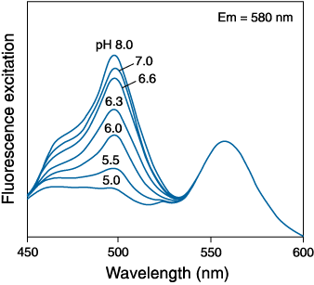
pH dependence of dyes
Mixed Fluorescein and Rhodamine
YFP variants
Fluorescein
Rhodamine

Slide 25
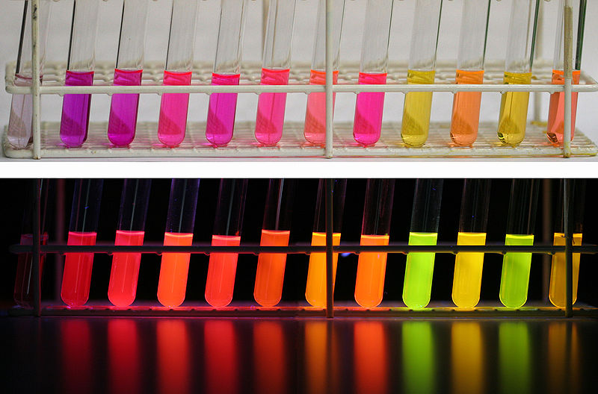
Environmental Dependence: Nile red
H2O
MeOH
EtOH
CH3CN
DMF
Acetone
EtAc
CH2Cl2
Hexane
MTBE
toluene
cyclohex
http://en.wikipedia.org/wiki/File:Nile_red_01.jpg

Slide 26
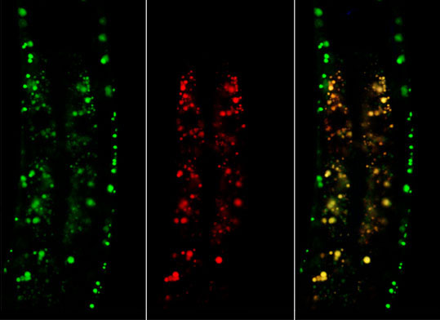
Environmental Dependence: Nile Red
C. elegans staining with Nile Red and BODIPY-fatty acid
(Kevin Jones, Ashrafi lab)

Slide 27
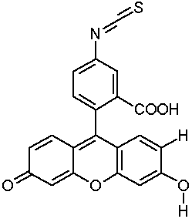
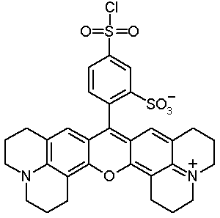
Fluorescent dyes in Biology
FITC
Texas Red
Protein labeling: couple to amino- or sulfhydryl groups
Direct and indirect (immuno-) fluorescence
Notes:
Show structure of FITC, TRITC, Cy3, Cy5
Discuss labeling strategies for proteins (targetting primary amino groups or sulfhydryls (cystein)
Explain direct and indirect immuno-fluorescence.
Show a number of images

Slide 28
Fluorescent labeling
Direct labeling (& microinjection)
of target molecules
Direct immunofluorescence:
labeled antibodies against target
Indirect immunofluorescence:
Unlabeled antibodies against target
Labeled antibodies against those antibodies

Slide 29
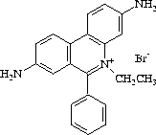
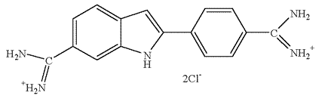
DNA Probes
DAPI
Hoechst 33258
Hoechst 33342
~20 fold enhancement
Ethidium Bromide
~30 fold enhancement
Notes:
Show structure of Ethidium Bromide (intercalation), DAPI and Hoechst 33342 (minor groove binders).
Fluorescence emission is highly enhanced after DNA binding

Slide 30
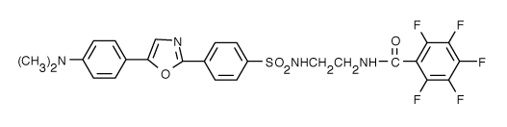
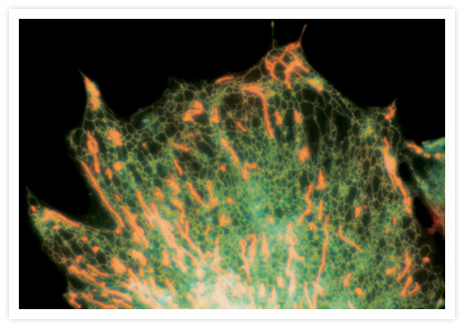
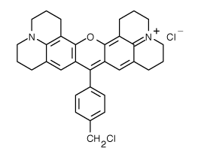
Other probes
ER-Tracker™ Blue-White DPX
MitoTracker Red CMXRos
Probes for Golgi, lysosomes, and peroxisomes are also available

Slide 31
Small molecules – pros / cons
1000s available – huge spectral range
Easy to acquire
Precisely tailored properties, including environmental sensitivity
Require fixing and staining, which can lead to artifacts
Potential self-quenching and environmental sensitivity

Slide 32
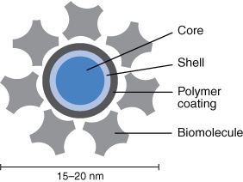
Quantum dots
“Artificial atoms” composed of small semiconductior nanocrystals

Slide 33
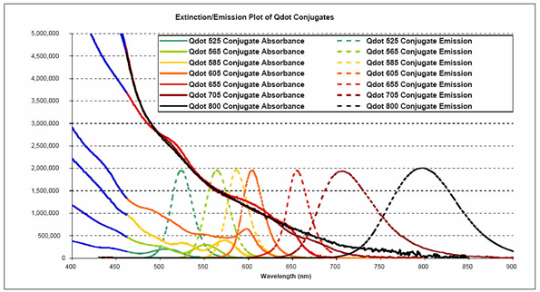
Quantum dots - spectra

Slide 34
Quantum dots – pros / cons
Little to no photobleaching
Very bright
Can use single excitation wavelength for multiple dyes
Narrow emission spectra
Large compared to small molecule dyes
Single quantum dots blink
Problems with non-specific binding

Slide 35
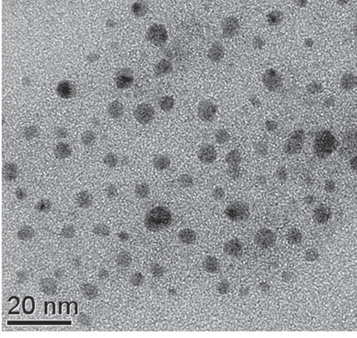
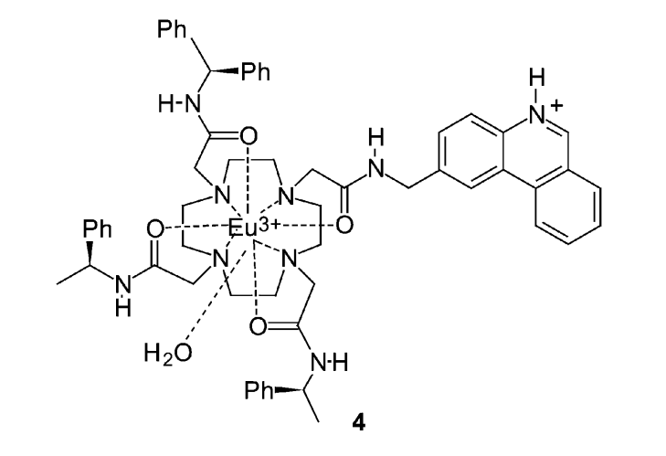
Lanthanides: Atomic phosphors
Phosphorescence from atomic 4f transitions
Organic dye antennas
Inorganic (nano)crystals
Eu:YVO₄
Eu:Y₂O₃
VO₄
Eu

Slide 36
Unique lanthanide properties
Very long lifetime: 100 μs – 1 ms
Very narrow emission lines
Can change wavelength by changing lanthanide
No photobleaching
Uses:
Time resolved luminescence
Lanthanide phosphors

Slide 37
Lanthanide Nanophosphors

Slide 38
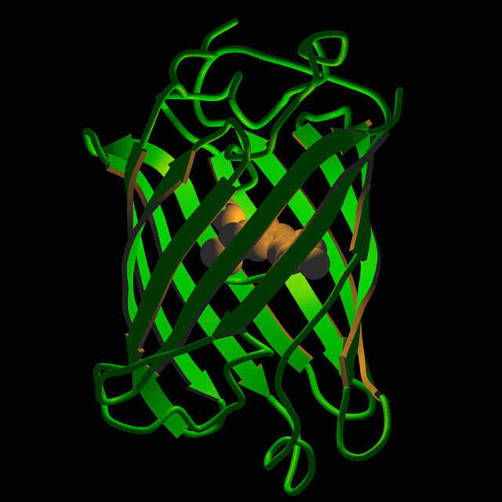
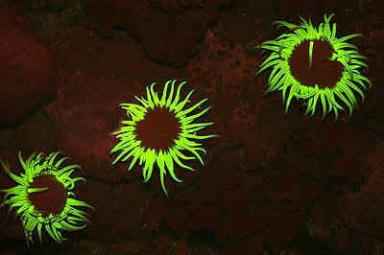
Fluorescent Proteins and Genetically Encoded Tags
See next lecture!
A. sulcata

Slide 39
Resources
www.microscopyu.com
micro.magnet.fsu.edu
www.chroma.com (esp. their handbook on filter design)
www.probes.com (esp. their handbook/catalog)
Douglas B. Murphy “Fundamentals of Light Microscopy and Electronic Imaging”
James Pawley, Ed. “Handbook of Biological Confocal Microscopy, 3rd ed.”
Acknowledgements
Nico Stuurman / Mats Gustafsson / Mike Davidson

