Slide 1
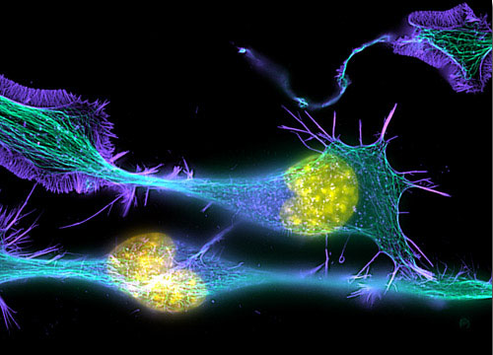
Principles & Practice of
Light Microscopy: 2
(Image: T. Wittman, Scripps)

Slide 2
Aperture and Resolution
Diffraction spot
on image plane
= Point Spread Function
Intermediate image plane
Objective
Tube lens
Sample
Back focal plane aperture

Slide 3
Aperture and Resolution
Diffraction spot
on image plane
= Point Spread Function
Intermediate image plane
Objective
Tube lens
Sample
Back focal plane aperture

Slide 4
Aperture and Resolution
Diffraction spot
on image plane
= Point Spread Function
Intermediate image plane
Objective
Tube lens
Sample
Back focal plane aperture

Slide 5
Aperture and Resolution
Diffraction spot
on image plane
= Point Spread Function
Intermediate image plane
Objective
Tube lens
Sample
α
Back focal plane aperture
Image resolution improves with Numerical Aperture (NA)
NA = n sin(α)
α = light gathering angle
n = refractive index of sample
where:

Slide 6
Filling the back focal plane
In trans-illumination microscopy, to get maximum resolution,
the illumination must “fill the back focal plane”
Back
focal
plane
For the highest resolution,
we need to have
α_{condenser} ≥ α_{objective}
NA_{condenser} ≥ NA_{objective}
with oil immersion objectives,
we need an oil immersion condenser!
Objective
α_{objective}
α_{condenser}
Condenser
Light source

Slide 7
Aperture, Resolution & Contrast
Can adjust the condenser NA with the aperture iris
Imaging
path
Intermed. image
Tube lens
Back aperture
Objective
Q: Don’t we always want
it full open??
A: No
Why? Tradeoff:
resolution vs. contrast
Sample
Condenser lens
Aperture iris
Field lens
Illumination
path
Field iris
Collector
Light source

Slide 8
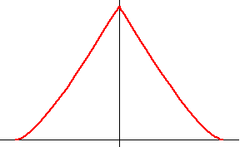
Spatial frequencies & the
Optical Transfer Function (OTF)
1
OTF(k)
Resolution limit:
k_{max} = 2 NA / λ
(Image
contrast)
k
(Spatial frequency,
periods/meter)
Observed
image
Object

Slide 9
Resolution & Contrast vs. Illumination aperture
Pupil
appearance
NA_{condenser} ≈ 0
(“Coherent
illumination”)
Contrast
(= Full aperture,
“incoherent
illumination”)
NA_{condenser} ≥ NA_{obj}
Resolution
Resolution limit:
k_{max} = (NA_{objective}+ NA_{condenser})/ λ
Increasing the illumination aperture
increases resolution
but decreases contrast

Slide 10
Definitions of Resolution
1
OTF(k)
Cutoff frequency
k_{max} = 2 NA / λ
As the OTF cutoff frequency
1/k_{max}
= 0.5 λ /NA
|k|
As the Full Width at Half Max
(FWHM) of the PSF
FWHM
≈ 0.353 λ /NA
As the diameter of the Airy disk
(first dark ring of the PSF)
= “Rayleigh criterion”
Airy disk diameter
≈ 0.61 λ /NA

Slide 11
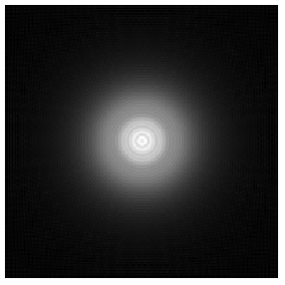
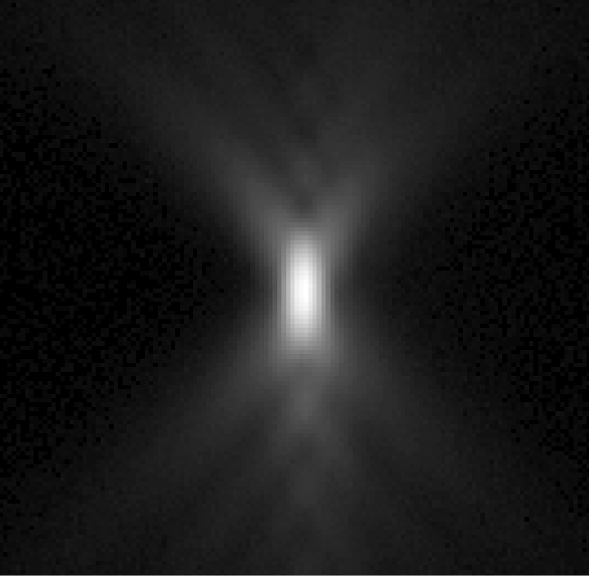
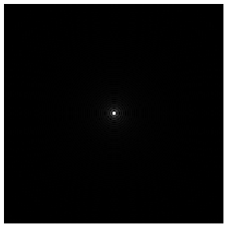
The 3D Point Spread Function (PSF)
The image of a point object
2D PSF
for different defocus
Z=+2µm
3D PSF
Calculated
Measured
z
Z=0
Z=-2µm
y
x
x

Slide 12
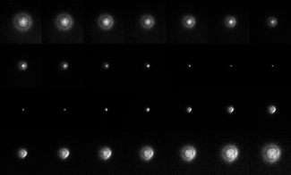
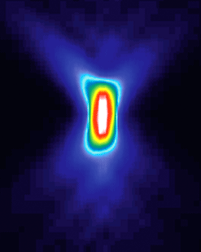
x - z

Slide 13
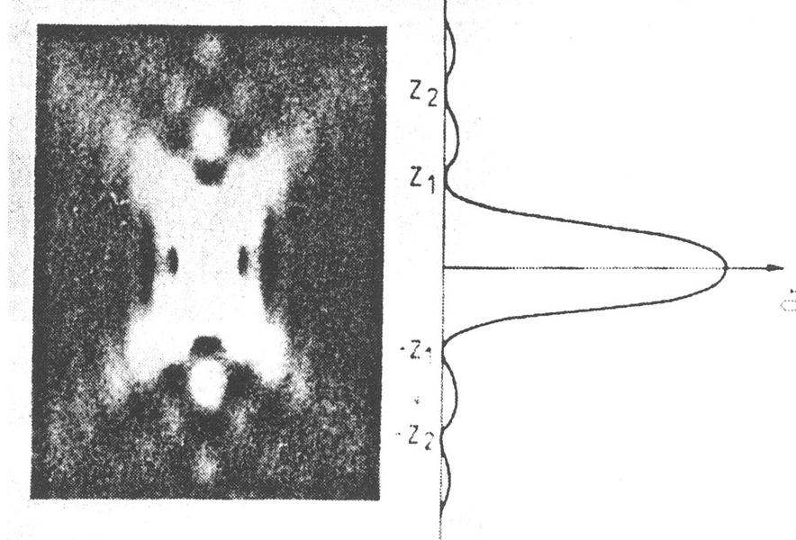
Z-resolution, a.k.a. depth of field, for widefield microscopy
Z-resolution:
2λn / NA²
NA | Resolution (nm; X-Y) | depth of field (μm)
0.3 | 1017 | 11.1
0.75 | 407 | 1.77
0.95 | 321 | 1.11
1.4 | 218 | 0.773

Slide 14
Summary: Numerical Aperture and Resolution
Numerical aperture, not magnification, sets the smallest details you can resolve in an image
Increasing NA also increases the amount of light collected by the lens, thereby increasing the brightness of the image – this scales as NA²

Slide 15
Specifications for some common objectives
Magnification | NA | Resolution (nm) | Depth of Field (nm) | Light gathering (arb. units)
10 | 0.3 | 1017 | 16830 | 0.09
20 | 0.75 | 407 | 2690 | 0.56
40 | 0.95 | 321 | 1680 | 0.90
40 | 1.3 | 235 | 896 | 1.69
60 | 1.2 | 254 | 926 | 1.44
60 | 1.4 | 218 | 773 | 1.96
100 | 1.4 | 218 | 773 | 1.96

Slide 16
Aberrations
They are the enemy

Slide 17
Aberrations
Chromatic aberrations
  Longitudinal chr. Ab.
  Lateral chr. Ab.
Wavefront aberrations
  Spherical aberration
  Astigmatism
  Coma
  …
Curvature of field
Distortion

Slide 18
Wavefront Aberrations
Aberrated wavefront
in the pupil
Ideal wavefront
in the pupil

Slide 19
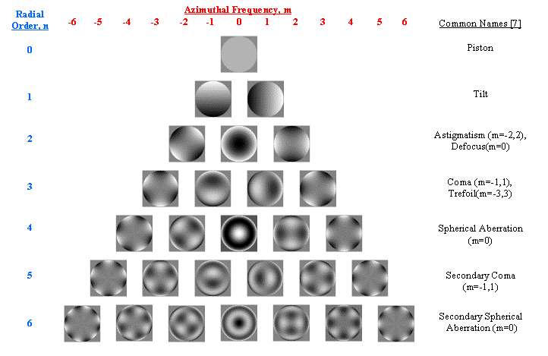
Wavefront Aberrations
(piston)
(tilt)
Astigmatism
Defocus
Coma
Trefoil
Spherical ab.
Secondary coma
Secondary
spherical ab.

Slide 20
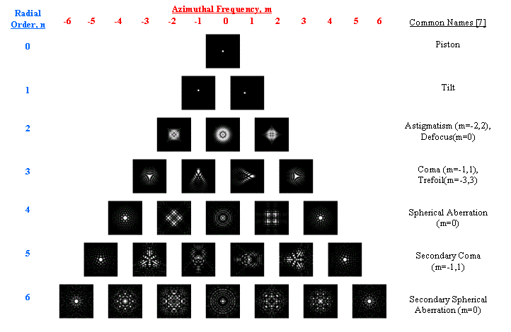
PSF Aberrations
(piston)
(tilt)
Astigmatism
Defocus
Coma
Trefoil
Spherical ab.
Secondary coma
Secondary
spherical ab.

Slide 21
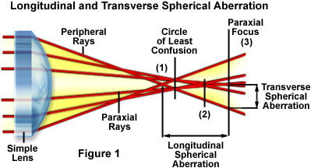
Spherical Aberration

Slide 22
Spherical Aberration
Point spread functions
Ideal
1 wave of spherical ab
z
x
x

Slide 23
Causes of spherical aberration
Modern objectives are complicated!
The optical design requires specifying the optical path length between the sample and the back focal plane of the lens
OPL = l₁n₁ + l₂n₂ + … + l_{n}n_{n}

Slide 24
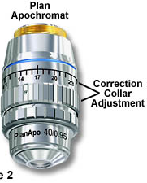
Sources of Spherical Aberration
Design compromises
Manufacturing tolerances
Immersion fluid index error
Temperature variation
Cover slip thickness
  (high-NA objectives except oil immersion)
Correction collar setting
Sample refractive index mismatch

Slide 25
Index Mismatch
& Spherical Aberration
objective
n₁
Immersion
fluid
Cover glass
n₂
Sample
Focus at cover slip
Focus
into sample
Spherical aberration
unless n₂ = n₁

Slide 26
Index Mismatch
& Spherical Aberration
z=0 µm
n₁=1.515 (oil)
z=25 µm
n₂=1.44
(Vectashield)
z=50 µm

Slide 27
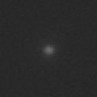
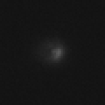
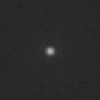
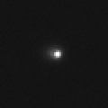
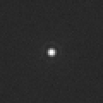
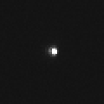
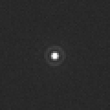
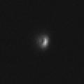
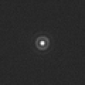
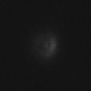
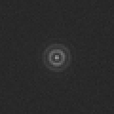
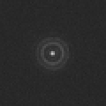
How to recognize spherical aberration
Unaberrated
Aberrated
0.5 μm steps
1 μm steps

Slide 28
What can you do about spherical aberration?
Use 0.17 mm coverslips (~ #1.5)
Work close to the coverslip
Match lenses to the refractive index of your samples, and vice versa
  For aqueous samples, use water immersion / water dipping lenses
  For fixed samples and oil immersion lenses, mount your sample in a medium with n = 1.515
Adjust objective correction collar when available
Use lower NA lenses

Slide 29
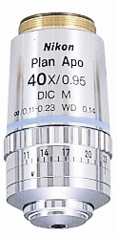
Correction collars

Slide 30
Correction collars
A correction collar can only eliminate spherical aberration at a single focal plane

Slide 31
Example
Aberrated
Unaberrated

Slide 32
Index Mismatch & Axial Scaling
n₁
Optical
focus
step δz_{o}
n₂
Mechanical
focus
step δz_{m}
If there is index mismatch,
your z pixel size is not what you think

Slide 33
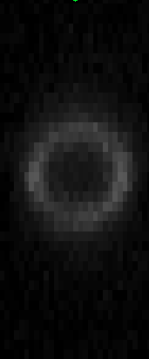
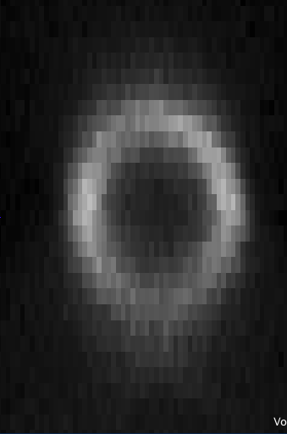
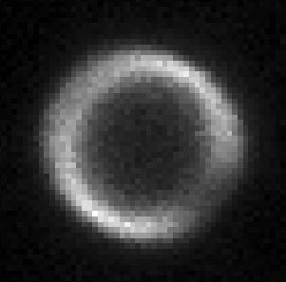
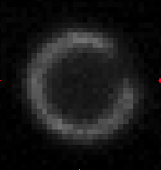
Index Mismatch & Axial Scaling
2 μm beads
z
z
xy
xy
n = 1.32
n = 1.52
Mark Chan

Slide 34
Sources of Astigmatism & Coma
Off-axis (edges of field of view)
All objectives have some
Present in the design
You get what you pay for
On-axis (center of field of view)
Should be none, by symmetry.
If they are there, they could be from:
  manufacturing or assembly tolerances
  dirt or abuse
  Misalignment (tilt, off-axis shift of something)
  bad downstream components (mirrors, dichroics, filters…)
  Air bubble in the immersion fluid or sample
  Tilted cover slip
    (dry and water-immersion high-NA lenses)

Slide 35
More about
Spatial frequencies & the
Optical Transfer Function (OTF)

Slide 36
The response to pure waves is well-defined by the
Optical Transfer Function (OTF)
1
OTF(k)
Resolution limit:
k_{max} = 2 NA / λ
(Image
contrast)
k
(Spatial frequency,
periods/meter)
Observed
image
Object

Slide 37
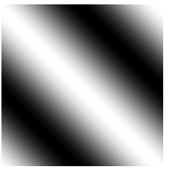
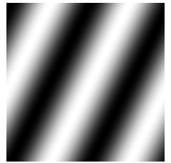
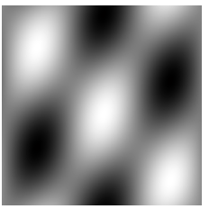
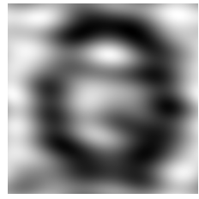
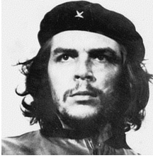
Think of Images as Sums of Waves
… or “spatial frequency components”
one wave
another wave
(2 waves)
+
=
(25 waves)
(10000 waves)
+ (…) =
+ (…) =

Slide 38
Frequency Space
To describe a wave,
we need to specify its:
Can describe it by
a value at a point
Frequency (how many periods/meter?)
Direction
Amplitude (how strong is it?)
Phase (where are the peaks & troughs?)
Distance from origin
Direction from origin
Magnitude of value
Phase of value
complex
k_{y}
k = (k_{x} , k_{y})
direction
k_{x}
period

Slide 39
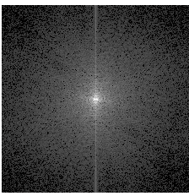
Frequency Space
and the Fourier Transform
k_{y}
Fourier
Transform
k_{y}
k_{x}
k_{x}

Slide 40
Properties of the Fourier Transform
Completeness:
The Fourier Transform contains all the information
of the original image
Symmetry:
The Fourier Transform of the Fourier Transform
is the original image
Fourier
transform

Slide 41
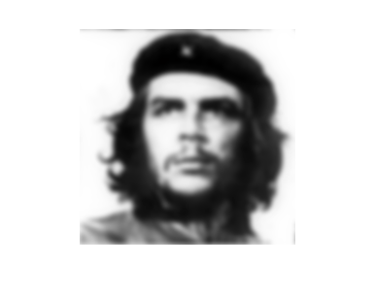
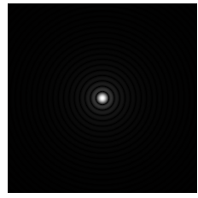
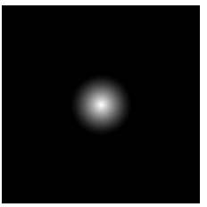
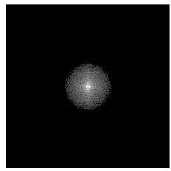
The OTF and Imaging
True
Object
convolution
Observed
Image
PSF
⊗
?
?
=
Fourier
Transform
OTF
•
=

Slide 42
Convolutions
(f ⊗ g)(r) = f(a) g(r-a) da
Why do we care?
They are everywhere…
The convolution theorem:
If
then
h(r) = (f⊗g)(r),
h(k) = f(k) g(k)
A convolution in real space becomes
a product in frequency space & vice versa
Symmetry: g ⊗ f = f ⊗ g
So what is a convolution, intuitively?
“Blurring”
“Drag and stamp”
f
g
f⊗g
⊗
=
y
y
y
⊗
=
x
x
x

Slide 43
The Transfer Function Lives in Frequency Space
Object
Observed
image
OTF(k)
|k|
k_{y}
Observable
Region
k_{x}

Slide 44
The 2D In-focus Optical Transfer Function (OTF)
OTF(k)
OTF(k)
k_{y}
|k|
k_{x}
(Idealized calculations)

Slide 45
The 3D OTF
2D PSF
2D OTF
2D F.T.
3D PSF
3D OTF
3D F.T.
?
?

Slide 46
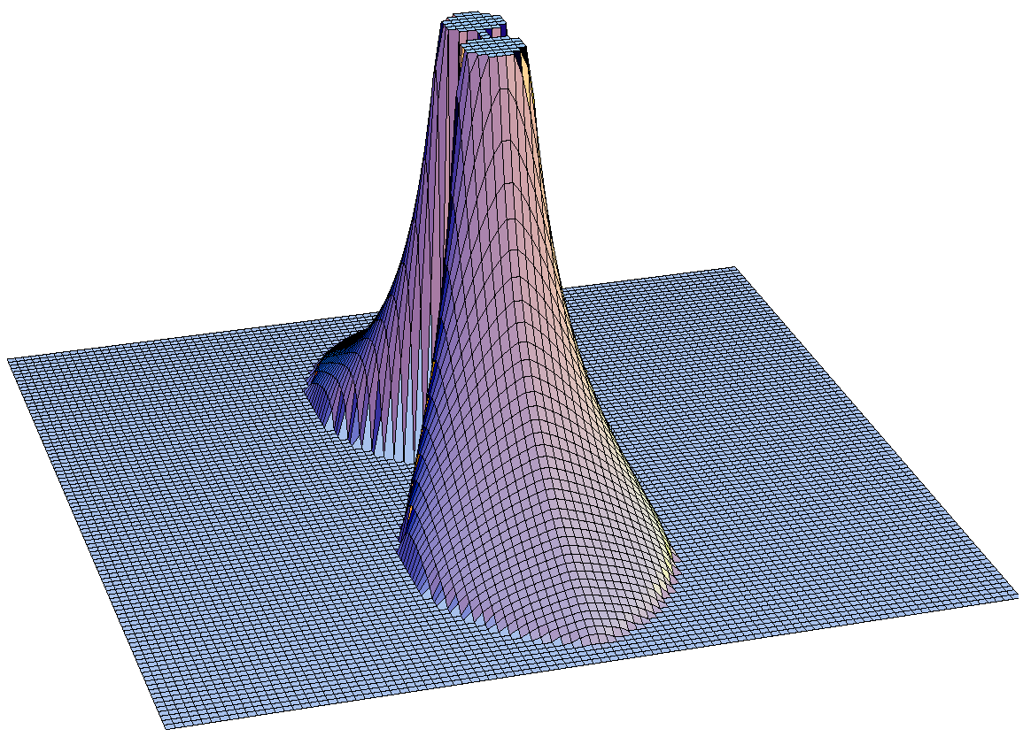
Values of the 3D OTF
k_{x}
k_{z}

Slide 47
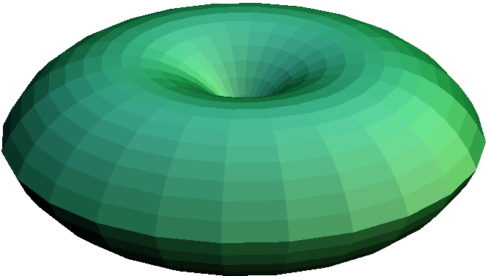
3D Observable Region
= OTF support
= Region where the OTF is non-zero
k_{y}
k_{y}
k_{z}
k_{z}

Slide 48
So what is the resolution?
k_{x}
K_{xy}max =
2 n sin(α) / λ
= 2 NA / λ
k_{z}
“Missing
Cone” of
information
K_{z}max =
n (1-cos(α)) / λ

Slide 49
So what is the resolution?
k_{x}
K_{xy}max =
2 n sin(α) / λ
= 2 NA / λ
Lowering the NA
Degrades the
axial resolution
faster than the
lateral resolution
But low axial resolution
= long depth of field
This is good,
if 2D is enough
k_{z}
“Missing
Cone” of
information
K_{z}max =
n (1-cos(α)) / λ

Slide 50
So what is the resolution?
k_{x}
Example:
a high-end objective
K_{xy}max =
2 n sin(α) / λ
= 2 NA / λ
NA = 1.4
n=1.515
α = 67.5°
λ = 600 nm
Lateral (XY) resolution:
1/ K_{xy}max = 0.21 µm
Axial (Z) resolution:
1/ K_{z}max = 0.64 µm
k_{z}
“Missing
Cone” of
information
K_{z}max =
n (1-cos(α)) / λ

Slide 51
Nomenclature
Optical Transfer Function, OTF
  Complex value with amplitude and phase
Contrast Transfer Function, CTF
Modulation Transfer Function, MTF
  Same thing without the phase information

Slide 52
Resources
Slides available at: http://nic.ucsf.edu/edu.html
http://www.microscopyu.com
http://micro.magnet.fsu.edu
Douglas B. Murphy “Fundamentals of Light Microscopy and Electronic Imaging”
James Pawley, Ed. “Handbook of Biological Confocal Microscopy, 3rd ed.”
Acknowledgements
Steve Ross, Mats Gustafsson

