Slide 1
Navigating Online Data Science Resources

Slide 2
What happens when you “Just Google it…” 🤔

Slide 3









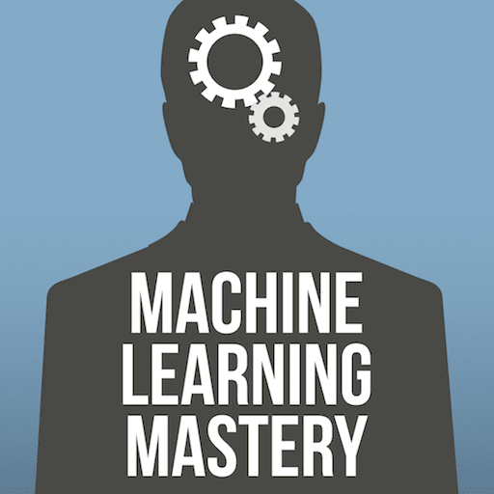


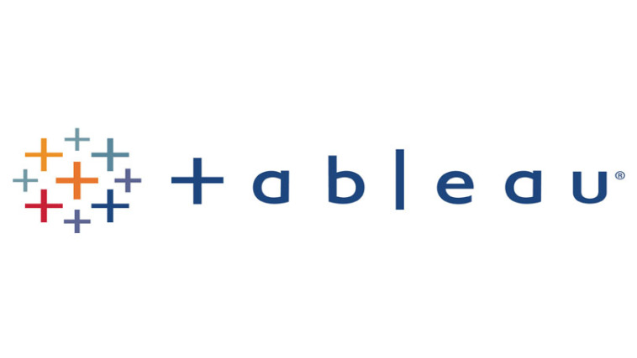



There are a lot of data science resources available online!

Slide 4
Today we will discuss:
Courses
Technical Documentation
Forums
Notes:
We will emphasize forums a little more because they’re underused

Slide 5

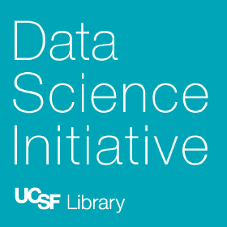
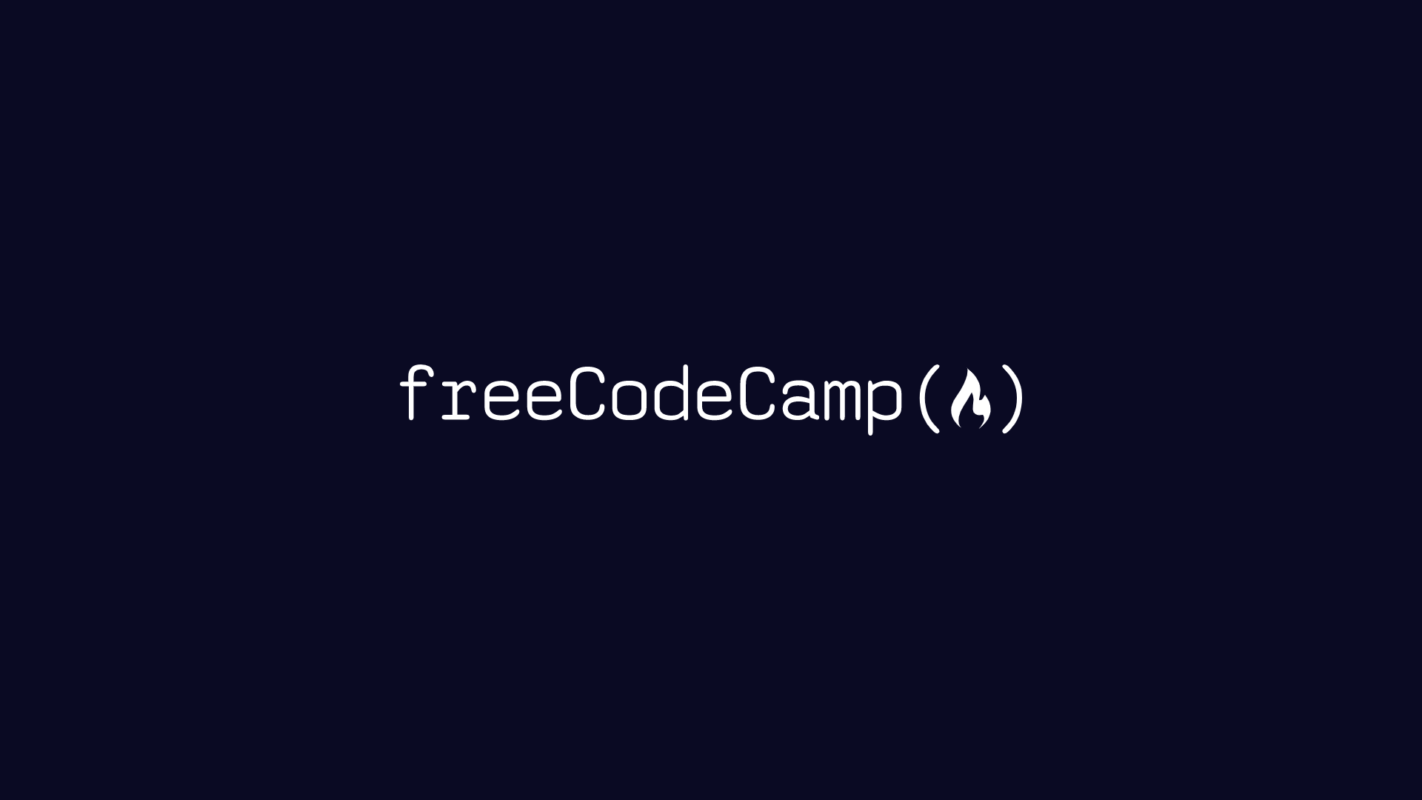
Courses
Online courses can help you get oriented around a new topic area.
Asynchronous
(self-paced)
Synchronous
(live instruction)
Notes:
If you don’t even know the right questions to ask, online courses could help get you oriented.
Asynchronous courses are self-paced, and they’re nice if you need flexibility.
Synchronous courses are live, and they’ve nice if you want a community.

Slide 6
Technical Documentation
Find information about a specific tool or skill.
“Learn to drive before learning how the engine works!”
What does it do?
How do you use it?
How does it work?
Notes:
Technical documentation is good if you have questions about a specific tool or skill.
To navigate the information within technical documentation, try to figure out what a tool does -> how do you use it -> how does it work

Slide 7
Online Forums
Use forums to view discussions and post specific questions.
Notes:
If technical documentation doesn’t make sense or your question isn’t covered, take a look at forums.

Slide 8
Howard is a recent graduate, and he is interested in learning more about “business intelligence.” He’s not sure what exactly it is, but he’s curious.
Exercise
What type of resource should Howard look for?
Navigating Online Data Science Resources
Courses
Technical Documentation
Online Forums

Slide 9
Howard is a recent graduate, and he is interested in learning more about “business intelligence.” He’s not sure what exactly it is, but he’s curious.
Exercise
What type of resource should Howard look for?
Navigating Online Data Science Resources
Courses
Technical Documentation
Online Forums

Slide 10
Marissa regularly uses the Scikit-learn Python package for machine learning. One day, as she is building a machine learning pipeline, she forgot the syntax for sklearn pipelines.
Exercise
What type of resource should Marissa look for?
Navigating Online Data Science Resources
Courses
Technical Documentation
Online Forums

Slide 11
Marissa regularly uses the Scikit-learn Python package for machine learning. One day, as she is building a machine learning pipeline, she forgot the syntax for sklearn pipelines.
Exercise
What type of resource should Marissa look for?
Navigating Online Data Science Resources
Courses
Technical Documentation
Online Forums

Slide 12
Luis is trying to upload some data to an S3 space onto JupyterHub hosted on an AWS Spark Cluster, but the files he uploads keeps getting truncated. He reviewed documentation, but he couldn’t find any solutions.
Exercise
What type of resource should Luis look for?
Navigating Online Data Science Resources
Courses
Technical Documentation
Online Forums

Slide 13
Luis is trying to upload some data to an S3 space onto JupyterHub hosted on an AWS Spark Cluster, but the files he uploads keeps getting truncated. He reviewed documentation, but he couldn’t find any solutions.
Exercise
What type of resource should Luis look for?
Navigating Online Data Science Resources
Courses
Technical Documentation
Online Forums

