Slide 1
Posting Questions in Online Forums

Slide 2

How many of you have used Stack Overflow before?

Slide 3
How many of you have posted a question on Stack Overflow before?

Slide 4
What’s preventing us from posting more Stack Overflow questions?
🤔

Slide 5
Online Forums can be scary! Here’s how you can approach them:
Be specific about what you’re asking.
Search for existing posts/discussions.
Create a reproducible example.
Ignore the bullies (and don’t be one)!
Notes:
We will emphasize forums a little more because they’re underused

Slide 6
Be specific about what you’re asking.
People can’t help you if they don’t know what you’re asking.
Notes:
If you don’t even know the right questions to ask, online courses could help get you oriented.
Asynchronous courses are self-paced, and they’re nice if you need flexibility.
Synchronous courses are live, and they’ve nice if you want a community.

Slide 7
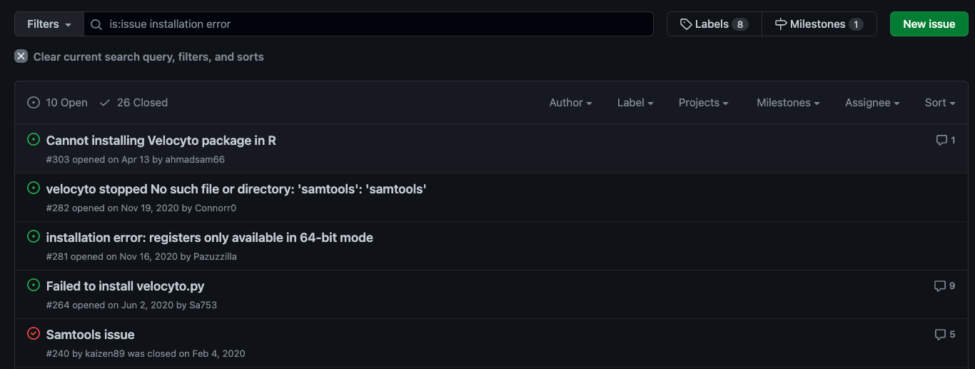
Search for existing posts/discussions.
Most likely, there are other people on the internet with the same question.
https://github.com/velocyto-team/velocyto.py/issues?q=is%3Aissue+installation+error
Notes:
If you don’t even know the right questions to ask, online courses could help get you oriented.
Asynchronous courses are self-paced, and they’re nice if you need flexibility.
Synchronous courses are live, and they’ve nice if you want a community.

Slide 8

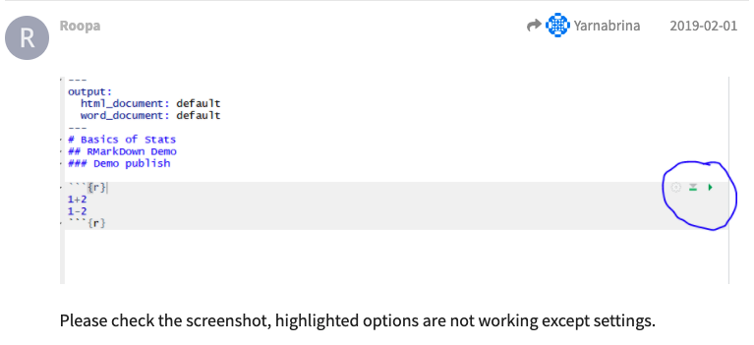
Create a reproducible example.
Reproducible examples enable others to troubleshoot.
Pro Tip: Screenshots
Mac:
command + shift + 5
Windows:
window + shift + s
https://community.rstudio.com/t/unable-to-run-current-chunk-of-code-rstudio/22857
Notes:
If you don’t even know the right questions to ask, online courses could help get you oriented.
Asynchronous courses are self-paced, and they’re nice if you need flexibility.
Synchronous courses are live, and they’ve nice if you want a community.

Slide 9
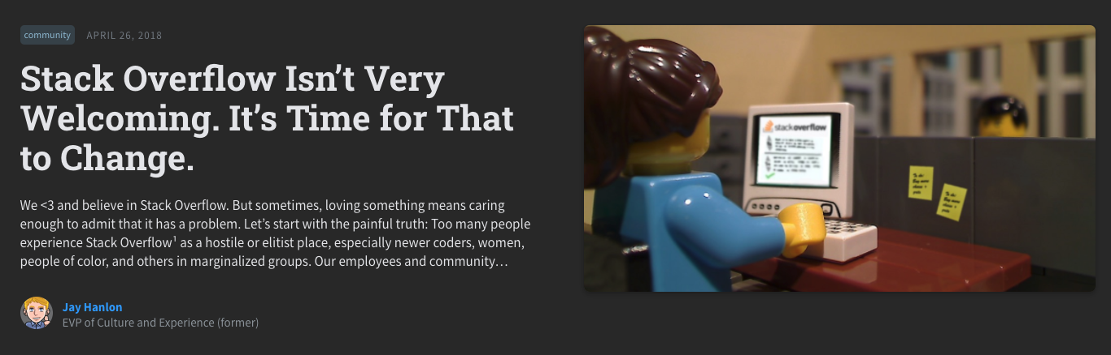
Ignore the bullies (and don’t be one)!
Most people in online forums are welcoming and happy to help.
https://stackoverflow.blog/2018/04/26/stack-overflow-isnt-very-welcoming-its-time-for-that-to-change/
Notes:
If you don’t even know the right questions to ask, online courses could help get you oriented.
Asynchronous courses are self-paced, and they’re nice if you need flexibility.
Synchronous courses are live, and they’ve nice if you want a community.

