Slide 1

Welcome to
Hacky Hour!
Getting Started with Gather.Town!

Slide 2
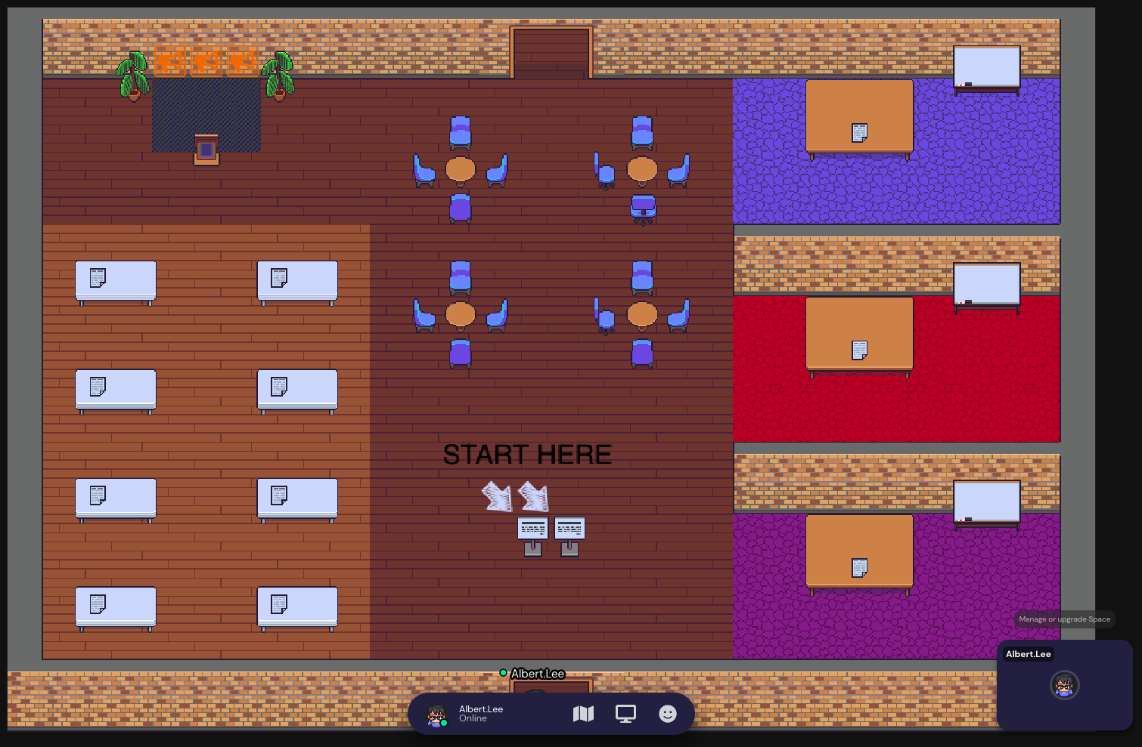
Today, we are using Gather.Town!

Slide 3
If it’s your first time, you might’ve already completed the tutorial.
Otherwise, you can review it here.

Slide 4
You may have to enable screenshare and other permissions if it’s your first time.
See the instructions here.

Slide 5
We will begin in the presentation space on the left side of the room.
Presentation
Space

Slide 6
Later for the group activities, you will go to the breakout rooms on the right.
The discussions in each breakout room is isolated.
Feel free to utilize the whiteboards in your group work.
Breakout Rooms

Slide 7
At the end of the session, there will be time for casual discussions and networking.
You can use the coffee tables in the networking area to hold isolated conversations.
Networking Area

Slide 8
Now you are ready for our Hacky Hour!
Head over to the presentation space!
Fun Tip: Hold z and see what happens 😉

Slide 9
Notes:
Now that you know a little more about the types of online resources you may encounter when you just google it, you should be able to select the resources that fit your needs when you see the google results! Thank you.

