Slide 1

Finding Data Science Help Online
Posting Questions in Online Forums
Notes:
Welcome to Finding Data Science Help Online. In this video, we will discuss Posting Questions in Online Forums.

Slide 2

How many of you have used Stack Overflow before?
Notes:
Have you ever used Stack Overflow?

Slide 3
How many of you have posted a question on Stack Overflow before?
Notes:
Now for those of you who claimed to have used StackOverflow, how many of you have actually posted a question there before? My guess is a lot fewer.

Slide 4
What’s preventing us from posting more Stack Overflow questions?
🤔
Notes:
So this brings up the question, what’s preventing us from posting more on Stack Overflow and other online forums?

Slide 5
Online Forums can be scary!
Here’s how you can approach them:
Search for existing posts/discussions.
Be specific about what you’re asking.
Create a reproducible example.
Ignore the bullies (and don’t be one)!
Notes:
One explanation is the online forums are scary! You’re interacting with many strangers, and you may have doubts about whether you’re posting correctly on the forums.
We have some recommendations that will hopefully encourage more of you to participate in forums. They are:
Be specific about what you’re asking
Search for existing posts and discussions.
Create a reproducible example
and ignore the bullies (and don’t be one)!

Slide 6
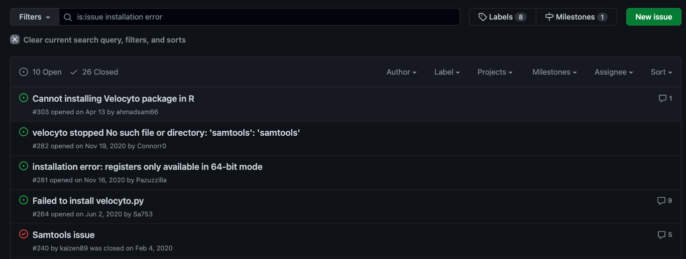
Search for existing posts/discussions.
Most likely, there are other people on the internet with the same question.
https://github.com/velocyto-team/velocyto.py/issues?q=is%3Aissue+installation+error
Notes:
First, make sure you search existing posts and discussion before posting because there are likely to be other people who have the same question. For example, let’s say I ran into problems trying to install a tool called velocyto. As you can see in the GitHub Issues discussions, many other users have run into installation issues when using velocyto. By checking existing posts and discussion first, I may be able to find existing solutions.

Slide 7
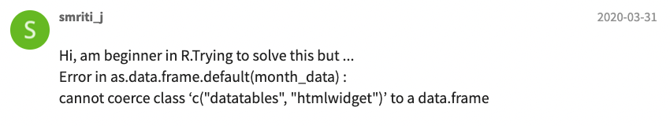
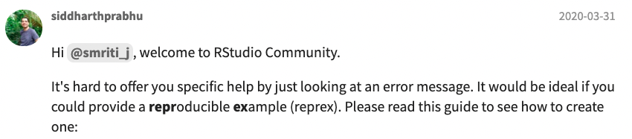
Be specific about what you’re asking.
People can’t help you if they don’t know what you’re asking.
https://community.rstudio.com/t/how-to-convert-datatable-into-data-frame-for-plot-in-ggplot2/59165
Notes:
Assuming you didn’t find the answer you were looking for in existing posts, now it’s time to create a new forum discussion. Make sure you are specific about your question because people can’t help you if they don’t know what you’re asking. Here is an example from the RStudio Community forum, and you see that this beginner user didn’t provide much details beyond just stating that there is an error. As a result, another forum particpant asked for more specifics, but at other times, forum participants may choose not to respond at all. So make sure to be provide enough details to help others understand the challenge you’re trying to address.

Slide 8

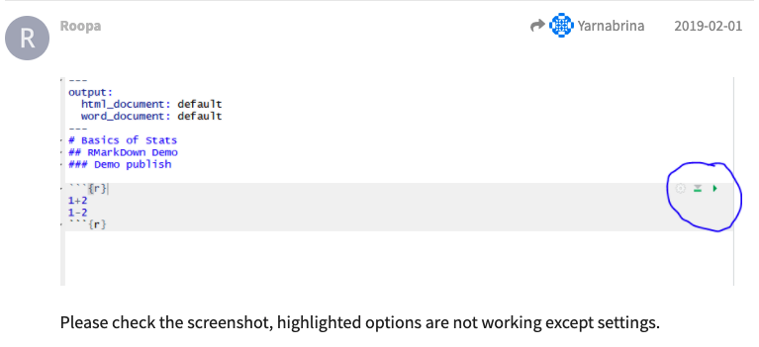
Create a reproducible example.
Reproducible examples enable others to troubleshoot.
Pro Tip: Screenshots
Mac:
command + shift + 5
Windows:
window + shift + s
https://community.rstudio.com/t/unable-to-run-current-chunk-of-code-rstudio/22857
Notes:
One way to help make your forums posts more specific is to create a reproducible example. In other words, provide all the information necessary for others to reproduce what you are seeing, and this may include code samples and data files.
In this example, the initial question isn’t very specific. However, things become much more clear after we take a look at the provided code sample. Can anyone spot the issue here?
One pro tip is to use screenshots. On Macs, you can do command shift 5 to take a screenshot, while on windows, you would do windows shift s.

Slide 9
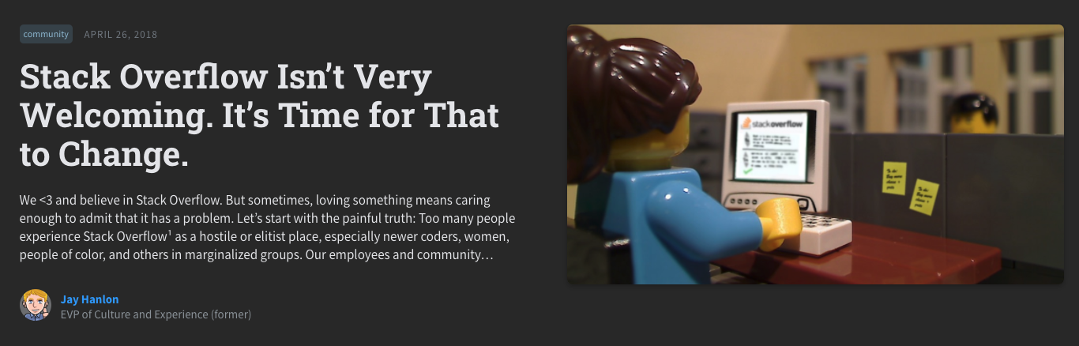
Ignore the bullies (and don’t be one)!
Most people in online forums are welcoming and happy to help.
https://stackoverflow.blog/2018/04/26/stack-overflow-isnt-very-welcoming-its-time-for-that-to-change/
Notes:
Last but not least. Ignore the forum bullies and don’t be one!
Unfortunately, there are many unpleasant forum participants who can be rude, and forum providers, such as StackOverflow, have acknowledged the issue. However, most folks who participate in forums are trying their best to create a welcoming and valuable community resource, and we hope that you all become supportive forum participants as well.

Slide 10
Notes:
Next time you run into a data science challenge, and you can’t find an existing solution online, follow the guidelines we provided to post a forum question. Hopefully someday, you may also find yourself answering questions from others as valuable contributors to the data science community. Thank you.

