Slide 1

Finding Data Science Help Online
Navigating Online Data Science Resources
Notes:
Welcome to Finding Data Science Help Online. In this video, we will discuss Navigating Online Data Science Resources.

Slide 2
What happens when you “Just Google it…” 🤔
Notes:
Once common “recommendation” you may receive as you are seeking answers to data science questions is “Just Google it”
What happens when you ”Just google it”
Well…

Slide 3









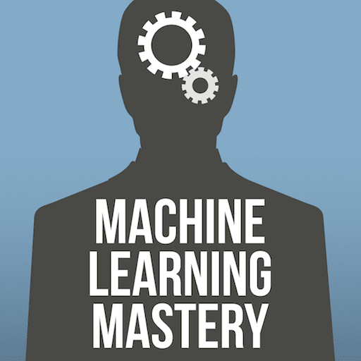


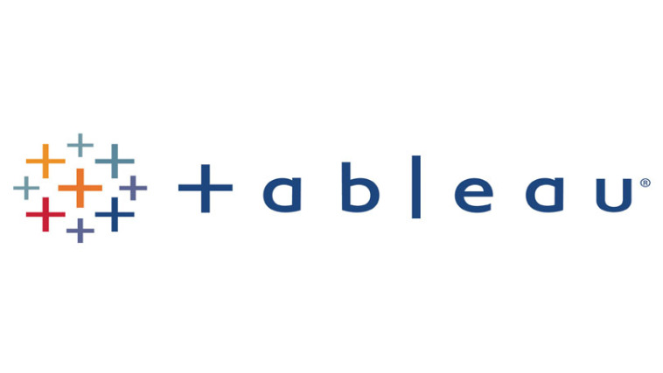



There are a lot of data science resources available online!
Notes:
You get a ton of google results. After all, there are a lot of data science resources available online. However, this is definitely overwhelming, and you need a way to select the resource that best fits your specific learning needs.

Slide 4
Today we will discuss:
Courses
Technical Documentation
Forums
Notes:
Today we will discuss three types of resources you should be aware of: Courses, Technical Documentation, and Forums. There are other types of online data science resources out there, but these three types should cover most of your needs.

Slide 5

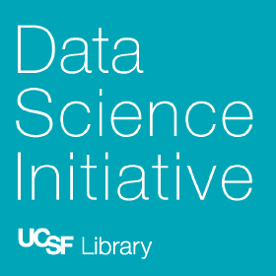
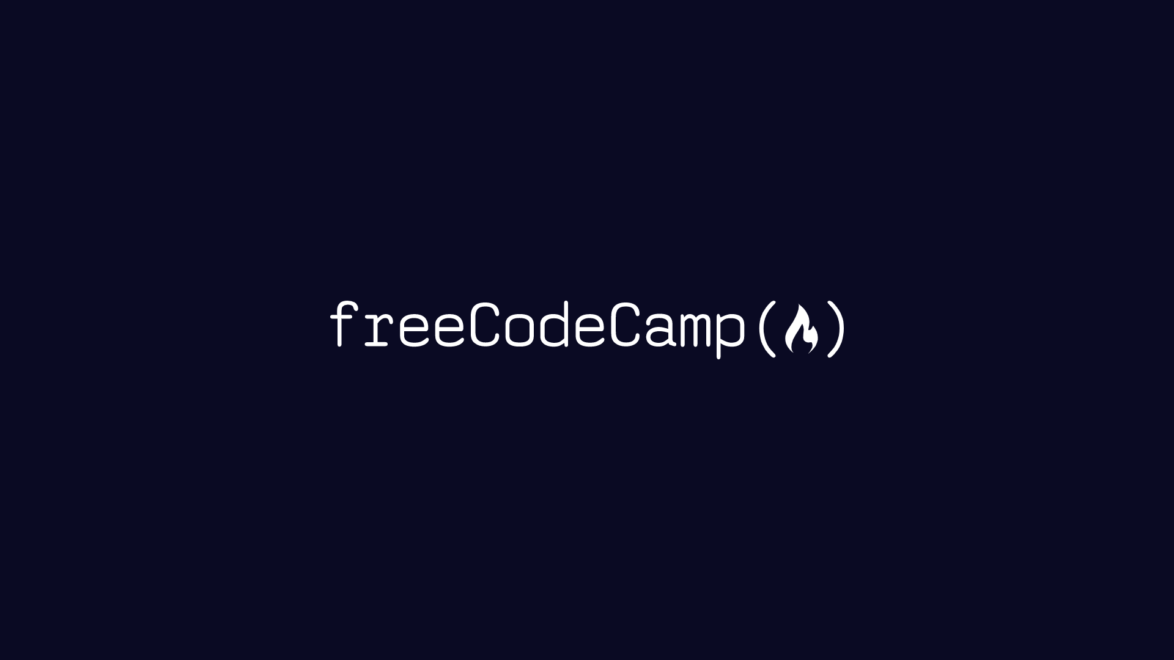
Courses
Online courses can help you get oriented around a new topic area.
Asynchronous
(self-paced)
Synchronous
(live instruction)
Notes:
First, let’s talk about courses. Online courses are super useful when you need to get oriented around a new topic area. If you aren’t sure what are the right questions to ask, online courses are a great starting point. The two main types of online courses are Asynchronous and Synchronous.
Asynchronous courses are self-paced, and you can fit them to your schedule. If you need flexibility, asynchronous courses could be a good fit for you. A few examples of asynchronous course providers are Coursera, LinkedIn Learning, FreeCodeCamp, and EdX.
Synchronous courses are taught in real time, and while they aren’t as flexible as asynchronous courses, they provide more opportunities for you to meet other learners who are learning at the same pace as you. For those of you who need a sense of community in your learning experience, synchronous courses are the way to go. The Data Science Initiative at UCSF Library provides synchronous workshops regularly, so be sure to check out the scheduled workshops.
If you don’t even know the right questions to ask, online courses could help get you oriented.
Asynchronous courses are self-paced, and they’re nice if you need flexibility.
Synchronous courses are live, and they’ve nice if you want a community.

Slide 6
Technical Documentation
Find information about a specific tool or skill.
“Learn to drive before learning how the engine works!”
What does it do?
How do you use it?
How does it work?
Notes:
The next type of resource we’ll discuss is technical documentation. Technical documentation is useful when you need information about a specific tool or skill such as pandas, scikit learn, or GitHub. Almost all data science tools you use will have some form of technical documentation. The key to using technical documentation effectively is learning to drive before learning how the engine works. What this means is you should first figure out what a tool does and how you use it before investigating the internal workings of the tool. For example, let’s say I was curious about using the OLS function from the Python Statsmodels library.

Slide 7
Online Forums
Use forums to view discussions and post specific questions.
Notes:
Last but not least, let’s discuss online forums. Forums are useful for viewing discussion and posting specific questions. If you did not find what you were looking for in technical documentation, forums may be the way to go. Some examples of online forums are Kaggle, stackoverflow, and Rstudio community, we will discuss forums in more depth later since they are often underutilized.

Slide 8
Howard is a recent graduate, and he is interested in learning more about “business intelligence.” He’s not sure what exactly it is, but he’s curious.
Exercise
What type of resource should Howard look for?
Navigating Online Data Science Resources
Courses
Technical Documentation
Online Forums
Notes:
Let’s answer a few questions to check our understanding. First …

Slide 9
Howard is a recent graduate, and he is interested in learning more about “business intelligence.” He’s not sure what exactly it is, but he’s curious.
Exercise
What type of resource should Howard look for?
Navigating Online Data Science Resources
Courses
Technical Documentation
Online Forums
Notes:
The correct answer is A because Howard doesn’t have a fully formed question, and he just needs to be oriented around a new topic.

Slide 10
Marissa regularly uses the Scikit-learn Python package for machine learning. One day, as she is building a machine learning pipeline, she forgot the syntax for sklearn pipelines.
Exercise
What type of resource should Marissa look for?
Navigating Online Data Science Resources
Courses
Technical Documentation
Online Forums
Notes:
Let’s try another one …

Slide 11
Marissa regularly uses the Scikit-learn Python package for machine learning. One day, as she is building a machine learning pipeline, she forgot the syntax for sklearn pipelines.
Exercise
What type of resource should Marissa look for?
Navigating Online Data Science Resources
Courses
Technical Documentation
Online Forums
Notes:
The answer here is Technical Documentation. Even for tools you use regularly, you will forget the specifics at times, and looking up technical documentation is a normal part of doing data science.

Slide 12
Luis is trying to upload some data to an S3 space onto JupyterHub hosted on an AWS Spark Cluster, but the files he uploads keeps getting truncated. He reviewed documentation, but he couldn’t find any solutions.
Exercise
What type of resource should Luis look for?
Navigating Online Data Science Resources
Courses
Technical Documentation
Online Forums
Notes:
Last question…

Slide 13
Luis is trying to upload some data to an S3 space onto JupyterHub hosted on an AWS Spark Cluster, but the files he uploads keeps getting truncated. He reviewed documentation, but he couldn’t find any solutions.
Exercise
What type of resource should Luis look for?
Navigating Online Data Science Resources
Courses
Technical Documentation
Online Forums
Notes:
The answer here is Online Forums. Since Luis already checked technical documentation and couldn’t find the answer to his question, he should use online forums to find the answer to his specific question.

Slide 14
Notes:
Now that you know a little more about the types of online resources you may encounter when you just google it, you should be able to select the resources that fit your needs when you see the google results! Thank you.

