Slide 1
Predicting Postoperative Lactate in Neonatal Cardiopulmonary Bypass Surgery for Congenital Heart Defect Repair.
(This project aims to understand what factors are key in determining lactate trajectory in the cardiac intensive care unit, while assuming linearity. We look at a subset of my Capstone cohort).
Matee Rehman MD

Slide 2
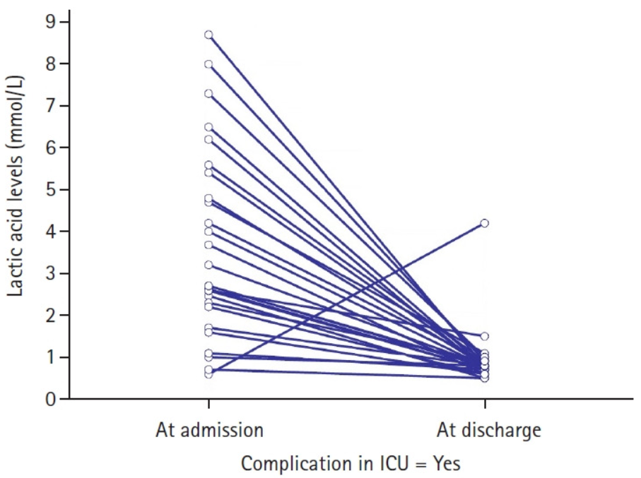
Literature
What’s the biology?
Lactate is a key marker* of adequate tissue oxygen delivery, especially in neonates¹ (≤28 days old) following CPB surgeries for CHD.
The higher the lactate, less the perfusion and/or oxygenation.
Essentially higher lactate levels may inform postoperative complication:
“Prolonged elevated blood lactate levels strongly correlate with poor outcomes in a variety of critically ill patients. We hypothesized that the dynamic postoperative changes in blood lactate levels during the first 24 h were significantly associated with postoperative morbidity and mortality in patients undergoing elective major abdominal surgery.” Li et al.
Persistent or rising postoperative lactate levels are associated with increased risk of postoperative complications across several surgical populations.
Serum lactate level is a risk factor for postoperative complications in patients undergoing cytoreductive surgery for peritoneal carcinomatosis. This study suggests that the risk of developing severe complications

Slide 3
Study Question
How are lactate levels at the 12th postoperative timepoint in the cardiac critical care unit impacted by other predictors in neonates with congenital heart disease after cardiopulmonary bypass surgery?
Predict: lactate at 12th postop hour
Predictors/Features: Early admission variables (labs, hemodynamics, surgical complexity and stress).
Comparison between Linear regression and Random Forrest regressor
Notes:
We test both predictive performance and whether complex ML adds value.

Slide 4
Dataset
UCSF IRB-approved data derived from APeX chart notes and imported onto and manually curated and cleaned through RedCap database management tool, and deidentified (MRNs and encounterIDs removed) and cleaned using R.
Population: Neonates from UCSF Mission Bay Children's Hospital who had CPB surgery for congenital heart defects.
N = 201
Outcome: Lactate at 12th Postop hr
14 features:
Lactate at 1st hr, lactate at 6th hr
MAP, HCT
CPB time, cross-clamp
vasoactive support

Slide 5
Preprocessing
0 → NA (physiologic variables)*
Median imputation
Categorical encoding (prematurity)
Dropped fully missing variables
*During data collection, some rows had "0's" placed for "NA's" - missing values, instead of being left blank (a convention standardized for subsequent rows). Since these were physiological variables where 0 is biologically implausible as a value, the 0s for those columns were replaced with NAs. (domain-informed decision)

Slide 6
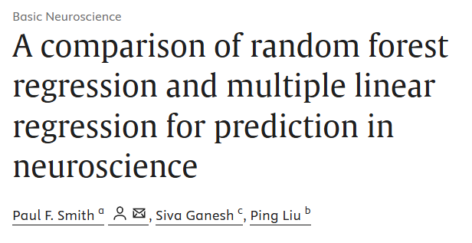
Modeling Approach
Linear Regression (baseline)
Random Forest Regressor
Metrics used:
RMSE
R²
Paul F. Smith, Siva Ganesh, Ping Liu,
A comparison of random forest regression and multiple linear regression for prediction in neuroscience,
Journal of Neuroscience Methods,
Volume 220, Issue 1,
2013, Pages 85-91, ISSN 0165-0270, https://doi.org/10.1016/j.jneumeth.2013.08.024.

Slide 7
Results
Primary Model
Assumption: Relationship is linear
Primary result: Linear regression outperformed Random Forest, suggesting the relationship is largely linear.
Model | RMSE | R²
Linear | 0.91 | 0.63
RF | 0.98 | 0.57

Slide 8
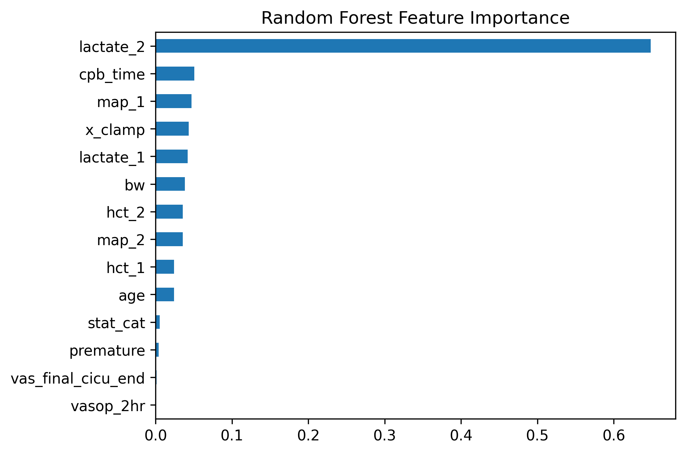
Key Predictors
Lactate at 6th postoperative hr (overwhelmingly dominant)
Mean Arterial Pressure (Makes clinical sense)
CPB time in mins (provides an estimate of surgical stress)
Birth weight in kg, Early Hematocrit % at 6th and 1st Postop hour in the CICU
Notes:
Prior lactate strongly dominates prediction, with additional contributions from hemodynamics and surgical factors

Slide 9
Results
Sensitivity Analysis
We removed lactate at the 6th postop CICU timepoint to check performance metrics once again
Key takeaways:
Complex ML did not outperform linear models
Simplicity may be sufficient in small clinical datasets
Model | RMSE | R²
Linear | 1.13 | 0.43
RF | 1.19 | 0.37
Notes:
Note: Performance drops substantially, but meaningful signal remains—indicating independent physiologic contributions.

Slide 10
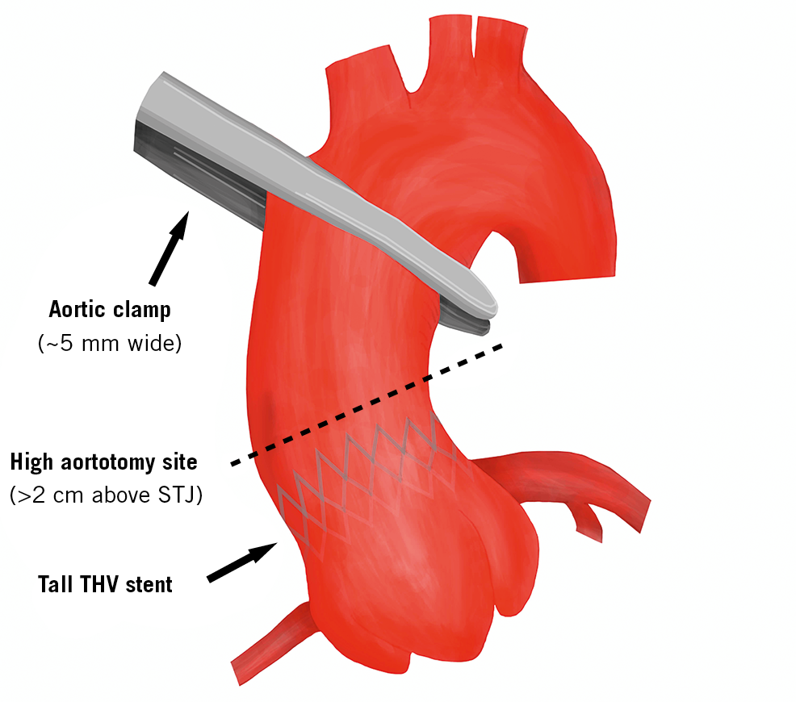
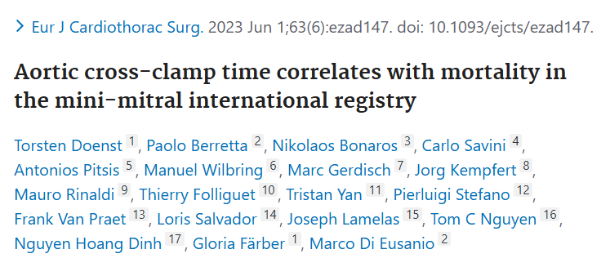
Interpretation
Strong temporal autocorrelation (early postop CICU lactate predicts late postop CICU lactate)
Independent signal from:
a) perfusion (mean arterial pressure)
b) Surgical burden (CPB time, Aortic Cross-Clamp Time*)
c) Linear model sufficient
*Aortic cross-clamp time (ACXT) is the duration the aorta is clamped during heart surgery, stopping blood flow to the heart (ischemia). Generally, a safe ACXT is under 60–90 minutes; exceeding 90–120 minutes significantly increases mortality and morbidity, particularly with factors like age, low ejection fraction, or complex repairs.

Slide 11
Limitations
Small sample size, single centered retrospective cohort with tonnes of missing values (MNAR – sicker patients = MORE LABS)
Observational data
No causal inference
Limited temporal resolution

Slide 12
Future Work (Capstone)
Time-series analysis and modeling
External validation with a bigger, multi-centered cohort
More granular physiologic data

Slide 13
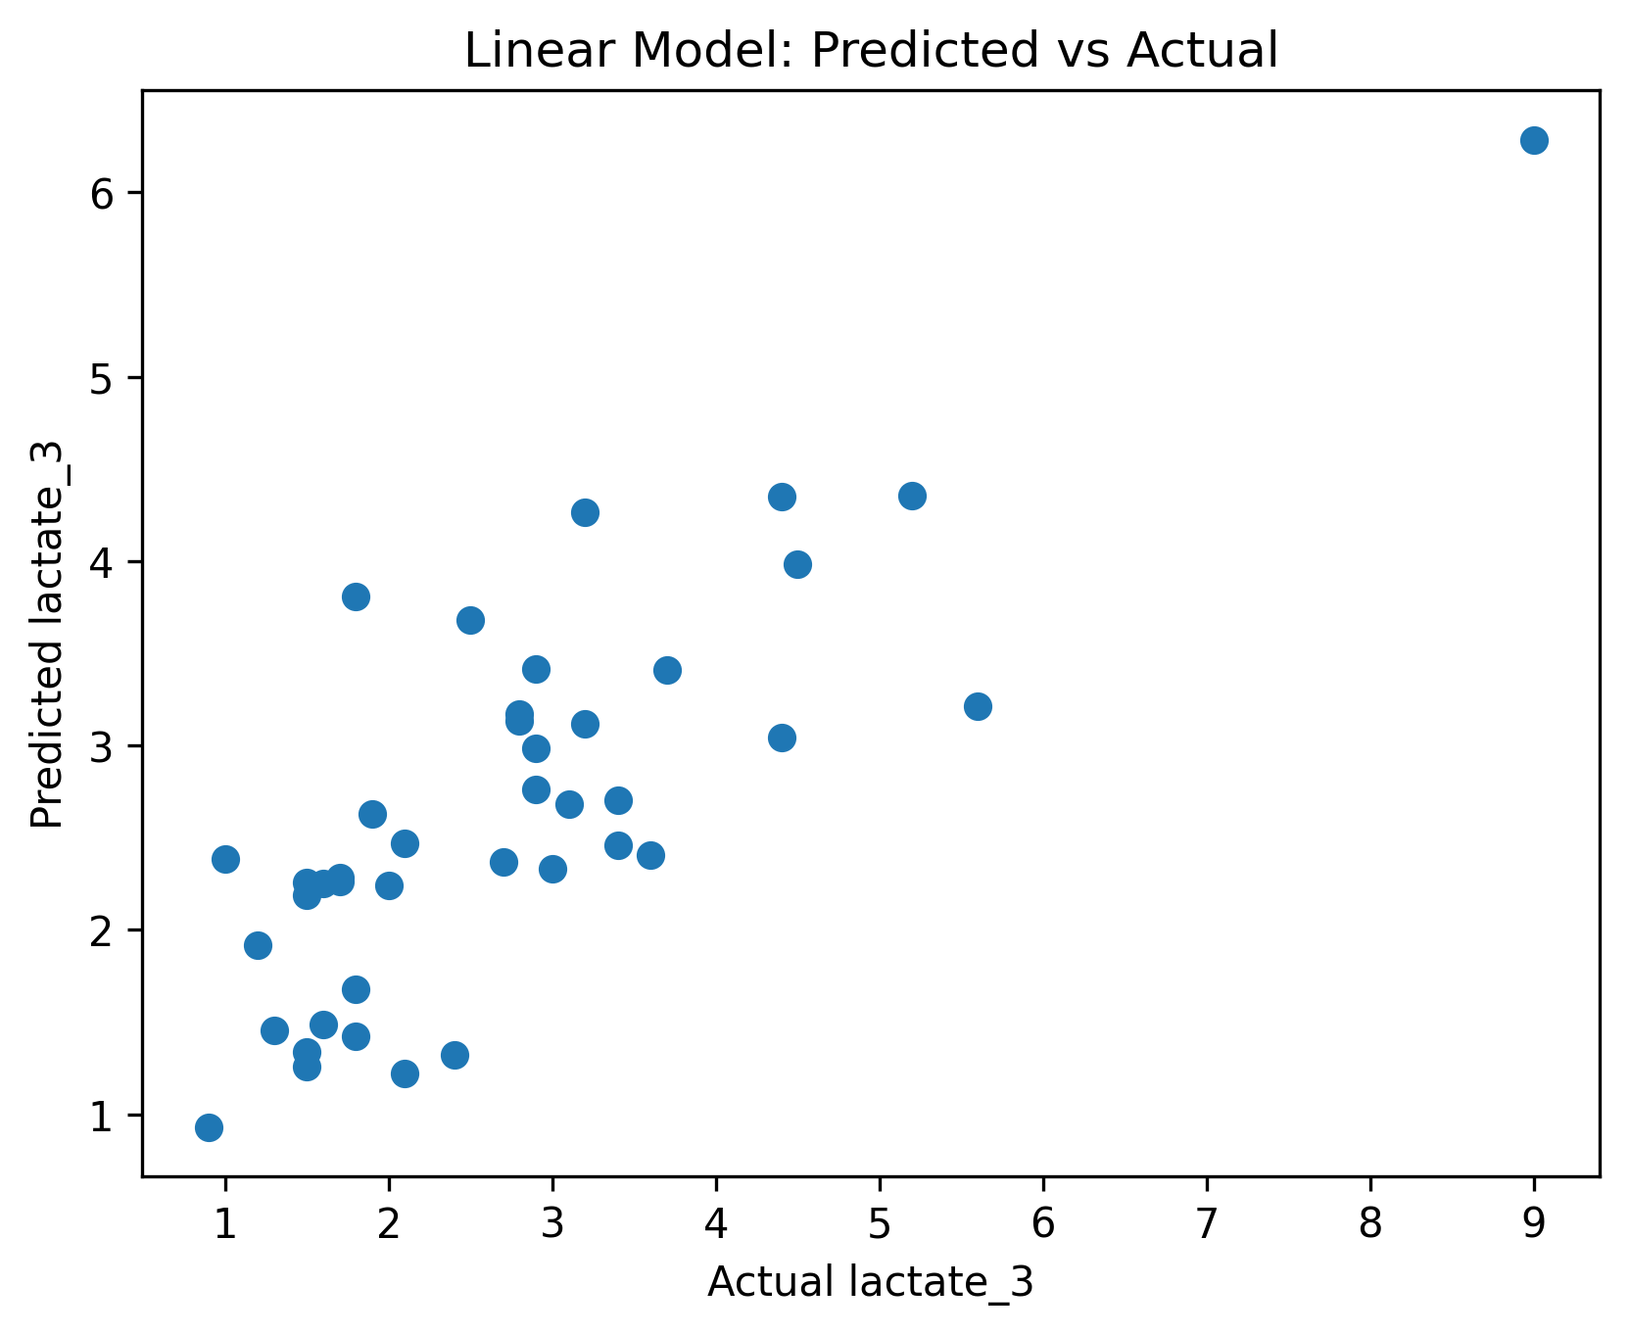
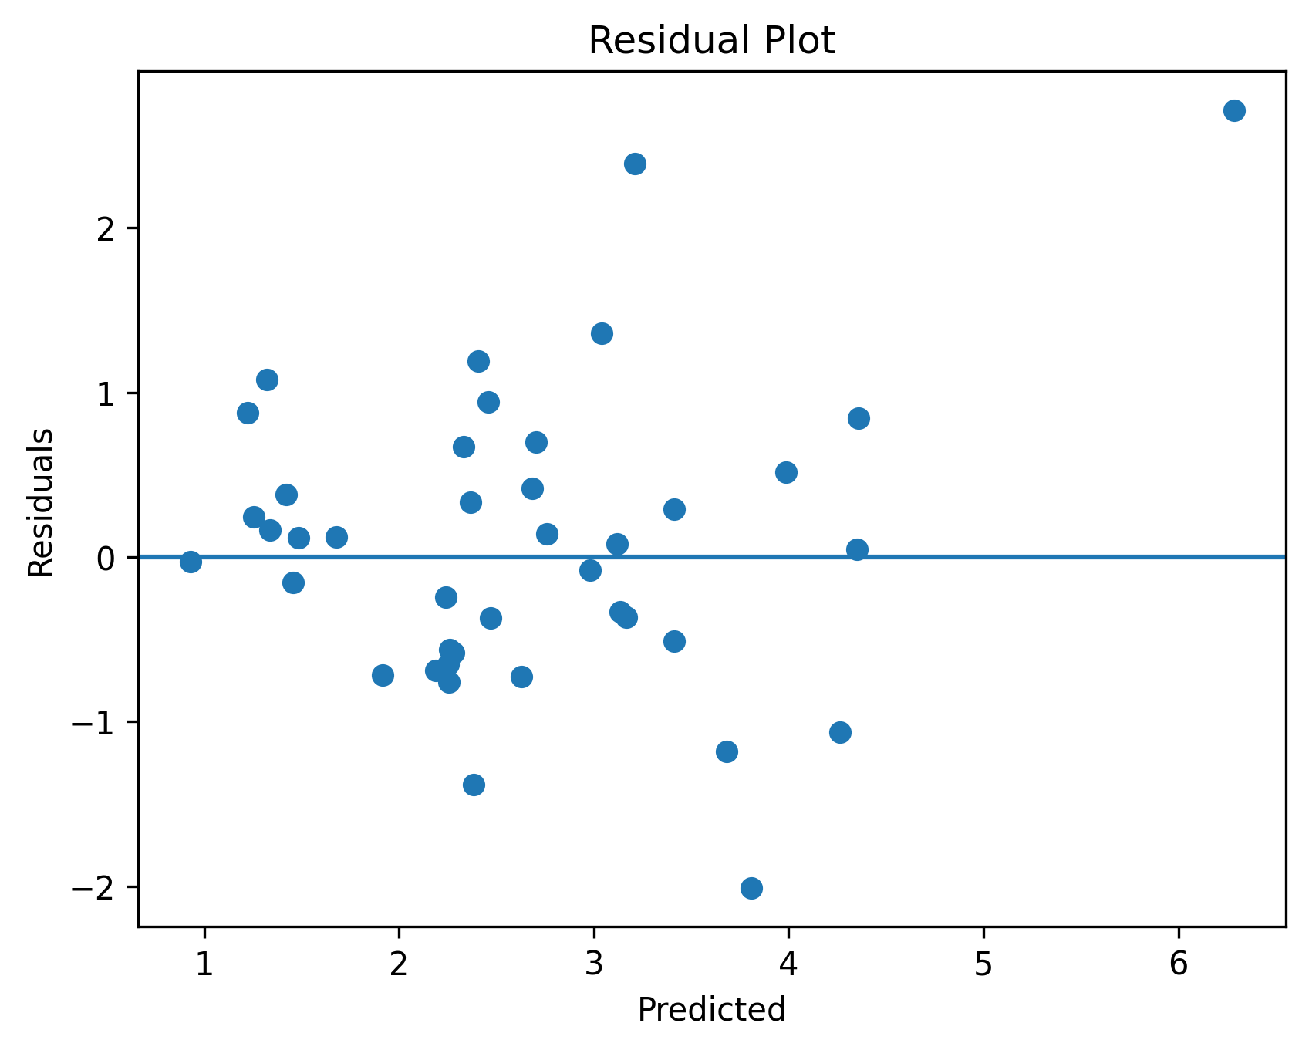
Appendix
Predicted vs Actual Plot & Residual Plot

Slide 14
Thank you

