Slide 1
UCT Engineers Without Borders iSondlo Garden Project
Electronics Team
Prototyping Phase Meeting
30 April 2023

Slide 2
Introduction
Divided into 4 phase:
I. Design and Procurement Phase
II. Prototyping Phase
III. Testing Phase
IV. Implementation Phase

Slide 3
Design and Procurement Phase
Design completed in 2021
Procurement planning completed in 2022
Finishing up procurement order for components for testing this week

Slide 4
Prototyping Phase
Components we need:
- Arduino UNO R3
- Soil Moisture sensors
- Temperature sensors
- 5V Relay Module
- Arduino power cable and wires

Slide 5
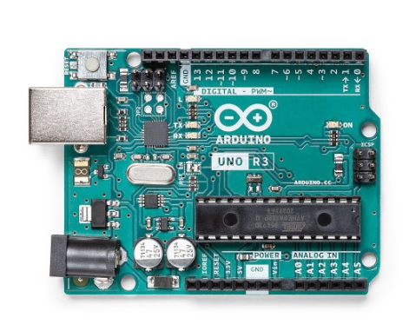
Arduino UNO R3
Arduino UNO board based on the ATmega328P
14 Digital I/O pins
6 : 14 PWM outputs
6 Analog Inputs
I2C/SPI and UART
USB-B connection
Power jack

Slide 6
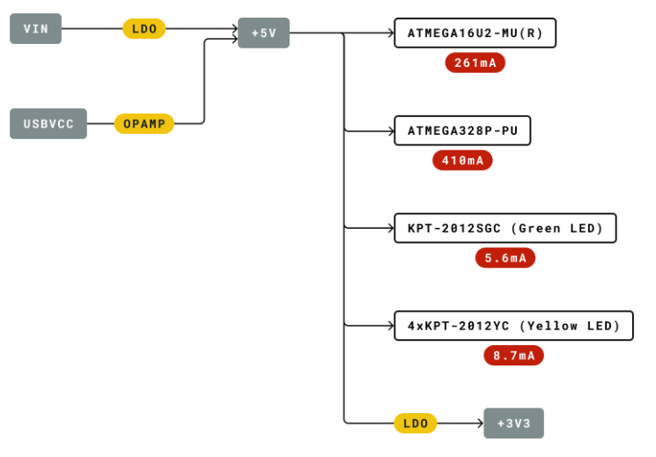
Powering the Arduino
USB Cable
V_I/0 = 3.3V
V_in = 5 V

Slide 7
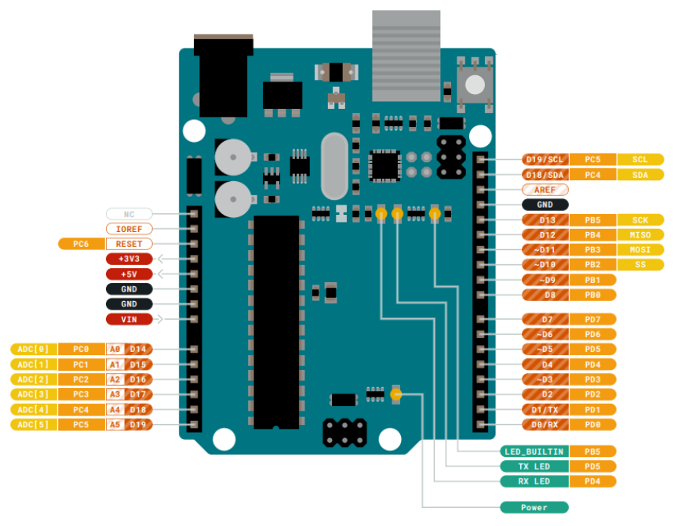
Arduino Digital And Analog Pins
14 digital I/O pins
6 analog pins
5V/3.3V Output

Slide 8
Temperature Sensor
DS1820B (3-pin)
9-12 bit resolution

