Slide 1
EWB iSondlo Project
Configuring the Arduino & Sensors
Electronics Team
20 October 2022

Slide 2
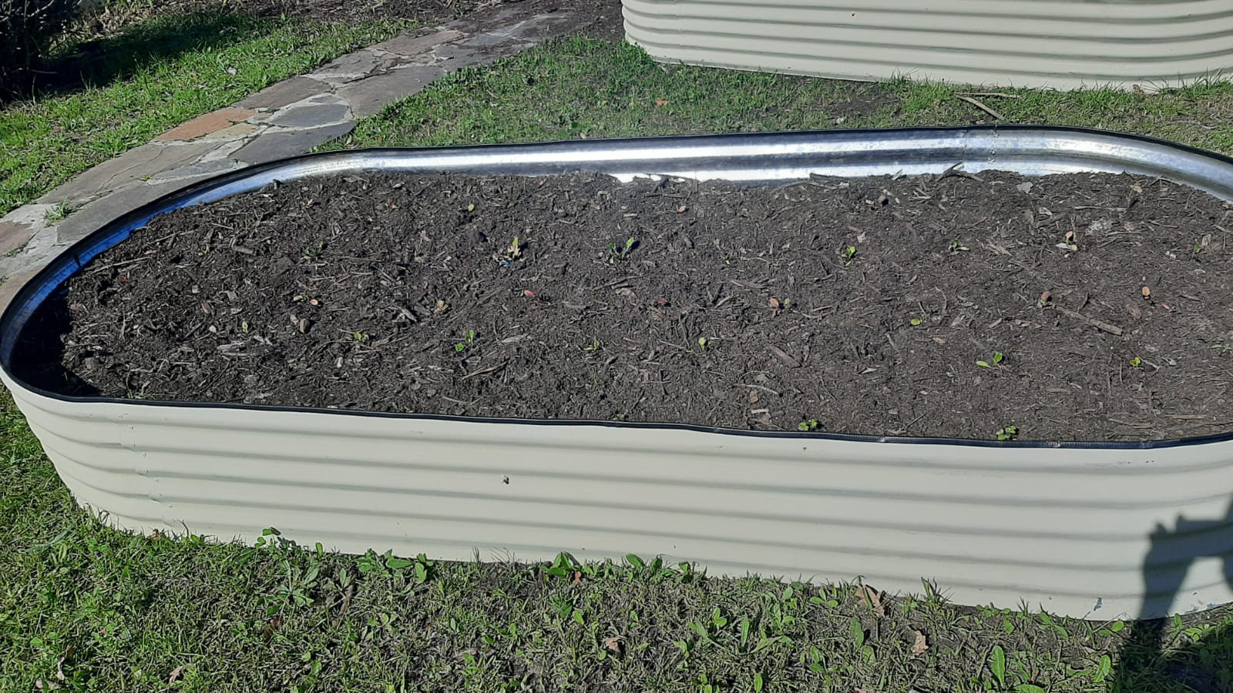
Scenario
Garden in a 132cm x 379cm corrugated iron container
Requires control and monitoring system to ensure that the environment yields high quality vegetables

Slide 3
Control and Monitoring System
Garden is monitored using 4 sensors:
      Temperature sensor:
        Maxim DS18B20 by Dallas Semiconductors
      Soil moisture sensors:
        KE2023 Keyes moisture sensor module
      Humidity sensor
        Ghitron HMZ-333A1
      Light sensor
        LDR

Slide 4
Control and Monitoring System
Controls flow of water to plants using:
      Relay switch
        KY0019 Keyestudio 5V Relay Module
      Solenoid valve

