Slide 1

Ατομική Διπλωματική Εργασία
Πανεπιστήμιο Κύπρου - Τμήμα Πληροφορικής
Φοιτητής: Γιώργος Δημοσθένους
Επιβλέπον Καθηγητής: Γεωργίου Χρύσης

Slide 2
Prediction of Virality and Popularity of YouTube Videos
~ Machine Learning Algorithms Analysis

Slide 3
Motivation

Slide 4

The exponential growth of video viewing traffic on the internet has led to the rise of the internet economy. Marketeers aiming to promote their content have turned their interest on this fairly new kind of advertisements on videos. Their main concern is that they would only like to promote their content on videos that will be viewed by as many people as possible. This need to be able to know which video is going to attract the more viewers, has made necessary the existence of a predictive mechanism that would be able to predetermine the popularity and virality of videos.

Slide 5
Goals
Objectives and achievements

Slide 6
Develop prediction models using stand-alone machine learning algorithms.
Test, evaluate and compare the stand-alone models to determine which one performs better.
Combine machine learning algorithms and methodologies to create hybrid algorithms.
Fine-tune algorithms to increase their performance.
Evaluate algorithms in detail to determine strengths, weaknesses and suitability for the problem.
Compare models and determine which produces the most desirable results.
Create powerful models that perform better under different scenarios
Create models that are able to extract the importance of each feature in the classification

Slide 7
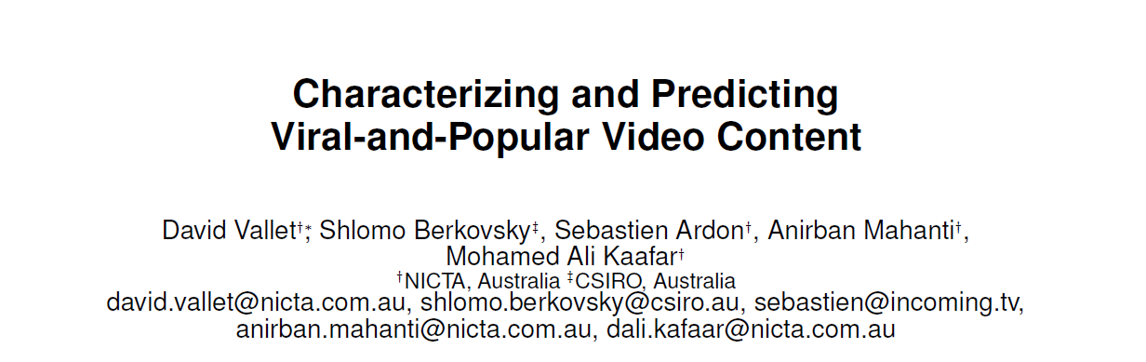
Previous Work

Slide 8
Methodology
General methodology followed

Slide 9
1. Data Collection
2. Labeling and Filtering
3. Feature Preparation
4. Development and Fine-tuning of Algorithms
5. Training and Classification
6. Evaluation of Algorithms
7. Comparison of Algorithms
8. Conclusions

Slide 10
Background Knowledge

Slide 11
Machine Learning
What is machine learning?

Slide 12
Machine learning provides computers with the ability to learn without being explicitly programmed and focuses on the development of algorithms whose outcome can change when exposed to new data.
Machine Learning
Supervised
Unsupervised
Reinforcement
Classification
Regression

Slide 13
Machine Learning Algorithms
Stand-alone algorithms

Slide 14

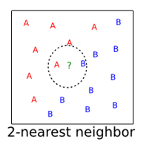
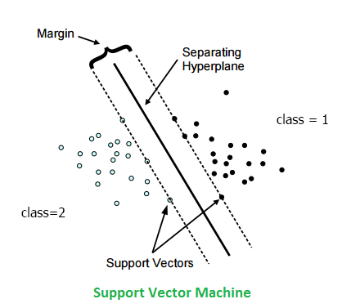
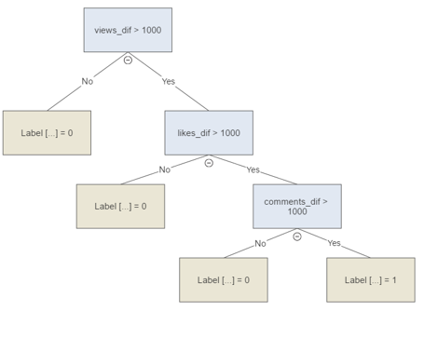
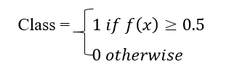
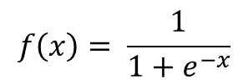
Logistic Regression
The probabilities describing the possible outcomes of a single trial are modeled using a logistic function.
K Nearest Neighbors
Nearest Neighbors algorithms are a family of machine learning algorithms that classify datasets based on a chosen distance metric.
SVM – Linear SVC
SVM algorithms aim to maximize the distance between the decision boundary, which is known as margin, and the training samples that are closest to this boundary, which are known as support vectors.
Linear SVC – Denotes use of linear kernel
Decision Tree
Decision trees function by breaking down sample training data by making decision based on asking a series of questions.
The decision algorithm starts at the root of the tree and splits the data on the feature that results in the largest information gain.
$$f\left(x\right)= \frac{1}{1+e^{−x}}$$

Slide 15
Machine Learning Algorithms
Hybrid algorithms

Slide 16
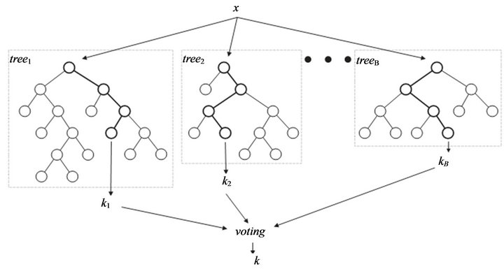
Algorithms with embedded randomness
Random Forest
Extra Trees
Bagging Decision Tree
Collection of randomized decision trees.
Random samples from dataset with replacement
Random features without replacement
Majority vote
* optimizes splits on trees (i.e. select those which give best information gain with respect to decision)
Collection of randomized decision trees.
Random samples from dataset with replacement
Random features without replacement
Majority vote
* Splits are made at random
Collection of randomized decision trees
Random samples from dataset with replacement
All training features used
Majority vote

Slide 17
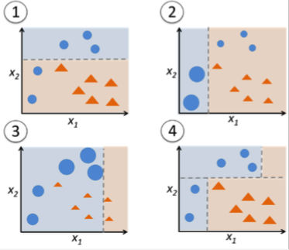
Boosting Algorithms
Ada Boosting Decision Tree
Gradient Boosting Decision Tree
Apply uniform weights to all the data and train the classifier
Increase the weights of the data that were classified incorrectly
Train another classifier on the new data
Repeat Steps 1-3 for a defined number of iterations
Combine results from all decision trees to come up with the final classification
Use loss function
Train weak learner ( Decision Tree)
Minimize loss function using gradient decent when adding a new decision tree to the ensemble
Repeat steps 1-3 for a defined number of iterations
Combine results from all decision trees to come up with the final classification

Slide 18
Other Hybrid Algorithms
Voting is a methodology that takes multiple estimator’s classifications as input and performs a majority voting procedure to decide the final classification of the training data.
Voting – (ABDT, GBDT): Ada Boosting and Gradient Boosting both improve the performance of a decision tree algorithm and Voting serves as a final improvement step for ABDT and GBDT classifications, deciding the final labeling that takes place.
Voting – (ABDT, GBDT, LR): Ada boosting Decision Tree, Gradient Boosting Decision Tree and Logistic Regression where used in an attempt to test the boundaries of the Voting methodology.
Bagging GBDT: Despite its’ high accuracy, GBDT has some flaws which could be reduced under the Bagging model.

Slide 19
Features
Training of the classifiers

Slide 20


Feature Kinds
Types of features:
Static
Differences
Accelerations
Daily Stats
Ratios
Age Ratios
YouTube – 31 Different Features
Twitter – 43 Different Features

Slide 21
Feature Importance
During classification the training features are assigned multiple weights according to their importance in labeling the videos. Different features are more important in different scenarios. For this reason, the importance of each feature is exported after each classification in the form of a percentage, to examine how much it has contributed in the final labeling of the video.
Feature Importance | Features | Importance
1 | views_acc | 12%
2 | views_1 | 11%
3 | ageRatioViews_1 | 9%
4 | video_duration | 9%
5 | comments_1 | 5%
6 | channel_uploads | 5%
7 | ageRatioLikes_1 | 4%
8 | comments_acc | 4%
… | … | …

Slide 22
Model Evaluation Metrics
Metrics used to evaluate the performance of the algorithms

Slide 23
Confusion Matrix
Confusion Matrix: Is a square matrix that represents the performance of a machine learning algorithm. It consists of true positive, true negative, false positive and false negative predictions of a classifier.
Confusion Matrix |  | Predicted Class
 |  | 0 | 1
True Class | 0 | TN | FP
 | 1 | FN | TP

Slide 24
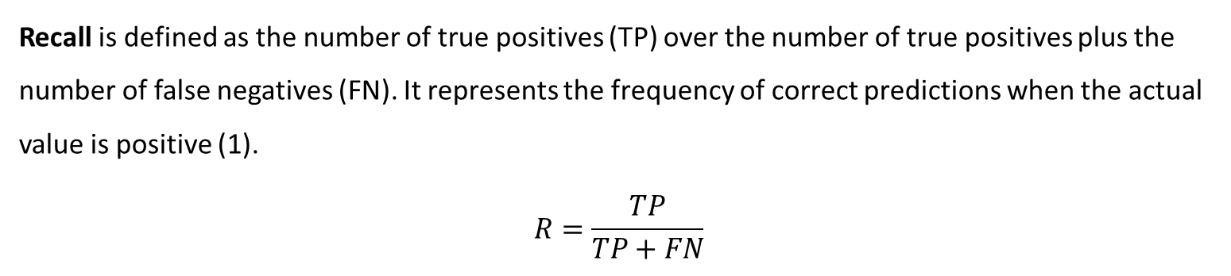
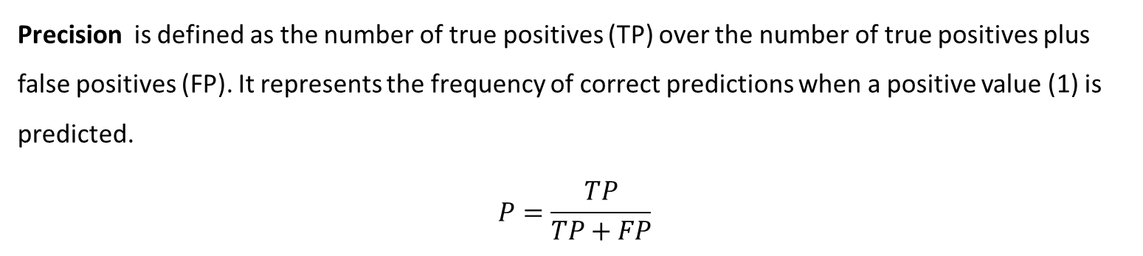
Precision is defined as the number of true positives (TP) over the number of true positives plus false positives (FP). It represents the frequency of correct predictions when a positive value (1) is predicted.
$$P=\frac{TP}{TP+FP}$$
Recall is defined as the number of true positives (TP) over the number of true positives plus the number of false negatives (FN). It represents the frequency of correct predictions when the actual value is positive (1).
$$R=\frac{TP}{TP+FN}$$

Slide 25
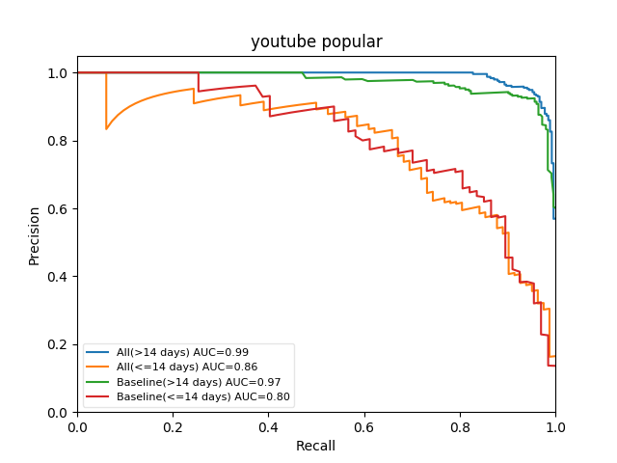
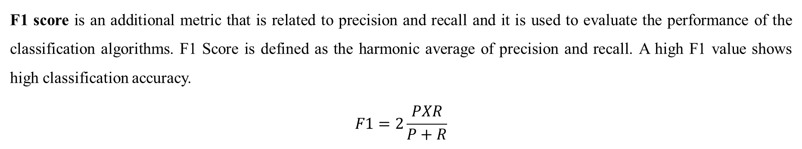
In order to evaluate the performance of the classification algorithms a precision-recall graph is formed. The higher the AUC in the precision-recall graph the more accurate the classification is.
F1 score is an additional metric that is related to precision and recall and it is used to evaluate the performance of the classification algorithms. F1 Score is defined as the harmonic average of precision and recall. A high F1 value shows high classification accuracy.
$$F1=2\frac{PXR}{P+R}$$

Slide 26
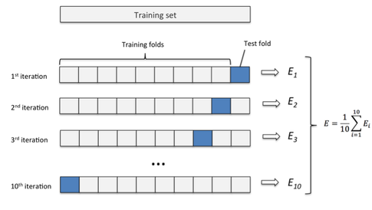
K – Fold Validation
K-fold cross-validation randomly splits the training dataset into k folds without replacement. K-1 folds are used for training the classifier and one fold is used for testing the classification. This procedure is repeated k times to obtain k different classifications on the entire dataset. The final classification is a result of the average performance of all the estimators.

Slide 27
Implementation Details
Tools developed for the purpose of this research

Slide 28
Data Collection
Raw Data
Feature Manager (JAVA)
Parses Raw Data
Machine Learning Models (SCIKIT- LEARN PYTHON)
Parses Training Datasets
Presentation (HTML,CSS,PHP)
Parses Model Output
Trains/Tests Classifiers
Exports Metrics and Feature Importance
Exports Training Features
Parses User Input
Presents Results

Slide 29
Evaluation of Algorithms
Evaluation methodology

Slide 30
Evaluation Methodology
Strict - 2.5%
Small Windows
Large Windows
Soft - 5%
Small Windows
Labeling Percentage
Training - Offset - Labeling WIndows
Large Windows
 | Training | Offset | Labeling
Small Windows | 1 | 1 | 1
Large Windows | 7 | 1 | 7
Total Videos = 130.000 | Popular + Viral + Recent + Random
 | Small Windows | Large Windows
Strict Labeling – 2.5% | 11039 | 11344
Soft Labeling – 5 % | 21160 | 21761

Slide 31
Evaluation Baselines
In order to decide if a classification algorithm is suitable for the purpose of the current research, three important baselines where established:
Average F1 scores of the classifications should be 0.75 at minimum.
Average F1 scores shouldn’t increase more than 8% when windows are changed from small to large. In other words, algorithms should have low window sensitivity.
All the classifications should have an AUC larger than 0.80.
Also took into consideration:
Dataset size
Feature dependence

Slide 32
Logistic Regression Evaluation
Extremely accurate classifications for videos that are older but mediocre classifications for videos that are recent (PRG)
Very accurate when using only baseline features (PRG)
Increasing the amount of videos in the dataset doesn’t improve accuracy (PRG)
Underperforms in cross-platform predictions (F1)
Low F1 scores (F1)
Very sensitive to window changes (F1)
Average F1 Scores (>=0.75) | Failed
Window Sensitivity (<=8%) | Failed
High AUC (>=0.80) | Failed
Due to the probabilistic nature of the logistic regression algorithm, it was expected that a high accuracy classification would be produced. Despite the fact that this algorithm performs fairly well in binary classification problems, it failed to fit the minimum needs of this research.

Slide 33
K Nearest Neighbors
Fails to produce high accuracy classifications for most of the cases (PRG)
Performs much better when only using baseline features (PRG)
Increasing the amount of videos in the dataset doesn’t have any effect on accuracy (PRG)
Low F1 Scores (F1)
Number of features doesn’t affect classification accuracy (F1)
Low window sensitivity (Baseline)
Average F1 Scores (>=0.75) | Failed
Window Sensitivity (<=8%) | Succeeded
High AUC (>=0.80) | Failed
The KNN behavior was as expected. The algorithm doesn’t seem to be highly dependent on window changes. The reason for this behavior is that this algorithm relies more on the number of neighbors (k) that it takes into account, rather than the number of training and labeling days or the size of the dataset.

Slide 34
SVM – Linear SVC
“Chaotic” classifications (PRG)
Very low accuracy classifications (F1)
Number of videos doesn’t affect classification accuracy (F1)
Number of training features doesn’t affect classification accuracy (F1)
Extremely low window sensitivity (F1)
Average F1 Scores (>=0.75) | Failed
Window Sensitivity (<=8%) | Succeeded
High AUC (>=0.80) | Failed
SVM – Linear SVC failed to reach expectations. It is popular for binary classifications. Consistent and independent of almost any external factor ( window sensitivity, number of videos, amount of features)

Slide 35
Decision Tree
High accuracy for older videos (PRG)
Moderate accuracy for all other cases (PRG)
Number of videos slightly improves accuracy (PRG)
Larger windows increase the accuracy of the classification (PRG)
F1 scores correlate with AUC values (F1 + PRG)
Number of features increases classification accuracy (F1)
Slightly oversensitive to window changes (Baseline)
Average F1 Scores (>=0.75) | Partly Failed
Window Sensitivity (<=8%) | Partly Failed
High AUC (>=0.80) | Partly Failed
From the window sensitivity test it is derived that while using strict datasets, the decision tree algorithm is slightly oversensitive (8.2%). For this reason it barely fails the three predefined tests. When a soft dataset is used, the algorithm succeeds in all three baseline tests, making it suitable for the needs of this research.
Dependence on the amount of features was expected due to the tree structure in the algorithm

Slide 36
Random Forest
Very high AUC values (PRG)
Number of videos doesn’t affect classification accuracy (PRG)
AUC values substantially increased when using larger windows (PRG)
High accuracy classifications for most cases (F1 +PRG)
Number of features increases the classification accuracy (F1)
Very sensitive to window changes (Baseline)
AUC: Fails in strict labeling datasets – succeeds in soft labeling datasets (Baseline)
Average F1 Scores (>=0.75) | Succeeded
Window Sensitivity (<=8%) | Failed
High AUC (>=0.80) | Partly Failed
The Random Forest algorithm substantially improves the performance and classification accuracy of a Decision Tree algorithm, but it suffers from very high window sensitivity. Dependence on the amount of features was expected due to the tree structure in the algorithm
Notes:
AUC: Fails in strict labeling datasets – succeeds in soft labeling datasets (Baseline) -> expected due to window sensitivity

Slide 37
Extra Trees
Very high AUC values (PRG)
Number of videos increases classification accuracy (PRG)
AUC values substantially increased when using larger windows (PRG)
High accuracy classifications for most cases (F1 +PRG)
Number of features increases the classification accuracy (F1)
Very sensitive to window changes (Baseline)
AUC: Fails in strict labeling datasets – succeeds in soft labeling datasets (Baseline)
Average F1 Scores (>=0.75) | Succeeded
Window Sensitivity (<=8%) | Failed
High AUC (>=0.80) | Partly Failed
The extra trees algorithm substantially improves the performance and classification accuracy of a Decision Tree algorithm, but suffers from extremely high window sensitivity. The major increase in the accuracy of the classification when more features are used is mostly attributed to the fact that Extra Trees consist of a bundle of Decision Trees
Notes:
AUC: Fails in strict labeling datasets – succeeds in soft labeling datasets (Baseline) -> expected due to window sensitivity

Slide 38
Bagging Decision Tree
Very high AUC values (PRG)
Number of videos slightly increases classification accuracy (PRG)
AUC values substantially increased when using larger windows (PRG)
High accuracy classifications for most cases (F1 +PRG)
Number of features increases the classification accuracy (F1)
Sensitive to window changes (Baseline)
AUC: Fails in strict labeling datasets – succeeds in soft labeling datasets (Baseline)
Average F1 Scores (>=0.75) | Succeeded
Window Sensitivity (<=8%) | Failed
High AUC (>=0.80) | Partly Failed
The Bagging Decision Tree algorithm improves substantially the performance and classification accuracy of a Decision Tree algorithm, but suffers from very high window sensitivity. The performance of the BDT algorithm is increased when more features are used due to the use of the Decision Tree structure. The algorithm is very window sensitive due to the randomness embedded in the bagging methodology.
Notes:
AUC: Fails in strict labeling datasets – succeeds in soft labeling datasets (Baseline) -> expected due to window sensitivity
Randomness = Window Sensitivity

Slide 39
Gradient Boosting Decision Tree
Extremely high AUC values (PRG)
Number of videos increases classification accuracy (PRG)
AUC values substantially increased when using larger windows (PRG)
High accuracy classifications for most cases (F1 +PRG)
Number of features increases the classification accuracy (F1)
Sensitive to window changes (Baseline)
Average F1 Scores (>=0.75) | Succeeded
Window Sensitivity (<=8%) | Partly Failed
High AUC (>=0.80) | Succeeded
The GBDT algorithm produces high quality classifications making it one of the best choices for the purpose of this research. A small drawback of this classifier is its mild oversensitivity to window changes. To overcome this problem some other hybrid algorithms are used along with GBDT which lower the classifier’s window sensitivity. Finally, the algorithm’s dependence in the amount of features used is due to the decision tree structure.
Notes:
AUC: Fails in strict labeling datasets – succeeds in soft labeling datasets (Baseline) -> expected due to window sensitivity
Randomness = Window Sensitivity

Slide 40
Ada Boosting Decision Tree
Very high AUC values (PRG)
Number of videos slightly increases classification accuracy (PRG)
AUC values slightly increased when using larger windows (PRG)
High accuracy classifications for most cases (F1 +PRG)
Number of features increases the classification accuracy – reduced dependence (F1)
Low window sensitivity (Baseline)
Average F1 Scores (>=0.75) | Succeeded
Window Sensitivity (<=8%) | Succeeded
High AUC (>=0.80) | Succeeded
The ABDT algorithm managed to pass all the baseline tests, making it ideal for this research. Looking at the average F1 scores and the AUC values, it can be concluded that ABDT produces high accuracy classifications. In addition to its’ high performance, ABDT has very low sensitivity to window changes making it ideal for future usage of the algorithm in variable windows to make popularity and virality predictions. It is particularly interesting that the ABDT algorithm has reduced dependence on the amount of features despite the Decision Tree structure used within the algorithm.

Slide 41
Voting – (ABDT,GBDT)
Very high AUC values (PRG)
Small dependence on number of videos (PRG)
AUC values slightly increased when using larger windows (PRG)
Very high F1 scores (F1)
High accuracy classifications for most cases (F1 +PRG)
Slightly increased cross-platform accuracy (F1)
Number of features increases the classification accuracy – reduced dependence (F1)
Moderate window sensitivity (Baseline)
Average F1 Scores (>=0.75) | Succeeded
Window Sensitivity (<=8%) | Succeeded
High AUC (>=0.80) | Succeeded
GBDT produced extremely high F1 scores and AUC values but suffered from mild window sensitivity. ABDT produced very high F1 scores and AUC values as well but was characterized by a very low sensitivity to window changes. Voting – (ABDT, GBDT) is a hybrid algorithm which uses the majority vote methodology to produce high accuracy values but at the same time achieve low window sensitivity. The only drawback of this algorithm is its very high computational cost.

Slide 42
Voting – (ABDT,GBDT,LR)
Very high AUC values (PRG)
Number of videos slightly increases classification accuracy (PRG)
AUC values slightly increased when using larger windows (PRG)
Low F1 scores in some cases (F1)
Number of features increases the classification accuracy (F1)
High window sensitivity (Baseline)
Average F1 Scores (>=0.75) | Succeeded
Window Sensitivity (<=8%) | Partly Failed
High AUC (>=0.80) | Succeeded
Logistic regression was added as part of the voting algorithm in order to examine how far can majority vote improve the quality of the classification. It is clear that when using too many different estimators, voting can lead to low quality classifications due to overfitting. More estimators doesn’t always mean better classifications. The F1 scores are a solid proof of how deceiving precision-recall graphs can sometimes be.

Slide 43
Bagging Gradient Boosting Decision Tree
Very high AUC values (PRG)
Small dependence on the number of videos (PRG)
Small dependence on the size of the windows (PRG)
Number of features increases the classification accuracy (F1)
Average F1 Scores (>=0.75) | Succeeded
Window Sensitivity (<=8%) | Succeeded
High AUC (>=0.80) | Succeeded
The new Bagging GBDT hybrid algorithm produced very promising results since it appears to have improved the overall performance of the GBDT classifier. Despite its’ high quality performance, the bagging GBDT is still characterized by a moderate but acceptable window sensitivity. It slightly underperforms in relation to other hybrid algorithms but it required lower computational cost.

Slide 44
Comparison of Algorithms
Comparison methodology

Slide 45
The comparison methodology consists of three different metrics used in the evaluation of the algorithms. Depending on the kind and needs of a research, different weights can be assigned to the following metrics, making one more important than the other. In the context of this research, average F1 score is the most important metric.
Average F1 Scores | Algorithm 1 | Algorithm 2 | Comparison
111 – 2.5%
717 – 2.5%
111 – 5%
717 – 5%
Window Sensitivity | Algorithm 1 | Algorithm 2 | Comparison
Strict Labeling
Soft Labeling
The following tables depict how the algorithms chosen were compared. The “Comparison” column contains the name of the best performing algorithm.
AUC | Algorithm 1 | Algorithm 2 | Comparison
All Features Old - AUC
All Features Recent - AUC
Baseline Features Old - AUC
Baseline Features Recent - AUC

Slide 46
Stand-alone Algorithms Comparison
Decision Tree produced much higher average F1 scores from the algorithms in comparison, proving that it is the most accurate algorithm when it comes to binary classifications.
SVM has the lowest window sensitivity compared to the rest of the algorithms, whereas Logistic Regression has the highest. SVM low window sensitivity is a product of its consistency as an algorithm, whereas Logistic Regression high window sensitivity is an outcome of its’ probabilistic nature.
Logistic Regression produced the highest AUC values, showing that it performs well when it comes to precision-recall. What this means is that Logistic Regression appears to be a good standalone algorithm for binary classification but its’ poor performance on F1 Scores proves that AUC values could be misleading.
AUC | LR | KNN | SVM | DT | Comparison
All Features Old - AUC | 0.95 | 0.70 | 0.65 | 0.92 | LR
All Features Recent - AUC | 0.71 | 0.51 | 0.44 | 0.68 | LR
Baseline Features Old - AUC | 0.97 | 0.94 | 0.67 | 0.91 | LR
Baseline Features Recent - AUC | 0.78 | 0.74 | 0.44 | 0.66 | LR
Average F1 Scores | LR | KNN | SVM | DT | Comparison
111 – 2.5% | 0.6136 | 0.6607 | 0.5721 | 0.7319 | DT
717 – 2.5% | 0.6875 | 0.7132 | 0.6028 | 0.7922 | DT
111 – 5% | 0.6243 | 0.6769 | 0.5868 | 0.737 | DT
717 – 5% | 0.6906 | 0.7218 | 0.6176 | 0.7904 | DT
Window Sensitivity | LR | KNN | SVM | DT | Comparison
Strict Labeling | 12% | 8% | 5.4% | 8.2% | SVM
Soft Labeling | 11% | 6.5% | 5.2% | 7.2% | SVM
Notes:
What is particularly interesting is that each algorithm dominated a different metric, with the exception of KNN.
In this section a comparison between all the single algorithms used takes place in order to examine which algorithm is more promising for further development.
Since the most reliable and important metric for this research is the F1 score, the Decision Tree algorithm was chosen for further development as it performed substantially better than the others.

Slide 47
Extra Trees VS Random Forest VS BDT
BDT and RF perform slightly better than ET in AUC and F1 scores
ET has the highest window sensitivity (more randomness)
BDT has the lowest window sensitivity (less randomness)
The Bagging Decision Tree algorithm has the best overall performance out of the three, so it was chosen for further comparison with different hybrid algorithms implemented using various methodologies.
AUC | ET | RF | BDT | Comparison
All Features Old - AUC | 0.98 | 0.98 | 0.98 | -
All Features Recent - AUC | 0.83 | 0.86 | 0.83 | RF
Baseline Features Old - AUC | 0.95 | 0.94 | 0.96 | BDT
Baseline Features Recent - AUC | 0.72 | 0.75 | 0.75 | RF/BDT
Average F1 Scores | ET | RF | BDT | Comparison
111 – 2.5% | 0.7581 | 0.7639 | 0.7645 | BDT
717 – 2.5% | 0.8345 | 0.8364 | 0.8347 | RF
111 – 5% | 0.7626 | 0.7679 | 0.7697 | BDT
717 – 5% | 0.8323 | 0.8335 | 0.8340 | BDT
Window Sensitivity | ET | RF | BDT | Comparison
Strict Labeling | 10.1% | 9.5% | 9.2% | BDT
Soft Labeling | 9.1% | 8.5% | 8.4% | BDT
Notes:
The first hybrid algorithms produced using Decision Trees where based on methodologies that integrate random characteristics and/or random subsets of data. Those ensemble algorithms where Extra Trees, Random Forest and Bagging Decision Tree. Each algorithm integrates randomness to its methodology to different extent.

Slide 48
BDT VS GBDT VS ABDT
Boosting methodologies produce better results than “random” methodologies
GBDT and ABDT are much less sensitive to window changes than BDT
GBDT produces slightly higher average F1 scores and AUC values than ABDT.
ABDT is substantially less sensitive to window changes than GBDT.
Depending on the nature of the problem either one of the two boosting algorithms can be chosen.
AUC | BDT | GBDT | ABDT | Comparison
All Features Old - AUC | 0.98 | 0.98 | 0.98 | -
All Features Recent - AUC | 0.83 | 0.84 | 0.82 | GBDT
Baseline Features Old - AUC | 0.96 | 0.96 | 0.97 | ABDT
Baseline Features Recent - AUC | 0.75 | 0.80 | 0.80 | GBDT/ABDT
Average F1 Scores | BDT | GBDT | ABDT | Comparison
111 – 2.5% | 0.7645 | 0.7736 | 0.7714 | GBDT
717 – 2.5% | 0.8347 | 0.8361 | 0.8276 | GBDT
111 – 5% | 0.7697 | 0.7802 | 0.7781 | GBDT
717 – 5% | 0.8340 | 0.8359 | 0.8281 | GBDT
Window Sensitivity | BDT | GBDT | ABDT | Comparison
Strict Labeling | 9.2% | 8.1% | 7.3% | ABDT
Soft Labeling | 8.4% | 7.1% | 6.4% | ABDT
Notes:
The Bagging Decision Tree algorithm is compared with two ensemble algorithms that apply some kind of boosting on top of the decision tree weak learner. More specifically Adaptive Boosting and Gradient Boosting respectively.

Slide 49
GBDT VS Voting – (GBDT, ABDT)
Goal: Use voting to create a hybrid algorithm that produces higher average F1 Scores and AUC values and lower window sensitivity than GBDT.
AUC values where overall the same
Voting – (GBDT, ABDT) produced higher average F1 scores than GBDT
Voting reduced window sensitivity
Voting – (GBDT, ABDT) performs better than GBDT in almost all the scenarios
Voting – (GBDT, ABDT) has much higher computational cost than GBDT
AUC | GBDT | Voting – (GBDT, ABDT) | Comparison
All Features Old - AUC | 0.98 | 0.98 | -
All Features Recent - AUC | 0.84 | 0.84 | -
Baseline Features Old - AUC | 0.96 | 0.97 | Voting
Baseline Features Recent - AUC | 0.80 | 0.80 | -
Average F1 Scores | GBDT | Voting – (GBDT, ABDT) | Comparison
111 – 2.5% | 0.7736 | 0.7739 | Voting
717 – 2.5% | 0.8361 | 0.8361 | -
111 – 5% | 0.7802 | 0.7803 | Voting
717 – 5% | 0.8359 | 0.8360 | Voting
Window Sensitivity | GBDT | Voting – (GBDT, ABDT) | Comparison
Strict Labeling | 8.1% | 8% | Voting
Soft Labeling | 7.1% | 7.1% | -
Notes:
Since the GBDT and the ABDT algorithms performed similarly, the Voting methodology was used to try and create a hybrid algorithm with higher average F1 Scores and AUC values and lower window sensitivity.
In addition to the above results, further comparison took place between the two algorithms, which contained all the scenarios examined in this research.

Slide 50
Voting – (GBDT, ABDT) VS Bagging GBDT
Bagging GBDT combines randomness with boosting to produce high quality classifications
Bagging GBDT has very high computational cost
Both algorithms tied in window sensitivity and AUC values
Voting – (GBDT, ABDT) produced higher F1 scores than Bagging GBDT
AUC | Voting – (GBDT, ABDT) | Bagging GBDT | Comparison
All Features Old - AUC | 0.98 | 0.98 | -
All Features Recent - AUC | 0.84 | 0.84 | -
Baseline Features Old - AUC | 0.97 | 0.96 | Voting
Baseline Features Recent - AUC | 0.80 | 0.80 | -
Average F1 Scores | Voting – (GBDT, ABDT) | Bagging GBDT | Comparison
111 – 2.5% | 0.7739 | 0.7737 | Voting
717 – 2.5% | 0.8361 | 0.8358 | Voting
111 – 5% | 0.7803 | 0.7802 | Voting
717 – 5% | 0.8360 | 0.8357 | Voting
Window Sensitivity | Voting – (GBDT, ABDT) | Bagging GBDT | Comparison
Strict Labeling | 8% | 8% | -
Soft Labeling | 7.1% | 7.1% | -

Slide 51
Conclusions
Comparison conclusion and final thoughts

Slide 52
Comparison Conclusion
After extensive research, experiments and comparison between multiple algorithms, a list with the most high performing hybrid algorithms was produced:
Gradient Boosting Decision Tree
Ada Boosting Decision Tree
Voting – (GBDT, ABDT) hybrid algorithms.
These algorithms appear to be the most suitable for this kind of research problems or any similar binary classification problems.

Slide 53
The Gradient Boosting Decision Tree algorithm produces extremely accurate classifications. It’s the strongest boosting algorithm and has a moderate computational cost. It’s superiority to any other boosting algorithm is mostly denoted by the high F1 Scores and AUC values produced. Its drawback is that GBDT appears to be slightly “oversensitive” to window changes.
The Ada Boosting Decision Tree algorithm produces very accurate classifications. It has a moderate computational cost. This hybrid algorithm is particularly powerful when window sensitivity is very important to the research. Its drawback is that it produces slightly lower F1 Scores and AUC values than Gradient Boosting Decision Tree.
The Voting – (GBDT, ABDT) algorithm produces extremely accurate classifications. It has the highest F1 Scores from all the other algorithms compared. It has moderate window sensitivity. Its drawback is that it comes with a very high computational cost.

Slide 54
Final Thoughts
Single algorithms are generally weak learners, meaning that they produce poor classifications
Decision Tree was a good algorithm to build stronger and more accurate, hybrid algorithms on top of
Hybrid algorithms produced high accuracy classifications but with some drawbacks in some cases
Any kind of randomization procedures within the algorithm itself, increases its sensitivity to window changes
Oversensitivity is undesirable since the aim of this research is to be able to produce powerful classifications independently of the training, offset and labeling window
Some training features are more important than others
Any kind of acceleration or ratios appear to assist more in the classification than most of the “static” features
The Voting – (GBDT, ABDT) hybrid algorithm is the most suitable for this research

Slide 55
It is worth noting that a set of other hybrid algorithms analyzed and evaluated in this study, produced high quality classifications as well and could be most suitable in scenarios where other metrics are more important (e.g. window sensitivity).
In short, similar problems with slightly different needs could use one of the other powerful models developed and evaluated in this study.
It is clear that there’s still room for improvement, especially in cross platform classifications.
A particularly interesting hypothesis was made. It seems that a different algorithms could be assigned in different subsections of the problem in hope of producing better classifications.

Slide 56
Future Work
Hypothesis and further development

Slide 57
Following the hypothesis that was made from looking at the evaluation results, it appears that dividing the problem into various subsections, could indeed produce much better results.
More specifically, the overall problem could be divided into four sections:
Predictions using Twitter Features
Predictions using YouTube features
Predictions using All Features
Cross-platform predictions
A different kind of hybrid algorithm could be assigned to each section. Each algorithm could then be fine-tuned and adjusted to the specific needs of each section in order to produce more accurate classifications.
Finally, further experimentation could take place regarding the training features. More specifically, features that don’t seem to be important to the classification could be removed in the future, whereas features that are important, could be combined to produce even more powerful training features.
Notes:
This approach to the problem is feasible and very promising. The outcome could be an extremely powerful model that could make high accuracy, platform independent, predictions.

Slide 58
Thank you for your time!
Feel free to ask any questions

