Slide 1
Association between S antibody levels to COVID-19 infection status from nationwide community surveillance data in South Korea
Zhang, Franky
Jo, Youngji

Slide 2
Background
Previous studies identified that neutralizing antibody levels are highly predictive of immune protection from symptomatic SARS-CoV-2 infection (Khoury DS et al, 2021) and the levels of antibody protection required to prevent symptomatic COVID-19 (Feng S et al, 2021)
Neutralizing Antibodies: The S antibodies include neutralizing antibodies, which can directly interfere with the ability of the virus to infect cells. Higher levels of S antibodies generally correlate with a stronger capacity to neutralize the virus and prevent infection.
Vaccine Efficacy: COVID-19 vaccine efficacy is linked to strong S antibody responses. Vaccines with higher S antibody titers are generally more effective in preventing or lessening COVID-19 severity.
Duration of Protection: S antibody protection duration is being studied. Although S antibodies offer initial defense, their levels may decrease over time, reducing protection. This has prompted booster shot recommendations to sustain immunity..
Variants of Concern: The rise of SARS-CoV-2 variants has complicated how S antibody levels protect us. Variants with mutations in the S protein can lower antibody effectiveness, risking breakthrough infections in vaccinated people. Research continues to explore the protection correlation against various variants..
Measurement and Interpretation: Quantitative S antibody level assessments offer insights into immune status, but the protective threshold varies and isn't precisely defined for the population.
1
Notes:
As of December 2022, South Korea achieved a vaccination coverage of 86.43% for at least one dose ^{[1]}.
It's important to note that the immune system's protection against COVID-19 is not solely dependent on S antibodies. Other components of the immune system, including T cells, also play crucial roles in responding to infection and providing long-term immunity. Continuous research is essential for a deeper understanding of the protective mechanisms against SARS-CoV-2 and for optimizing vaccination strategies.

Slide 3
Objective
Repeatable Community-Based Antibody Surveys
Lack of representative community-based seroprevalence data (most other studies are hospital-based with relatively small sample size)
Challenges in assessing risk trends based on antibody titer variations through cross-sectional surveys
1) Case control study design: Examining the association between Spike (S) protein antibody levels and COVID-19 infection
2) Cohort study design: Determine the change of S antibody level by infection or vaccination over time
2
Notes:
The S protein is a structural protein on the surface of the virus that facilitates its entry into human cells. Vaccines that target the S protein are designed to elicit an immune response specifically against this protein. Here’s how the S antibody level is associated with protection against COVID-19 infection:

Slide 4
Epidemic curve of COVID-19 in Korea (2020.1.20.~2023.4.20.)
Longitudinal cohort investigation with serial sampling of the same individual each time
4th peak
5th peak
6th peak
7th peak
Community-based seroprevalence survey of COVID-19 in Korea
1st peak
2nd peak
3rd peak
Follow-up survey
3

Slide 5
Methodology
N+
Hybrid immunity
S+
Surveillance Period: 1st survey: August 2022 2nd survey: December 2022 Surveillance Area: 258 cities and counties nationwide in South Korea 258 public health centers and 113 private medical facilities Surveillance Subjects: 10,000 individuals aged 5+ were randomly selected from 5,000 households. Surveillance method: Nationwide community-based surveillance. Surveyors conduct one-on-one interviews via tablets.
Outcome measurement: anti-Spike (S) antibody level and Confirmed infection between 1st and 2nd surveillance v.s. No confirmed infection
Study design: nested case-control study design for aim 1, Cohort study design for aim 2 Statistical analysis: Descriptive analysis, Logistic regression, Statistical inference
10,000
Subjects
N-
Vaccine Induced
N+
Infection induced
S-
N-
Naive
4
Notes:
First say what is antibody, two type of antibodies. N+ means infection before. S+ means infection/vaccinated.

Slide 6
Flow chart of case control study design
9,945
Total amount of objects in
the 1st surveillance
Exclude those who did not attend or missing S antibody level in the 2nd survey (n = 2,423)
Exclude the population with vaccination between 1st survey and infection if had (n =22)
Exclude the population with increased S Antibody level in the 2nd survey (n = 1,207)
Confirmed infection
between 1st and 2nd Survey (n = 744)
No infection
between 1st and 2nd Survey (n = 5,549)
Exclude those had N- antibody at the 2nd Survey (n = 76)
Exclude the population with vaccination during 1st and 2nd Survey (n = 1,349)
Included in the Case Group :
n = 668
Included in the Control Group:
n = 4,200
5

Slide 7
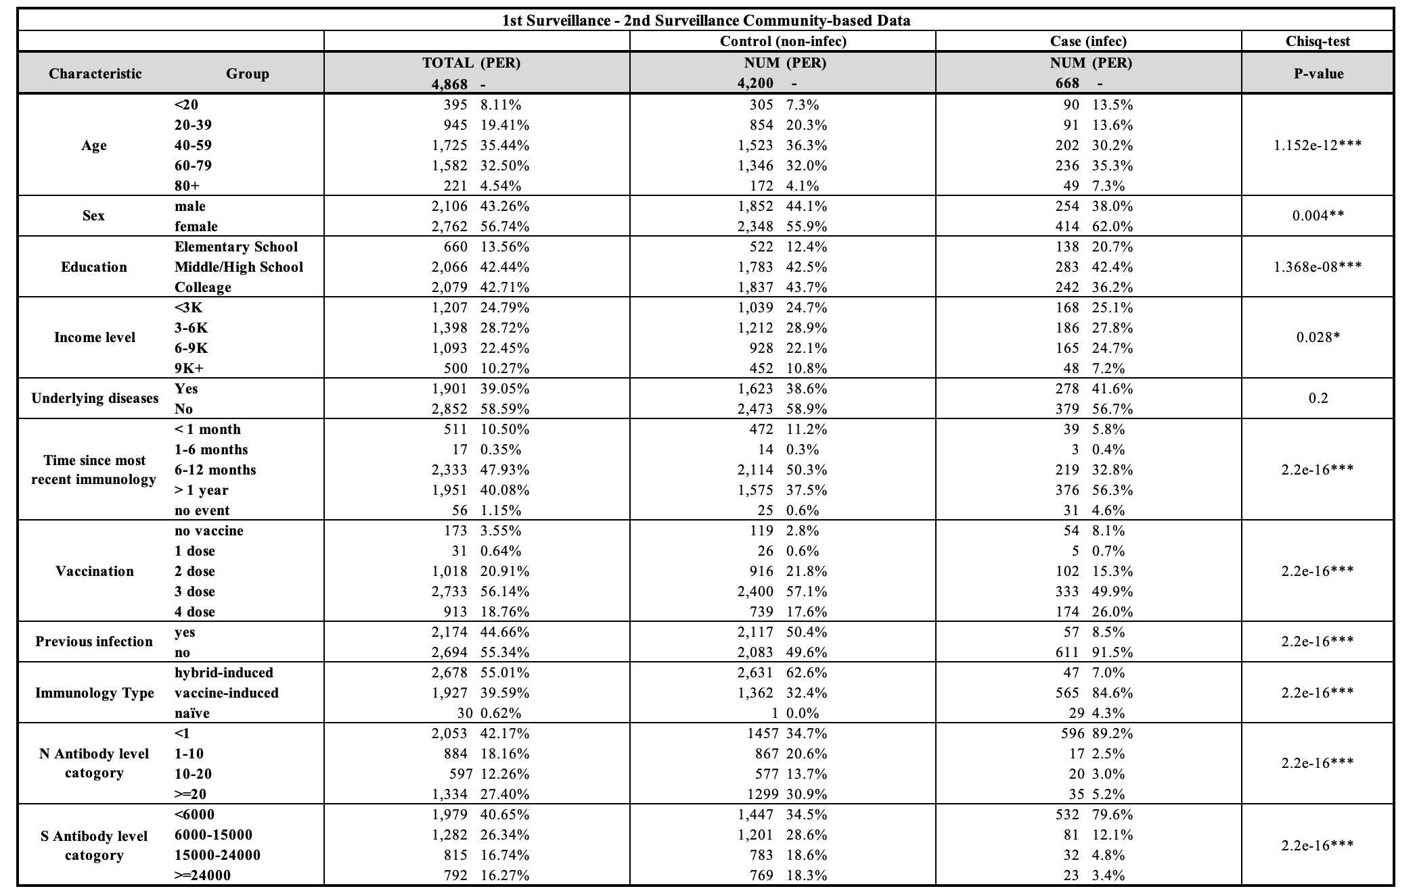
Summary table comparing case and control group characteristics
6

Slide 8
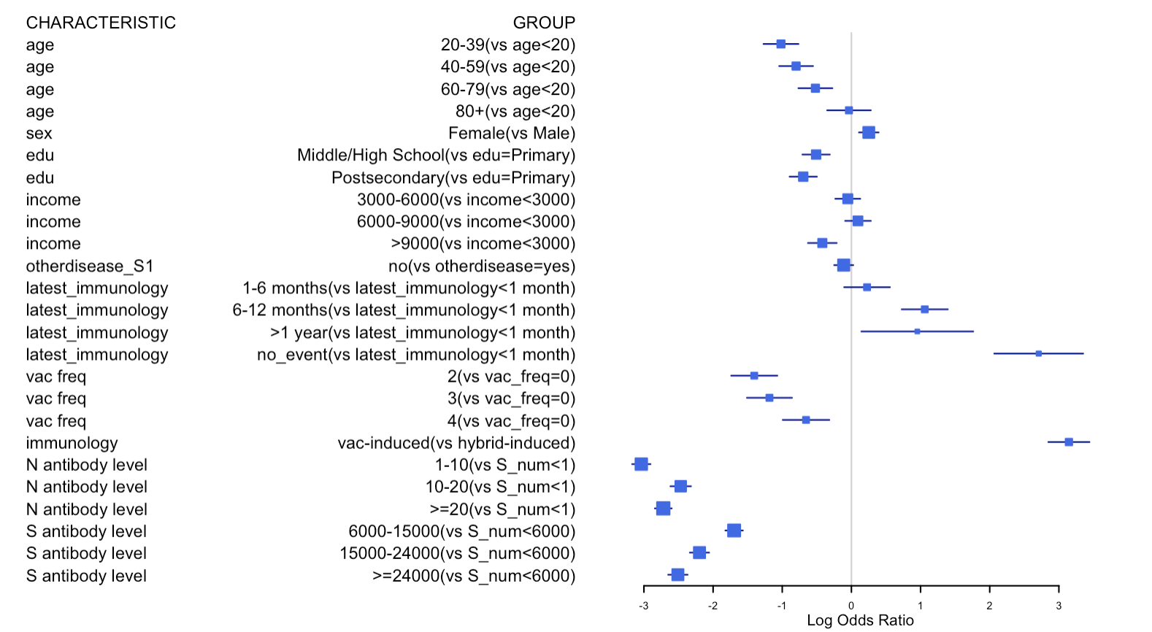
Forest plot showing infection risk odds ratios
lower risk
higher risk
7

Slide 9
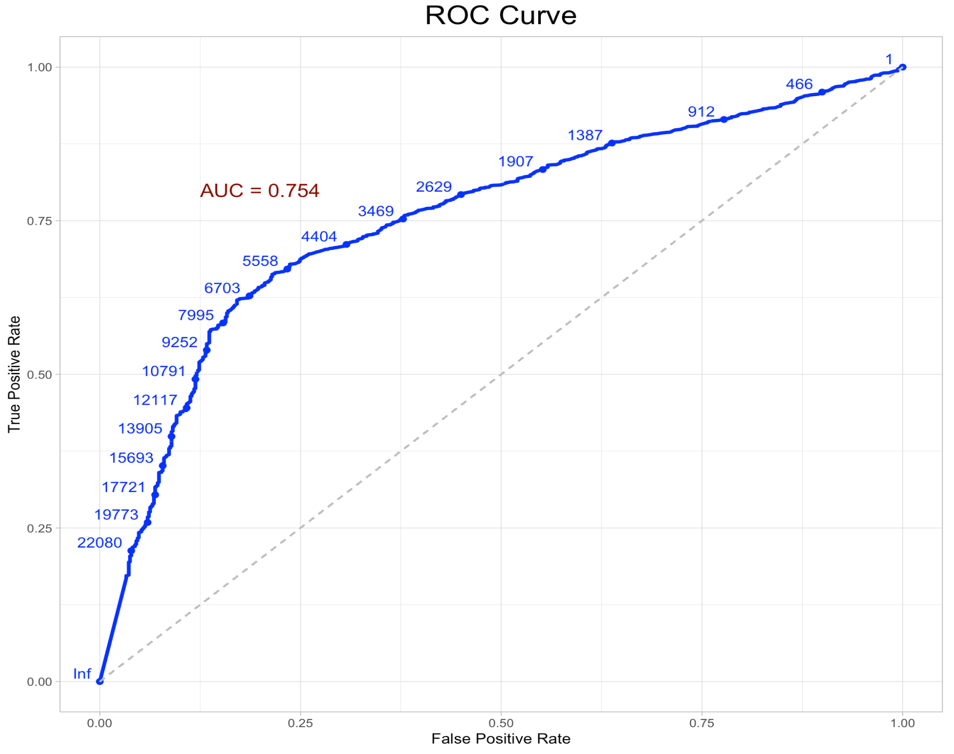
ROC Curve
8

Slide 10
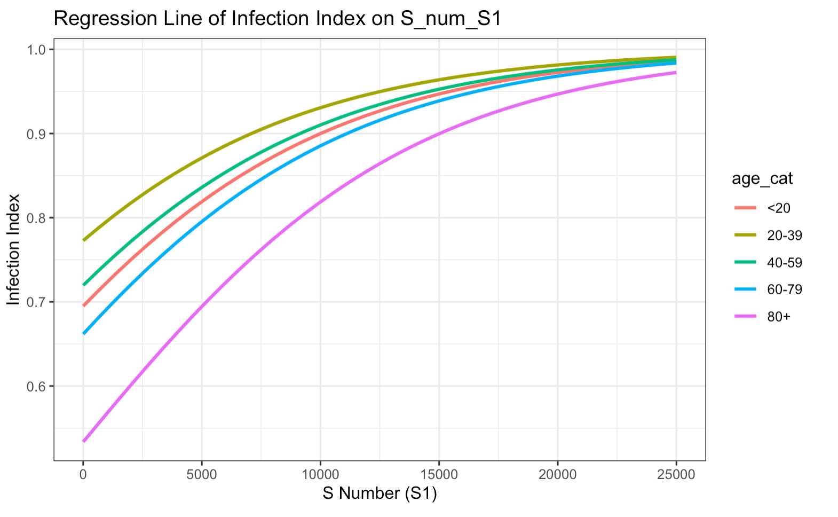
Logistic regression curve (model: infection ~ S antibody level + Age)
No infection
.89
.85
.84
.82
.71
Infection
9

Slide 11
Cohort study design
Object of investigation
(1st Surveillance)
N = 9,945
Hybrid-induced
(S+N+ Vac&Infec)
N = 4,736(47.6%)
Vaccine-induced
(S+N- Vac only)
N = 4,017(40.4%)
Infection-induced
(S-N+)
N = 19 (0.2%)
Naïve
(S-N-)
N = 174(2%)
Infec
(1st – 2nd)
N = 48(1%)
non-Infec
(1st – 2nd)
N = 4,688(99%)
Infec
(1st – 2nd)
N = 585(15%)
non-Infec
(1st – 2nd)
N = 3,431(85%)
Infec
(1st – 2nd)
N = 1 (5%)
non-Infec
(1st – 2nd)
N = 18 (95%)
Infec
(1st – 2nd)
N = 30(18%)
non-Infec
(1st – 2nd)
N = 144(82%)
Breakthrough infection/reinfection
Breakthrough infection
Reinfection
Seroconversion
10

Slide 12
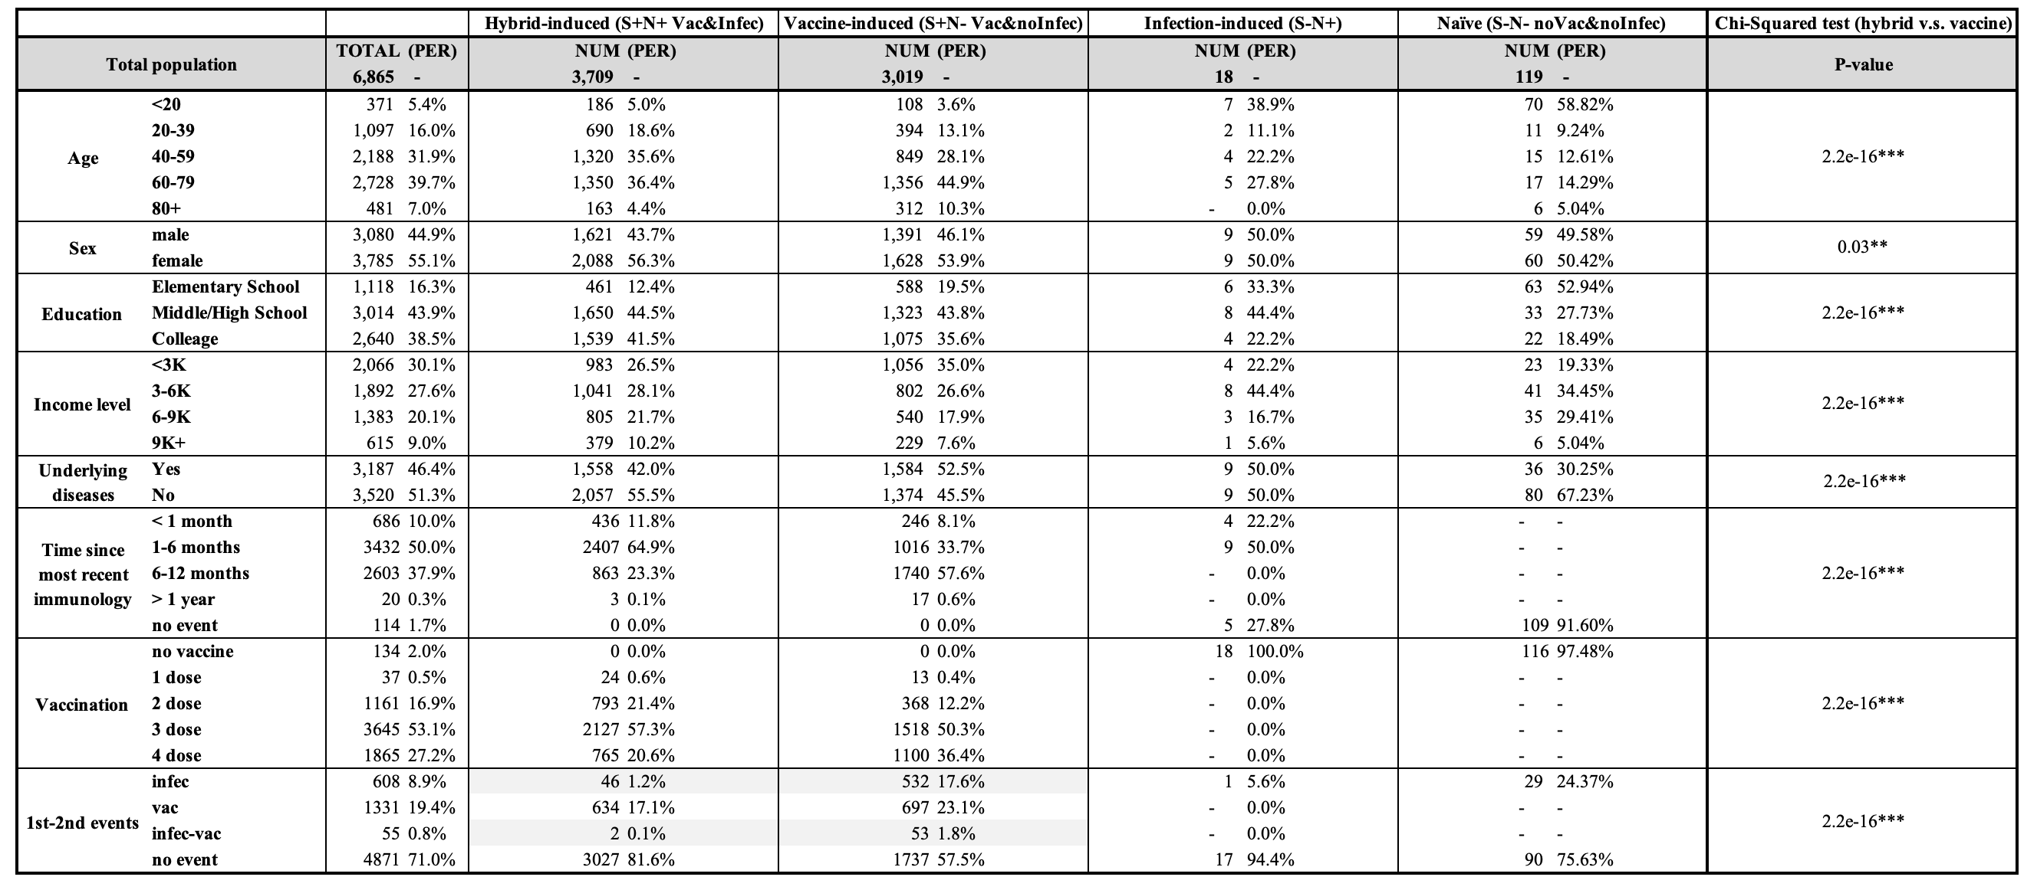
Summary table of immunology population
11

Slide 13
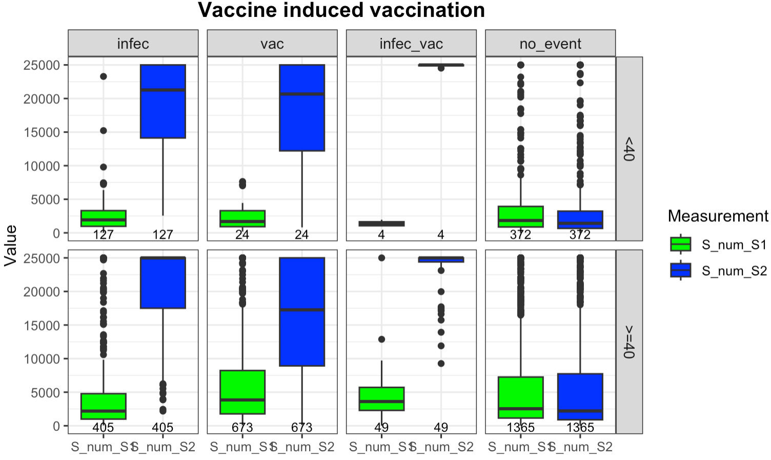
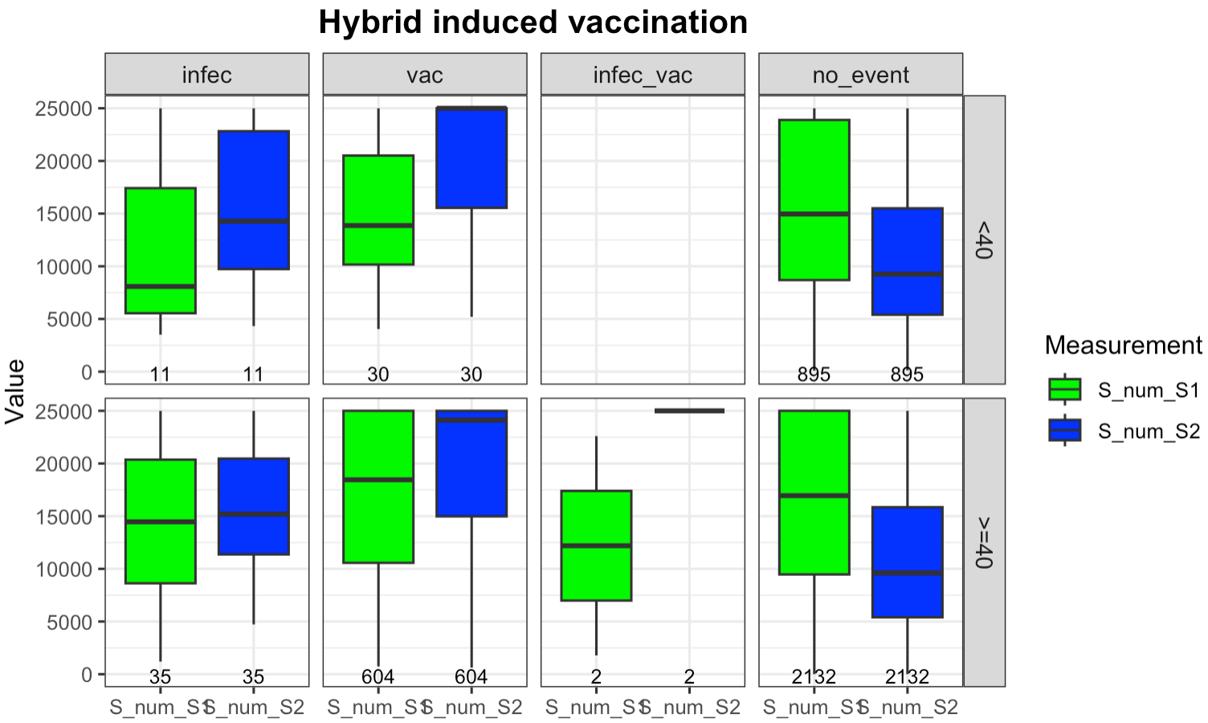
Box plot comparing S antibody level changes between 1st and 2nd surveillance
The vaccine-induced population had a bigger boost in their S antibody levels than hybrid-induced ones, no matter if they were vaccinated, infected, or both.
12

Slide 14
Box plot comparing S antibody level changes between 1st and 2nd surveillance
If no events occur, the rate of decrease in S antibody levels in the vaccine-induced population is lower compared to the hybrid-induced group.
12

Slide 15
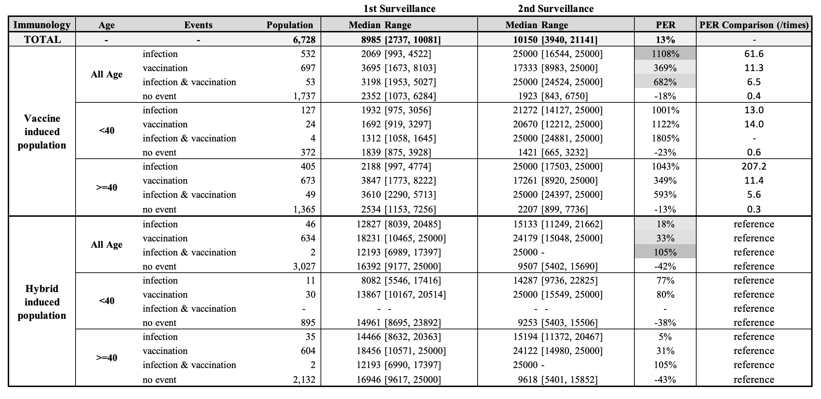
Summary table quantifying S antibody level changes between 1st and 2nd surveillance
The increase in S antibody levels among the vaccine-induced population is at least 6 times greater than that of the hybrid-induced population, regardless of whether they have undergone infection, vaccination, or both.
13

Slide 16
Summary table quantifying S antibody level changes between 1st and 2nd surveillance
If no events occurred, the rate of decline in S antibody levels for the vaccine-induced population is only half that observed in the hybrid-induced population.
14

Slide 17
Summary table quantifying S antibody level changes between 1st and 2nd surveillance
Regardless of immunity type, younger individuals showed a greater increase in S antibody levels after infection or vaccination, and a faster decline in the absence of these events, especially in the vaccine-induced group. The later pattern was not observed in the hybrid-induced group.
15

Slide 18
Summary table quantifying S antibody level changes between 1st and 2nd surveillance
Across various events, infection leads to a higher S antibody level increase in the vaccine-induced population, whereas vaccination prompts a greater rise in the hybrid-induced group.
16

Slide 19
Discussion
Summary:
Case control study design:
Population Spike (S) antibody level threshold can guide appropriate vaccination interval by age group. Maintaining a Spike (S) antibody level at 6,000 reduced COVID-19 infection probabilities to .85, .89, .87, and .71 for age groups <20, 20-39, 40-59, and >60, respectively.
Age presents a clear correlation with COVID-19 infection risk, indicating that the youngest and oldest groups face the highest risk.
Cohort study design:
Overall, the hybrid-induced population had a lower likelihood of infection, associated with higher Spike (S) antibody levels.
Spike (S) antibody level changes are influenced by event type (infection, vaccination, or both), immunity type, and age. Vaccine-induced individuals' antibody increases are tenfold higher than those in hybrid-induced individuals after immunological events.
Limitations: .
17
Notes:
Symptom intensity varies widely, but our study data is confined to binary (Yes/No) responses.
Spike (S) antibody levels do not account for neutralizing antibodies, which may better predict symptom severity.

Slide 20
Reference
[1] https://ourworldindata.org/covid-vaccinations
[2] Amjadi, M. F., & O'Connell, S. E. (2021). Specific COVID-19 symptoms correlate with high antibody levels against SARS-CoV-2. *AAI*.
[3] Imai, K., Kitagawa, Y., Tabata, S., Kubota, K., Nagura-Ikeda, M., Matsuoka, M., Miyoshi, K., Sakai, J., & all authors. (2021). Antibody response patterns in COVID-19 patients with different levels of disease severity in Japan. *Journal of Medical Virology*.
[4] Goldblatt, D., Fiore-Gartland, A., Johnson, M., Hunt, A., Bengt, C., Zavadska, D., Snipe, H. D., Brown, J. S., Workman, L., Zar, H. J., Montefiori, D., Shen, X., Dull, P., Plotkin, S., Siber, G., & Ambrosino, D. (2021). Towards a population-based threshold of protection for COVID-19 vaccines. *Vaccine*.
18

Slide 21
Appendix

Slide 22
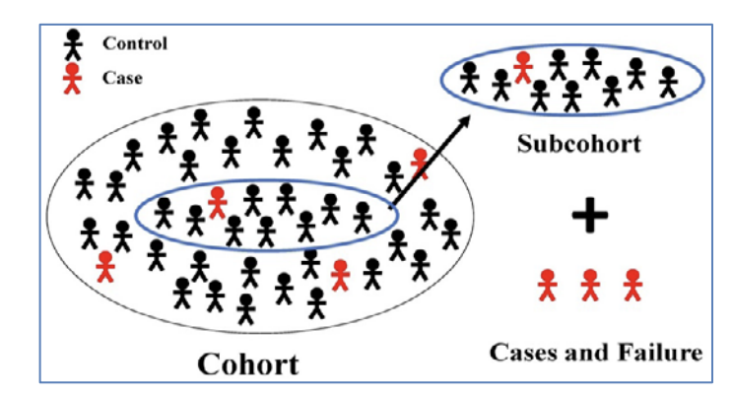
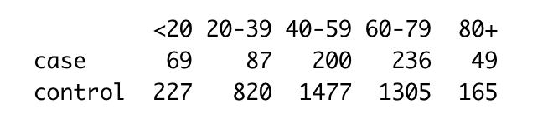
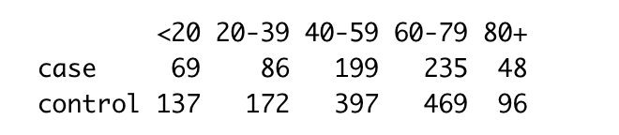
Methodology
Nested Case-control Study (NCC)
Unbalanced case-control data refer to a situation in epidemiological and medical research where the number of cases does not match the number of controls.
To maximize statistical efficiency and minimize bias, for each case, a subset of controls is selected from the same cohort. Controls are often matched to cases on various factors like age, gender, or other characteristics to ensure comparability.
{Epi} in R, by B. Carstensen and M. Plummer, Mar 30, 2024
Raw Case-control cohort
Nested Case-control design cohort

Slide 23
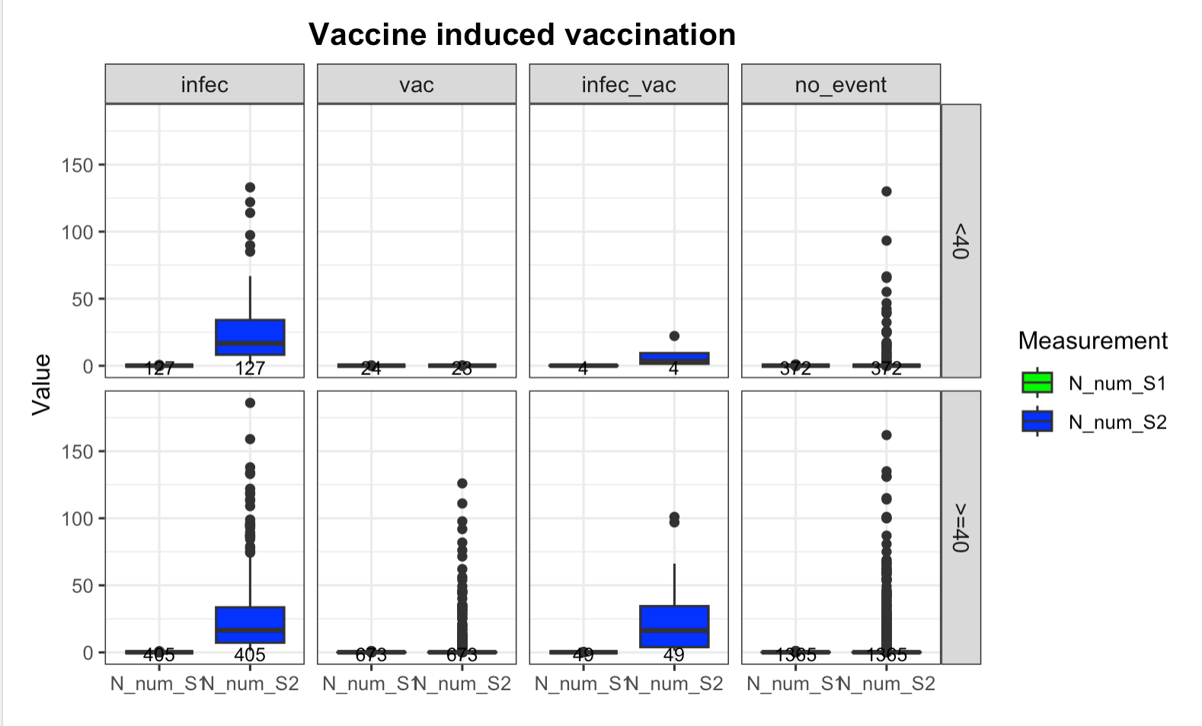
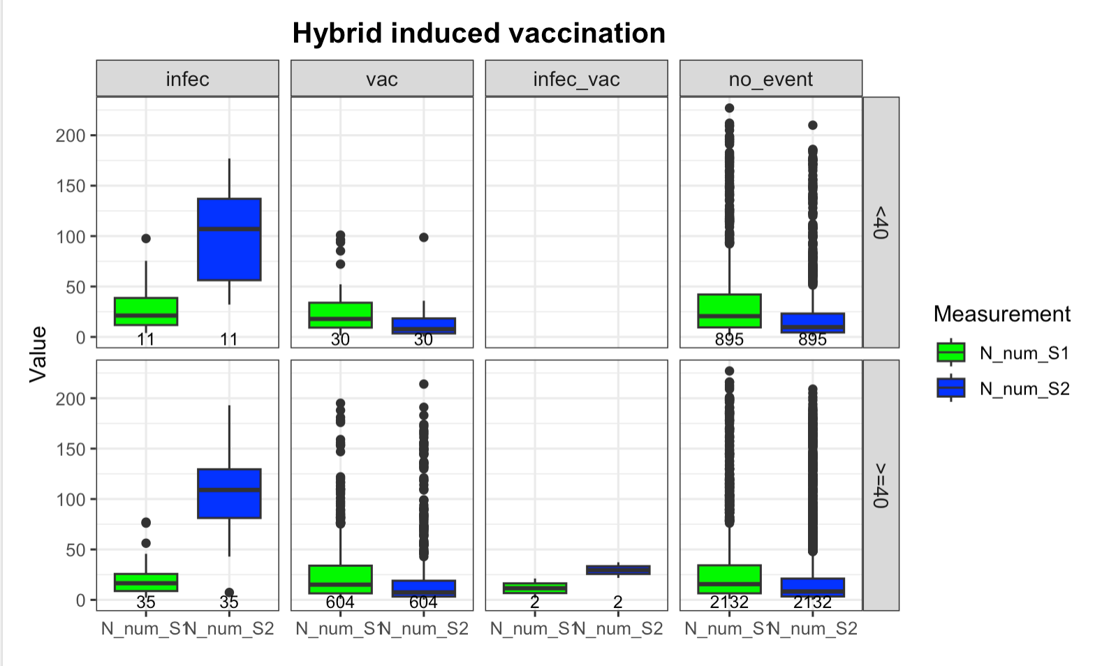
Figure 2: Box plots for N antibody level grouped by Age and later events
The trends in N antibody levels are not well-defined, as these antibodies are typically produced only in response to an infection.

Slide 24
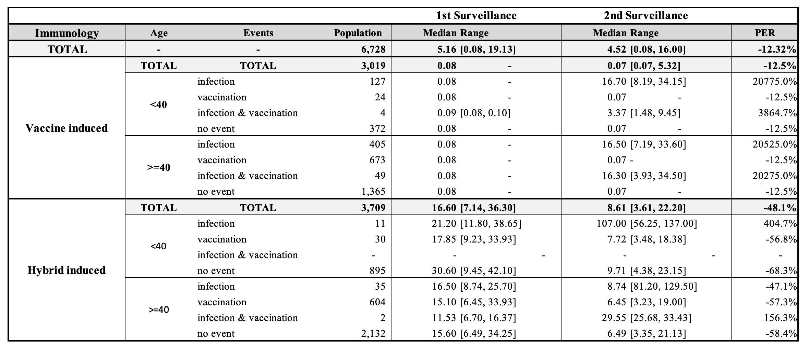
Table 3: Quantification table for the difference of N antibody level from 1st to 2nd Surveillance

