Slide 1
Protective effectiveness of SARS-CoV-2 infection risk (across age groups) between hybrid and vaccine induced immunity against the omicron variant
Youngji Jo
Franky Zhang

Slide 2
Background
Natural SARS-CoV-2 infection and vaccination against COVID-19 both contribute to building the population’s immunity.
However, estimating the magnitude and durability of this protection in the population has become a challenge because of the surge in the omicron (B.1.1.529) variant, which has resulted in many individuals with hybrid immunity (immunity developed through a combination of SARS-CoV-2 infection and vaccination), varying rates and timings of past infection and vaccination, multiple types of vaccination and numbers of doses, and variants of concern that can escape pre-existing immunity.3,4
Severe previous studies of COVID-19 vaccines have shown waning immunity over time (after 2 doses), as measured by primarily decreasing antibody titers and vaccine effectiveness (breakthrough infections) [9, 10]. Systematic reviews of SARS-CoV-2 vaccine effectiveness studies have provided clarity on the durability of protection by immune status (hybrid vs. previous infection alone) [ref], and different combinations of the number of doses and type of vaccine (vaccines vs. unvaccinated). Previous infection was found to provide higher protection against reinfection and more sustained protection against hospital admission or severe disease than vaccination alone. However, individuals with hybrid immunity had the highest magnitude and durability of protection against all outcomes, emphasising the importance of providing vaccination to previously infected individuals.
Yet, most seroepidemiological studies conducted after the COVID-19 vaccine administration began have focused on specific groups (e.g., healthcare workers) [1, 2]. The age-specific durability of antibody responses after infection and/or vaccination is less well explored within the general population [8].
In South Korea, with high vaccination, the majority of the population is hybrid and vaccine-induced immunity. In this study, we directly compared age-specific trends of anti-S levels and the relative breakthrough infection events in the nationwide community-based cohort, which enables large-scale population follow-up with repeated testing of antibodies over time in a population with detailed demographic and clinical characterization and long-term follow-up.
Objectives : Comparison of S ab waning and breakthrough infections risks across age subgroups between hybrid and vaccine groups against Omicro variants
First, how does anti-S waning vary after the last immunological events across age groups between hybrid and vaccine groups.
Second, what is the total protective effect of anti-S level on risk of SARS-CoV-2 infection against omicron variants in South Korea.
Third, what are the risk factors and risk probability across age groups between hybrid and vaccine groups.

Slide 3
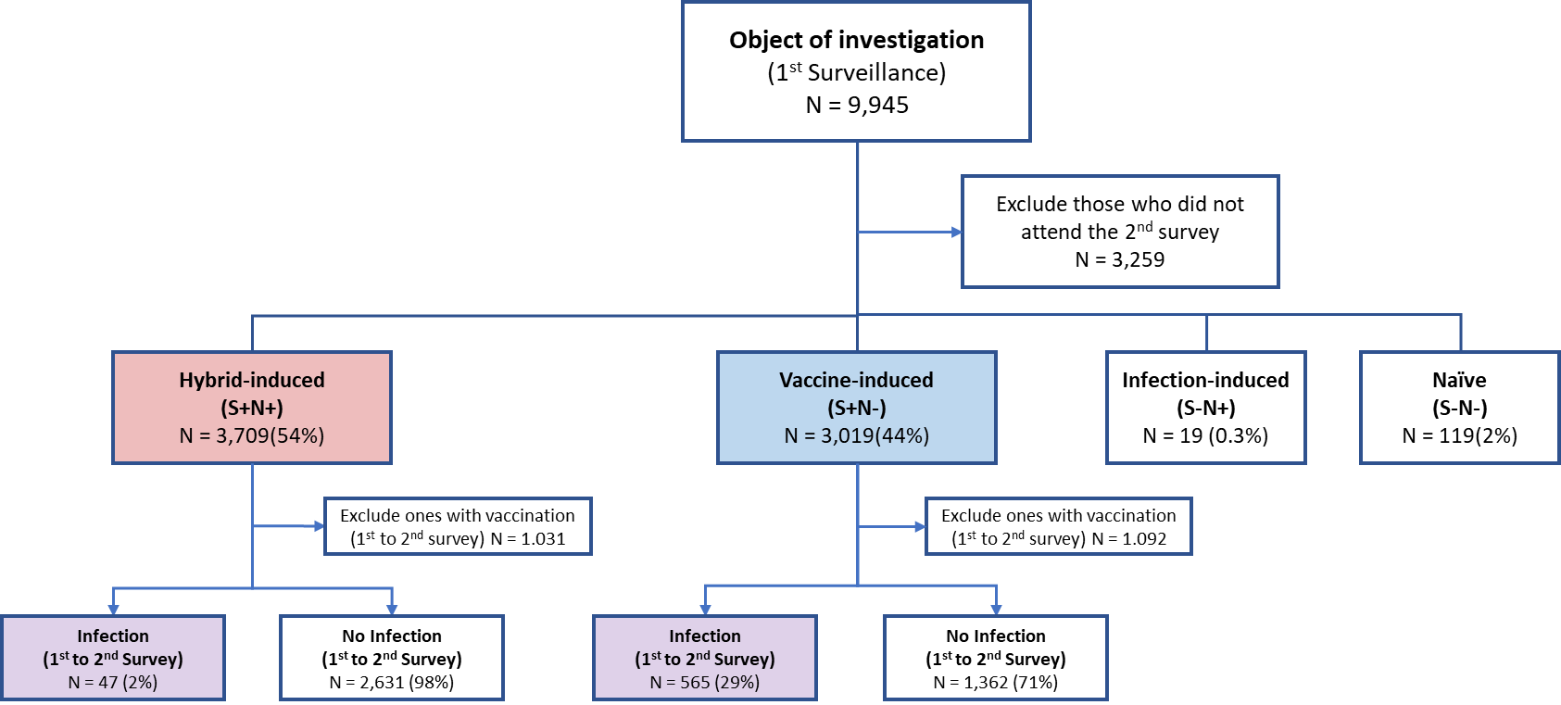
Flow chart

Slide 4
Table

Slide 5
S antibody

Slide 6
Survival curve

Slide 7
Odds ratio

Slide 9
Logistic regression

Slide 10
Implications
Our study highlights significant differences in the efficacy of hybrid-induced and vaccine induced immunity in preventing COVID-19 infections across various age groups, which correlated with higher initial S antibody levels.
Previous studies also showed individuals 60 years or older had lower antibody levels after vaccination compared to younger participants and increased age has been associated with reduced vaccine responses in a number of studies irrespective of vaccine type [36, 37]. A similar effect has been seen with antibody responses after infection [11]. Another study showed no consistent associations of lower antibody levels with age, but a very strong age gradient (lower incidence with older age) of post-vaccination infection.
Younger individuals (< 20) in the vaccine-induced group exhibit the highest infection risk, following age >60 and age 40-60.
To achieve 80% infection free probability, antibody thresholds were 250,000 for age <20 group, 200,000 for age >60 group, 150,000 for age 40-60 and 100,000 for age 20-40.
However, the infection hospitalization risks were substantially higher for age >40 than age <40.
The high risk for younger (<20 age) may be due to the increased exposure/contact with the lift of social distancing policy; The high risk for older (>60 age) may be due to the decreased immune system efficiency with age (known as immunosenescence) respectively.
These results are consistent with risk of infection being a complex combination of SARS-CoV-2 case prevalence, individual immune response to vaccination, and individual level of exposure. Given the relaxation of measures across many countries, groups previously less exposed, for example, due to shielding guidance, may become more at risk.
This highlights the importance of continuing to inform such individuals of their personal risk of SARS-CoV-2 infection, and benefit of booster vaccinations.
At the individual level, our results show that the need for, and optimal timing of, the primary vaccination series and booster dose might be different in an individual who has had a breakthrough infection after initiation of the primary/booster series compared to an individual who had the primary/booster series vaccination only.
It might therefore be reasonable for individuals with hybrid immunity (relative to the individuals with vaccine induced immunity only) to delay subsequent doses of vaccination by 6 months, while still maintaining high levels of protection against severe disease.
On a population level, the optimal number of vaccine doses and the inter-dose interval might differ in settings with various degrees of vaccine-induced versus infection-induced immunity.
Unique contribution of our study…..
This study is strengthened by its large sample size (community based surveillance with wide age spectrums) and detailed serological assessment twice after an epidemic wave of omicron variants (==connection between S ab level and protective efficacy against breakthrough infection by different immune status and age groups).
Combining appropriate information from serology, questionnaires, and registries, we were able to identify previously infected and vaccinated people (i.e, the hybrid and vaccine group by S antiboty status, not just by testing results or self-reporting) as accurately as possible and avoid many sources of bias that would lead to differential misclassification of people as infected.
identify the risk factor for each hybrid/vaccine group and quantified estimate of the protection by age group.
Further research is warranted to understand the interplay between natural and vaccine-induced immunity and the role of exposure to specific variants and the interval between exposures (vaccination doses and infection).
The need for further booster doses should take into consideration both vaccine doses and infections and also the clinical characteristics during infections.
Future follow-up of our population will allow us to assess the risk and severity of breakthrough infections in people with different vaccine responses covering also dynamic aspects of multiple isotype and antigen responses.

Slide 11
Limitations
Our results (relative efficacy of hybrid vs vaccine group) may differ by the subgroup distribution (and sequence/time interval of respective events) under each group (Hybrid: infc only, primary + inf, primary + 3rd + inf, primary + 4th + Inf ; Vaccine: primary, primary + 3rd, primary+ 4th ), and calendar time (after Omicron waves so the hospitalization cases are small).
Potential sources of misclassification bias: N ab decay, sensitivity/specificity of ab testing, timing of the test (relative to infection and vaccination), vaccination post infection/breakthrough infection – this can all affect to the ab decay trend. (Since hybrid S/N positive can be defined by the recent infection event, vaccine group risk may be
Unmeasured bias in exposure: This was an observational study in which persons elected to have previous infections and received a vaccine at different times, and there was no control for the probable differences in healthcare–seeking or risk-averse behavior of individual persons. Although the regression approach corrects for confounders for which data are available, including data on exposure risk, the possibility of residual bias remains. The residuals analysis revealed an overall reasonable fit, with a few large residuals in the cohorts vaccinated with two or three doses. These cohorts had large sample sizes, leading to substantial sensitivity to even a modest lack of fit.
Another issue is that we measured binding but not neutralizing antibodies, which is arguably a better surrogate of immune protection. IgG levels to S and RBD and neutralization titers are typically highly correlated [15]. Moreover, current commercially available antibody assays were developed before the variants of concerns (VoCs) emerged and whether the use of antibody assays based on the original Wuhan-Hu-1 strain accurately captures infections with other variants should be evaluated in ongoing seroepidemiological studies.
Our analysis did not incorporate the sequence of and timing between vaccination and previous infection for hybrid immunity. Nine studies reported information on the sequence of immunological challenges; however, the data were spread across different types of exposures (eg, hybrid immunity with different numbers of vaccine doses) and sequence permutations. Data from studies measuring neutralising antibodies suggest that the sequence and timing of immunological challenges could interact with the level of protection conferred,36,39 but further studies with linked individual-level data are needed. Fourth, in the 11 studies reporting data based on multiple vaccines, the relative proportions of individuals vaccinated by each product was unclear, complicating our ability to generate estimates specific to vaccine brands. Bates et al. showed that a boost in humoral immune responses occurs regardless of whether the infection is acquired before or after any vaccination and concerns neutralizing and binding antibodies as well [29].
Third, data were scarce for some analyses, which implies the need for caution in interpretation of results, particularly for estimates of the comparative protective effectiveness of hybrid immunity relative to vaccination, estimates by vaccination type, and estimates by the variant causing the primary infection. Scarce data also precluded stratified analyses by age, sex, ethnicity, severity of primary infection, and protection against the distinct omicron subvariants. Stratifications by participant demographic characteristics were often omitted by researchers and should be consistently reported. Another limitation is that only a low number of vaccinated individuals received the Janssen COVID-19 vaccine, limiting our ability to describe responses related to this vaccine.
Our findings emphasize the importance of an effective immune response, as measured by S antibody levels, in providing protection against COVID-19. Furthermore, the results suggest that monitoring population-level S antibody thresholds can guide the optimization of vacci- nation schedules, particularly by tailoring vaccination intervals to different age groups to en- hance protective efficacy. This research offers valuable insights into the dynamics of antibody- mediated immunity and its implications for public health strategies, providing a foundation for developing targeted immunization programs that maximize protection across diverse demo- graphics. Our findings make clear the substantial durability of hybrid immunity and could help inform the timing and prioritisation of vaccination programmes in populations with high rates of past infection. Further follow-up is needed to assess the protective effectiveness of hybrid immunity against hospital admission or severe disease, the two outcomes that drive most COVID-19 policy decisions, to clarify how much waning of protection might occur over a longer duration, especially if new variants of concern emerge. More precise quantification of the duration of this protection will help inform the necessity and timing of future booster `
Conclusions
In summary, in this large cohort study, we compared the antibody responses induced by different COVID-19 vaccines, in people with different histories of exposure to the virus and underlying characteristics. All these differences accounted for non-homologous vaccine responses among individuals. We showed that infection and vaccination resulted in higher and longer-lasting antibody responses compared to vaccination alone, in the long term as well. Importantly, the response to primary infection was strongly related to the response to vaccination, adding to the growing literature on the potency of previous (or first) exposures to shape our immune system. Moreover, in addition to the well-studied determinants of antibody responses after vaccination (e.g., age, sex, smoking), we identified other novel determinants (e.g., cardiovascular and mental health diseases). Taken together, our results indicate that vaccination campaigns should be tailored according to vaccines available, previous history of SARS-CoV-2 infection, and characteristics of the population in order to achieve optimal responses and protection as possible across individuals.
DOI: https:// doi. org/ 10. 7554/ eLife. 80428
https://www.nejm.org/doi/full/10.1056/NEJMoa2118946
https://doi.org/10.1186/s12916-022-02547-2
Hybrid/vaccine group risk over time; Risk factors for each groups; S ab thresholds to infection -- we were able to show the --- vaccine types are so heterogeneous didn’t show effect of different combinations of the number of doses and type of vaccine on antibody levels.
Notes:
Our results pertained to the rate of confirmed infection, so they were sensitive to detection bias due to different tendencies to perform PCR testing in the study cohorts. During the study period, the same official PCR testing policy applied to both previously infected persons and those who had received two doses of vaccine — namely, mandatory PCR testing on contact with an infected person. Although differences in testing rates among cohorts and among subcohorts within specified cohorts were observed, their overall magnitude was relatively small. The rate of PCR testing was typically lower in the recovered, unvaccinated cohort than in the other cohorts, so the level of protection in this cohort as compared with that in the two-dose cohort may have been overestimated. The data regarding severe disease were not affected by this bias.
Another source of potential bias was cohort misclassification. To be classified as a recovered person in our study, a PCR test must have been performed and found to have been positive. However, not all infected persons had received a diagnosis,²⁵ and some of these persons had been vaccinated. Thus, some of the persons who were classified as being in the two-dose cohort or the three-dose cohort should have been considered to have had hybrid immunity. Under simple assumptions about the misclassification mechanism, we found that misclassification may have led to a 10% or even a 20% underestimation of the infection rate among vaccinated, uninfected persons, depending on the misclassification rate. Although the magnitude of the bias depends on our assumptions, the bias toward underestimation of the infection rate among vaccinated, uninfected persons is real if those who had recovered from Covid-19 and had been misclassified as belonging to the vaccinated cohorts were more protected from reinfection than their uninfected counterparts.

Slide 12
1st surveillance
2nd
surveillance
infec only (no vaccine),
Primary vaccines (1and2) + Infection,
Primary vaccines (1and2) + 3rd booster+ Infection,
Primary vaccines (1and2) + 3rd and 4th booster+ Infection
Primary vaccines (1and2),
Primary vaccines (1and2) + 3rd booster,
Primary vaccines (1and2) + 3rd and 4th booster

