Slide 1
Association between S antibody levels to COVID-19 infection status and symptom level from nationwide community surveillance data in South Korea
Zhang, Franky
Jo, Youngji

Slide 2
Background
Previous studies identified that neutralizing antibody levels are highly predictive of immune protection from symptomatic SARS-CoV-2 infection (Khoury DS et al, 2021) and the levels of antibody protection required to prevent symptomatic COVID-19 (Feng S et al, 2021)
Neutralizing Antibodies: The S antibodies include neutralizing antibodies, which can directly interfere with the ability of the virus to infect cells. Higher levels of S antibodies generally correlate with a stronger capacity to neutralize the virus and prevent infection.
Vaccine Efficacy: COVID-19 vaccine efficacy is linked to strong S antibody responses. Vaccines with higher S antibody titers are generally more effective in preventing or lessening COVID-19 severity.
Duration of Protection: S antibody protection duration is being studied. Although S antibodies offer initial defense, their levels may decrease over time, reducing protection. This has prompted booster shot recommendations to sustain immunity..
Variants of Concern: The rise of SARS-CoV-2 variants has complicated how S antibody levels protect us. Variants with mutations in the S protein can lower antibody effectiveness, risking breakthrough infections in vaccinated people. Research continues to explore the protection correlation against various variants..
Measurement and Interpretation: Quantitative S antibody level assessments offer insights into immune status, but the protective threshold varies and isn't precisely defined for the population.
Notes:
As of December 2022, South Korea achieved a vaccination coverage of 86.43% for at least one dose ^{[1]}.
It's important to note that the immune system's protection against COVID-19 is not solely dependent on S antibodies. Other components of the immune system, including T cells, also play crucial roles in responding to infection and providing long-term immunity. Continuous research is essential for a deeper understanding of the protective mechanisms against SARS-CoV-2 and for optimizing vaccination strategies.

Slide 3
Objective
Repeatable Community-Based Antibody Surveys
Lack of representative community-based seroprevalence data (most other studies are hospital-based with relatively small sample size)
Challenges in assessing risk trends based on antibody titer variations through cross-sectional surveys
Examining the association between Spike (S) protein antibody levels and COVID-19 infection
Cohort-based design and case control design, separately
1) Determine the change of S antibody level by infection or vaccination over time
Notes:
The S protein is a structural protein on the surface of the virus that facilitates its entry into human cells. Vaccines that target the S protein are designed to elicit an immune response specifically against this protein. Here’s how the S antibody level is associated with protection against COVID-19 infection:

Slide 4
Epidemic curve of COVID-19 in Korea (2020.1.20.~2023.4.20.)
Longitudinal cohort investigation with serial sampling of the same individual each time
4th peak
5th peak
6th peak
7th peak
Community-based seroprevalence survey of COVID-19 in Korea
1st peak
2nd peak
3rd peak
Follow-up survey

Slide 5
Methodology
N+
Hybrid immunity
S+
10,000
Subjects
N-
Vaccine Induced
Surveillance Period: 1st survey: August 2022 2nd survey: December 2022 Surveillance Area: 258 cities and counties nationwide in South Korea 258 public health centers and 113 private medical facilities Surveillance Subjects: 10,000 individuals aged 5+ were randomly selected from 5,000 households. Surveillance method: Nationwide community-based surveillance. Surveyors conduct one-on-one interviews via tablets.
Outcome measurement: anti-Spike (S) antibody level and Confirmed infection between 1st and 2nd surveillance v.s. No confirmed infection
Statistical analysis: Descriptive analysis, Logistic regression, Nested case-control study design, Statistical inference
N+
Infection induced
S-
N-
Naive
Notes:
First say what is antibody, two type of antibodies. N+ means infection before. S+ means infection/vaccinated.

Slide 6
Methodology
N+
Hybrid immunity
S+
10,000
Subjects
N-
Vaccine Induced
Surveillance Period: 1st survey: August 2022 2nd survey: December 2022 Surveillance Area: 258 cities and counties nationwide in South Korea 258 public health centers and 113 private medical facilities Surveillance Subjects: 10,000 individuals aged 5+ were randomly selected from 5,000 households. Surveillance method: Nationwide community-based surveillance. Surveyors conduct one-on-one interviews via tablets.
Outcome measurement: anti-Spike (S) antibody level and Group I: confirmation with infection between 1st and 2nd surveillance versus no infection Group II: confirmation with symptom versus non symptom
Study design: nested case-control study Statistical analysis: descriptive analysis, logistic regression, statistical inference
N+
Infection induced
S-
N-
Naive
Notes:
First say what is antibody, two type of antibodies. N+ means infection before. S+ means infection/vaccinated.

Slide 7
Cohort Study Design
Object of investigation
(1st Surveillance)
N = 9,945
Hybrid-induced
(S+N+ Vac&Infec)
N = 4,736(47.6%)
Vaccine-induced
(S+N- Vac&noInfec)
N = 4,017(40.4%)
Naïve
(S-N-)
N = 174(2%)
Infec
(1st – 2nd)
N = 48(1%)
non-Infec
(1st – 2nd)
N = 4,688(99%)
Infec
(1st – 2nd)
N = 585(15%)
non-Infec
(1st – 2nd)
N = 3,431(85%)
Infec
(1st – 2nd)
N = 30(18%)
non-Infec
(1st – 2nd)
N = 144(82%)
Reinfection
Breakthrough infection
Seroconversion

Slide 8
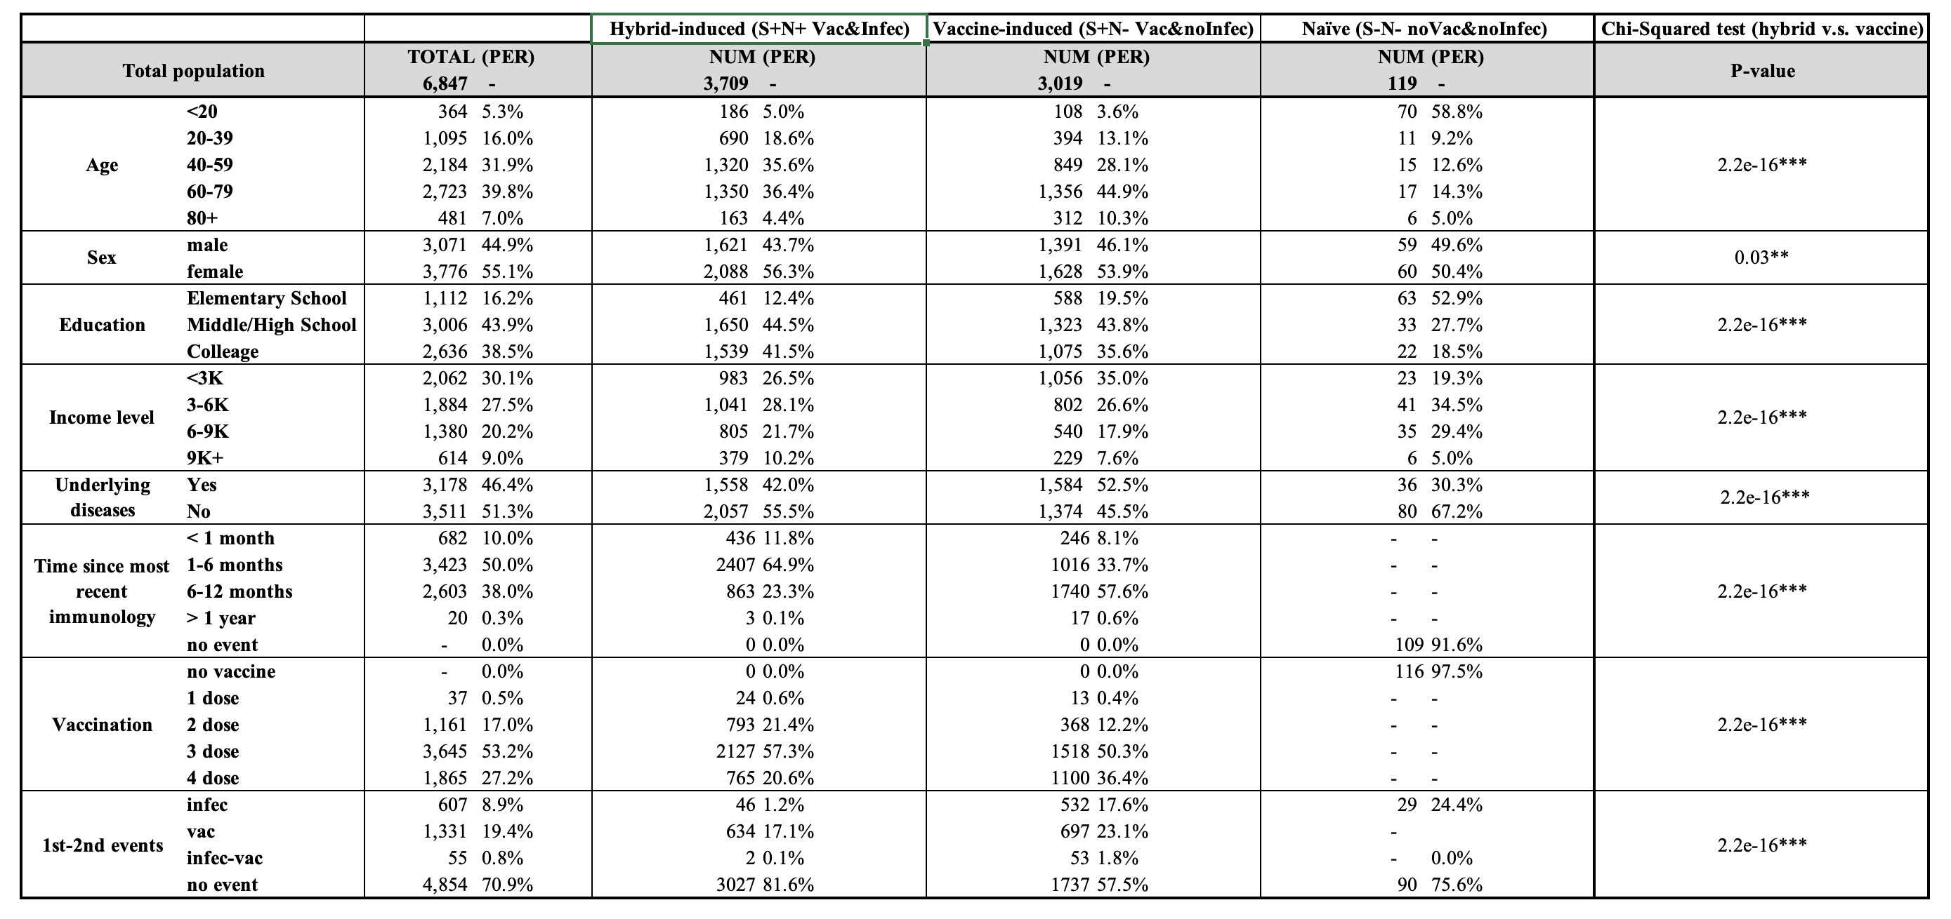
Table 1: Description of Cohort Study Design

Slide 9
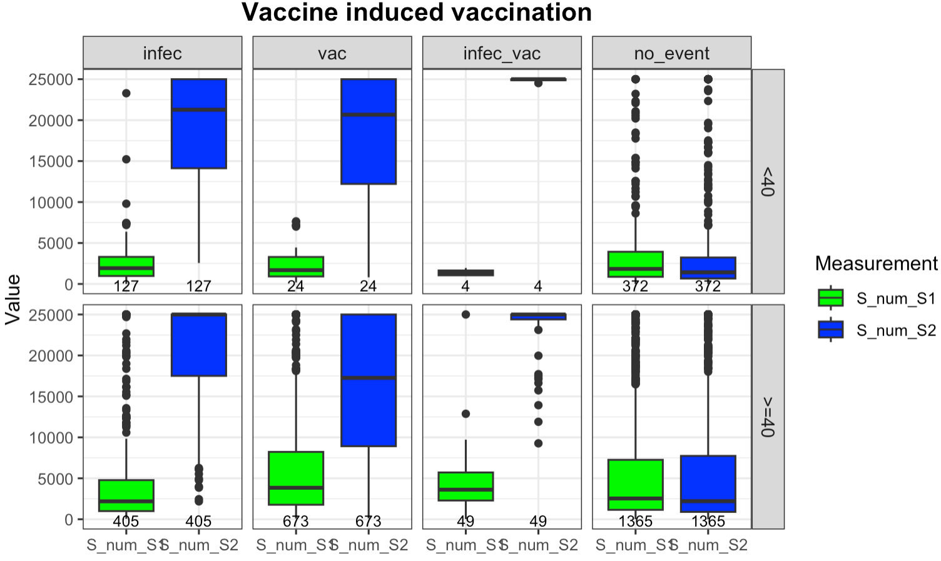
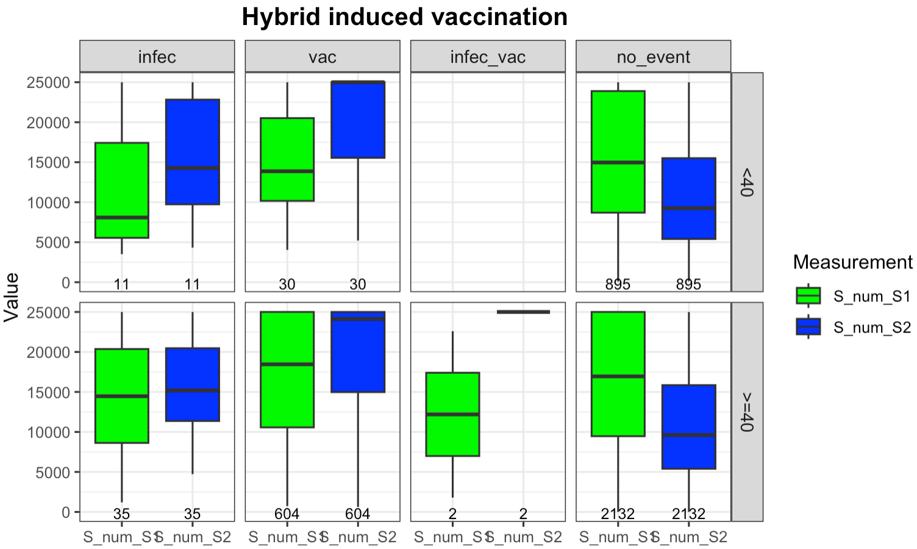
Figure 1: Box plots for S antibody level grouped by Age and later events
The vaccine-induced population had a bigger boost in their S antibody levels than hybrid-induced ones, no matter if they were vaccinated, infected, or both.
However, the hybrid-induced population were less likely to get infected.
Different blue and green for subgroups

Slide 10
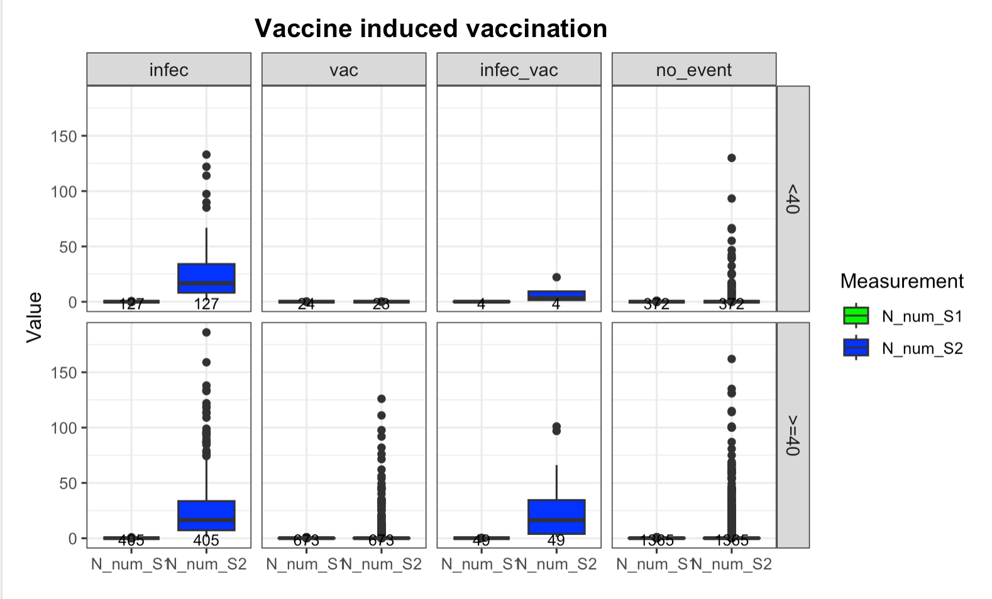
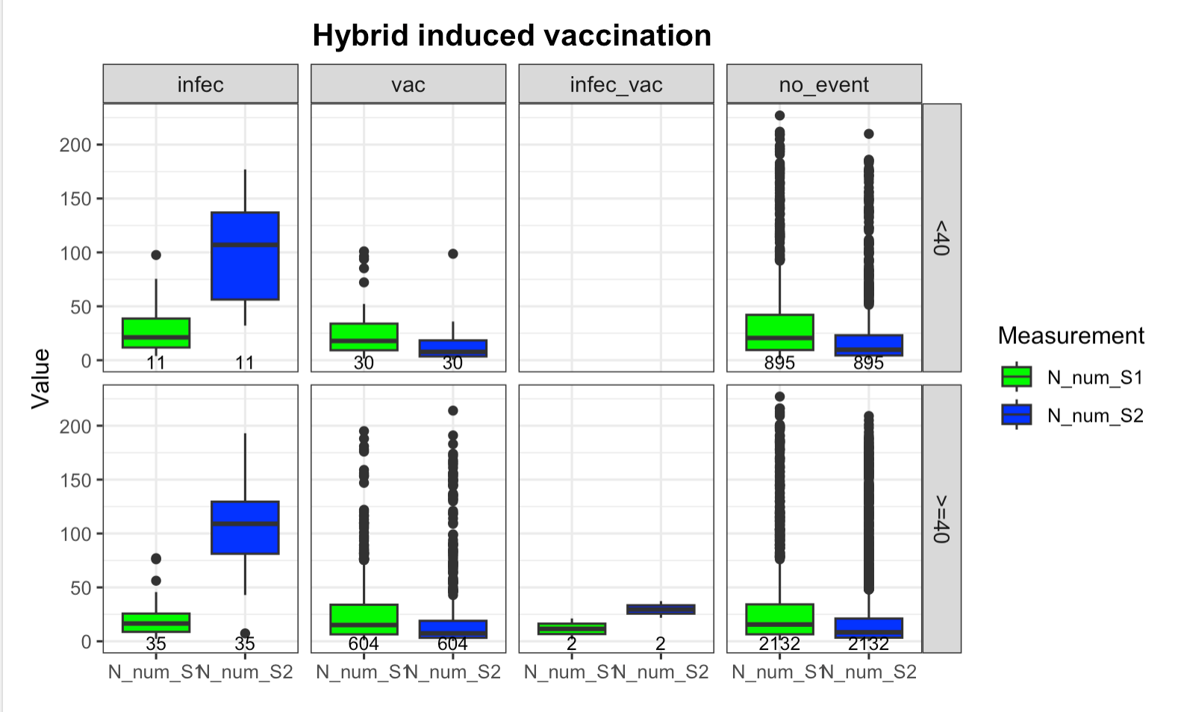
Figure 2: Box plots for N antibody level grouped by Age and later events
The trends in N antibody levels are not well-defined, as these antibodies are typically produced only in response to an infection.

Slide 11
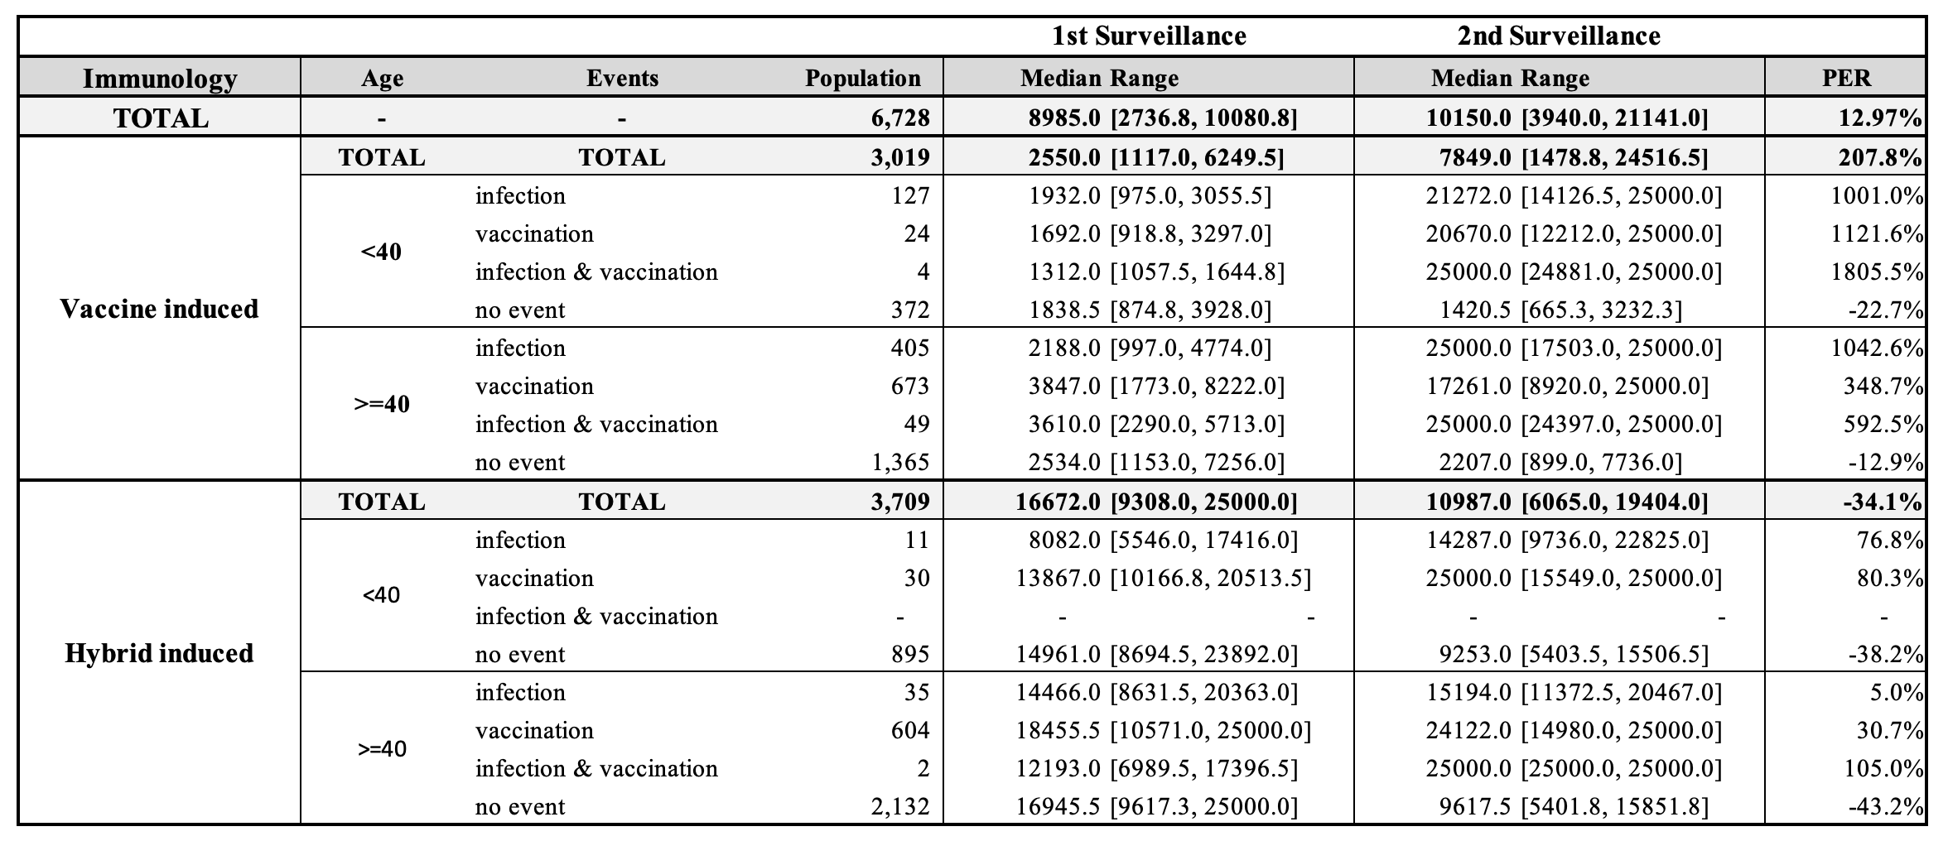
Table 2: Quantification table for the difference of S antibody level from 1st to 2nd Surveillance

Slide 12
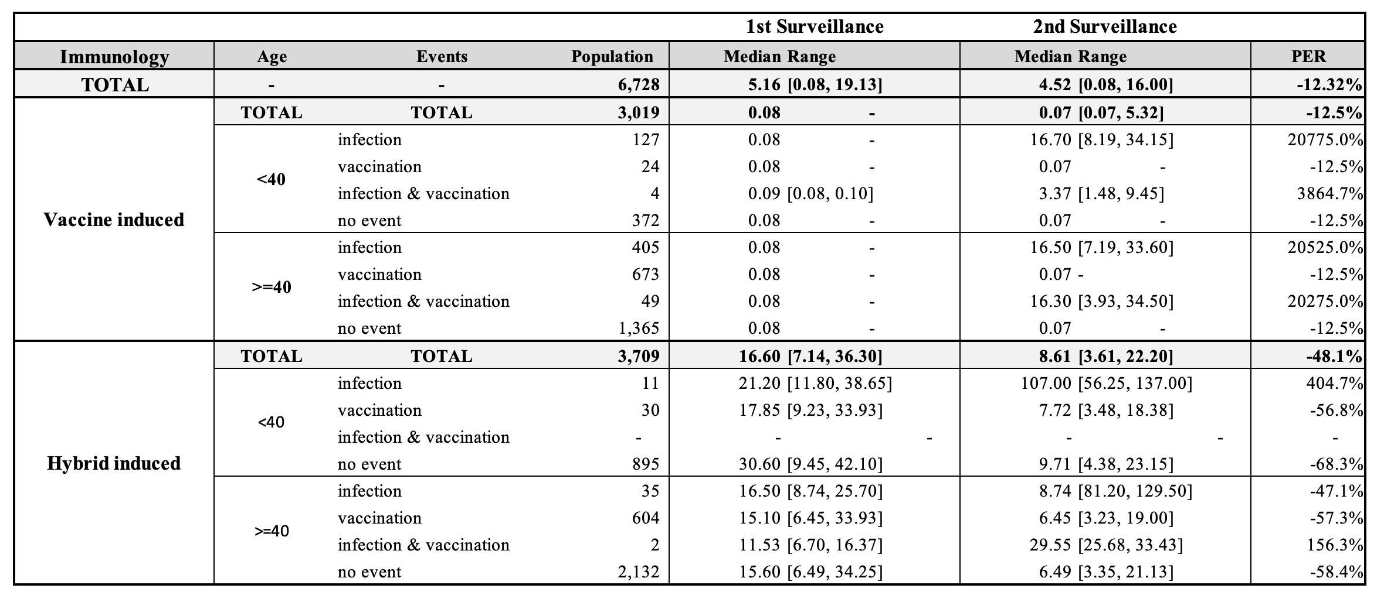
Table 3: Quantification table for the difference of N antibody level from 1st to 2nd Surveillance

Slide 13
Case-based Study
Object of investigation
N = 9,945
Case-control study
Infected (S+N+/S-N+)
N = 5,392(54%)
Uninfected(S+N-)
N = 4,379(44%)
Naive(S-N-)
N = 174(2%)
Symptomatic Infection
N = 4,621(46%)
Asymptomatic Infection
N = 771(8%)

Slide 14
Figure 3: Step-by-step flowchart to create Case-based study cohort
9,945
Total amount of objects in
the 1st surveillance
Exclude those who did not attend or missing S antibody level in the 2nd survey (n = 2,423)
Exclude the population with vaccination between 1st survey and infection if had (n =22)
Exclude the population with increased S Antibody level in the 2nd survey (n = 1,207)
Confirmed infection
between 1st and 2nd Survey (n = 744)
No infection
between 1st and 2nd Survey (n = 5,549)
Exclude those had N- antibody at the 2nd Survey (n = 76)
Exclude the population with vaccination during 1st and 2nd Survey (n = 1,349)
Included in the Case Group :
n = 668
Included in the Control Group:
n = 4,200

Slide 15
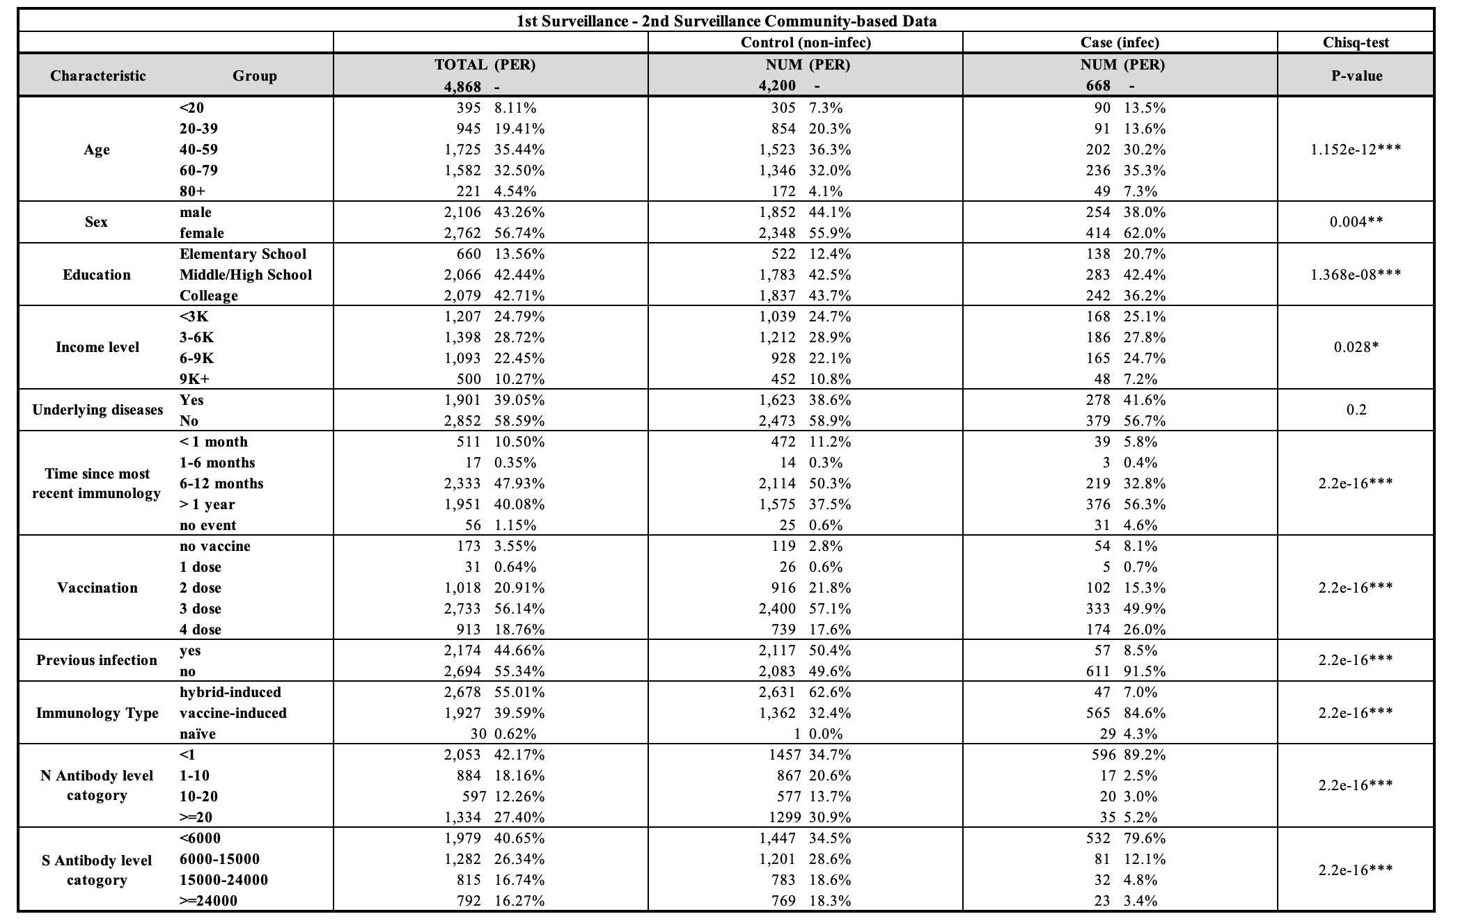
Table 4: Description table for Case-based study cohort

Slide 16
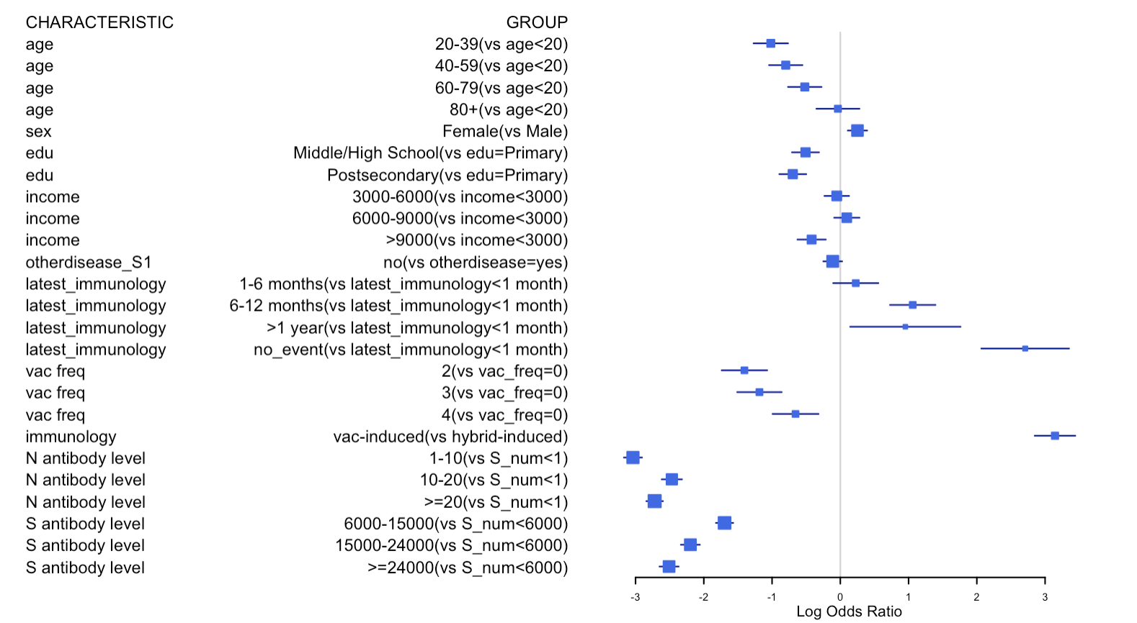
Figure 4: Forest plot for odds ratio of infection (higher log odds ratio means higher infection risk)

Slide 17
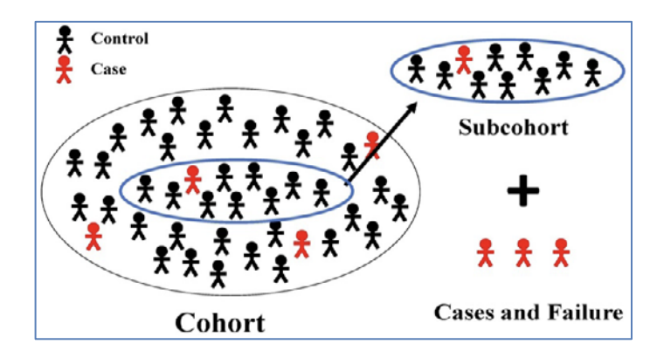
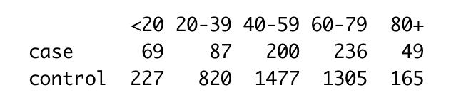
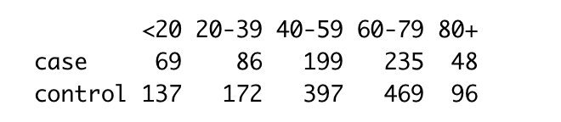
Methodology
Nested Case-control Study (NCC)
Unbalanced case-control data refer to a situation in epidemiological and medical research where the number of cases does not match the number of controls.
To maximize statistical efficiency and minimize bias, for each case, a subset of controls is selected from the same cohort. Controls are often matched to cases on various factors like age, gender, or other characteristics to ensure comparability.
{Epi} in R, by B. Carstensen and M. Plummer, Mar 30, 2024
Raw Case-control cohort
Nested Case-control design cohort

Slide 18
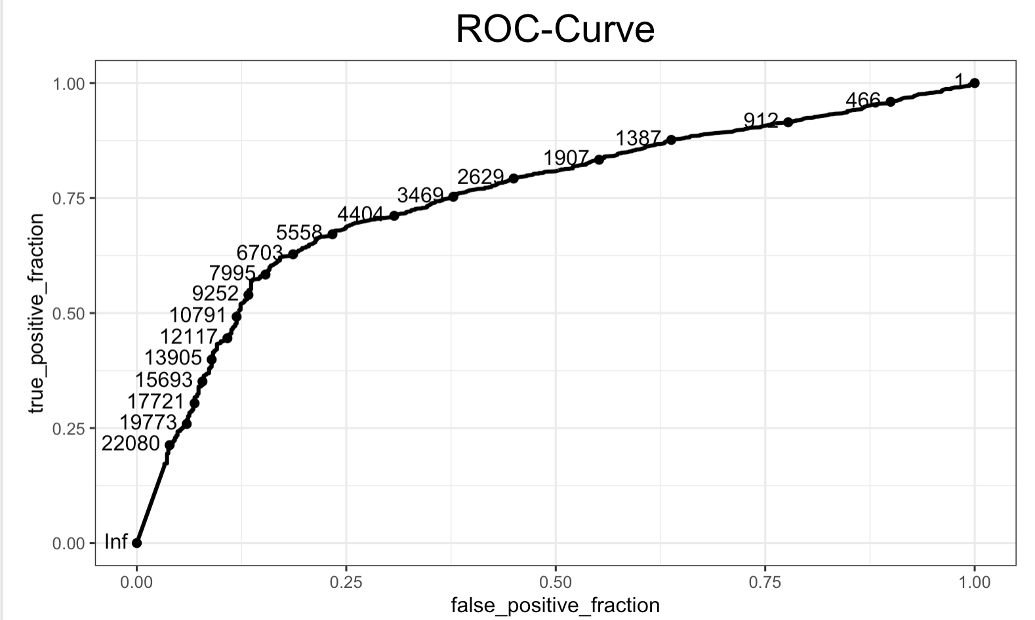
Figure 5: ROC curve for relationship between infection probability and S antibody level

Slide 19
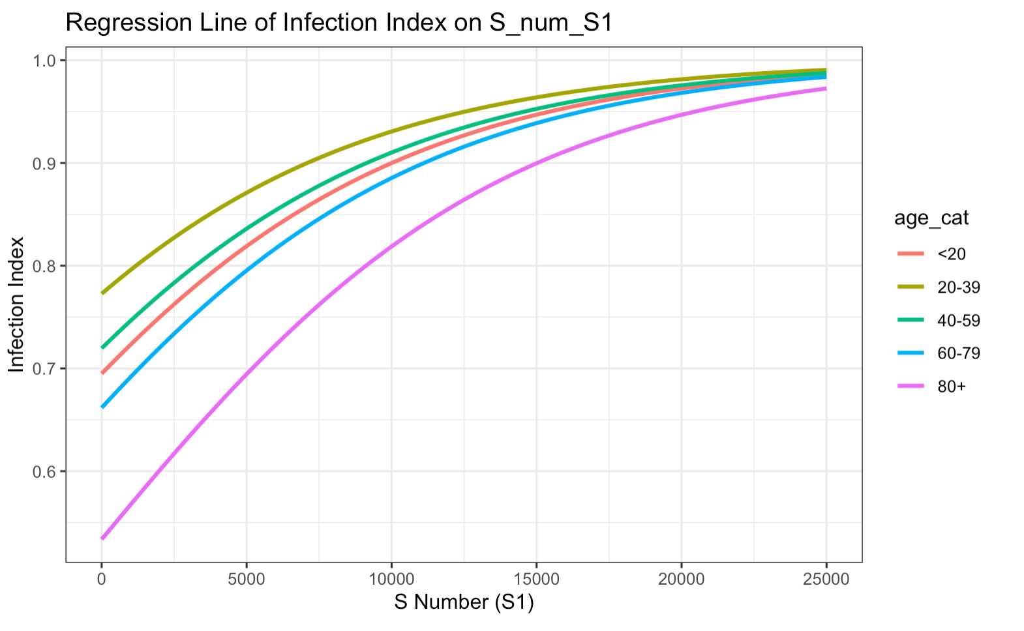
Figure 5: Logistic regression curves based on nested case-control design (Model: Infection ~ S antibody level + Age)

Slide 20
Discussion
Summary:
Case-based Study descriptive analysis indicated that populations with higher S antibody levels have a lower risk of COVID-19 infection, and logistic regression curve showed that maintaining a Spike (S) antibody at 7500, the probability of infection for age groups <20, 20-39, 40-59, and >60 are .87, .91, .88, .85 and .76, respectively.
Population S antibody level threshold can guide appropriate vaccination interval by age group.
The association between S (spike) antibody levels and the severity of symptoms in individuals infected with COVID-19 shows a complex relationship between the immune response and disease outcomes→ While higher levels of S antibodies, especially those capable of neutralizing the virus, are generally associated with a more severe initial presentation of symptoms (Sancilio A et al, 2022), they may also indicate a more effective immune response.
Limitations:
Symptom levels can be a wide range but our study data is limited to binary information (Yes/No).
Spike antibody level can not explain the neutralizing antibody, which could be a better predictor for symptom severity.
Small sample size for those who are infected and asymptomatic individuals, making it difficult to prove a statistically significant difference.
Longer duration of follow up on RR may be warranted.

Slide 21
Reference
[1] https://ourworldindata.org/covid-vaccinations
[2] Amjadi, M. F., & O'Connell, S. E. (2021). Specific COVID-19 symptoms correlate with high antibody levels against SARS-CoV-2. *AAI*.
[3] Imai, K., Kitagawa, Y., Tabata, S., Kubota, K., Nagura-Ikeda, M., Matsuoka, M., Miyoshi, K., Sakai, J., & all authors. (2021). Antibody response patterns in COVID-19 patients with different levels of disease severity in Japan. *Journal of Medical Virology*.
[4] Goldblatt, D., Fiore-Gartland, A., Johnson, M., Hunt, A., Bengt, C., Zavadska, D., Snipe, H. D., Brown, J. S., Workman, L., Zar, H. J., Montefiori, D., Shen, X., Dull, P., Plotkin, S., Siber, G., & Ambrosino, D. (2021). Towards a population-based threshold of protection for COVID-19 vaccines. *Vaccine*.

