Slide 1
Association between S antibody levels to COVID-19 infection status and symptom level from nationwide community surveillance data in South Korea
Jo, Youngji
Zhang, Franky

Slide 2
Potential reference
Amjadi, M. F., & O'Connell, S. E. (2021). Specific COVID-19 Symptoms Correlate with High Antibody Levels against SARS-CoV-2. AAI. https://doi.org/10.4049/immunohorizons.2100022
Investigating the development and longevity of antibodies against SARS-CoV-2 in COVID-19 convalescent patients. Antibodies were found in 98% of subjects five weeks post-symptom resolution, with levels remaining stable at three months. Higher antibody levels were linked to greater disease severity, older age, male gender, higher BMI, and comorbidities. Notably, symptoms like fever, body aches, and low appetite during COVID-19 were associated with higher antibody levels.
Hansen, C. B., & Jarlhelt, I. (2021). SARS-CoV-2 Antibody Responses Are Correlated to Disease Severity in COVID-19 Convalescent Individuals. AAI. https://doi.org/10.4049/jimmunol.2000898
New ELISA-based assays for detecting SARS-CoV-2 antibodies, critical for understanding COVID-19 and informing vaccine development. Tested on 350 individuals recovering from COVID-19, from asymptomatic to severe cases, the assays evaluated antibody responses to the virus's N and S proteins. Findings show that IgM, A, and G responses to the receptor-binding domain correlate with disease severity, providing valuable insights for diagnostics and understanding long-term immunity.

Slide 3
Potential reference
Yi, S., Choe, Y. J., Lim., & Park, Y.-J. (2022). Impact of national Covid-19 vaccination Campaign, South Korea. *Vaccine, 40*(26), 3670-3675. https://doi.org/10.1016/j.vaccine.2022.05.002 “In South Korea, the COVID-19 vaccination campaign effectively reduced SARS-CoV-2 infections, severe diseases, and deaths. Vaccinated individuals had a 63% lower infection rate than unvaccinated individuals, with vaccine effectiveness reaching 93% and 95% against severe disease and death, respectively. From March to October 2021, the campaign prevented an estimated 46,508 infections, 3,424 severe cases, and 718 deaths. However, the decreased infection protection highlights the importance of continuous vaccination program evaluation.”
Kwon, S. L., & Oh, J. (2022). COVID-19 vaccination program in South Korea: A long journey toward a new normal. *Health Policy and Technology, 11*(2), 100601. https://doi.org/10.1016/j.hlpt.2022.100601
“Securing early vaccines was crucial for COVID-19 control, and South Korea's ability to innovate and adapt quickly overcame initial procurement delays, expanding vaccine coverage. With new variants and reduced vaccine effectiveness, Korea is now moving to include booster shots in its vaccination strategy. Despite challenges in vaccine supply and administration, South Korea's proactive approach has been effective, highlighting the need for continuous adaptation, including booster programs to combat evolving virus strains.”

Slide 4
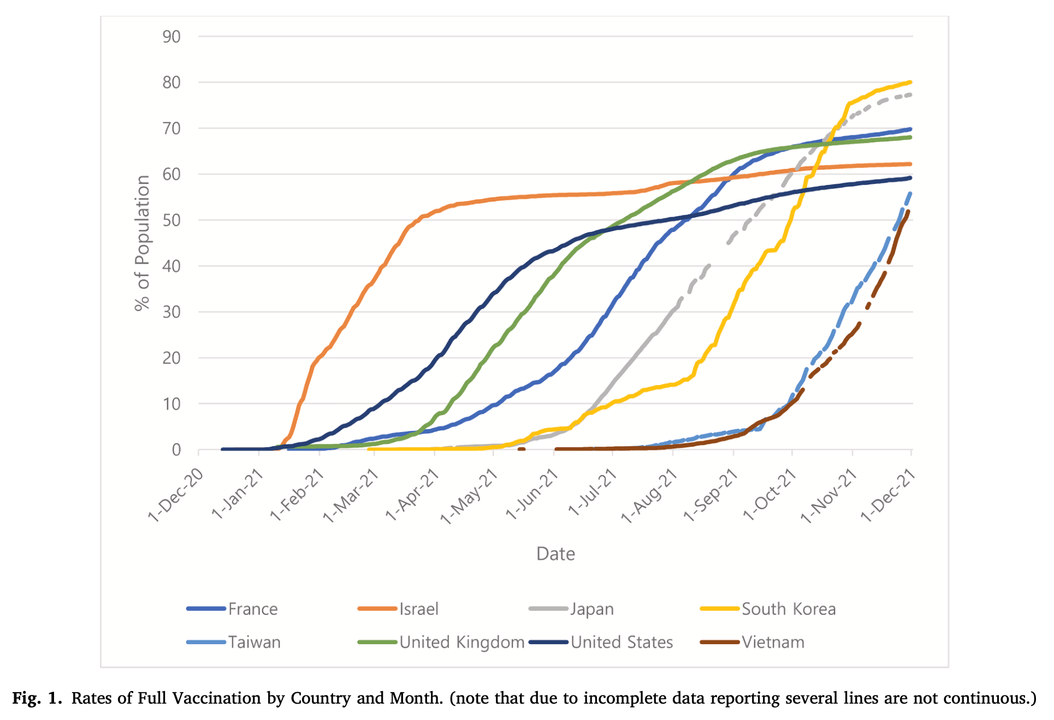

Slide 5
Background
Objectives(to assess S antibody level to infection status and symptom level)
I: If S antibody level contribute to protection against infection?
II: If S antibody level contribute to relief the COVID-19 symptoms?

Slide 6
1. 왜 지역사회 기반 반복적인 항체조사 및 추적조사가 필요한가?
1. 대표성 있는 지역사회 항체양성률 자료 부재
- 혈청 검체의 편의추출로 인해 결과해석 한계 상존
2. 코로나19 항체 양성률 기반 코로나19 확산 위험도 평가 부재
- 항체조사 연구결과 확장성 미흡 및 예측 정확성 저하
3. 단면조사를 통해서는 항체역가의 변동에 따른 위험도 추이평가 어려움

Slide 7
Introduction
Epidemic curve of COVID-19 in Korea (2020.1.20.~2023.4.20.)
4th peak
5th peak
6th peak
7th peak
Community-based seroprevalence survey of COVID-19 in Korea
1st peak
2nd peak
3rd peak
Follow-up survey

Slide 8
조사배경
Seroprerevalence survey design
Repeated cross-sectional investigation in the same geographical area
Aug,2022
Apr,2023
Sep,2023
Jan,2024
One-time
cross-sectional investigation
1st Survey
3rd Survey
?
2nd Survey
Dec,2022
Longitudinal cohort investigation with serial sampling of the same individual each time
?

Slide 9
조사운영과정
3차 항체조사 수행개요
조사기간
2023년 3월 27일(월)~2023년 4월 15일(토)
조사지역
전국 258개 시군구
조사대상
258개 시군구 내 확률비례계통추출법으로 선정된 1,000개의 집계구에서
무작위로 추출된 5,000가구에 거주하는 만 5세 이상 가구원 10,000명
조사방법
조사원이 선정된 가구를 방문하여 태블릿으로 1:1대면조사
참여기관
조사수행업체: 글로벌리서치
채혈기관: 258개 보건소 및 113개 민간의료기관
검체분석기관: 씨젠

Slide 10
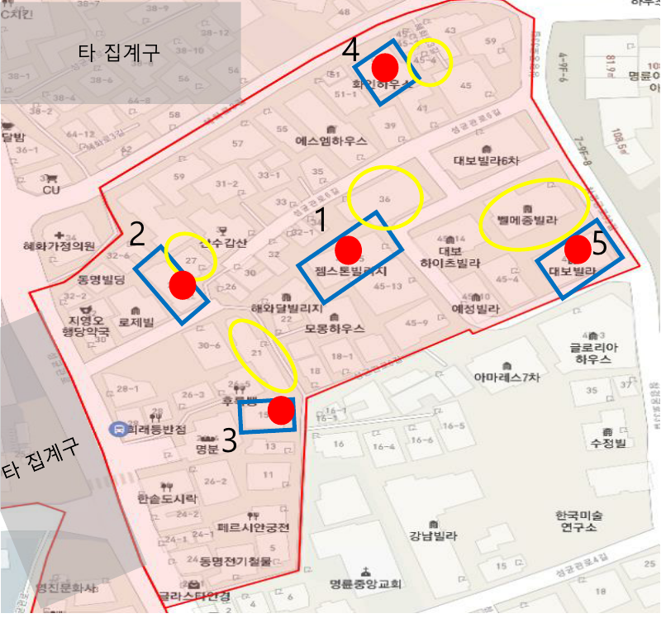
조사운영과정
집계구내 본가구 및 예비가구 선정기준
지역별 최소 2개 이상 배정
(*지역별 목표 수에 따라 다름)
집계구
본가구
글로벌리서치에서 무작위로 선정한
5개의 본 가구
예비가구
본 가구가 동의거부, 부적합가구인 경우
반시계방향 나선형으로 예비가구지정
(조사원 요청시 조사관리자가 지정 후 승인)

Slide 11
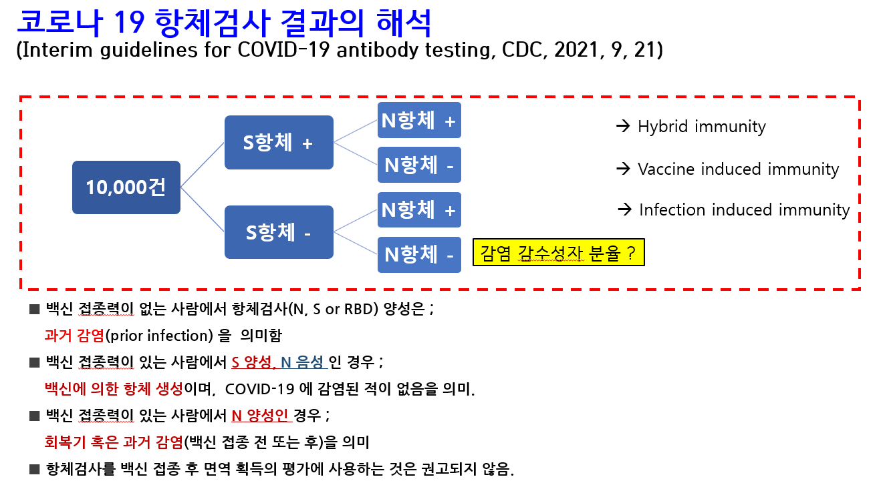

Slide 12
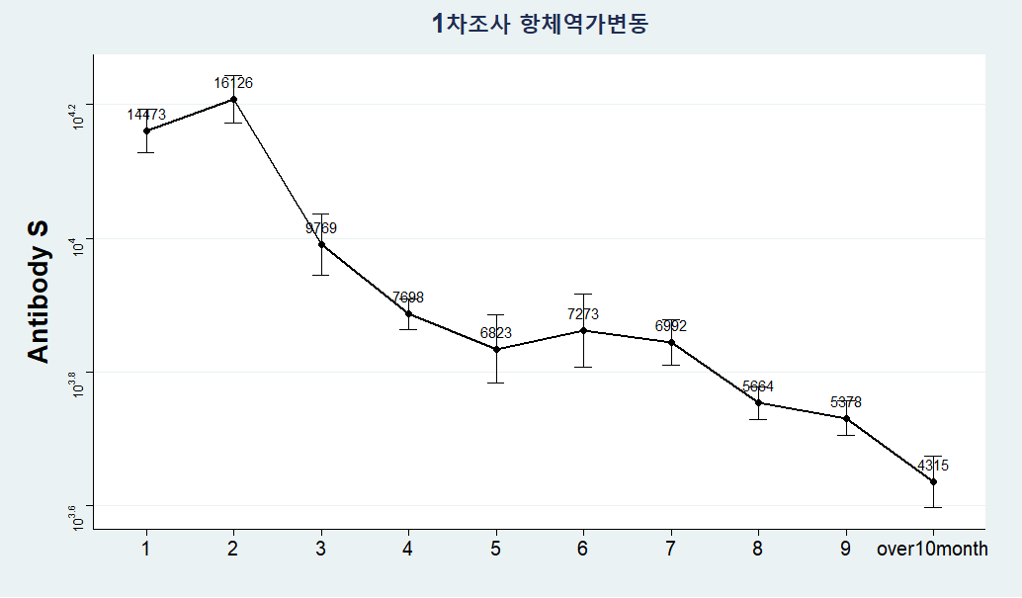
1차 조사 참여자 항체역가 감소 추이 (전체, 9007명)
채혈일자 – 가장 마지막 접종력 또는 확진일

Slide 13
Methodology
Key terms in Research Surveillance time: 1st surveillance: Aug 2022 2nd surveillance: Dec 2022
Surveillance method: Nationwide community-based surveillance
Outcome measurement: S antibody level and Group I: confirmation with infection between 1st and 2nd surveillance versus no infection Group II: confirmation with symptom versus non symptom
Statistical analysis: Group I: descriptive analysis, logistic regression, statistical inference Group II: descriptive analysis
Object of investigation
N = 9,945
Case-control study
Infected (S+N+/S-N+)
N = 5,392(54%)
Uninfected(S+N-)
N = 4,379(44%)
Naive(S-N-)
N = 174(2%)
Symptomatic Infection
N = 4,621(46%)
Asymptomatic Infection
N = 771(8%)

Slide 14
Figure1: Flowchart to create cohorts with 1st and 2nd Survey data.
9,945
Total amount of objects in
the 1st survey
3,381
Objects found to be free of infection by the time of 2nd Survey
3,221
Objects fail to meet inclusion criteria
694
Objects in Group I(a)
5,870
Objects without confirmation between 1st and 2nd Survey
1,278
Objects with missing S-antibody level in 1st or 2nd survey
1,123
Objects with higher S-antibody level in 2nd survey comparing with 1st
Group I
126
Objects with vaccination between 1st and 2nd survey
694
Group I(a): Objects with confirmed infection between 1st and 2nd Survey
3,343
Group I(b): Objects without confirmed infection between 1st and 2nd Survey
140
Objects fail to meet inclusion criteria
88
Objects answering “symptomatic” for both 1st and 2nd Survey
52
Objects with vaccination between 1st Survey and confirmation
Group II
48
Group II(a): Objects with symptomatic infection between 1st and 2nd Survey
506
Group II(b): Objects with asymptomatic infection between 1st and 2nd Survey

Slide 15
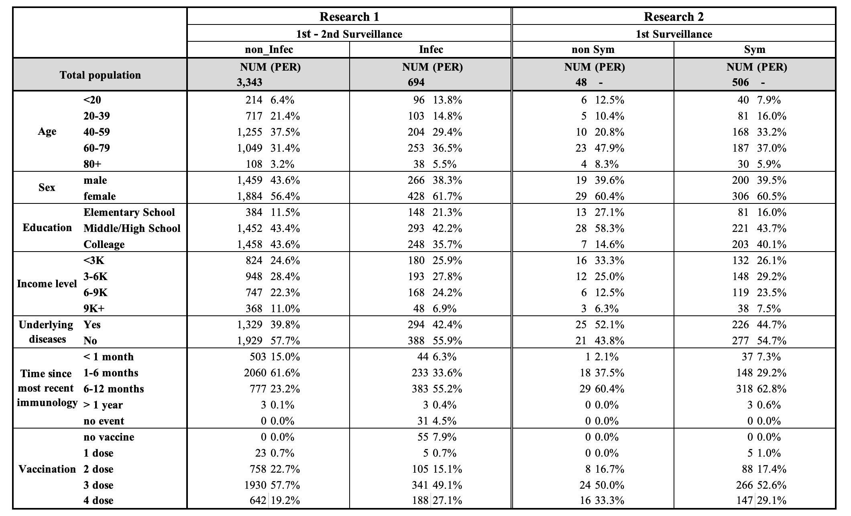
Table1: Data description for Research I and II

Slide 16
Group I
1st survey
2nd survey
Case I
V
Case II
V
S Antibody Level
Confirmed
V
Vaccine

Slide 17
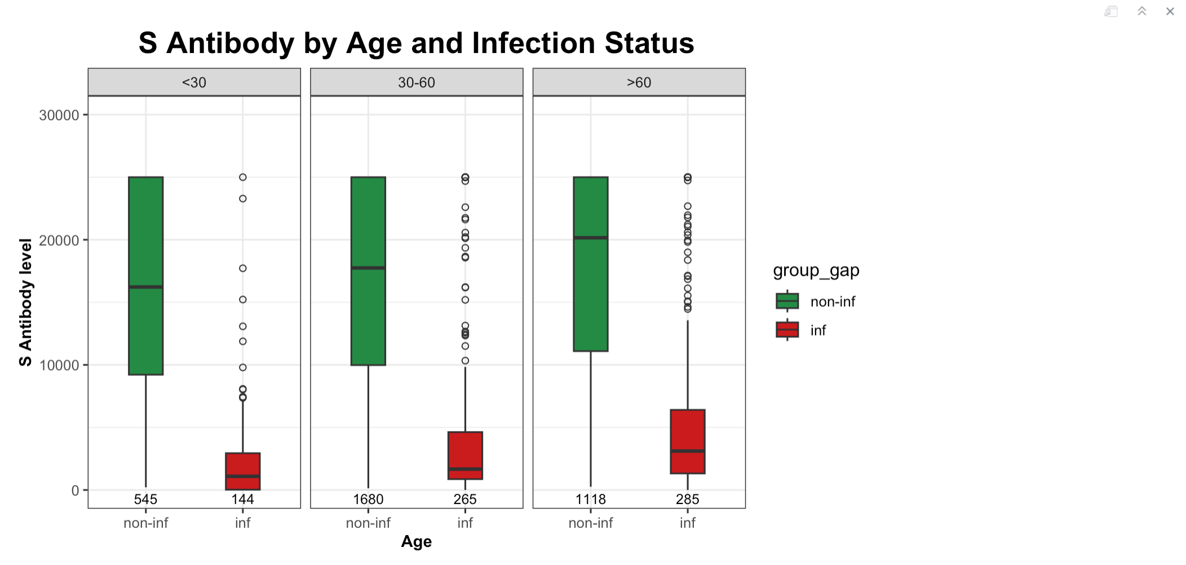
Figure2a: Box plot of S antibody levels, grouped by Age
Whatever the age group, the average S antibody level of objects with infection between 1st and 2nd survey is obviously
lower than those without infection

Slide 18
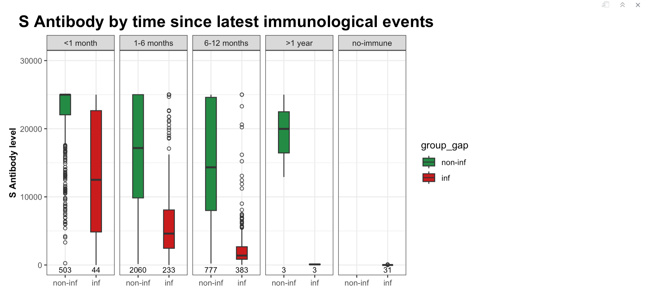
Figure2b: Box plot of S antibody levels, grouped by most recent immunological event gap
Whatever the most recent immunological gap, the average S antibody level of objects without infection is obviously
higher than those with infection; Additionally, as the most recent immunological gap goes on, the median S antibody
level goes down

Slide 19
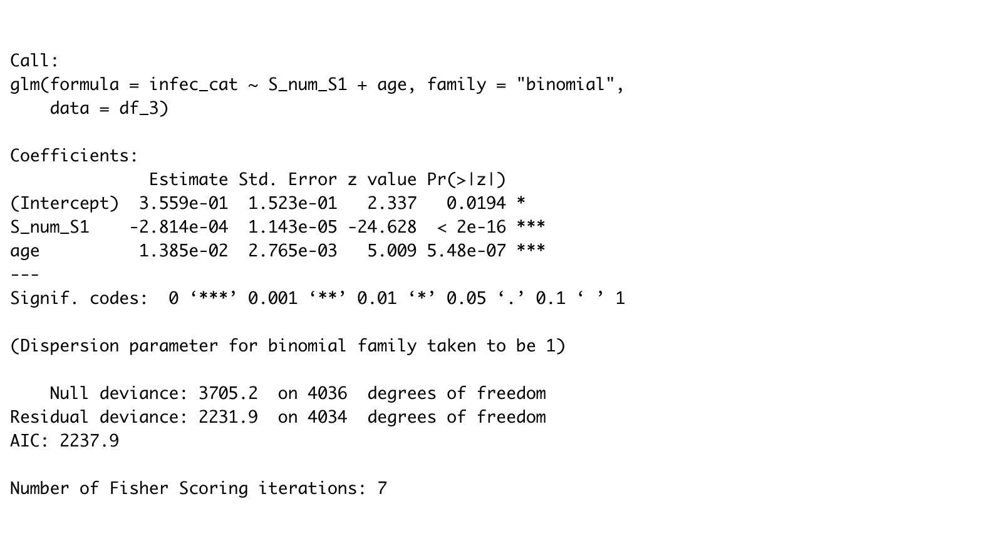
Regression Model

Slide 20
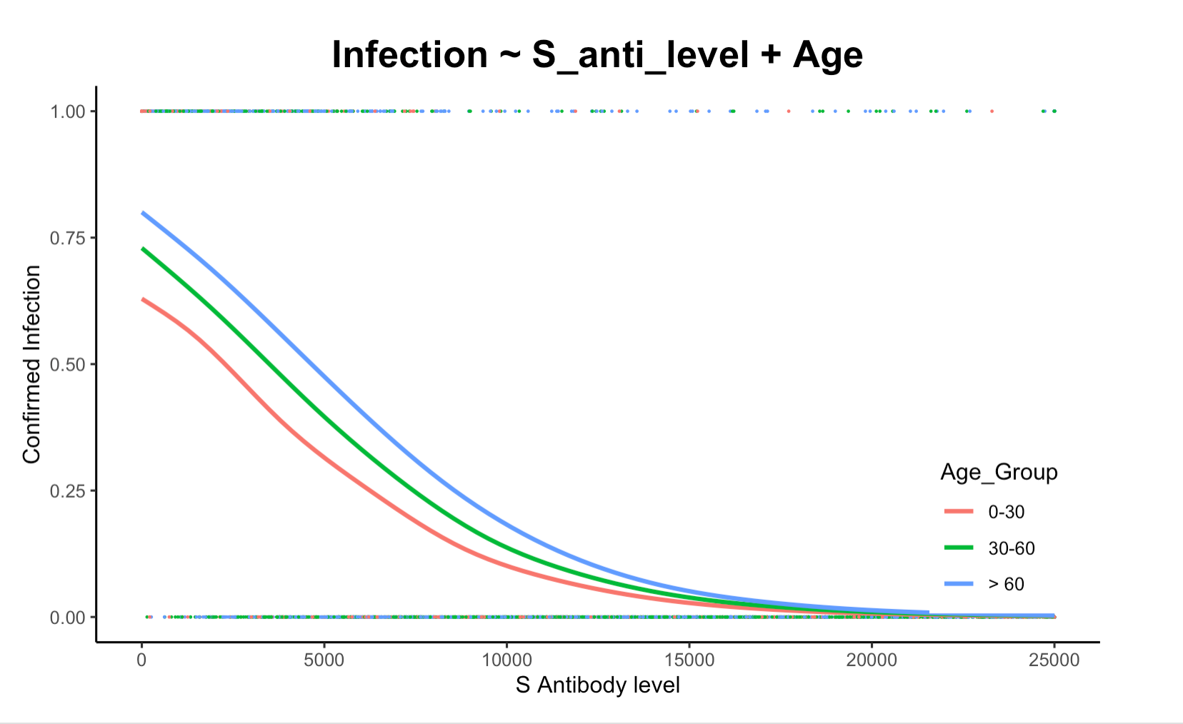
Regression Model Plot

Slide 21
Research II
1st survey
2nd survey
Case I
V
Case II
V
S Antibody Level
Symptomatic Confirmed
V
Vaccine
Asymptomatic Confirmed

Slide 22
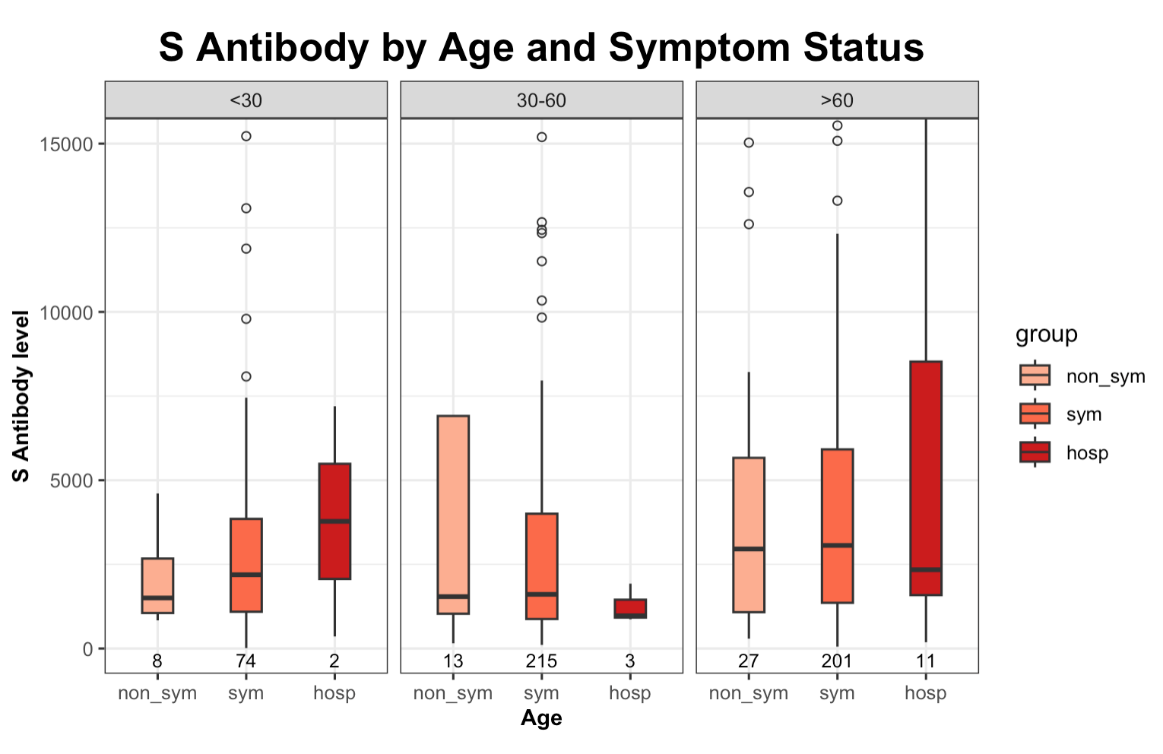
Figure3a: Box plot of S antibody levels, grouped by Age
Overall, the sample sizes for asymptomatic groups, particularly those under 60, are quite small. Regarding the older age group, individuals with higher S antibody levels tend to exhibit fewer symptoms.

Slide 23
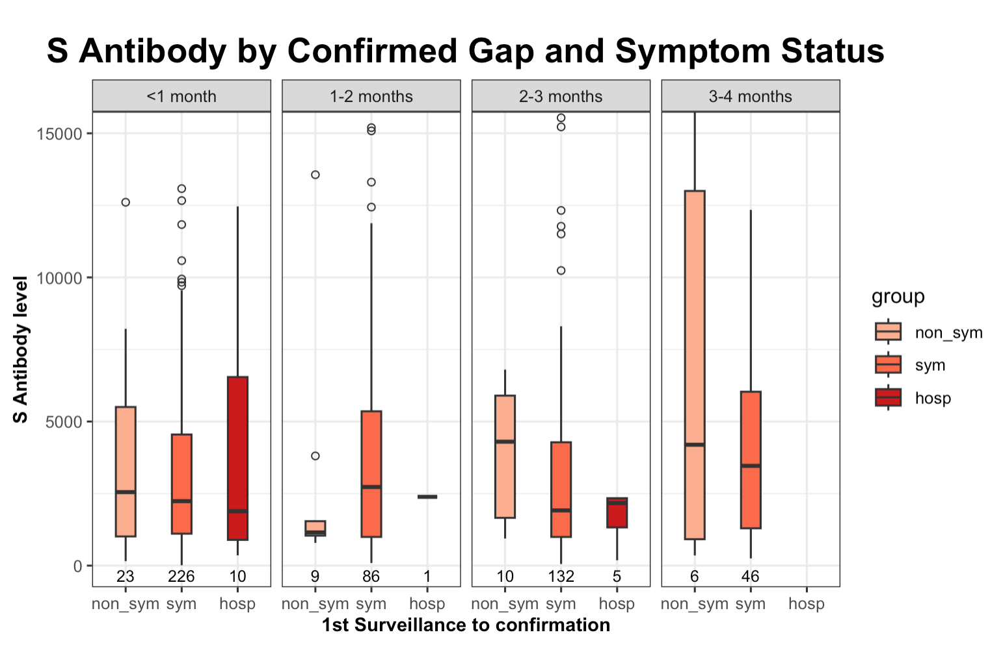
Figure3b: Box plot of S antibody levels, grouped by Post time
Excluding the non-representative group (1-2 months) due to extremely low sample sizes, once the gap between the first surveillance and confirmation is accounted for, individuals with higher S antibody levels are less likely to exhibit severe symptoms.

Slide 24
Discussion
Summary:
Group I descriptive analysis indicated higher S antibody levels in uninfected individuals, and logistic regression showed that S antibody thresholds for a 75% chance of avoiding COVID-19 infection are 6000, 8000, and 10000 for age groups <30, 30-60, and >60, respectively.
Group II analysis demonstrate a correlation where elevated levels of S antibodies are associated with a reduced likelihood of experiencing severe COVID-19 symptoms in some subgroups.
Limitations:
The dataset indicates that the cohort of confirmed infections captured between the first and second surveillance points is limited, particularly within the asymptomatic subset, rendering it challenging to demonstrate a statistically significant difference.

Slide 25
Appendix

Slide 26
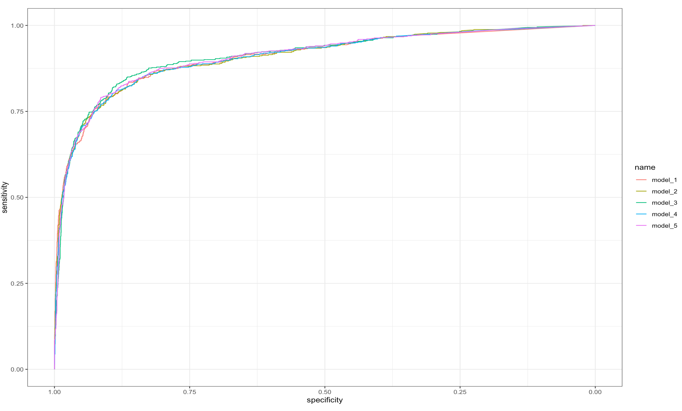
Regression Model comparison
Infec ~ S_num
Infec ~ S_num + Income
Infec ~ S_num + Age
Infec ~ S_num + Otherdisease
Infec ~ S_num + edu

Slide 27
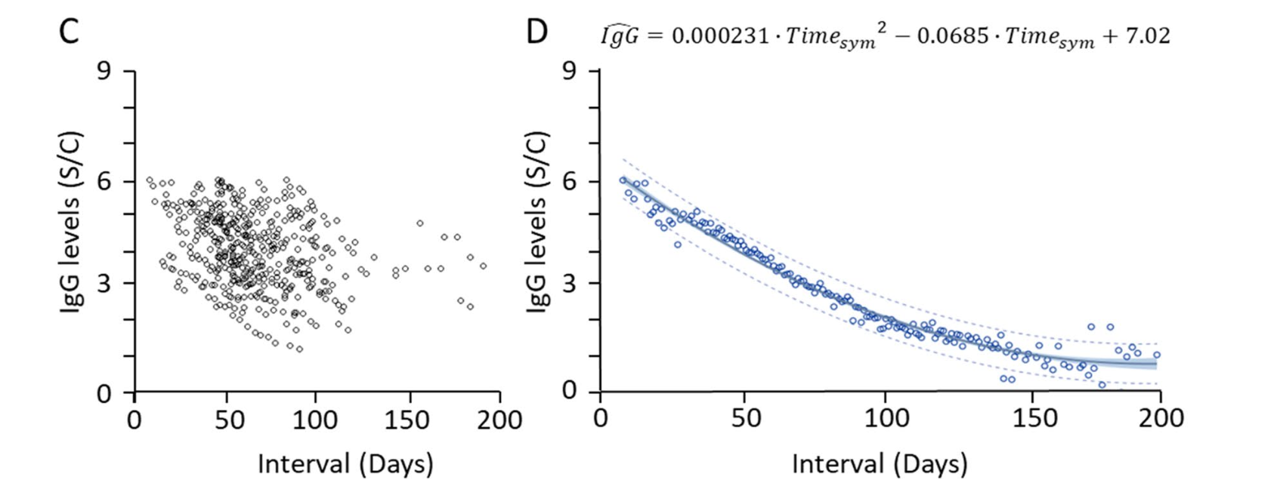
Topic: If S antibody level contribute to COVID-19 symptoms ?
What do we currently have ?
S Antibody Level
Symptomatic/Confirmed
Asymptomatic/Confirmed
UNKNOWN
with Decay
*
1st survey
2nd survey
contagion
V
vaccine
V
*
*
Date of latest vaccination
Date of Confirmation1
1) Date of Survey1
2) S Antibody level of Survey1
3) IF any Symptom before
Date of Confirmation2
1) Date of Survey2
2) S Antibody level of Survey2
3) IF any Symptom before
UNKNOWN
DOI: 10.1038/s41598-021-96171-4

Slide 28
DATA PREPROCESSING
S Antibody Level
Symptomatic/Confirmed
1st Case
Asymptomatic/Confirmed
V
vaccine
V
2nd Case
EXCLUDE
V
3rd Case
4th Case
EXCLUDE
V
5th Case
V
Aug 2022
1st survey
Dec 2022
2nd survey

Slide 29
Other cases needed to be carefully considered ?
1st Case
EXCLUDE
V
V
2nd Case
EXCLUDE
V
1st confirmation
- Symptomatic!
1st Survey
- IF any Symptom before?
- Yes
2nd confirmation
- Asymptomatic ?
- Symptomatic?
2nd Survey
- IF any Symptom before?
- Yes

Slide 30
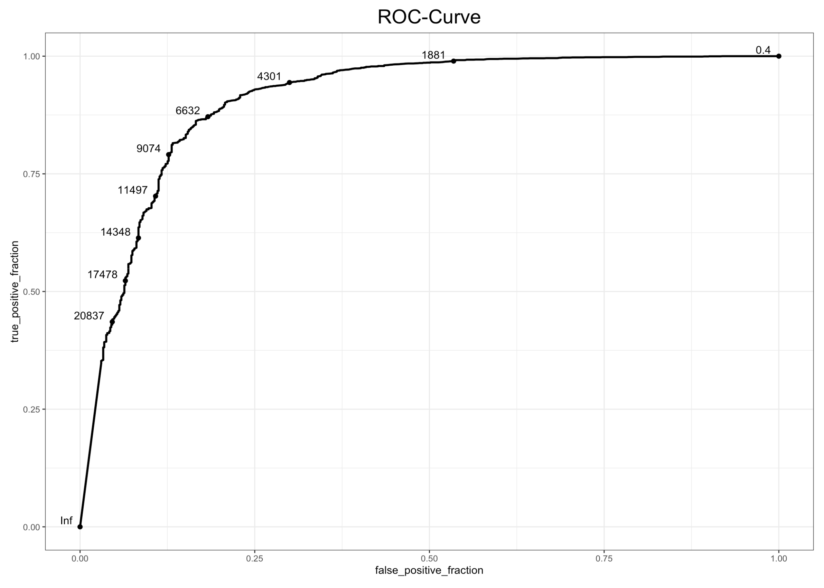
Confusion Matrix used here:
 | Infec-Yes | Infec-No
S_num > cutoff | a | b
S_num < cutoff | c | d
Sensitivity and Specificity
calculation here:
Sensitivity = [a/(a + c)]
Specificity = [d/(b + d)]

