Slide 1
Association between S antibody levels to COVID-19 infection status and symptom level from nationwide community surveillance data in South Korea
Jo, Youngji
Zhang, Franky

Slide 2
Background
COVID-19 Vaccination in South Korea
As of December 2022, South Korea achieved a vaccination coverage of 86.43% for at least one dose ^{[1]}.
Immune Response and Antibodies to the Nuclear (N) and Spike (S) Proteins
Lower antibody levels were linked to greater disease severity, older age, male gender, higher BMI, and comorbidities. Notably, symptoms like fever, body aches, and low appetite during COVID-19 were associated with lower antibody levels. ^{[2]}
Research in Japan (2021) on COVID-19 found that severe and critical cases had higher IgG and IgM seroconversion rates against N and S proteins than mild cases, suggesting stronger antibody responses correlate with disease severity, while mild cases had lower antibody seroconversion rates ^{[3]}.
The protective threshold for each vaccine was calculated for IgG anti-Spike antibody. The mean protective threshold for all vaccine studies for WT virus was 154 BAU/ml (95 % CI 42–559), and for studies with antibody distributions that enabled precise estimation of thresholds (i.e. leaving out 2-dose mRNA regimens) was 60 BAU/ml (95 %CI 35–102) ^{[4]}.
Motivation of our research
Examining the Correlation Between Spike (S) Protein Antibody Levels and COVID-19 Infection Using Statistical Approaches and Community-Based Survey Data
Furthermore, investigating the Correlation Between Spike (S) Protein Antibody Levels and the Severity of COVID-19 Symptoms

Slide 3
Introduction
Epidemic curve of COVID-19 in Korea (2020.1.20.~2023.4.20.)
4th peak
5th peak
6th peak
7th peak
Community-based seroprevalence survey of COVID-19 in Korea
1st peak
2nd peak
3rd peak
Follow-up survey

Slide 4
조사배경
Seroprerevalence survey design
Repeated cross-sectional investigation in the same geographical area
Aug,2022
Apr,2023
Sep,2023
Jan,2024
One-time
cross-sectional investigation
1st Survey
3rd Survey
?
2nd Survey
Dec,2022
Longitudinal cohort investigation with serial sampling of the same individual each time
?

Slide 5
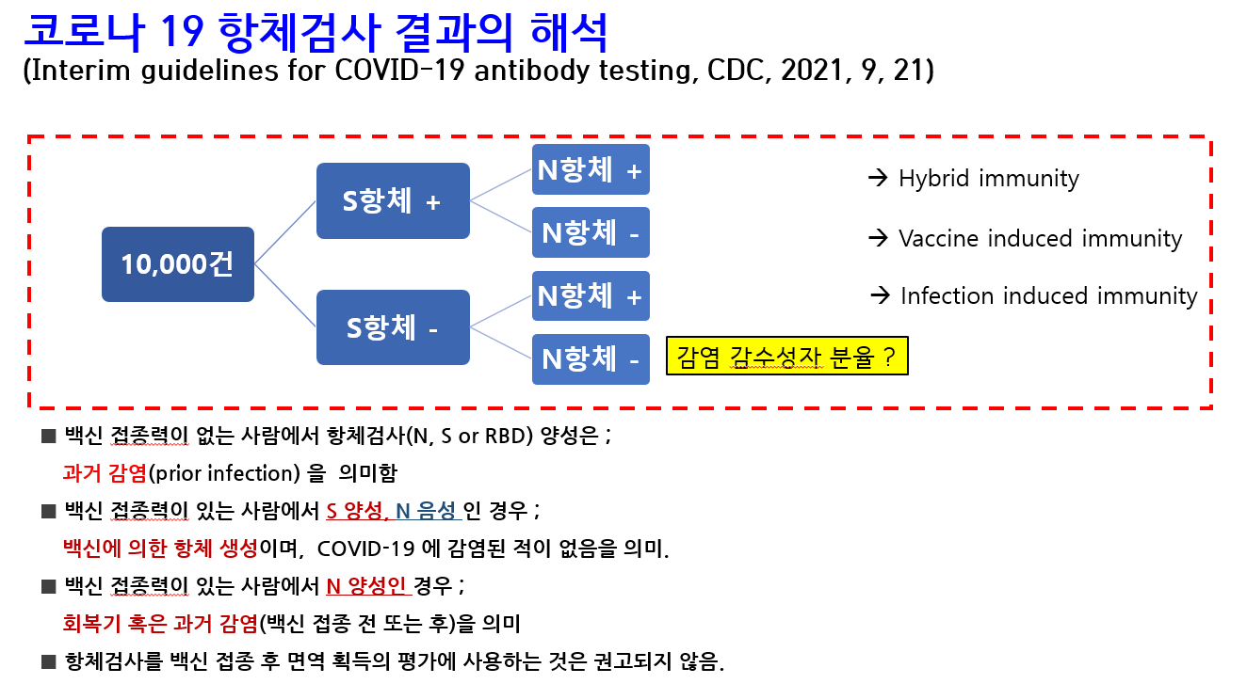

Slide 6
Methodology
Surveillance Period: 1st survey: August 2023 2nd survey: December 2023 Surveillance Area: 258 cities and counties nationwide Surveillance Subjects: 10,000 individuals aged 5+ were randomly selected from 5,000 households. Surveillance method: Nationwide community-based surveillance. Surveyors conduct one-on-one interviews via tablets. Participating institutions: Survey agency: Global Research Blood collection Institutions: 258 public health centers and 113 private medical facilities Specimen analysis institution: Seegene
Outcome measurement: anti-Spike (S) antibody level and Group I: confirmation with infection between 1st and 2nd surveillance versus no infection Group II: confirmation with symptom versus non symptom
Statistical analysis: Group I: descriptive analysis, logistic regression, statistical inference Group II: descriptive analysis
N+
Hybrid immunity
S+
10,000
Subjects
N-
Vaccine Induced
N+
Infection induced
S-
N-
Naive
Object of investigation
N = 9,945
Group I
Infected (S+N+/S-N+)
N = 5,392(54%)
Uninfected(S+N-)
N = 4,379(44%)
Naive(S-N-)
N = 174(2%)
Group II
Symptomatic Infection
N = 4,621(46%)
Asymptomatic Infection
N = 771(8%)

Slide 7
Why Are Repeatable Community-Based Antibody Surveys and Follow-Ups Essential?
1. Lack of Representative Community-Based Seroprevalence Data
- Limitations in interpreting results due to convenience sampling of serum specimens.
2. Absence of COVID-19 Spread Risk Assessment Based on Antibody Seroprevalence
- Limited scalability of antibody study findings and decreased predictive accuracy.
3. Challenges in Assessing Risk Trends Based on Antibody Titer Variations Through Cross-Sectional Surveys
- Difficulty in evaluating risk trends due to fluctuations in antibody titers over time.

Slide 8
Figure1: Flowchart to create cohorts with 1st and 2nd Survey data.
9,945
Total amount of objects in
the 1st survey
3,381
Objects found to be free of infection by the time of 2nd Survey
3,221
Objects fail to meet inclusion criteria
694
Objects in Group I(a)
5,870
Objects without confirmation between 1st and 2nd Survey
1,278
Objects with missing S-antibody level in 1st or 2nd survey
1,123
Objects with higher S-antibody level in 2nd survey comparing with 1st
Group I
126
Objects with vaccination between 1st and 2nd survey
694
Group I(a): Objects with confirmed infection between 1st and 2nd Survey
3,343
Group I(b): Objects without confirmed infection between 1st and 2nd Survey
140
Objects fail to meet inclusion criteria
88
Objects answering “symptomatic” for both 1st and 2nd Survey
52
Objects with vaccination between 1st Survey and confirmation
Group II
48
Group II(a): Objects with symptomatic infection between 1st and 2nd Survey
506
Group II(b): Objects with asymptomatic infection between 1st and 2nd Survey

Slide 9
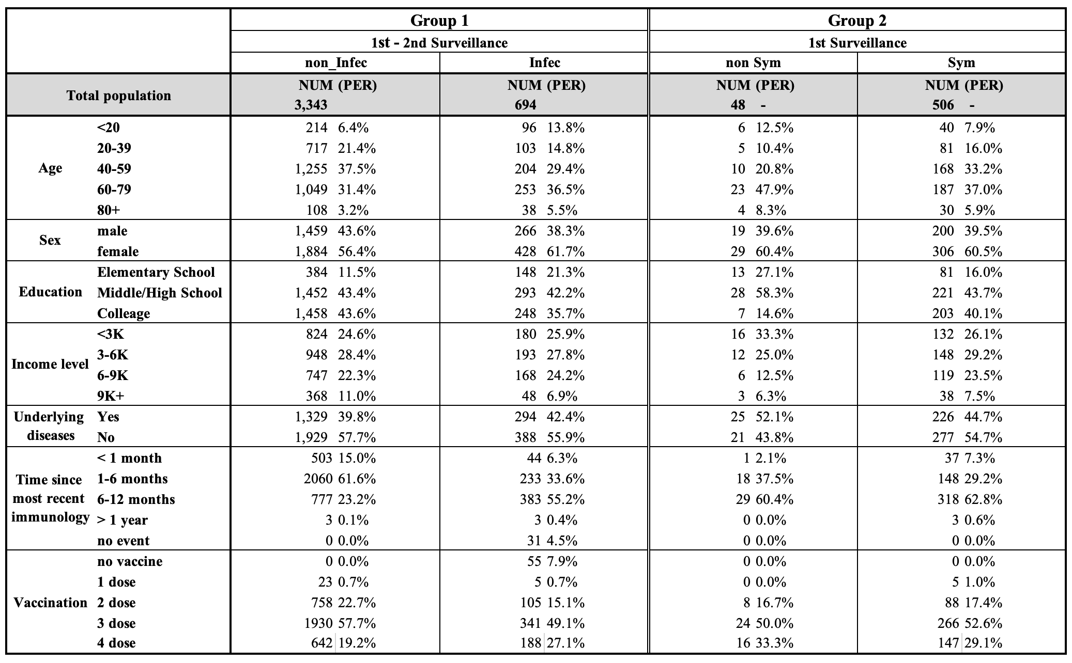
Table1: Data description for Research I and II

Slide 10
Group I
1st survey
2nd survey
Case I
V
Case II
V
S Antibody Level
Confirmed
V
Vaccine

Slide 11
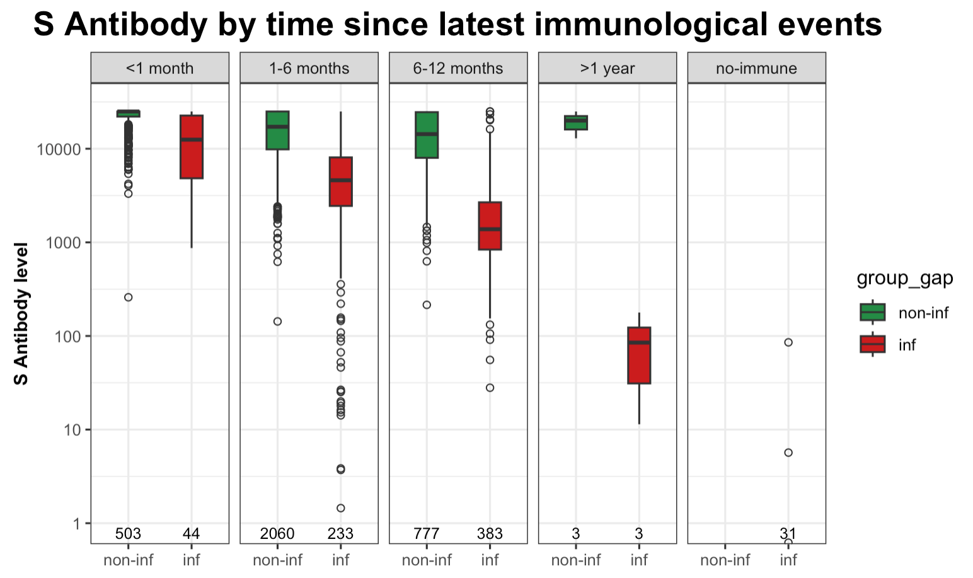
Figure2b: Box plot of S antibody levels, grouped by most recent immunological event gap
10^{4.0}
10^{3.0}
10^{2.0}
10^{1.0}
10^{0.0}
Whatever the most recent immunological gap, the average S antibody level of objects without infection is obviously
higher than those with infection; Additionally, as the most recent immunological gap goes on, the median S antibody
level goes down

Slide 12
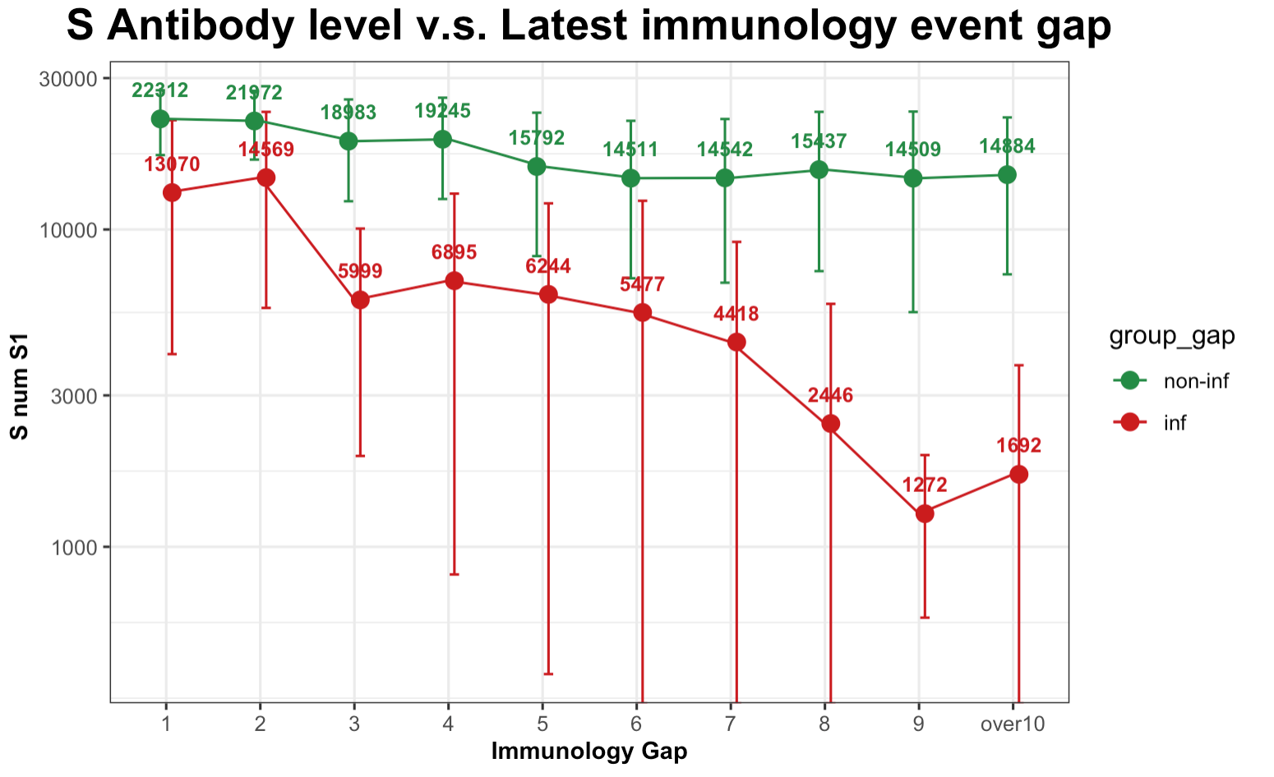
Figure2b: Line plot of S antibody levels versus latest immunological gap
10^{4.5}
10^{4.0}
10^{3.5}
10^{3.0}
Whatever the most recent immunological gap, the average S antibody level of objects without infection is obviously
higher than those with infection; Additionally, as the most recent immunological gap goes on, the median S antibody
level goes down

Slide 13
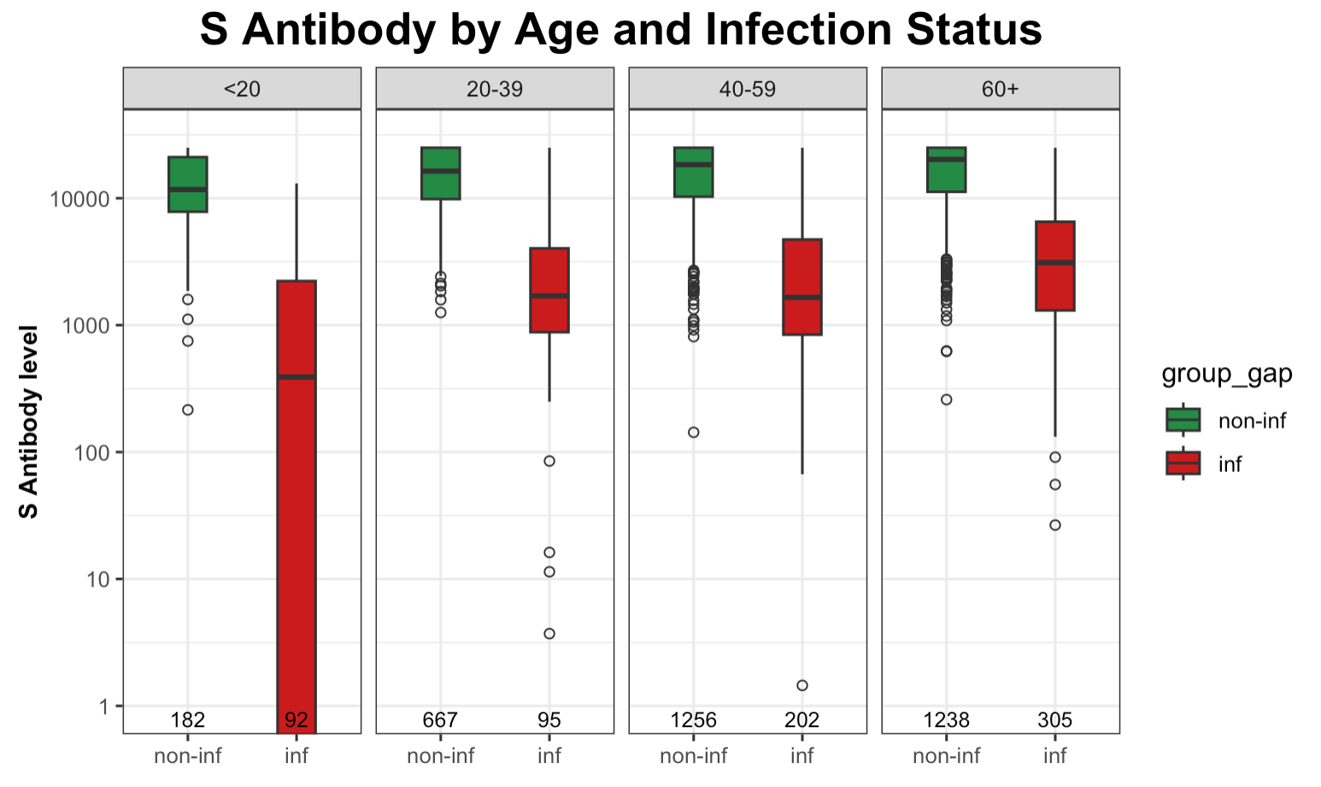
Figure2a: Box plot of S antibody levels, grouped by Age
10^{4.0}
10^{3.0}
10^{2.0}
10^{1.0}
10^{0.0}
Whatever the age group, the average S antibody level of objects with infection between 1st and 2nd survey is obviously
lower than those without infection

Slide 14
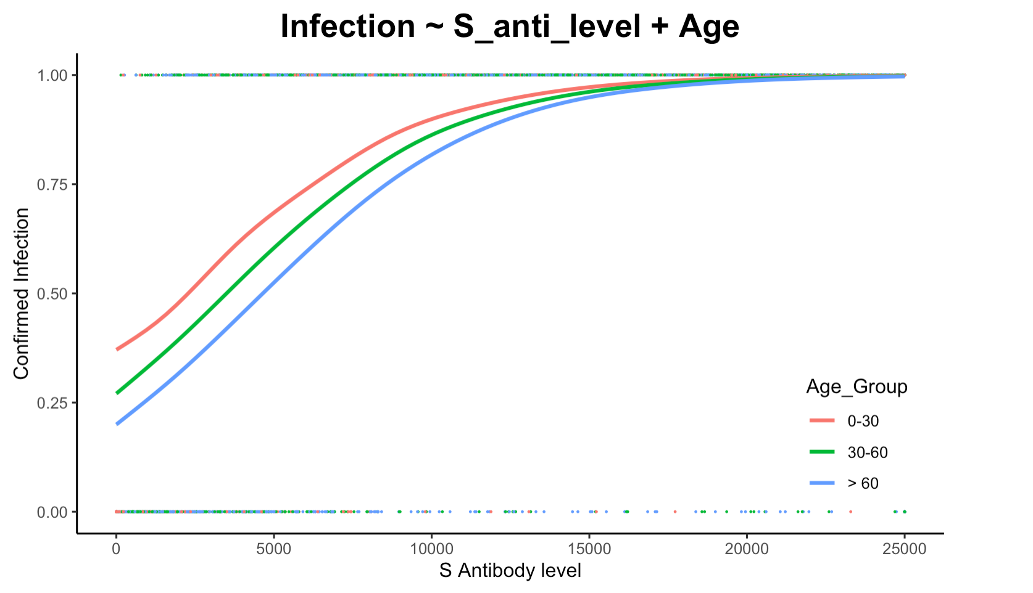
Regression Model Plot

Slide 15
Group II
1st survey
2nd survey
Case I
V
Case II
V
S Antibody Level
Symptomatic Confirmed
V
Vaccine
Asymptomatic Confirmed

Slide 16
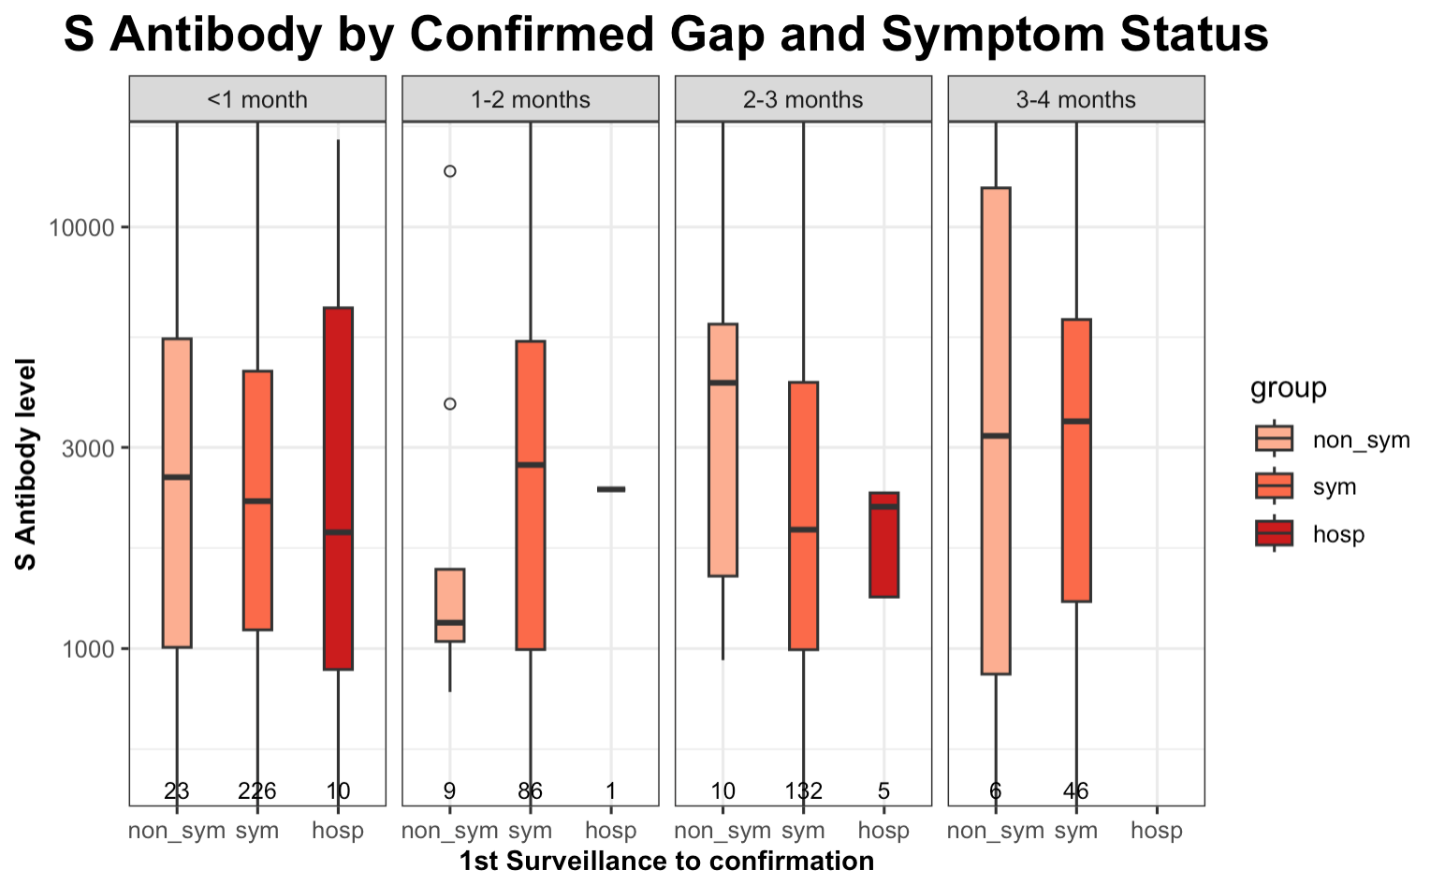
Figure3b: Box plot of S antibody levels, grouped by Post time
Excluding the non-representative group (1-2 months) due to extremely low sample sizes, once the gap between the first surveillance and confirmation is accounted for, individuals with higher S antibody levels are less likely to exhibit severe symptoms.
10^{4.0}
10^{3.5}
10^{3.0}

Slide 17
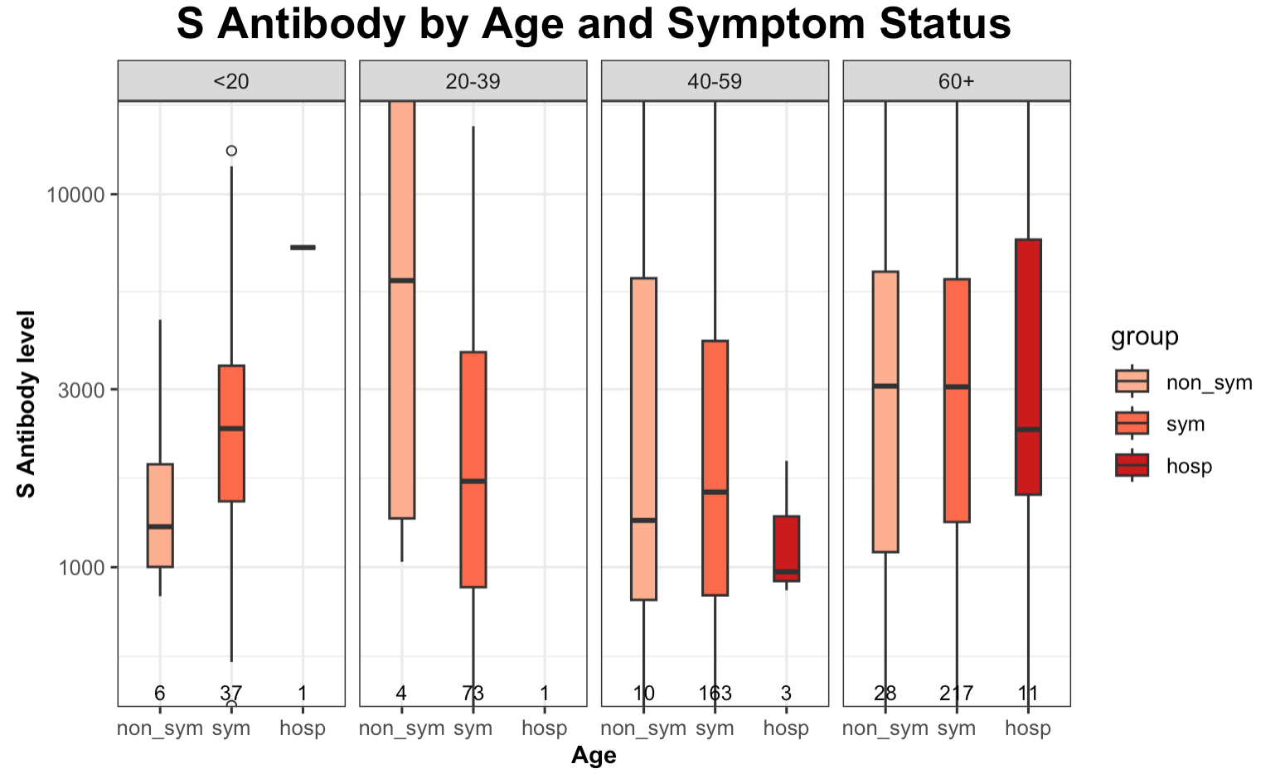
Figure3a: Box plot of S antibody levels, grouped by Age
Overall, the sample sizes for asymptomatic groups, particularly those under 60, are quite small. Regarding the older age group, individuals with higher S antibody levels tend to exhibit fewer symptoms.
10^{4.0}
10^{3.5}
10^{3.0}

Slide 18
Discussion
Summary:
Group I descriptive analysis indicated higher S antibody levels in uninfected individuals, and logistic regression showed that Spike (S) antibody thresholds for a 75% chance of avoiding COVID-19 infection are 6000, 8000, and 10000 for age groups <30, 30-60, and >60, respectively.
Group II analysis revealed there was no clear relationship between Spike antibody level and the severity of COVID-19 symptom.
Population S antibody level threshold can guide appropriate vaccination interval by age group.
Limitations:
Symptom range can be wide but in our study is binary.
Spike antibody level can not explain the neutralizing antibody, which could be better predictor for symptom severity.
The dataset shows that the group of confirmed infections identified between the first and second surveillance points, especially among asymptomatic individuals, is small, making it difficult to prove a statistically significant difference.
Future efforts should concentrate on integrating data from the third surveillance to enhance the cohort's comprehensiveness.

Slide 19
Reference
[1] https://ourworldindata.org/covid-vaccinations
[2] Amjadi, M. F., & O'Connell, S. E. (2021). Specific COVID-19 symptoms correlate with high antibody levels against SARS-CoV-2. *AAI*.
[3] Imai, K., Kitagawa, Y., Tabata, S., Kubota, K., Nagura-Ikeda, M., Matsuoka, M., Miyoshi, K., Sakai, J., & all authors. (2021). Antibody response patterns in COVID-19 patients with different levels of disease severity in Japan. *Journal of Medical Virology*.
[4] Goldblatt, D., Fiore-Gartland, A., Johnson, M., Hunt, A., Bengt, C., Zavadska, D., Snipe, H. D., Brown, J. S., Workman, L., Zar, H. J., Montefiori, D., Shen, X., Dull, P., Plotkin, S., Siber, G., & Ambrosino, D. (2021). Towards a population-based threshold of protection for COVID-19 vaccines. *Vaccine*.

Slide 20
Appendix

Slide 21
Summary:
Group I descriptive analysis indicated higher S antibody levels in uninfected individuals, and logistic regression showed that Spike (S) antibody thresholds for a 75% chance of avoiding COVID-19 infection are 6000, 8000, and 10000 for age groups <30, 30-60, and >60, respectively.
Group II analysis revealed there was no clear relationship between Spike antibody level and the severity of COVID-19 symptom.
Compared to the study by Imai, K. and Kitagawa, Y., Japan 2021^{[3]}, our research focused on collecting Spike antibody levels from patients exhibiting a range of COVID-19 symptom severities. This approach, distinct from utilizing immobilized recombinant S protein, clarifies the link between anti-Spike antibodies, COVID-19 infection rates, and symptom severity.
Contrasting with the study conducted by David Goldblatt in 2022^{[4]}, our research establishes a protection threshold based on total anti-Spike antibody levels, as opposed to focusing solely on IgG. This approach offers a unique perspective in determining the protective correlate, providing a broader understanding of immunity.
Limitations:
The dataset shows that the group of confirmed infections identified between the first and second surveillance points, especially among asymptomatic individuals, is small, making it difficult to prove a statistically significant difference.
Future efforts should concentrate on integrating data from the third surveillance to enhance the cohort's comprehensiveness.

Slide 22
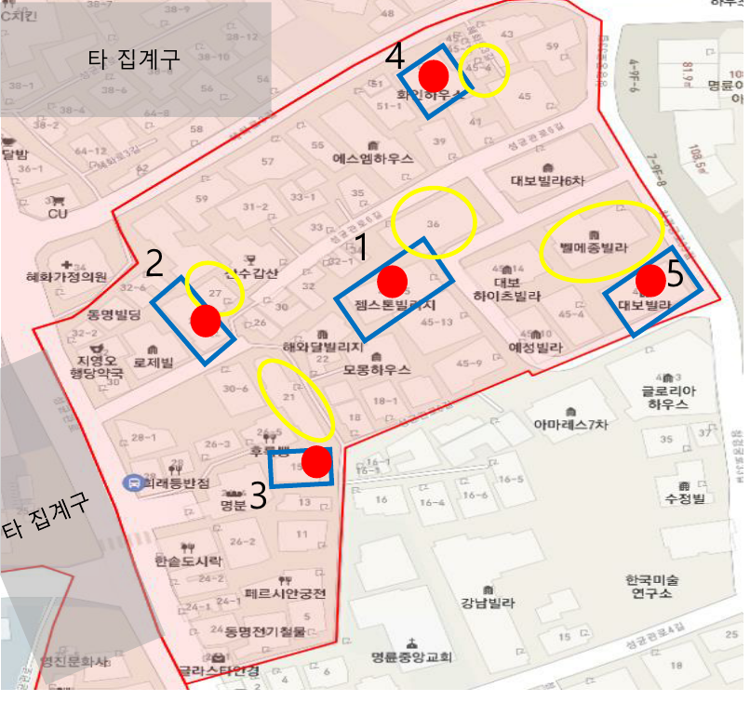
Selection criteria for main and reserve households in the aggregate premises
Aggregate Sphere
At least 2 assignments per region
(*Depends on the number of goals per region)
Main Furniture
Randomly selected by Global Research 5 Pattern Furniture
If this household declines consent or is unsuitable, spare furniture is designated in a counterclockwise spiral upon the surveyor's request, approved by the survey manager.
Spare Furniture

Slide 23
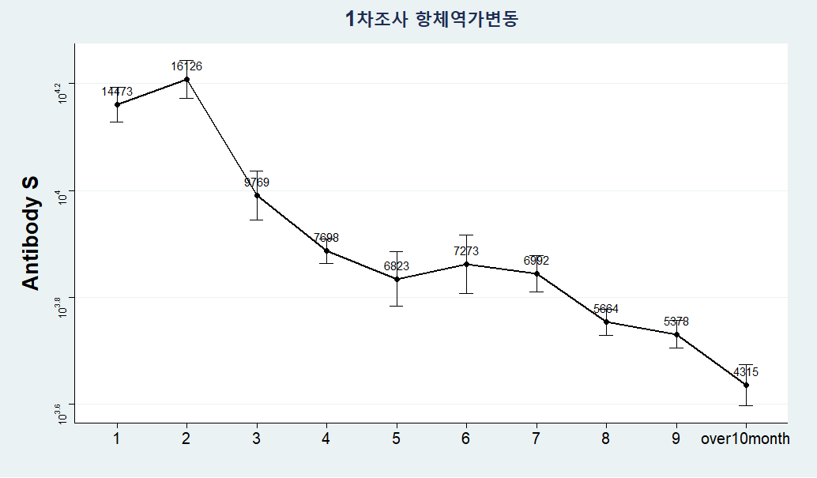
Trend of Decreased Antibody Titers Among Participants in the Follow-Up Survey (Total, 9,007 individuals)
Blood Collection Date – Last Vaccination Record or Date of Confirmation

Slide 24
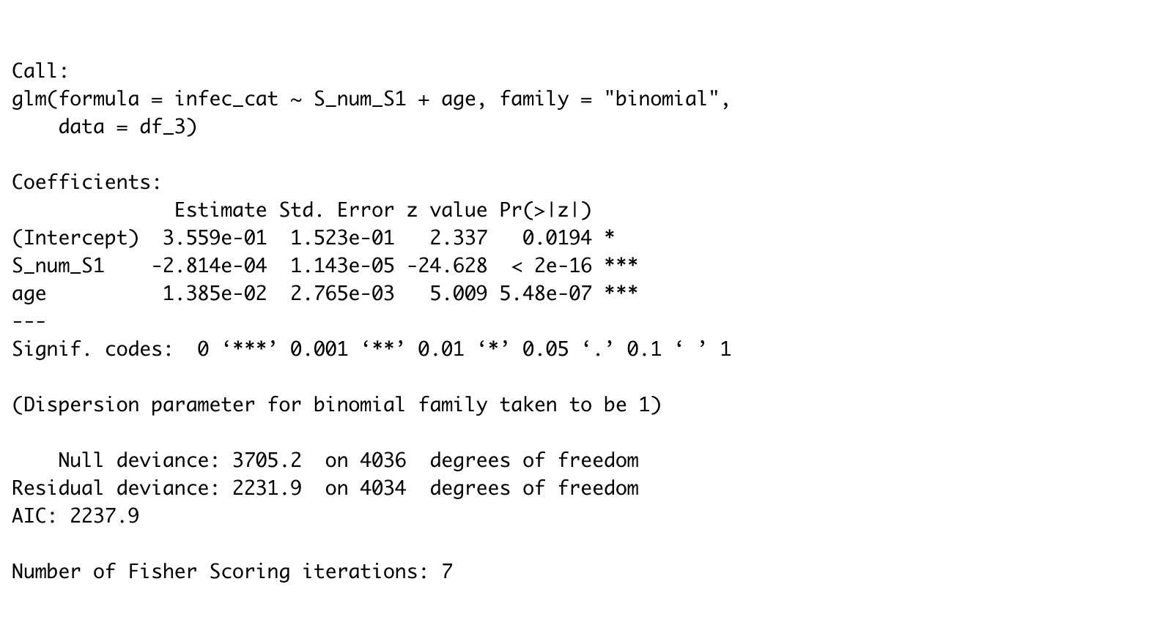
Regression Model
Both ”S_num_S1” and “age” are significant here

Slide 25
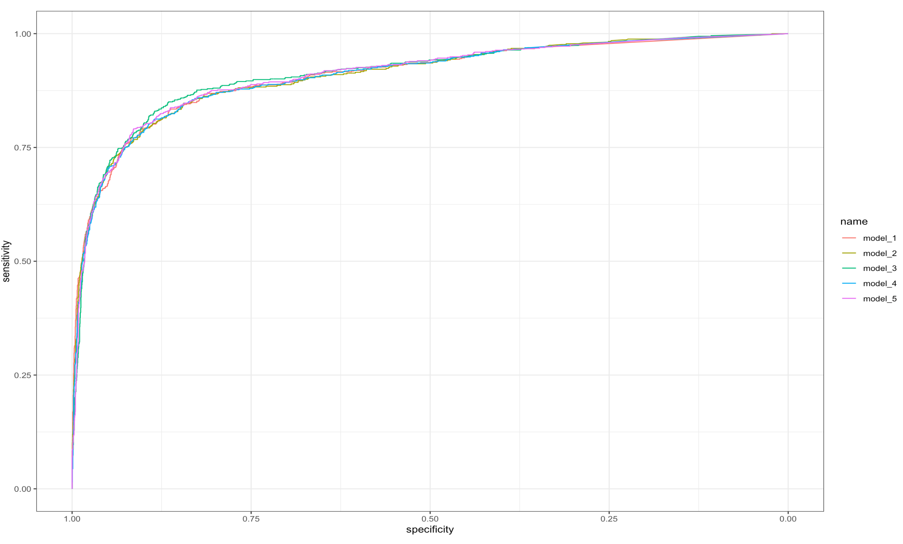
Regression Model comparison
Infec ~ S_num
Infec ~ S_num + Income
Infec ~ S_num + Age
Infec ~ S_num + Otherdisease
Infec ~ S_num + edu

Slide 26
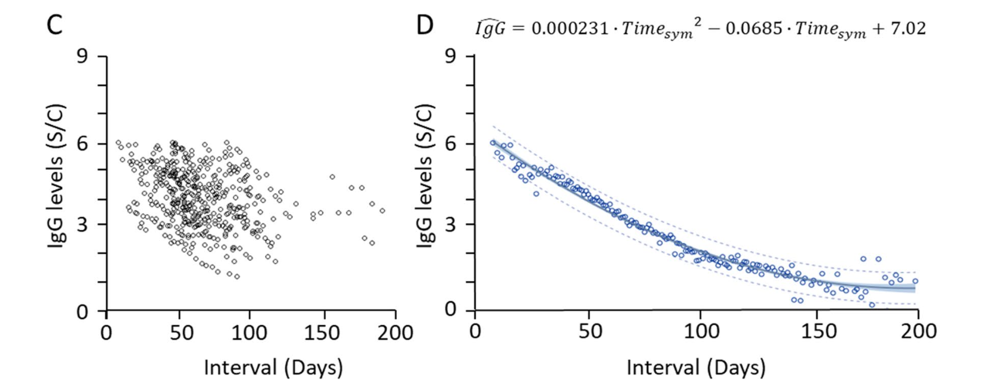
Topic: If S antibody level contribute to COVID-19 symptoms ?
What do we currently have ?
S Antibody Level
Symptomatic/Confirmed
Asymptomatic/Confirmed
UNKNOWN
with Decay
*
1st survey
2nd survey
contagion
V
vaccine
V
*
*
Date of latest vaccination
Date of Confirmation1
1) Date of Survey1
2) S Antibody level of Survey1
3) IF any Symptom before
Date of Confirmation2
1) Date of Survey2
2) S Antibody level of Survey2
3) IF any Symptom before
UNKNOWN
DOI: 10.1038/s41598-021-96171-4

Slide 27
DATA PREPROCESSING
S Antibody Level
Symptomatic/Confirmed
1st Case
Asymptomatic/Confirmed
V
vaccine
V
2nd Case
EXCLUDE
V
3rd Case
4th Case
EXCLUDE
V
5th Case
V
Aug 2022
1st survey
Dec 2022
2nd survey

Slide 28
Other cases needed to be carefully considered ?
1st Case
EXCLUDE
V
V
2nd Case
EXCLUDE
V
1st confirmation
- Symptomatic!
1st Survey
- IF any Symptom before?
- Yes
2nd confirmation
- Asymptomatic ?
- Symptomatic?
2nd Survey
- IF any Symptom before?
- Yes

Slide 29
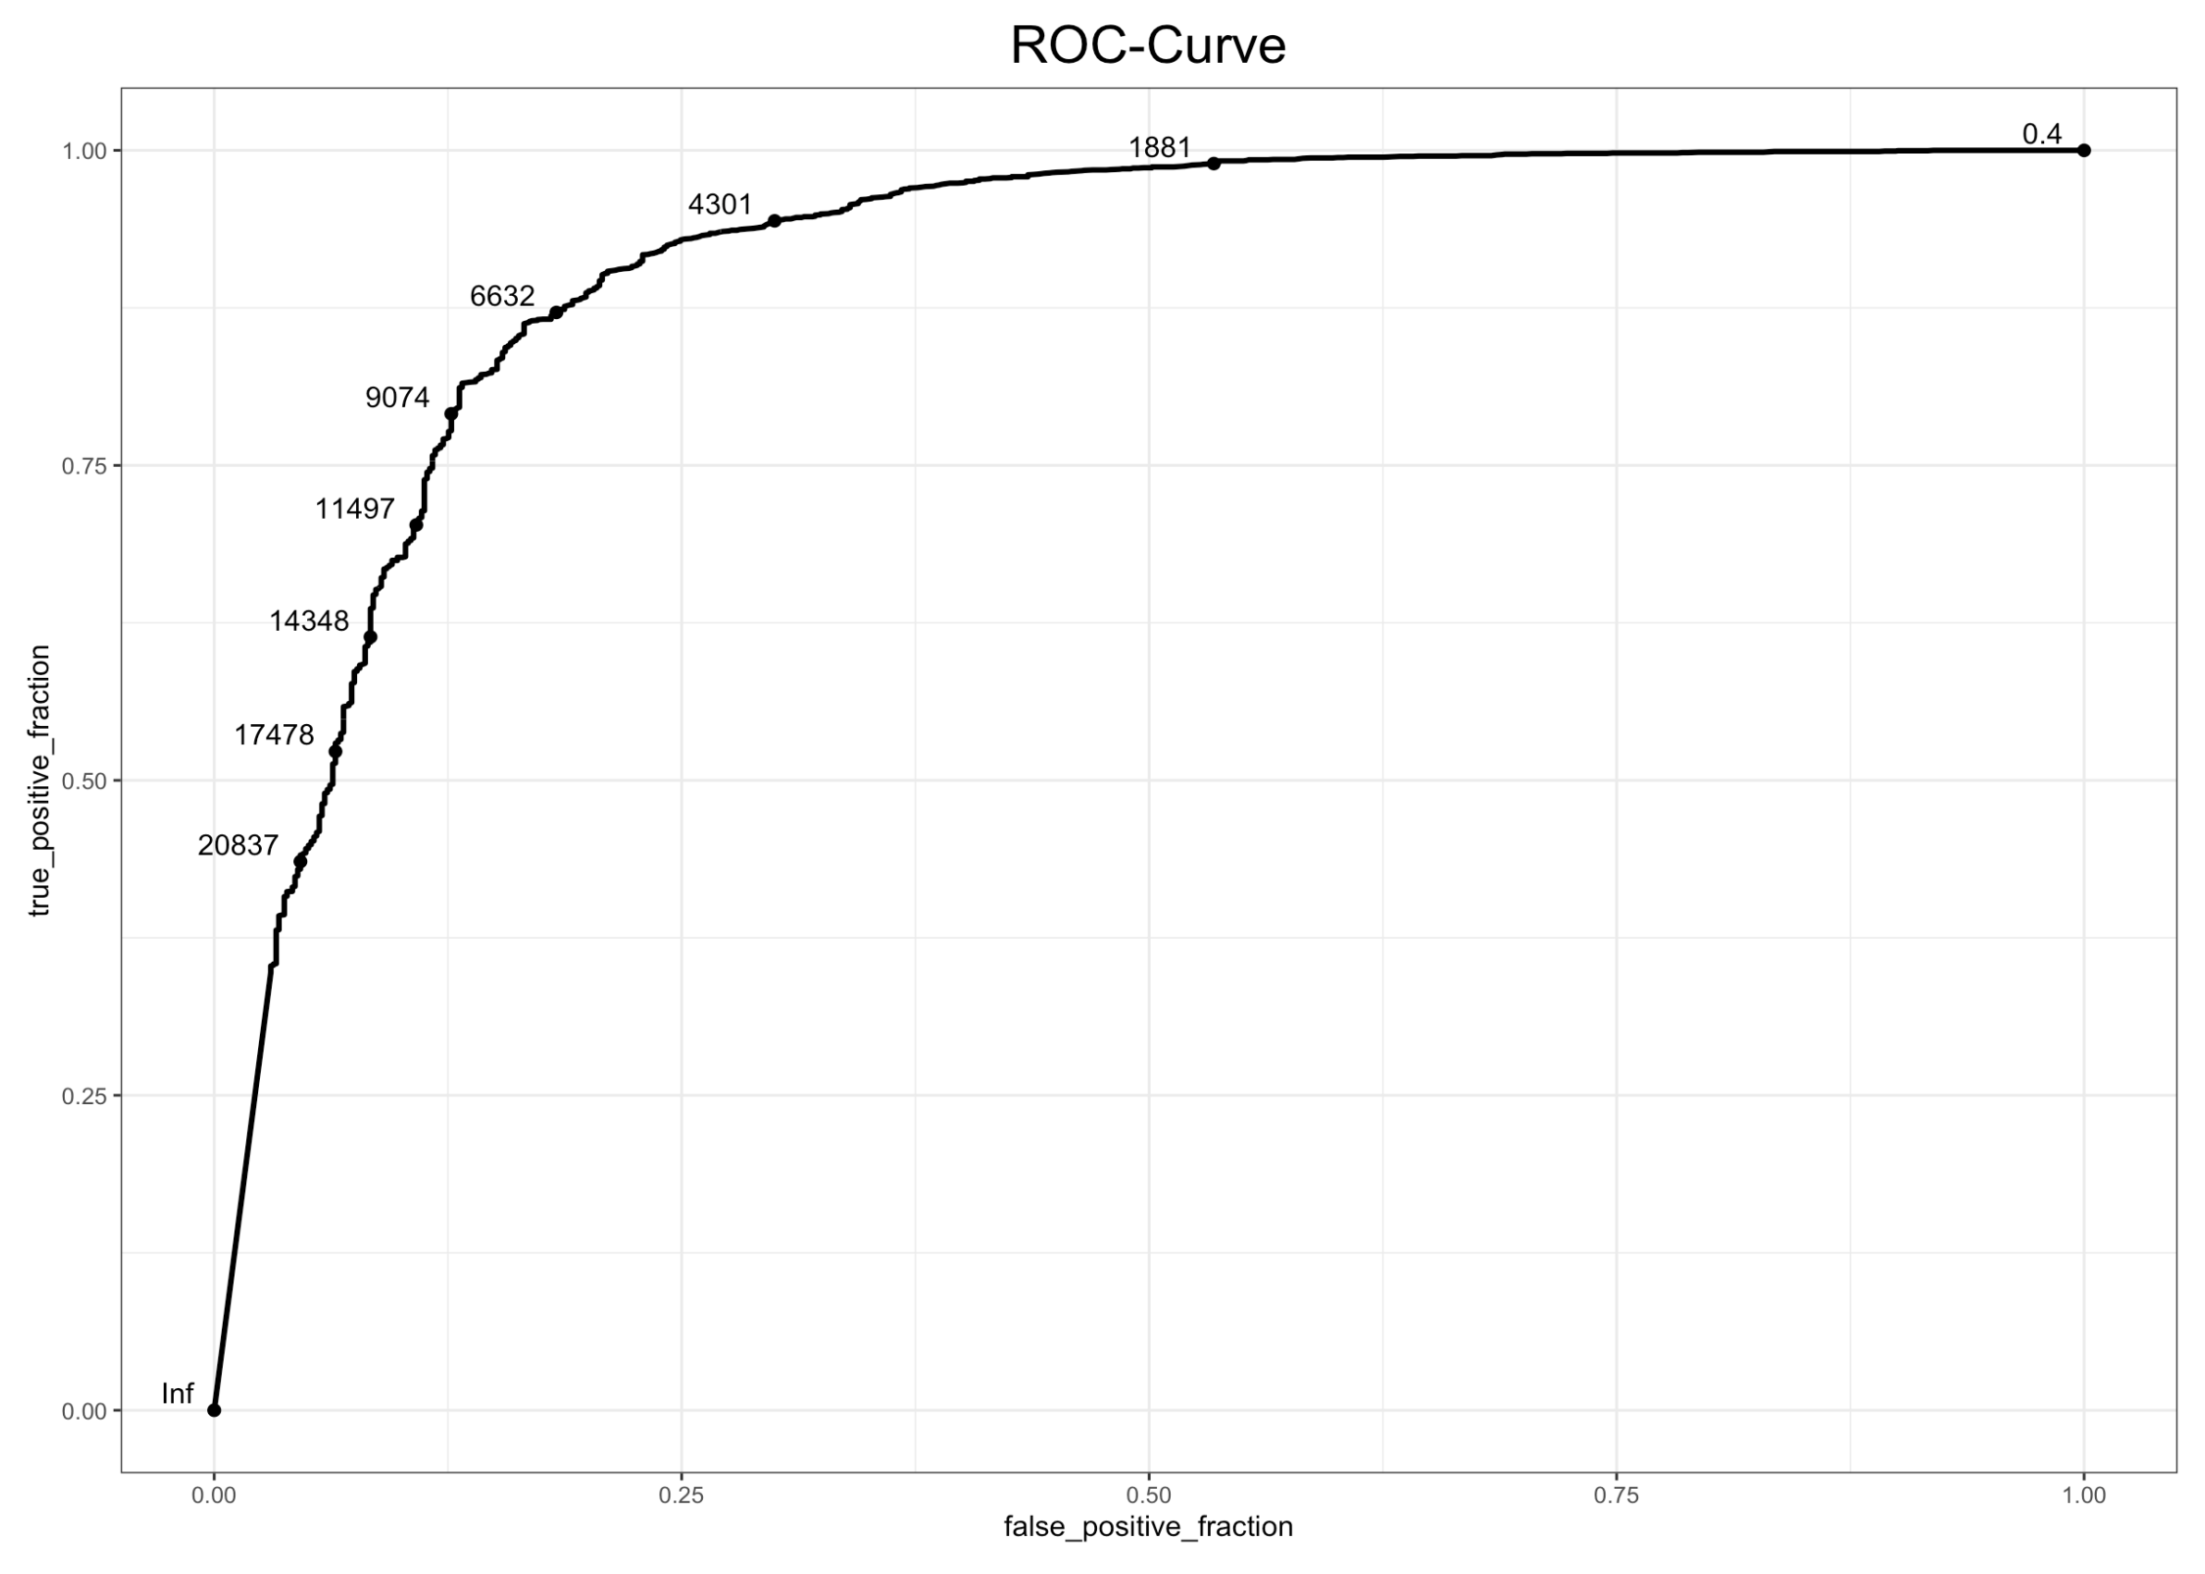
Confusion Matrix used here:
 | Infec-Yes | Infec-No
S_num > cutoff | a | b
S_num < cutoff | c | d
Sensitivity and Specificity
calculation here:
Sensitivity = [a/(a + c)]
Specificity = [d/(b + d)]

