Slide 1
Model to predict future dominance of
COVID-19 variants using early growth rates
across 30 countries
Jan 29, 2025
Authors (TBD): Franky Zhang, RP, KC, JJ, YJ*, CO*

Slide 2
Introduction
Data Description
Dataset includes infection counts from over 3,000 COVID-19 variants across the Top 30 countries with the highest infections, covering January 2020 to May 2024.
Data is recorded daily, allowing for detailed day-level analysis.
The top 30 countries include (selected based on the total number of cases over the entire time):
Australia, Austria, Belgium, Brazil, Canada, China,
Czech Republic, Denmark, France, Germany, India, Ireland,
Israel, Italy, Japan, Luxembourg, Mexico, Netherlands,
Norway, Peru, Poland, Russia, Slovenia, South Korea,
Spain, Sweden, Switzerland, Turkey, the United Kingdom, USA.

Slide 3
Introduction
1st Analysis: How well does the early share growth rate predict future share dominance across countries?
a) To determine the optimal observation period for each country based on the best model performance (R²).
b) To identify the range of growth rates that contribute most to dominance (based on coefficients from a step function derived from OTCs).
Model Utility: Our model can predict future dominance by monitoring the share growth rate of a new variant, using its specific growth rate range and a defined observation period (e.g., 45 days). The term “dominance” can also be replaced with “duration.”

Slide 4
Introduction
1st Analysis: How well does the early share growth rate predict future share dominance across countries?
a) We set flexible observation days for each variants based on eligibility criteria (whether it reaches a share growth rate threshold 20% by 7 days to max 30 days) for the OTC model → The OTC model takes flexible early share growth rate for each variants between 7 to 30 days to predict the future mean share as dominance.
b) To identify the range of growth rates that contribute most to dominance (based on coefficients from a step function derived from OTCs).
c) to identify the specific variants and counties which this model can be helpful
Model Utility: Our model can predict future dominance by monitoring the share growth rate of a new variant, using its specific growth rate range and a defined observation period (e.g., 45 days). The term “dominance” can also be replaced with “duration.”

Slide 5
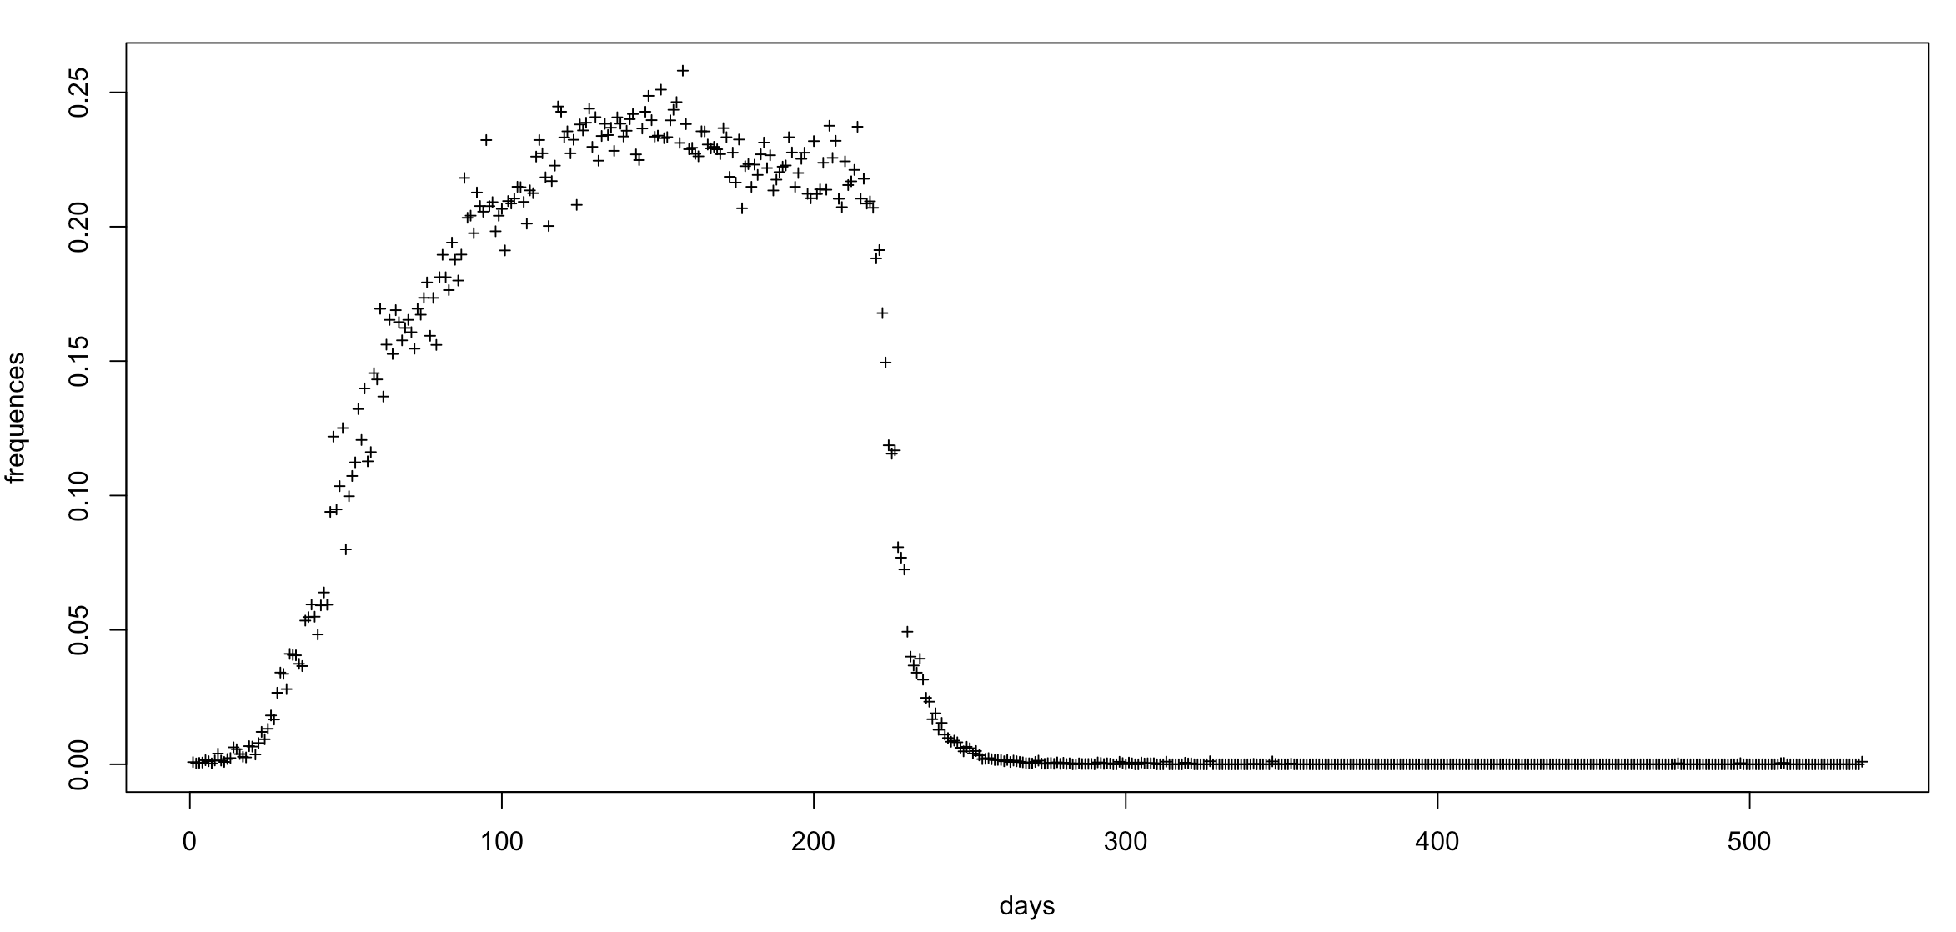
Explanation of Model Input and Output

Slide 6
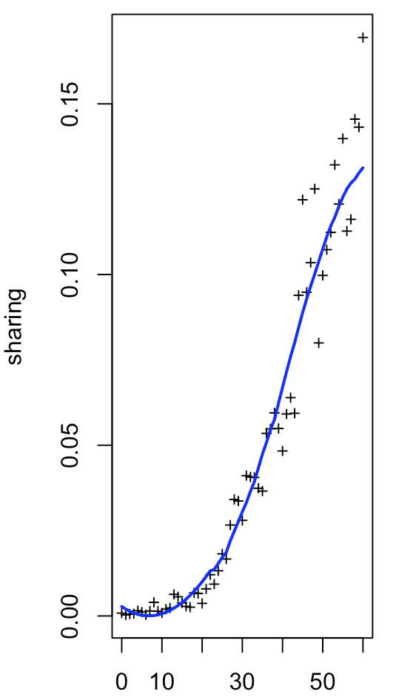
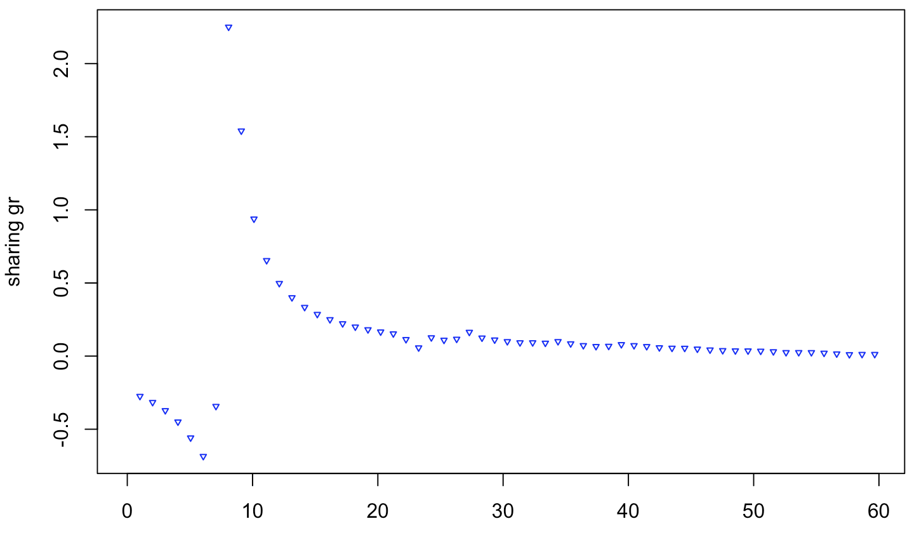
Explanation of Model Input and Output
Input Growth Rate (GR) series

Slide 7
Explanation of Model Input and Output
Output scaler
Criteria: Start with the first consecutive week where at least one infection occurs each day. End with the last consecutive week where at least one infection occurs each day.
Definition of “Dominance”:
Calculate the mean share of the longest consecutive period of the variant, rather than using the mean share or maximum share over the entire period.
Summary of the model:
Using initial-stage growth rates to predict future dominance, represented by the mean share over the longest consecutive period. (The model predicts the mean share and duration of this period but cannot determine when the variant’s prevalence will end.)

Slide 9
Innovation/Strengths (Justification of the model approach)
Why do we choose to use the share growth rate instead of the frequency growth rate?
Since testing policies have changed a lot over time, so that the total number of cases is not a good representative of how prevalent a variant is. Using the relative proportion as a measure of dominance, this is less sensitive to testing policy and therefore provides a more stable measure over time.
Why do we choose the Occupational Time Curve (OTC) transformation:
In conventional approach, researchers often estimates a smooth curve as functional parameter θ(c) using basis expansions, such as B-splines, natural cubic splines, and tensors, among others (Goldsmith, Zipunnikov and Schrack, 2015; Goldsmith et al., 2012). Given our goal is to define a prediction model across countries with different variants trend, such time-based functional model ignores the information of different start time of each variant across countries. Moreover, time-based functional models often produce fluctuating time-varying coefficients, making it challenging to interpret the impact of share growth rate on dominance across different observation periods for initial growth.
Therefore, our approach is to transform the timing varying sequence to the frequency probability of initial share growth rate information. By discretizing the continuous functional parameter estimate θ(c) as a piece-wise function with change points, it allows effectively defining windows of share growth rates by fusing the θ(c) of adjacent growth rate ranges with similar effects on the dominance. The process categorizes the frequency-based growth rate in the stepwise function quantifying the relative contribution of different growth rate range on the share dominance;
How and why did we redefine the initial period (input):
We used a constant observation period for initial growth rates (from 30-60 days) across countries but identified the optimal observation date based on the best model prediction (R^2). If we adjust to a flexible initial period with a threshold point, we observe that some variants (about 30%) reach the share threshold (set as 10%) in as little as seven days. This rapid rise makes it challenging to apply predictive models due to small number and different rage of data points, even when transformed into frequency-based OTCs.
For each variant, the original initial stage may include a prolonged period with a single recorded infection on the first day, followed by a long gap with no cases. This could result from misrecorded cases, which were especially common in the early stages of COVID-19. If such a period is considered part of the initial stage, it would provide no meaningful information for prediction.
We also excluded instances of negative growth during the initial period, as these are likely artifacts of the smoothing process applied to the unstable early-stage share growth rate.
How did we define dominance (output):
We define the dominance based on the period of a wave (defined by the start/end time criteria on Slide 6). While we considered other approaches such as the mean share over the entire period or the maximum share observed, these approaches likely mislead the dominance pattern where there is an extended post-peak period or a rapid rise to a high share without sustained dominance.

Slide 10
Methodologies
The GSAID data, over 3,000 lineages for TOP 30 countries, was grouped into 22 shared classified lineages based on strings of possible parent lineages (following the UKHSAC alias grouping).
In the latest version, the initial stage was redefined as a consecutive period with at least one infection per day to better capture the relevant information. And the dominance was redefined to the mean share during the longest prevalence.
The Savitzky-Golay smoothing (S-G smoothing) was applied to denoise the time series and calculate the growth rate for both infection frequencies and the sharing of variants.
The smoothed growth rates were converted into Occupation Time Curves (OTCs) to facilitate clearer interpretation following Functional Data Analysis (FDA).
The Adapted Lasso Regression was applied to estimate the functional parameters, showing in the following steps.

Slide 11
Re-define the initial stage
Left Panel: Original selection of the the initial 30 days for variants.
Right Panel: Updated definition of the initial 30-day period for variants.
Criteria: Start with the first consecutive week where at least one infection occurs each day.

Slide 12
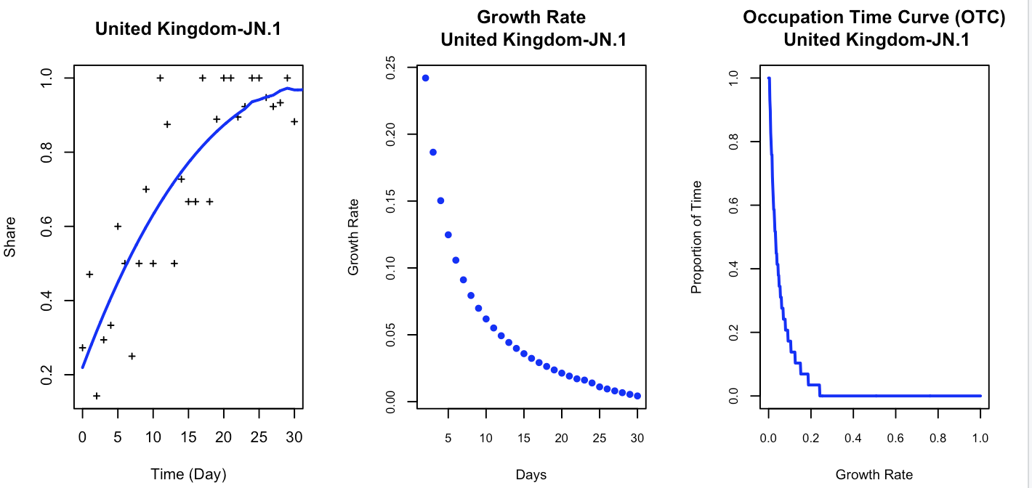

Occupation Time Curve Conversion
Input Series
$$OTC\left(c\right)=P(X\left(t\right)≥c)$$
Output Scaler
Dominance = 96 (%)
Duration = 313 (Days)

Slide 13
Occupation Time Curve Conversion

Slide 14
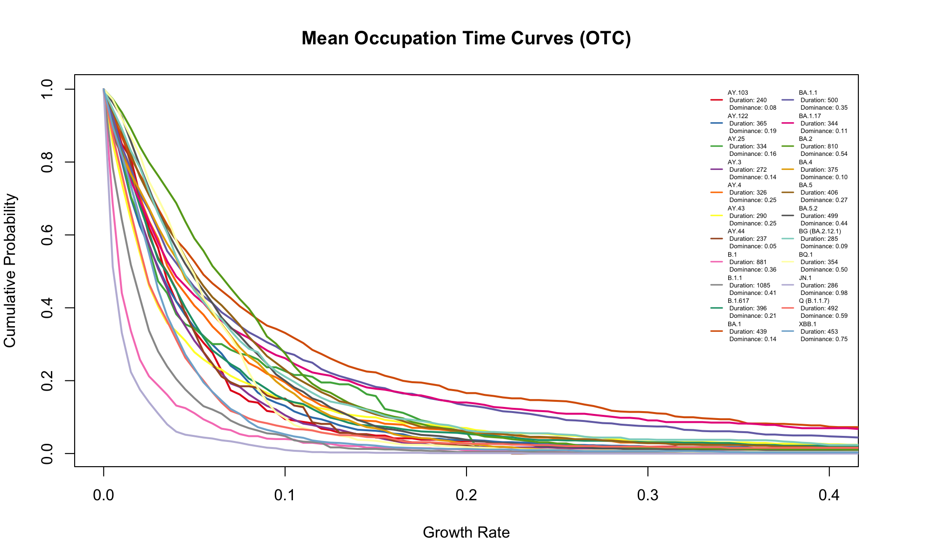

Slide 15
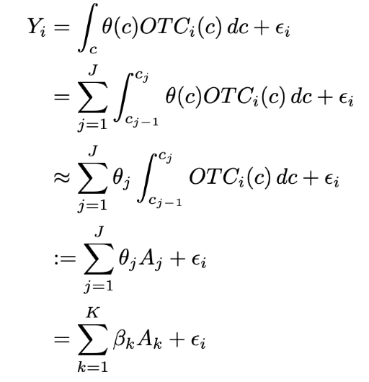
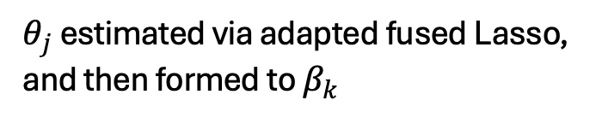
Functional Regression with OTCs
$θ_{j}$ estimated via adapted fused Lasso, and then formed to $β_{k}$

Slide 16
Results
Red dots:
the best tuning result

Slide 17
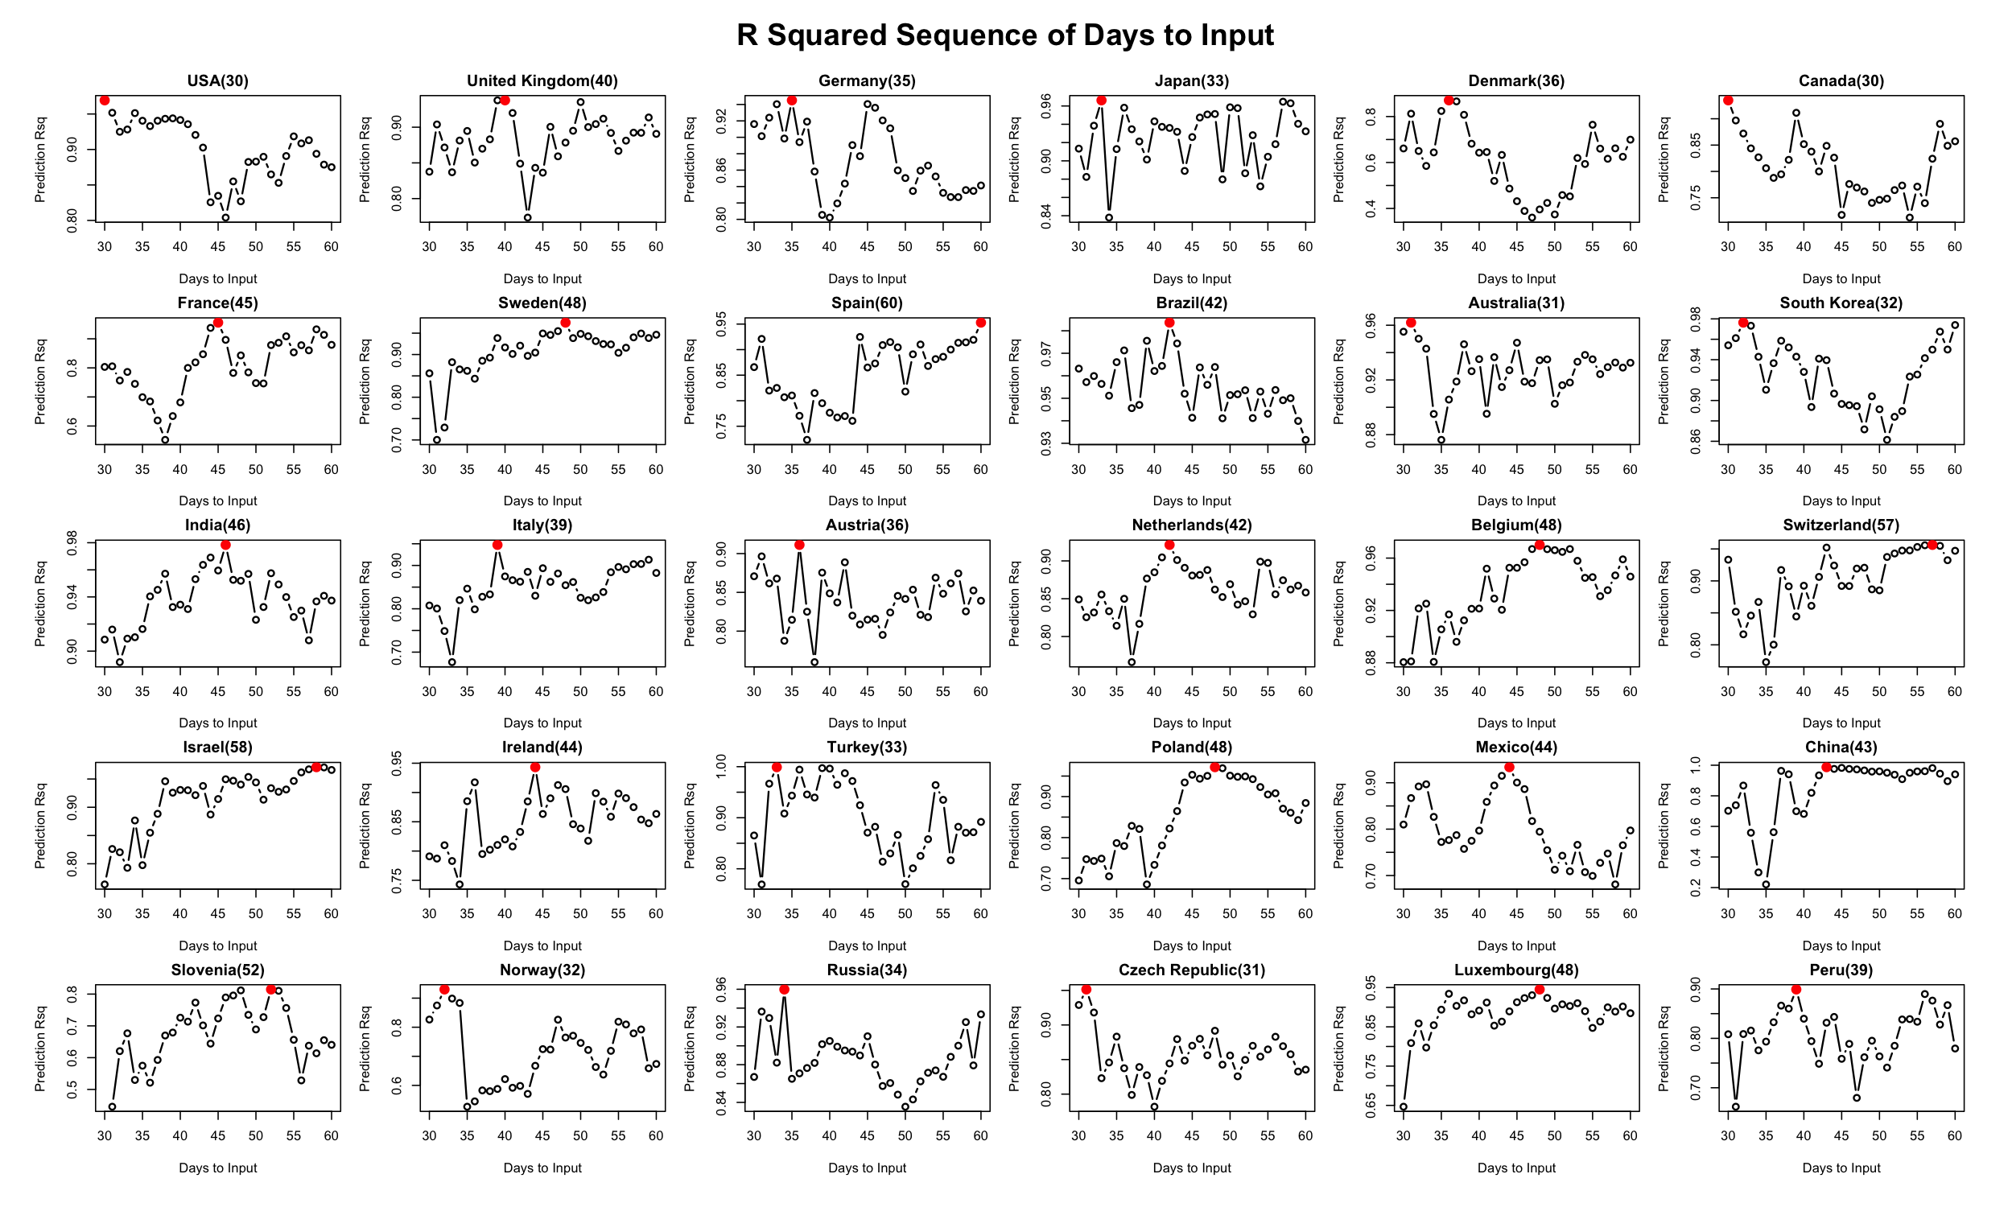

Slide 18
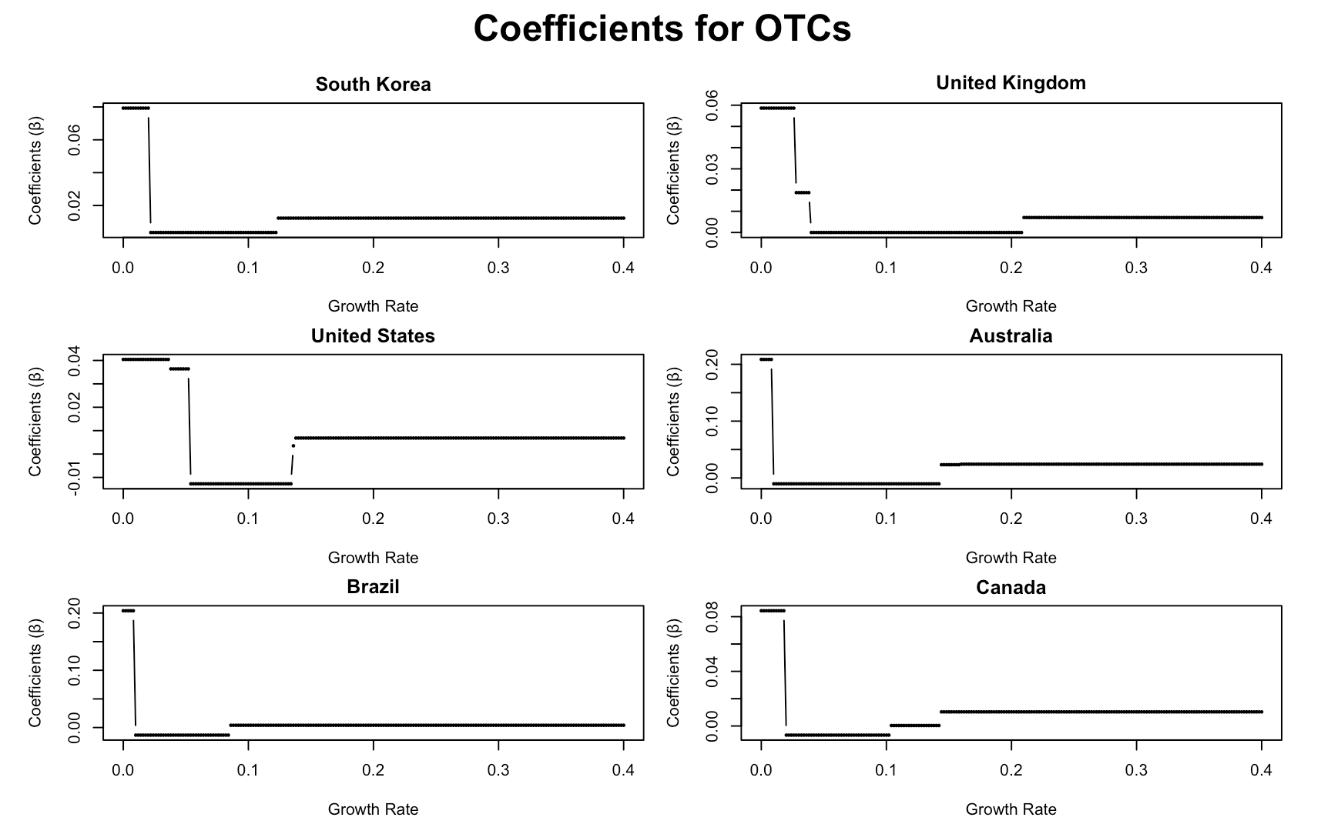
Results

Slide 19
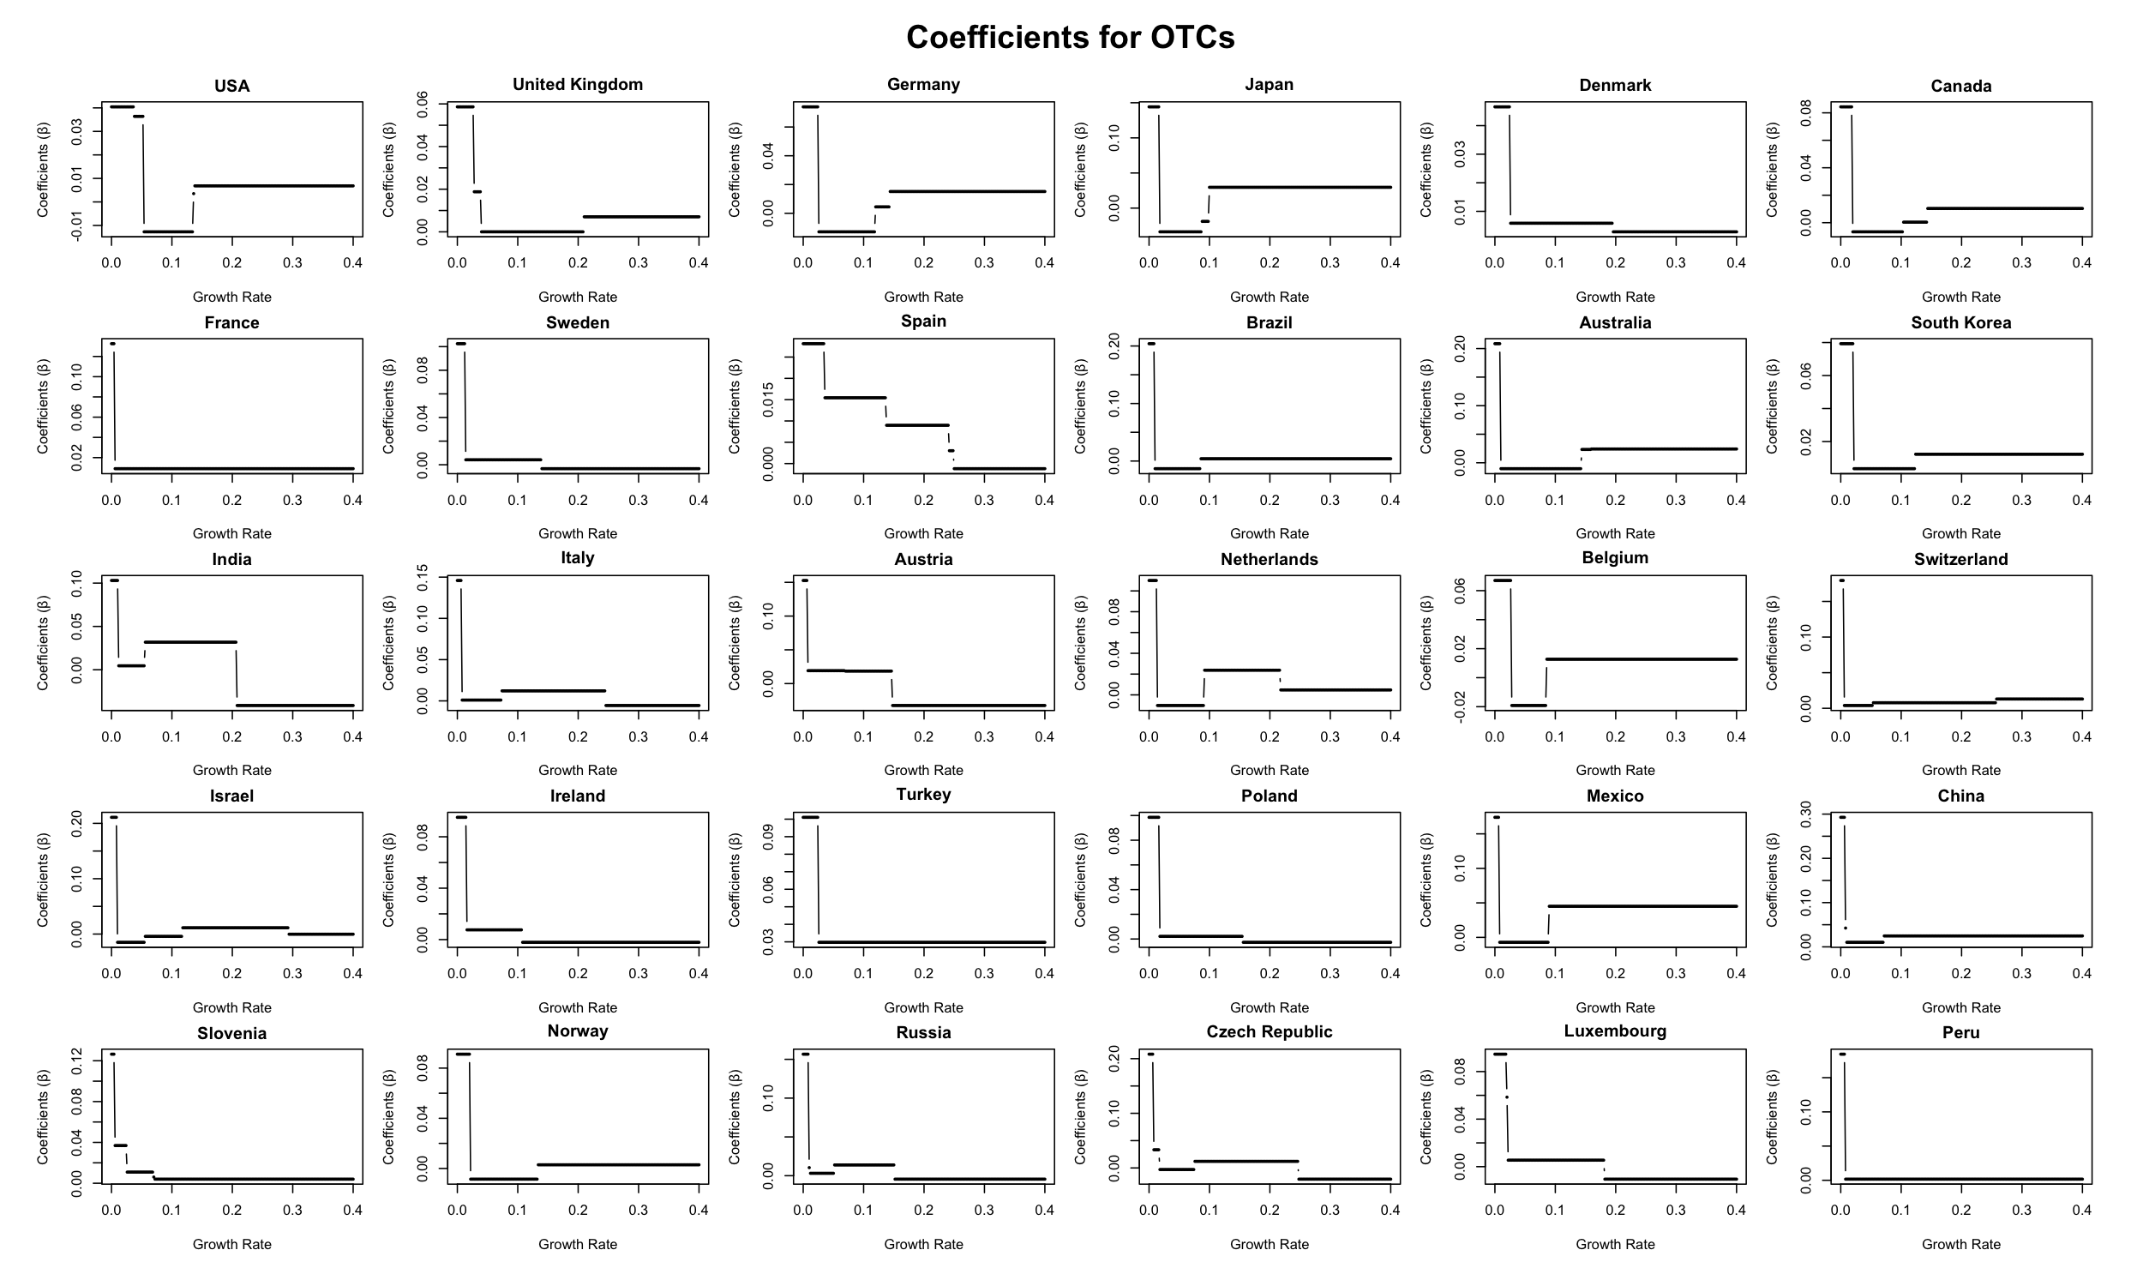

Slide 20
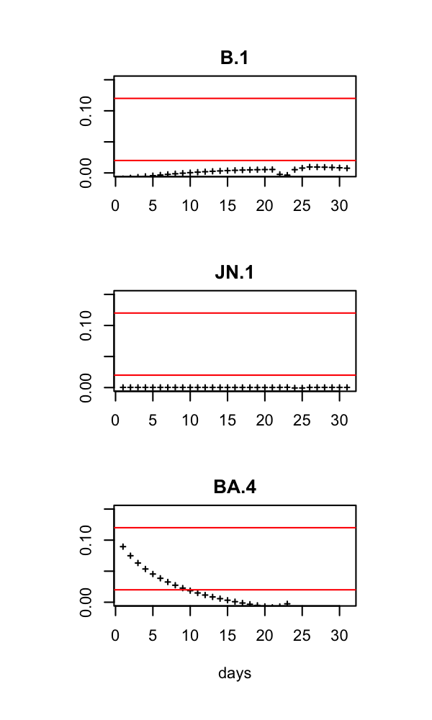
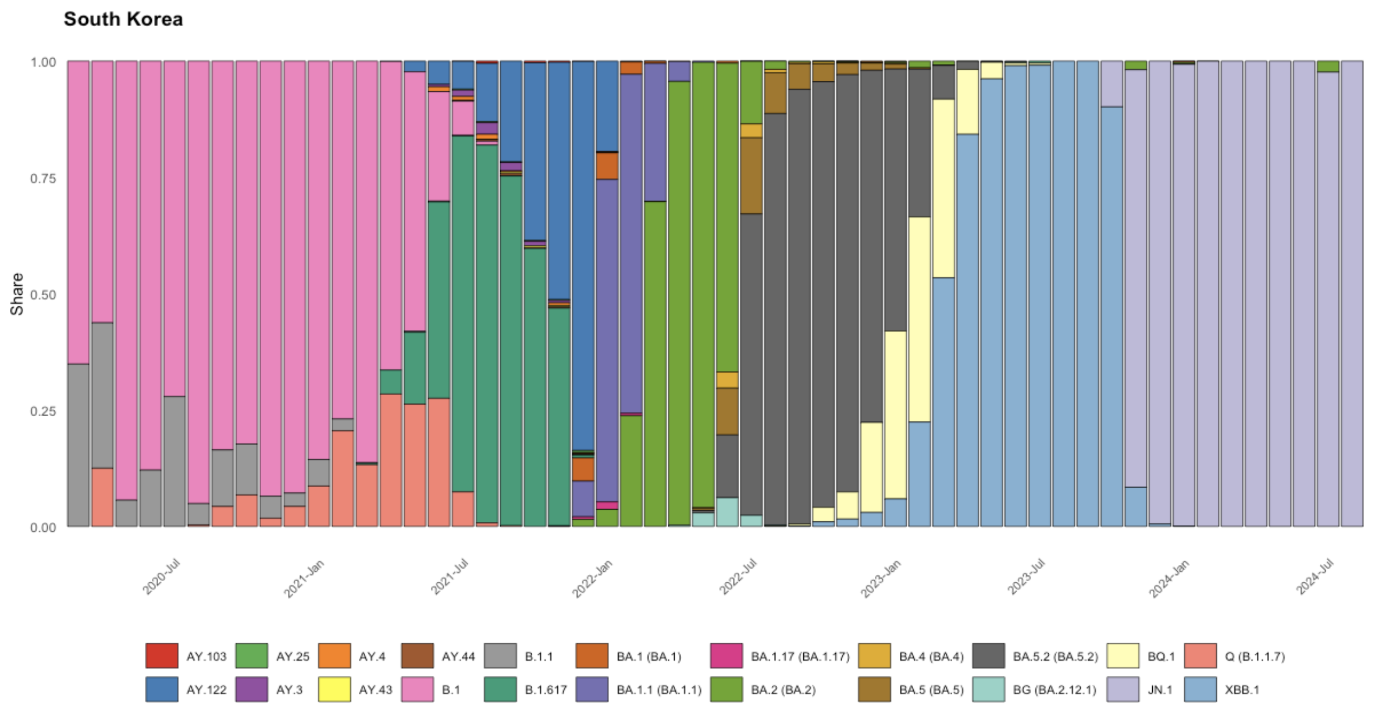
Interpretations
median
Optimal #Input days: 32
Dominance: 0.79
Predicted: 0.91
low
high
high
low
median
median
Dominance: 0.99
Predicted: 1
low
high
median
Dominance: 0.05
Predicted: 0.13
low
high

Slide 21
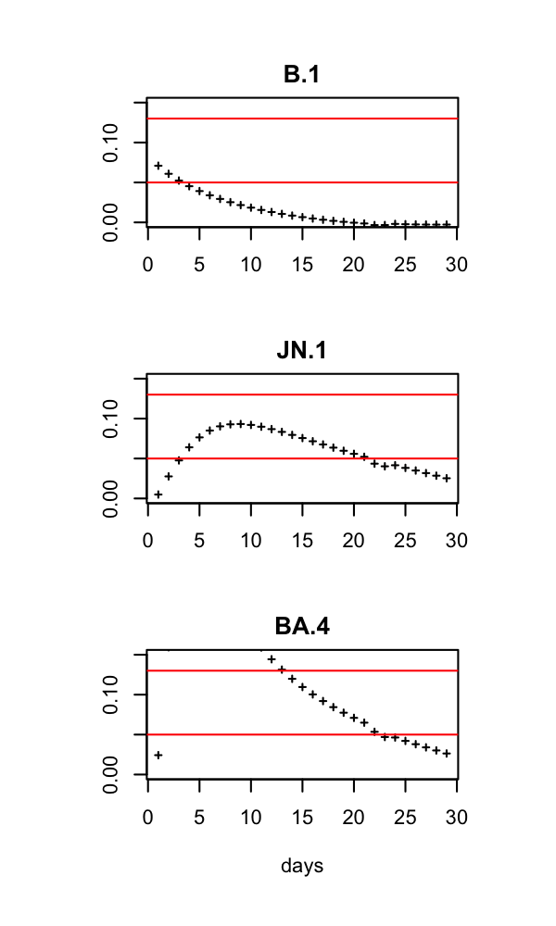
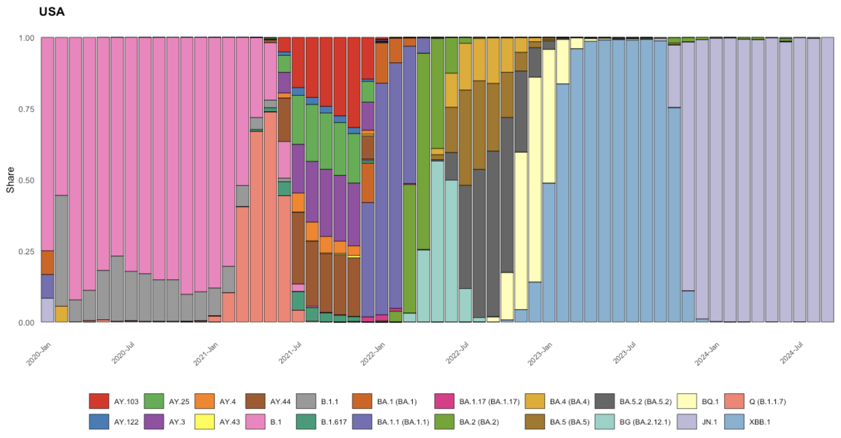
Interpretations
median
Optimal #Input days: 30
Dominance: 0.60
Predicted: 0.89
low
high
high
low
median
median
Dominance: 0.92
Predicted: 0.77
low
high
median
Dominance: 0.08
Predicted: 0.15
low
high

Slide 22
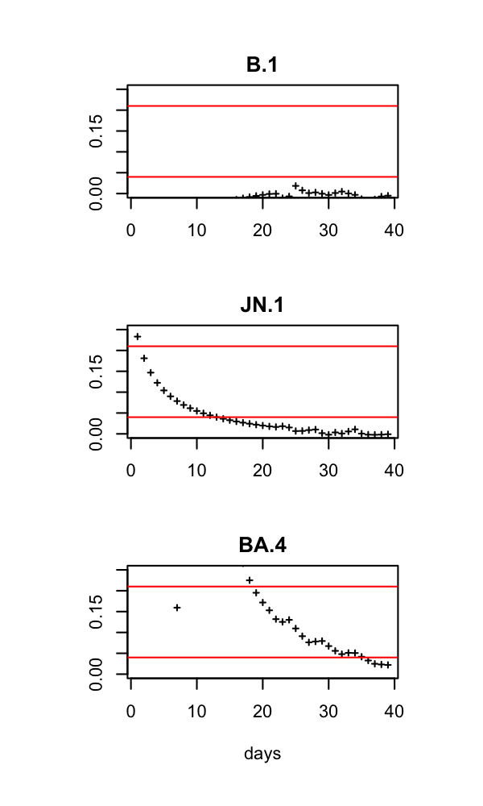
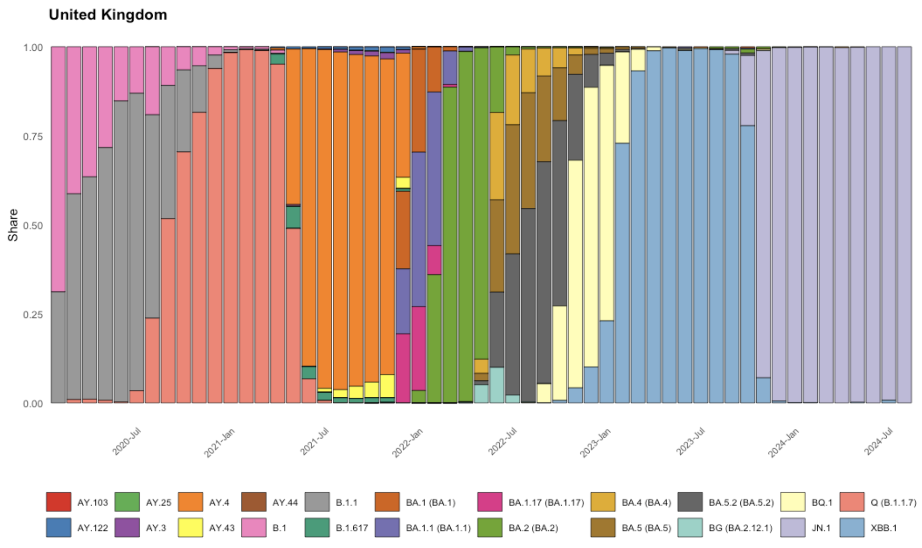
Interpretations
median
Optimal #Input days: 40
Dominance: 0.13
Predicted: 0.17
low
high
high
low
median
median
Dominance: 0.96
Predicted: 0.98
low
high
median
Dominance: 0.10
Predicted: 0.12
low
high

Slide 23
Implications
How can this model predict future dominance based on the growth rate pattern of a new variant during the first 30-60 days of observation?
When a new variant emerges in a country, such as the United States, we monitor its share until it meets the criteria for the initial stage—having at least one infection per day for consecutive weeks. Once this threshold is met, we observe the variant over the optimal period (30 days for the United States) and calculate the growth rate of the S-G smoothed data and plug into the pre-trained model. The model then calculates the predicted dominance, providing an early signal of the variant's potential future dominance. We think our model approach can be used to predict the dominance among competing respiratory infection viruses (e.g., COVID-19, influenza, RSV, Rhinovirus, Coronavirus, Adenovirus) in the winter season based on the first 30 days of observation.
Our model accounts each variant independently. Whether and how does this model account for the varying number of competing variants?
To be discussed

Slide 24
Global Hospitalization/Infection Rate Prediction Using Variant Share Sequences

Slide 25
Introduction
2nd Analysis: Which variants contributed the most to the hospitalization-to-infection rate during the Omicron wave across countries?
a) To determine whether, and to what extent, dominant variants were closely associated with the hospitalization-to-infection rate.
b) To compare groups of dominant variants and their association with the hospitalization-to-infection rate across countries.
Model Utility:
To estimate population-level epidemic consequences based on nationwide sampled genotype data.
To quantify the discrepancy between high share dominance and high hospitalization-to-infection contribution.

Slide 26
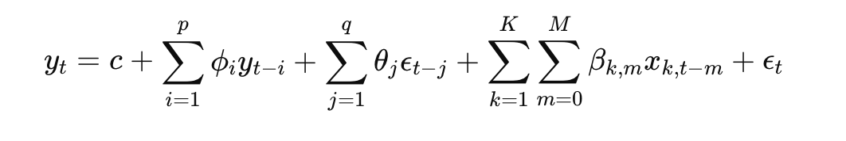
Data Description
Linking 22 shared classified lineages data to the Hospitalization and Infection data from Our World in Data website.
The hospitalization-infection (Hosp-Infec) rate was calculated as a sequence, and the problem was modeled as a multiple time series prediction problem.
Definition and Methodology
The Hosp-Infec rate was calculated using the absolute number of infections and hospitalizations recorded.
The ARIMAX model was applied for multiple time series predictions to better provide the the contribution of exogenous variables (multiple series of variants)

Slide 28
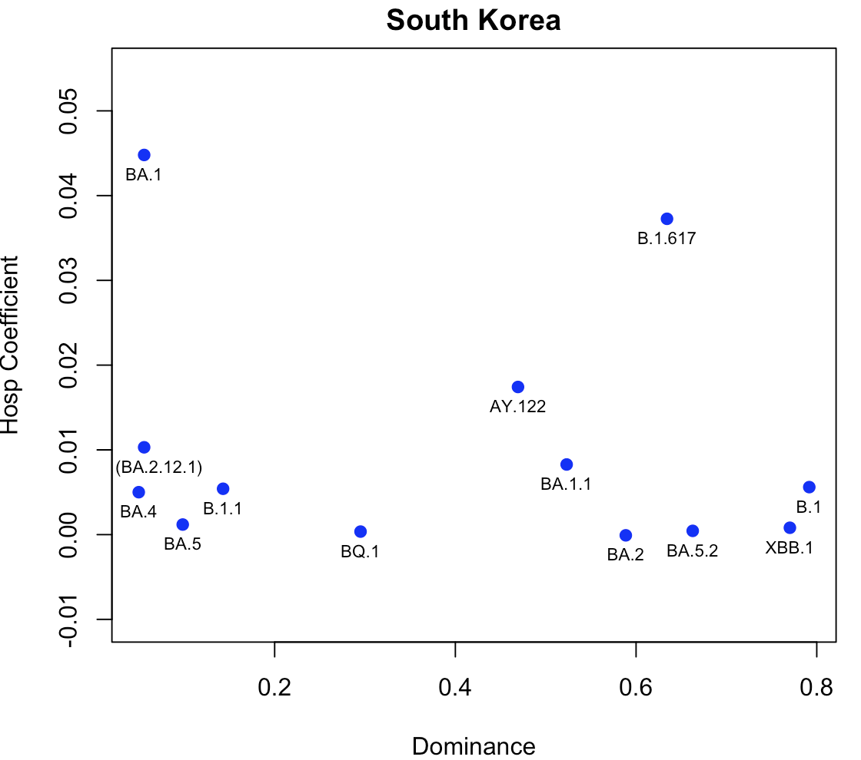
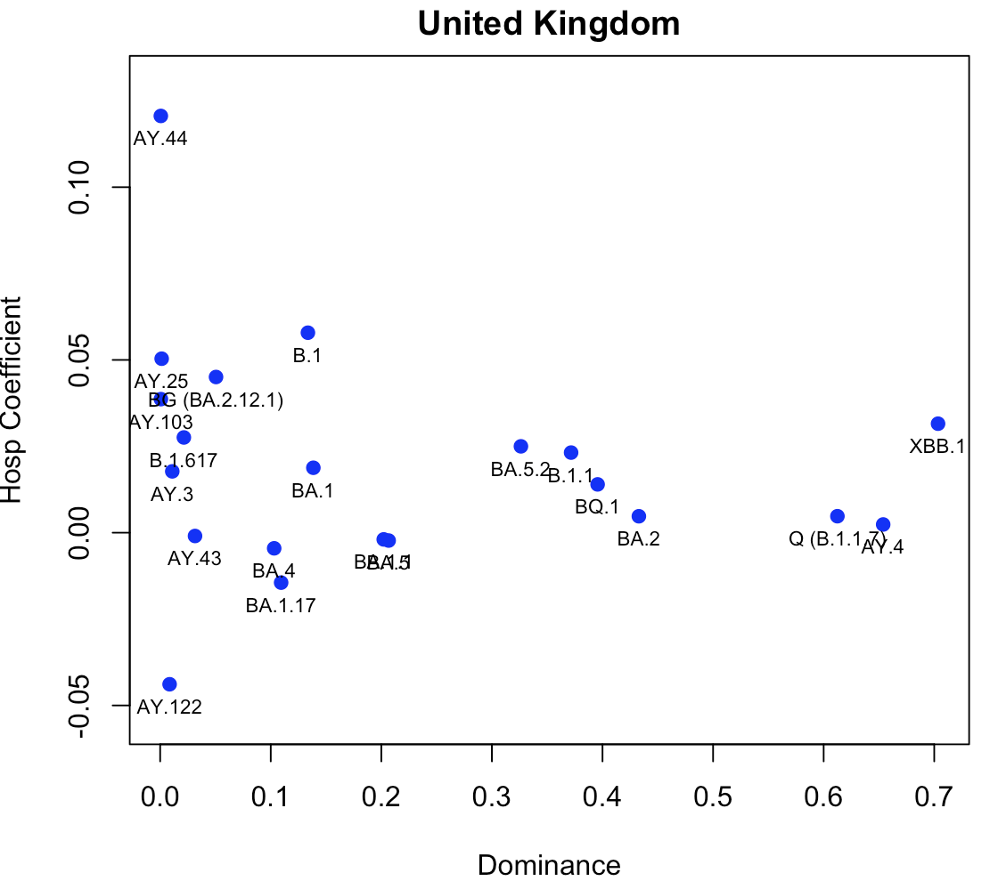

Slide 29
