Slide 1
Model to predict future dominance of
COVID-19 variants using early growth rates
across 30 countries
Jan 29, 2025
Authors (TBD): Franky Zhang, RP, KC, JJ, YJ*, CO*

Slide 2
Introduction
Data Description
Dataset includes infection counts from over 3,000 COVID-19 variants across the Top 30 countries with the highest infections, covering January 2020 to May 2024.
Data is recorded daily, allowing for detailed day-level analysis.
The top 30 countries include (selected based on the total number of cases over the entire time):
Australia, Austria, Belgium, Brazil, Canada, China,
Czech Republic, Denmark, France, Germany, India, Ireland,
Israel, Italy, Japan, Luxembourg, Mexico, Netherlands,
Norway, Peru, Poland, Russia, Slovenia, South Korea,
Spain, Sweden, Switzerland, Turkey, the United Kingdom, USA.

Slide 3
Introduction
1st Analysis: How well does the early share growth rate predict future share dominance across countries?
We set flexible observation days for each variants based on eligibility criteria (whether it reaches a share growth rate threshold 20% by 7 days to max 30 days) for the OTC model → The OTC model takes flexible early share growth rate for each variants between 7 to 30 days to predict the future mean share as dominance.
To identify the range of growth rates that contribute most to dominance (based on coefficients from a step function derived from OTCs).
To identify the specific variants and countries which this model can be helpful.
Model Utility: Our model can predict future dominance by monitoring the share growth rate of a new variant, using its specific growth rate range and a defined observation period (e.g., 45 days). The term “dominance” can also be replaced with “duration.”

Slide 4
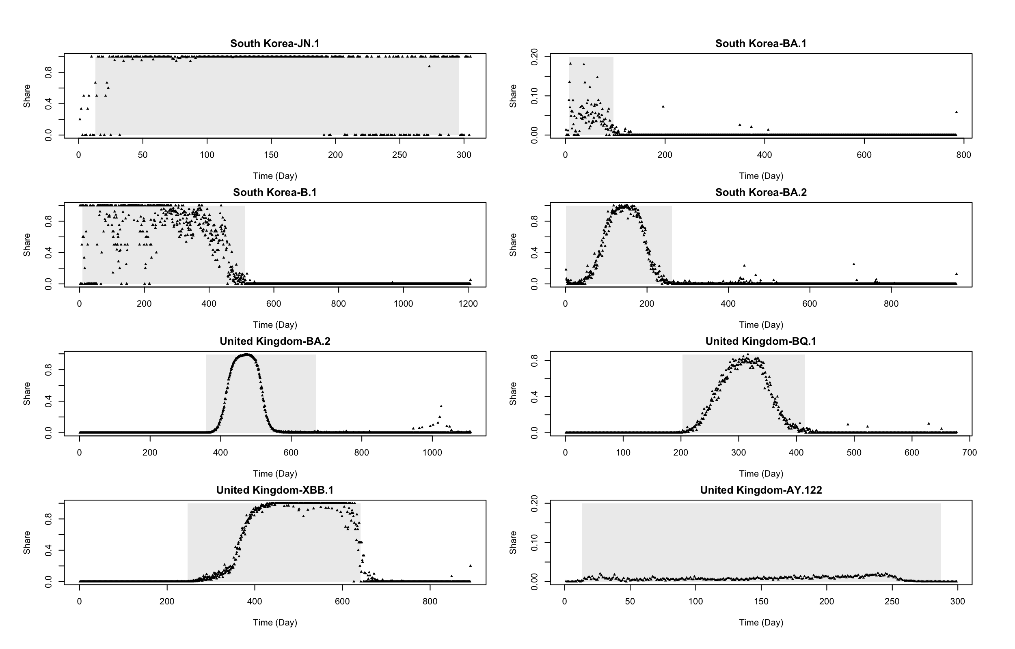
Epidemic Wave Definition
Criteria & Definitions:
Use a 7-day rolling window to identify the start and end of the Epidemic Wave for the variant, highlighting these periods with grey segments. Dominance is defined by the mean share of an Epidemic Wave, while duration refers to the time span of the Epidemic Wave.

Slide 5
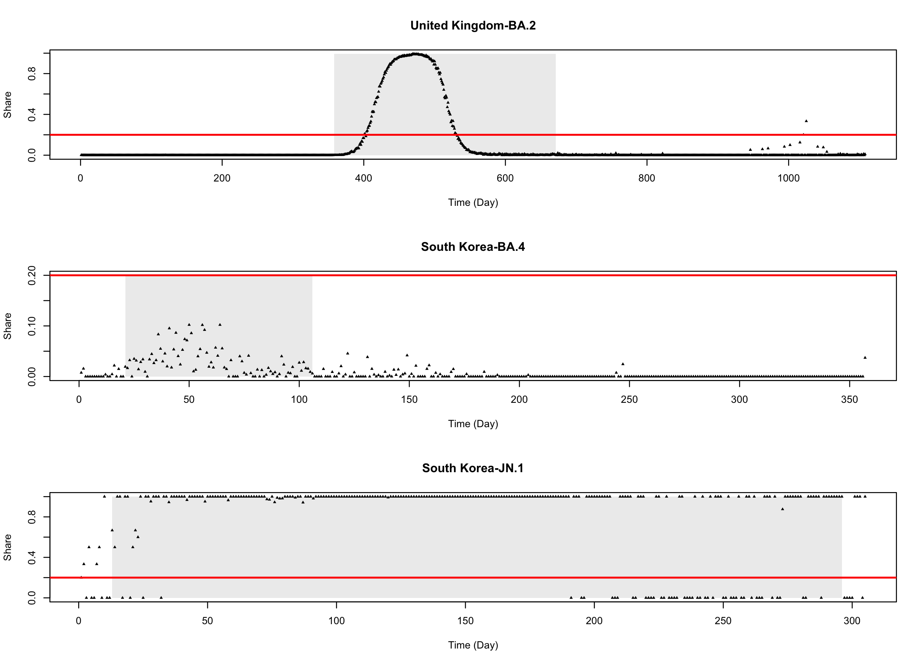
Initial Stage Definition
Flexible observation period:
Share threshold (.2 in this case): The period before reaching this threshold is defined as the "initial period”
Tolerance (30 days in this case): The maximum of observation period.
Minimum requirement (7 days in this case): If a variant reaches the share threshold within the minimum period, it will not be included in the prediction model.
Mostly we assume such variants already showing dominant signal, but might not necessarily true, If it quickly drops.
30 days
< 7 days

Slide 6
296 variants left;
United kingdom: 19;
United States: 19;
South Korea: 7;
Canada: 19 …
Countries < 10 variants;
China, Czech Republic, Poland, Slovenia, Turkey, Austria, Luxembourg, Peru, Russia, Mexico, South Korea
Share threshold = 10%
349 variants left;
United kingdom: 19;
United States: 19;
South Korea: 10;
Canada: 19 …
Countries < 10 variants;
China, Czech Republic, Poland, Slovenia, Turkey, Austria, Luxembourg, Peru, Russia
Minimum = 7 days
Share threshold = 20%
379 variants left;
United kingdom: 20;
United States: 20;
South Korea: 10;
Canada: 19 …
Countries < 10 variants;
China, Czech Republic, Poland, Slovenia, Turkey
Share threshold = 30%
30 Countries (22 variants most per country )
In total: 511 variants
314 variants left;
United kingdom: 19;
United States: 19;
South Korea: 7;
Canada: 19 …
Countries < 10 variants;
China, Czech Republic, Poland, Slovenia, Turkey, Austria, Luxembourg, Peru, Russia, Mexico, South Korea
Share threshold = 10%
Minimum = 5 days
366 variants left;
United kingdom: 19;
United States: 20;
South Korea: 10
Canada: 19 …
Countries < 10 variants;
China, Czech Republic, Poland, Slovenia, Turkey, Austria, Luxembourg, Peru, Russia
Share threshold = 20%
388 variants left;
United kingdom: 19;
United States: 20;
South Korea: 10;
Canada: 19 …
Share threshold = 30%
Countries < 10 variants;
China, Czech Republic, Turkey

Slide 7
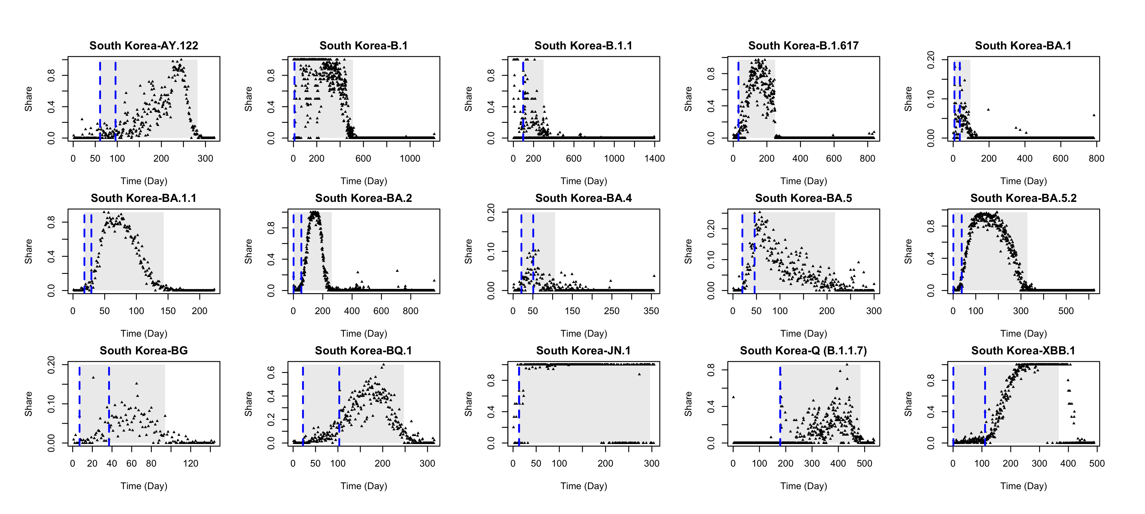
Problematic variant in South Korea (7 days, 20%)

Slide 8
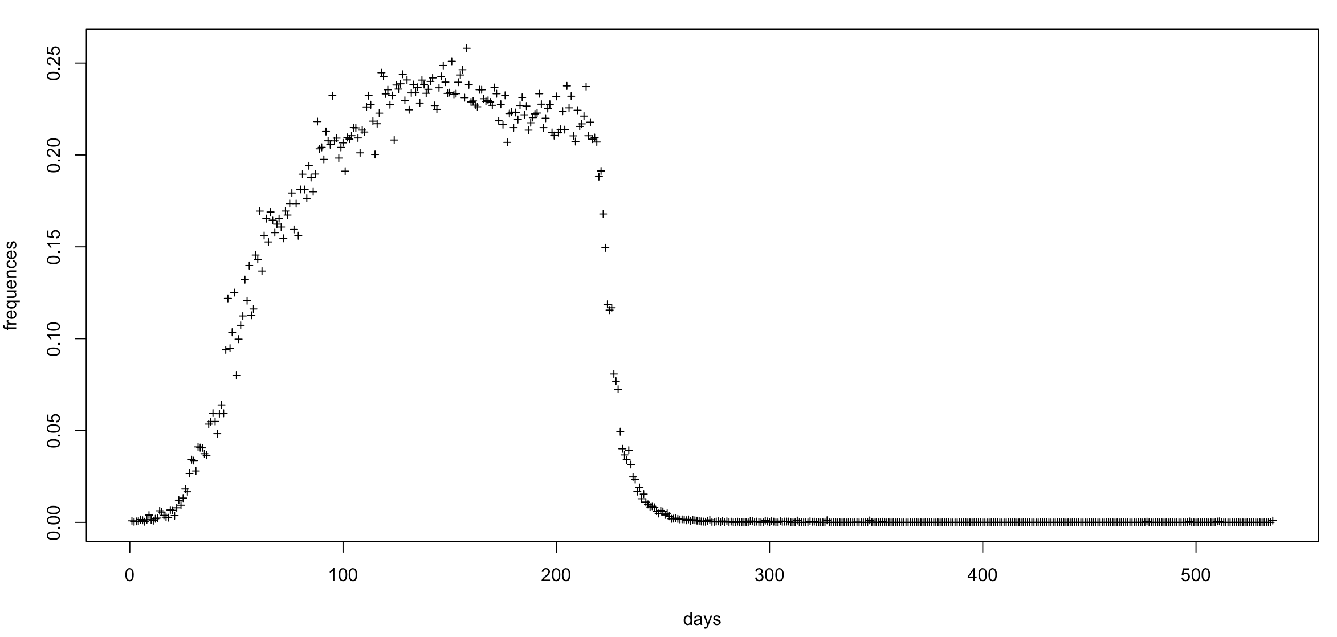
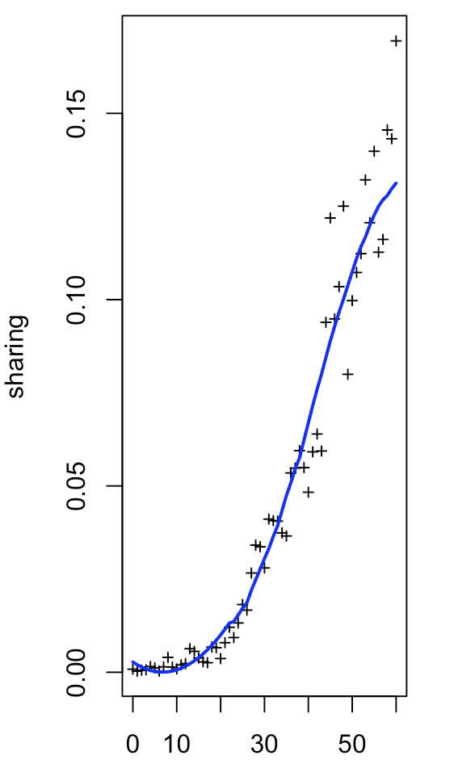
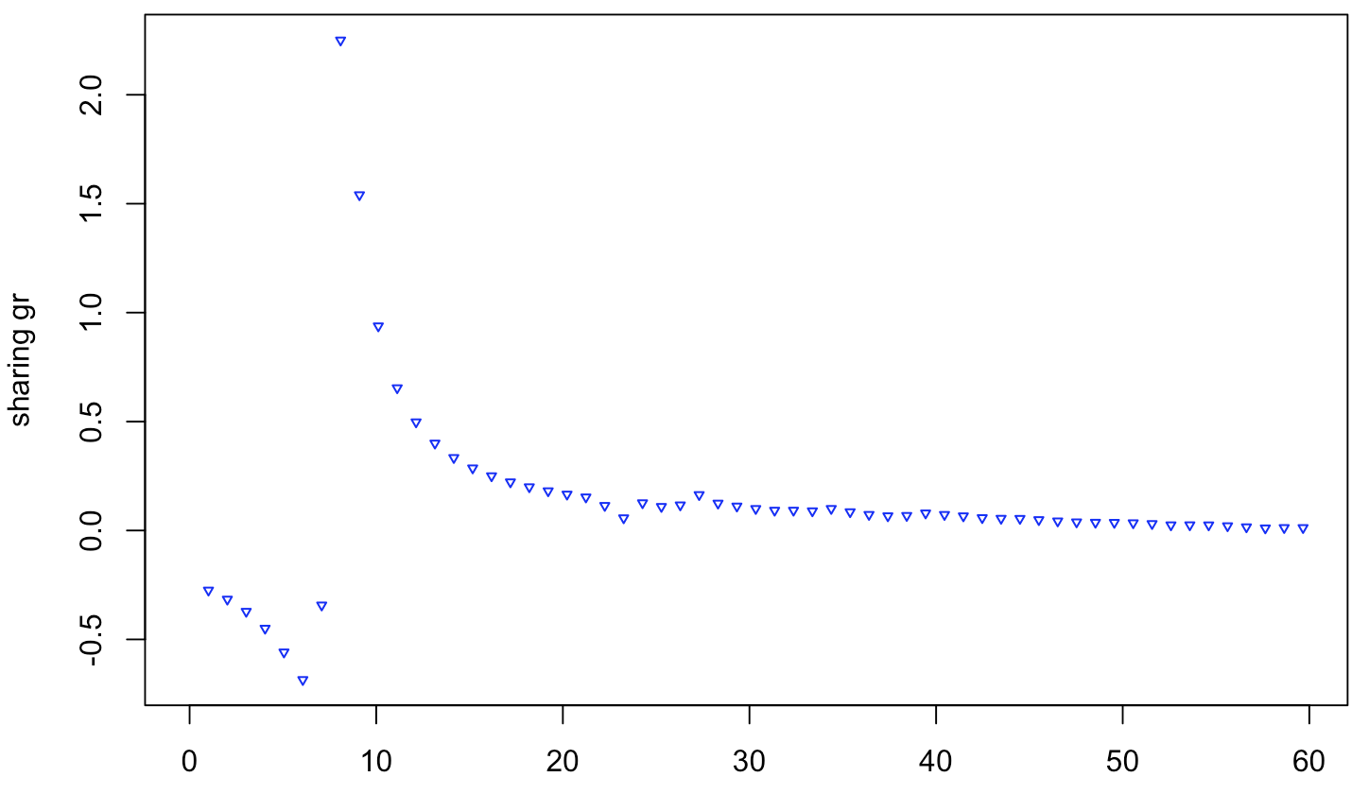
Explanation of Model Input and Output
Input Growth Rate (GR) series

Slide 10
Methodologies
The GSAID data, over 3,000 lineages for TOP 30 countries, was grouped into 22 shared classified lineages based on strings of possible parent lineages (following the UKHSAC alias grouping).
In the latest version, the initial stage was redefined by a flexible observation period before reaching the threshold (20% here), to avoid overlapping with dominance information.
The growth rate were calculated and converted into Occupation Time Curves (OTCs) to facilitate clearer interpretation following Functional Data Analysis (FDA).
The Adapted Lasso Regression was applied to estimate the functional parameters, showing in the following steps.

Slide 11
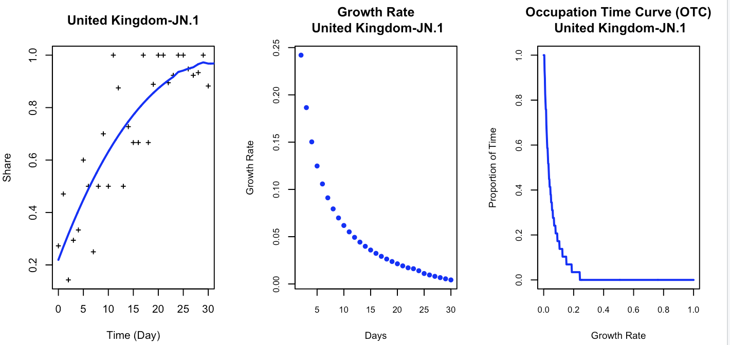

Occupation Time Curve Conversion
Input Series
$$OTC\left(c\right)=P(X\left(t\right)≥c)$$
Output Scaler
Dominance = 96 (%)
Duration = 313 (Days)

Slide 12
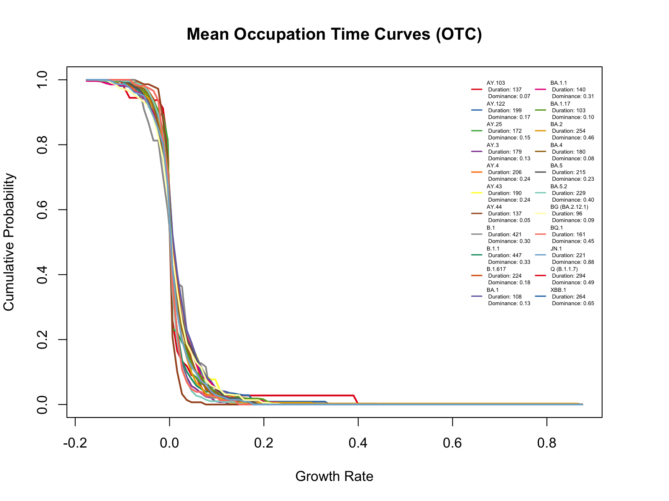

Slide 13
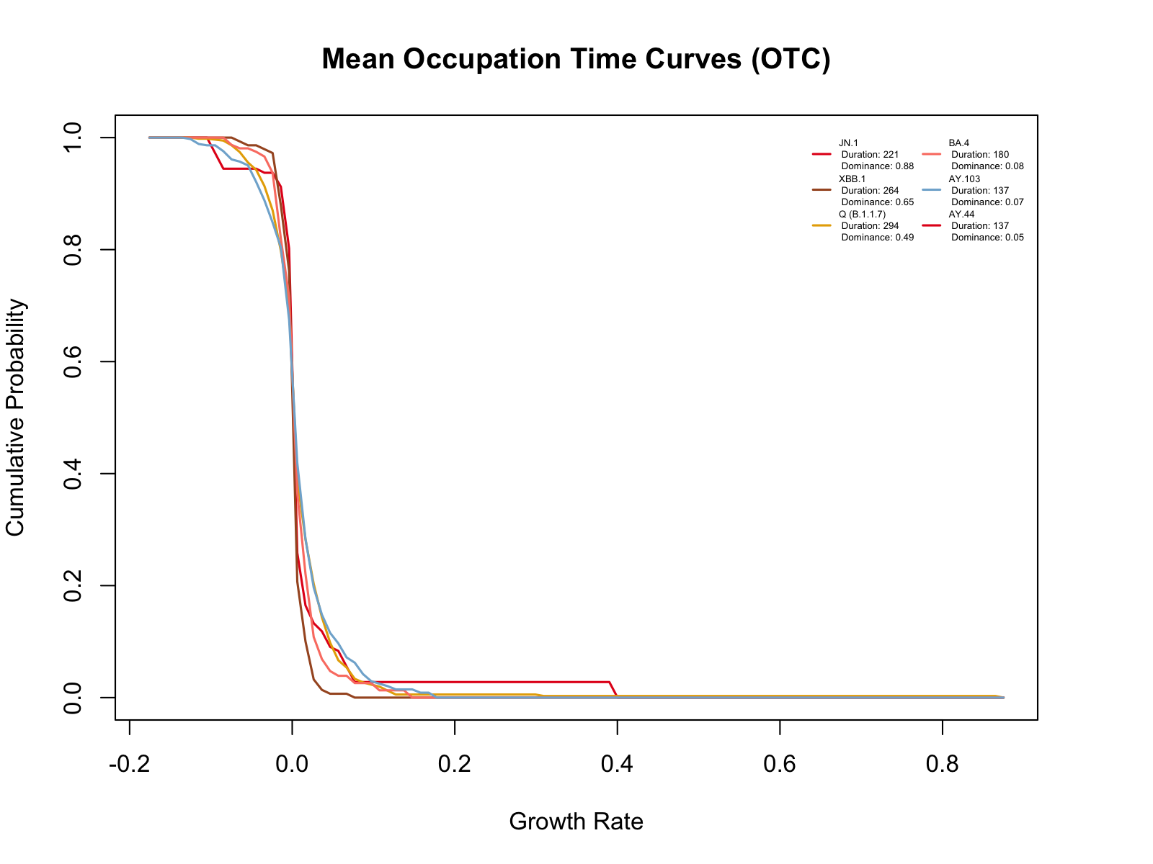

Slide 14
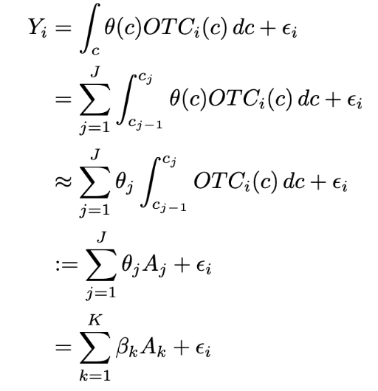
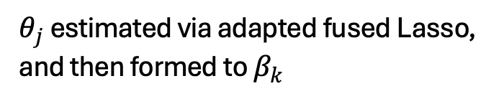
Functional Regression with OTCs
$θ_{j}$ estimated via adapted fused Lasso, and then formed to $β_{k}$

Slide 15
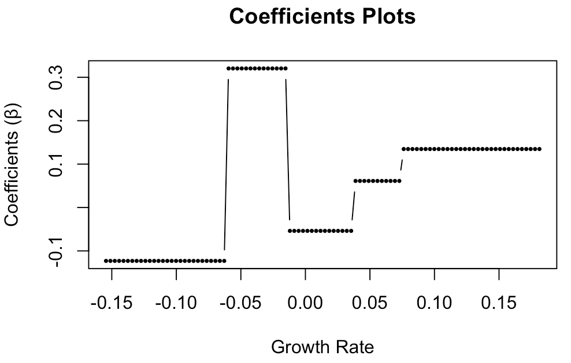
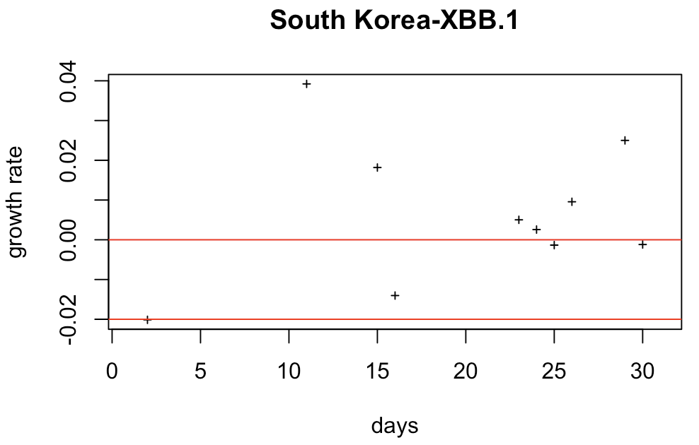
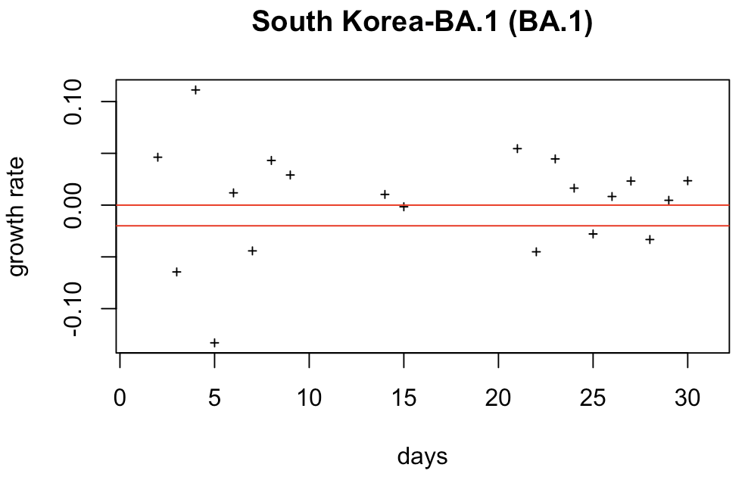
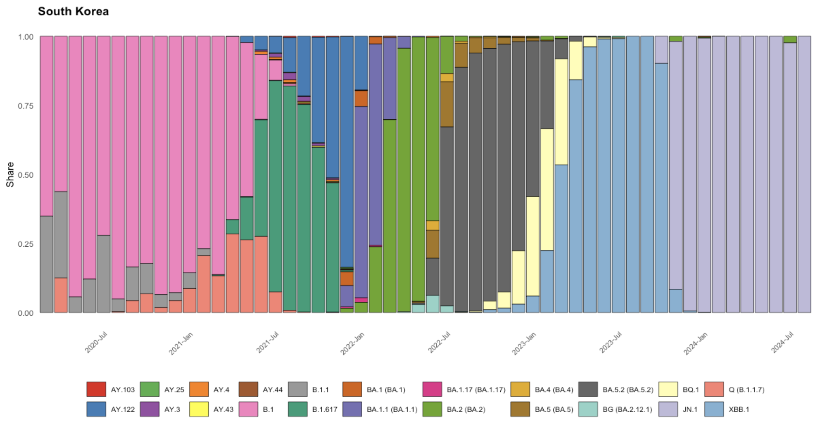
Dominance Interpretations (South Korea)
R^2 = 0.95
median
median
Dominance: 0.77
Predicted: 0.70
negative
high
high
negative
median
Dominance: 0.05
Predicted: 0.02
high
negative

Slide 16
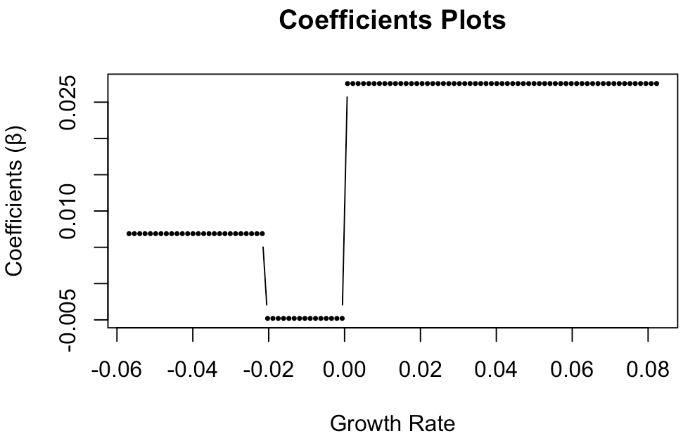
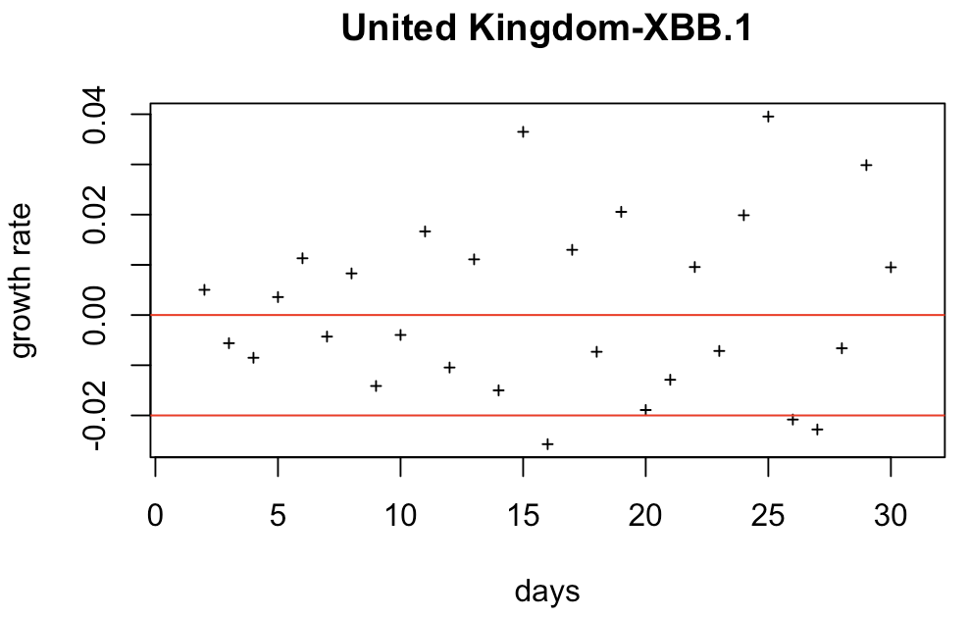
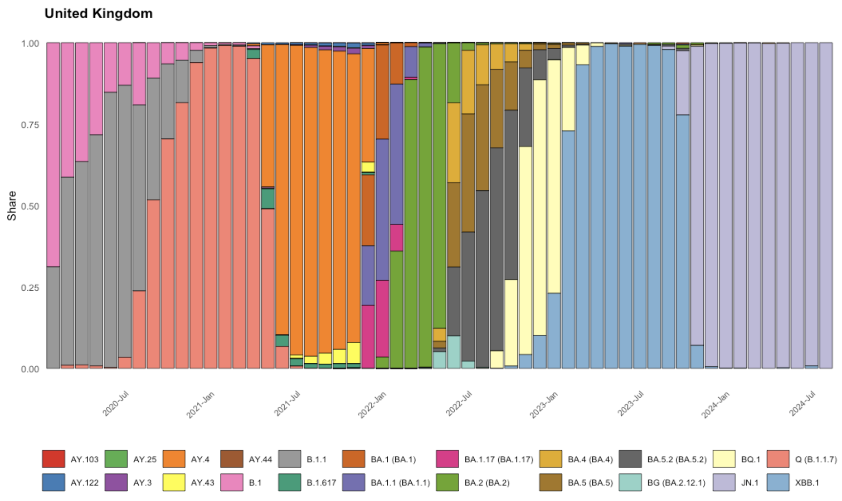
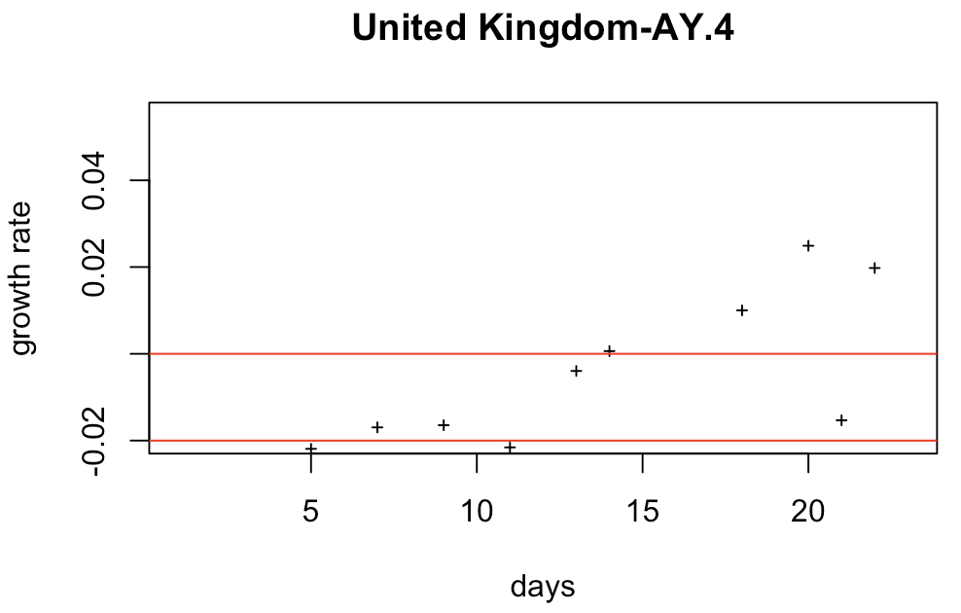
Dominance Interpretations (United Kingdom)
R^2 = 0.83
high
high
Dominance: 0.70
Predicted: 0.66
median
low
low
median
high
Dominance: 0.35
Predicted: 0.30
low
median

Slide 17
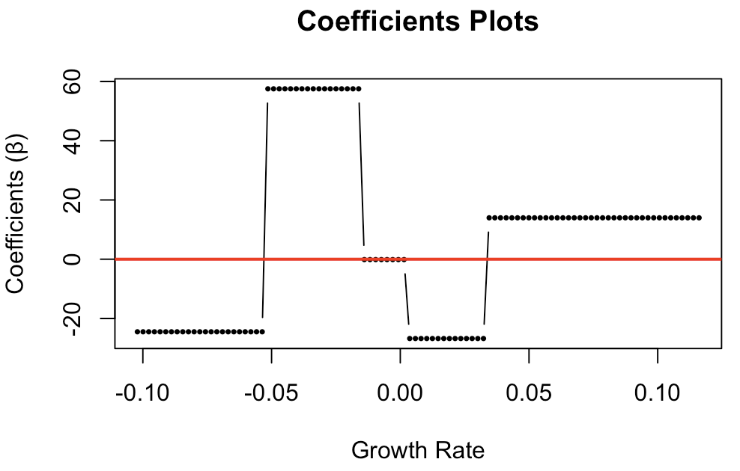
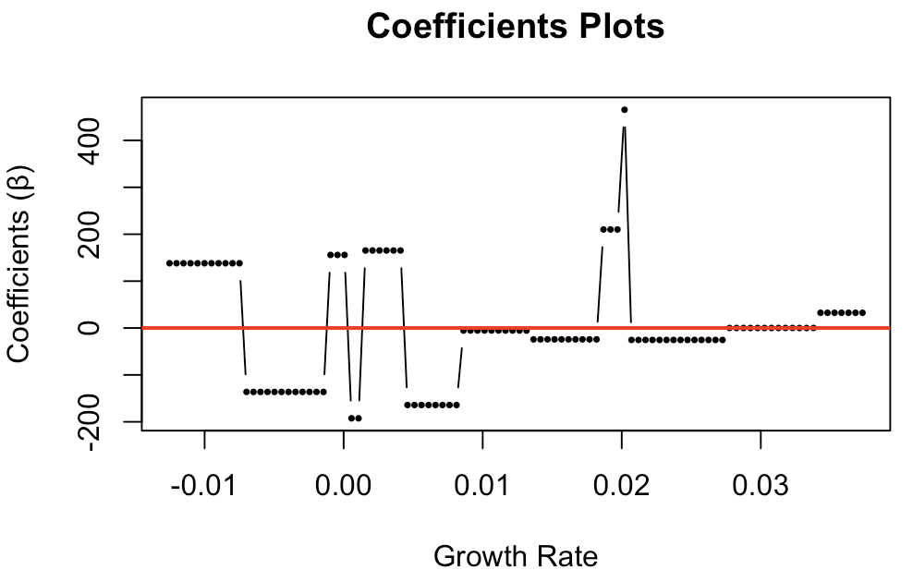
Duration Interpretation
South Korea
United Kingdom
R^2 = 0.97
R^2 = 0.91

Slide 18
Innovation/Strengths (Justification of the model approach)
Why do we choose to use the share growth rate instead of the frequency growth rate?
Since testing policies have changed a lot over time, so that the total number of cases is not a good representative of how prevalent a variant is. Using the relative proportion as a measure of dominance, this is less sensitive to testing policy and therefore provides a more stable measure over time.
Why do we choose the Occupational Time Curve (OTC) transformation:
In conventional approach, researchers often estimates a smooth curve as functional parameter θ(c) using basis expansions, such as B-splines, natural cubic splines, and tensors, among others (Goldsmith, Zipunnikov and Schrack, 2015; Goldsmith et al., 2012). Given our goal is to define a prediction model across countries with different variants trend, such time-based functional model ignores the information of different start time of each variant across countries. Moreover, time-based functional models often produce fluctuating time-varying coefficients, making it challenging to interpret the impact of share growth rate on dominance across different observation periods for initial growth.
Therefore, our approach is to transform the timing varying sequence to the frequency probability of initial share growth rate information. By discretizing the continuous functional parameter estimate θ(c) as a piece-wise function with change points, it allows effectively defining windows of share growth rates by fusing the θ(c) of adjacent growth rate ranges with similar effects on the dominance. The process categorizes the frequency-based growth rate in the stepwise function quantifying the relative contribution of different growth rate range on the share dominance;
How and why did we redefine the initial period (input):
We use a flexible observation period to prevent input information from overlapping with the target output, "Dominance." This period extends until the set threshold is reached or the maximum number of days is reached. However, cases where the threshold is met within seven days cannot be modeled.
For each variant, the original initial stage may include a prolonged period with a single recorded infection on the first day, followed by a long gap with no cases. This could result from misrecorded cases, which were especially common in the early stages of COVID-19. If such a period is considered part of the initial stage, it would provide no meaningful information for prediction.
We also excluded instances of negative growth during the initial period, as these are likely artifacts of the smoothing process applied to the unstable early-stage share growth rate. (during this update, we didn’t exclude)

Slide 19
Global Hospitalization/Infection Rate Prediction Using Variant Share Sequences

Slide 20
Introduction
2nd Analysis: Which variants contributed the most to the hospitalization-to-infection rate during the Omicron wave across countries?
a) To determine whether, and to what extent, dominant variants were closely associated with the hospitalization-to-infection rate.
b) To compare groups of dominant variants and their association with the hospitalization-to-infection rate across countries.
Model Utility:
To estimate population-level epidemic consequences based on nationwide sampled genotype data.
To quantify the discrepancy between high share dominance and high hospitalization-to-infection contribution.

Slide 21
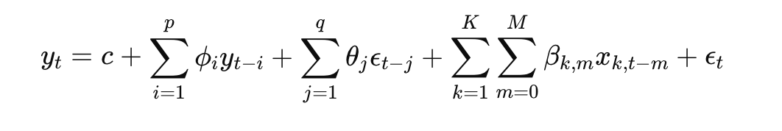
Data Description
Linking 22 shared classified lineages data to the Hospitalization and Infection data from Our World in Data website.
The hospitalization-infection (Hosp-Infec) rate was calculated as a sequence, and the problem was modeled as a multiple time series prediction problem.
Definition and Methodology
The Hosp-Infec rate was calculated using the absolute number of infections and hospitalizations recorded.
The ARIMAX model was applied for multiple time series predictions to better provide the the contribution of exogenous variables (multiple series of variants)

Slide 23
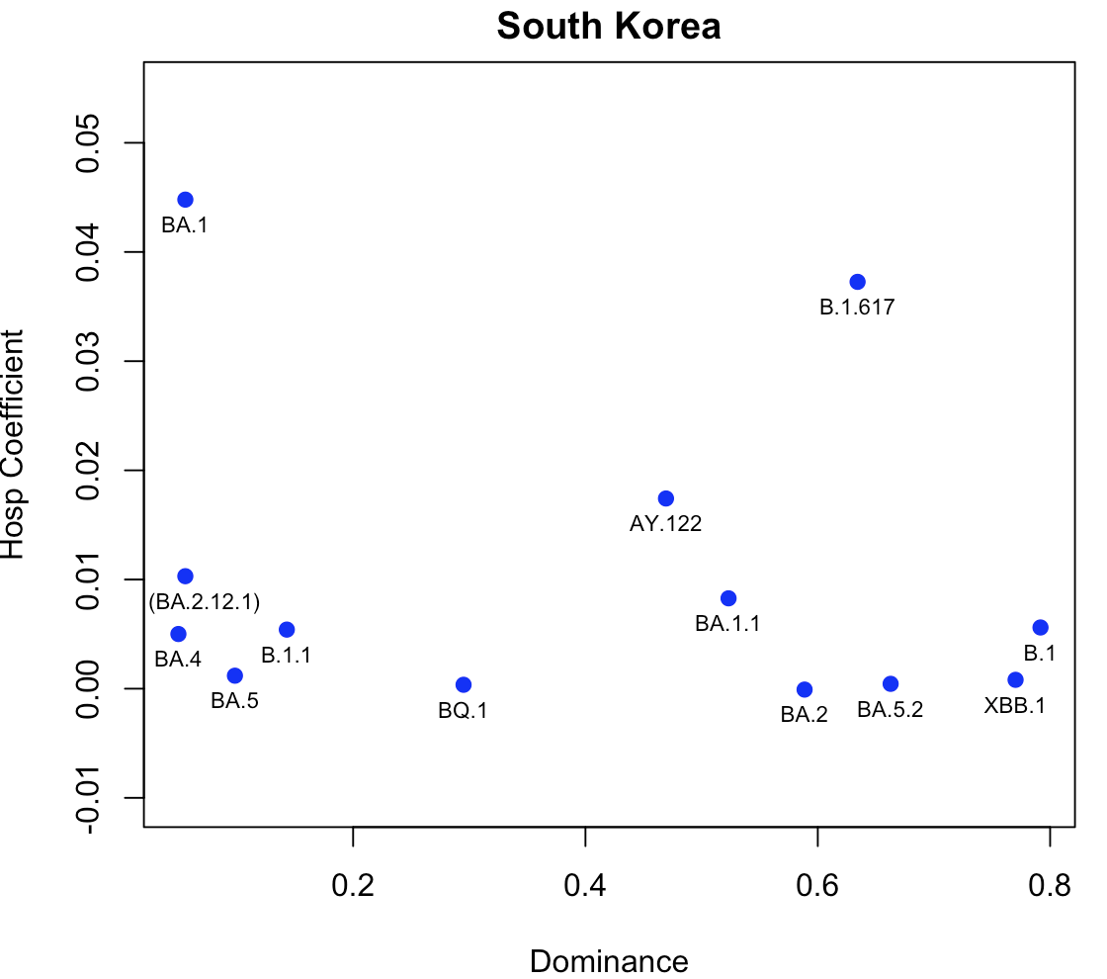
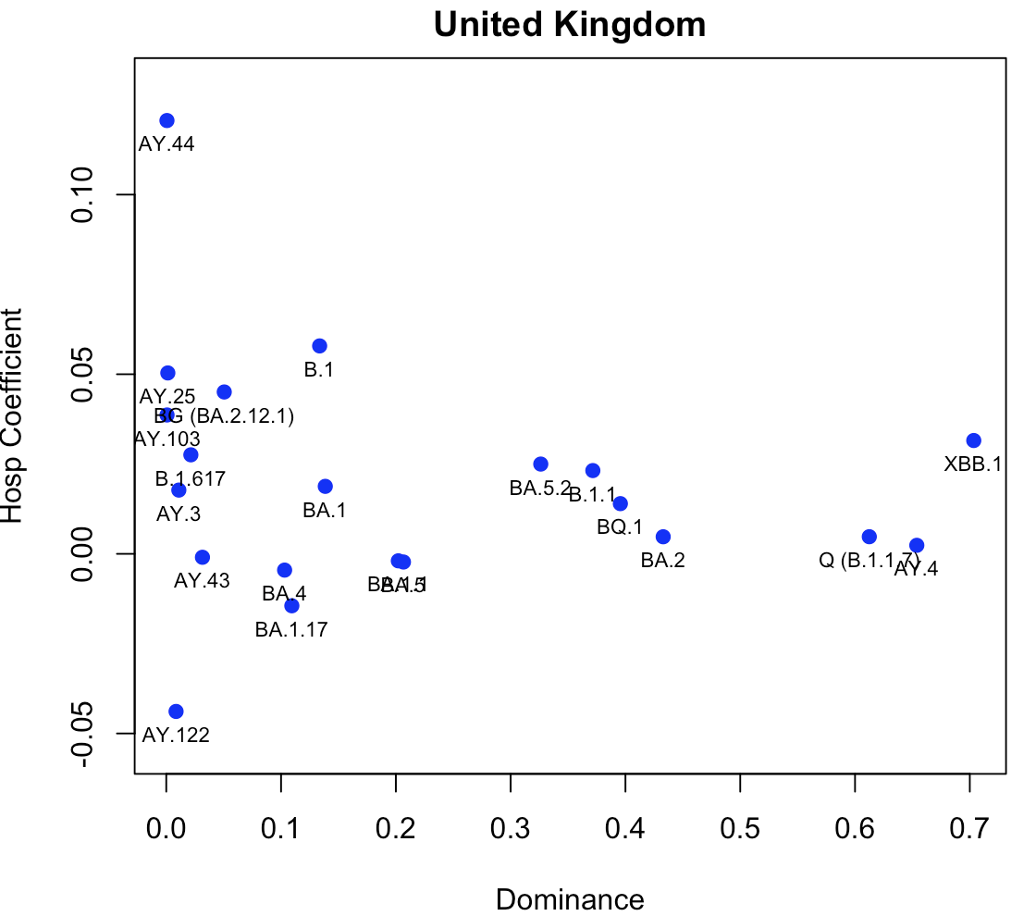

Slide 24
