Slide 1
Time Series Analysis of Global COVID-19 Variants
Oct 16, 2024
Franky Zhang

Slide 2
Data Description
Dataset includes infection counts from over 2,000 COVID-19 variants across the TOP 30 countries with the highest infections, covering January 2020 to May 2024.
Data is recorded daily, allowing for detailed day-level analysis.
List the countries I include
Apply the model to South Korea and UK, and evaluate
Definition and Methodology
The term "Dominance of Variants" is defined in two ways: the sum of the monthly share of infections and the average of the monthly share of infections.
The daily infection data, over 2,000 lineages for TOP 30 countries, was grouped into 22 shared classified lineages based on strings of possible parent lineages.
The Generalized Additive Model (GAM) was used to smooth the infection frequency and share within each country, and the growth rate was calculated from the first derivative of the smoothed curves.
Functional Data Analysis (FDA) was applied for prediction using various inputs and outputs, effectively avoiding the multicollinearity problem.
1

Slide 3
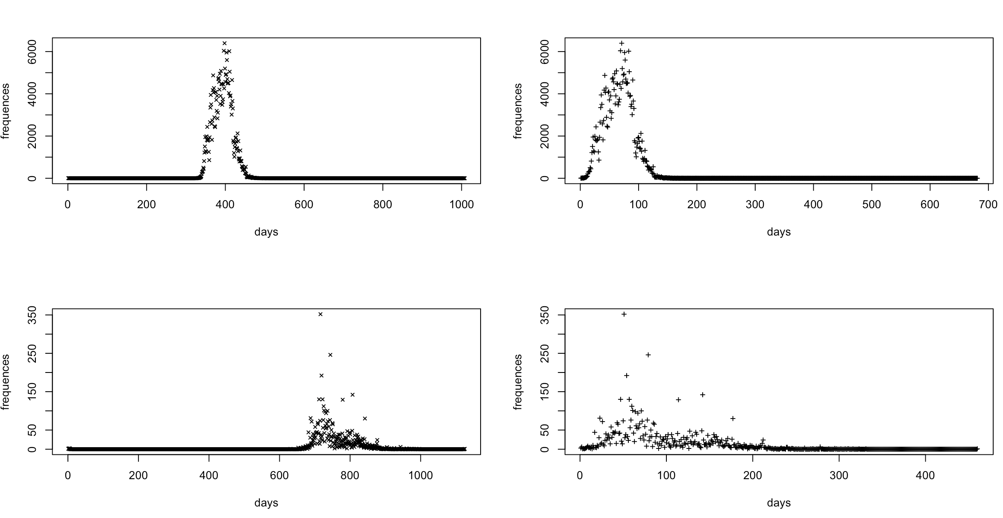
Re-define the initial stage
60 days period
60 days period

Slide 4
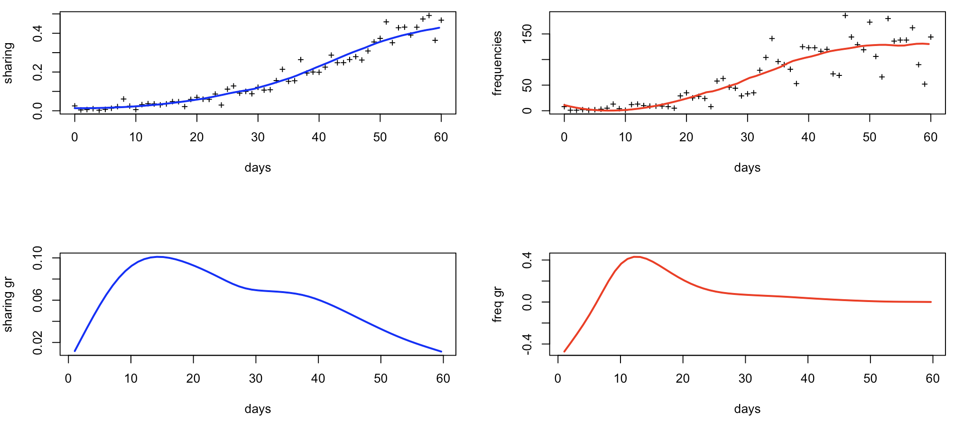
Smooth and calculate growth rate
"United Kingdom-BQ.1"

Slide 5
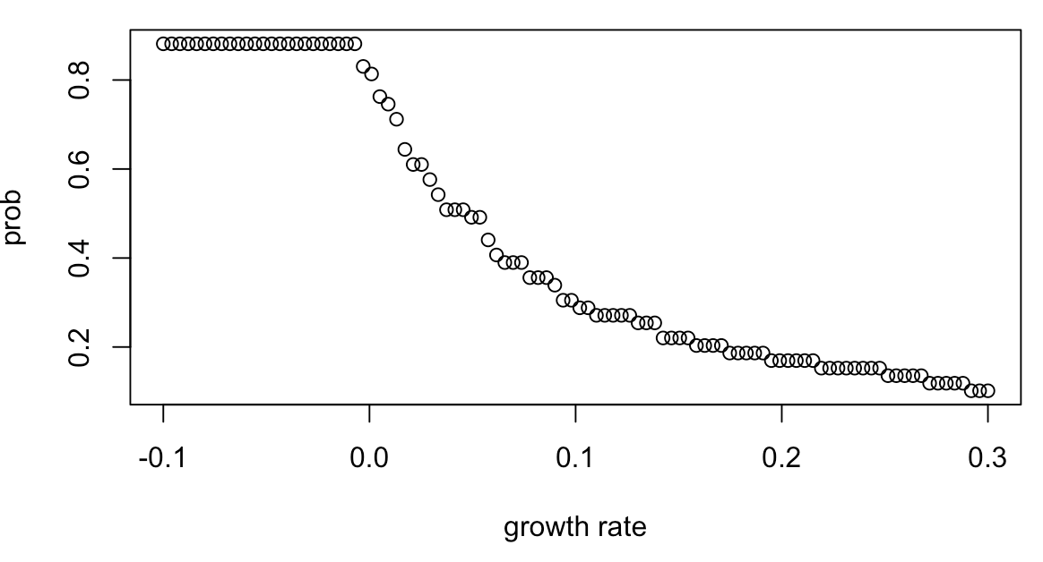
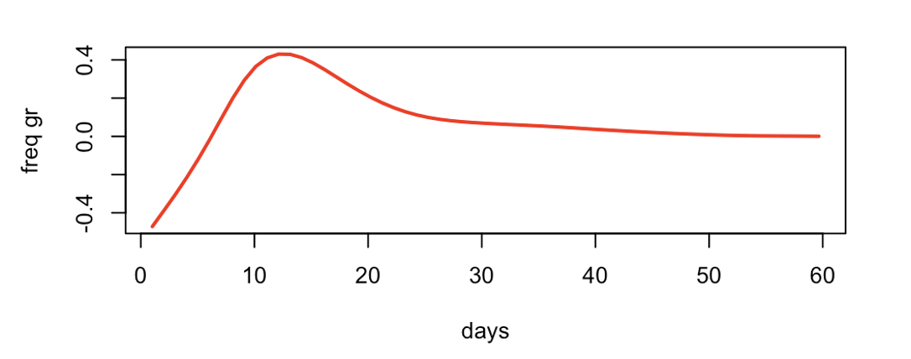
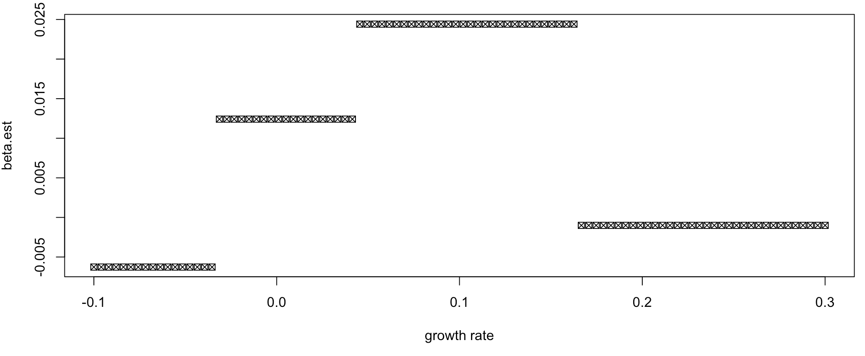

Slide 6
List the variants type that satisfiy the model criteria.
Compare with the hospitalization variants.

Slide 7
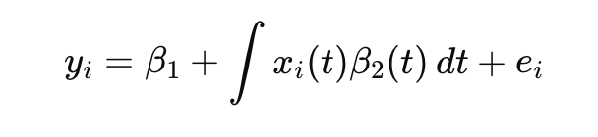
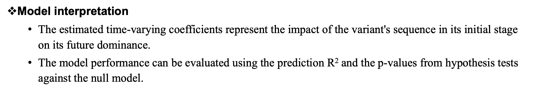
Brief Intro to FDA modeling
Output:
Defined Dominance for i^{th} variant in the country
Coefficients:
Time-varying coefficients, generated using the Fourier basis in our case.
Input:
The frequency or share sequence of the variant in its initial stage.
Model interpretation
The estimated time-varying coefficients represent the impact of the variant's sequence in its initial stage on its future dominance.
The model performance can be evaluated using the prediction R² and the p-values from hypothesis tests against the null model.
2

Slide 8
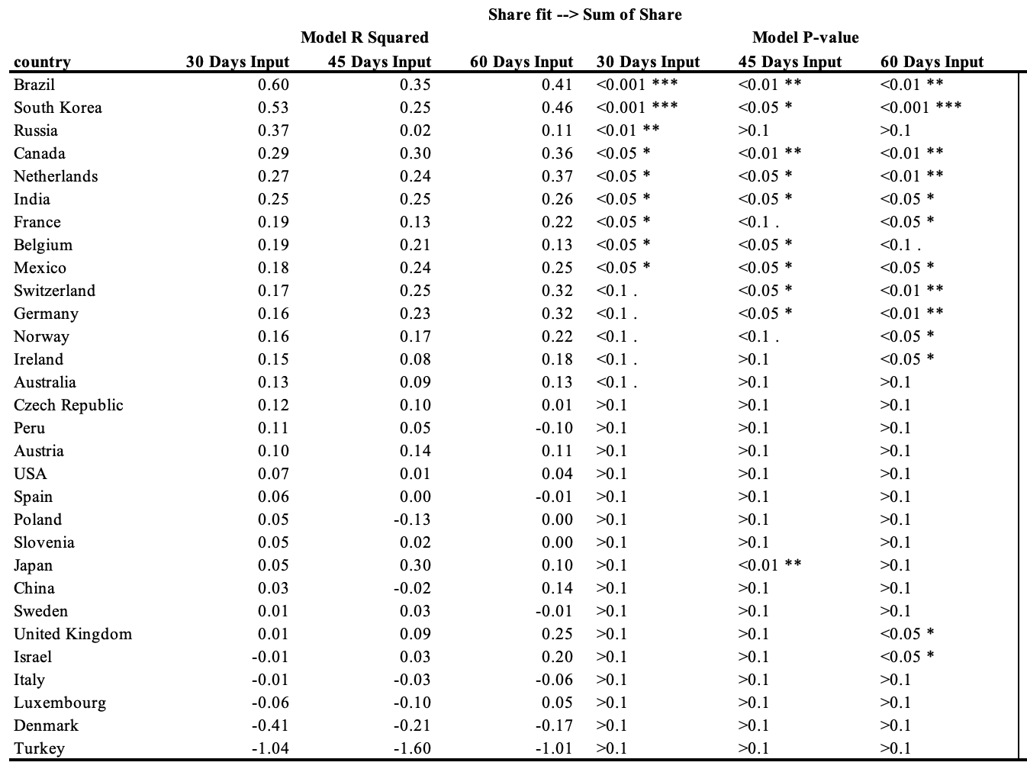
Results
Predictable Countries
3

Slide 9
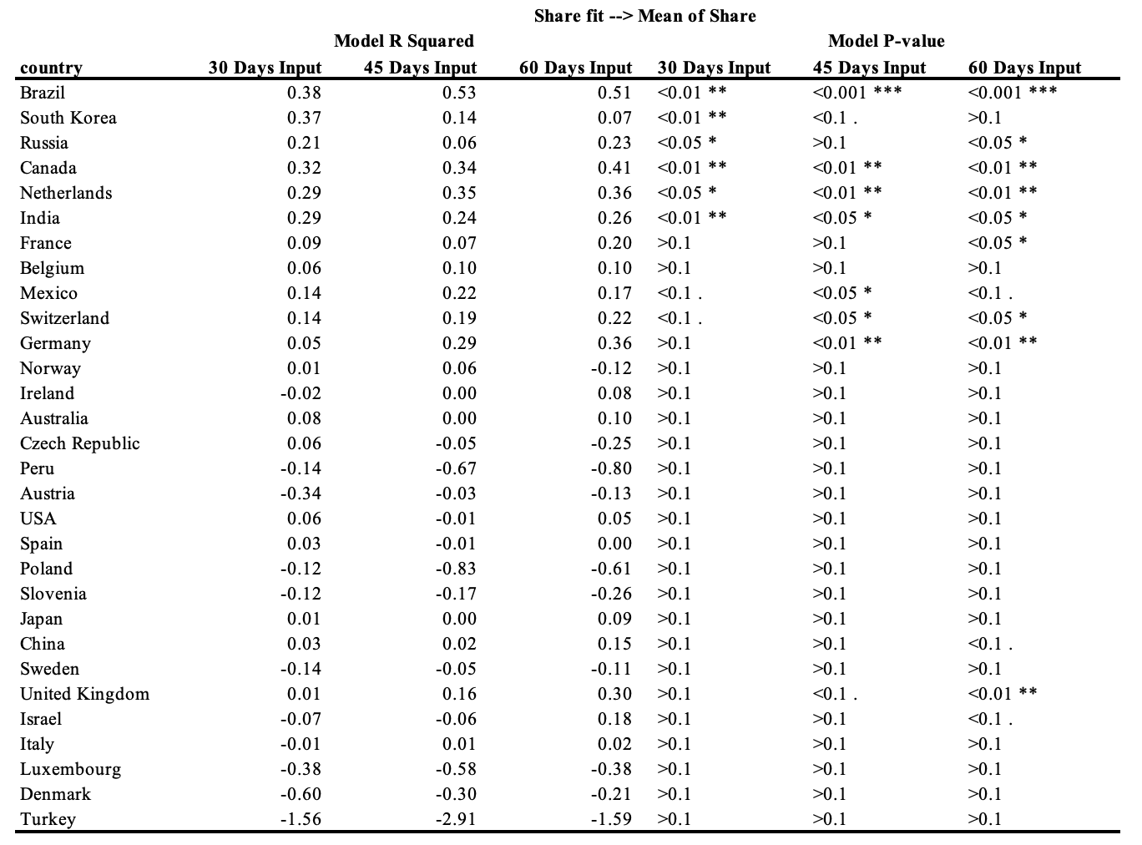
Results
Predictable Countries
4

Slide 10
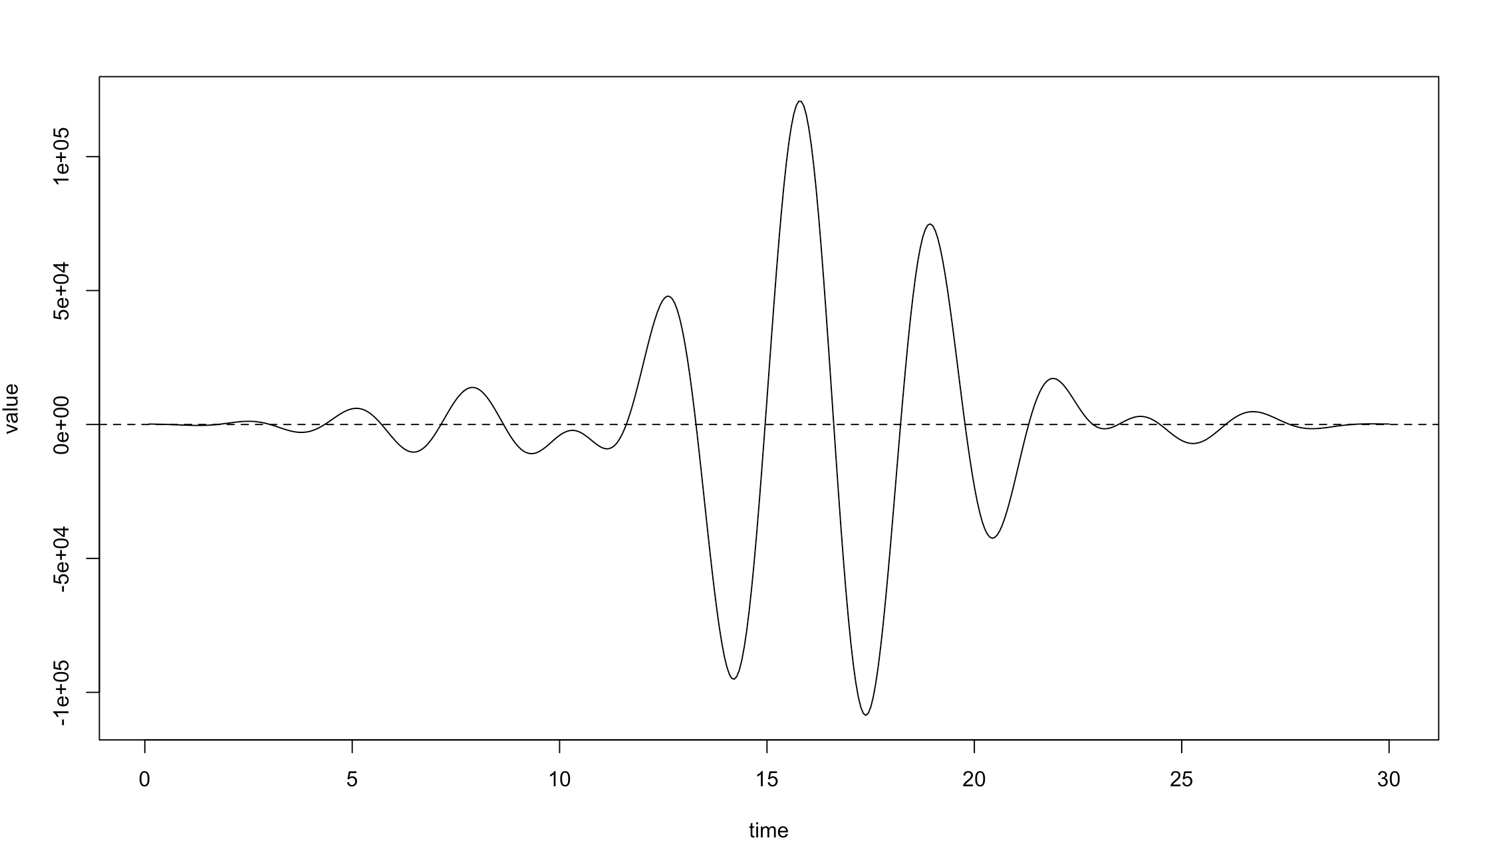
Results
Model interpretation
Input: first 30 days share of the variants; Output: sum of the monthly share;
Country selected: South Korea.
5

Slide 11
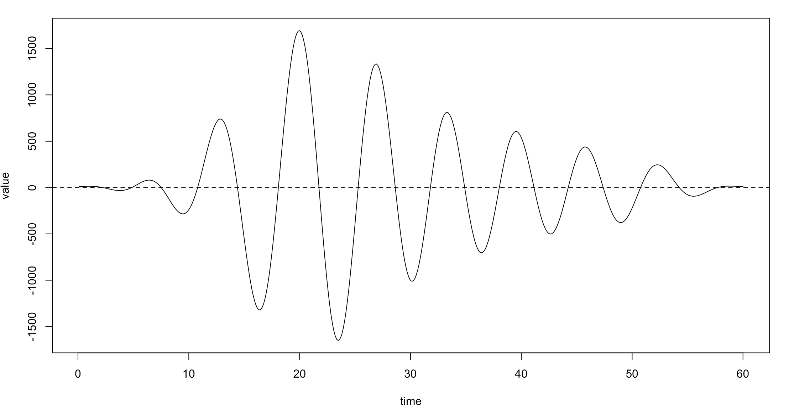
Results
Model interpretation
Input: first 60 days share of the variants; Output: sum of the monthly share;
Country selected: South Korea.
6

Slide 12
Discussion
Pros
The model can provide a reasonably accurate prediction of the future dominance of variants, based solely on the initial stage of frequency or share, for some countries.
For example, in the case of South Korea, the period from day 10 to day 20 makes the largest contribution to the model's prediction, as revealed by the fluctuation in the time-varying coefficients.
Cons
The prediction R squared values are low for some countries, even when compared to simple linear regression.
The patterns of the basis functions, or the functional analysis in general, are difficult to interpret in terms of a clear positive or negative impact over time.
7

Slide 13
Global Hospitalization/Infection Rate Prediction Using Variant Share Sequences

Slide 14
Data Description
Linking 22 shared classified lineages data to the Hospitalization and Infection data from Our World in Data website.
The hospitalization-infection (Hosp-Infec) rate was calculated as a sequence, and the problem was modeled as a multiple time series prediction problem.
Definition and Methodology
The Hosp-Infec rate was calculated using the absolute number of infections and hospitalizations recorded.
The XGBoost model was applied for multiple time series predictions to better provide the desired interpretation, specifically focusing on the contribution of different variants to the prediction.
8

Slide 15
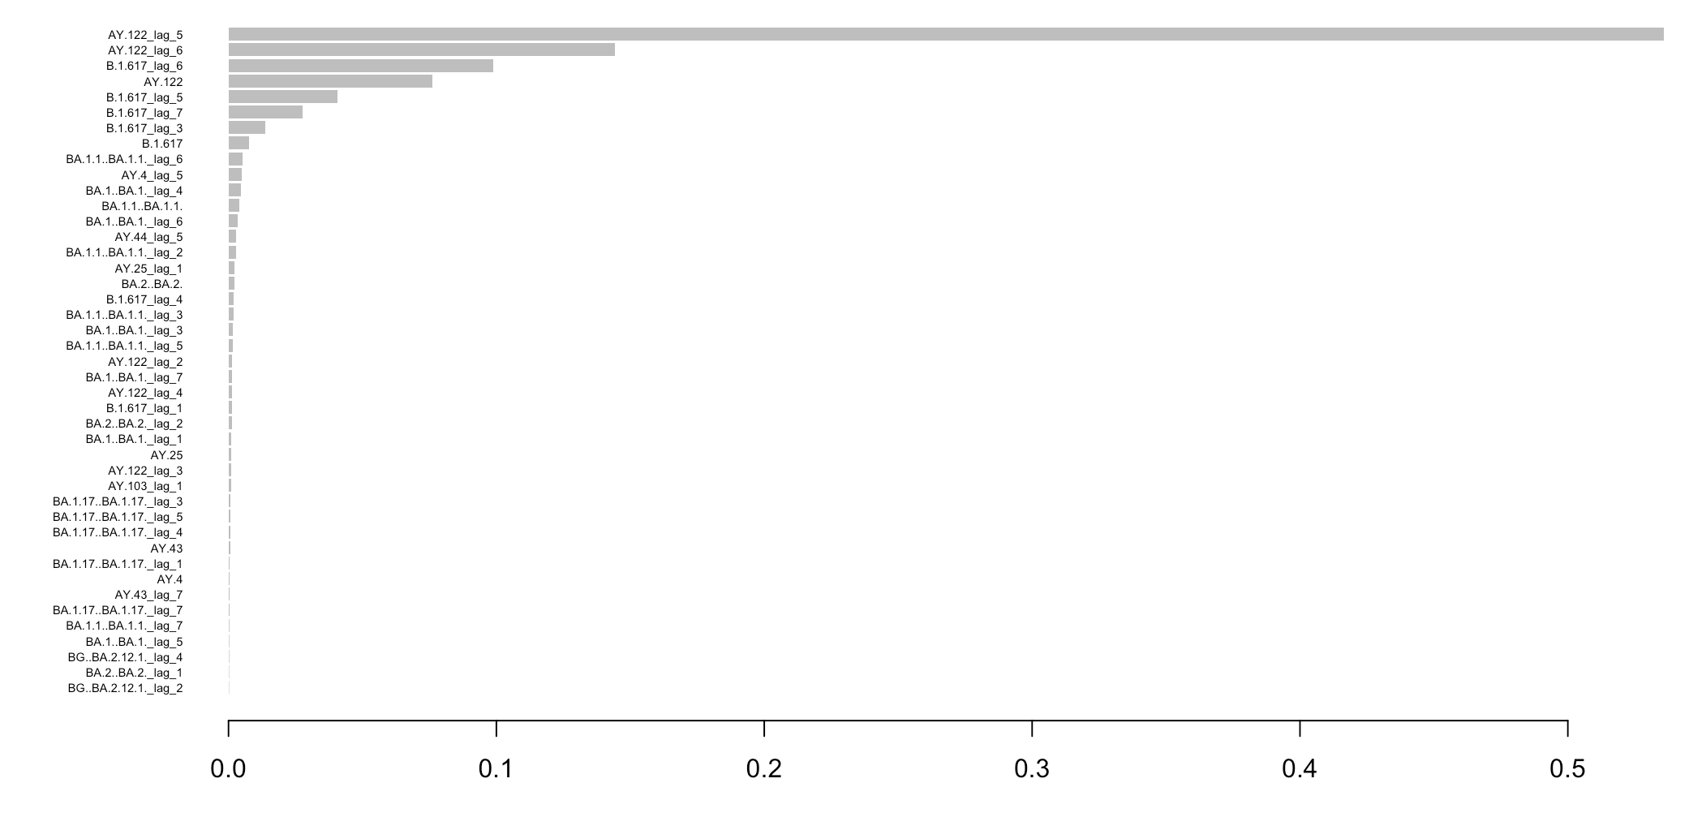
Results
South Korea
AY.122
B.1.617
9

Slide 16
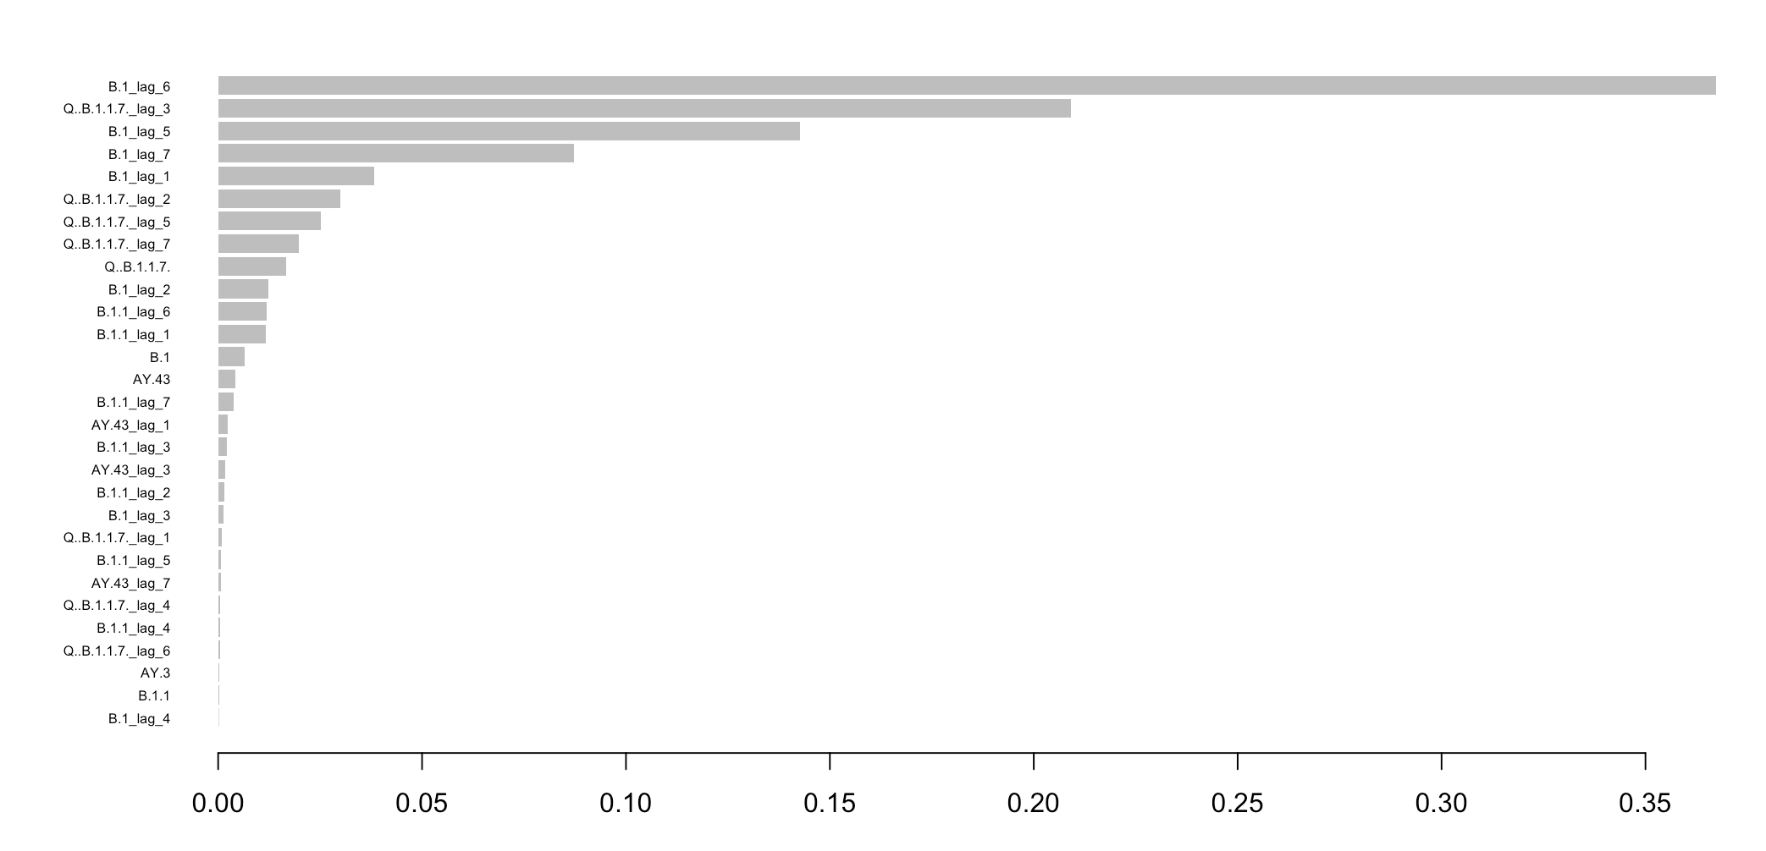
Results
Untied Kingdom
B.1
B.1.1
Q.B.1.1.7
10

Slide 17
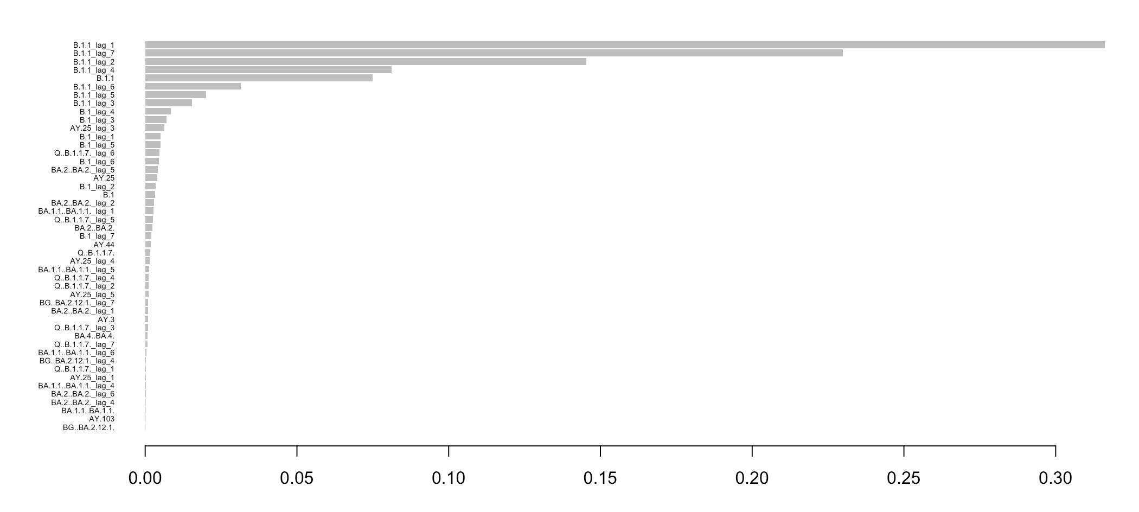
Results
United States
B.1
B.1.1
11

Slide 18
Next Steps
Discussion
A more classical statistical multiple time series prediction method was applied, focusing on the top 3 most contributing variants identified by XGBoost, to provide a clearer interpretation.
Revisiting the classification procedure may reveal interesting insights about specific variants, including their unique characteristics and behaviors. Analyzing these variants could provide valuable information regarding their spread patterns, mutation rates, and influence on infection dynamics.
12

