Slide 1
Time Series Analysis of Global COVID-19 Variants
Oct 16, 2024
Franky Zhang

Slide 2
Introduction
Data Description
Dataset includes infection counts from over 2,000 COVID-19 variants across the TOP 30 countries with the highest infections, covering January 2020 to May 2024.
Data is recorded daily, allowing for detailed day-level analysis.
The top 30 countries include (selected based on the total number of cases over the entire time period):
Australia, Austria, Belgium, Brazil, Canada, China,
Czech Republic, Denmark, France, Germany, India, Ireland,
Israel, Italy, Japan, Luxembourg, Mexico, Netherlands,
Norway, Peru, Poland, Russia, Slovenia, South Korea,
Spain, Sweden, Switzerland, Turkey, the United Kingdom, USA.
1

Slide 3
Objectives (1st analysis)(Add to the d.ocx)
How much early share growth rate can predict the future share dominance (across countries).
a) To determine optimal observation days for each country by the best model performance (R^2). (consider wider grip)
b) To determine the range of growth rates most contributing to the dominance. (by the coefficient, step function, derived from OTCs)
Utility of the model: our model can predict the future dominance by monitoring the share growth rate of the new variant, based on the specific growth rate range and observation day (e.g. 45 days).
The dominance can be replaced to the duration

Slide 4
Objectives(2nd paper)
Which variants contributed mostly to the hospitalization-infection rate during the Omicron wave across countries.
a) To determine whether and to what extent dominant variants were closely associated with the hops-infec rate.
b) To compare group of dominant variants and association with hops-infec rate across countries.
Utility of the model:
To estimate population level epidemic consequence based on nationwide sampled genotype data.
To quantify the discrepancy between high share dominance and high hosp-infec contribution.

Slide 5
Grouping Questions
Keep the current grouping result or exclude the more general groups (B.1)?

Slide 6
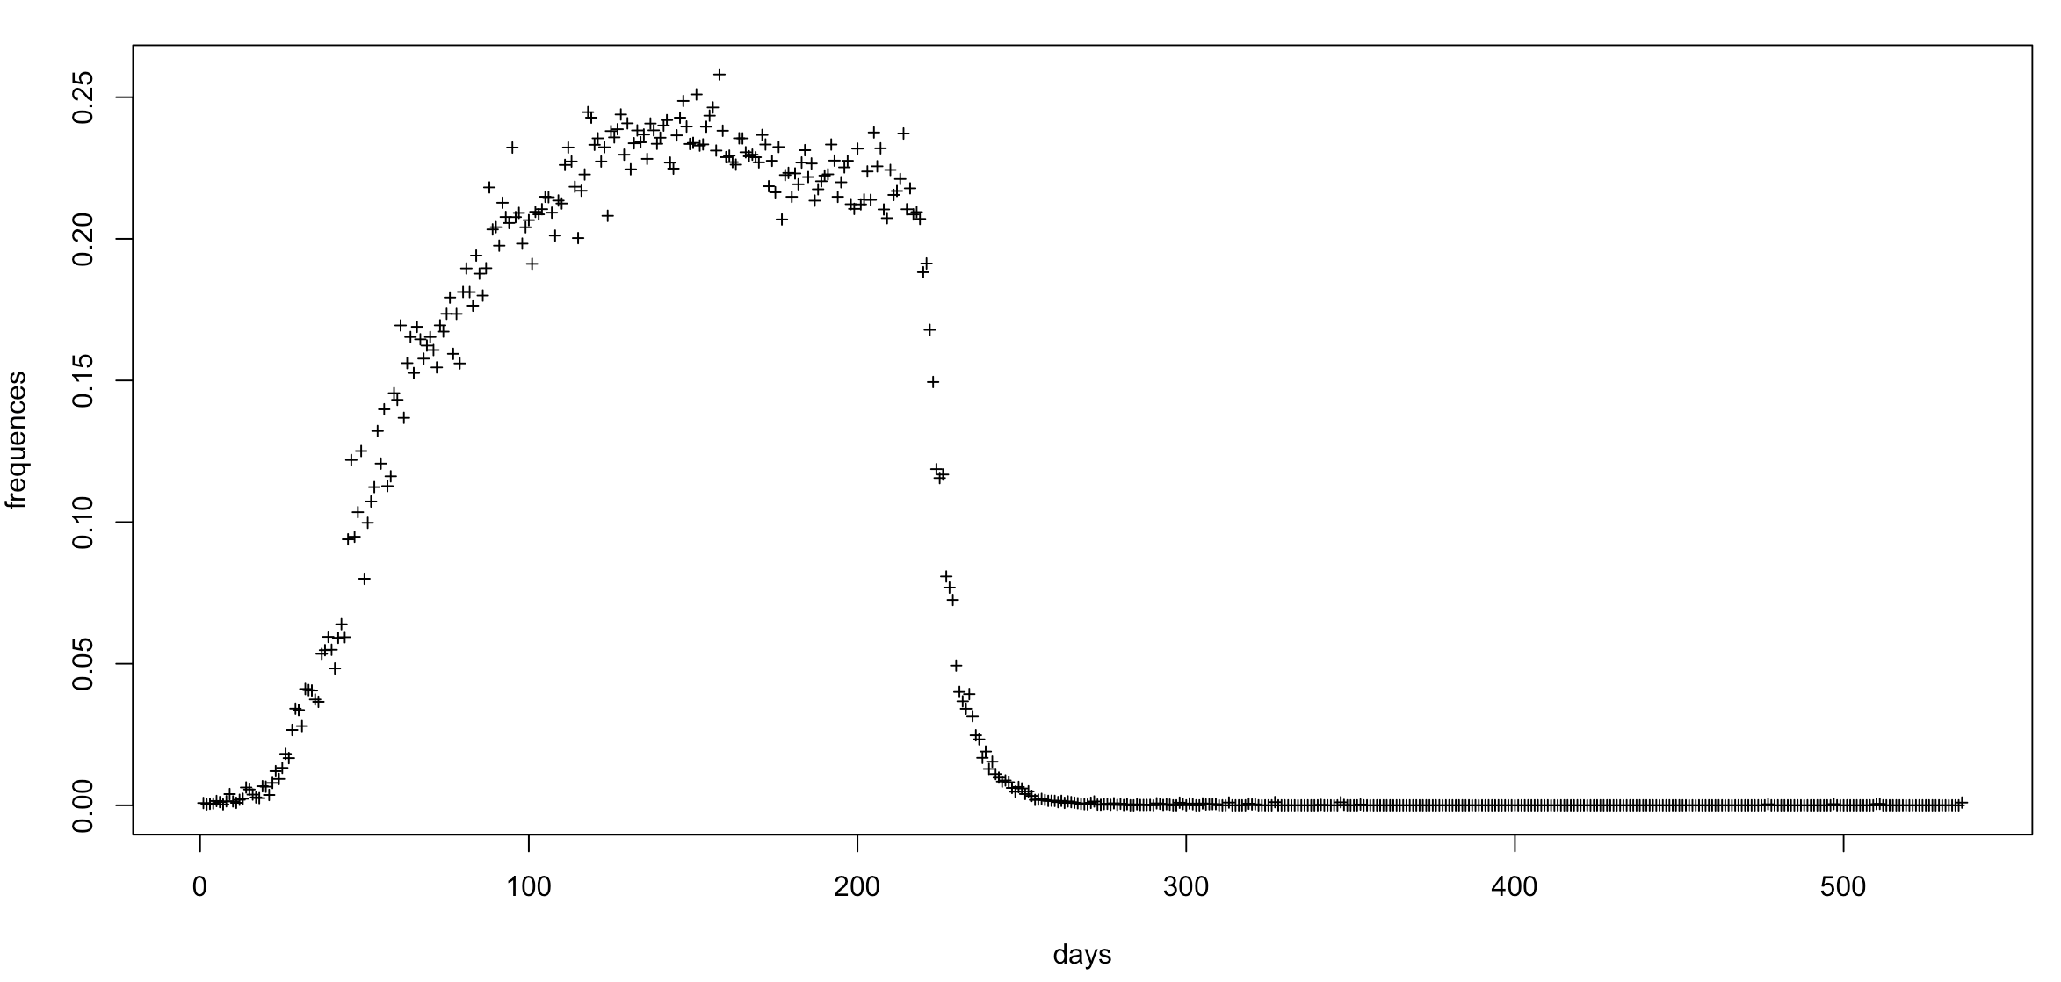
Explanation of Model Input and Output
2

Slide 7
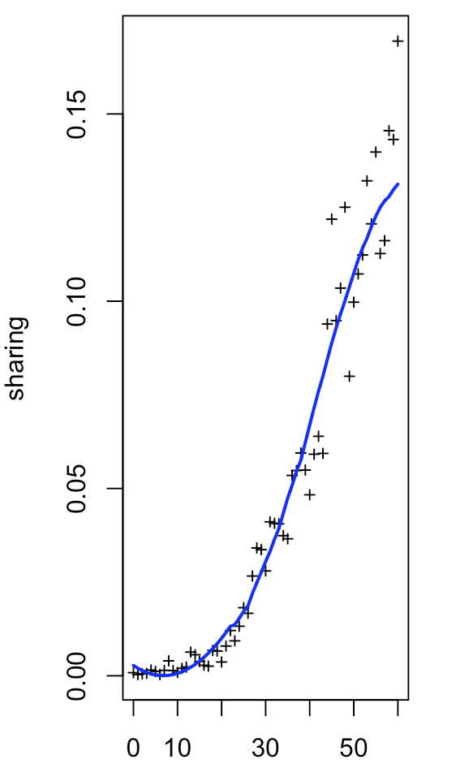
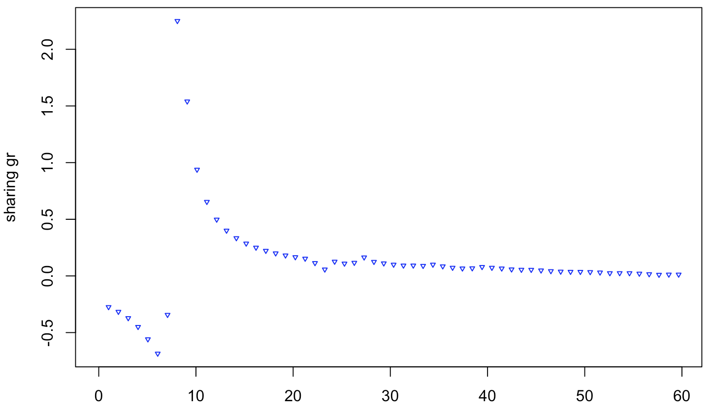
Explanation of Model Input and Output
Input GR series
3

Slide 8
Explanation of Model Input and Output
Definition of “Dominance”:
Calculate the mean share of the longest consecutive period of the variant, rather than using the mean share or maximum share over the entire period.
Summary of the model:
Using the initial-stage growth rates of the share to predict future dominance, represented by the mean share over the longest consecutive period.
Our model can predict the mean share and duration during its longest period but it cannot determine when the prevalence of the variant will end.
Output scaler
4

Slide 9
Introduction
Methodology
The GSAID data, over 2,000 lineages for TOP 30 countries, was grouped into 22 shared classified lineages based on strings of possible parent lineages (following the UKHSAC alias grouping).
In the latest version, the initial stage was redefined as a consecutive period with at least one infection per day to better capture the relevant information. And the dominance was redefined to the mean share during the longest prevalence.
The Savitzky-Golay smoothing (S-G smoothing) was applied to denoise the time series and calculate the growth rate for both infection frequencies and the sharing of variants.
The smoothed growth rates were converted into Occupation Time Curves (OTCs) to facilitate clearer interpretation following Functional Data Analysis (FDA).
The Adapted Lasso Regression was applied to estimate the functional parameters, showing in the following steps.
5

Slide 10
Redefine the initial stage
6

Slide 11
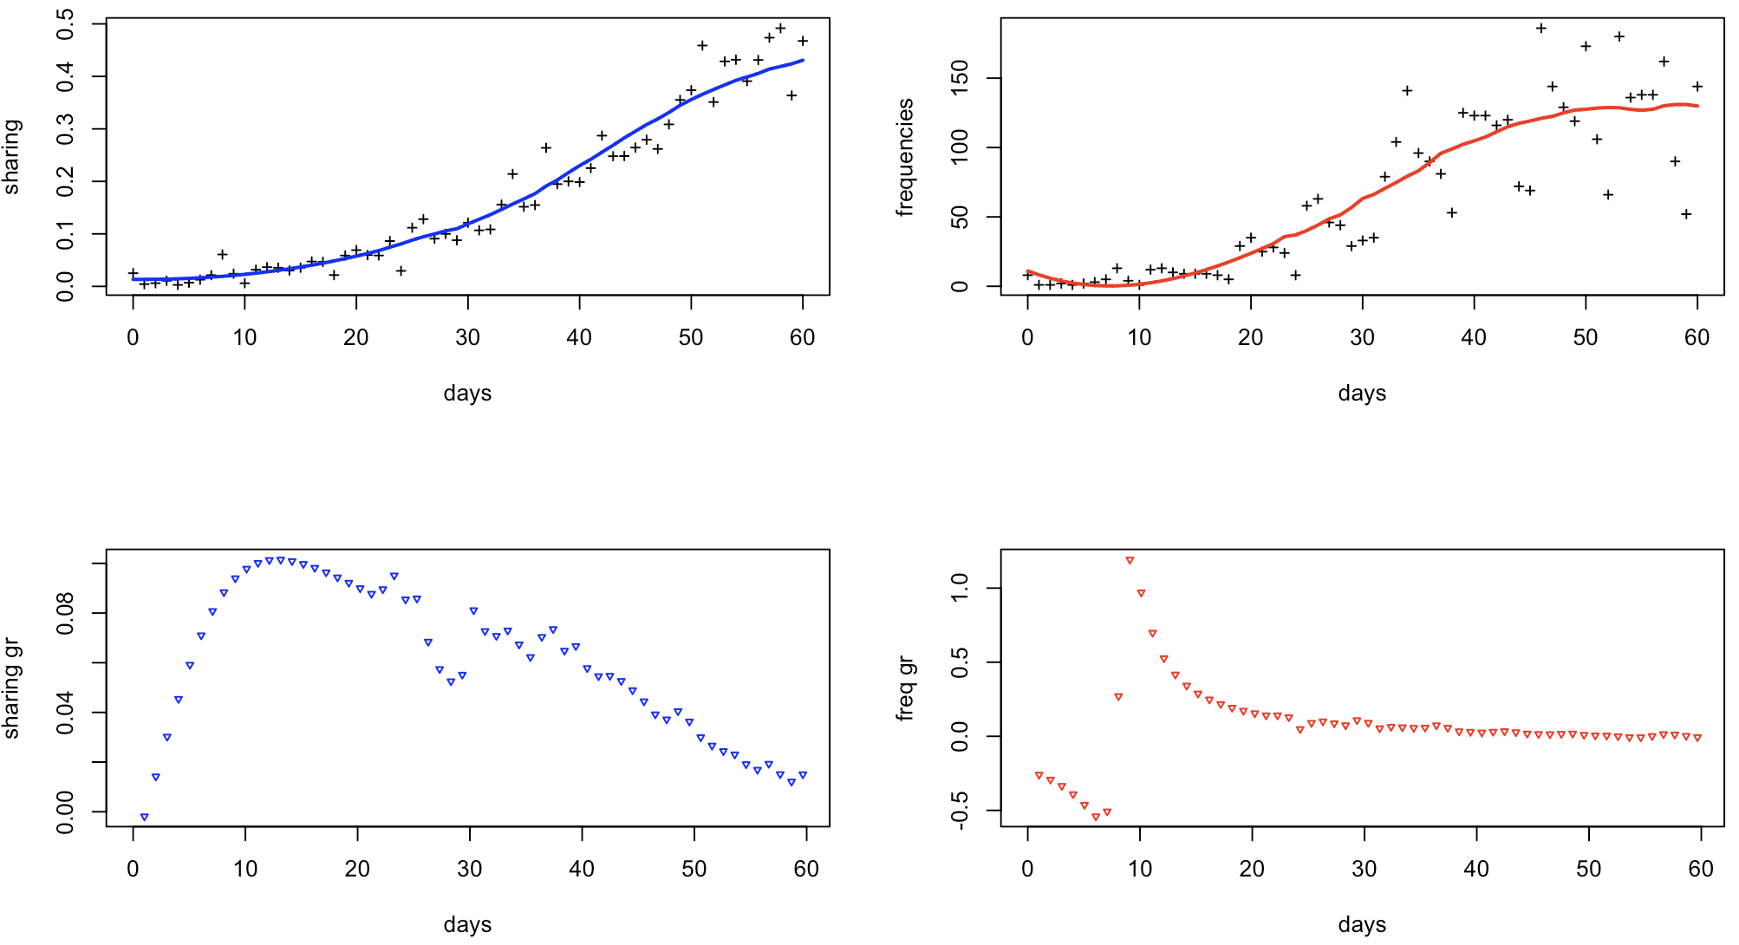
Smooth and calculate growth rate
United Kingdom-BQ.1 (initial 60 Days)
Variant Sharing
Variant Frequencies
7

Slide 12
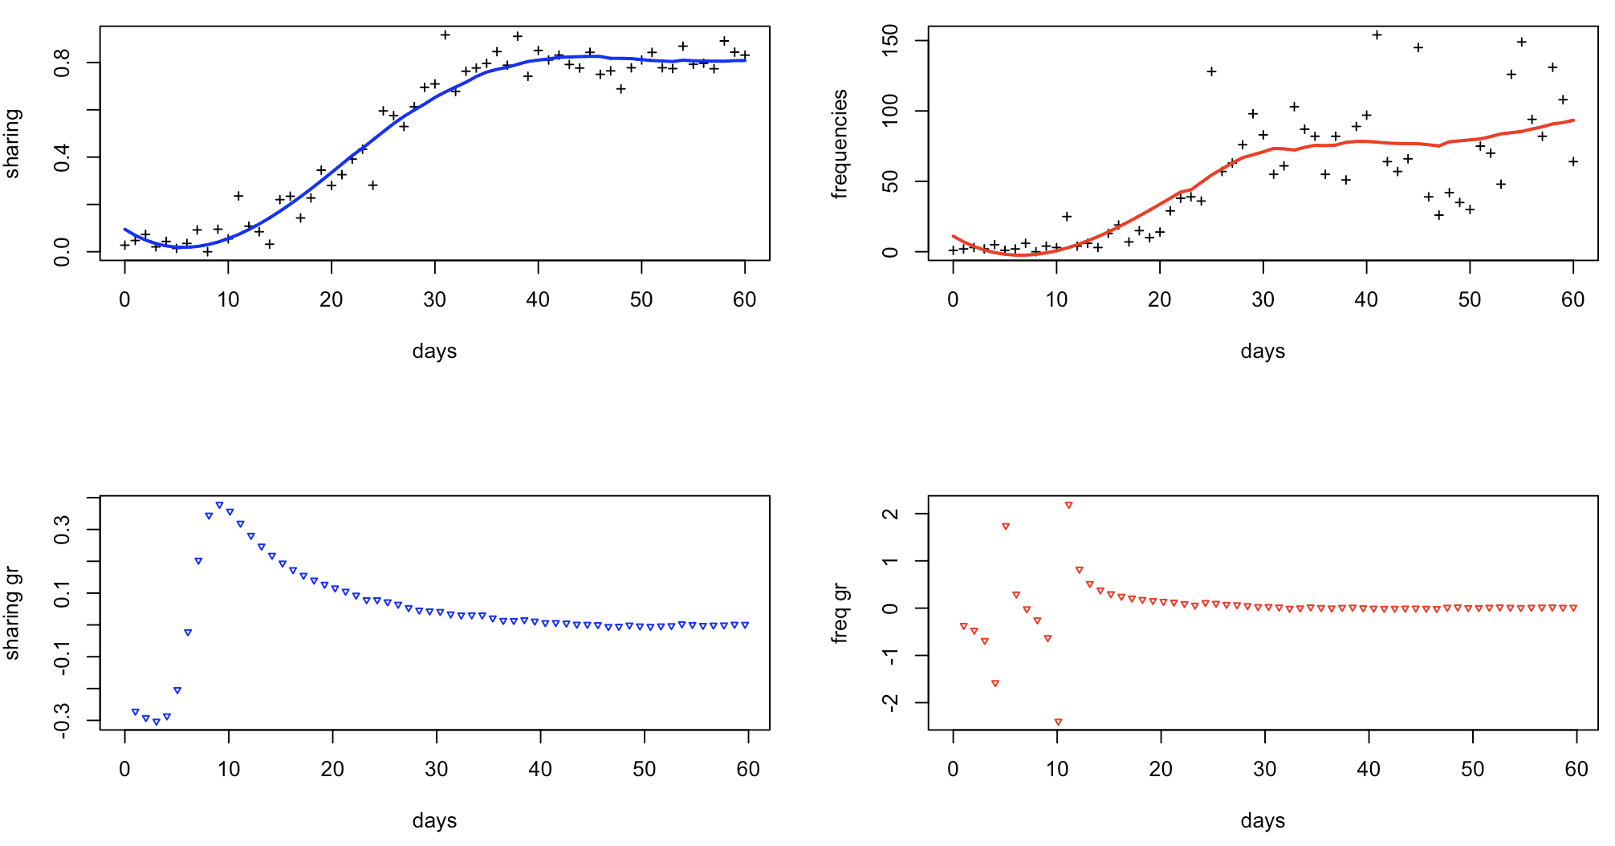
Smooth and calculate growth rate
"South Korea-BA.1.1 (BA.1.1)"
Variant Sharing
Variant Frequencies
8

Slide 13

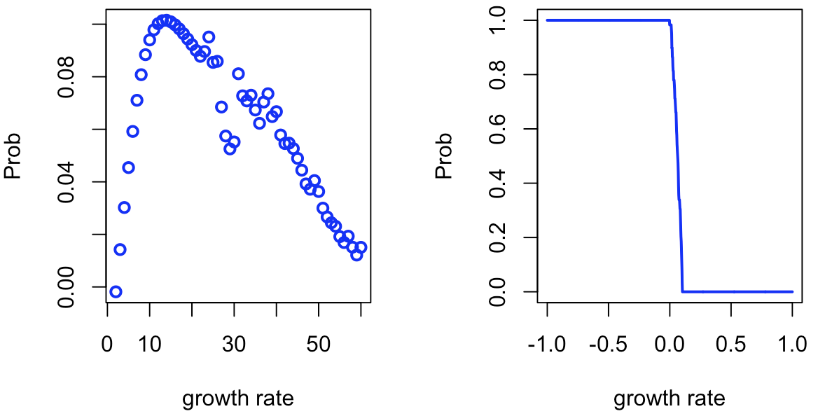

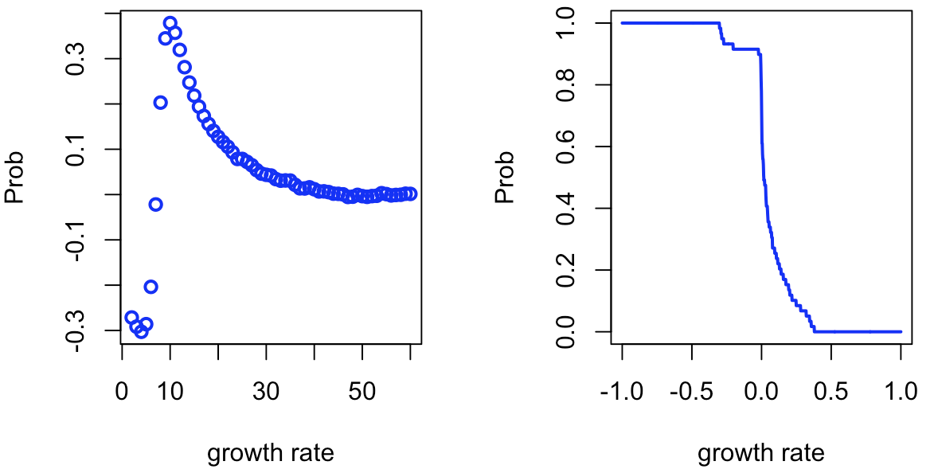

Occupation Time Curve Conversion
United Kingdom-BQ.1 (initial 60 Days)
days
South Korea-BA.1.1 (BA.1.1) (initial 60 Days)
9
days

Slide 14
Occupation Time Curve Conversion
10

Slide 15
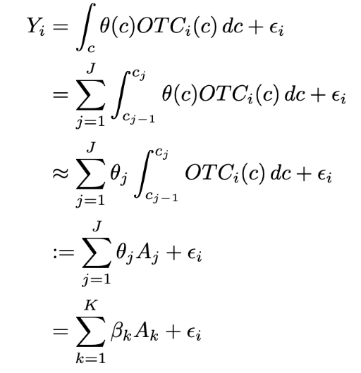
Functional Regression with OTCs
Theta_j Estimated via adapted fused Lasso,
and then formed to Beta_k
11

Slide 16
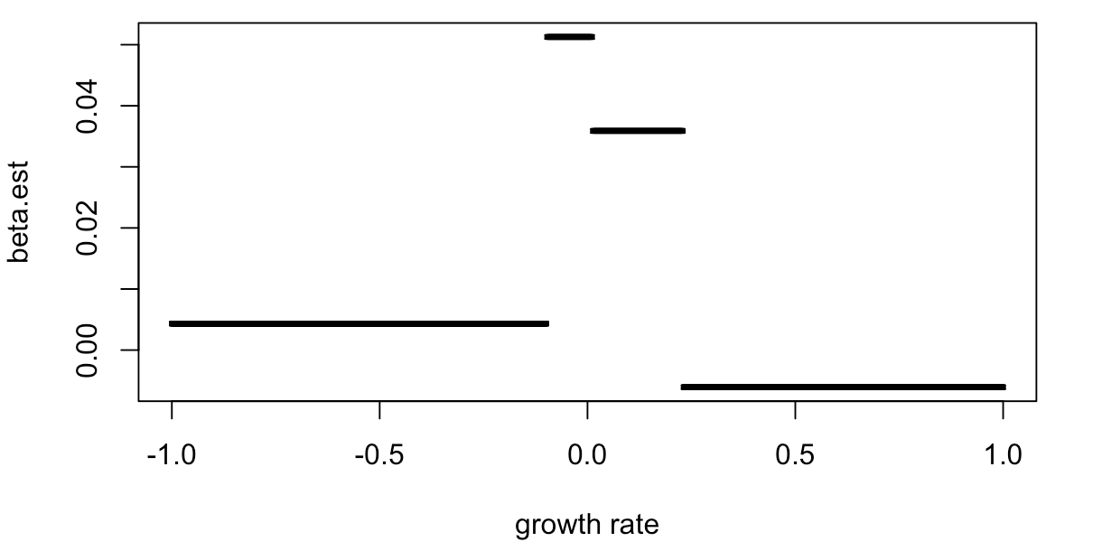
Functional Regression with OTCs
Interpretation
The highlighted area indicates that the model predicts variants with growth rates clustering around -0.1 and 0.1 to be dominant.
Variants with extremely low or high sharing growth rates are predicted to be less dominant by the model.
12

Slide 17
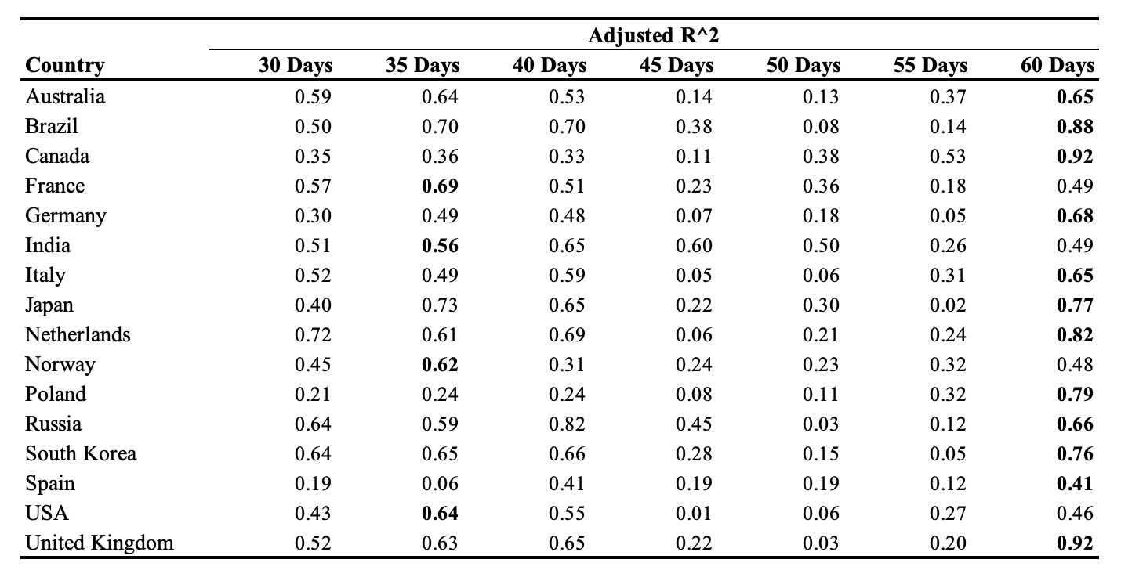

Slide 18
Global Hospitalization/Infection Rate Prediction Using Variant Share Sequences

Slide 19
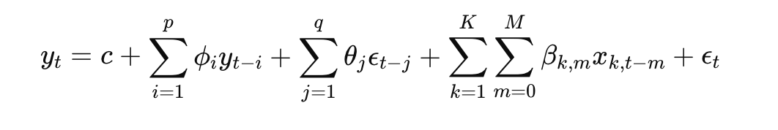
Data Description
Linking 22 shared classified lineages data to the Hospitalization and Infection data from Our World in Data website.
The hospitalization-infection (Hosp-Infec) rate was calculated as a sequence, and the problem was modeled as a multiple time series prediction problem.
Definition and Methodology
The Hosp-Infec rate was calculated using the absolute number of infections and hospitalizations recorded.
The ARIMAX model was applied for multiple time series predictions to better provide the the contribution of exogenous variables (multiple series of variants)
14

Slide 21
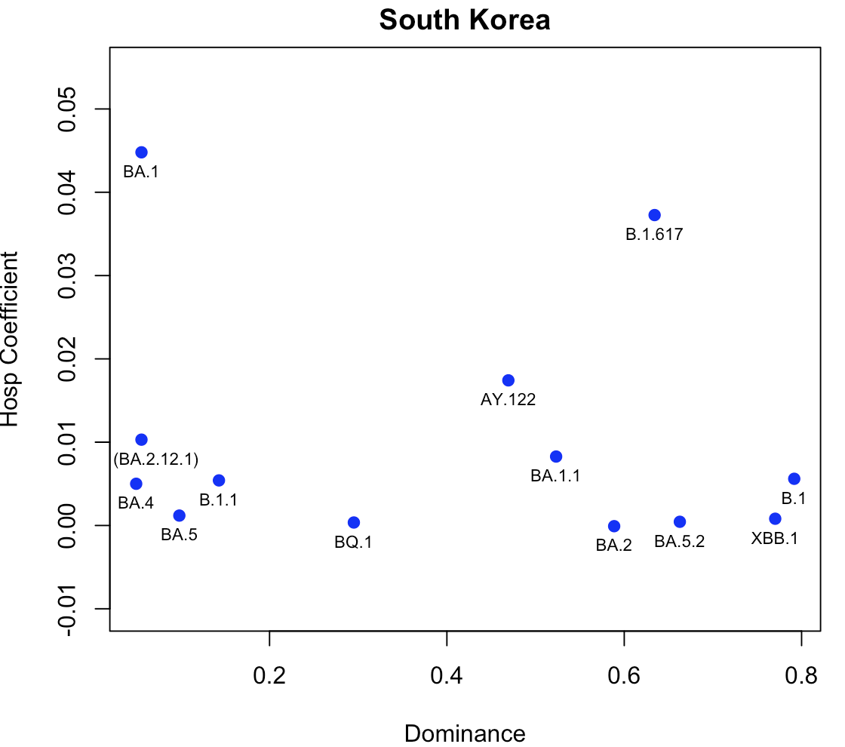
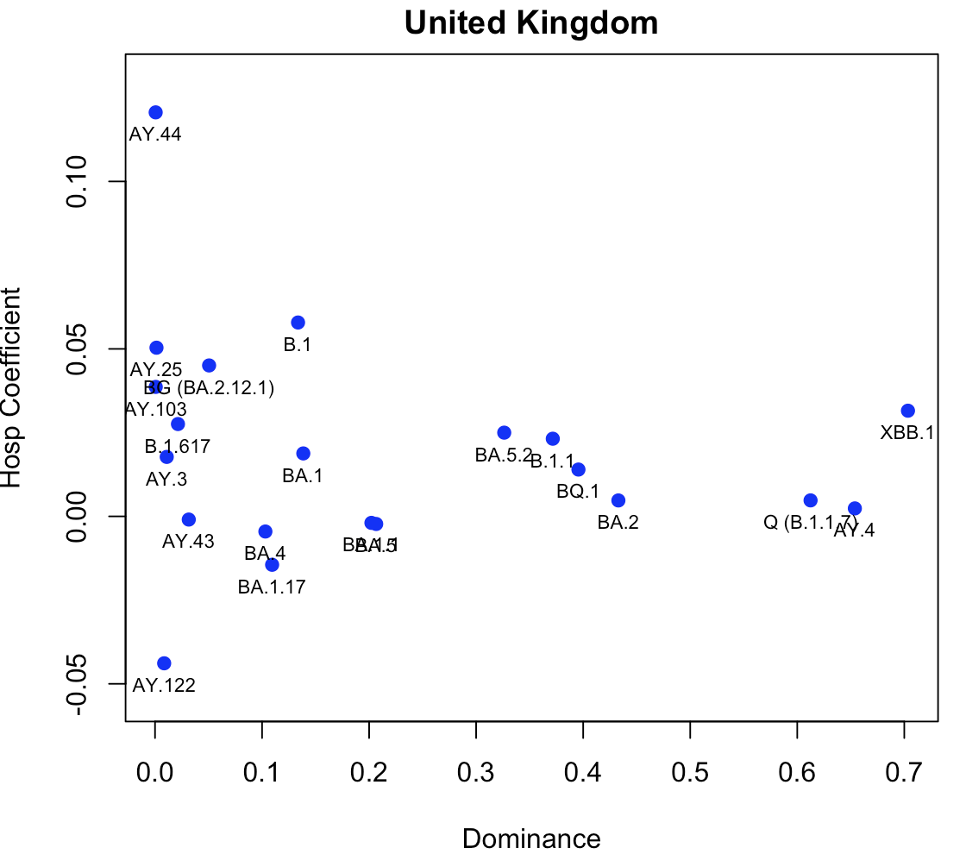
Add time span to the title

Slide 22
