Slide 1
Predicting COVID-19 Variant Dominance Using Early-Stage Time Series from GISAID Data
Aug 28, 2024
Franky Zhang

Slide 2
Introduction
Data Description
Global GISAID data provides open access to genomic information on influenza viruses and, more recently, the SARS-CoV-2 virus responsible for COVID-19.
The dataset includes the number of infections caused by different COVID-19 variants across various countries, with current data available for South Korea and the United Kingdom, spanning specific dates from January 2020 to May 2024.
Allowing for data processing with a resolution that uses the day as the unit of analysis.
Deliverable Goals
Exploring the Relationship Between Early-Stage Patterns and the Dominance of COVID-19 Variants.
Developing robust statistical models that can be applied across various countries globally to predict the dominance of COVID-19 variants using entire time series data rather than relying on summary statistics.
Quantify the associations between countries and viral strains to guide surveillance efforts.
1

Slide 3
Methodology
Variants Classification: The daily infection data, encompassing over 2,000 lineages for each country (South Korea and the United Kingdom), was grouped into 88 classified lineages based on strings of possible parent lineages.
Smoothing to Generate Growth Rate: The grouped data was smoothed using a Generalized Additive Model (GAM), which reduced noise and irregularities, resulting in a smoother curve that more accurately represents the underlying trend. The growth rate was then derived from the first derivative of smoothed curves.
Series Compression and Model fitting: The time series data for the initial period of each variant's appearance in the country was compressed using Piecewise Aggregate Approximation (PAA). For example, 30 days of data were compressed into a time series of length 6. Linear regressions were then fitted to the compressed data.
2

Slide 4
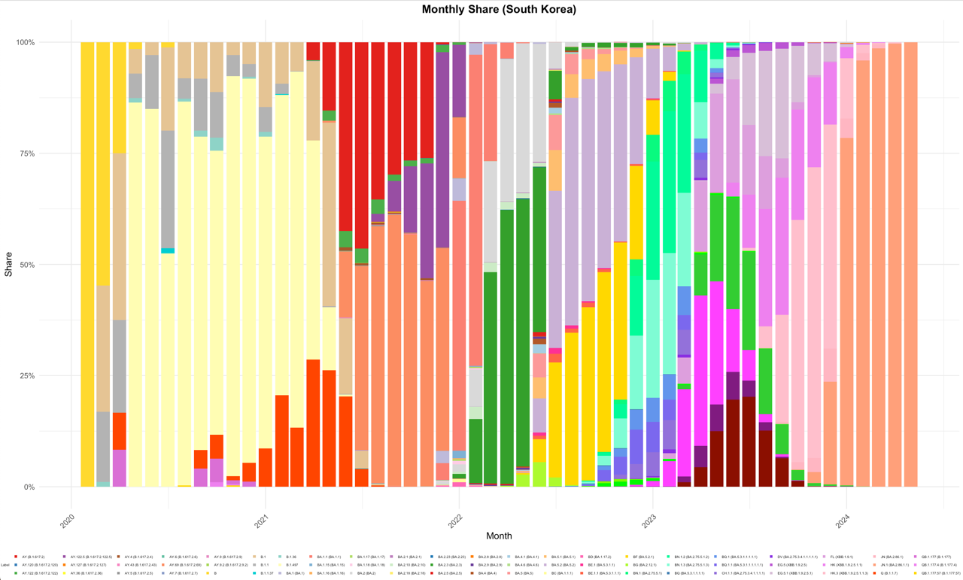
Definition of Dominance: Sum of the shares
Monthly Sharing (South Korea)
3

Slide 5
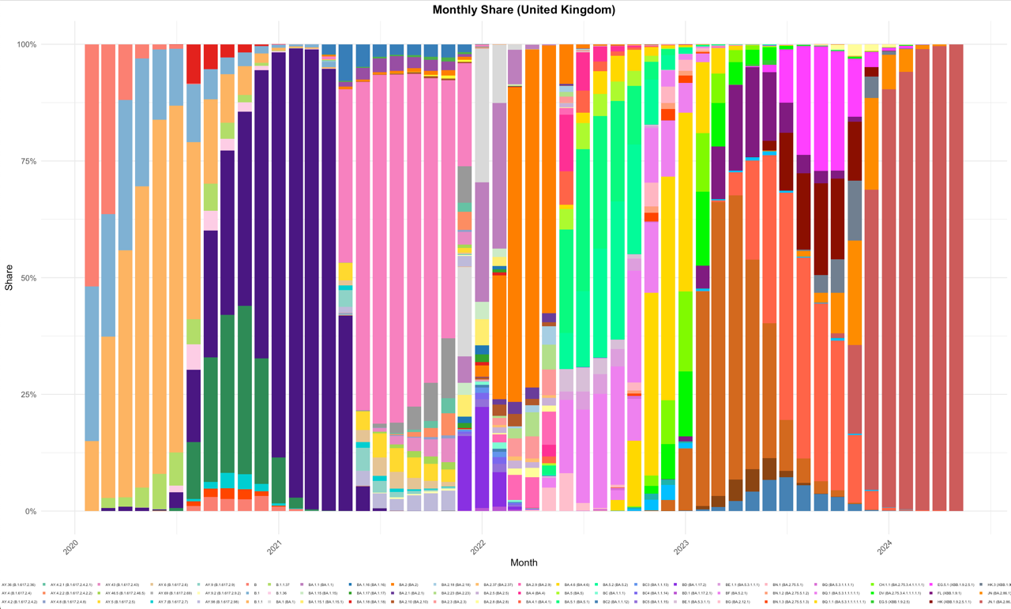
Monthly Sharing (United Kingdom)
4
Notes:
Confirm if the colors are consistent. One additional fig, use the same classification level group, same color scale, easy to compare.

Slide 6
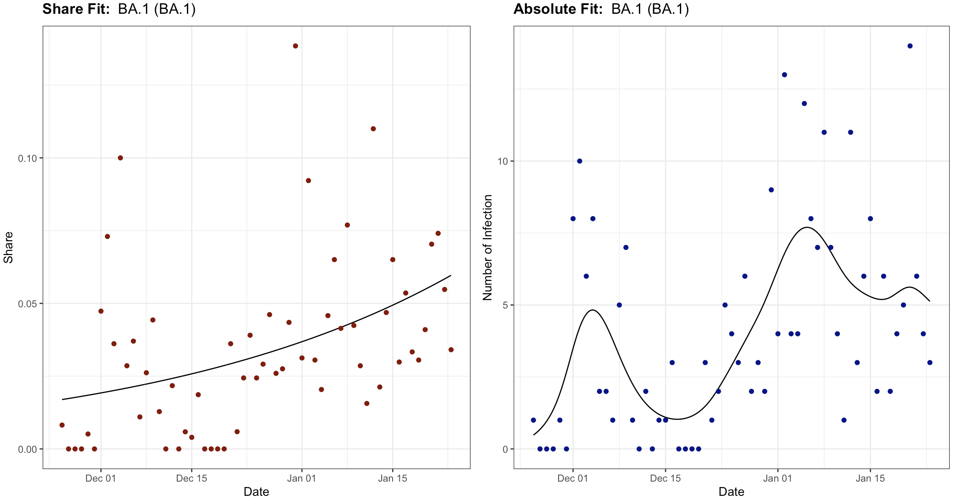
Smoothing Procedure
The Patterns of Share and infection numbers can be very different.
The smoothing Procedure can be understood as denoising.
The growth rates can be calculated from the first derivative.
5
Notes:
Absolute to frequencies

Slide 7
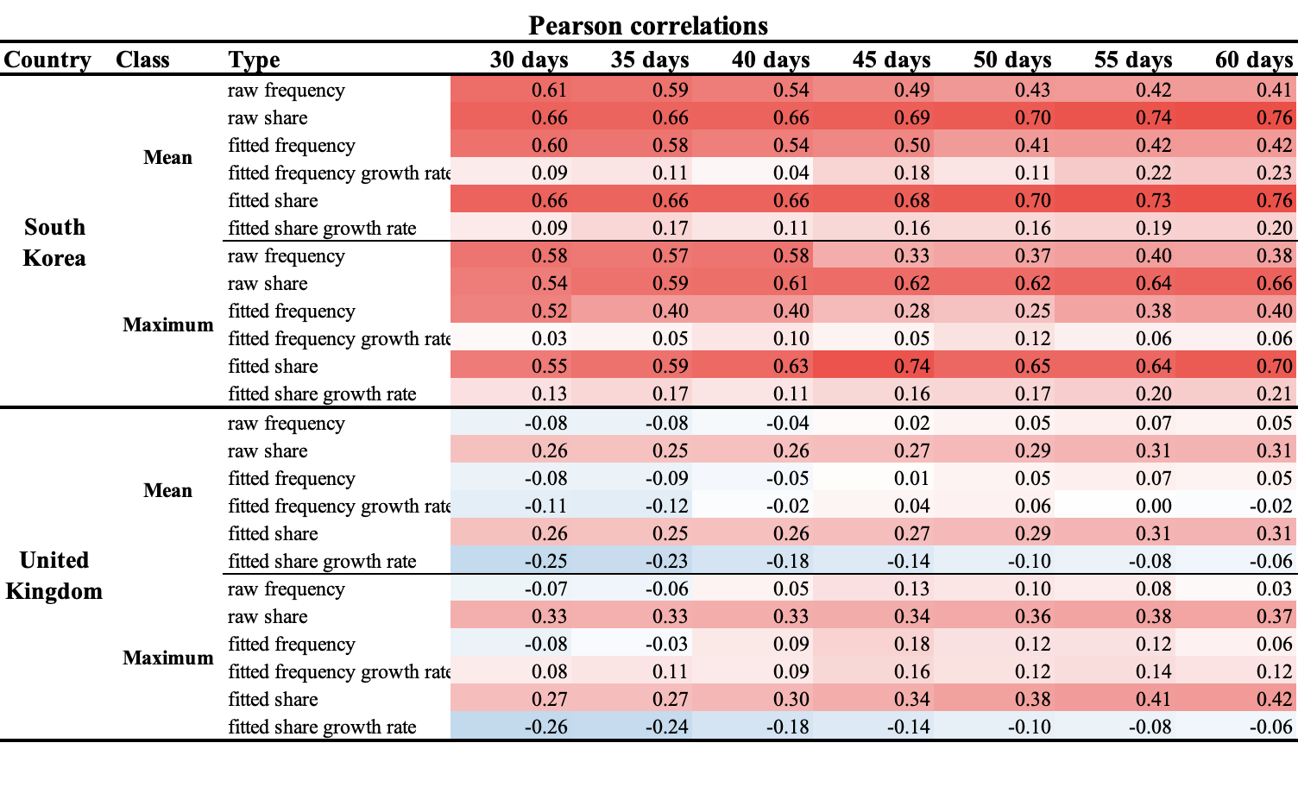
Correlation Analysis
6

Slide 8
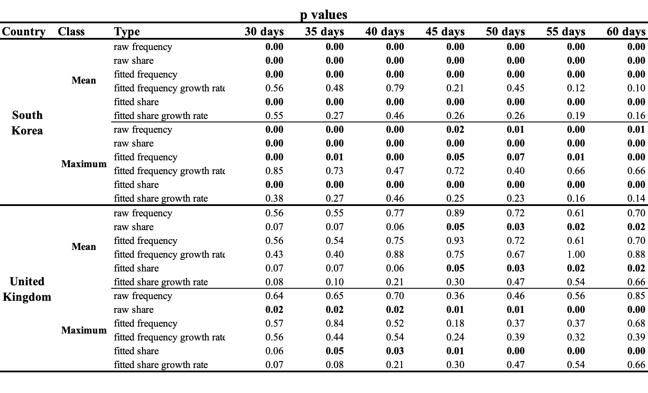
Correlation Analysis
7

Slide 9
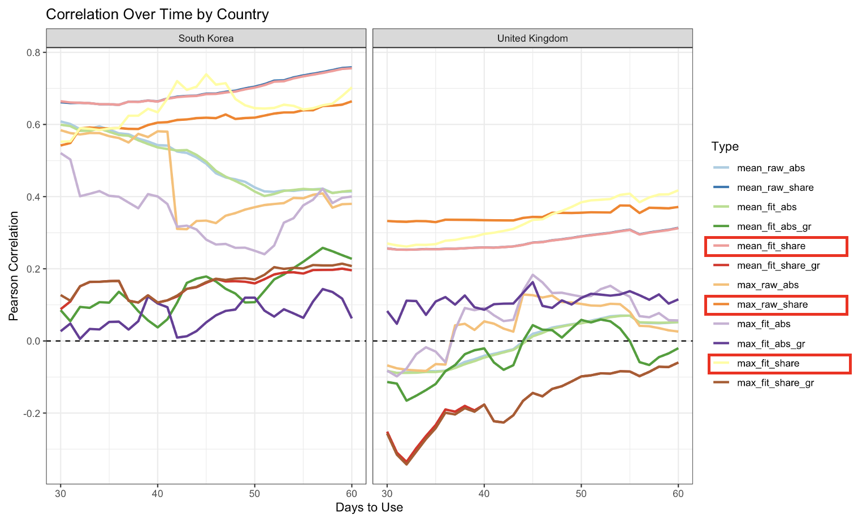
Correlation Analysis (Grouped by Country)
The share data is more closely correlated with the dominance of the variants, as defined by the area under the curve.
The data from South Korea shows significantly stronger correlations compared to that from the United Kingdom.
8

Slide 10
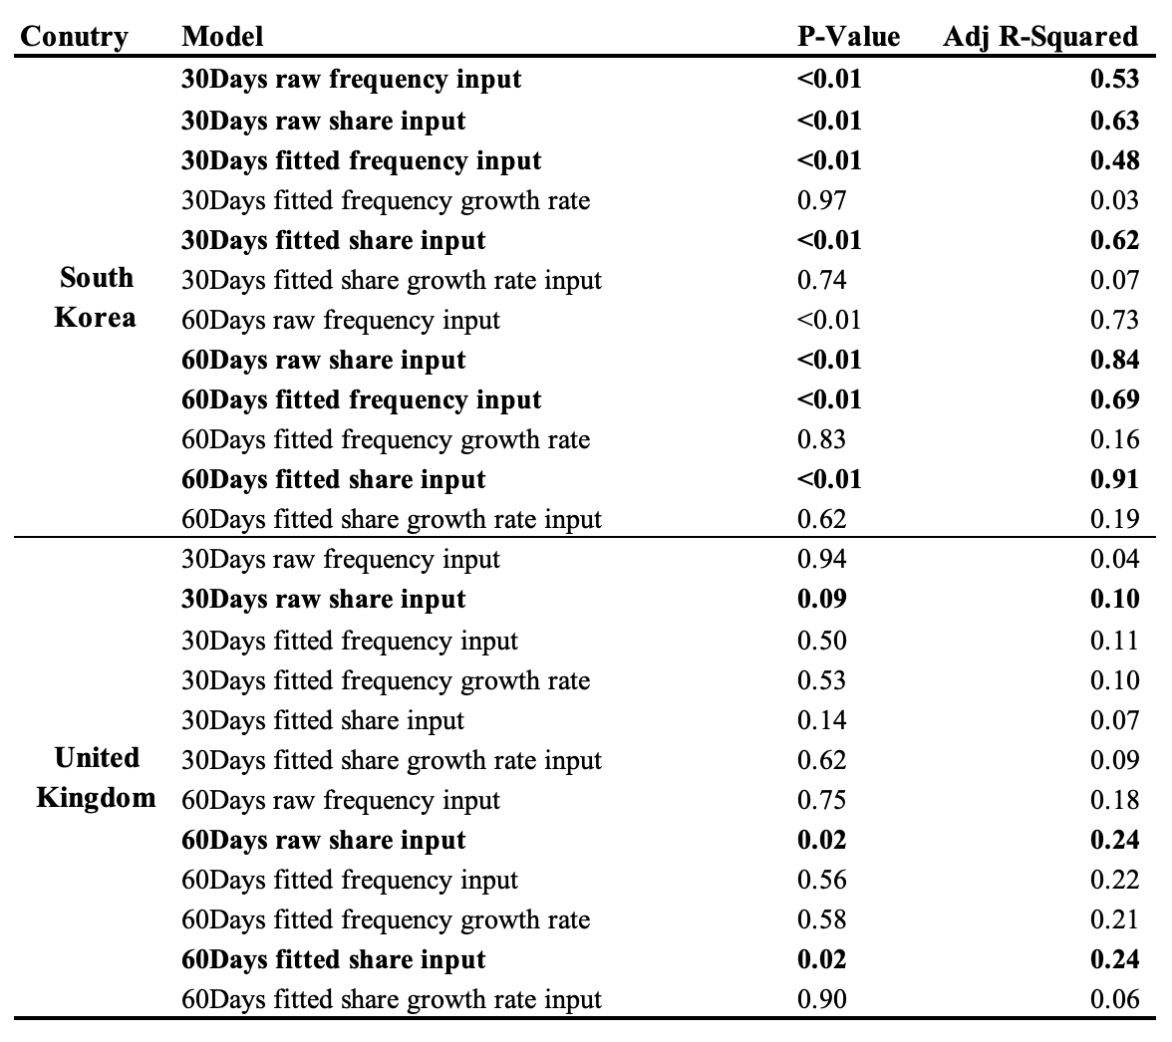
Series Compression and Model Fitting
From the aspects of time series, fitted shares, the denoised shares, showed better regression results in South Korea.
In the United Kingdom, the model can explain at most 24% of the variance.
9

Slide 11
All countries GISAID Data

Slide 12
Data Processing
Data Description
The GISAID dataset includes data from 222 countries, covering 666 distinct lineages, spanning from January 2020 to August 2024, with a weekly resolution (more data from 2021).
South Korea contains 327 different lineages, while the United Kingdom has 565.
Data Processing
Exclude the variants that are still ongoing as of August 2024.
Select the top 64 countries with over 3,000 infection cases as of August 2024.
Exclude variants with a duration of less than 60 days.
Dominance here is defined based on cumulative weekly shares.

Slide 13
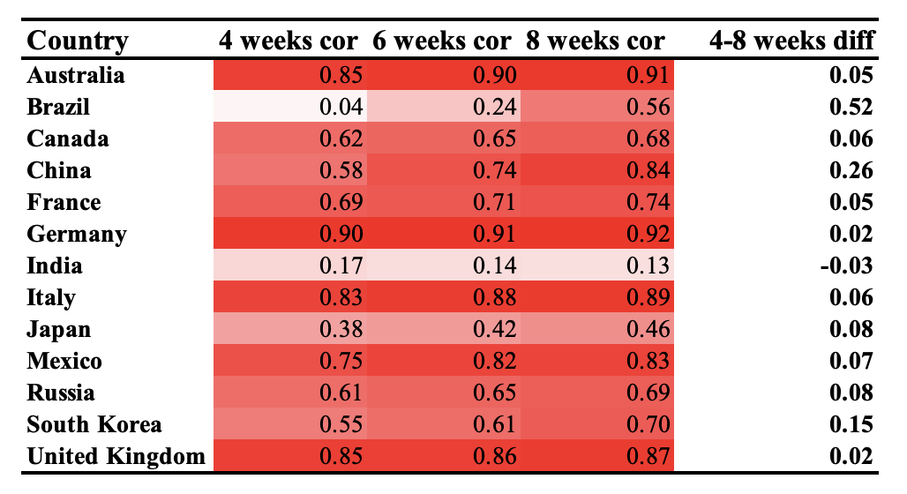
Data Exploration
Pearson Correlation between mean share and Dominance
Overall, all countries exhibit a positive relationship between the mean share at the initial stage and future dominance.
Comparatively, Brazil, India, and Japan show weaker positive correlations.
Except for India, all other major countries show increasing correlations as the input time increases, particularly in Brazil and China.

Slide 14
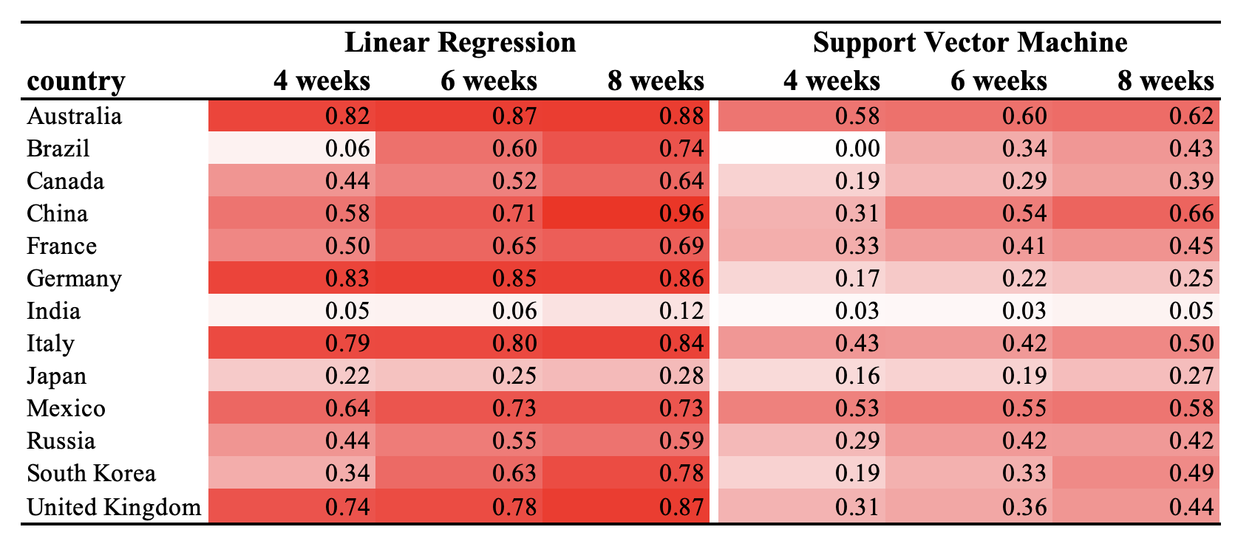
Model Exploration (R Squared)
Overall, the model analysis results are consistent with the correlation analysis.
In this context, linear regression outperforms SVM in terms of R squrared.

Slide 15
Discussion
Limitations
The current evaluation of dominance is based on the sum of the monthly share for each variant, which can be interpreted as the area under the curve in boxplots. However, this approach does not fully align with the definition of dominance.
Even after applying PAA compression, correlations between inputs still persist.
Key findings
Among the three types of models differentiated by the input data—raw daily shares, fitted daily shares, fitted growth rates, and summary statistics—regardless of the number of days of data used, the model utilizing raw daily shares appears to yield the best regression results.
Thirty days of raw or smoothed frequency inputs are sufficient for predicting dominance in South Korea, but this approach does not perform well in the United Kingdom.
For example, in South Korea, the 30-day smoothed and compressed share for the classified variant “B.1.497” is 0.81, 0.96, 0.43, 0.83, 0.87, 0.98. This results in a predicted dominance that is 6.5 times greater than that of “B.1.1,” which has shares of 0.18, 0.20, 0.41, 0, 0.20, and 0.
10

Slide 16
Future Steps
The complete GISAID dataset from all countries will be utilized. The challenges include variations in variant naming across different countries and discrepancies in data resolution due to differing data collection methods.
Time-varying covariates and coefficients in Cox regression models will be utilized to predict a binary outcome: whether a variant will become dominant or not.
11
Notes:
Full countries gisaid data;
Add utilities of this finding, interpretation (example).
Summaries the challenges and gaps, apply the method to all countries. (variants name, resolutions)

