Slide 1
3) COVID-19 variants growth rates and comparison between South Korea and the United Kingdom

Slide 2
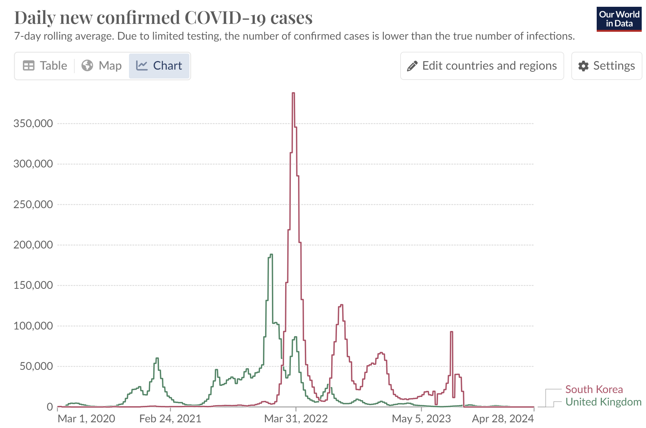

Slide 3
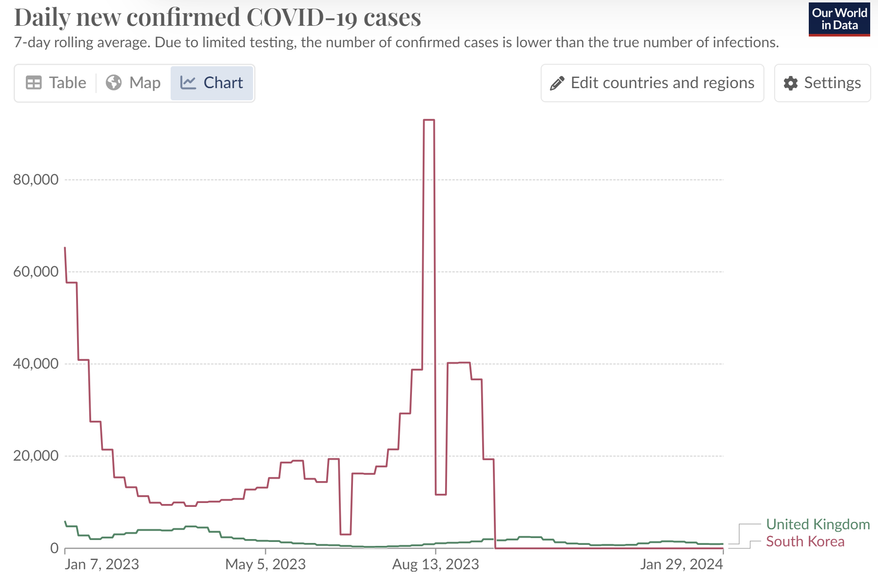
SK does not collect daily COVID-19 case data from Oct 2023

Slide 4
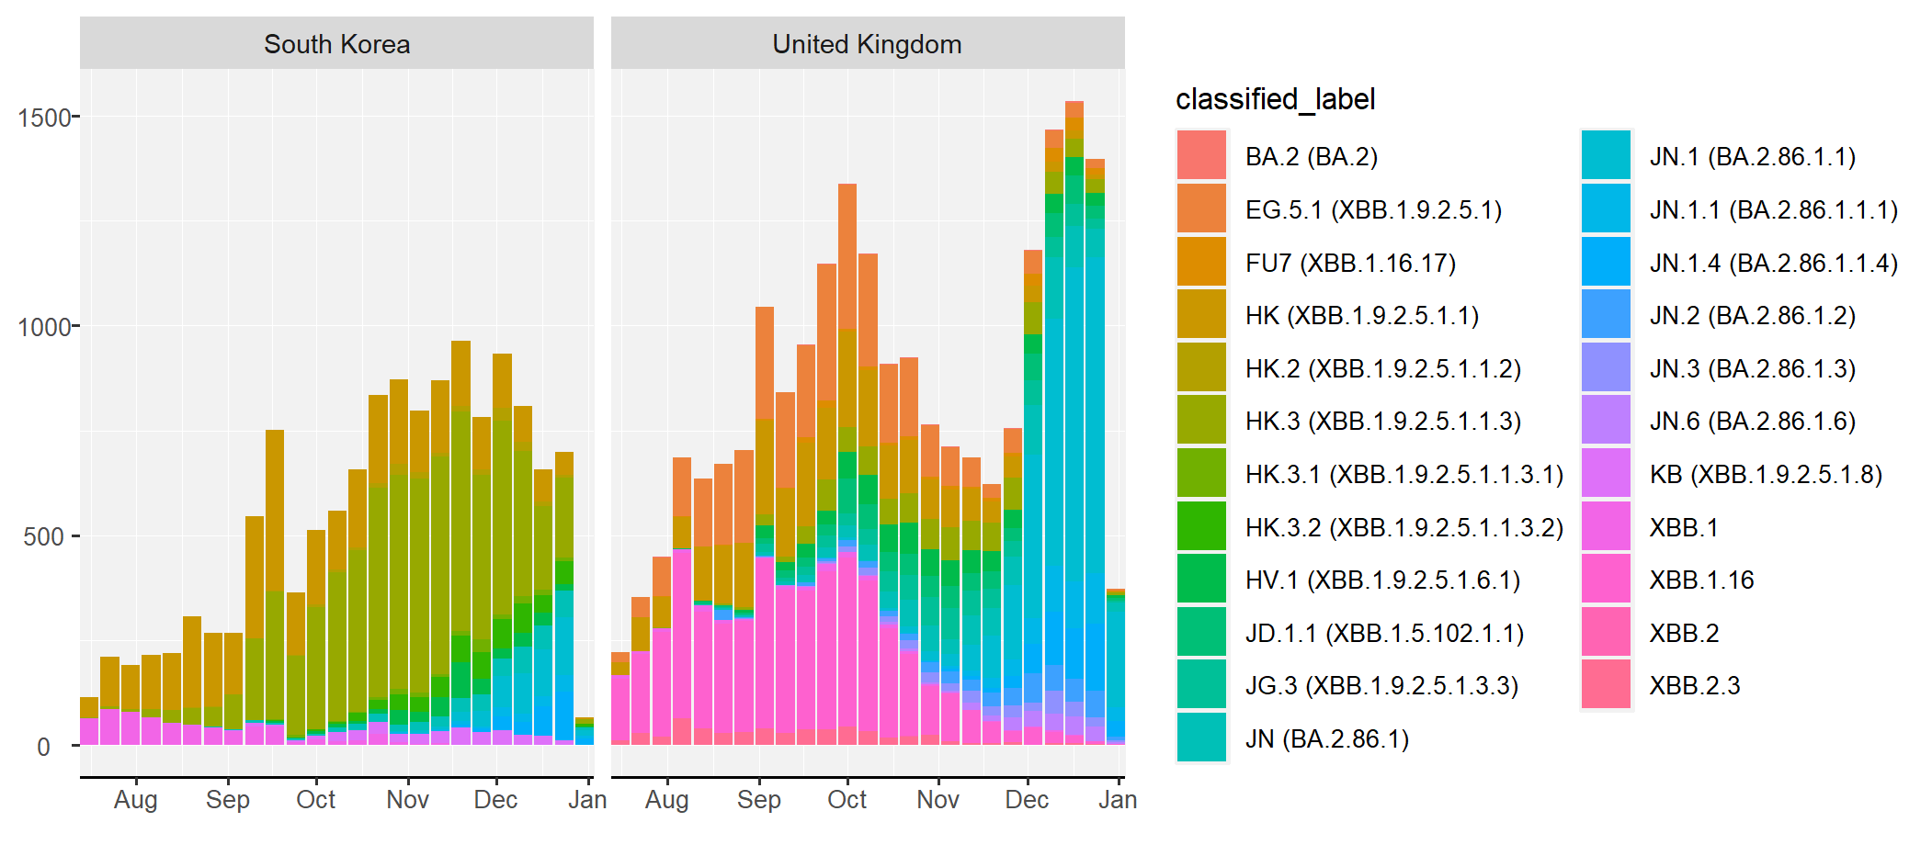
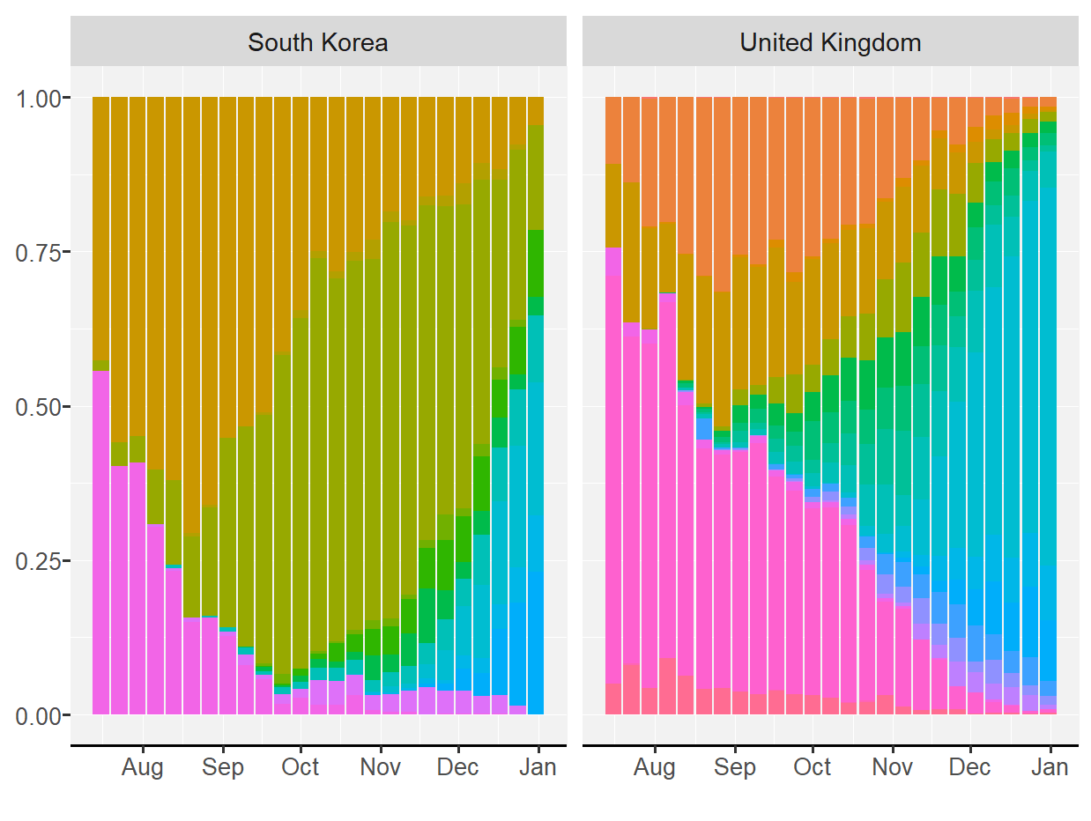
GISAD data in South Korea and the United Kingdom
Variants share transition (Jul, 2023- Jan, 2024)
SK: XBB.1 > HK > HK.3
UK: XBB.1.16 > EG.5.1 > JN1

Slide 5
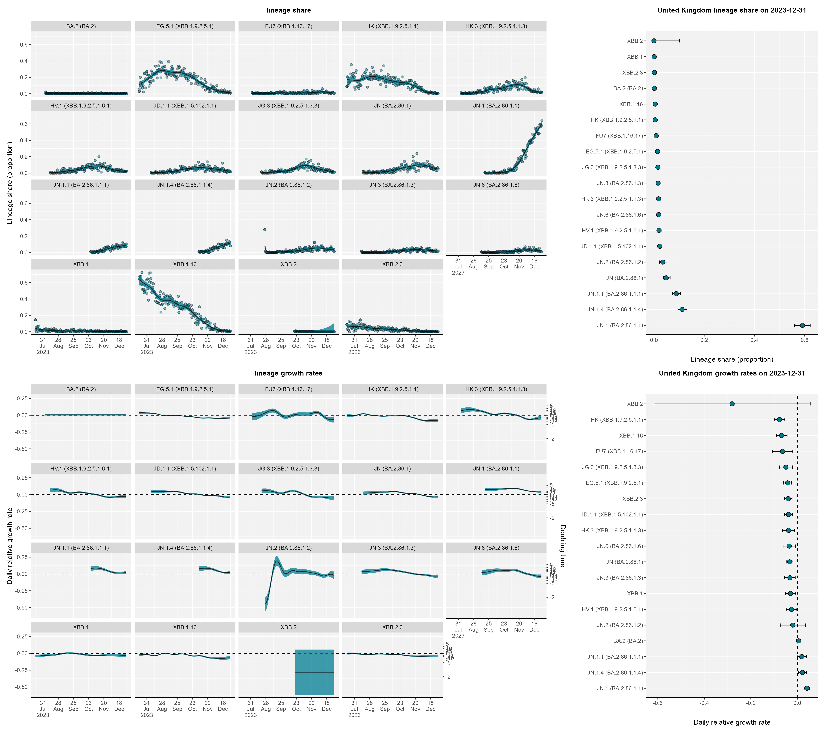
The United Kingdom Covid-19 variants
(Jul 2023-Jan 2024)
BA.2
EG.5.1
FU7
HK
HK.3
HV.1
JD.1.1
JG.3
JN
JN.1
JN.1.1
JN.1.4
JN.2
JN.3
JN.6
XBB.1
XBB.1.16
XBB.2
XBB.2.3
Based on codes developed by Drs. Chris Overton and Rob Paton and data from GSAID

Slide 6
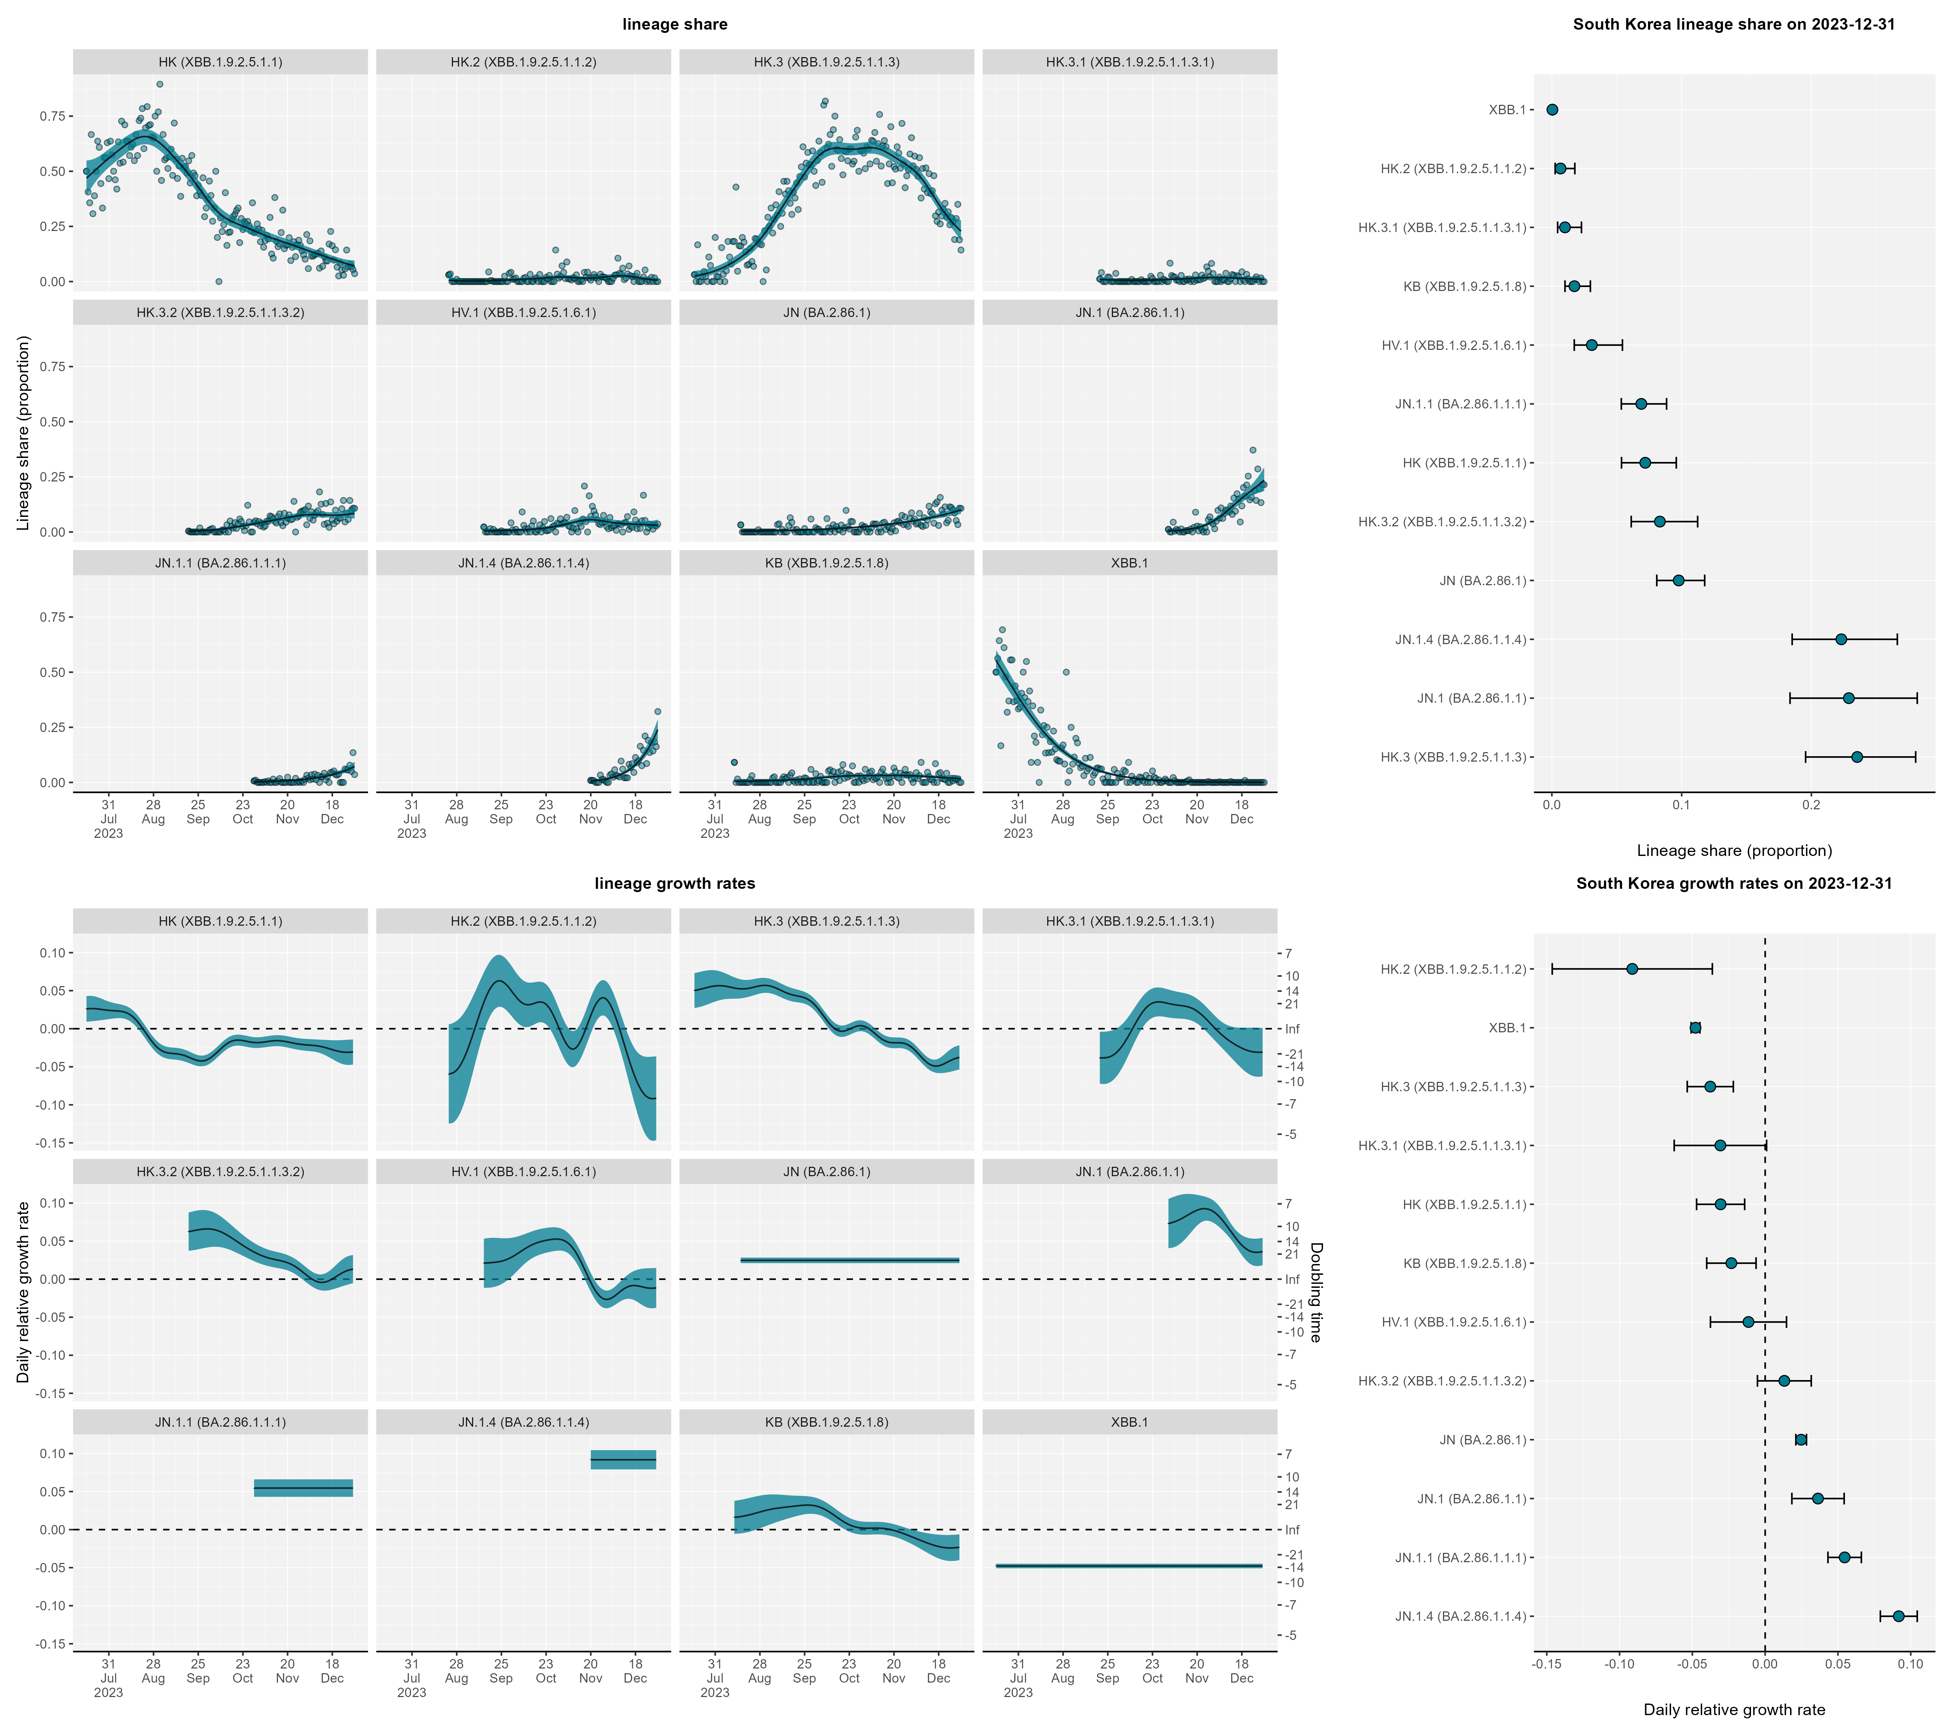
South Korea Covid-19 variants
(Jul 2023-Jan 2024)
HK
HK.2
HK.3
HK.3.1
HK.3.2
HV.1
JN
JN.1
JN.1.1
JN.1.4
KB
XBB.1
Based on codes developed by Drs. Chris Overton and Rob Paton and data from GSAID
Notes:
Growth rate inflection points were observed when a variant reached around 60% prevalence.

Slide 7
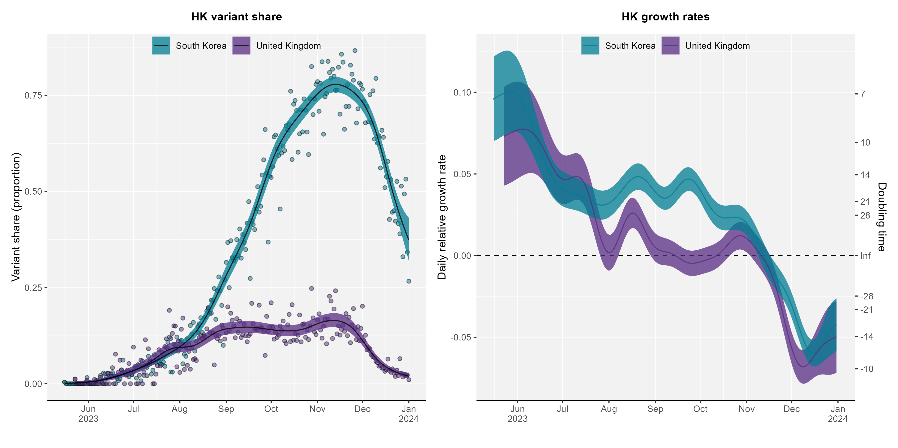

Slide 8
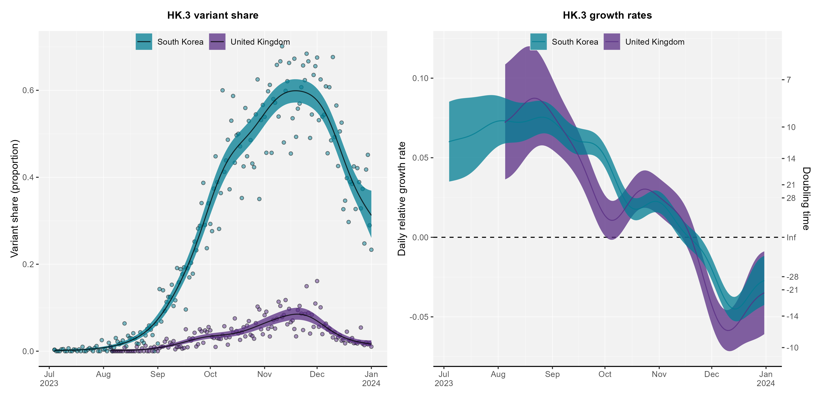

Slide 9
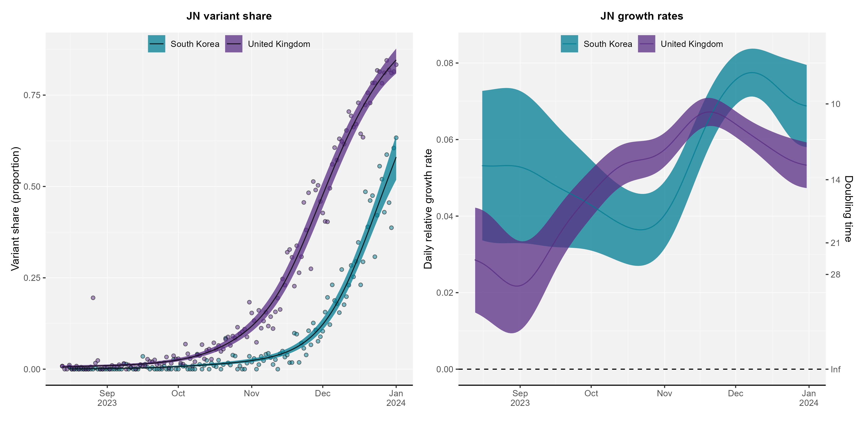

Slide 10
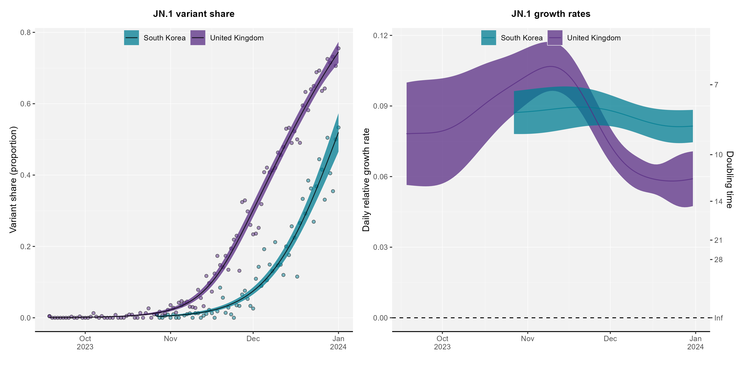

Slide 11
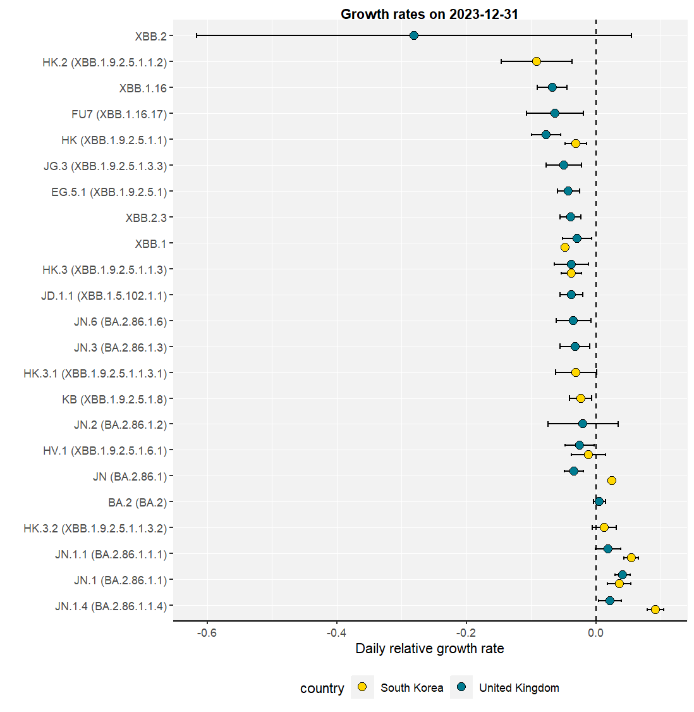
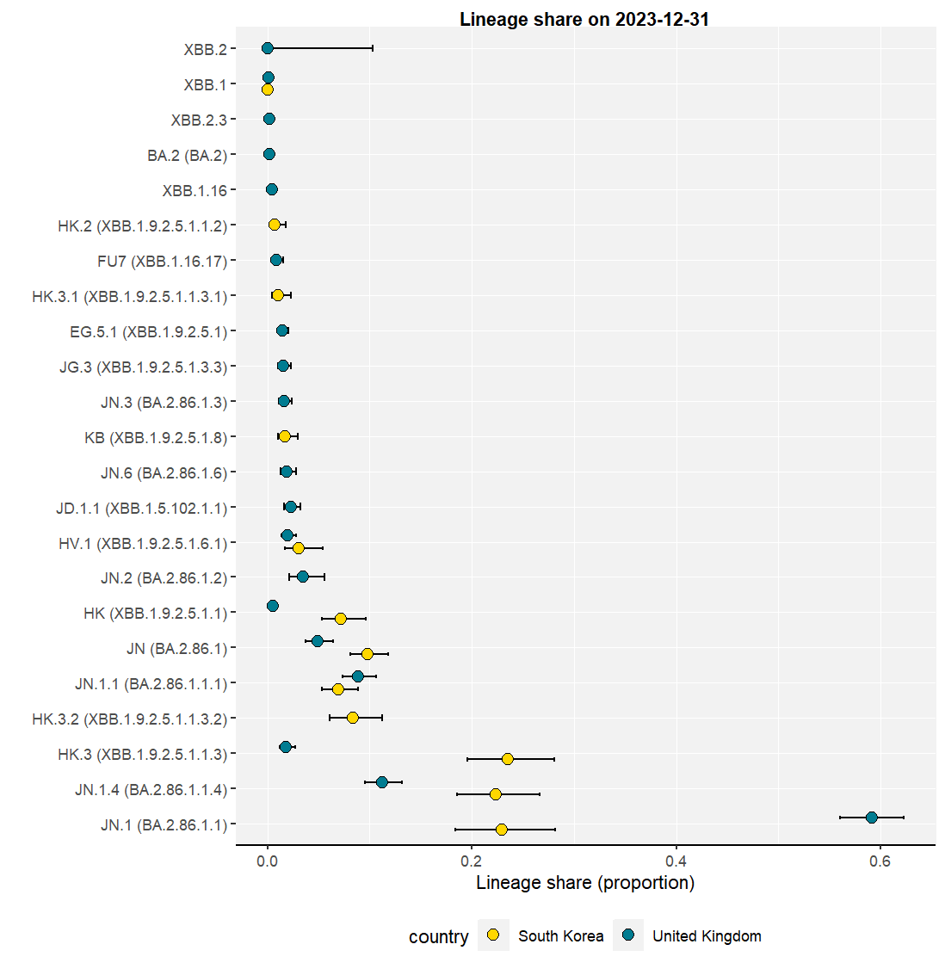
Variants comparisons
Total 23 variants were observed from Jul 2023 – Jan 2024 in SK and UK; 12 variants in SK and 19 variants in UK (8 variants in common): JN.1.4, JN.1.1, JN.1, HV.1, JN, HK.3, XBB.1, HK
On Dec 31, 2023, SK has 3 dominant variants (HK3, JN1.4, and JN.1) and
UK has a dominant variant with JN.1

Slide 12
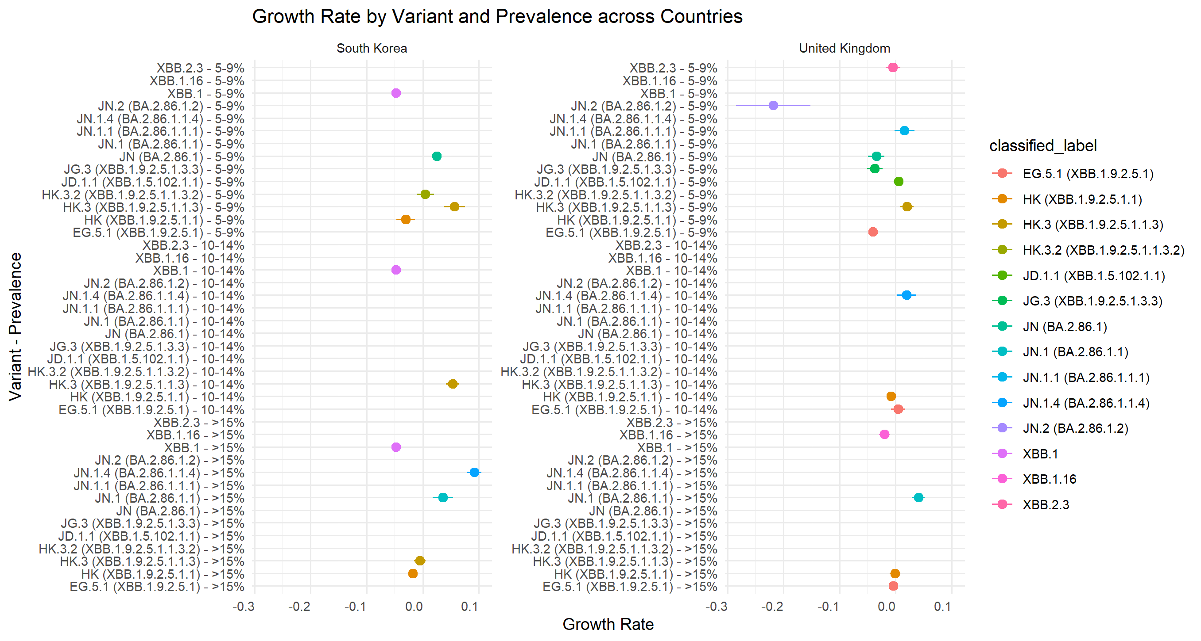
HK.3 and JN.1 show the greatest early growth rates (more transmissible or better at immune evasion) among the other variants in SK and UK
It took about 4 months to become dominant (from 0 to 60%) prevalence for HK.3 in SK; However, HK.3 only increased about 20% prevalence in UK.
SK experienced a high incidence peak (>90K) in August, while the UK remained at a low incidence peak (<3K). Why is it so different?

Slide 13
Discussion points
How can we predict the level/timing of future epidemic peak based on an early variant growth rate at low prevalence?
What are the early signs of variants to predict how quickly a variant becomes dominant?
level and duration of early growth rates of individual variants
distribution of existing dominant variants
To enhance the early outbreak investigation of new variants, which additional data needs to be systematically collected and analyzed?

Slide 14
Detecting a fast growth rate at a low prevalence an early warning system
Early growth rates can indicate whether a new variant has a competitive advantage (more transmissible or better at evading the immune response) over existing strains.
Understanding growth rates at low prevalences allows for timely interventions, such as updating vaccines, reinforcing public health measures, or issuing travel advisories.
Accurate early growth rates help in modeling the future spread of the variant, which helps in planning healthcare resources and implementing control measures.

