Slide 1
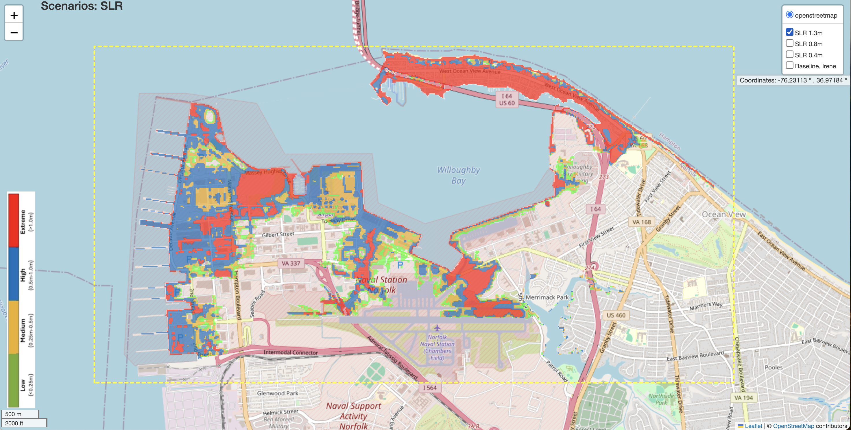
Use mouse or this button to zoom in/out
Select scenarios to make comparisons

Slide 2
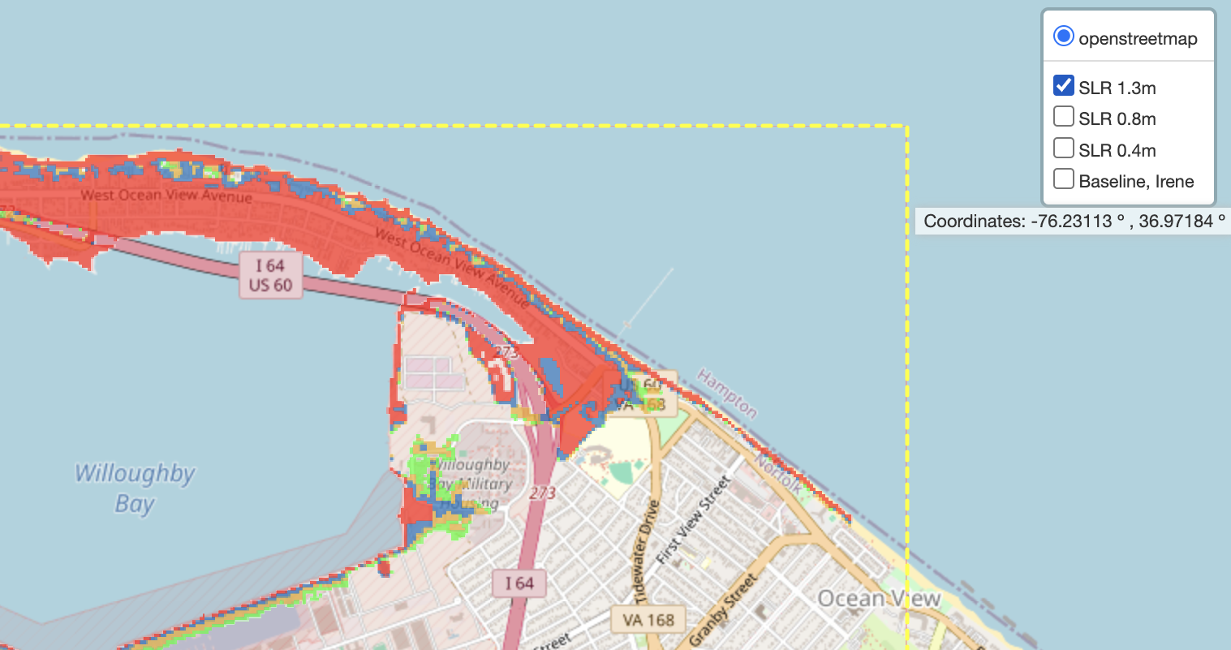
Select scenarios to make comparisons

