Slide 1


Slide 2
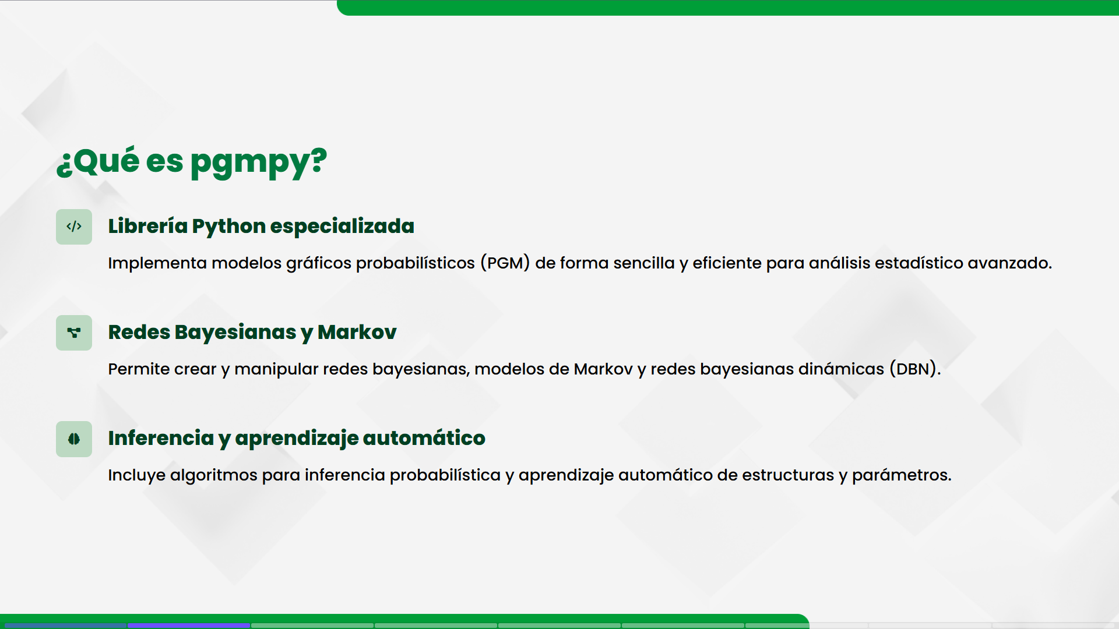

Slide 3
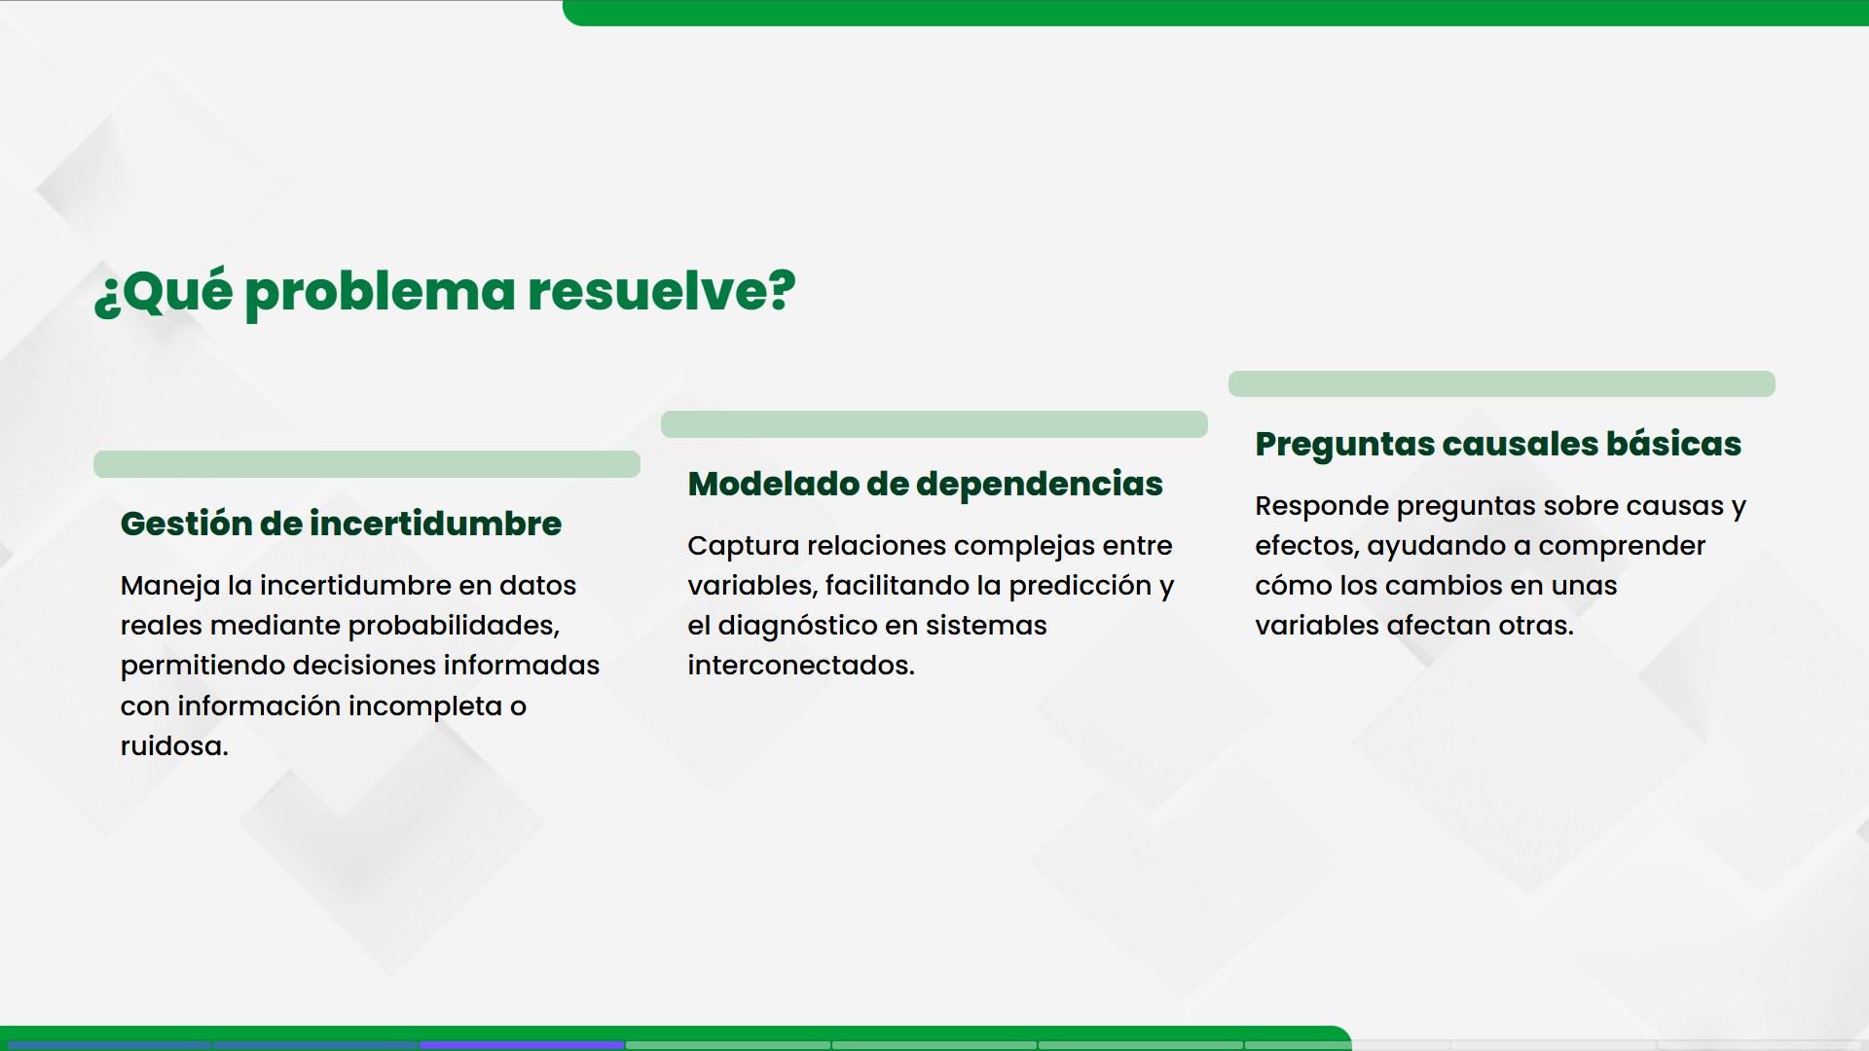

Slide 4
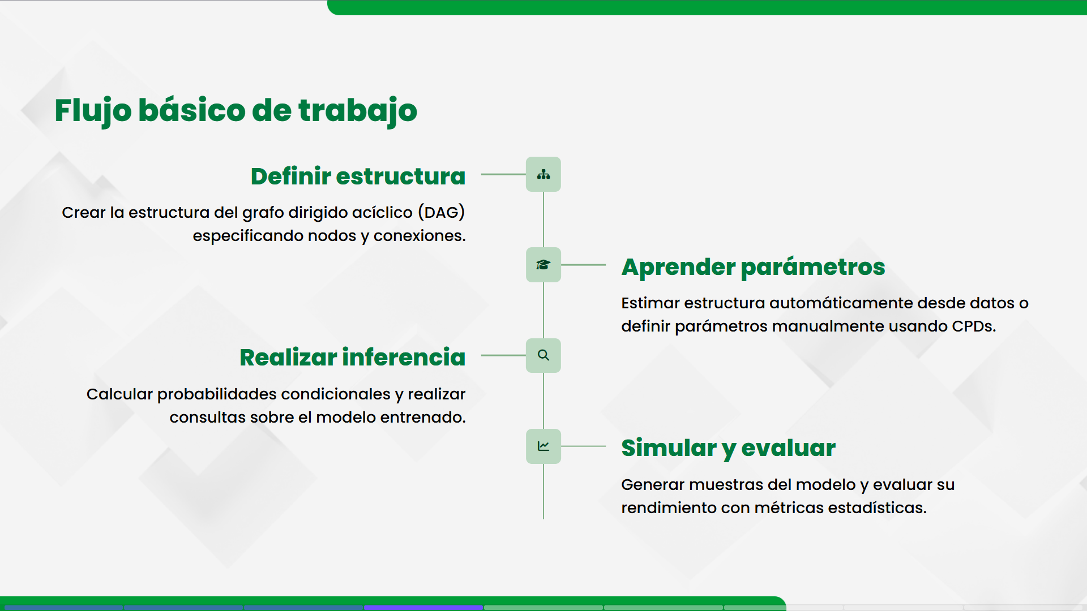

Slide 5


Slide 6

https://github.com/UD4vyd/Probabilidad

