Slide 1
AI/ML-Powered Framework for Enhanced Network Intrusion Detection using Non-IOC Methods.
PIP4004 University Project-II
Final Review
Batch Number:CCS_G04
Roll Number | Student Name
20211CCS0006 | S Varun Kumar
20211CCS0008 | Deepak R
20211CCS0046 | Chinmaya GP
20211CCS0094 | Darshan U
Under the Supervision of,
Dr. Shanthi S
Associate Professor
School of Computer Science & Engineering
Presidency University

Slide 2
Introduction
The security of critical information infrastructure depends on the ability to detect and mitigate threats before they cause significant harm.
Traditional intrusion detection systems primarily rely on Indicators of Compromise (IoCs) to identify security breaches, which limits their effectiveness against unknown or evolving threats.
This project aims to develop an AI/ML-based intrusion detection system that leverages machine learning algorithms to detect network compromises without relying on predefined IoCs.
By analyzing network behavior and identifying anomalies, the proposed system can detect various cyberattacks, including blackhole, gray hole, flooding, and scheduling attacks

Slide 3
Literature Review
Title1 :Method of Network Intrusion Discovery Based on Convolutional Long-Short Term Memory Network and Implementation in VSS. (IEEE)
This paper proposed an improved method of network intrusion discovery based on convolutional long-short term memory network. This method implements the convolution operation in deep learning into the network structure of long-short term memory and improves the accuracy of network intrusion discovery.
In addition, this paper implemented method to the network intrusion discovery scenarios of video surveillance system (VSS). The result shows that the proposed method has advantages in accuracy, recall, precision, and other similar methods.

Slide 4
Literature Review (Contd…)
Advantage: Efficient detection of complex intrusion patterns using Convolutional Long-Short Term Memory Network.
Disadvantage: High computational requirements, potentially limiting real-time application in resource-constrained environments.

Slide 5
Literature Review (Contd…)
Title 2 :Effective algorithms to detect stepping-stone intrusion by removing outliers of packet RTTs. (IEEE)
This paper proposes an efficient algorithm to eliminate most of the possible RTT outliers of the packets captured in the Internet environment.
Develop an efficient SSI detection algorithm by mining network traffic using an improved version of k-Means clustering. This paper proposes detection algorithm for SSI is accurate, effective, and efficient in the context of the Internet.

Slide 6
Literature Review (Contd…)
Advantage: Robust detection of stepping-stone intrusions by focusing on packet round-trip time outliers.
Disadvantage: May be susceptible to false positives in dynamic network conditions, impacting accuracy.

Slide 7
Literature Review (Contd…)
Title3 :Tier-Based Optimization for Synthesized Network Intrusion Detection System
In this study, an optimal framework for a network intrusion detection system based on image processing is proposed. The framework is a fusion of augmented feature selection flow with an image transformation and enhancement methodology.
Initially, the proposed framework reduces the number of features to achieve overall efficiency. Later, the non-image data is transformed into images. The transformed images are then enhanced for achieving effective anomaly detection based on a deep-learning classifier.

Slide 8
Literature Review (Contd…)
Advantage: Improved scalability and efficiency through tier-based optimization in the design of the intrusion detection system.
Disadvantage: Complexity in implementation and potential challenges in maintaining synchronization among different tiers

Slide 9
Literature Review (Contd…)
Title4 :HC-DTTSVM: A Network Intrusion Detection Method Based on Decision Tree Twin Support Vector Machine and Hierarchical Clustering. (IEEE)
In this study, a network intrusion detection method based on decision tree twin support vector machine and hierarchical clustering, named HC-DTTWSVM, is proposed. First, the hierarchical clustering algorithm is applied to construct the decision tree for network traffic data, where the bottom-up merging approach is used to maximize the separation of the upper nodes of the decision tree.
Then, twin support vector machines are embedded in the constructed decision tree to implement the network intrusion detection model, which can effectively detect the network intrusion category in a top-down manner.

Slide 10
Literature Review (Contd…)
Advantage: Enhanced accuracy with Decision Tree Twin Support Vector Machine and improved scalability through hierarchical clustering.
Disadvantage: Training complexity due to the combination of decision tree and support vector machine components.

Slide 11
Literature Review (Contd…)
Title5 :Network Intrusion Detection Based on Extended RBF Neural Network With Offline Reinforcement Learning. (IEEE)
This work extends the classic radial basis function (RBF) neural network by including it as a policy network in an offline reinforcement learning algorithm. With this approach, all parameters of the radial basis functions (along with the network weights) are learned end-to-end by gradient descent without external optimization.
It further explores how additional dense hidden-layers, and the number of radial basis kernels influence the results. This novel approach is applied to five prominent intrusion detection datasets (NSL-KDD, UNSW-NB15, AWID, CICIDS2017 and CICDDOS2019) achieving better performance metrics than alternative state-of-the-art models

Slide 12
Literature Review (Contd…)
Advantage: Adaptability to evolving intrusion patterns through offline reinforcement learning in an Extended RBF Neural Network.
Disadvantage: Initial training overhead and potential resource-intensive offline learning phase.

Slide 13
Literature Review (Contd…)
Title6 :Deep Belief Network Integrating Improved Kernel-Based Extreme Learning Machine for Network Intrusion Detection. (IEEE)
This paper uses the Kernel-based Extreme Learning Machine (KELM) with the supervised learning ability to replace the BP algorithm in DBN in a bid to ameliorate the situation. Considering the problem of poor classification performance usually caused by randomly initializing kernel parameters with KELM, an enhanced grey wolf optimizer (EGWO) is designed to optimize the parameters of KELM.

Slide 14
Literature Review (Contd…)
Advantage: Achieves high accuracy through the integration of Deep Belief Network and Improved Kernel-Based Extreme Learning Machine.
Disadvantage: May require extensive computational resources, limiting deployment in resource-constrained environments.

Slide 15
Literature Review (Contd…)
Title7: A Binarized Neural Network Approach to Accelerate in-Vehicle Network Intrusion Detection. (IEEE)
This paper propose a new IDS system using Binarized Neural Network (BNN). Compared to full-precision counterparts, BNNs can offer faster detection, smaller memory cost, and lower energy consumption.
The proposed IDS is based on a BNN model that suits CAN traffic messages and takes advantage of sequential features of messages rather than each individual message. This paper also explore various design choices for BNN, including increasing network width and depth, to improve accuracy as BNNs typically sacrifice accuracy.

Slide 16
Literature Review (Contd…)
Advantage: Accelerates intrusion detection in in-vehicle networks by utilizing a binarized neural network, reducing computational overhead.
Disadvantage: Potential loss of precision due to binarization, impacting the detection accuracy in certain scenarios.

Slide 17
Literature Review (Contd…)
Title8 :Network Intrusion Detection Method Based on Hybrid Improved Residual Network Blocks and Bidirectional Gated Recurrent Units. (IEEE)
This paper proposes a hybrid network classifier consisting of improved residual network blocks and bidirectional gated recurrent units.
Before inputting the classification network, the feature dimensionality of the network data is first reduced using an improved autoencoder, and then the processed network data is detected using the constructed hybrid network classifier.

Slide 18
Literature Review (Contd…)
Advantage: Improved detection accuracy by combining hybrid improved residual network blocks with bidirectional gated recurrent units.
Disadvantage: Increased complexity in model architecture, requiring careful tuning and potentially higher computational costs.

Slide 19
Literature Review (Contd…)
Title9 :Early Detection of Network Intrusions Using a GAN-Based One-Class Classifier. (IEEE)
The proposed method uses packet data for features to determine if packets are malicious traffic. Such an approach inevitably increases the probability of falsely detecting normal packets as an intrusion or an intrusion as normal traffic for the initial session.
As a solution, the proposed method learns the patterns of packets that are unhelpful in order to classify network intrusions and benign sessions. To this end, a new training dataset for Generative Adversarial Network (GAN) is created using misclassified data from an original training dataset by the LSTM-DNN model trained using the original one.

Slide 20
Literature Review (Contd…)
Advantage: Achieves early detection through a Generative Adversarial Network (GAN)-based one-class classifier, capturing subtle anomalies.
Disadvantage: Sensitivity to training data quality; may require extensive labeled data for effective training

Slide 21
Literature Review (Contd…)
Title10 :Flexible and Robust Real-Time Intrusion Detection Systems to Network Dynamics. (IEEE)
This paper proposes a new flexible and robust NIDS based on Recurrent Neural Network (RNN) with a multi-classifier to generate a detection model in real time.
The proposed system adaptively and intelligently adjusts the generated model with given system parameters that can be used as security parameters to defend against the attacker’s obfuscation techniques in real time

Slide 22
Literature Review (Contd…)
Advantage: Offers flexibility and robustness in real-time intrusion detection by adapting to dynamic network behaviors.
Disadvantage: Implementation complexity may increase, and continuous adaptation may pose challenges in certain network conditions.

Slide 23
Proposed Method
The proposed system leverages machine learning algorithms to detect network intrusions without relying on predefined Indicators of Compromise (IoCs).
By analyzing network traffic patterns and behavioral anomalies, the system can accurately classify cyberattacks such as blackhole, gray hole, flooding, and scheduling attacks.
The implementation integrates multiple ML models, including Logistic Regression, k-Nearest Neighbors, Support Vector Classifier, Naïve Bayes, Decision Tree, Random Forest, Gradient Boosting, CatBoost, XGBoost, and Multilayer Perceptrons, to enhance detection accuracy and minimize false positives.

Slide 24
Proposed Method (Contd…)
Designed for adaptability, the system ensures robust detection across various computing devices, including systems, firewalls, routers, and networks. The approach emphasizes real-time monitoring, scalability, and automated reporting, enabling proactive security measures against evolving cyber threats.

Slide 25
Objectives
Develop a machine learning-based intrusion detection system for identifying network compromises without relying on predefined IoCs.
Implement and evaluate multiple ML algorithms to classify cyberattacks such as blackhole, gray hole, flooding, and scheduling attacks.
Ensure adaptability and scalability of the detection model across various devices, including systems, firewalls, routers, and networks.
Minimize false positives while enhancing detection accuracy for proactive and real-time threat mitigation.

Slide 26
Methodology
The Non-IoC Based Network Intrusion Detection System using Machine Learning is divided into the following key modules:
Data Collection Module
Captures real-time and historical network traffic data from various sources such as routers, firewalls, and network devices.
Logs network packets, system logs, and traffic flow for further analysis.
Ensures data integrity and minimizes missing values for effective feature extraction.

Slide 27
Methodology (Contd…)
2. Data Preprocessing Module
Data Cleaning: Removes noise, duplicate values, and irrelevant data.
Feature Engineering: Extracts meaningful features like packet size, source/destination IP, protocol type, and traffic flow patterns.
Data Normalization: Scales the extracted features to improve model efficiency and accuracy.

Slide 28
Methodology (Contd…)
3. Machine Learning Model Training Module
Implements and trains multiple ML models, including Logistic Regression, k-Nearest Neighbors, Support Vector Classifier, Naïve Bayes, Decision Tree, Random Forest, Gradient Boosting, CatBoost, XGBoost, and Multilayer Perceptron.
Compares model performances to select the best one based on accuracy, precision, recall, and F1-score.
Uses labeled data to train models for detecting attack types like blackhole, gray hole, flooding, and scheduling attacks.

Slide 29
Methodology (Contd…)
4. Attack Classification Module
Classifies detected intrusions based on learned patterns from ML models.
Identifies attack types and categorizes them as blackhole, gray hole, flooding, or scheduling attacks.
Continuously updates classification patterns based on new attack strategies.

Slide 30
Methodology (Contd…)
5. Prediction & Threat Detection Module
Deploys trained ML models for real-time intrusion detection.
Predicts whether network traffic is normal or an attack and classifies detected threats accordingly.
Uses adaptive learning techniques to improve accuracy over time.

Slide 31
Methodology (Contd…)
6. Alert & Reporting Module
Generates real-time alerts when an intrusion is detected.
Logs attack details, including timestamp, affected system, and attack type, for further investigation.
Provides visualization dashboards to monitor network security and analyze past threats.

Slide 32
Methodology (Contd…)
7. System Deployment & Scalability Module
Ensures seamless integration with existing network security infrastructure.
Optimizes performance for real-time threat detection across systems, firewalls, routers, and networks.
Scales the solution to handle large volumes of traffic with minimal latency.

Slide 33
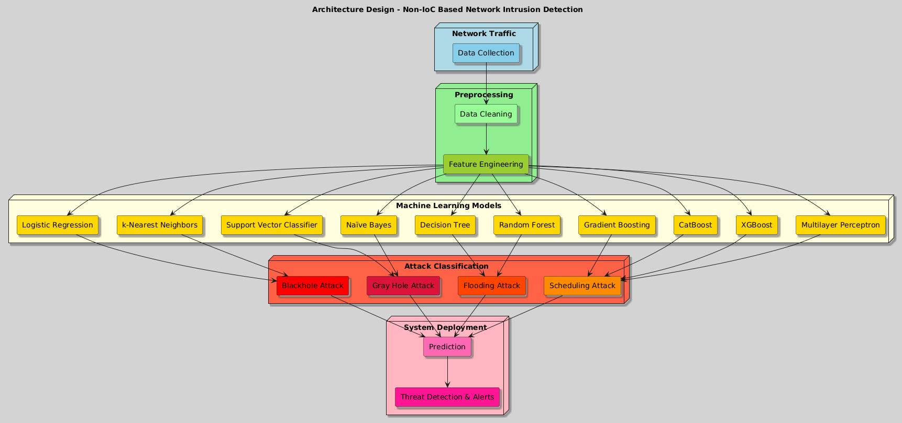
Methodology (Contd…)

Slide 34
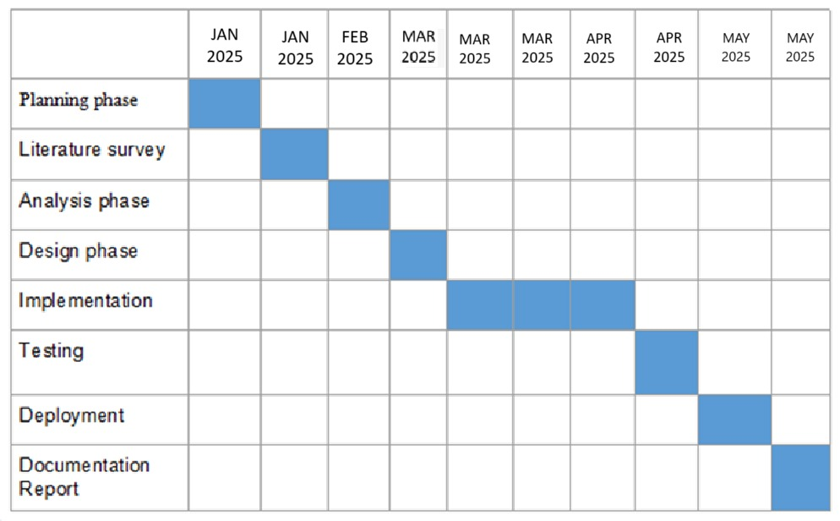
Timeline of Project

Slide 35
Expected Outcomes
Achieve high detection accuracy for cyberattacks such as blackhole, gray hole, flooding, and scheduling attacks by leveraging multiple ML models.
Effectively detect unknown or evolving threats by analyzing network behavior and anomalies without relying on predefined IoCs.
Design a scalable framework adaptable to diverse computing environments, including systems, firewalls, routers, and complex network infrastructures.
Implement a reporting mechanism with clear visualizations and alerts for detected intrusions, enabling quick decision-making and incident response.

Slide 36
Conclusion
The development of an AI-powered framework for enhanced network intrusion detection using non-IOC methods marks a significant advancement in cybersecurity. Traditional intrusion detection systems heavily rely on predefined Indicators of Compromise (IoCs), limiting their effectiveness against emerging and sophisticated threats.
This project successfully addresses this limitation by leveraging machine learning algorithms to analyze network behavior and detect anomalies, enabling the identification of cyberattacks without relying on predefined IoCs.

Slide 37

Research Publication

Slide 38

Research Publication Certificates

Slide 39

Contd.

Slide 40

Contd.

Slide 41

Contd.

Slide 42
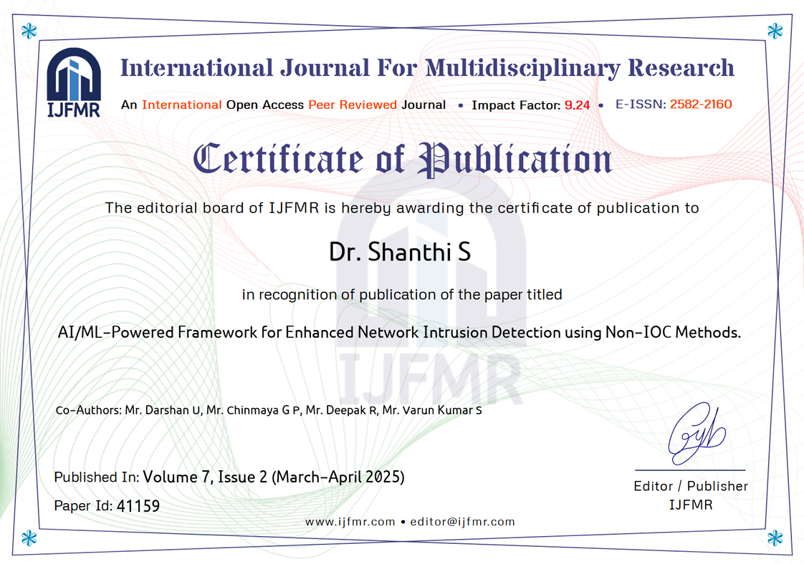
Contd.

Slide 43

Plagiarsm Report

Slide 44

SDG Mapping

Slide 45
SDG Mapping
Alignment with SDG 9: Industry, Innovation, and Infrastructure
At the core of my project is the goal of strengthening digital infrastructure through innovative technology, aligning closely with SDG 9, which focuses on building resilient infrastructure, promoting inclusive and sustainable industrialization, and fostering innovation.
Target 9.1: Develop Quality, Reliable, Sustainable, and Resilient Infrastructure
Target 9.5: Enhance Scientific Research and Upgrade Technological Capabilities

Slide 46
GitHub Link
https://github.com/UDARSHA/Capstone-Project-PIP4004.git

Slide 47
References
Zhijie Fan, Zhiwei Cao, “Method of Network Intrusion Discovery Based on Convolutional Long-Short Term Memory Network and Implementation in VSS”. IEEE Xplore. 2021. https://ieeexplore.ieee.org/document/9513285
Lixin Wang, Jianhua Yang, Michael Workman, “Effective algorithms to detect stepping-stone intrusion by removing outliers of packet RTTs”. IEEE Xplore. 2021. https://ieeexplore.ieee.org/document/9552669
Murtaza Ahmed Siddiqi, Woogul Pak, “Tier-Based Optimization for Synthesized Network Intrusion Detection System”. IEEE Xplore. 2022. https://ieeexplore.ieee.org/document/9916253
Li Zou, Xuemei Luo, Yan Zhang, Xiao Yang, Xiangwen Wang, “HC-DTTSVM: A Network Intrusion Detection Method Based on Decision Tree Twin Support Vector Machine and Hierarchical Clustering”. IEEE Xplore. 2023. https://ieeexplore.ieee.org/document/10057402

Slide 48
References (Contd…)
Manuel Lopez-Martin, Antonio Sanchez-Esguevillas, “Network Intrusion Detection Based on Extended RBF Neural Network With Offline Reinforcement Learning”. IEEE Xplore. 2021. https://ieeexplore.ieee.org/document/9612220
Zhendong Wang, Yong Zeng, Yaodi Liu, “Deep Belief Network Integrating Improved Kernel-Based Extreme Learning Machine for Network Intrusion Detection”. IEEE Xplore. 2021. https://ieeexplore.ieee.org/document/9319853
Linxi Zhang, Xuke Yan, Di Ma, “A Binarized Neural Network Approach to Accelerate in-Vehicle Network Intrusion Detection”. IEEE Xplore. 2022. https://ieeexplore.ieee.org/document/9895417
Hongchen Yu, Chunying Kang, Yao Xiao, “Network Intrusion Detection Method Based on Hybrid Improved Residual Network Blocks and Bidirectional Gated Recurrent Units”. IEEE Xplore. 2023. https://ieeexplore.ieee.org/document/10113329

Slide 49
References (Contd…)
Taehoon Kim, Wooguil Pak, “Early Detection of Network Intrusions Using a GAN-Based One-Class Classifier”. IEEE Xplore. 2022. https://ieeexplore.ieee.org/document/9945961
Kicho Yu, Khanh Nguyen, Younghee Park, “Flexible and Robust Real-Time Intrusion Detection Systems to Network Dynamics”. IEEE Xplore. 2022. https://ieeexplore.ieee.org/document/9858115

Slide 50
Thank You

