Slide 1
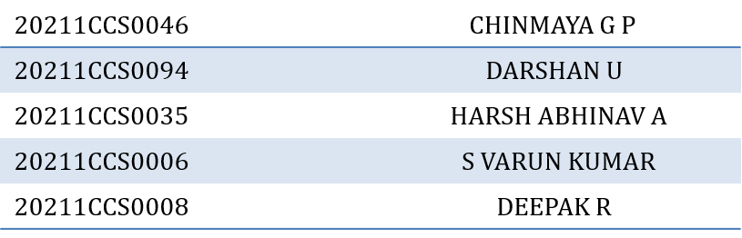
Predictive Analysis on Medicines Availability in Hospitals Using Machine Learning and Deep Learning Technique.
PIP104 University Project-II
Final Review
Batch Number: CCS-G23
Roll Number | Student Name
Under the Supervision of,
Dr. Shanthi S
Associate Professor
School of Computer Science & Engineering
Presidency University

Slide 2
Introduction
Infectious diseases continue to be a major global health concern. These illnesses, caused by various pathogens like bacteria, viruses, and fungi, can spread rapidly and have devastating consequences. The increasing interconnectedness of our world, coupled with climate change, has created a perfect storm for the emergence and spread of infectious diseases.
Urban areas are particularly vulnerable to infectious disease outbreaks. High population density, increased contact rates, and the mobility of people within and between cities facilitate the transmission of pathogens. This is especially true in developing countries where healthcare infrastructure may be inadequate.
Climate change is also playing a significant role in the spread of infectious diseases. Rising temperatures can create favorable conditions for the growth and survival of disease-carrying mosquitoes and other vectors. Changes in precipitation patterns can lead to flooding and water contamination, increasing the risk of waterborne diseases. Additionally, extreme weather events can disrupt healthcare services and infrastructure, making it difficult to respond to outbreaks.

Slide 3
Literature Review
Comprehensive Analysis of Deep Learning‑Based Approaches for Prediction and Prognosis of Infectious Diseases :
Infectious diseases pose a significant global health threat, with the potential to cause widespread morbidity and mortality. Accurate prediction and prognosis of these diseases are crucial for effective prevention, treatment, and public health interventions. Traditional epidemiological and statistical methods have limitations in handling complex data and capturing non-linear relationships. Deep learning, a subset of artificial intelligence, has emerged as a promising approach for addressing these challenges.
This literature review aims to provide a comprehensive analysis of deep learning-based approaches for the prediction and prognosis of infectious diseases. We will explore various studies conducted in this field, evaluate their methodologies, and discuss the potential benefits and limitations of deep learning applications.

Slide 4
Literature Review
2. Prediction of Seasonal Diseases Based on Climate Change Using Big Data :
Climate change is a pressing global issue with significant implications for human health. Seasonal diseases, such as malaria, dengue fever, and influenza, are particularly susceptible to climatic factors. Accurate prediction of these diseases can enable timely public health interventions and resource allocation. Big data, with its vast volume, variety, velocity, and veracity, offers a powerful tool for analyzing complex relationships between climate variables and disease outbreaks.
This literature review explores the application of big data analytics in predicting seasonal diseases based on climate change. We will discuss the key research methodologies, datasets utilized, and the findings from existing studies.

Slide 5
Literature Review
3. AI for science: Predicting infectious diseases :
Infectious diseases pose a significant threat to global health, with the potential to cause widespread morbidity and mortality. Accurate and timely prediction of these diseases is crucial for effective prevention and control measures. Traditional epidemiological methods often face limitations in handling complex data and capturing non-linear relationships. Artificial intelligence (AI) has emerged as a promising tool for addressing these challenges.
This literature review explores the application of AI in predicting infectious diseases, focusing on the key methodologies, datasets, and findings from existing studies.

Slide 6
Literature Review
4. Deep learning techniques for detection and prediction of pandemic diseases :
The COVID-19 pandemic highlighted the urgent need for effective methods to detect and predict the emergence of infectious diseases. Traditional epidemiological and statistical approaches often face limitations in handling complex data and capturing non-linear relationships. Deep learning, a subset of artificial intelligence, has emerged as a promising tool for addressing these challenges.
This literature review explores the application of deep learning techniques in the detection and prediction of pandemic diseases. We will discuss the key methodologies, datasets utilized, and the findings from existing studies.

Slide 7
Literature Review
5. Disease Prediction Using Machine Learning :
Disease prediction has been a longstanding challenge in healthcare. Traditional methods often rely on expert knowledge and statistical analysis, which can be time-consuming and limited in their ability to handle complex data. Machine learning, a subset of artificial intelligence, has emerged as a powerful tool for addressing these limitations. By leveraging algorithms that can learn from data, machine learning models can identify patterns and relationships that are not readily apparent to humans.
This literature review explores the application of machine learning in disease prediction, focusing on the key methodologies, datasets, and findings from existing studies.

Slide 8
Literature Review
6. A review on prediction of seasonal diseases based on climate change using big data
The review identifies climate change may affect the pathoGens of chicken pox. This study found that the disease transmission of chickenpox is increased in late winter and early spring. As well as, the other infectious diseases are out breaks their pathogens based on seasons. The survey examines that, depend upon the climate change the disease transmission may increase or decreased. The study found that the climate change may also introduce new pathogen already it does not exist in the society.
So the health authorities are prepared to face these types of infectious diseases and the health care providers will educate the people to prevent the spread of these types of infectious diseases .For example, public must follow social distancing to avoid the spread of These infectious diseases The analysis identifies most dengue out breaks are increased during summer and winter .Data was taken from the Global Weather Data for SWAT Inc(2016). Local Moran’s I Autocorrelation method utilizes to visualize the dengue hotspot regions.

Slide 9
Literature Review
7. Healthcare predictive analytics using machine learning and deep learning techniques
Over the past decades, ML has had a significant impact on our daily lives with examples including efficient computer vision, web search, and recognition of optical char acters. In addition, by applying ML approaches, AI at the human level has also been improved. However, when it comes to the mechanisms of human information processing (such as sound and vision), the performance of traditional ML algorithms is far from satisfactory. The idea of deep learning (DL) was formed in the late 20th inspired by the deep hierarchical structures of human voice recognition and production systems. DL breaks have been introduced in 2006 when Hinton built a deep structured learning architecture called deep belief network (DBN).
The performance of classifiers using DL has been extensively improved with the increased complexity of data compared to classical learning methods. The performance of classic ML algorithms and DL methods. The performance of typical ML algorithms becomes stable when they reach the training data threshold, but DL improves its performance as the complexity of data increases.

Slide 10
Literature Review
8. Machine Learning Applied to Infectious Diseases—Overview
Machine-learning algorithms can contribute to the control of infectious diseases by helping to both spatially and temporally predict the evolution and spread of infectious diseases [5]. Machine-learning algorithms are capable of analyzing large, complex data sets and identifying patterns and trends that may be difficult for humans to detect. This makes them well suited for the prediction of infectious diseases, which often involve multiple factors such as population demographics, environmental conditions, and individual behaviors.
In recent years, many studies have applied machine-learning techniques to the prediction of infectious diseases, and the results have been promising. One of the key challenges in using machine learning for disease prediction is the availability of high-quality, comprehensive data. Infectious disease surveillance systems often collect data on a variety of factors, including the number of reported cases, the locations of outbreaks, and the demographics of infected individuals. However, these data are often incomplete, biased, or noisy, which can affect the performance of machine-learning models.

Slide 11
Proposed Method
This Proposed Method is used to predict disease according to symptoms. This system uses decision tree classifier for evaluating the model. This system is used by end-users. The system will predict disease based on symptoms. This system uses. Machine Learning and Deep Learning Technology for predicting diseases, the decision tree classifier algorithm is used.
This Proposed Method aims to assist users in identifying potential health conditions based on their reported symptoms. By employing machine learning and deep learning techniques, specifically the decision tree classifier algorithm, the system can analyze symptom data and provide a preliminary assessment of possible diseases.

Slide 12
Objectives
Seasonal Disease Prediction: Healthcare practitioners can better prepare by using machine learning to forecast seasonal illness outbreaks based on historical and environmental data.
Best Medicines Recommendation: Create an AI-powered recommendation system that uses clinical data, treatment results, and patient feedback to determine which medications are best for anticipated seasonal illnesses.
Medicine Quantity Prediction: To avoid shortages and guarantee a sufficient supply during seasonal epidemics, use predictive analytics to forecast the number of medications needed.
Doctor Availability Monitoring: Establish a mechanism to predict and track the need for physicians during periods of high disease incidence, guaranteeing appropriate access to healthcare and effective staffing.

Slide 13
Methodology
Random Forest Algorithm
The Random Forest algorithm is an ensemble learning method that constructs multiple decision trees and combines their results to make more accurate predictions. The key advantages of Random Forest are:
Robustness: It reduces overfitting by averaging the results of several decision trees, which helps improve generalization.
Handling Complex Data: It can handle both categorical and numerical data, making it suitable for healthcare data that may include various types of information (e.g., patient demographics, seasonal trends).
Feature Importance: Random Forest can identify the most important factors influencing medicine demand, providing valuable insights into inventory management. The Random Forest model will be trained using historical medicine usage data, including consumption patterns, seasonal factors, and patient data, to predict future demand.

Slide 14
Methodology
2. Decision Tree Algorithm
The Decision Tree algorithm is a supervised learning model that splits the dataset into smaller subsets based on certain features, making it easier to interpret and visualize the decision making process. Decision Trees are:
Easy to Interpret: Their decision-making process is transparent, which makes it easy for healthcare staff to understand why a certain prediction was made.
Fast Prediction: Decision Trees are computationally efficient, providing real-time predictions for inventory management.
Handling Non-linearity: They can capture non-linear relationships in the data, making them useful for dynamic environments like hospital operations. In this project, Decision Trees will be trained on various factors, such as patient admission rates, disease outbreaks, and historical usage patterns, to predict the required medicines.

Slide 15
Methodology
3. Convolutional Neural Networks (CNN) for Similarity Percentage
CNNs are primarily used for image processing, but they can also be adapted to analyze structured data and uncover hidden patterns in large datasets. In this context, CNNs can be used for similarity percentage analysis, identifying relationships between various input features and the corresponding medicine demand.Pattern Recognition: CNNs excel at detecting patterns in data, such as trends in medicine usage related to disease outbreaks or seasonal fluctuations.The CNN will be used to analyze historical data and predict future trends in medicine demand, by calculating similarity percentages between past and future data points.

Slide 16
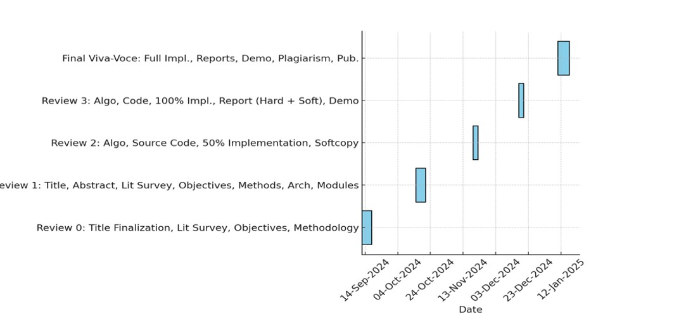
Timeline of Project

Slide 17
Expected Outcomes
Early Detection: The system can help users identify potential health issues at an early stage, when treatment is often more effective.
Increased Accessibility: The system can provide access to healthcare information and preliminary assessments, even in remote or underserved areas.
Time and Cost Savings: By providing a preliminary assessment, the system can help users avoid unnecessary medical appointments and expenses.
Improved Patient Engagement: The system can empower users to take a more active role in their own healthcare by providing them with information and tools to manage their health.

Slide 18
Expected Outcomes
Enhanced Healthcare Outcomes: By improving early detection and access to healthcare, the system can contribute to better overall health outcomes.
Support for Clinical Decision Making: The system can provide healthcare providers with valuable insights that can inform their clinical decision-making.
Advancements in Medical Research: The system can contribute to medical research by providing large datasets of symptom-disease associations that can be used to develop new diagnostic tools and treatments.

Slide 19
Conclusion
The proposed disease prediction system offers a promising approach to improving healthcare accessibility and outcomes. By leveraging machine learning and deep learning techniques, the system can provide users with a convenient and informative tool for identifying potential health conditions based on their symptoms.
The system's expected outcomes include early detection, increased accessibility, time and cost savings, improved patient engagement, enhanced healthcare outcomes, support for clinical decision making, and advancements in medical research.
While the system shows great potential, it is important to note that it is not intended to replace professional medical advice. Users should always consult with a healthcare provider for a proper diagnosis and treatment plan.

Slide 20
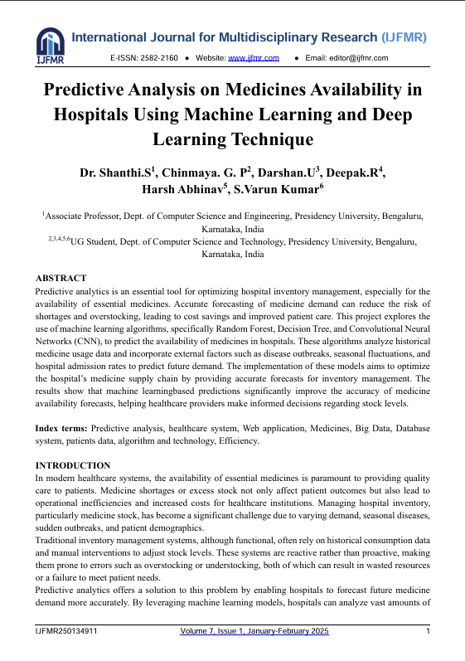
Research Publication

Slide 21
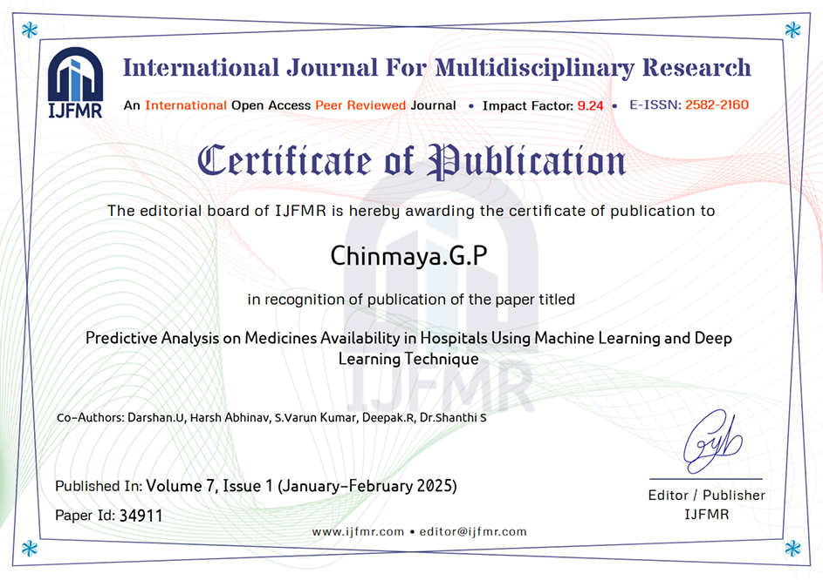
Research Publication Certificates

Slide 22
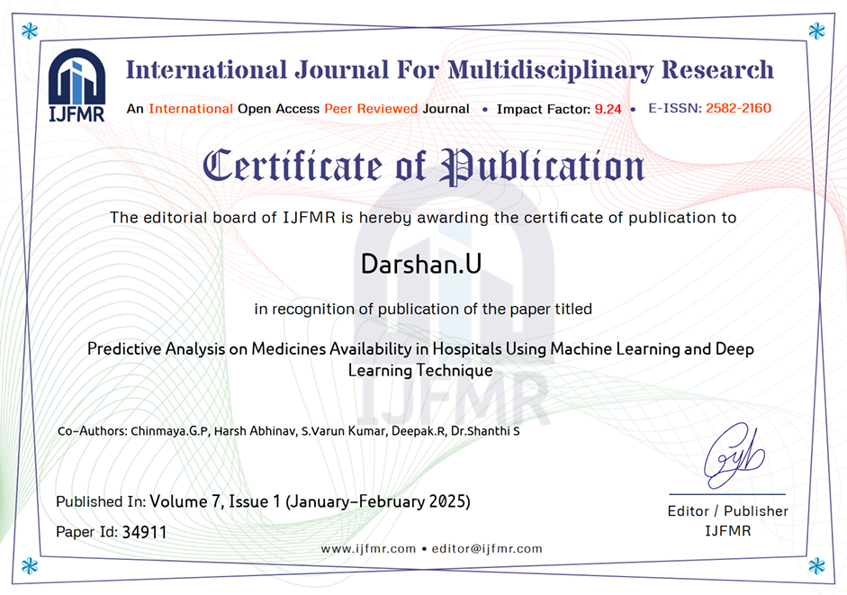
Contd.

Slide 23
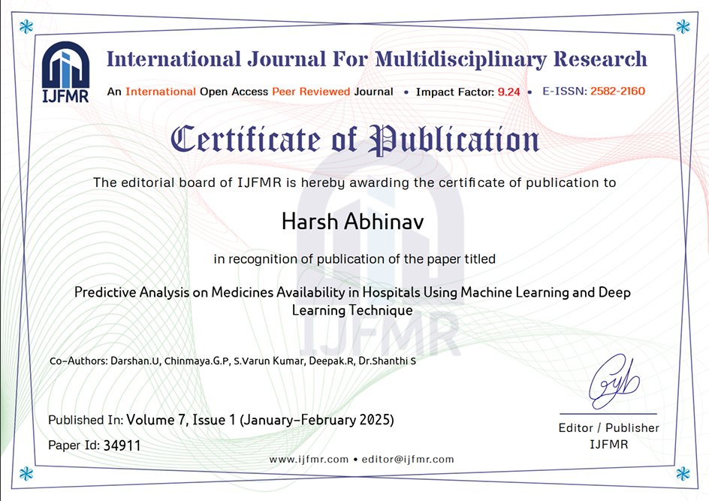
Contd.

Slide 24

Contd.

Slide 25
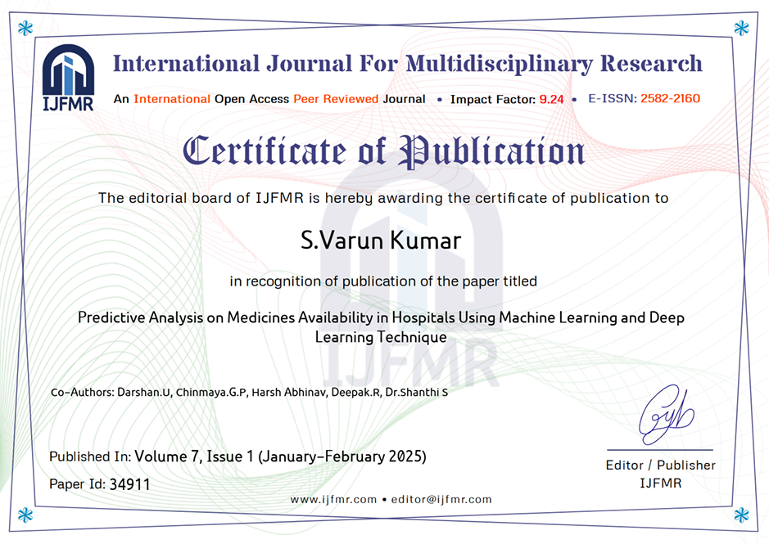
Contd.

Slide 26

Contd.

Slide 27
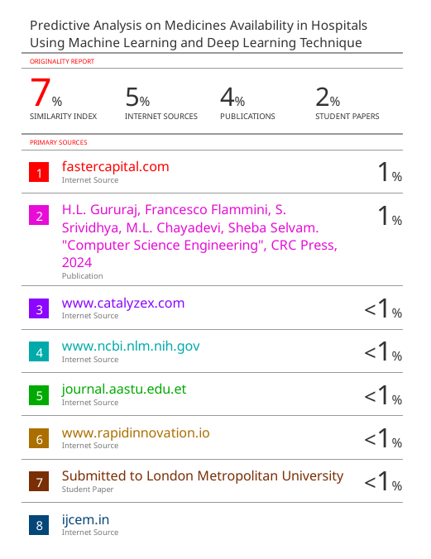
Plagiarsm Report

Slide 28

SDG Mapping

Slide 29
Contd.
Alignment with SDG 3: Good Health and Well-being
The heart of my project lies in ensuring the timely availability of medicines in hospitals, a critical factor for achieving universal health coverage (UHC). This aligns with the following key targets under
Target 3.8: Achieve Universal Health Coverage.
Target 3.b: Access to Affordable Essential Medicines

Slide 30
GitHub Link
https://github.com/UDARSHA/project.git

Slide 31
References
Kavita Thakur, Manjot Kaur, Yogesh Kumar, “Comprehensive Analysis of Deep Learning Based Approaches for Prediction and Prognosis of Infectious Diseases”. link.springer.com. 8 June 2023. https://link.springer.com/article/10.1007/s11831-023-09952-7
K. Indhumathia, K. Sathesh Kumar,“A review on prediction of seasonal diseases based on climate change using big data”. pubmed.ncbi.nlm.nih.gov. 2020 Oct 2. https://pubmed.ncbi.nlm.nih.gov/33024706/
Alexis Pengfei Zhao, Shuangqi Li, Zhidong Cao, Paul Jen-Hwa Hu, Jiaojiao Wand, Yue Xiang, Da Xie, Xi Lu, “AI for science: Predicting infectious diseases”.Sciencedirect.com. 2024. https://www.sciencedirect.com/science/article/pii/S266644962400015X#
Sunday Adeola Ajagbe, Matthew O. Adigun,“Deep learning techniques for detection and prediction of pandemic diseases”. link.springer.com. 29 May 2023. https://link.springer.com/article/10.1007/s11042-023-15805-z
Suresh Singh Rajpurohit ,“Disease Prediction using Machine Learning”. ijcrt.org. 3 March 2022 . https://ijcrt.org/papers/IJCRT2203398.pdf

Slide 32
References
Ahmad Z Al Meslamani, Isidro Sobrino, José de la Fuente, “Machine Learning Applied to Infectious Diseases—Overview”. pmc.ncbi.nlm.nih.gov. 10 Jun 2024. https://pmc.ncbi.nlm.nih.gov/articles/PMC11168216/#
Zeydin Pala, Ramazan Atıcı, Erkan Yaldız, “Forecasting Future Monthly Patient Volume using Deep Learning and Statistical Models”. link.springer.com. 10 March 2023. https://link.springer.com/article/10.1007/s11277-023-10341-3
Zengchen Yu, KeWang, Zhibo Wan, Shuxuan Xie, Zhihan Lv,“Popular deep learning algorithms for disease prediction: a review”. link.springer.com. 13 September 2022.https://link.springer.com/article/10.1007/s10586-022-03707-y
Nalin M. Rajendran, M. Karthikeyan, B. Karthik Raja, K. Pragadishwaran, E. A. Gopalakrishnan & V. Sowmya, “Communicable Disease Prediction using Machine Learning and Deep Learning Algorithms”. link.springer.com. 04 October 2023. https://link.springer.com/chapter/10.1007/978-981-99-5166-6_66
Mohammed Badawy, Nagy Ramadan and Hesham Ahmed Hefny,“Healthcare predictive analytics using machine learning and deep learning techniques”. jesit.springeropen.com. 29 August 2023. https://jesit.springeropen.com/articles/10.1186/s43067-023-00108-y

Slide 33
Thank You

