Slide 1
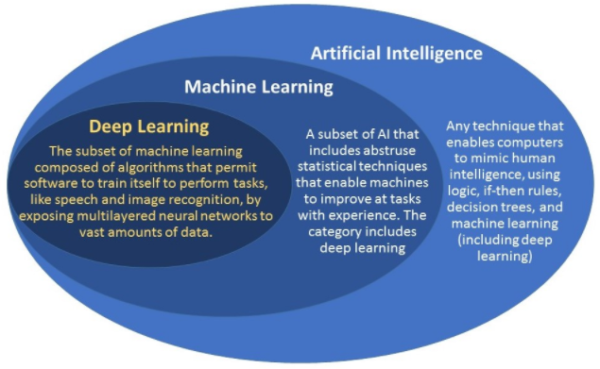
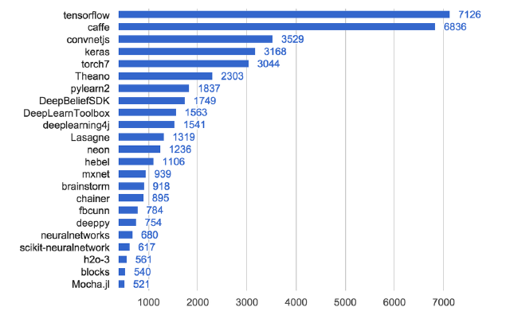
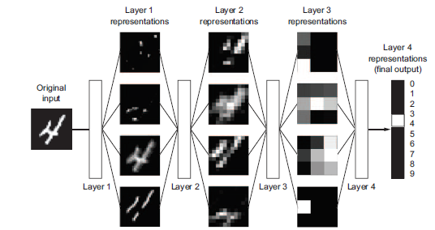
Deep Learning – Tools (open source)
keras :
Deep Learning Library in python for Theneo and Tensor flow for developing and evaluating deep learning models
It wraps the efficient numerical computation libraries Theano and TensorFlow
Deep Learning computation libraries:
TensorFlow : supported by Google
Theano : supported by University of Montreal's MILA
Torch : supported by Facebook, Twitter and NVIDIA

Slide 2


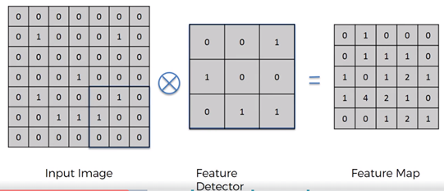
CNN - Convolution Neural Network
CNN: The Convolutional Neural Network(CNN) is a type of Supervised Deep Learning that is used to analyze
Computer Vision (Image & Video Recognition).
Like Neural Network, CNN is also made up of Neurons with learnable weights and Biases.
In the CNN the input is Multi Channeled Image(RGB 64X64X3), unlike in ANN where the input is vector.
Yann LeCun - Founding Father of CNN
1988 – Back Propagation and CNN Theory

Slide 3
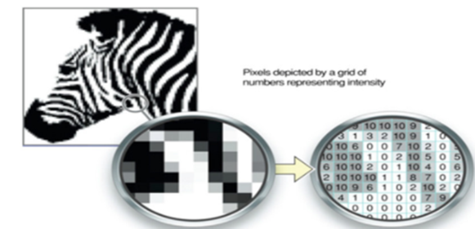
Image Pixel Values
Images are in the form of arrays of Pixels, depends on the resolution and size of images, Computer will see the
image as an array of Pixel numbers (ex - 32X32X3 (RGB) )
Each of these pixels will be given a value from 0 to 255 which describe the pixel intensity at that point.
For example, we have a colored image of 64X64X3 that will be having total number of 12288 Pixels arrays.
This arrays of pixels of an input image can be used by computer model to describe the probability of image being
a certain class.
For a small image of 64X64X3, there are high number of input features of 12288 variables (each pixel is a relevant variable) and for
that Fully connected Neural Network has to estimate the total 12288 weights for each Neuron in next layer.
The convolution operation brings a solution to this problem as it reduces the number of free parameters, allowing the network to be
deeper with fewer parameters.
Input (12288) Features
Neural Network Model
Predict Image Class

Slide 4
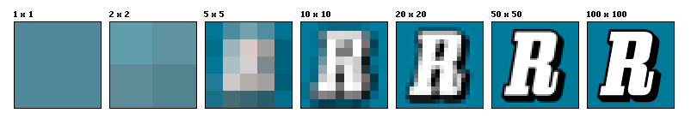
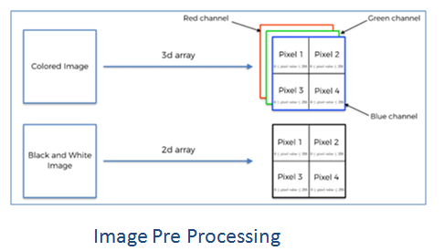
Image Pixel Values
The term image resolution is often considered equivalent to Pixel count in digital imaging.
Following are the different pixel resolution for the same image.
( Wikipedia Ref)
( Example: An image that is 2048 pixels in width and 1536 pixels in height has a total of 2048×1536 = 3,145,728 pixels or 3.1 megapixels. )
Based on type of input image, need to convert them into 2-D or 3-D arrays of Pixel values (image pre processing).

Slide 5
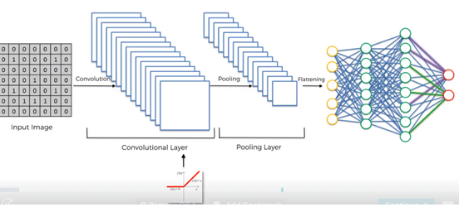
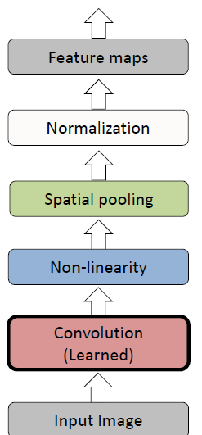
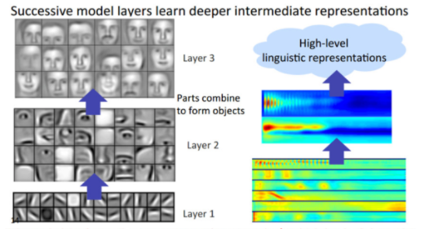
Convolutional Neural Network (Yann Lecun, Geoffrey Hinton)
In Image recognition , CNN model identify the unique features very specific to particular image Class (Car, Mobile, Cat, Dog etc) by first create low level of features such as edge & curves.

Slide 6
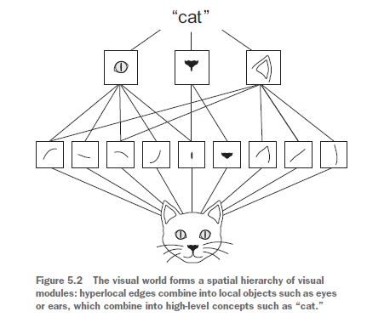
Convolution Step
Convolution Steps:
Feature detector will be multiply over part of input image to get the Feature Map (high number).
Each Feature Map get some highest number that contain the specific patterns in input image.
Convolution steps will use different feature detectors to generate low level of Features like edges and curves.
Input Image = 7X7
Feature Detector = 3X3
Feature Map = 5X5

Slide 7

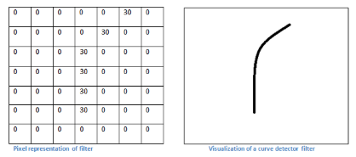
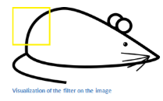
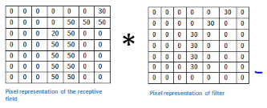
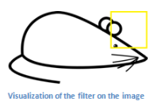
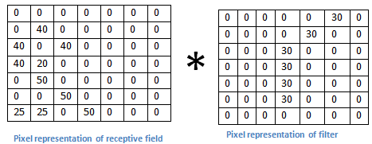
Convolution Step
Convolution Example: Edge detection convolution filter
TO DO:
Need to add my own XL based pixedl number to explain this in detailed
High value of Multiplication Sum
(50*30 + 50*30 + …..) = Large Value
Low value of Multiplication Sum
(0*30 + 0*30 + …..) = Low Value
In the above example, after applying the convolution filter of curve detector, it will generate the feature Map where it will show the areas in which there most likely to be curve in the picture.

Slide 8
Feature detector will slide over the entire input image and by a Stride and compute the Dot Product between receptive field and filter get the Feature Maps.
Feature Detector or Kernel or Filter (Typical filter 5x5x3 )
Feature Map or Convolved Map or Activation Map
Zero-padding – adds Zeros around the outside of input so that convolution should not loose the information at the borders layer.
Output Convolved Map Size ( W2 , H2, D2)
Input Image = 5 X 5 X 3 : W1 = 5, H1=5, D1=3
Two Filter = (3X 3 X 3) x 2, D2 = 2
Receptive Field(F) = 3
Zero-Padding (P) = 1
Stride (S) = 2 (Filter is shifting by 2 pixel amount)
W2 = (W1 – F + 2P)/ S + 1 = (5- 3 + 2*1)/2 + 1 = 3
H2 = (H1 - F + 2P) S + 1 = (5 - 3 + 2*1)/2 + 1 = 3
D2 = 2
Output = (3 x 3 x 2)

Slide 9
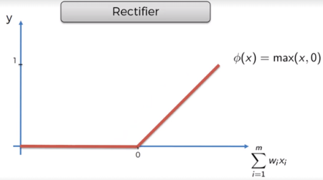
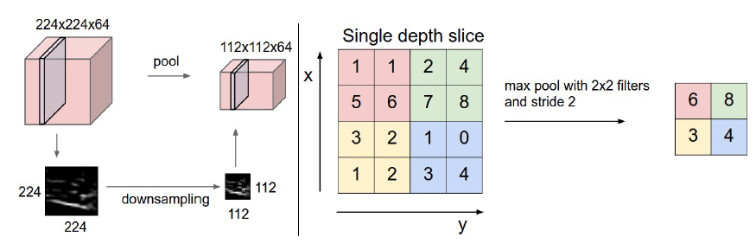
ReLu and Pooling
Relu (Rectifier Liner Unit) :
A non-linearity layer (ReLu) activation function that takes the feature map generated
by the convolutional layer and creates the activation map as its output.
In CNN, ReLu has significant advantages as compare to other activation functions.
(1) ReLU propagate the gradient efficiently and therefore reduce the likelihood of a vanishing gradient problem.
(2) ReLu threshold negative values to zero, and therefore solve the cancellation problem as well as result in a much more sparse
activation volume at its output and sparsity provide robustness to small change in input noise.
Pooling :
Pooling is to reduce the size of feature map without loosing the information.
Its function is to progressively reduce the spatial size of the representation to reduce the amount of parameters
and computation in the network. It also control the over-fitting.
There are different type of Pooling like Max-pooling, Average-pooling, L2-norm pooling.
Example of Max pooling of 2x2 filter and stride = 2, Max-pooling takes the max value of the 4 pixels.

Slide 10
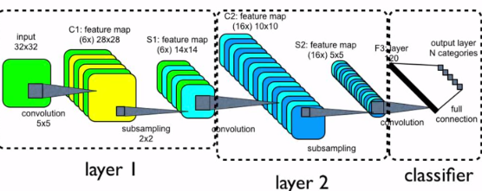
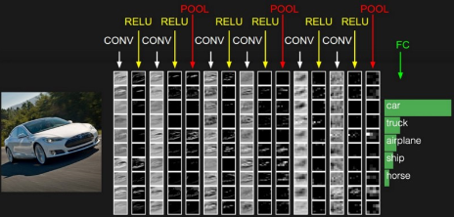
CNN Complete Flow
Flattening : is converting the n-dimensional output of convolution/pooling step into 1-dimensional vector that can
be used in the next step of ANN Full connection modeling for the classification.
Fully Connected Layer (ANN): This is the last layer of CNN model that uses a Softmax activation function for classifying the generated features of the input image into various classes based on the training dataset.

Slide 11
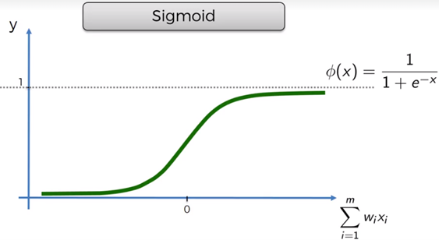

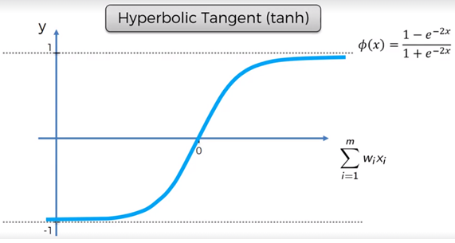
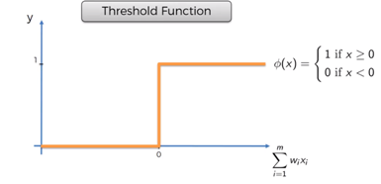
Activation Function

Slide 12
Neural Network Classification
Two key architecture decisions that you need to make to make your model:
(i) how many layers you’re going to use
(ii) how many “hidden units” you will chose for each layer
Pre processing of predictors to standardize them before applying to neural network for best
performance.
Categorical variables need to transformed into dummy variables before applying to neural network.
Neural Network back propagation weights updating gets stop when
(i) when misclassification error reached to threshold.
(ii) when the limit on the number of training epoch is reached.
To avoid the over fitting, limit the number of epochs and not to over train the data and keep measuring the validation error after each epoch and select optimum epoch based on minimum validation error.

Slide 13

Neural Network Classification
Two key architecture decisions that you need to make to make your model:
(i) how many layers you’re going to use
(ii) how many “hidden units” you will chose for each layer
Pre processing of predictors to standardize them before applying to neural network for best performance.
Categorical variables need to transformed into dummy variables before applying to neural network.
MLP(Multiple Perceptron NN) Tuning Parameters:
hidden_layer_sizes : Number of hidden layer in multiple NN (default = 100)
activation : Activation function for the hidden layer. {‘identity’, ‘logistic’, ‘tanh’, ‘relu’}, default ‘relu’
‘identity’, no-op activation, useful to implement linear bottleneck, returns f(x) = x
‘logistic’, the logistic sigmoid function, returns f(x) = 1 / (1 + exp(-x)).
‘tanh’, the hyperbolic tan function, returns f(x) = tanh(x).
‘relu’, the rectified linear unit function, returns f(x) = max(0, x), It gives an output x if x is positive and 0 otherwise.
Optimizers (Solver) : Stochastic Gradient Descent (SGD), ADAM and RMSprop.
solver : {‘lbfgs’, ‘sgd’, ‘adam’}, default ‘adam’-stochastic gradient descent.
learning rate : Learning rate to update weights {‘constant’, ‘invscaling’, ‘adaptive’}, default ‘constant’
( invscaling – gradually decrease scaling exponent of ‘power_t’, adaptive – decrease in case of no tol improvement
Loss Function: For regression - Mean Squared Error (MSE), For classification cross-entropy function.
Cross Entropy -
(v) Tolerance(tol) : Tolerance for the optimization (default = .0001)
(vi) Maximum iteration (max_iter): The solver iterates until convergence (determined by ‘tol’) or this number of iterations.(default = 200)
(vii) validation_fraction : Proportion of training data set for validation for early stopping.
float, optional, default 0.1.

Slide 14
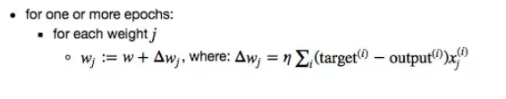
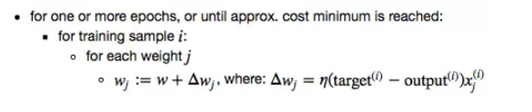
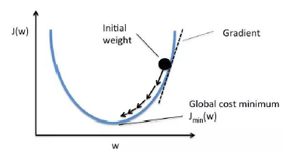


Neural Network Classification
Gradient Descent (Batch) : Updates the weights after each epoch.
Stochastic Gradient Descent ( Iterative) : Updates the weights for each training samples.
Mean Squared Error
Cross Entropy

Slide 15
