Slide 1
Refrigeration and Air-Conditioning ME 413
Energy-Saving Room Monitoring System: Detecting and Alerting for Air Leakage of Open Doors
by
Bishal Kumar Sahani (12140450)
Uday Verma (12141700)

Slide 2
Table of Contents
Problem Statement
Objective
Detailed Methodology
Work Plan
Current Status
Items Required
Budget Estimation
Future Outlooks

Slide 3
Problem Statement
In today’s world, a large energy is being utilized to cool down the buildings and maintaining comfortable indoor environments. But air-conditioning can also lead to significant energy wastage when there are inefficiencies in the system such as vents or leakages in the room. These inefficiencies lead to the escape of cooled air, resulting in increased energy consumption to maintain desired temperature levels. The problem at hand is to identify and monitor leakages and open doors in rooms to minimize energy consumption and enhance energy efficiency.

Slide 4
Objective
Developing a system that detects leakages in rooms by either door or windows.
Implementing sensors to detect open doors or windows, ensuring real-time tracking of door and windows status.
Integrate the data from sensors to a web applications to send notifications to the room owner/individual.
Implementing alert mechanisms to notify the individuals in real time when leakages are detected.

Slide 5
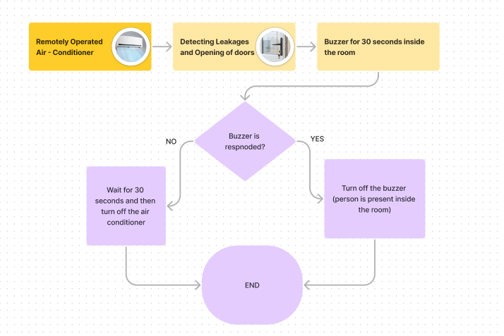
Detailed Methodology (Approach)
1st Methodology (Hardware Implementation) -

Slide 6
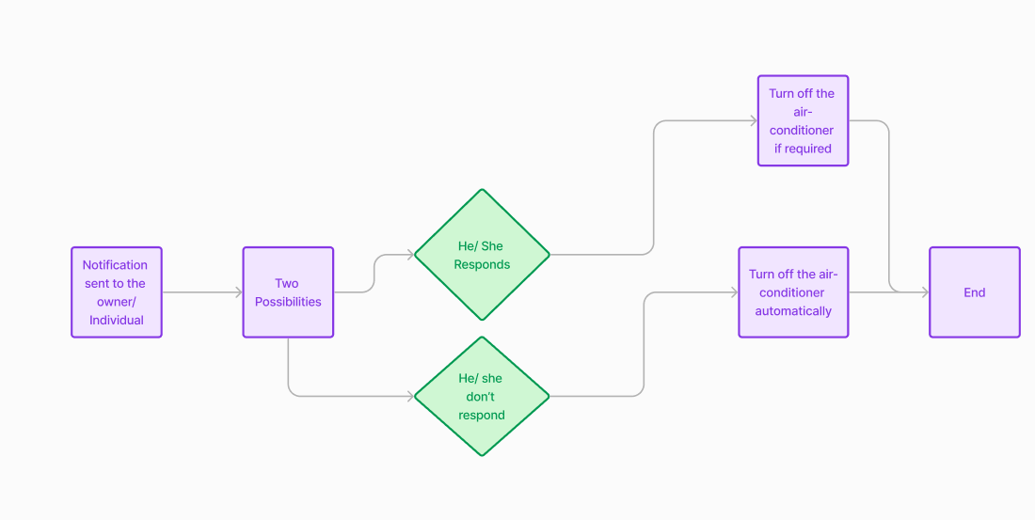
Detailed Methodology (Approach)
2nd Methodology (Software Implementation) -

Slide 7
Work Plan
Project Initiation Phase
Requirement Analysis and Circuit Design
Hardware Setup
Software Development and Integration
Testing Software
Final Deployment

Slide 8
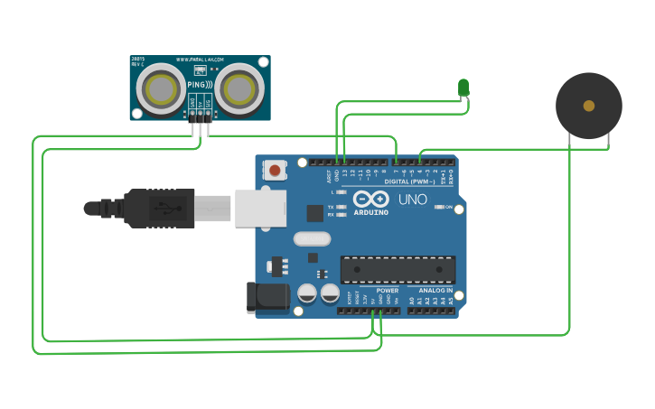
Current Status
Circuit Design

Slide 9
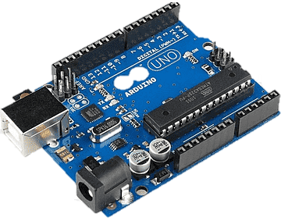
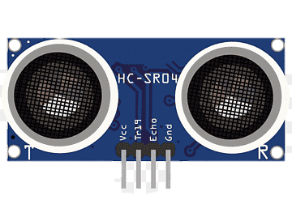
Items Required
Arduino UNO – Link
Ultrasonic - Link

Slide 10

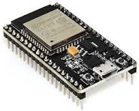
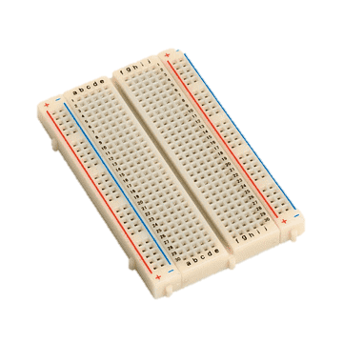
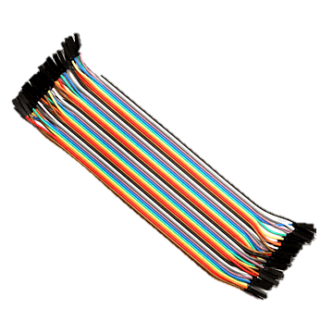


Buzzer - Link
ESP 32 - Link
Jumper Wires & bread board - Link

Slide 11
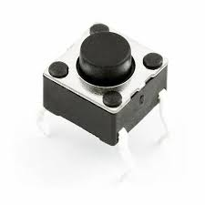
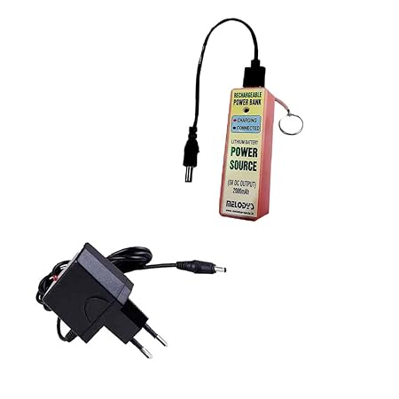
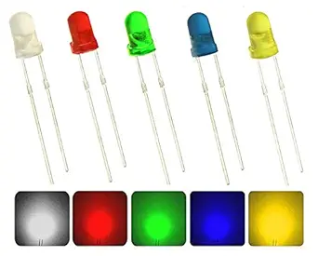
Switch - Link
Battery - Link
LED - Link

Slide 12
Budget Estimation
Item Name | Item Price (Rs.)
Arduino | 474
Ultrasonic | 201
Buzzer | 88
ESP-32 | 600
Breadboard & Jumper wires | 320
Switch | 49
Battery | 280
LED | 149
Miscellaneous | 500
Total | 2661 Rs

Slide 13

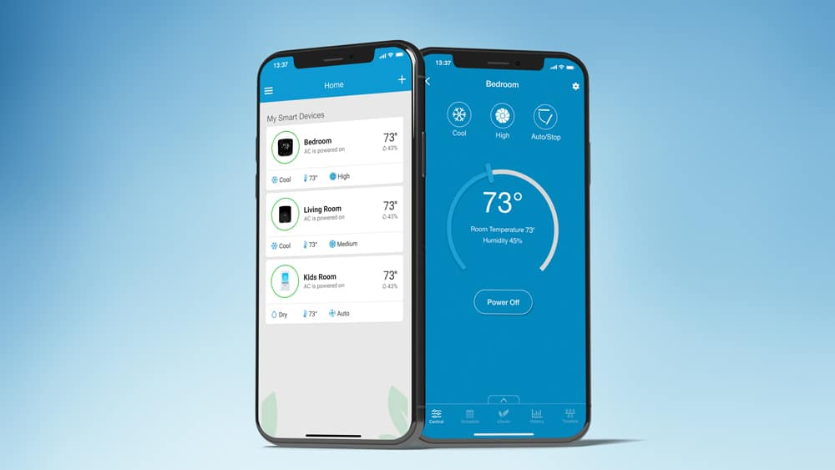
Future Outlooks
Applications in cars, houses, etc.
Other more functionalities.

Slide 14


