Slide 1
CI/CD分享
何顯浩
日期：20240611

Slide 2
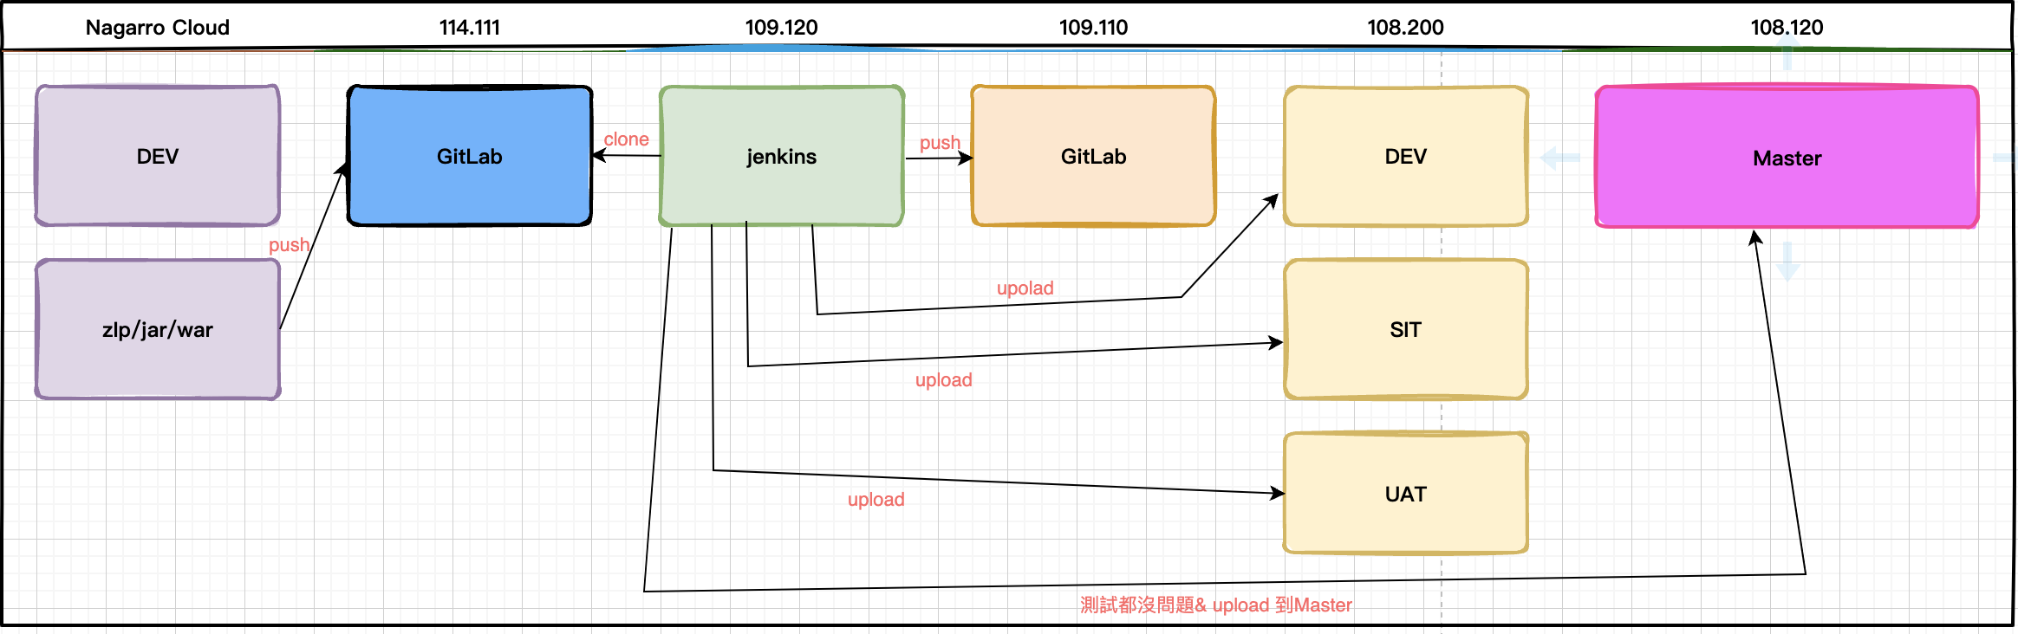
CI/CD流程表

Slide 3
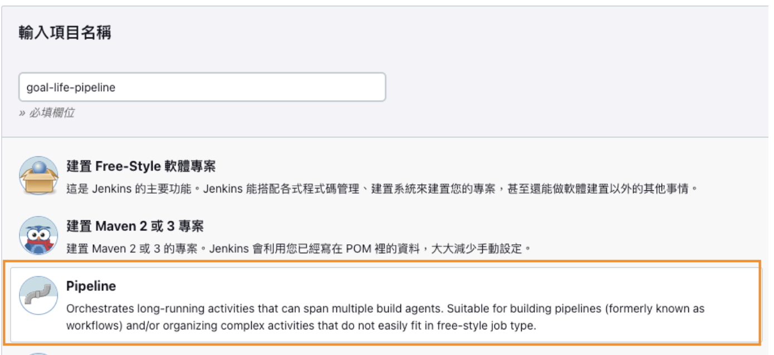
Jenkins 專案

Slide 4
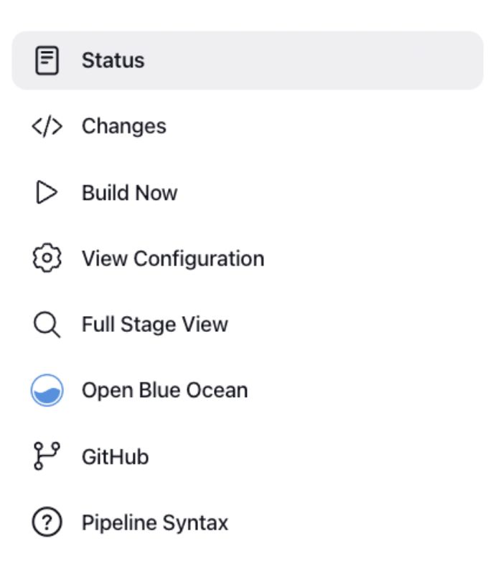
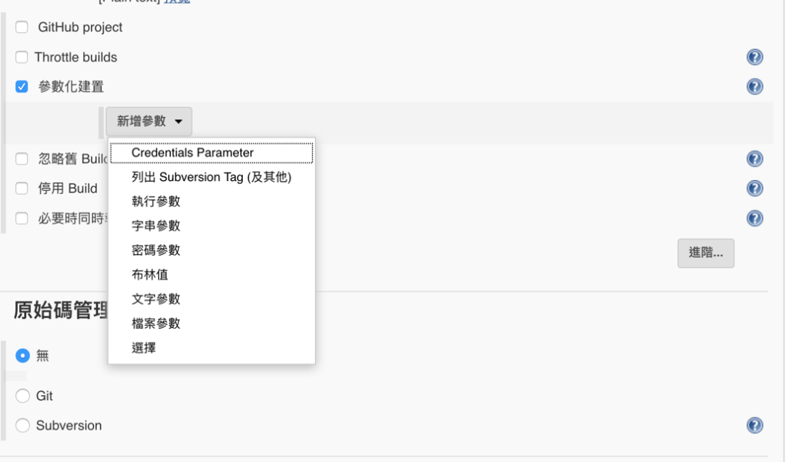
Jenkins 組態設定

Slide 5
Jenkins pipelines
Clone GitLab & push file to GitLab / commit branch
Import zip file
Stop Jboss
Copy jar file & edit the module.xml
Start Jboss

