Slide 1
Flood Monitoring and Early Warning System Problem Statement: Inadequate and delayed response to flood disasters due to inefficient monitoring and warning systems results in significant property damage and loss of life.
Team Members:
ARUNA . R
HARI BAALAJI . M
SABARI . B
UDHAYA KUMAR . A

Slide 2
Objective of the Project
Develop a robust flood monitoring system that provides real-time data and early warning to vulnerable regions.
Utilize advanced algorithms to analyze and predict flood occurrences accurately.
Reduce property damage and save lives by providing timely and actionable information.

Slide 3
Limitations of Existing Algorithms
Latency: Delays in data collection, processing, and dissemination.
Accuracy: Insufficient accuracy in predicting flood magnitudes and affected areas.
Coverage: Limited geographical coverage, missing critical regions.
Integration: Difficulty in integrating with local communication systems and public alert systems.

Slide 4
Concept of Proposed Method/Algorithm
Hybrid Model: Integrating hydrological models with machine learning algorithms.
Data Integration: Sourcing data from multiple sensors (satellites, river gauges, weather stations) for comprehensive monitoring.
Dynamic Prediction: Real-time analysis and updating of flood predictions based on incoming data.

Slide 5
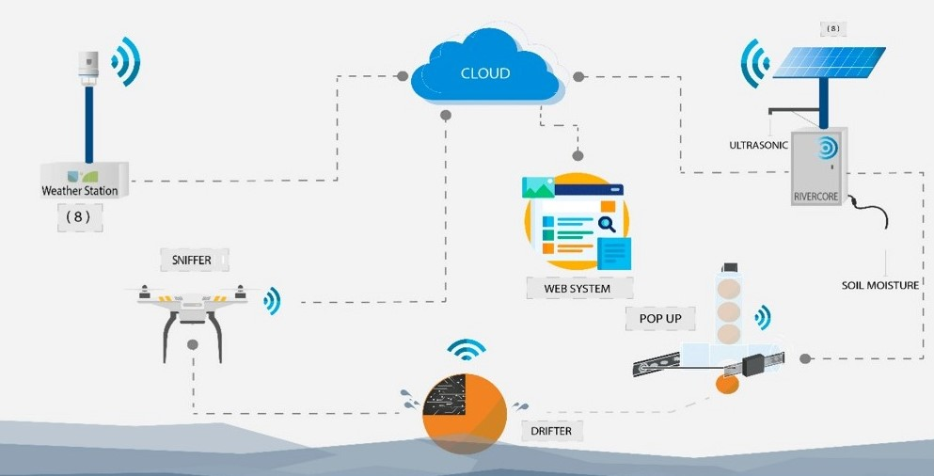
Elements Of The Early Warning System

Slide 6
Details of Algorithm
Input Data: Rainfall measurements, river flow rates, soil moisture levels, satellite imagery, etc.
Processing:
Layer 1: Hydrological models to process raw data and create initial flood forecasts.
Layer 2: Machine learning algorithms to refine forecasts based on patterns, historical data, and real-time inputs.
Output:
Predicted flood intensity.
Expected flood-affected areas.
Estimated time to event.

Slide 7
Conclusion
The proposed system offers timely and accurate flood warnings.
Integrating multiple data sources ensures comprehensive monitoring.
Machine learning algorithms refine predictions, offering a dynamic response to changing conditions.
Anticipated to reduce property damage and save lives by providing actionable information to affected communities.

Slide 8
References
Books/Journals:
Bates, B. C., Kundzewicz, Z. W., Wu, S., & Palutikof, J. (2008). Climate change and water. IPCC Secretariat.
Tingsanchali, T. (2012). Urban flood disaster management. Procedia Engineering, 32, 25-37.
Satellite Data and Remote Sensing:
Bhattacharya, B., & Solomatine, D. P. (2005). Neural networks and M5 model trees in modelling water level–discharge relationship. Neurocomputing, 63, 381-396.
Taubenböck, H., Post, J., Roth, A., Zosseder, K., Strunz, G., & Dech, S. (2007). A conceptual vulnerability and risk framework as outline to identify capabilities of remote sensing. Natural hazards and earth system sciences, 7(2), 265-276.
Machine Learning in Hydrology:
Solomatine, D. P., & Dulal, K. N. (2003). Model tree as an alternative to neural network in rainfall–runoff modelling. Hydrological Sciences Journal, 48(3), 399-411.

Slide 9
Early Warning Systems and Disaster Management:
Sorensen, J. H. (2000). Hazard warning systems: Review of 20 years of progress. Natural hazards review, 1(2), 119-125.
UNISDR. (2006). Global survey of early warning systems. United Nations Office for the Coordination of Humanitarian Affairs.
Online Resources:
NASA's Earth Science Division: Provides a multitude of satellite data and tools, many of which can be applied to flood monitoring.
European Centre for Medium-Range Weather Forecasts (ECMWF): They offer real-time global data which can be crucial for flood early warning systems.

