Slide 1

VEL TECH HIGH TECH
Dr. RANGARAJAN Dr. SAKUNTHALA ENGINEERING COLLEGE
An Autonomous Institution
Department of Information Technology
Secure Online Auction System Using
Web Application
BATCH:18
S.SANJAY (REG.NO:113020205027)
M.A.ARUN (REG.NO:113020205302)
3rd Year Information Technology
Supervisor
Name : MS.YASASWINI
Designation : Assistant professor/IT

Slide 2
AGENDA
ABSTRACT
OBJECTIVE
LITERATURE SURVEY
EXISISTING SYSTEM
DRAWBACKS FOR EXISISTING SYSTEM
PROPOSED SYSTEM
ARCHITETCTURE DIAGRAM
ADVANTAGE FOR PROPOSED SYSTEM
ALGORITHM USED
HARDWARE TOOLS
SOFTWARE TOOLS
MODULES
SAMPLE OUTPUT
FUTURE ENHANCEMENT
REFRENCE

Slide 3
ABSTRACT
Online auction systems allow to achieve an optimal trading of digital goods and services in a competitive market. blockchain-based auctions allow the bidders to take part in the process while maintaining the confidentiality of their bids in a decentralized, transparent, secure and auditable way. However, in a competitive market, parties would prefer not to disclose their interests to competitors, and to remain anonymous during auctions. In this project, we firstly analyze the specific requirements for blockchain-based anonymous fair auctions. We propose a formal model tailored to study auction systems facilitating anonymity, and we put forward a generic protocol relying on existing cryptographic primitives, such as designated verifier ring signature, to achieve bid confidentiality and bidder anonymity. Finally, we prove it to be secure against the security model we defined.

Slide 4
OBJECTIVE
OBJECTIVES OF THE PROJECT:
General Objective:
To create an online auction platform that will give vendors a place to network with potential customers and sell goods to keen bids.
Specific objectives:
The Online auction management system shall accomplish the following as way of achieving the major goal:
Create an online forum where bidders auction for items posted by the seller through the online system.
2. Create a panel where by a sellers receives requests from a buyer and sends back a feedback, an answer to a question or requests to meet the bidder.
3. To implement and test the workability of the newly developed system.

Slide 5
SECURE ONLINE AUCTION SYSTEM
USING WEB APPLICATION
Literature Review1:
Title of the Research Paper | Key Points | Materials/ Software's used | Methodology/ Technique used | Inference
Development of Internet Auction systems (2020) | Online auction, system design, content analysis,content search | HTML/CSS Python | 1.Issue a message inviting the client to enter key data 2.Identify the customer 3.Give the customer a list of goods | The protocol prevents any single auctioneer from cheating during auction but reveals every bid to all the auctioneers

Slide 6
SECURE ONLINE AUCTION SYSTEM
USING WEB APPLICATION
Literature Review2:
Title of the Research Paper | Key Points | Materials/ Software's used | Methodology/ Technique used | Inference
Analysis, design and implementation of a secure online auction system (2016) | Auction fraud, Domain model class diagram, design class diagram, system sequence diagam,UML. | HTML Python | Seller: A seller lists an item for sale in the auction Bidder: A bidder submits a bid for an item Auctioneer: the auctioneer is responsible for auction | Considering the limitations of the existing literarure, we designed auction.our main target is to deect shill bidding in real time

Slide 7
SECURE ONLINE AUCTION SYSTEM
USING WEB APPLICATION
Literature Review3:
Title of the Research Paper | Key Points | Materials/ Software's used | Methodology/ Technique used | Inference
Secure E-Auction System Using Blockchain (2020) | Blockchain,E-Auction, Information Security, Smart contract | HTML/CSS Python | 1.Registering Assets or auction item 2.Making a Request to Auction an Asset 3.Making a Final Decision | In this paper ,they presented block chain e-auction system that can be applied to improve to improve the existing e-auction systems, so we try to apply and improve this block chain e-auction system in our online auction system project

Slide 8
SECURE ONLINE AUCTION SYSTEM
USING WEB APPLICATION
Literature Review4:
Title of the Research Paper | Key Points | Materials/ Software's used | Methodology/ Technique used | Inference
Anonymous Fair Auction on Blockchain (2021) | Blockchain, Auction, Anonymity, Designated identity verifier ring signature | HTML/CSS | Seller: A seller lists an item for sale in the auction Bidder: A bidder submits a bid for an item Auctioneer: the auctioneer is responsible for auction | In this paper they introduced A Generic protocol for anonymous fair auction using only standard cryptographic building blocks,this protocol can help our project to create an online auction website which run an anonymous auction.

Slide 9
SECURE ONLINE AUCTION SYSTEM
USING WEB APPLICATION
Literature Review5:
Title of the Research Paper | Key Points | Materials/ Software's used | Methodology/ Technique used | Inference
Secure Online Auction Sealed Bid Auction (2018) | Sealed bid auction, Auction Security, Auction corruption, Auction protocols | HTML/CSS | Seller: A seller lists an item for sale in the auction Bidder: A bidder submits a bid for an item Auctioneer: the auctioneer is responsible for auction | In this Paper they presented a secure first price sealed auction protocol,where information is shared among part of the auction house. So we try to improve this protocol in our project for providing more security

Slide 10
EXISISTING SYSTEM
Auction is the most popular way of moving away from fixed prices. Online auctions work in much the same way as real ones: sellers put the item up for sale and potential buyers set their prices . The difference is that online auctions are usually time-limited, so bidding can only be made at a certain point in time. The rules for participation in the auction by volume are quite simple. Here is a description of the different types of auctions (English, Dutch, auction with minimum price), a list of prohibited items, the order of registration and even listed measures of influence on the Violators of the Rules. The blackmailer comes by email to the violator of the Rules and his product is immediately withdrawn from the auction.

Slide 11
DRAWBACKS OF EXISISTING
SYSTEM
The difference is that online auctions are usually time-limited, so bidding can only be made at a certain point in time.
The rules for participation in the auction by volume are quite simple.
The blackmailer comes by email to the violator of the Rules and his product is immediately withdrawn from the auction.

Slide 12
PROPOSED SYSTEM
Any new system that needs to be developed, whether it is traditional web development method, or the emerging blockchain-based method, does needs to follow a planned development methodology. Software Development Life Cycle (SDLC) provides a systematic methodology comprising of technologies and methods with the aim to develop high quality software systems . The system requirement gathering of the e-auction system was conducted by two methods, 1) surveying the literature review and 2) using established requirements gathering method of interviewing. The participants in the interviewing process included electronic auction stakeholders such as individuals who have either participated as an electronic auction bidder (user), an electronic auction facilitator (administrator) or an electronic auction seller. Participants were selected based on their prior experience in using such electronic auctioning platforms. After conducting the interviews and processing the data gathered through it.

Slide 13
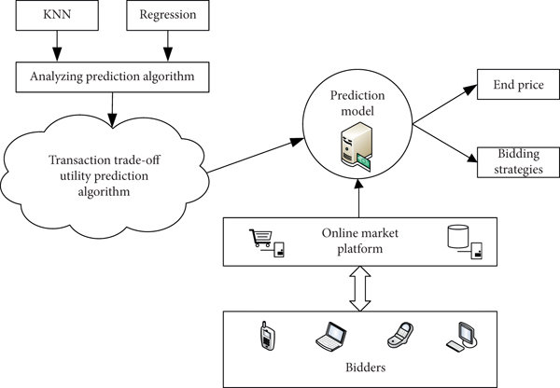
ARCHITECTURE DIAGRAM

Slide 14
ADVANTAGE OF PROPOSED
SYSTEM
The electronic auction system should ensure that communication channels should remain anonymous thereby keeping identities of the stakeholders (auctioneer, bidder, bidder server etc.) unspecified.
Registration for bidders is a one-time process, thus winners should not need to re-register at later stages.
It is necessary to maintain proficiency and eloquence of the electronic bidding process
After registering to the system, each bidder should be permitted to participate in multiple auctions

Slide 15
ALGORITHM USED
PREDICTION ALGORITHM
The transaction trade-off utility prediction algorithm refers to a method or model that helps predict the utility or desirability of a transaction or trade-off between different options. The goal is to assess the potential benefits or drawbacks of a particular transaction to aid decision-making.

Slide 16
Requirements (Hardware/Software):
1.PC
2.Windows 8/10/11
3.Web browser (chrome,firefox)
4.HTML/CSS
5.Python
6.SQL Database

Slide 17
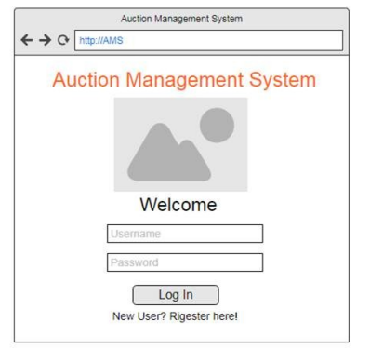
MODULES
MODULE 1:

Slide 18
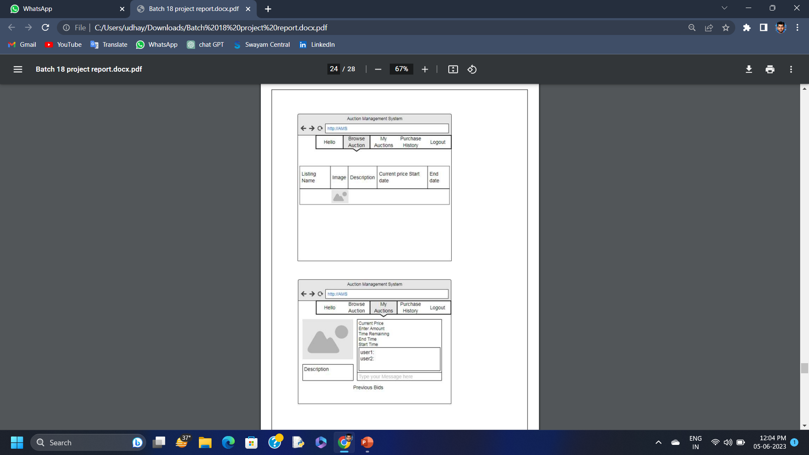
MODULES
MODULE 2:

Slide 19
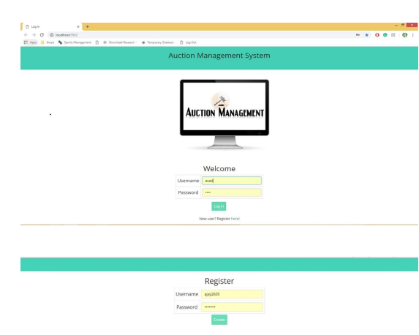
SAMPLE OUTPUT

Slide 20
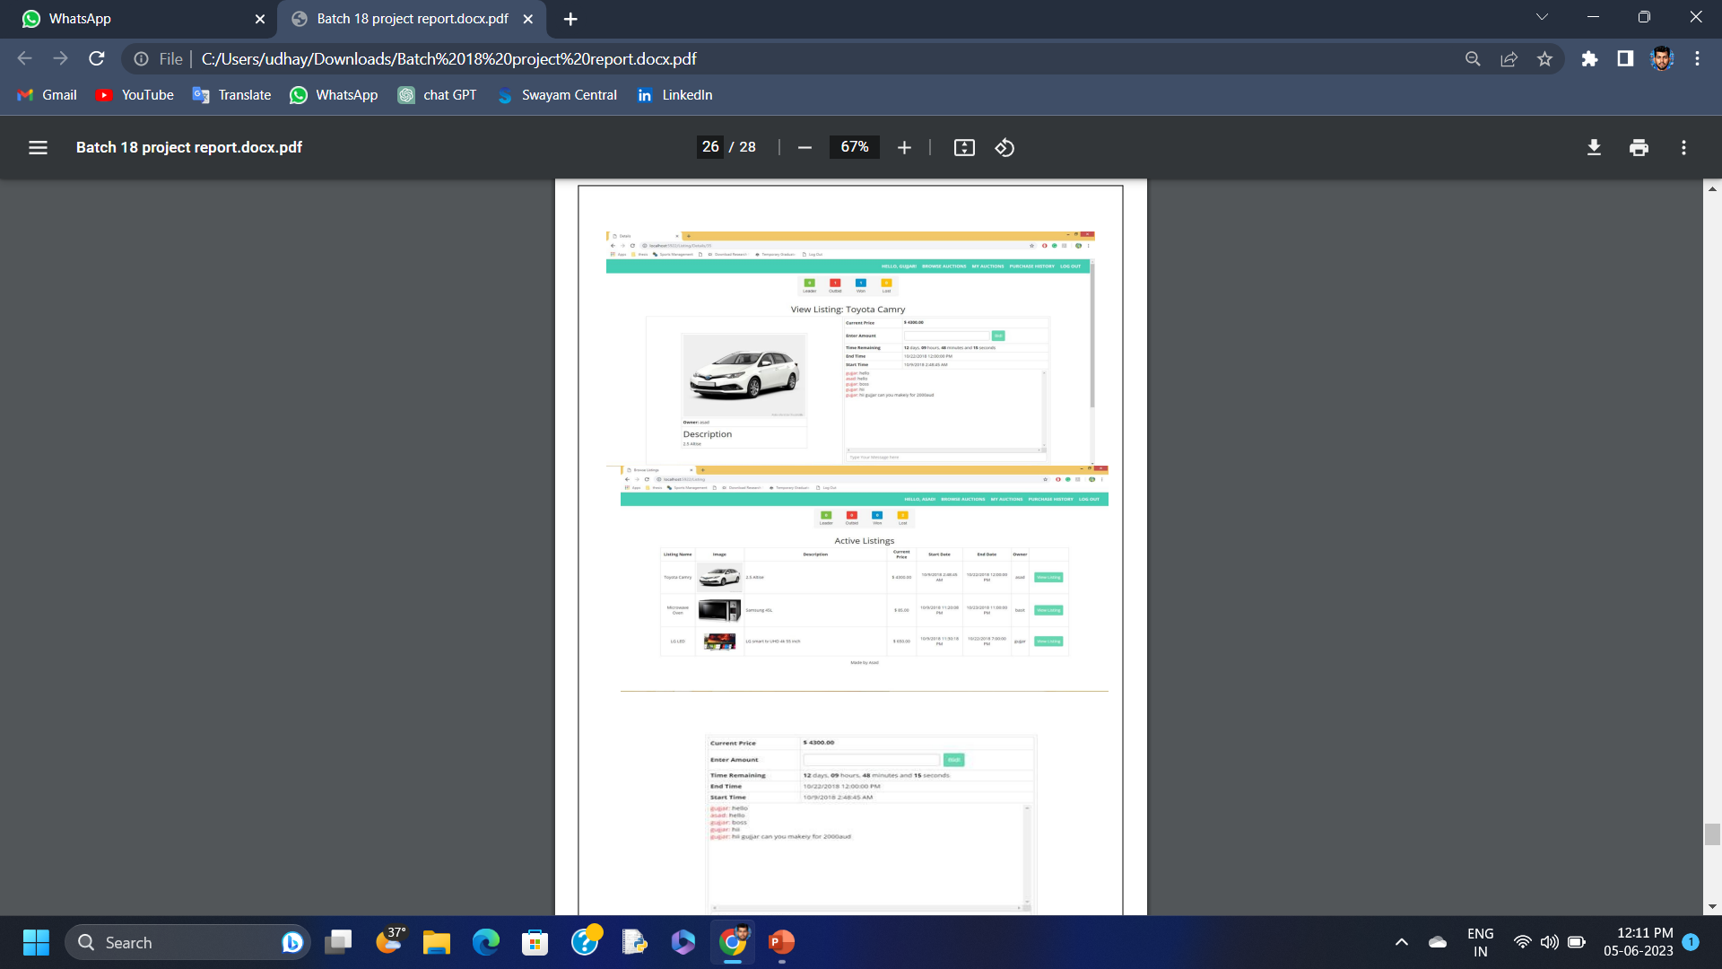

Slide 21
REFERENCE
Clearwater, S.H., Xerox Corp, 2010. Auction-based control system for energy resource management in a building. U.S. Patent 5,394,324. Dutta, R. and Ramamoorthy, K., International Business Machines Corp, 2009. User rating system for online auctions. U.S. Patent 7,552,081. Fageha, M. and Aibinu, A. 2013. Managing Project Scope Definition to Improve Stakeholdersâ€™ Participation and Enhance Project Outcome. Procedia – Social and Behavioral Sciences, 74, pp.154- 164. Gemino, A. and Parker, D. 2009. Use Case Diagrams in Support of Use Case Modeling. Journal of Database Management, 20(1), pp.1-24. Kamau, C.,2015. Efficacy of Monitoring and Evaluation Function in Achieving Project Success in Kenya: A Conceptual Framework. Science Journal of Business and Management, 3(3), p.82. Konia, B.S., MARKET MY SITE Inc, 2007. Online auction bid management system and method. U.S. Patent 7,225,151. Lin, Z., Li, D., Janamanchi, B. and Huang, W., 2010. Reputation distribution and consumer-toconsumer online auction market structure: an exploratory study. Decision Support Systems, 41(2), pp.435-448. Maltzman, R., eBay Inc, 2008. Method and system to enable a fixed price purchase within a online auction environment. U.S. Patent 7,340,429. Milunovic, S. and Filipovic, J.,2013. Methodology for quality management of projects in manufacturing industries. Total Quality Management & Business Excellence, 24(1-2), pp.91-107. Sanchez, H., Robert, B., Bourgault, M. and Pellerin, R. (2009). Risk management applied to projects, programs, and portfolios. International Journal of Managing Projects in Business, 2(1), pp.14-35. Rotman, G., Rotman, R. and Martin, J., Paid Inc, 2008. Method and system for improved online auction. U.S. Patent 7,324,968. Shavit, E. and Teichner, L., STRATEGIC PROCESSING CORP, 2011. Interactive market management system. U.S. Patent 4,799,156. Zwikael, O. (2009). The Relative Importance of the PMBOKÂ® Guide’s Nine Knowledge Areas during Project Planning. Project Management Journal, 40(4)

